Slide 1
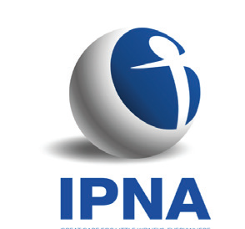
ANEMIA MANAGEMENT IN HEMODIALYSIS PATIENTS
Second IPNA Teaching Course
Joint IPNA - ISN Teaching Course
Dania Nehmé Chelala
Nephrologist HDF-USJ
June 13, 2019

Slide 2
OUTLINE
Back to history
Back to basics
Impact of anemia
Optimizing anemia management in HD

Slide 3
OUTLINE
Back to history
Back to basics
Impact of anemia
Optimizing anemia management in HD

Slide 4
HISTORY
First link of Anemia to CKD by Richard Bright [1]
Demonstration of:
- A circulating factor which stimulates erythropoiesis [2]
- The kidney as the main source of Erythropoietin [3]
Purification and cloning of Erythropoietin [4]
Introduction of recombinant human EPO in Anemia management [5]
Treatment
Outcomes and Guidelines…
1977
1983
…
1836
1957
Late 80s
….
1: Bright R.: Cases and observations: Illustrative of renal disease accompanied by the secretion of albuminous urine. Guys Hosp Rep 1: 338, 1836; 2: Erslev A.: Humoral regulation of red cell production. Blood 8: 349–357, 1953; 3: Jacobson LO, Goldwasser E, Fried W, Plzak L.: Role of the kidney in erythropoiesis. Nature 179: 633–634, 1957; 4: Miyake T, Kung CK, Goldwasser E.: Purification of human erythropoietin. J Biol Chem 252: 5558–5564, 1977; 5: Eschbach JW et al. Correction of the anemia of end-stage renal disease with recombinant human erythropoietin. Results of a combined phase I and II clinical trial. N Engl J Med 316: 73–78, 1987

Slide 5
OUTLINE
Back to history
Back to basics
Impact of anemia
Optimizing anemia management in HD

Slide 6
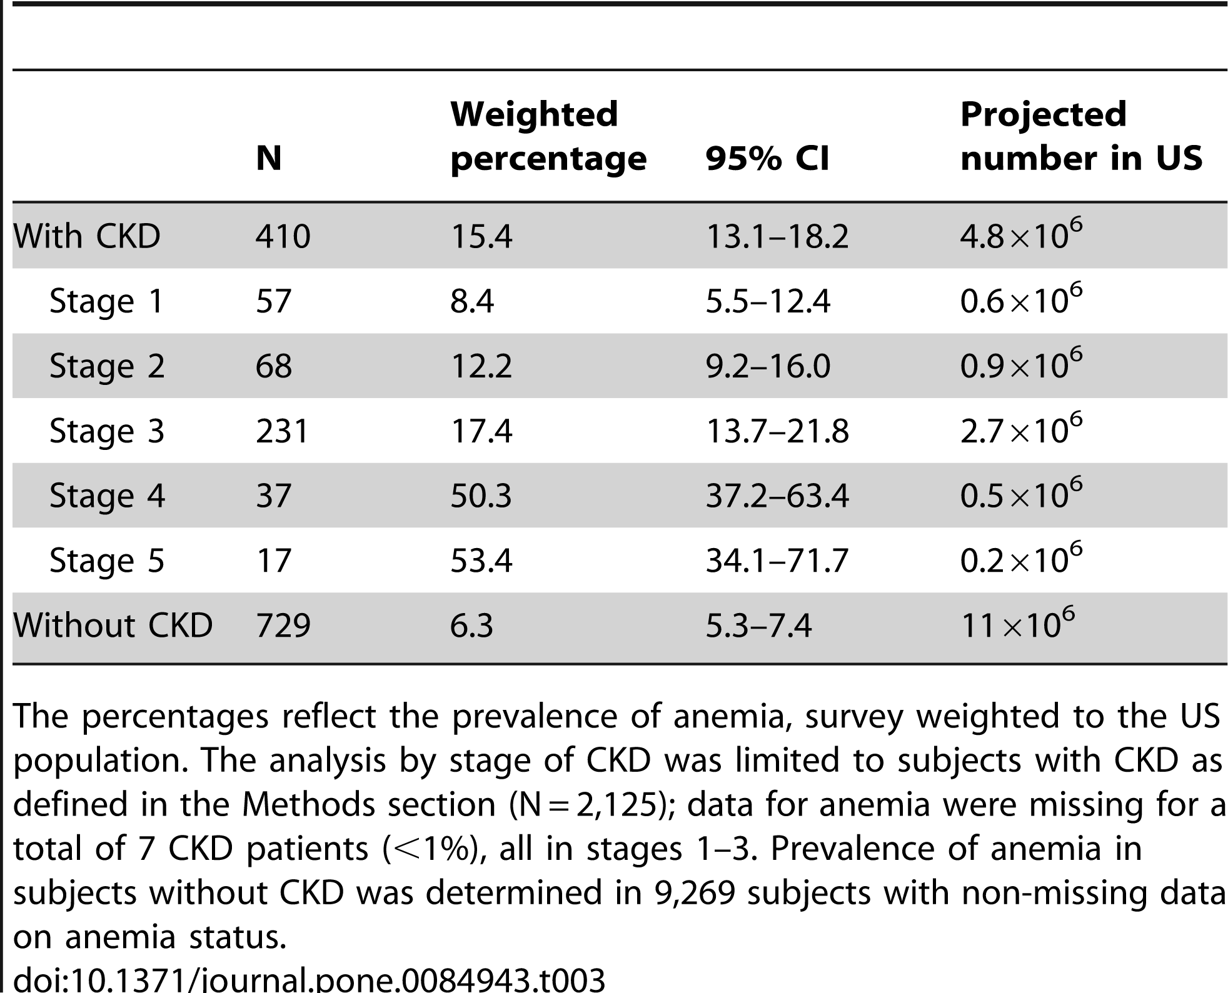
ANEMIA PREVALENCE in CKD
PLoS One. 2014; 9(1): e84943. Published online 2014 Jan doi: 10.1371/journal.pone.0084943 PMCID: PMC3879360
Prevalence of Anemia in Chronic Kidney Disease in the US Melissa E. Stauffer and Tao Fan²
Notes:
A total of 12,077 adults participated in the interview and examination components of the NHANES surveys in 2007–2008 and 2009–2010.Anemia was defined as serum hemoglobin levels ≤12 g/dL in women and ≤13 g/dL in men. We found that an estimated 14.0% of the US adult population had CKD in 2007–2010. Anemia was twice as prevalent in people with CKD (15.4%) as in the general population (7.6%). The prevalence of anemia increased with stage of CKD, from 8.4% at stage 1 to 53.4% at stage 5.

Slide 7
ANEMIA PREVALENCE in CKD
PLoS One. 2014; 9(1): e84943. Published online 2014 Jan doi: 10.1371/journal.pone.0084943 PMCID: PMC3879360
Prevalence of Anemia in Chronic Kidney Disease in the US Melissa E. Stauffer and Tao Fan²
Notes:
A total of 12,077 adults participated in the interview and examination components of the NHANES surveys in 2007–2008 and 2009–2010.Anemia was defined as serum hemoglobin levels ≤12 g/dL in women and ≤13 g/dL in men. We found that an estimated 14.0% of the US adult population had CKD in 2007–2010. Anemia was twice as prevalent in people with CKD (15.4%) as in the general population (7.6%). The prevalence of anemia increased with stage of CKD, from 8.4% at stage 1 to 53.4% at stage 5.

Slide 8
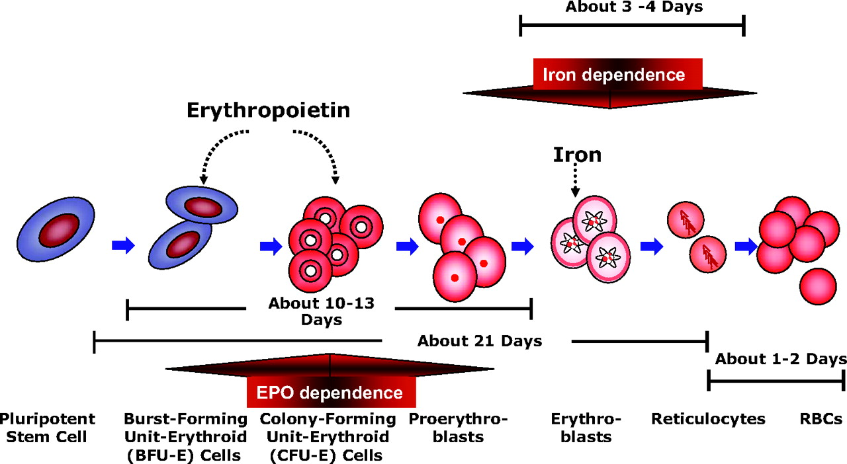
ERYTHROPOIESIS
Iron Metabolism, Iron Deficiency, Thrombocytosis, and the Cardiorenal Anemia Syndrome Anatole Besarab and al. The Oncologist September 1, 2009 vol. 14 no. Supplement 1 22-33
Notes:
Erythropoietin (EPO) and iron are both important in erythropoiesis

Slide 9
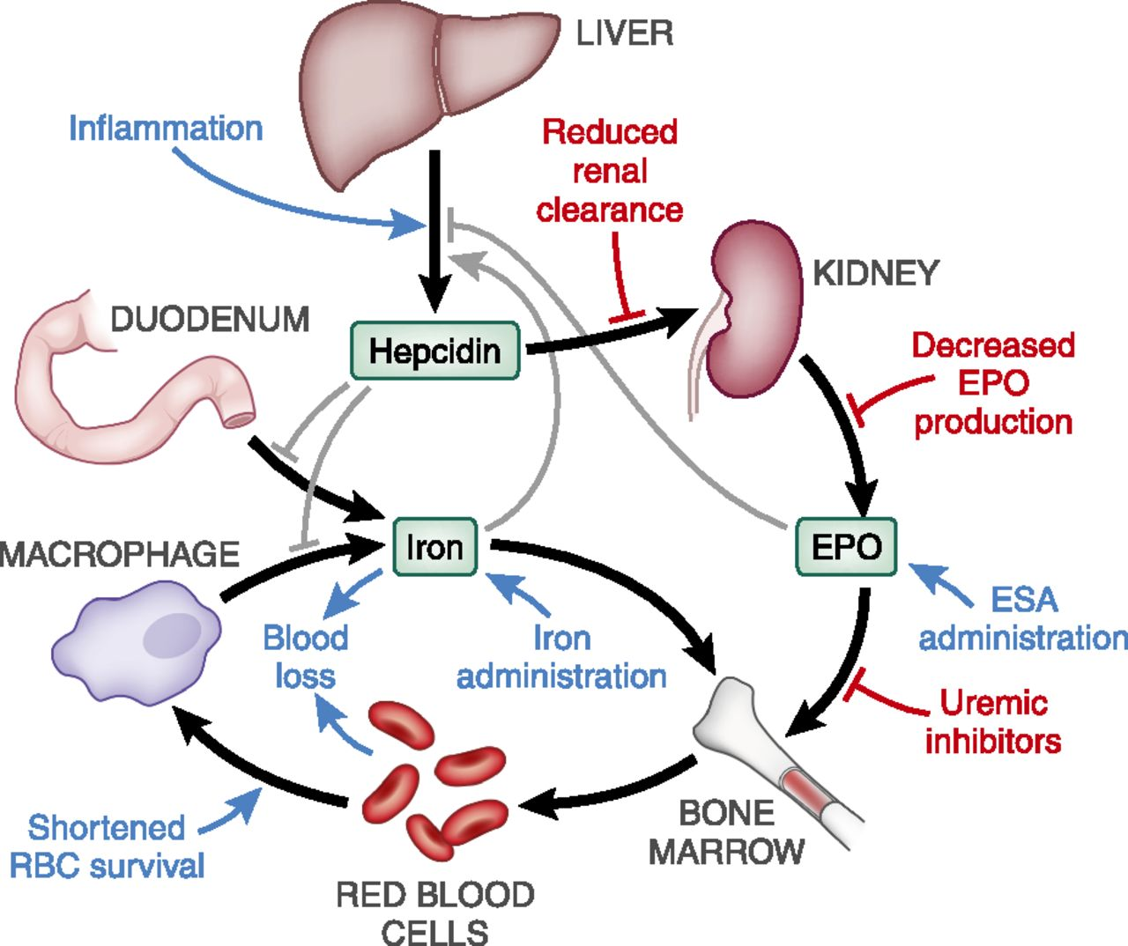
ANEMIA of CKD: PATHOPHYSIOLOGY HEPCIDIN INCREASE
Schematic representation of the mechanisms underlying anemia of CKD
Jodie L. Babitt, and Herbert Y. Lin JASN 2012;23:1631-1634
Notes:
Schematic representation of the mechanisms underlying anemia of CKD. Iron and EPO are crucial for red blood cell production in the bone marrow. Iron availability is controlled by the liver hormone hepcidin, which regulates dietary iron absorption and macrophage iron recycling from senescent red blood cells. There are several feedback loops that control hepcidin levels, including iron and EPO. In CKD patients (particularly in end stage kidney disease patients on hemodialysis), hepcidin levels have been found to be highly elevated, presumably due to reduced renal clearance and induction by inflammation, leading to iron-restricted erythropoiesis. CKD also inhibits EPO production by the kidney, and may also lead to circulating uremic-induced inhibitors of erythropoiesis, shortened red blood cell lifespan, and increased blood loss. Black and gray arrows represent normal physiology (black for iron and hormonal fluxes, gray for regulatory processes). Colored arrows represent the additional effects of CKD (blue for activation, red for inhibition). RBC, red blood cell
Iron and EPO are crucial for red blood cell production in the bone marrow.
Hepcidin, an endogenous antimicrobial peptide secreted by the liver, has been identified as controlling the level of plasma iron by regulating:
- The intestinal absorption of dietary iron
- The release of iron from macrophages (macrophage iron
recycling from senescent red blood cells)
- The transfer of iron stored in the hepatocytes.
Increase in hepcidin level in the course of inflammatory disease may be a significant mediator of the accompanying anemia.
Hepcidin is elevated in CKD patients

Slide 10
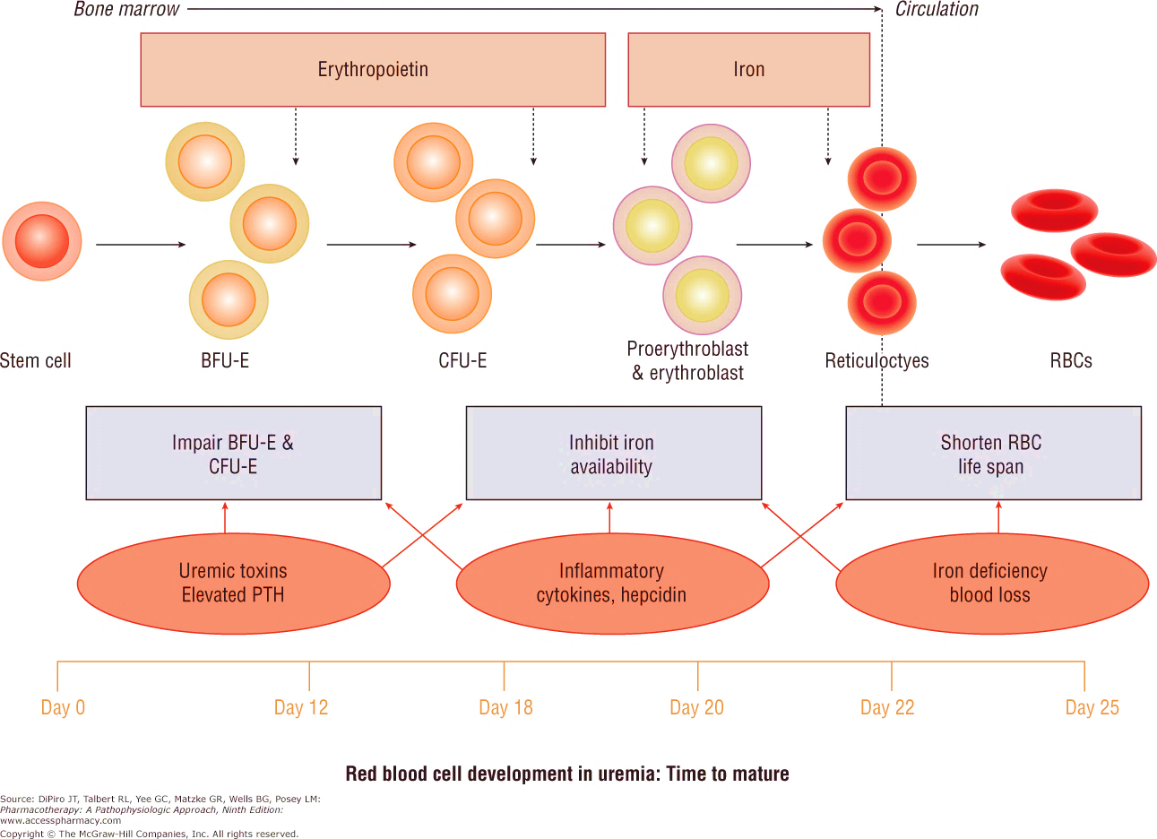
ANEMIA of CKD: PATHOPHYSIOLOGY

Slide 11
ANEMIA and CKD
NORMOCHROMIC NORMOCYTIC
Anemia of CKD
OTHER TYPES
Anemia in CKD: Another cause of anemia on top of CKD

Slide 12
ANEMIA of CKD: PATHOPHYSIOLOGY
ANEMIA
EPO DEFICIENCY
IRON DEFICIENCY
NUTRITIONAL DEFICIENCY
SHORTENED RBC SURVIVAL
Notes:
The anemia of CKD is, in most patients, normocytic and normochromic
Anemia of CKD is a multifactorial process due to:
- Relative EPO deficiency, a presumed reflection of the reduction in functioning renal mass
- Shortened erythrocyte survival
- Disordered iron homeostasis.
The kidneys are responsible for approximately 90% of erythropoietin production in an individual
In the individual with normal kidney function, hypoxia leads to erythropoietin gene transcription, and increased RBC production
In CKD, there is primary deficiency of erythropoietin production by the interstitial fibroblasts leading to anemia
The anemia that develops is directly related to the amount of residual renal function

Slide 13
ANEMIA in CKD: PATHOPHYSIOLOGY
High hepcidin level, Inflammation, Infection: Functional Iron deficiency and impaired BM responsiveness to EPO
ANEMIA
EPO DEFICIENCY
IRON DEFICIENCY
NUTRITIONAL DEFICIENCY
SHORTENED RBC SURVIVAL
Folic Acid Vit B12
BM Fibrosis: CKD-MBD
Others: blood loss. Medications
Notes:
The anemia of CKD is, in most patients, normocytic and normochromic
Anemia of CKD is a multifactorial process due to:
- Relative EPO deficiency, a presumed reflection of the reduction in functioning renal mass
- Shortened erythrocyte survival
- Disordered iron homeostasis.
The kidneys are responsible for approximately 90% of erythropoietin production in an individual
In the individual with normal kidney function, hypoxia leads to erythropoietin gene transcription, and increased RBC production
In CKD, there is primary deficiency of erythropoietin production by the interstitial fibroblasts leading to anemia
The anemia that develops is directly related to the amount of residual renal function

Slide 14
OUTLINE
Back to history
Back to basics
Impact of anemia
Optimizing anemia management in HD

Slide 15
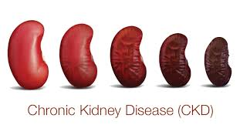
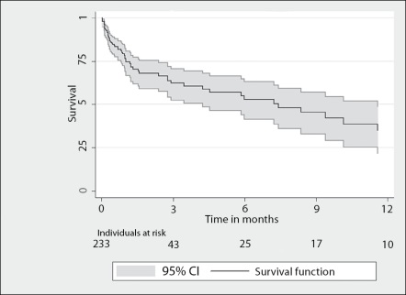
IMPACT of ANEMIA in CKD
Quality of life
Progression of kidney dysfunction in CKD
Cardiovascular dysfunction: left ventricular hypertrophy and heart failure
Survival
Fredric O. Finkelstein et al. Health-Related Quality of Life and Hemoglobin Levels in Chronic Kidney Disease Patients Clin J Am Soc Nephrol. 2009 Jan; 4(1): 33–38.
AUChang JM et al Anemia and left ventricular hypertrophy with renal function decline and cardiovascular events in chronic kidney disease. Am J Med Sci. 2014 Mar;347(3):183-9
Levin A et al.Haemoglobin at time of referral prior to dialysis predicts survival: an association of haemoglobin with long-term outcomes. Nephrol Dial Transplant. 2006 Feb;21(2):370-7.

Slide 16
OUTLINE
Back to history
Back to basics
Impact of anemia
Optimizing anemia management in HD

Slide 17
ANEMIA MANAGEMENT GUIDELINES
International:
- Kidney Disease Improving Global Outcomes (KDIGO): Clinical practice guideline for anemia in chronic kidney disease (2012)
- International Society of Nephrology (ISN): Clinical practice guidelines for assessment and management of iron deficiency (2008)
Canada:
- Canadian Society of Nephrology (CSN): Clinical practice guidelines and recommendations on peritoneal dialysis adequacy (2011)
- CSN: Clinical practice guidelines for assessment and management of iron deficiency (2008)
- CSN: Clinical practice guidelines for evaluation of anemia (2008)
- CSN: Clinical practice guidelines for evidence-based use of erythropoietic-stimulating agents (2008)
- CSN: Clinical practice guidelines for supplemental therapies and issues (2008)
- CSN: Introduction to the clinical practice guidelines for the management of anemia associated with chronic kidney disease (2008)
United Kingdom:
- UK Renal Association (RA): Clinical practice guidelines on anaemia of chronic kidney disease (2017)
- National Institute for Health and Care Excellence (NICE): Guideline on chronic kidney disease – Managing anaemia (2015)
Europe:
European Renal Best Practice (ERBP): A position statement for anaemia management in patients with chronic kidney disease (2009)
Japan:
[In Japanese] Japanese Society for Dialysis Therapy (JSDT): Guidelines for renal anemia in chronic kidney disease

Slide 18
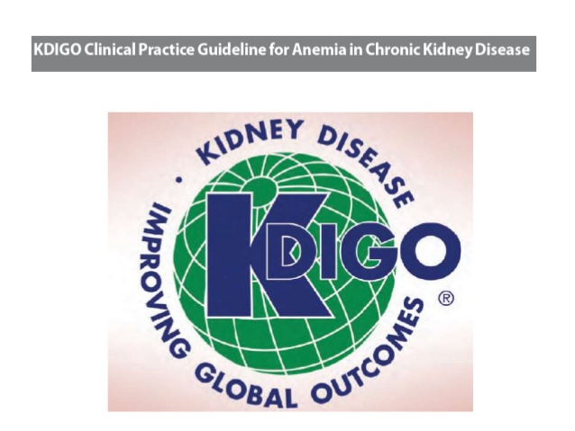
ANEMIA MANAGEMENT
VOLUME 2 | ISSUE 4 | AUGUST (2)2012
Kidney Disease: Improving Global Outcomes (KDIGO) Anemia Work Group. KDIGO Clinical Practice
Guideline for Anemia in Chronic Kidney Disease. Kidney inter. Suppl. 2012; 2: 279–335.

Slide 19
DIAGNOSIS of ANEMIA
Diagnosis of anemia
1.2.1: Diagnose anemia in adults and children >15 years with CKD when the Hb concentration is < 13.0 g/dl (<130 g/l) in males and < 12.0 g/dl (<120 g/l) in females. (Not Graded)
1.2.2: Diagnose anemia in children with CKD if Hb concentration is <11.0 g/dl (<110 g/l) in children 0.5–5 years, <11.5 g/dl (115 g/l) in children 5–12 years, and <12.0 g/dl (120 g/l) in children 12–15 years. (Not Graded)

Slide 20
ANEMIA MANAGEMENT EVALUATION

Slide 21
ANEMIA MANAGEMENT EVALUATION

Slide 22
ANEMIA MANAGEMENT in CKD HOW to MAKE it OPTIMAL?
Hb TARGET?
IRON STATUS and TREATMENT
ESA TREATMENT
TREATMENT ADHERENCE
Countless research
articles have been written and ... still
being written..

Slide 23
ANEMIA MANAGEMENT in CKD Hb TARGET
Hb TARGET?

Slide 24
ANEMIA MANAGEMENT in CKD Hb TARGET

Slide 25
ANEMIA MANAGEMENT in CKD Hb TARGET
Increased risk with targeting higher Hb
Improvement in QOL in both groups
No benefit in LVH in the group with higher Hb

Slide 26
ANEMIA MANAGEMENT in CKD Hb TARGET
Increased risk with targeting higher Hb
Improvement in QOL in both groups
No benefit in LVH in the group with higher Hb
CHOIR: "Aim for Hemoglobin of 11 to 12 g/dL"

Slide 27
ANEMIA MANAGEMENT in CKD HOW to MAKE it OPTIMAL?
TARGET Low Hb LEVEL
AVOID
TRANSFUSIONS

Slide 28
ANEMIA MANAGEMENT in CKD HOW to MAKE it OPTIMAL?
TARGET Low Hb LEVEL
Countless research
articles have been written and ... still
being written..
AVOID
TRANSFUSIONS
IRON STATUS and TREATMENT
ESA TREATMENT
TREATMENT ADHERENCE

Slide 29
ANEMIA MANAGEMENT in CKD HOW to MAKE it OPTIMAL?
TARGET Low Hb LEVEL
AVOID
TRANSFUSIONS
IRON STATUS and TREATMENT
ESA TREATMENT
TREATMENT ADHERENCE

Slide 30
IRON STATUS
Positive Iron Balance in Chronic Kidney Disease: How Much is Too Much and How to Tell?
Wish J.B.ª · Aronoff G.R.^{b,c} · Bacon B.R.^{d} · Brugnara C.^{e} · Eckardt K.-U.^{f} · Ganz T.^{g} · Macdougall I.C.^{h} · Núñez J.^{i} · Perahia A.J.^{j} · Wood J.C.^{k}
Am J Nephrol 2018;47:72–83 https://doi.org/10.1159/000486968

Slide 31
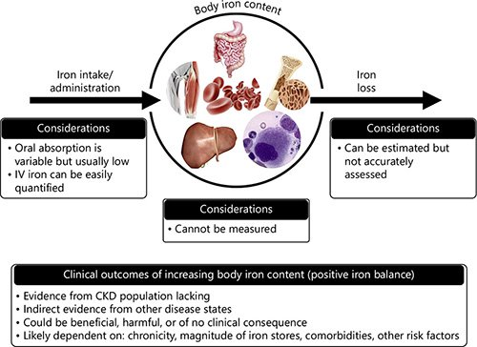
Am J Nephrol 2018;47:72–83 https://doi.org/10.1159/000486968

Slide 32
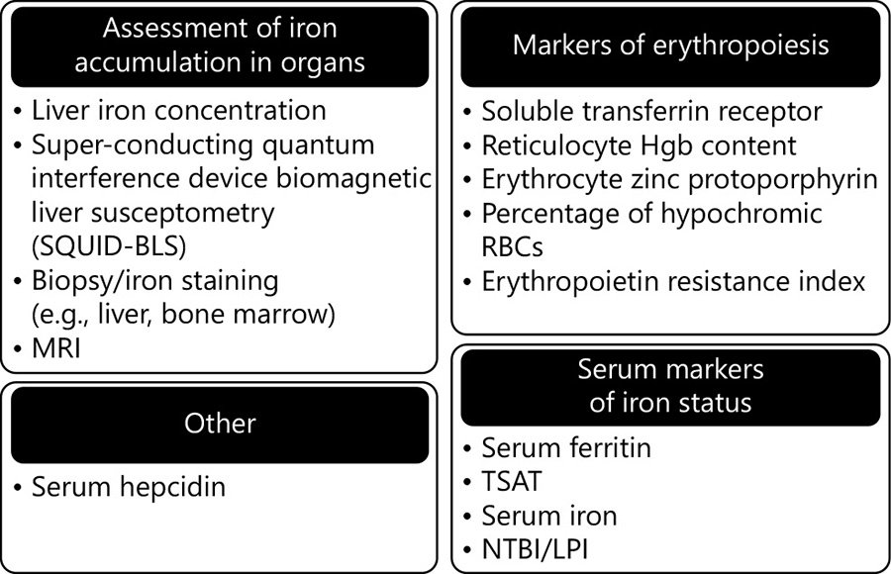
Assessing Iron Stores in Patients with CKD
Am J Nephrol 2018;47:72–83 https://doi.org/10.1159/000486968
Notes:
Many laboratory/imaging tests can give insight into a patient’s iron status Unfortunately, no single measure is ideal for identifying positive iron balance or increased stores, singling out those patients at risk of developing iron toxicity, and guiding IV iron dosing in clinical practice

Slide 33
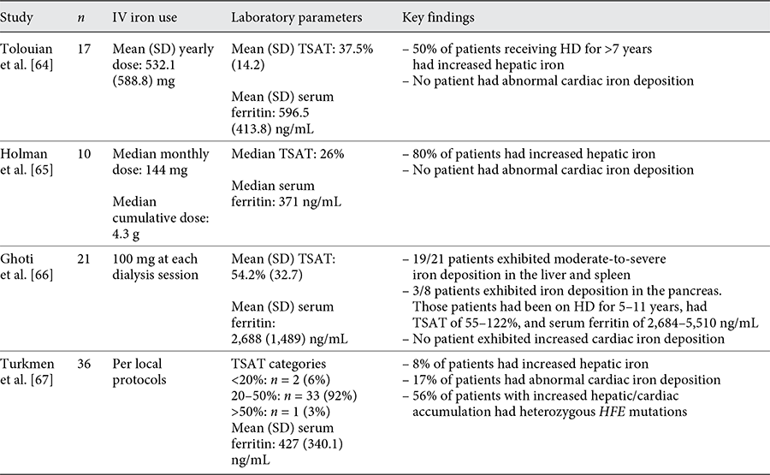
When Does Positive Iron Balance Become Iron Toxicity?

Slide 34
Iron management in chronic kidney disease: conclusions from a “Kidney Disease: Improving Global Outcomes” (KDIGO) Controversies Conference
Kidney International, Volume 89, Issue 1, 2016, pp. 28-39
Iain C. Macdougall, Andreas J. Bircher, Kai-Uwe Eckardt, Gregorio T. Obrador, Carol A. Pollock, Peter Stenvinkel, Dorine W. Swinkels, Christoph Wanner, Günter Weiss, Glenn M. Chertow, Conference Participants
When should iron supplementation in dialysis patients be avoided, minimized or withdrawn?
Rostoker G
Semin Dial.2019 Jan;32(1):22-29. doi: 10.1111/sdi.12732. Epub 2018 Jun 28.

Slide 35
ANEMIA MANAGEMENT in CKD
IRON SUPPLEMENTATION
IRON SUPPLEMENTATION
WHY
HOW
WHEN

Slide 36
ANEMIA MANAGEMENT in CKD IRON SUPPLEMENTATION: WHY
Iron deficiency
Iron losses
Impaired dietary iron absorption
Circulating iron pool depleted by ESA treatment
Platelet dysfunction
Frequent phlebotomy Blood trapping in the dialysis apparatus.
Besarab A, Ayyoub F.: Anemia in renal disease. In: Diseases of the Kidney and Urinary Tract, edited by Schrier RW, editor. , 8th Ed., Philadelphia, Lippincott Williams and Wilkins, 2007, pp 2406–2430
Fudin R et al.: Correction of uremic iron deficiency anemia in hemodialysed patients: A prospective study. Nephron 79: 299–305, 1998

Slide 37
ANEMIA MANAGEMENT in CKD IRON SUPPLEMENTATION
Benefit | Risks (especially intravenous iron)
Avoid or decrease | Harm to individual patients
• Blood transfusions | • Hypersensitivity reactions and other acute reactions
• Treatment with ESA | • Iron overload
• Symptoms related to anemia or iron deficiency | • Increase in oxidative stress
 | • Increased risk of infection
 | • Unknown risks of long-term intravenous iron
Cases A, Egocheaga MI, Tranche S, Pallarés V, Ojeda R, Górriz JL, et al. Anemia en la enfermedad renal crónica: Protocolo de estudio, manejo y derivación a Nefrología. Nefrologia. 2018;38:8–12.

Slide 38
IRON SUPPLEMENTATION WHEN?
TSAT ≤ 30%
Ferritin ≤ 500
KDIGO Clinical Practice Guideline for Anemia in Chronic Kidney Disease. Kidney Int Suppl 2012; 2: 279–335

Slide 39
IRON SUPPLEMENTATION WHEN?
National Institute for Clinical Excellence (NICE) GUIDELINES 2015
CKD patients with anemia not on ESA | Offer iron if TSAT <20% and ferritin <100 ng/mL (unless ferritin >800 ng/mL) Iron before initiation of ESA
CKD patients with anemia on ESA | Offer iron to achieve TSAT >20% and ferritin >100 ng/mL (unless ferritin is >800 ng/mL)
Review the dose of iron when serum ferritin levels reach 500 ng/mL Do not exceed 800 ng/mL | Hb levels to be used to guide ESA therapy in all patients with CKD: 10.0–12.0 g/dL (age ≥2 yrs) 9.5–11.5 (age <2 yrs) The correction to normal levels of Hb with ESAs is not usually recommended in people with CKD

Slide 40
IRON SUPPLEMENTATION Practice Points
Iron deficiency (absolute or functional) is a common cause of anemia in CKD patients.
The number of HD patients with IV iron supplementation and the prescribed doses increased in the past years.
The prevalence of HD patients with ferritin levels above 800 ng/mL has increased
Iron overload in HD patients has been reported in several studies but the relationship between iron overload and mortality risk is not clear
Serum ferritin is not always a predictor of iron overload, due to confounding factors, as inflammation and malnutrition
Iron therapy in chronic kidney disease: Recent changes benefits and risks; Sandra Ribeiro et al, Blood Reviews Volume 30, Issue 1, January 2016, Pages 65-72https://doi.org/10.1016/j.blre.2015.07.006

Slide 41
IRON SUPPLEMENTATION HOW ?
CKD on HD
IV Iron
CKD
Not on HD?
Notes:
The 2012 Kidney Disease Improving Global Outcomes guidelines propose two strategies for the routine administration of IV iron in hemodialysis: ‘periodic’ (also called ‘rescue’ or ‘bolus’) iron repletion, consisting of serial IV iron administration aiming to replenish iron stores or ‘maintenance’ iron administration, consisting of smaller doses at regular intervals, aiming to stabilize iron storage
Current recommendations for the use of intravenous iron therapy in the management of anaemia in patients with chronic kidney disease (CKD) are based on limited clinical evidence. Since the publication of the Kidney Disease: Improving Global Outcomes (KDIGO) Clinical Practice Guideline for Anaemia in Chronic Kidney Disease in 2012, a number of randomized clinical trials [notably, the Ferinject Assessment in Patients with Iron Deficiency Anaemia (FIND-CKD) and Randomized Trial to Evaluate IV and Oral Iron in Chronic Kidney Disease (REVOKE) trials] and observational studies have been completed, and a further large clinical trial-Proactive IV Iron Therapy in Dialysis Patients (PIVOTAL)-is currently underway. In this article, the implications of the findings from these recent studies are discussed and the critical evidence gaps that remain to be addressed are highlighted.

Slide 42
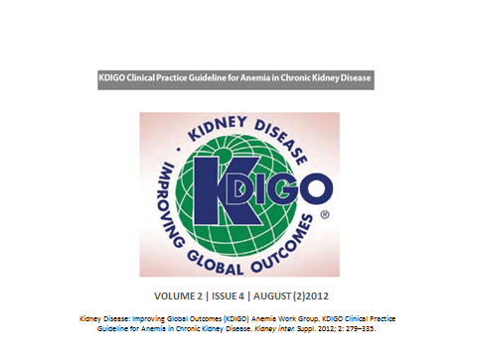
Two strategies for the routine administration
of IV iron in hemodialysis:
Periodic’ (also called ‘rescue’ or ‘bolus’) iron repletion, consisting of serial IV iron administration aiming to replenish iron stores
‘Maintenance’ iron administration, consisting of smaller doses at regular intervals, aiming to stabilize iron storage

Slide 43
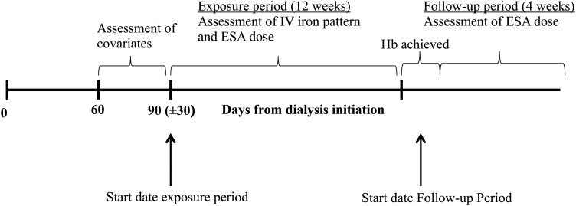
Michels WM, Jaar BG, Ephraim PL, et al. Intravenous iron administration strategies and anemia management in hemodialysis patients. Nephrol Dial Transplant. 2017;32(1):173–181. doi:10.1093/ndt/gfw316
Notes:
population comprised patients initiating in-center hemodialysis between 1 January 2003 and 31 December 2009 at 209 dialysis facilities operated by Dialysis Clinic, Inc. (

Slide 44
Maintenance strategies defined as administration of at least one dose of IV iron each week, every other week, every 3 weeks or every 4 weeks throughout the 12-week exposure period.
All patients who did not meet the criteria for maintenance strategies during this 12-week period assigned into a single ‘non-maintenance’ strategy group

Slide 45
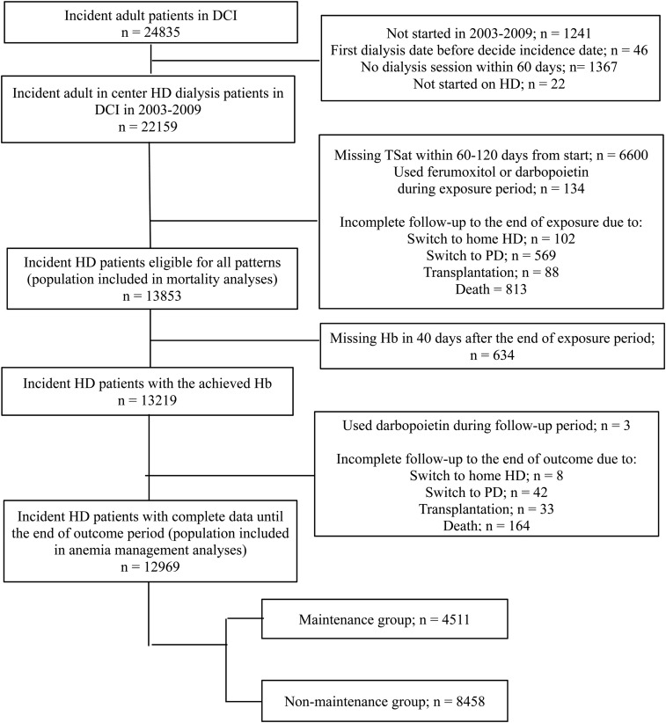

Slide 46
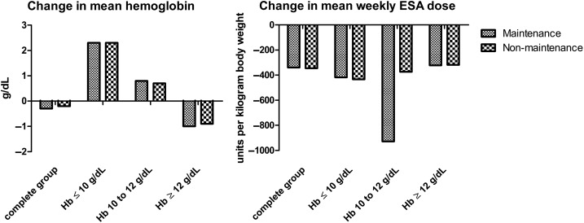
Differences in hemoglobin levels and mean weekly erythropoietin stimulating agent (ESA) doses before and after the exposure period.
The figure represents the difference in means of hemoglobin levels and mean weekly doses corrected for body weight (units/kg).

Slide 47
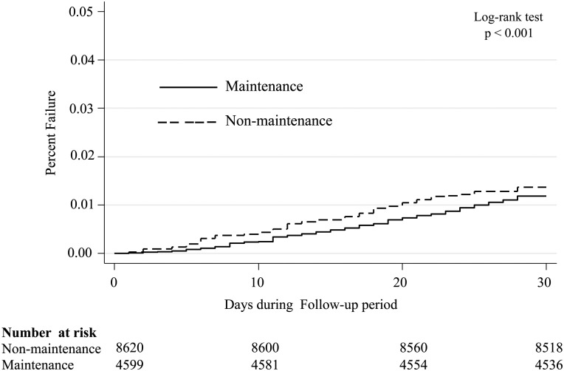
Cumulative probability of mortality for the maintenance and non-
maintenance IV iron administration strategy groups

Slide 48
CONCLUSIONS:
Maintenance IV iron v/s non maintenance administration strategies were not associated with improved achievement of Hb targets among patients recently initiating hemodialysis
They were associated with significantly lower ESA requirements
Associated with lower early mortality

Slide 49
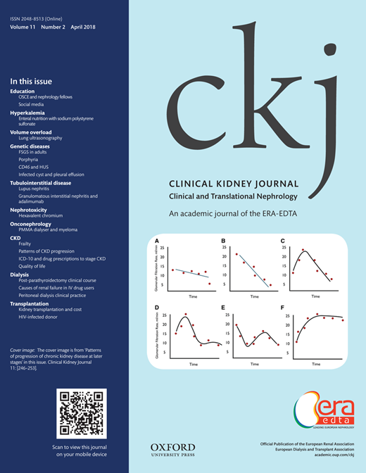
IV IRON ADMINISTRATION
Intravenous iron therapy in patients with chronic kidney disease: recent evidence and future directions.
Macdougall IC. Et al
Clin Kidney J. 2017 Dec;10 (Suppl 1):i16-i24
In this article, the implications of the findings from RCT are discussed :
The Ferinject Assessment in Patients with Iron Deficiency Anaemia (FIND-CKD)
Randomized Trial to Evaluate IV and Oral Iron in Chronic Kidney Disease (REVOKE)
They have added to the clinical evidence base in support of the efficacy and short-term safety of IV iron therapy in patients with CKD-ND and CKD-5D

Slide 50
PIVOTAL TRIAL CONFIRMS LONG-TERM SAFETY AND EFFICACY OF INTRAVENOUS IRON DOSING STRATEGY ALLOWING HIGHER FERRITIN CONCENTRATION AND TRANSFERRIN SATURATION IN PATIENTS UNDERGOING HAEMODIALYSIS
The trial met its primary endpoint of non inferiority as assessed by a composite of death and cardiovascular events, demonstrating that a liberal, proactive intravenous (IV) iron dosing regimen did not expose patients to an increased level of harm
Treatment with greater doses of iron, allowing for higher ferritin and transferrin saturation (TSAT) levels, was associated with significantly reduced rates of the primary outcome, hospitalisation for heart failure
Among patients on maintenance haemodialysis, a proactive, high-dose regimen of IV iron significantly reduceds dose requirements for erythropoiesis-stimulating agents (ESAs) and the need for blood transfusions, without adversely impacting mortality or safety endpoints such as hospitalisation or infection
Notes:
Results from the PIVOTAL trial were presented during the High-Impact Clinical Trials session at American Society of Nephrology (ASN) Kidney Week 2018

Slide 51
IRON PRESCRIPTION REAL LIFE
‘’ Is Iron supplementation widely used in CKD patients to’’:
Treat iron deficiency
Prevent iron deficiency in ESA treated patients
Raise Hb level with or without ESA treatment
Reduce ESA doses in patients receiving ESA

Slide 52
Study design and participants
A national observational study that included all ND-CKD patients that applied to the Lebanese MOPH for ESA treatment during a 5-month period from July 2016 till end of November 2016.
Exclusion criterias: Patients <18 years old, kidney transplant patients and patients with serum ferritin missing values Duplicate names were excluded.
Data collected : demographic factors , Hb level, serum creatinine (mg/dl), serum ferritin (ng/ml) and serum transferrin saturation if available.
The study was approved by the ethics committee of the Saint-Joseph University-Beirut (approval number CEHDF 983).
Aoun M, Karam R, Sleilaty G, Antoun L, Ammar W (2018) Iron deficiency across chronic kidney disease stages: Is there a reverse gender pattern? PLoS ONE 13(1): e0191541. https://doi.org/10.1371/journal.pone.0191541

Slide 53
Iron requirement was assessed based on two guidelines’ target-to-treat cutoffs:
1- Ferritin <100 ng/ml and/or TSAT < 20% (KDOQI 2006),
2- Ferritin ≤500 ng/ml and TSAT ≤30% (KDIGO 2012).
Results:
- A total of 238 CKD patients were included over 5 months.
- All patients had a ferritin level in their record and 64% had an available TSAT.
- Median age was 71.0 (59.8–79.3) years and 61.8% were female.
- All had an eGFR<60 ml/min.
The proportion of patients found to require iron therapy ranged
between 48 and 78%.

Slide 54
ANEMIA MANAGEMENT in CKD HOW to MAKE it OPTIMAL?
TARGET Low Hb LEVEL
AVOID
TRANSFUSIONS
IRON STATUS and TREATMENT
ESA TREATMENT
TREATMENT ADHERENCE

Slide 55
TYPES of ESA’s
Long-acting ESAs
(since 2001)
Administration:
less frequent
up to 1 per month
Short-acting ESAs
(since 1989)
Administration:
1-3 per week

Slide 56
Benefits | Risks
• Reduces the risk of transfusions | Risk in the individual patient (e.g.):
• Improves the symptoms of anemia | • Ictus
• Improves quality of life | • Arterial hypertension
 | • Vascular access thrombosis
 | • Cancer progression?
Cases A, Egocheaga MI, Tranche S, Pallarés V, Ojeda R, Górriz JL, et al. Anemia en la enfermedad renal crónica: Protocolo de estudio, manejo y derivación a Nefrología. Nefrologia. 2018;38:8–12.

Slide 57
ESA DEVELOPMENT
1989 | FDA approval of the first rHuEPO for the treatment of renal anemia
1996 | PRCA reported
1998 | Normal Hematocrit Trial
2001 | FDA approval for darbepoetin α
2006 | KDOQI guideline for anemia in CKD
2006 | CREATE and CHOIR studies
2007 | FDA approval of MIRCERA
2007 | DRIVE study
2009 | TREAT study
2011 | FDA modifies dosing recommendations for ESAs
2012 | KDIGO Clinical Practice Guideline for Anemia in CKD
2012 | CAPRIT study
2013 | EMERALD and PEARL studies
… 2018 | OTHERS ….
Adapted from: Hung SC et al. Erythropoiesis-stimulating agents in chronic kidney disease: what have we learned in 25 years?
J Formos Med Assoc.2014 Jan;113(1):3-10. doi: 10.1016/j.jfma.2013.09.004. Epub 2013 Oct 3.
Notes:
CAPRIT = Correction of Anemia and Progression of Renal Insufficiency in Transplant Patients; CHOIR = Correction of Hemoglobin and Outcomes in Renal Insufficiency; CKD = chronic kidney disease; CREATE = Cardiovascular risk Reduction by Early Anemia Treatment with Epoetin β; DRIVE = Dialysis Patients' Response to IV Iron with Elevated Ferritin; EMERALD = Efficacy and Safety of Peginesatide for the Maintenance Treatment of Anemia in Patients with Chronic Renal Failure Who Were Receiving Hemodialysis and Were Previously Treated with Epoetin; EPO = erythropoietin; ESA = erythropoiesis-stimulating agents; FDA = Food and Drug Administration; KDIGO = Kidney Disease: Improving Global Outcomes; KDOQI = Kidney Disease Outcomes Quality Initiative; MIRCERA = methoxy polyethylene glycol-epoetin beta; PEARL = Peginesatide for the Correction of Anemia in Patients with Chronic Renal Failure Not on Dialysis and Not Receiving Treatment with Erythropoiesis-Stimulating Agents; PRCA = pure red cell aplasia; rHuEPO = recombinant human erythropoietin; TREAT = Trial to Reduce Cardiovascular Events with Aranesp Therapy.

Slide 58
USE of IRON and ESA: INDICATIONS
 | TREATMENT | Hb g/dl | T SAT % | FERRITINE ng/ml
NON DIALYSIS CKD | ESA | < 10 | > 25 | > 200
DIALYSIS CKD | IV IRON and ESA | < 10 | < 30 | > 500
 | ESA | < 10 | > 30 | > 500
Monitoring without treatment | > or = 10 | > 20 | > 200
IV Iron | > or = 10 | < or = 20 | < or = 200
NO ESA | Patients with history of stroke or malignancy or an active malignancy
KDIGO Clinical Practice Guideline for Anemia in Chronic Kidney Disease. Kidney Int Suppl 2012; 2: 279–335

Slide 59
Conclusions
Although iron stores are difficult to measure in clinical practice, available data suggest that IV iron dosing in excess of approximately 2–3 g per year is likely to exceed typical iron losses in patients undergoing HD. Such dosing would be expected to place patients into a state of positive iron balance and increasing iron stores. Positive iron balance and increasing iron stores do not necessarily represent pathological states among patients with CKD receiving IV iron. While there is a theoretical risk of iron toxicity associated with IV iron, available (mainly short-to-intermediate duration) data suggest that current practices, despite inducing a state of positive iron balance, are not associated with overt clinical toxicity. Judicious use of IV iron therapy in this population, in particular, avoiding TSAT >45–50%, would seem to pose low risk to the vasculature, heart, and endocrine organs. It stands to reason that as the duration of a positive balance state is extended in CKD patients, the potential for long-term organ toxicity increases. Long-term studies are therefore urgently needed to obtain data that will allow definitive guidance and enable better assessment of the risk:benefit ratio.

Slide 60
ESA DOSING
Epoetin-alfa Or Epoetin-beta | 20 to 50 IU/kg body weight three times a week | SC or (IV)
Darbepoetin-alfa | 0.45 μg/kg body weight once weekly Or 0.75 μg/kg body weight once every 2 weeks | SC or (IV) SC
CERA dosing | 0.6 μg/kg body weight once every 2 weeks Or 1.2 μg/kg body weight once every 4 weeks (CKD ND) | SC or IV SC
DOSE ADJUSTMENT
KDIGO Clinical Practice Guideline for Anemia in Chronic Kidney Disease. Kidney Int Suppl 2012; 2: 279–335

Slide 61
ESA DOSING
Lower initial ESA doses if:
Higher baseline Hb concentrations
History of CVD
Patients with a history of thrombo-embolism or seizures
Patients with high blood pressure
KDIGO Clinical Practice Guideline for Anemia in Chronic Kidney Disease. Kidney Int Suppl 2012; 2: 279–335

Slide 62
TARGET Hb LEVEL and DOSE ADJUSTMENT
The objective of initial ESA therapy is a rate of increase in Hb of 1 to 2 g/dl per month with Target Hb not to exceed 11,5 g/dl
Hb initially monitored every week, dose adjustment made every 4 weeks (minimum interval adjustments in the outpatient setting is 2 weeks).
KDIGO Clinical Practice Guideline for Anemia in Chronic Kidney Disease. Kidney Int Suppl 2012; 2: 279–335

Slide 63
DOSE ADJUSTMENT
If the Hb is increasing and approaching 11.5 g/dl, the dose should be reduced by approximately 25%.
If the Hb continues to increase, doses should be temporarily withheld until the Hb begins to decrease, at which point therapy should be reinitiated at a dose approximately 25% below the previous dose.
If the Hb increases by more than 1.0 g/dl in any 2-week period, the dose should be decreased by approximately 25%.
KDIGO Clinical Practice Guideline for Anemia in Chronic Kidney Disease. Kidney Int Suppl 2012; 2: 279–335

Slide 64
ANEMIA MANAGEMENT in HD THE PITFALLS
Dose adjustment:
ESA resistance
“Pseudo resistance”: Prescription/ Adherence
Wish JB et al. Positive Iron Balance in Chronic Kidney Disease: How Much is Too Much and How to Tell? Am J Nephrol. 2018;47(2):72-83

Slide 65
CAUSES of ESA RESISTANCE
Causes of ESA Resistance
Iron Deficiency
B12, Folate deficiency
ACE inhibitors
Inflammation
Inadequate dialysis
HyperPTH

Slide 66
SUMMARY
In HD patients: all correctable causes of anemia must be addressed, specially iron deficiency prior to ESA therapy.
Target low Hb level
Iron supplementation with regular monitoring is mandatory
In initiating and maintaining ESA therapy, Individualize treatment: balance the potential benefits of reducing blood transfusions and anemia-related symptoms and the risks in some patients
Reliable products with lower cost may allow better adherence to treatment

