Slide 1
Arteriovenous Fistula in Hemodialysed Children
Sevcan A. Bakkaloğlu, MD
Department of Pediatric Nephrology
Gazi University, Ankara, TURKEY

Slide 2
Dialysis modality in children
NAPRTCS 2007, 2011

Slide 3
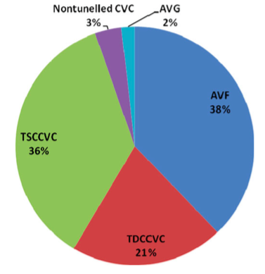
Vascular access in pediatric HD patients
NAPRTCS 2011 Report
TSN 2009 Report
EPDWG 2013
111 pts
IPHN – 2018
552 pts, 870 VA

Slide 4
KDOQI guidelines recommend AVF placement in pediatric patients who weigh >20 kg and who are unlikely to receive a transplant within 1 year.
Successful AVF placement has been demonstrated in young children, those weighing <20 kg (even <10 kg) in the setting of a dedicated vascular access clinic with an experienced surgeon
AVF formation is also considered for children in whom a kidney transplant is deemed unlikely within the following 6 months.
KDOQI Work Group. Am J Kidney Dis. 2006;48(1suppl 1):S274-S276. , Bourquelot P, Wolfeler L, Lamy L. Proc Eur Dial Transplant Assoc 1981; 18: 537–541
Bourquelot P, Cussenot O, Corbi P et al. Pediatr Nephrol 1990; 4: 156–159, Shroff R, Sterenborg RB, Kuchta A et al. Pediatr Nephrol 2016; 31: 2337–2344

Slide 5
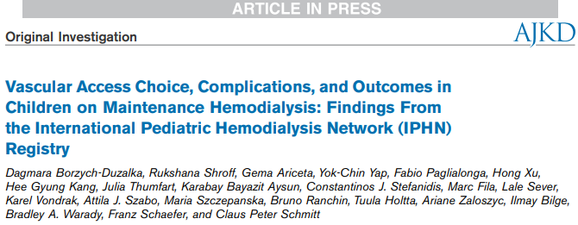
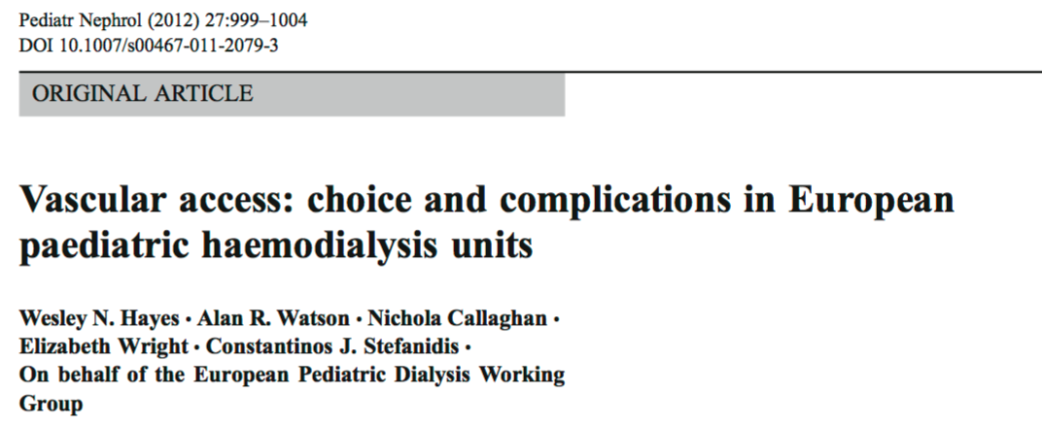
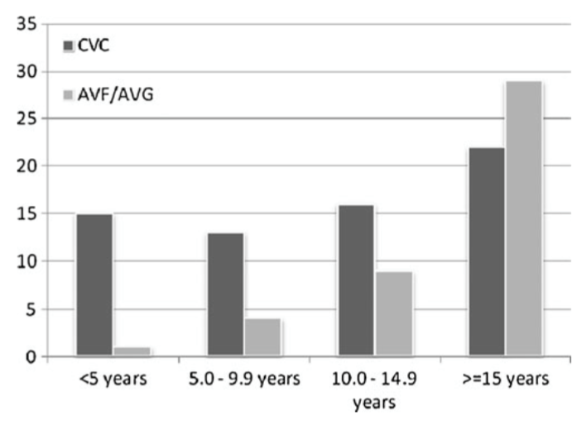
AVF
CVC
Borzych-Duzalka D, Shroff R, Stefanidis CJ et al. Am J Kidney Dis. 2019 epub
Hayes W, Pediatr Nephrol 2012

Slide 6
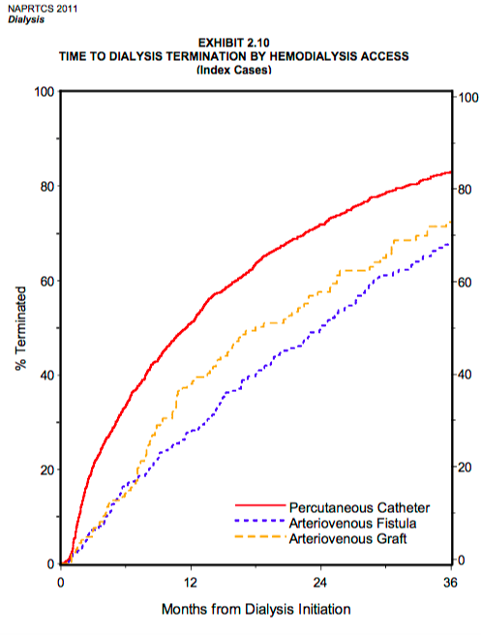
HD access failure rates
Access survival was 92%, 90%, 86%, and 83% with AVFs
70%, 64%, 62%, and 60% with CVCs after 1, 2, 3, and 4 years of HD
NAPRTCS 2011
Dialysis report
IPHN - 2019
Dialysis courses with a CVC terminate much sooner than for AVF/AVG
By 3 months, 21% of CVC accesses termination vs 7% for AVF and 7% for AVG
By 24 months, respective figures are 72% vs 50% and 58%.
Borzych-Duzalka D, Shroff R, Stefanidis CJ et al. Am J Kidney Dis. 2019 epub

Slide 7
Age-related anatomical limitations and expected early living related transplantation were associated with CVC use.
Borzych-Duzalka D, Shroff R, Stefanidis CJ et al. Am J Kidney Dis. 2019 epub
Notes:
Age-related anatomical limitations and expected early living related transplantation were associated with CVC use.
Higher blood flow rates and Kt/V_{urea} were achieved with AVFs than with CVCs.

Slide 8
The benefits of AVFs over CVLs in pediatric studies
better quality dialysis
fewer infections and access related sepsis
fewer interventions, fewer access changes (higher primary and secondary patency, access longevity)
less hospitalization
better quality of life
better survival (in adults)
Chand DH, et al. Hemodial Int 2015; 19: 100–107
Chand DHet al. Am J Kidney Dis 2017; 69: 278–286
Chand DH, et al. Semin Dial 2009; 22: 679–683 12.
Ma A, et al. Pediatr Nephrol 2013; 28: 321–326 13.
Mak RH, Warady BA. Nat Rev Nephrol 2013; 9: 9–11 14.
Menon S, et al. Clin J Am Soc Nephrol 2009; 4: 1170–1175
Shroff R, Sterenborg RB, Kuchta A et al. Pediatr Nephrol 2016; 31: 2337–2344
Matoussevitch V, et al. J Vasc Access 2015; 16: 382–387
Shroff R, et al. NDT 2019
Notes:
has resulted in reluctance in considering an AVF for children with ESKD.

Slide 9
Optimal vascular access
The ideal vascular access should be easy to use, reliable and durable
should deliver an adequate flow rate
adequate dialysis
a low rate of complications
start with a functioning AVF where appropriate (Grade 2C)
Reserve cuffed CVLs for very small children depending on vessel size and surgical expertise, those requiring urgent or unplanned HD, patient preference and where a short period on HD is anticipated before transplantation (Ungraded)
AVF
AVG ?
Tunnelled CVC
Non-tunnelled CVC
AVGs are usually used only as a last resort or ‘rescue option’ for a vascular access site in children
K-DOQI, Renal Association, Peds VA Guidelines

Slide 10
Main reasons of low usage of AVF
technical difficulties in forming AVFs in small children
lack of a dedicated vascular access team (dialysis physician, a surgeon, a dialysis nurse and radiologist for arterial and venous mapping to plan future AVF formation)
In a prospective study in children it has been shown that after 2 years of setting up a dedicated vascular access clinic, the percentage of children dialysing via a CVC had decreased from 68% to 22%
patient concerns regarding puncture pain
further reluctance to place an AVF arises from expected short waiting times to kidney transplantation
perceived ease and convenience of CVCs --- immediate use – no puncture pain
Shroff R, et al. Pediatr Nephrol 2016; 31: 2337–2344

Slide 11
Complications of AVF - IPHN
before the first use
thrombosis
hemorrhage
infection
stenosis
local edema)were reported in 16% AVF and in 35% AVG placements
AVF dysfunction rate: 1 per 28 months (CVC 1/13 monts)
thrombosis (58%),
insufficient blood flow (14%),
puncture failure (13%),
presence of an aneurysm (3%),
unspecified cases (14%).
Neither access site nor puncture technique nor patient age affected the risk for AVF dysfunction
Borzych-Duzalka D, Shroff R, Stefanidis CJ et al. Am J Kidney Dis. 2019 epub

Slide 12
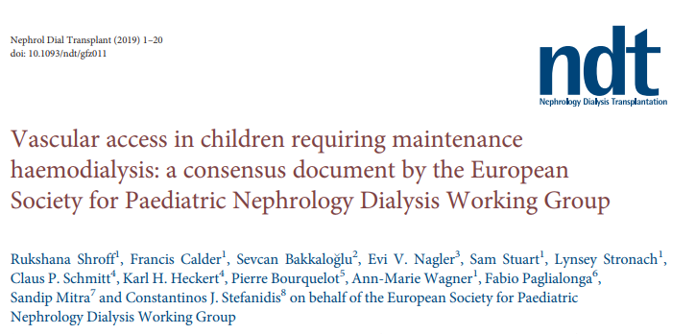
choice of vascular access type, preoperative evaluation, monitoring, and prevention and management of complications
relevant systematic reviews, randomized controlled trials (RCTs) and prospective observational studies
Data pertaining to vascular access in pediatric HD are limited
In the absence of applicable study data, guidance is based on the consensus opinion of experts from ESPN Dialysis WG

Slide 13
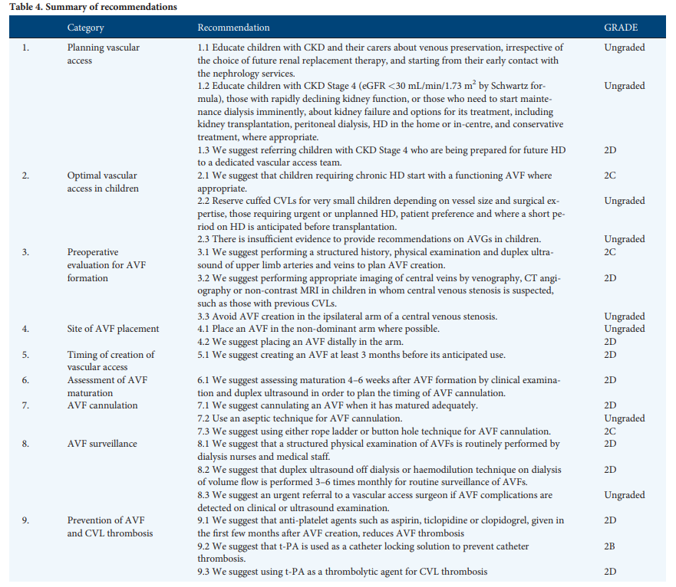

Slide 14
Vein preservation
referral of children with CKD Stage 4 who are being prepared for future HD to a dedicated vascular access team (Grade 2D)
Children, their carers and healthcare workers (doctors, nurses, phlebotomy staff) should receive education on venous preservation
wearing of Medic alert type bracelets
venipuncture above the wrist in either arm should be avoided, except in an emergency, to preserve the forearm cephalic, antecubital and upper arm veins.
nondominant arm may be spared for later AVF creation.
using the dorsal veins of both hands needs to be emphasized.
Notes:
Vein preservation is the number 1 issue

Slide 15
Preoperative evaluation for AVF formation
Structured history, physical examination and duplex ultrasound of upper limb arteries and veins (Grade 2C)
previous CVC
repeated venipuncture of peripheral vessels
hypotension
heart failure
non-visible veins despite tourniquet application
the quality of arterial pulse, to assess for arterial occlusion or impairment of arterial flow
optimal venous system should have a luminal diameter of at least 2.0 mm (in children ??) and a length of continuity with the proximal vein without obstruction
Appropriate imaging of central veins by venography, CT angiography or MRI in children in whom central venous stenosis is suspected, such as those with previous CVCs (Grade 2D)
Avoid AVF creation in the ipsilateral arm of a central venous stenosis (Ungraded)
Notes:
perform

Slide 16
Site of AVF placement
Place an AVF in the non-dominant arm where possible. (Ungraded)
Place an AVF distally in the arm (Grade 2D)
we suggest that a single-stage cephalic-based AVF at the wrist (radiocephalic) or elbow (brachio-cephalic) is the first choice,
when this is not possible a brachio-basilic transposed AVF is the next option.
Mainly radiocephalic AVFs has shown excellent primary patency rates of 78%
Bourquelot’s large single surgeon microsurgery experience in 323 children revealed a 2-year patency of 85% in radiocephalic fistulae
primary failure and inadequate function is less common with brachial AVFs vs radial AVFs in meta-analysis in adults and prospective studies in children
Matoussevitch V, et al.. J Vasc Access 2015; 16: 382–387
Bourquelot P, et al. Pediatr Nephrol 1990; 4: 156–159
Rooijens PP, et al. Eur J Vasc Endovasc Surg 2004; 28: 583–589
Tannuri U, et al. Pediatr Transplant 2009; 13: 360–364

Slide 17
Timing of creation of vascular access Assessment of AVF maturation
create an AVF at least 3 months before its anticipated use (Grade 2D)
assess maturation 4 to 6 weeks after AVF formation by clinical examination and duplex ultrasound in order to plan the timing of AVF cannulation (Grade 2D)
the overall process from preoperative assessment until the fistula is fully operational may require an average of 6 months
Sometimes angioplasty to achieve assited maturation may be required and needs extra time
Psychologic preparation

Slide 18
Prevention of primary AVF failure
initial vein diameter
avoid hypotension in the early days after AVF formation
maintain the children in a state of controlled overhydration for a few days
children and their parents are instructed not to perform BP measurements on the AVF arm
avoid tight clothing that can restrict venous flow and
continue with physical activity but avoid sports or other activities that may cause direct trauma to the AVF
In adult practice, patients are routinely encouraged to perform hand-squeezing exercises to enhance fistula maturation

Slide 19
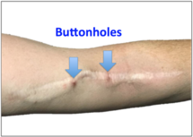
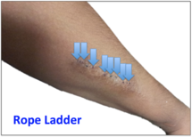
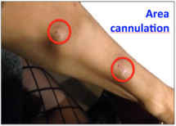
AVF cannulation
cannulate an AVF when it has matured adequately (Grade 2D)
4-6 weeks – 62 days (IPHN) (IQR, 37-134) days
a highly skilled person performs the first fistula puncture,
usually starting with a smaller needle size,
Ultrasound-assisted cannulation may improve the cannulation rate of more difficult AVFs.
use an aseptic technique for AVF cannulation (Ungraded)
use either rope ladder or button hole technique for AVF cannulation (Grade 2C)
creating scar tissue channels in a fistula by placing needles in the same spots at the same angle for several treatments in a row
systematically moving up and down the full length and sides of an AVF
a long vein segment is required
cannulation—placing needles in the same general spot over and over increases aneurysm formation
Notes:
In 67% of patients, a rope ladder technique with antegrade needle direction was used, whereas buttonhole technique was used in 32%

Slide 20
Button hole vs control cannulation
No difference in
patient and access survival
quality of life
needling pain
infection
bleeding during or after dialysis
aneurysm development
the buttonhole technique
causes less extensive aneurysm formation
leads to higher infection rates than rope ladder or area cannulation
IPHN
67% of rope ladder
32% buttonhole
Wong B, Muneer M, Wiebe N et al. Buttonhole versus rope-ladder cannulation of arteriovenous fistulas for hemodialysis: a systematic review. Am J Kidney Dis 2014; 64: 918–936
Grudzinski A, Mendelssohn D, Pierratos A et al. A systematic review of buttonhole cannulation practices and outcomes. Semin Dial 2013; 26: 465–475
Notes:
Rates of bacteraemia were higher with buttonhole cannulation
Application of mupirocin cream was associated with reduced risk of infection

Slide 21
AVF surveillance
a structured physical examination of AVFs is routinely performed by dialysis nurses and medical staff (Grade 2D)
inspection (swelling, signs of infection, aneurysms, stenosis or haematoma),
palpation (characteristic thrill will become pulsatile if there is a downstream stenosis, and some collapse of the vein on elevation of the arm)
auscultation (classic bruit that will be high pitched over a stenosis)
duplex ultrasound off dialysis or haemodilution technique on dialysis of volume flow is performed 3–6 times monthly for routine surveillance of AVFs (Grade 2D)
an urgent referral to a vascular access surgeon if AVF dysfunction or complications are detected on clinical or ultrasound examination (Ungraded)

Slide 22
CVCs remain the favored access type in all pediatric age groups despite international recommendations to the contrary
CVCs allow less efficient dialysis and are associated with much higher complication and access failure rates compared with AVFs, resulting in faster consumption of the vascular access reserve in a population facing decades of RRT
Timely and thorough evaluation of fistula options in each child prepared for maintenance HD, together with a dedicated vascular surgeon is critical
Effective policies augmenting the use of AVF should be applied

Slide 24
Prevention of AVF thrombosis
anti-platelet agents given in the first few months after AVF creation, reduces AVF thrombosis. (Grade 2D)
8 drugs (aspirin, dipyridamole, warfarin, clopidogrel, sulfinpyrazone, ticlopidine, human type-I pancreatic elastase, fish oil) compared against each other or placebo in different combination
Only ticlopidine (a platelet aggregation inhibitor) favoured active treatment (OR 0.45; 95% CI 0.25–0.82; P ¼ 0.009) in increasing the patency of AVF or grafts in the short term (1 month)
A systematic review suggests that perioperative heparin may increase AV fistula patency at 1 month but comes at a cost of increase in bleeding complications.
Tanner NC, Da Silva AF. Medical adjuvant treatment to improve the patency of arteriovenous fistulae and grafts: a systematic review and metaanalysis. Eur J Vasc Endovasc Surg 2016; 52: 243–252
Smith GE, Souroullos P, Cayton T et al. A systematic review and metaanalysis of systemic intraoperative anticoagulation during arteriovenous access formation for dialysis. J Vasc Access 2016; 17: 1–5

Slide 25
International Pediatric Hemodialysis Network
A total of 870 vascular accesses were placed in the 552 patients during 314 cumulative patient-years
They consisted of 628 permanent cuffed CVCs, 225 AVFs, and 17 AVGs
a median age of 12 years
only 5% of the population being <2 years
Patients with AVFs/AVGs were older than those with CVCs
Borzych-Duzalka D, Shroff R, Stefanidis CJ et al. Am J Kidney Dis. 2019 epub

