Slide 1
Case Presentation
Sami bannoura, MD
Bassel zein Sabatto, md
Notes:
Thank committee
And dr Mourani

Slide 2
Cataract
Notes:
Presented to Another hospital
Normal range for albumin

Slide 3
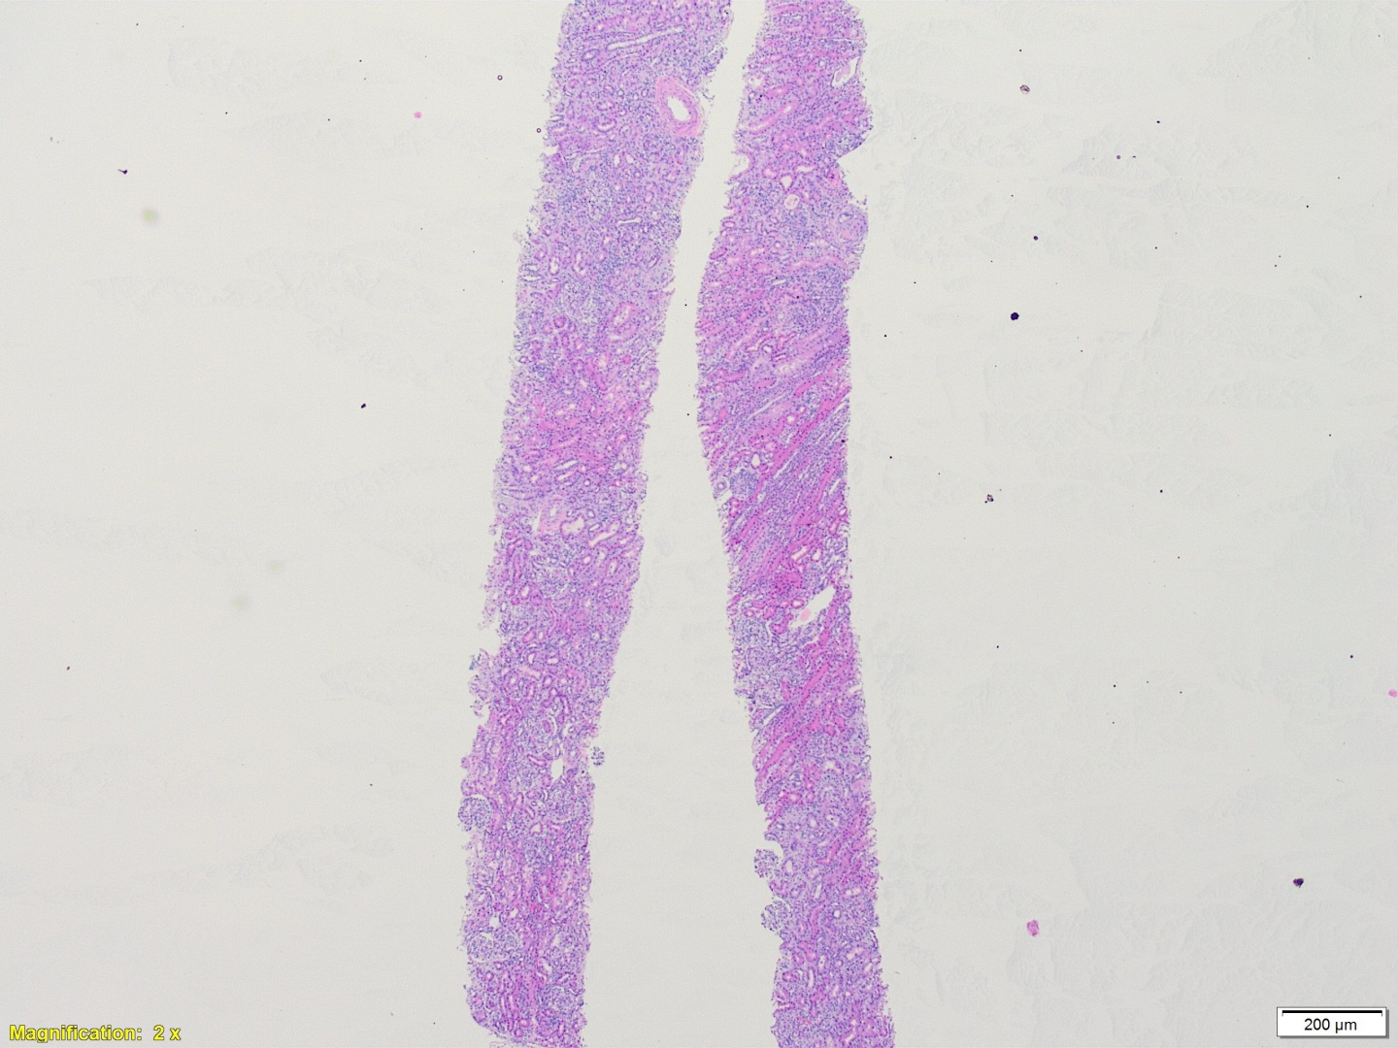
Notes:
Frozen section, we have glomeruli, adequate for IF
Low power in important ,

Slide 4
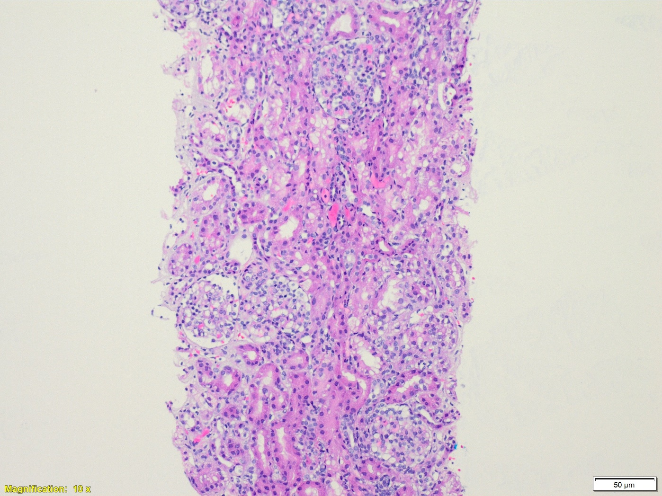
Microscopic Description
Notes:
Presence of glomeruli : minimal mesangial hypercellularity, back to back tubules.
Study four compartmnets

Slide 5
Microscopic Description
Mesangial expansion and hypercellularity.
Notes:
Element of mesangial expansion and hypercellularity
There is also minimal interstitial inflammation
Acute tubular injury
Creatinine ???

Slide 6
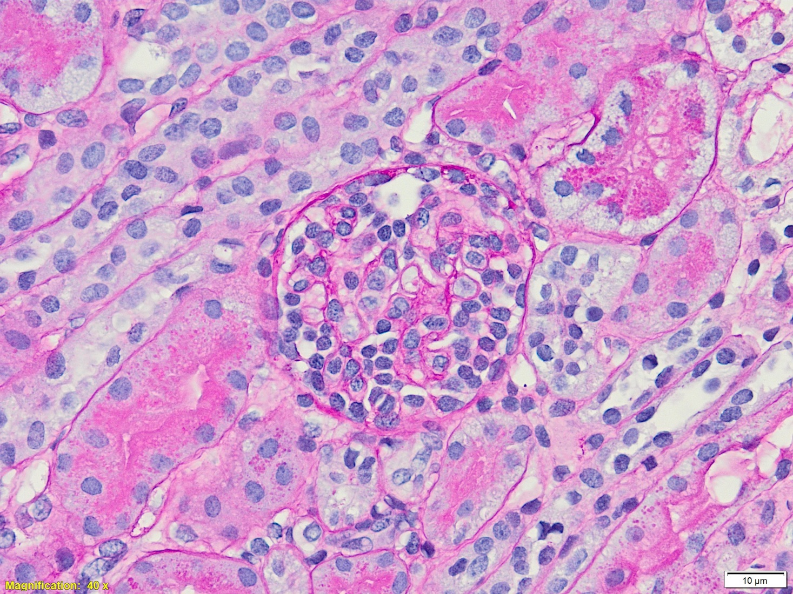
Microscopic Description
Notes:
Element of mesangial expansion and hypercellularity
There is also minimal interstitial inflammation
Acute tubular injury
Creatinine ???

Slide 7
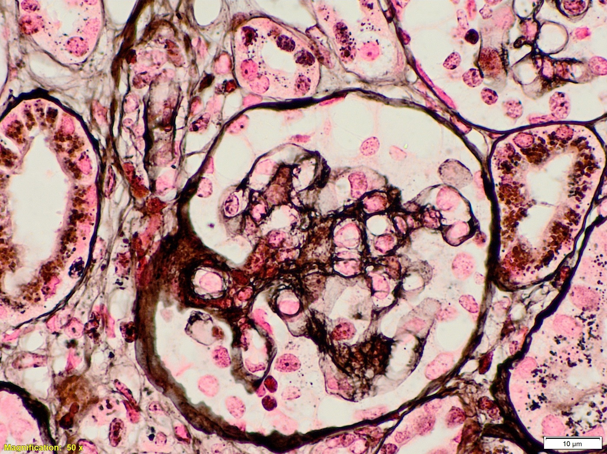
Microscopic Description
Notes:
Element of mesangial expansion and hypercellularity
There is also minimal interstitial inflammation
Acute tubular injury
Creatinine ???

Slide 8
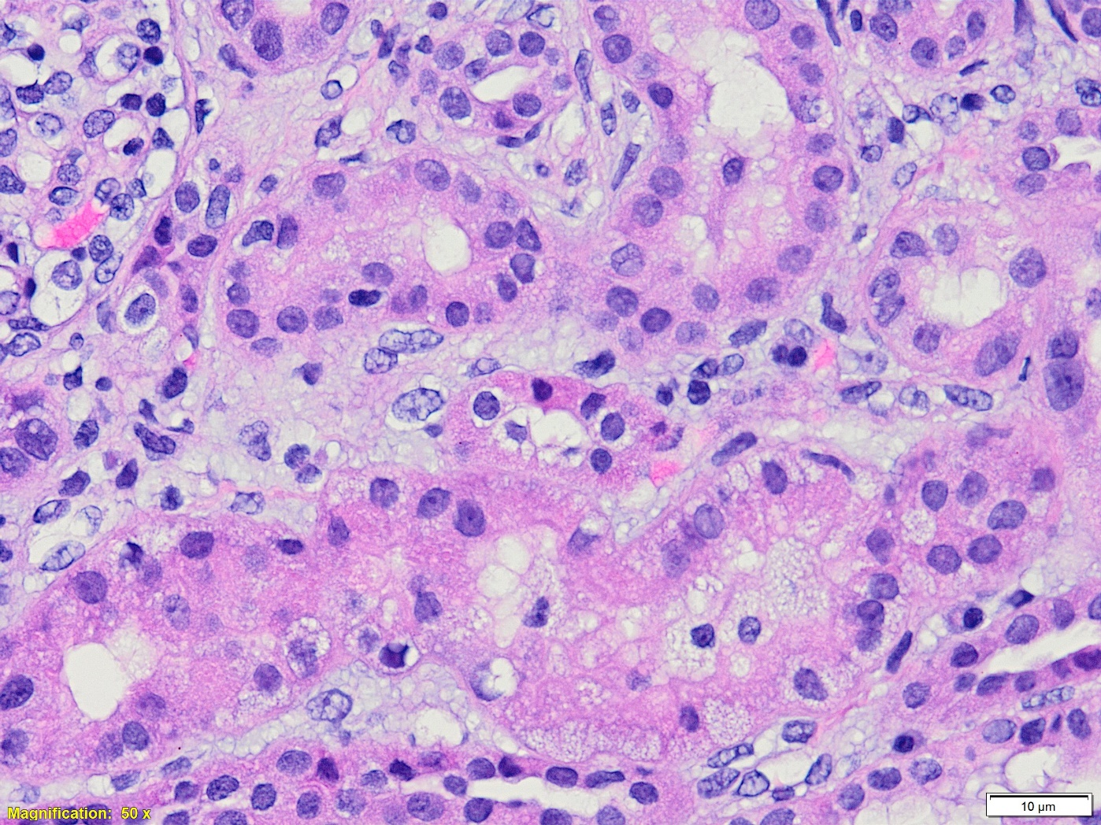
Microscopic Description
Notes:
Element of mesangial expansion and hypercellularity
There is also minimal interstitial inflammation
Acute tubular injury
Creatinine ???

Slide 9
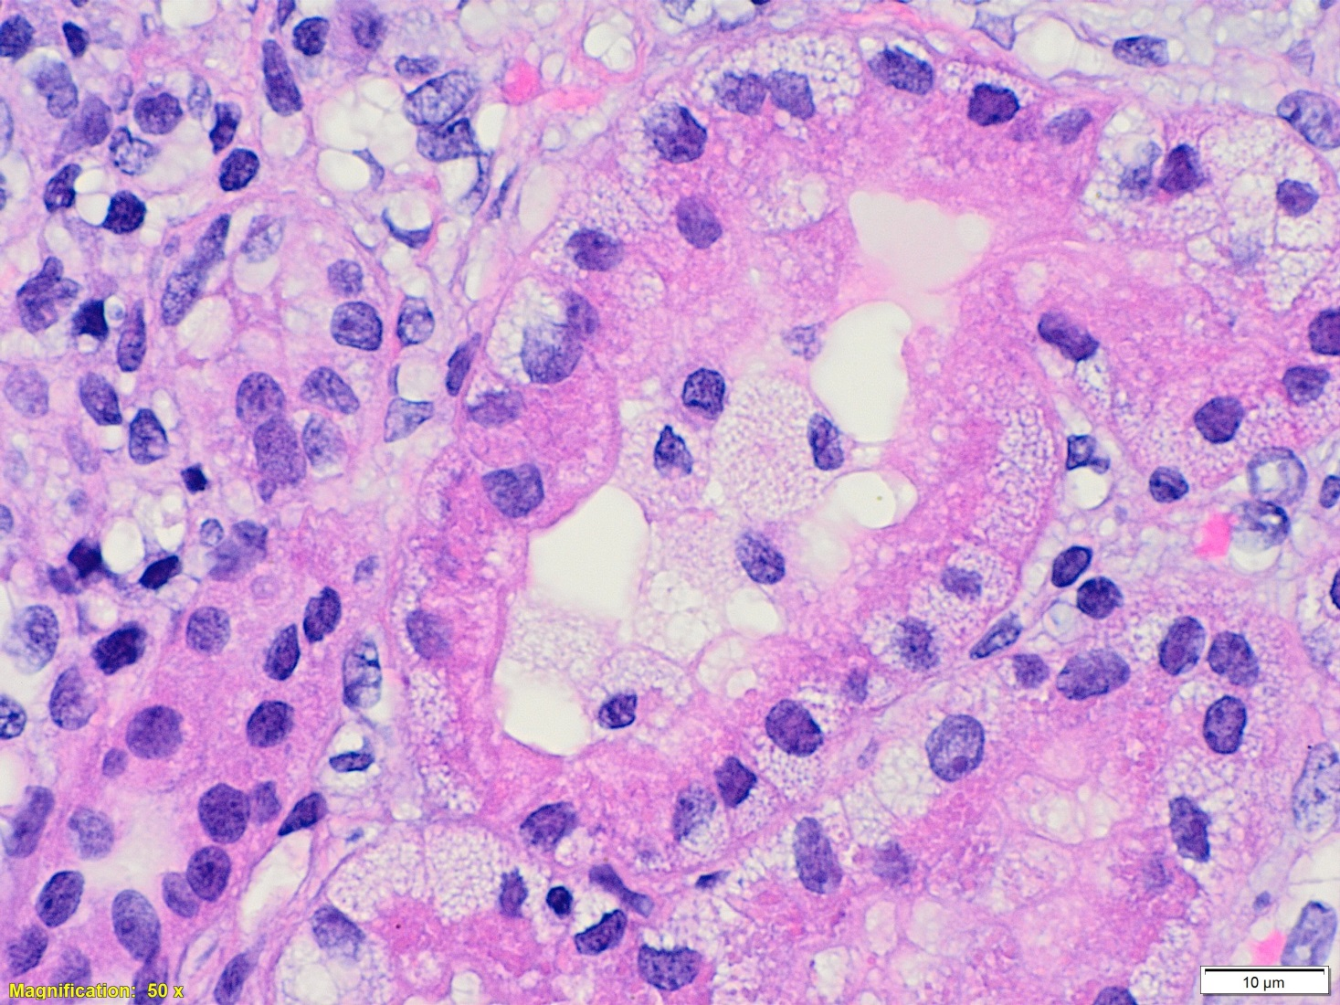
Microscopic Description
Tubules show isometric vacuolization with Oil red O positivity.
Notes:
Lipoid nephrosis.
Owing mainly to impaired clearance and, to a lesser extent, increased biosynthesis.
Metabolism of albumin-bound fatty acids by the proximal tubule during heavy proteinuria may directly underlie subsequent tubulointerstitial inflammation and altered response to injury.

Slide 10
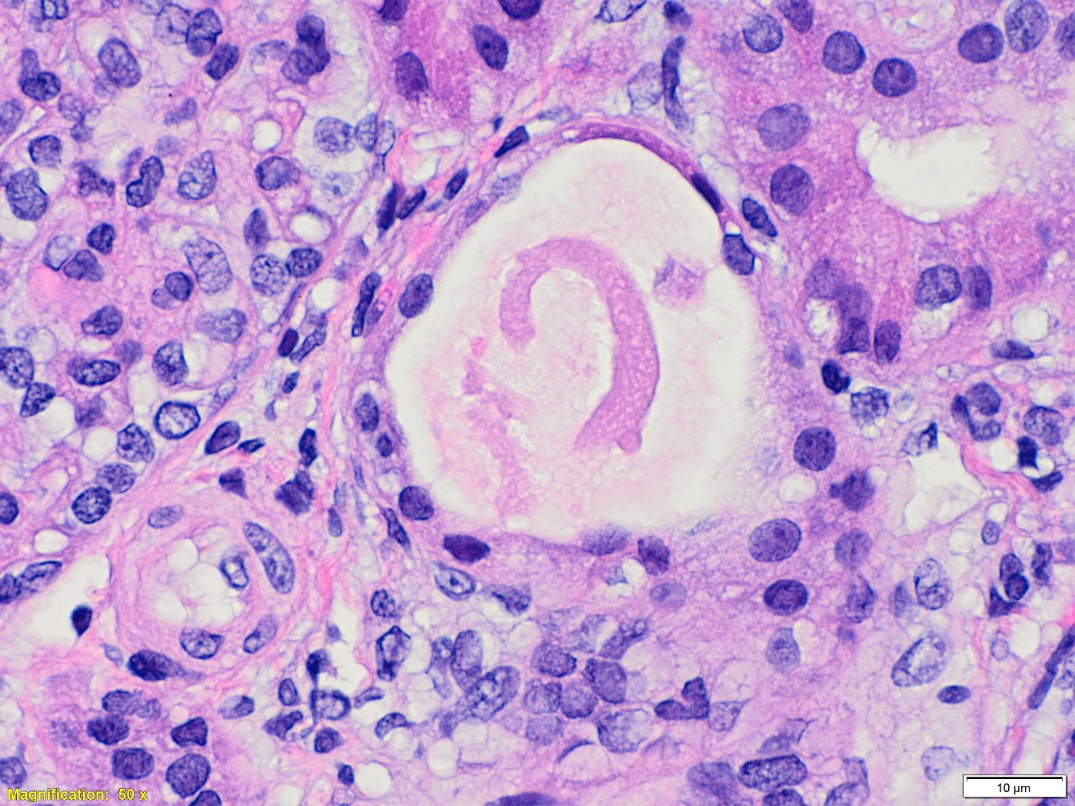
Microscopic Description
Few tubules are dilated
Notes:
Dilatation, Flattened epithelium

Slide 11
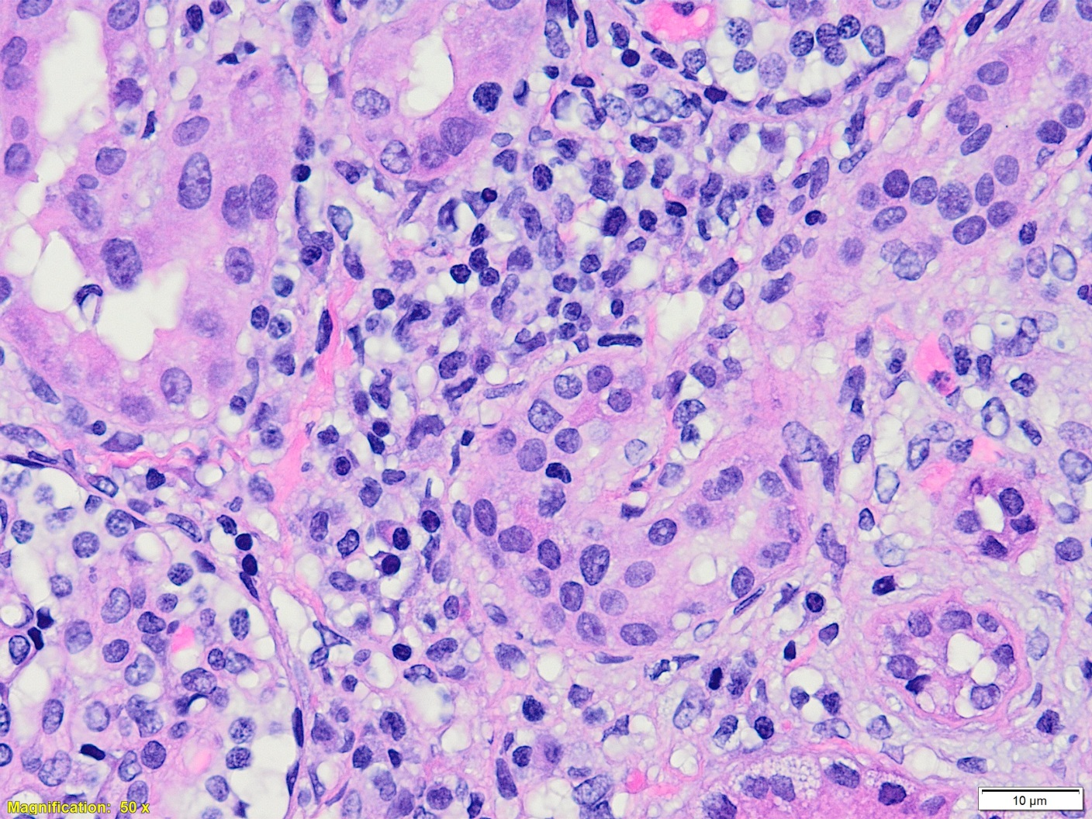
Microscopic Description
Focal interstitial inflammation noted formed by mononuclear cells comprising lymphocytes, plasma cells and a rare eosinophils.
Notes:
There is an element of interstitial inflammation

Slide 12
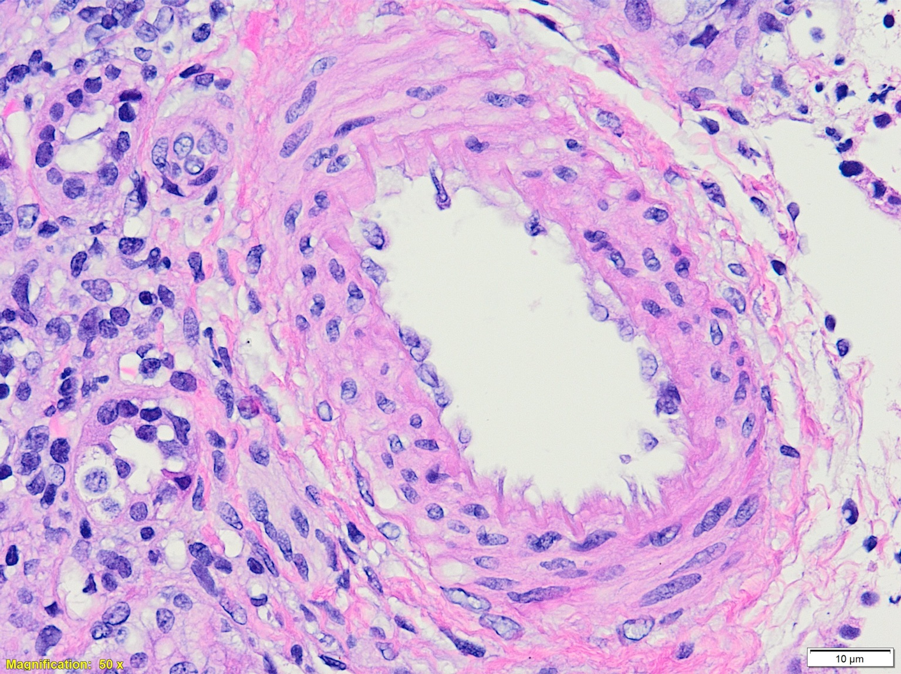
Microscopic Description
No arterial nor hyaline arteriolar sclerosis noted.
Notes:
No vasculitis

Slide 13
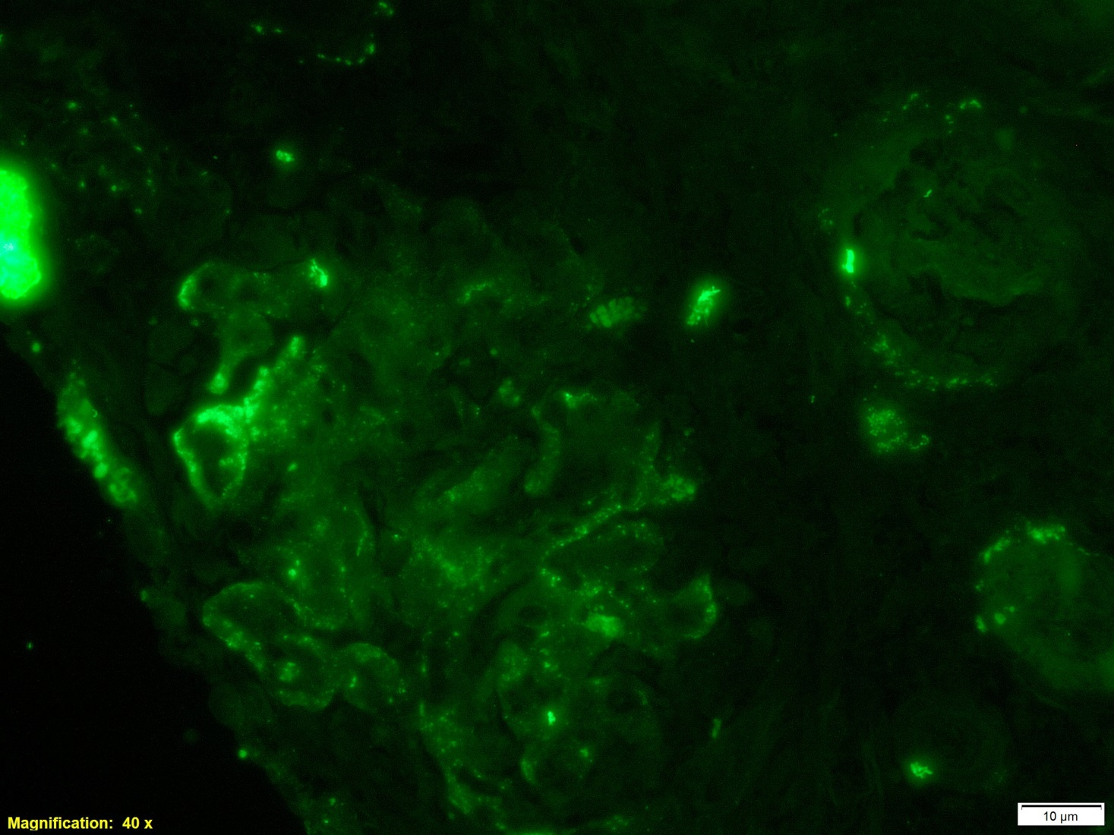
Immunofluorescence
IgM
C3
Notes:
IgA: Negative.
IgG: Negative.
IgM: 2+ focal mesangial and capillary positivity.
C3: 1+ focal mesangial and capillary positivity. Arterioles show focal C3 reactivity.
C1q: +/- focal mesangial positivity.
Kappa:+/- focal mesangial positivity.
Lambda: Negative.
Fibrinogen: Non-specific interstitial staining.
C4: 1+ focal mesangial

Slide 14
Immunofluorescence
C3
Notes:
Reabsorption droplets c3 positive

Slide 15
Can we reach a definitive diagnosis?
Proper classification of the cause of the nephrotic syndrome requires ultrastructural study and molecular pathology.

Slide 16
Congenital nephrotic syndrome (CNS)
Heterogenous conditions with nephrotic syndrome within first 3 months of life.
Onset between 3 - 12 month, (Infantile nephrotic syndrome).
May be inherited, sporadic, acquired or part of a general malformation syndrome.

Slide 17
congenital nephrotic syndrome
Heritable Disorders.
The Finnish Type (CNF). Most common.
Diffuse Mesangial Sclerosis (DMS).
Familial Focal Segmental Glomerulo­sclerosis (FFSGS)
Acquired (Secondary) CNS.
Congenital infections (such as syphilis, toxoplasmosis, and cytomegalo­virus), mercury intoxication, and systemic lupus erythematosus.

Slide 18
congenital nephrotic syndrome
Congenital Nephrosis Associated with Other Syndromes:
Denys-Drash syndrome, Epidermolysis bullosa, Nail-Patella Syndrome, Diffuse mesangial sclerosis and bilateral cataract, …
Sporadic CNS of Childhood Type
MCNS, MesPGN, Non Familial FSGS
Notes:
One report in the literature of bilateral cataract and diffuse mesangial sclerosis

Slide 19
Finnish type
Autosomal recessive disorder (OMIM: Nephrotic Syndrome, Type 1; NPHS1)
Also called NPHS1, Finnish congenital nephrosis
1.5% of cases of nephrotic syndrome in childhood
Occurs in 1 per 10,000 newborns in Finland, lower incidence elsewhere (1 in 50,000 in North America)

Slide 20
Glomerular capillary .
WT1 is a transcription factor important for podocyte function.
Nephrin is a major component of the slit diaphragm (SD) connecting podocyte foot processes.
Podocin is an adapter protein located intracellularly in the SD area.
Laminin is a major structural protein of the glomerular basement membrane (GBM).
Notes:
Nephrin is a transmembrane protein that probably forms the main building block of an isoporous zipper-like slit diaphragm filter structure. Defects in nephrin lead to the abnormal or absent slit diaphragm resulting in massive proteinuria and renal failure
More than 60 mutations. In finland two nonsense mutations account for over 94% of all mutations.
Most mutations found in non­Finnish patients are missense mutations, but they include also nonsense and splice site mutations, as well as deletions and insertions.
Nephrin protein is produced by glomerular podocyte, encoded by NPHS1 at 19q13.1.
Normally expressed at slit diaphragm of glomerular podocyte but missing or defective in patients with Finnish type syndrome
Can be diagnosed in utero via genetic testing; (heavy proteinuria in utero, increased AFP)
At birth, large placentas, proteinuria, edema, infections, premature birth, mild facial / limb abnormalities and poor development

Slide 21
Finnish type
Doesn't respond to steroids or immunosuppression.
Death without kidney transplant
Dramatic improvement with transplant but 20% have recurrence of nephrotic syndrome, which may respond to rituximab.

Slide 22
Histology
Depends on the stage of the disease.
The most striking feature, diffuse cystic dilatation of the proximal tubules, though cases without dilatation have been reported.
Distal tubular ectasia with flattening of tubular epithelium.
Microcysts with or without tubular PAS+ hyaline casts.

Slide 23
Histology
Glomeruli typically show minimal abnormali­ties;
Mild mesangial hypercellularity
Increased amount of the mesangial matrix.
Occasional immature glomeruli.
No glomerular deposits of immunoglobulin or complement. IgM and C3 nonspecific.
Extensive effacement of epithelial cell foot processes is seen by electron microscopy.
Notes:
Immature glomeruli are commonly seen, with palisade of epithelial cell nuclei around a small glomerular tuft within a dilated urinary space.

Slide 24
Electron Microscopy
Epithelial foot processes exhibited wide effacement.
No electron-dense deposits were found.

Slide 25
Histology
Progressive obliteration of the capillary loops and glomerular sclerosis.
Tubular atrophy and interstitial fibrosis.
May evolve to FSGS.

Slide 26
Role of Pathologist
Proper classification of the cause of the congenital nephrotic syndrome requires ultrastructural study and molecular pathology in addition to the routine light and immunofluorescent microscopy.
Notes:
For proper classification , The message of this case, we need genetic and electron in addition to histoogly and if

Slide 27
Thank you

