Slide 1
BronchoPulmonary Dysplasia Updates & Prevention
GABY FALAKHA
PEDIATRICIAN - NEONATOLOGIST
Beirut, September 13th, 2019

Slide 2
I have no disclosure or conflict of interest

Slide 3
Introduction
The incidence of BPD continues to rise despite advances in perinatal care.
The etiology of BPD is multifactorial and remains incompletely understood.
Multiple interventions have been proposed to prevent and treat BPD, many not evidence based.
In 25 years there have been no new drug for prevention or treatment of BPD
Philippa Bowen et al. Pediatrics and Child Health 24:1, 2013

Slide 4
Definition of BPD
Supplemental Oxygen for more than 28 days, graded at 36 weeks post-menstrual age for severity according to the level of respiratory support required
BPD | 36 weeks PMA
Mild | Able to tolerate room air for >60 minutes while keeping TcPaO₂ ≥90%
Moderate | Need for FiO₂ ≤30%
Severe | Need for FiO₂ ≥30% and/or PPV
Copyright © 2016 American Thoracic Society

Slide 5
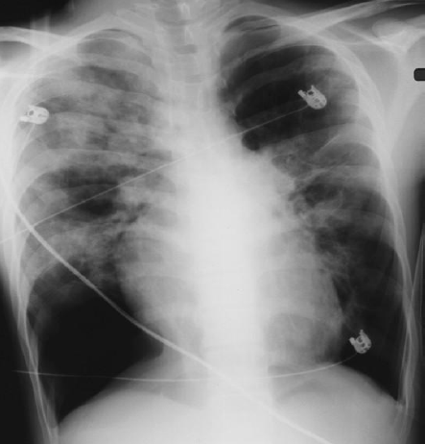
Bronchopulmonary Dysplasia Old/New
20-30 years ago Extremely Preterm Infants didn’t survive
BPD patients had on average ≥ 32 weeks and > 1500 g, were ventilated aggressively with 100% Oxygen and had cystic changes, scarring and areas of atelectasis and hyperinflation.

Slide 6
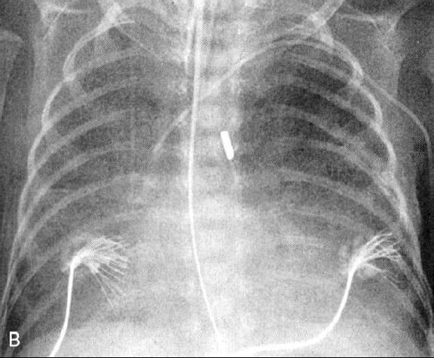
Bronchopulmonary Dysplasia Old/New
Gestational age 23-28 Weeks
Weight less than 1000 g
More gentle ventilation with < 100% Oxygen
Treated with Surfactant
Diffuse haziness which progresses to a fine lacy pattern.

Slide 7
Keypoint nr. 1
New BPD is an arrest in alveolar development and a remodeling of the airways

Slide 8
Incidence
The incidence of BPD is inversely proportional to weight and gestational age
BPD affects 10 000-15 000 infants annually in the United States.
Approximately 40% of extremely low birthweight infants (birthweight of <1000 g) develop BPD
It is uncommon among infants born after 32 weeks or weighing more than 1500g.
Javaid A, Morris I, Bronchopulmonary dysplasia, Paediatrics and Child Health (2017), j.paed.2017.10.004

Slide 9
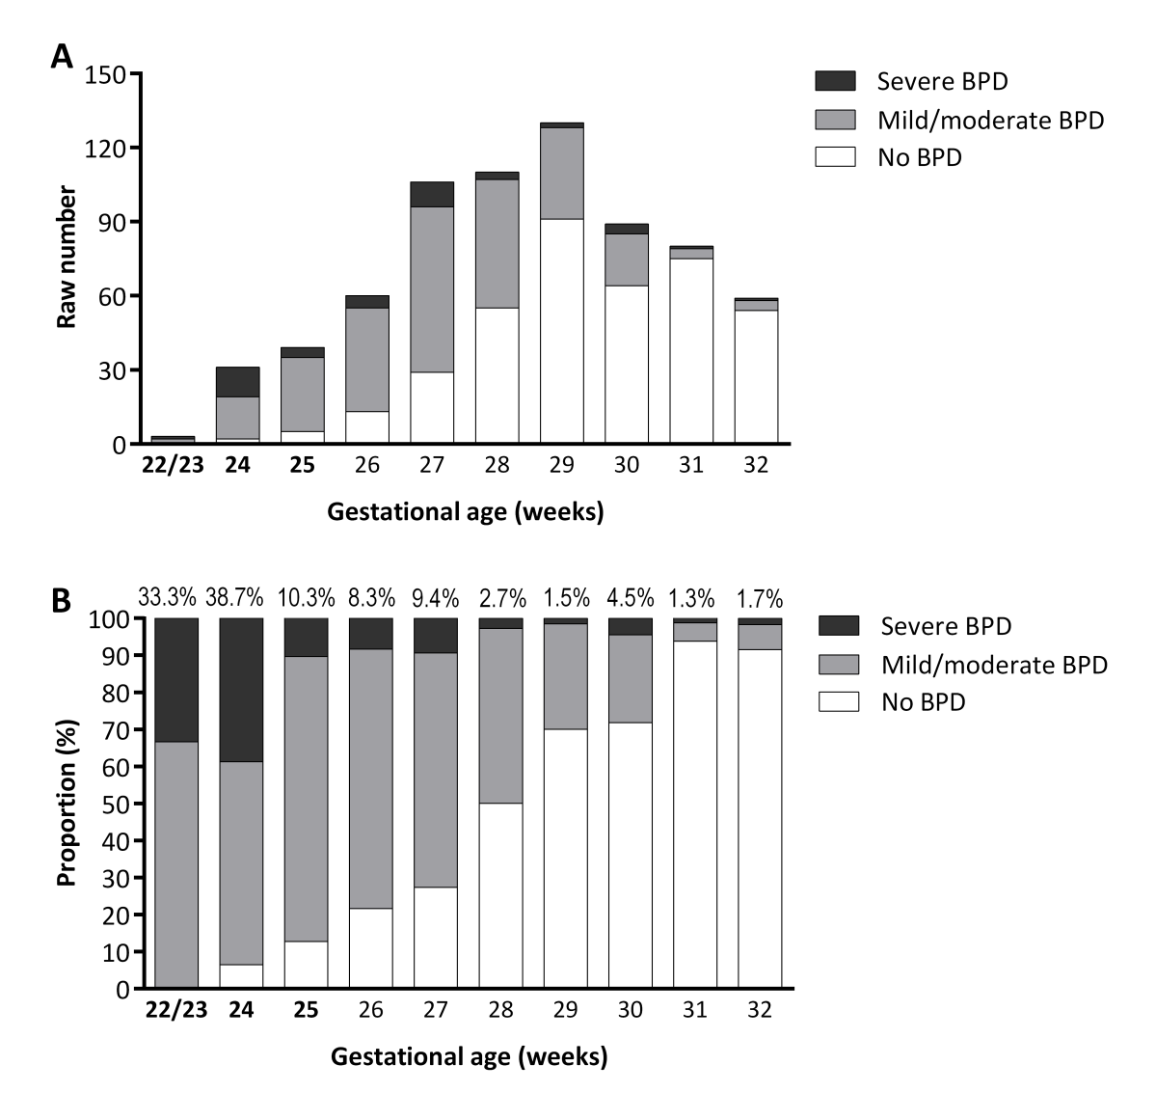
Severe BPD Incidence and predictive factors in a prospective, multicenter study in very preterm infants with respiratory distress syndrome
846 premature infants born at ≤32 week gestation who developed respiratory distress syndrome (RDS)
6% of infants developed severe BPD, while 39.1% had mild or moderate BPD.
Rutkowska et al. J Matern Fetal Neonatal Med. 2019 Jun;32(12):1958-1964

Slide 10
Severe BPD Incidence and predictive factors in a prospective, multicenter study in very preterm infants with respiratory distress syndrome
846 premature infants born at ≤32 week gestation who developed respiratory distress syndrome (RDS)
6% of infants developed severe BPD, while 39.1% had mild or moderate BPD.
Rutkowska et al. J Matern Fetal Neonatal Med. 2019 Jun;32(12):1958-1964

Slide 11
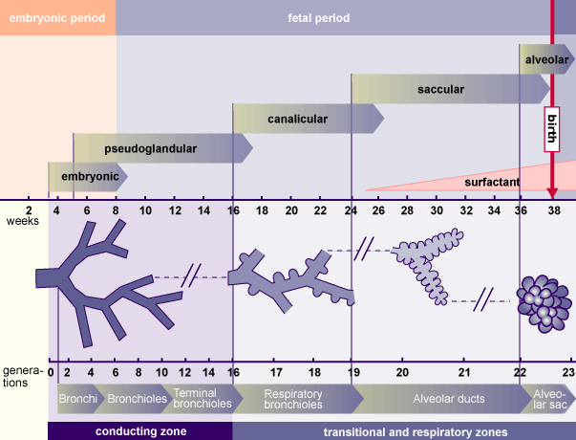
Development of the lungs

Slide 12
Development of the lungs

Slide 13
Pathophysiology of Bronchopulmonary Dysplasia

Slide 14
Pathophysiology of Bronchopulmonary Dysplasia
Antenatal
1st Hit
Genetics
Prematurity
Chorioamnionitis
BPD
Altered alveolar and airway vascular structure and function
Increased susceptibility to childhood and adult lung disease

Slide 15
Pathophysiology of Bronchopulmonary Dysplasia
Antenatal
Delivery
1st Hit
2nd Hit
Genetics
Prematurity
Chorioamnionitis
Resuscitation
Volutrauma
Oxygen toxicity
Lack of Surfactant
BPD
Altered alveolar and airway vascular structure and function
Increased susceptibility to childhood and adult lung disease

Slide 16
Pathophysiology of Bronchopulmonary Dysplasia
Antenatal
Delivery
Postnatal
1st Hit
2nd Hit
3^{d} Hit
Genetics
Prematurity
Chorioamnionitis
Resuscitation
Volutrauma
Oxygen toxicity
Lack of Surfactant
Mechanical Ventilation
Oxygen toxicity and poor anti-oxidant activity
Infection
PDA
Poor nutrition
BPD
Altered alveolar and airway vascular structure and function
Increased susceptibility to childhood and adult lung disease

Slide 17
Keypoint nr. 2
The injury resulting in BPD likely begins before delivery and can be initiated by resuscitation at birth and then amplified by postnatal exposure

Slide 18
Genetics of BPD
1st Hit Antenatal
Twin studies demonstrate that moderate to severe BPD has a heritability of 50%-80%¹
A recent genome wide association and gene set analysis for BPD suggest that phenotypic differences in the severity of BPD are also manifest at the genomic level²
1. Shaw GM, O’Brodovich HM. Progress in understanding the genetics of bronchopulmonary dysplasia. Semin Perinatol 2013;37:85-93.
2. Ambalavanan N, et al. Integrated genomic analyses in bronchopulmonary dysplasia. J Pediatr 2015;166:531-7.

Slide 19
Chorioamnionitis
1st Hit Antenatal
In a cohort of VLBW infants weighing less than 1500 g at birth, the incidence of “clinical chorioamnionitis” was 18%, but the incidence of “histologic chorioamnionitis” was 48%.
Approximately 70% of infants (born before 30 weeks' gestation) delivered by cesarean section with intact membranes had histologic chorioamnionitis.
The most common microorganisms detected in the amniotic fluid with chorioamnionitis are the Ureaplasma species
Goldenberg RL, et al. WW: Intrauterine infection and preterm delivery. N Engl J Med 2000; 342: pp. 1500-1507
DiGiulio DB: Diversity of microbes in amniotic fluid. Semin Fetal Neonatal Med 2012; 17: pp. 2-11

Slide 20
Chorioamnionitis and BPD
1st Hit Antenatal
Clinical responses to exogenous surfactant may be diminished after exposure to chorioamnionitis
Infants with histologic chorioamnionitis had lower maximal expiratory flows at 40 weeks postconceptional age and had the greatest risk for wheezing and physician-diagnosed asthma, up to the age of 2.2 years
Been JV, et al: Chorioamnionitis alters the response to surfactant in preterm infants. J Pediatr 2010; 156: pp. 10-15
Jones MH, et al: Chorioamnionitis and subsequent lung function in preterm infants. PLoS ONE 2013; 8: pp. e81193

Slide 21
Ureaplasma and BPD
1st Hit Antenatal
The mycoplasma species Ureaplasma parvum , U. urealyticum , and Mycoplasma hominis are genitourinary tract commensals in adults
They're associated with adverse pregnancy outcomes and neonatal morbidities of prematurity
Ureaplasma spp. are detected in respiratory samples from 28 to 33 % of infants <1500 g birthweight¹
In the Rhesus macaque intrauterine U. parvum infection model, Azithromycin delayed onset of labor, eradicated the infection, and prevented fetal lung injury²
1.Lowe J, et al. Pediatr Infect Dis J. 2014;33(7):697–702.
2.Acosta EP, et al. J Infect Dis. 2014;209(6):898–904.

Slide 22
Bronchopulmonary dysplasia in neonates born to mothers with preeclampsia: Impact of small for gestational age
1st Hit Antenatal
Methods
Retrospective single-center cohort study including 141 neonates born between 24 and 30 weeks' gestation to mothers with preeclampsia.
Neonates born small for gestational age (birthweight < 10th percentile) were compared to those with adequate birthweight for gestational age
Dravet-Gounot P, et al. (2018). https://doi.org/10.1371/journal.pone.0204498

Slide 23
Bronchopulmonary dysplasia in neonates born to mothers with preeclampsia: Impact of small for gestational age
1st Hit Antenatal
Methods
Retrospective single-center cohort study including 141 neonates born between 24 and 30 weeks' gestation to mothers with preeclampsia.
Neonates born small for gestational age (birthweight < 10th percentile) were compared to those with adequate birthweight for gestational age
Dravet-Gounot P, et al. (2018). https://doi.org/10.1371/journal.pone.0204498

Slide 24
Pathophysiology of Bronchopulmonary Dysplasia
Antenatal
Delivery
1st Hit
2nd Hit
Genetics
Prematurity
Chorioamnionitis
Resuscitation
Volutrauma
Oxygen toxicity
Lack of Surfactant
BPD
Altered alveolar and airway vascular structure and function
Increased susceptibility to childhood and adult lung disease

Slide 25
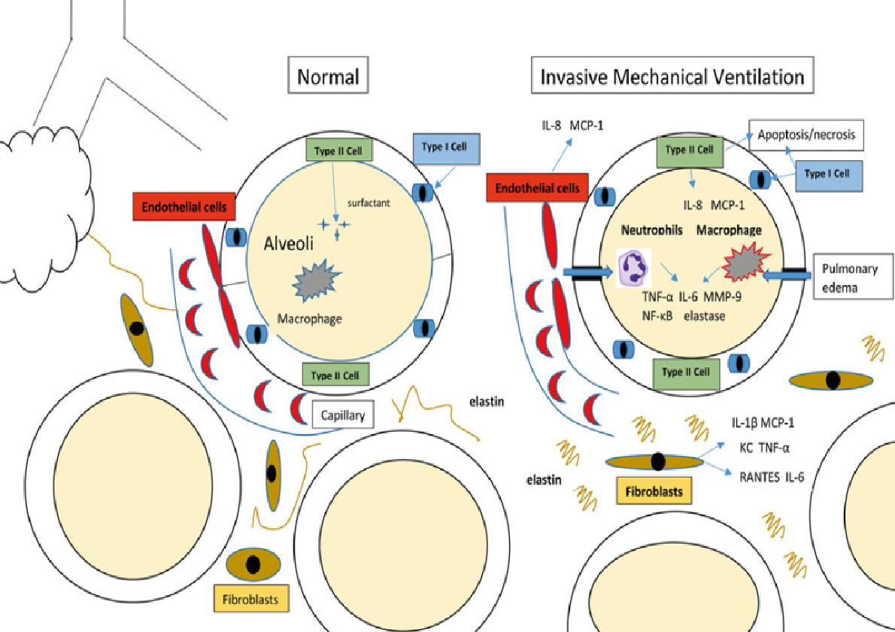
Overidistention (Volutrauma)
2nd Hit
DR
Overdistention and excessive stretch of alveoli leads to:
Disruption of alveolar and small airway epithelium
Acute edema, proteinaceous exudate and release of proteases, cytokines, and chemokines
Activation of macrophages and invasion of neutrophils
Inactivation of Surfactant
IL interleukin, MCP-1 monocyte chemoattractant protein-1, TNF-α tumor necrosis factor alpha, MMP-9 matrix metalloproteinase-9, NF-κB nuclear factor kappa-light-chain enhancer of activated B cells, KC keratinocyte chemoattractant, RANTES regulated on activation, normal T-cell expressed and sec
Lauren M. Ramos , Tanbir Najrana , and Juan Sanchez-Esteban Bronchopulmonary Dysplasia Respiratory Medicine Book Humana Press

Slide 26
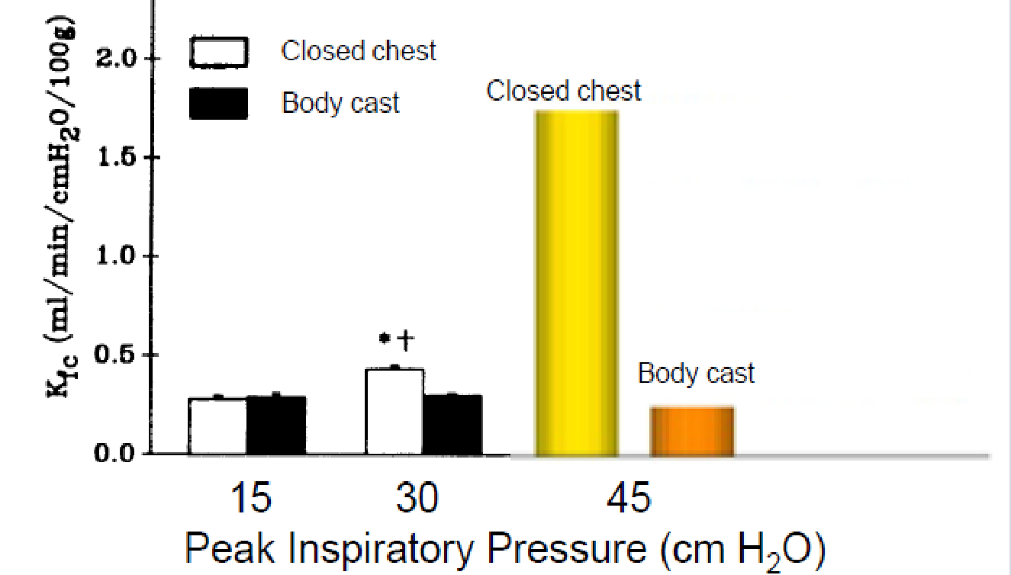
Mechanisms of Lung Injury During Neonatal Resuscitation
2nd Hit
DR
Volutrauma/Barotrauma
Kfc (Capillary filtration coefficient) increased 31% after 30 cmH2O PIP and 430% after 45 cm H2O PIP.
Volume distention of the lung rather than high PIP per se produces microvascular damage in the lung
LUCRECIA A. HERNANDEZ, et al. Chest wall restriction limits high airway pressure-induced lung injury in young rabbits J Appl Physiol 66:2364-2368, 1989

Slide 27
Atelectrauma
Lung damage caused by ventilation in the presence of atelectasis
Ventilation of injured lungs using inadequate end-expiratory pressure results in repeated alveolar collapse and expansion (RACE), which rapidly leads to more lung injury.
Most importantly, when a large portion of the lungs is atelectatic, whatever VT is entering the lungs preferentially enters the aerated portion of the lung leading to Volutrauma of that part
Mols G, Priebe HJ, Guttmann J. Alveolar recruitment in acute lung injury. Br J Anaesth 2006;96(2):156–66.

Slide 28
CPAP in the Delivery Room
2nd Hit
DR
CPAP immediately after birth facilitates alveolar recruitment and formation of a functional residual capacity.
Avoids volutrauma or atelectrauma
COIN Trial 610 infants 25-28 weeks
SUPPORT Trial 1316 infants 24-28 weeks
VON Trial 648 infants 26-29 weeks
Each trial demonstrated a non-significant reduction in the rate of death or BPD at 36 weeks PMA among infants treated with CPAP, compared with empirical intubation and mechanical ventilation.
Morley CJ, et al. Nasal CPAP or intubation at birth for very preterm infants. N Engl J Med 2008; 358: 700–708.
Finer NN, et al. Early CPAP versus surfactant in extremely preterm infants. N Engl J Med 2010; 362: 1970–1979.
Dunn MS, et al. Randomized trial comparing 3 approaches to the initial respiratory management of preterm neonates. Pediatrics 2011; 128: e1069–e1076.

Slide 29
Delivery room interventions to prevent BPD in extremely preterm infants : FiO₂
2nd Hit
DR
EE Foglia et al. Delivery room interventions to prevent BPD Journal of Perinatology (2017), 1171 – 1179

Slide 30
Delivery room interventions to prevent bronchopulmonary dysplasia in extremely preterm infants: FiO₂
EE Foglia et al. Delivery room interventions to prevent BPD Journal of Perinatology (2017), 1171 – 1179

Slide 31
Kapadia et al., 2013 88 infants 24 346/7 weeks GA
Vento et al., 2009
78 infants 24-28 weeks GA
EE Foglia et al. Delivery room interventions to prevent BPD Journal of Perinatology (2017), 1171 – 1179

Slide 32
Delivery room interventions to prevent bronchopulmonary dysplasia in extremely preterm infants : FiO₂
Infants < 28 weeks gestation demonstrated higher mortality in the 21% FiO2 group
(22% vs 6%, P = 0.01)
Oei JL, et al. Targeted oxygen in the resuscitation of preterm infants, a randomized clinical trial. Pediatrics 2017;139: e20161452.
EE Foglia et al. Delivery room interventions to prevent BPD Journal of Perinatology (2017), 1171 – 1179

Slide 33
Keypoint nr. 3
A high FIO₂ leads to BPD and ROP, a low FiO₂ increases mortality

Slide 34
Sustained inflation
2nd Hit
DR
Administration by face mask or nasopharyngeal tube of a high peak pressure of 20-25 cm H2O, maintained for 10-45 seconds
Sustained inflation did not improve outcomes for extremely preterm infants and cannot be recommended for delivery room resuscitation.
Early death predominantly affected the smallest infants, suggesting that these fragile patients need particularly gentle delivery room resuscitation.
Sustained Inflation for Delivery Room Resuscitation of Extremely Preterm Infants
Robin H. Steinhorn, MD reviewing Kirpalani H et al. JAMA 2019 Mar 26 Perlman J. JAMA 2019 Mar 26

Slide 35
Keypoint nr. 4
“There is perhaps nothing more dangerous for the preterm lung
than an anxious physician with an endotracheal tube and an Ambu bag”
Alan Jobe

Slide 36
Pathophysiology of Bronchopulmonary Dysplasia
Antenatal
Delivery
Postnatal
1st Hit
2nd Hit
3^{d} Hit
Genetics
Prematurity
Chorioamnionitis
Resuscitation
Volutrauma
Oxygen toxicity
Lack of Surfactant
Mechanical Ventilation
Oxygen toxicity and poor anti-oxidant activity
Infection
PDA
Poor nutrition
BPD
Altered alveolar and airway vascular structure and function
Increased susceptibility to childhood and adult lung disease

Slide 37
Why do preterm neonates have trouble breathing?
Deficiency of surfactant predisposes to atelectasis
A marked imbalance exists between chest wall rigidity and elastic recoil of neonatal lungs leading to airway collapse
A flatter diaphragm and more horizontal ribs limit inspiratory reserve volume. Hence the minute volume is achieved by increasing the rate of respiration
Raju Narasimhan, et al. A review of non-invasive ventilation support in neonates PAEDIATRICS AND CHILD HEALTH 24:1

Slide 38
Non-Invasive ventilation
NCPAP (Nasal Continuous Positive Airway Pressure)
BiPAP (Bilevel Positive Airway Pressure)
NIPPV, sNIPPV (Nasal Intermittent Positive Pressure Ventilation)
HHHFNC (Heated Humidified High Flow Nasal Cannula)
InSurE (Intubate Surfactant Extubate to CPAP)
LISA (Less Invasive Surfactant Administration)
MIST (Minimal Invasive Surfactant Treatment)
Success of NIV also depends on careful patient selection, appropriate methods of fixation of nasal interfaces on infants and the experience of clinical staff involved in infant’s care.
Raju Narasimhan, et al. A review of non-invasive ventilation support in neonates PAEDIATRICS AND CHILD HEALTH 24:1

Slide 39
Association of Noninvasive Ventilation Strategies With Mortality and BPD Among Preterm Infants A Systematic Review and Meta-analysis
OBJECTIVE To compare 7 ventilation strategies for preterm infants born at less than 33 weeks’ gestational age and spontaneously breathing, including:
CPAP alone
INSURE with CPAP
LISA
NIPPV
Nebulized surfactant administration
Surfactant administration via laryngeal mask airway
Mechanical ventilation.
Isayama T, et al. Association of noninvasive ventilation strategies with mortality and bronchopulmonary dysplasia among preterm infants:
a systematic review and meta-analysis. JAMA 2016; 316: 611–624.

Slide 40
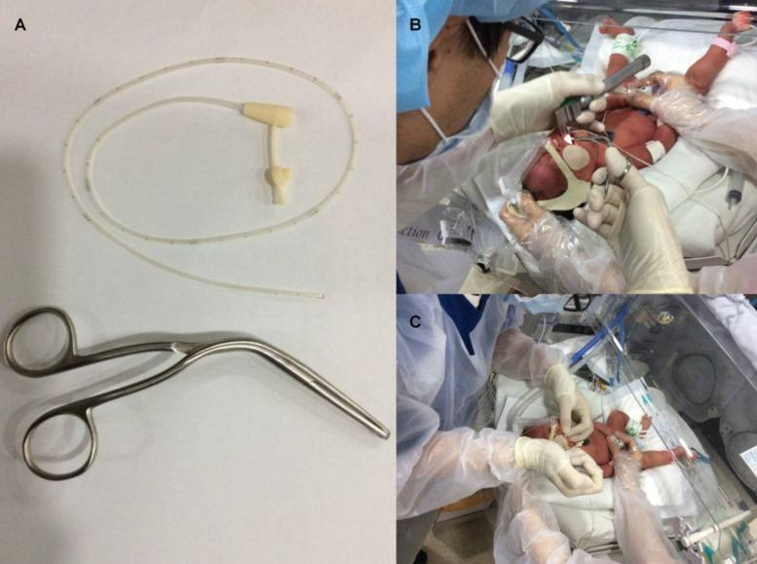
LISA Less Invasive Surfactant Administration

Slide 41
Association of Noninvasive Ventilation Strategies With Mortality and Bronchopulmonary Dysplasia Among Preterm Infants A Systematic Review and Meta-analysis
RESULTS: 5598 infants involved in 30 trials
BPD incidence was 26%
Compared with mechanical ventilation, LISA had a lower odds of BPD (OR 0.53)
Compared with nasal CPAP alone, LISA had a lower odds of BPD (OR, 0.58)
Ranking probabilities indicated that LISA was the best strategy with a surface under the cumulative ranking curve of 0.85 to 0.94, but this finding was not robust for death when limited to higher-quality evidence.
Isayama T, et al. Association of noninvasive ventilation strategies with mortality and bronchopulmonary dysplasia among preterm infants:
a systematic review and meta-analysis. JAMA 2016; 316: 611–624.

Slide 42
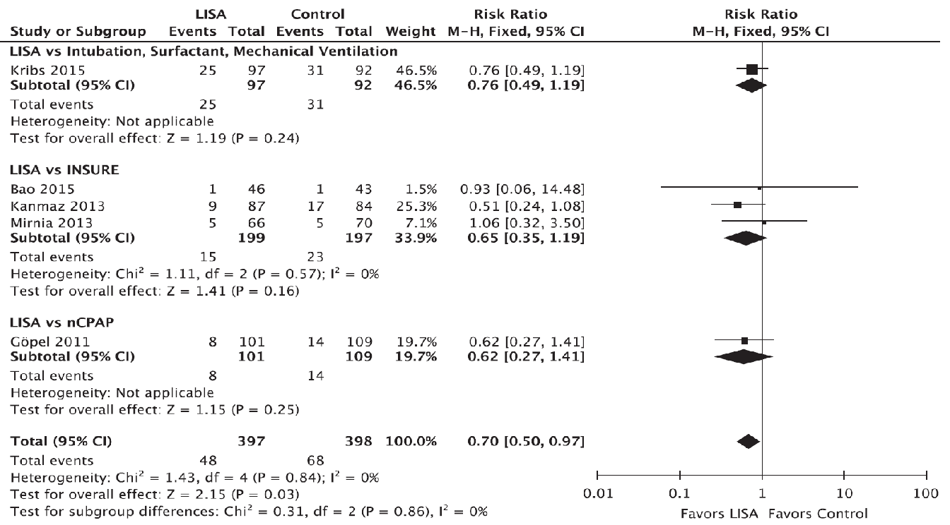
LISA / Intubation +MV, Insure, nCPAP
Rigo V, et al. Eur J Pediatr 2016; 175: 1933–1942.
Aldana-Aguirre JC, et al.. Arch Dis Child Fetal Neonatal Ed 2017; 102

Slide 43
Decreased Indicators of Lung Injury with CPAP in Preterm Lambs
Premature lambs studied at 134 days
Lambs divided into 3 groups:
No Ventilation
IPPV at a Frequency 40/min, PIP (maintain pCO2 at 40 mmHg), PEEP 4 cm H₂O
Bubble CPAP, 5 cm H₂O
Lungs were evaluated at 2 hours
Alan Jobe, et al. Pediatric Research Vol. 52, No. 3, 2002

Slide 44
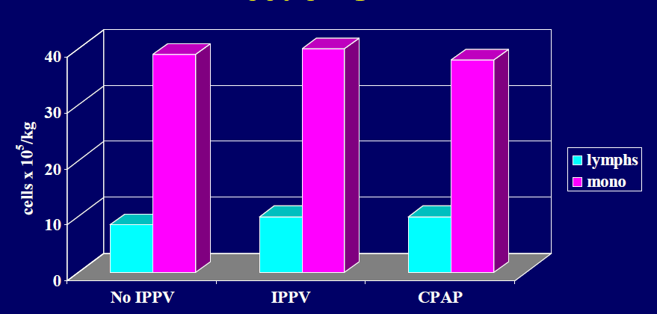
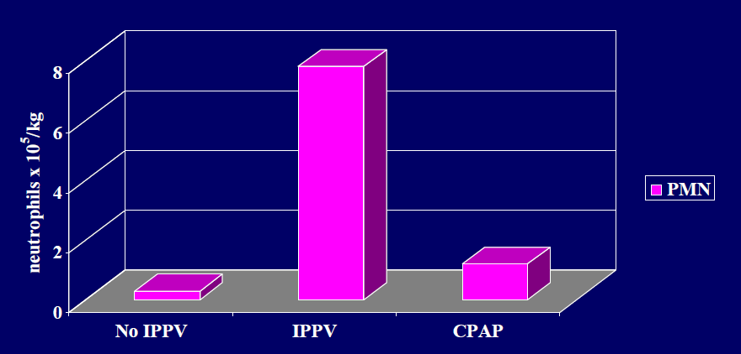
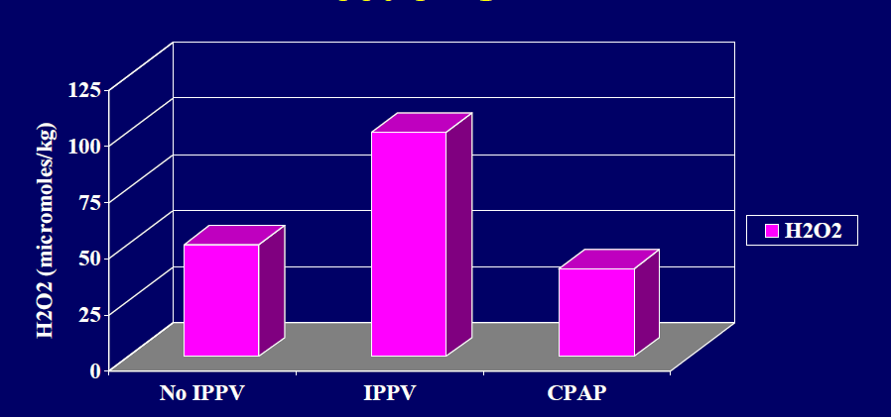
Decreased Indicators of Lung Injury with CPAP in Preterm Lambs
Nr. Of Neutrophils in BAL
Alan Jobe, et al. Pediatric Research Vol. 52, No. 3, 2002

Slide 45
Need for Mechanical Ventilation
Data from the Neonatal Research Network show that 89% of ELBW infants were treated with MV during the first day of life.
Among survivors, almost 95% were invasively ventilated at some point during their hospital stay.
In the SUPPORT trial, 83% of the ELBW infants initially assigned to noninvasive support required endotracheal intubation and MV at some point.
The CPAP or Intubation trial enrolled infants between 25 and 28 weeks of gestational age only if they had adequate respiratory effort at birth, but even in this group, 46% of the infants assigned to noninvasive support required endotracheal intubation and MV
Morley CJ, Davis PG, Doyle LW, et al. N Engl J Med 2008;358(7):700–8.

Slide 46
Positive End Expiratory Pressure (PEEP)
Stabilizes alveoli during the expiratory phase and help establish FRC
Siew and colleagues demonstrated, by using phase-contrast radiography in preterm rabbits, that virtually no FRC was established after several minutes when PPV was delivered without PEEP.
In contrast, FRC was rapidly established when 5 cm H2O of PEEP was applied.
Siew ML, et al. J Appl Physiol (1985) 2009;106:1487–93.

Slide 47
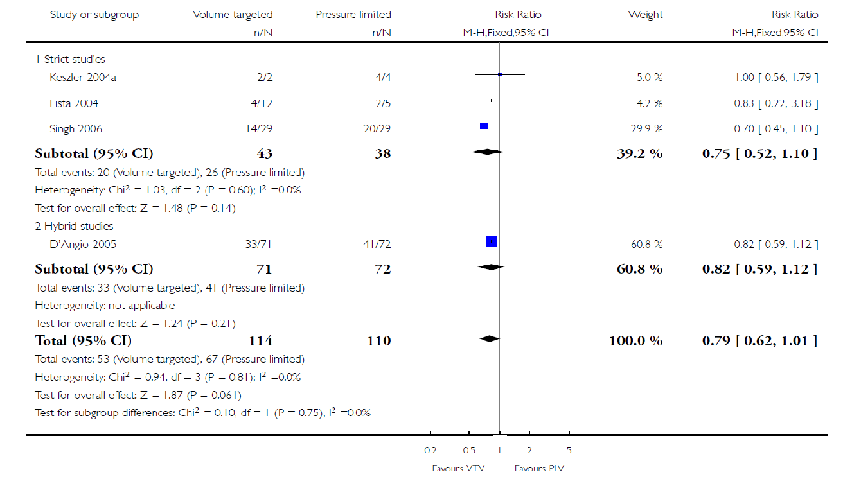
Volume-targeted versus pressure-limited ventilation in neonates
Volume-targeted ventilation (VTV) versus pressure-limited ventilation (PLV) – (Infants weighing less than 1000 g) Outcome: Death or bronchopulmonary dysplasia at 36 weeks.
RR 0.73, 95% CI 0.59 to 0.89; NNTB 8, 95% CI 5 to 20
Klingenberg C, et al. Volume-targeted versus pressure-limited ventilation in neonates. Cochrane Database of Systematic Reviews 2017, Issue 10.

Slide 48
BPD Prevention
Prevention /prɪˈvɛnʃn/
Noun
The action of stopping something from happening or arising.

Slide 49
BPD Prevention
Antenatal
Prevent Preterm birth
Progesterone
Cervical cerclage
Smoking cessation
Transfer fewer embryos (IVF)
Good nutrition and follow up during pregnancy
Healthy Newborn Lungs

Slide 50
BPD Prevention
Antenatal
Delivery
Prevent Preterm birth
Progesterone
Cervical cerclage
Smoking cessation
Transfer fewer embryos (IVF)
Good nutrition and follow up during pregnancy
At Birth
Surfactant
CPAP
FiO²
Gentler ventilation
Healthy Newborn Lungs

Slide 51
BPD Prevention
Antenatal
Delivery
Postnatal
Prevent Preterm birth
Progesterone
Cervical cerclage
Smoking cessation
Transfer fewer embryos (IVF)
Good nutrition and follow up during pregnancy
At Birth
Surfactant
CPAP
FiO²
Gentler ventilation
NICU
Volume Targeted Ventilation
Extubate ASAP
Treat Infection
Adequate nutrition
Caffeine
Steroids
Vitamin A
Others
Healthy Newborn Lungs

Slide 52
Keypoint nr. 4
A combination of multiple strategies acting on the various causal pathways is needed in BPD prevention

Slide 53
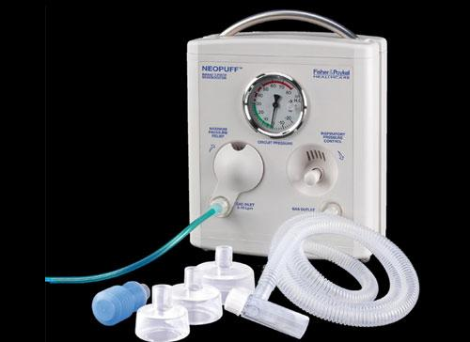
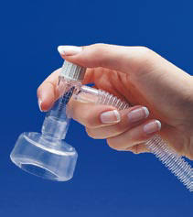
Delivery Room Interventions Neopuff ( T piece)
2nd Hit
DR
The most valuable tool in the Delivery room
Limits PIP
Maintains Peep
Avoids Volutrauma, atelectrauma
Helps create a pulmonary FRC

Slide 54
Steroids The PREMILOC trial
A Multicenter, randomized, placebo controlled trial designed to look at the effect of early low-dose hydrocortisone on survival without BPD in extremely preterm infants with gestation age between 24 to 27 ^{6/7} weeks.
Hydrocortisone was administered at a dose of 1mg/kg per day divided in two doses per day on days 1-7, followed by one dose of 0.5mg/kg per day for the next 3 days.
Of the 255 infants assigned to hydrocortisone, 153 (60%) survived without BPD, compared to 136 (51%) of 266 infants assigned to placebo.
Long-term follow-up results are encouraging with no significant difference in neuro-developmental outcomes between infants in the 2 groups at the 2 year follow-up.
Baud O, et al. JAMA. 2017; 317: 1329–1337.
Baud O, et al. Lancet. 2016;387:1827–1836.

Slide 55
Inhaled steroids The Neurosis trial
Inhaled Budesonide vs. placebo was administered to extremely premature infants (23 ^{0/7} weeks to 27 ^{6/7} weeks GA) starting within 24 h after birth and continuing until the infants no longer needed supplemental oxygen and positive-pressure support or reached a postmenstrual age of 32^{0/7} weeks.
Budesonide was administered at a dose of 2 puffs (200 micrograms per puff) every 12 hours in the first 14 days of life and one puff administered every 12 hours from day 15 until the last dose of the study drug had been administered.
Infants who received Budesonide had a lower rate of BPD (27.8% versus 38%) but a higher death rate (16.9%vs.13.6%)
Bassler D, et al. N Engl J Med. 2015; 373: 1497–1506.

Slide 56
Intratracheal Budesonide + Surfactant
Very low birth weight infants (n=265) with severe RDS requiring mechanical ventilation and a FiO2 ≥ 0.50 were randomized to receive either intratracheal Budesonide (0.25mg/kg) combined with surfactant (Survanta 100mg/kg) or surfactant alone within four hours of birth.
The intervention group had a significantly lower incidence of BPD or death (42.0 % vs. 66 %)
A meta-analysis of two RCTs demonstrated that intra-tracheal budesonide-surfactant mixture was associated with a decreased risk of BPD (RR:0.57; 95% CI: 0.43-0.76, NNT=5) in VLBW infants.
Yeh TF, et al. Am J Respir Crit Care Med .2016; 193:86–95.
VenkataramanR, et al. Pediatr Pulmonol .2017; 52:968– 975.

Slide 57
Conclusions Dexamethasone can reduce the risk of BPD in preterm infants.
Of the different dexamethasone regimens, aggressive initiation seems beneficial, while a combination of high-dose and long-term use should be avoided because of the possible adverse neurodevelopmental outcome
Zeng L, et al. Arch Dis Child Fetal Neonatal Ed 2018;103:F506–F511. doi:10.1136/archdischild-2017-313759

Slide 58
Conclusions Dexamethasone can reduce the risk of BPD in preterm infants.
Of the different dexamethasone regimens, aggressive initiation seems beneficial, while a combination of high-dose and long-term use should be avoided because of the possible adverse neurodevelopmental outcome
Zeng L, et al. Arch Dis Child Fetal Neonatal Ed 2018;103:F506–F511. doi:10.1136/archdischild-2017-313759

Slide 59
Diuretics and fluid restriction
A systematic review of studies of administration of furosemide found inconclusive results regarding efficacy in infants with a developing chronic lung disease.
It was concluded that a single dose of 1 mg/kg of intravenous furosemide to such infants had a transient increase in oxygenation and lung compliance, but had no detectable or consistent positive effects when given earlier than three weeks of age
A RCT to compare two fluid regimens in infants with BPD (145 ml/kg/day concentrated formula versus 180 ml/kg/day) did not show any significant difference in the duration of supplementary oxygen or mechanical ventilation, weight loss or length of stay
Barrington KJ, et al. Fluid restriction for treatment of preterm infants with chronic lung disease. Cochrane Database Syst Rev. 2017;2:CD005389
Stewart A, et al. Intravenous or enteral loop diuretics for preterm infants with (or developing) chronic lung disease. Cochrane Database Syst Rev. 2011;9

Slide 60
Inhaled nitric oxid
A selective pulmonary vasodilator required for alveolar and vascular development.
Alterations in NO signaling have been observed in conjunction with, or perhaps as a cause of, the lung and vascular injury characteristic of BPD¹
However, based on large clinical studies, early prophylactic or rescue iNO in preterm neonates with respiratory failure did not reduce BPD²
1.Balasubramaniam V, et al. Am J Physiol Lung Cell Mol Physiol 2006;291:L119–27.
2.Donohue PK, et al. Pediatrics 2011;127:e414–22.

Slide 61
Caffeine
Stimulates breathing, reducing the need for Mechanical Ventilation
Has diuretic and anti-inflammatory effects on the developing lung
Reduced by 36 % the incidence of BPD in the Caffeine for Apnea of Prematurity (CAP) trial¹
BPD was reduced by 52 % if treatment started on postnatal days 1–3 (early), whereas it was reduced by only 23 % if started after day 3 (late)²
Expiratory flows were improved by 0.5 SD in children randomized to caffeine³
1. Schmidt B, Roberts RS, Davis P, et al. N Engl J Med 2006;354:2112–21.
2. Davis PG, Schmidt B, Roberts RS, et al. J Pediatr 2010;156:382–7.
3. Doyle LW, et al. Am J Respir Crit Care Med 2017;196:1318–24.

Slide 62
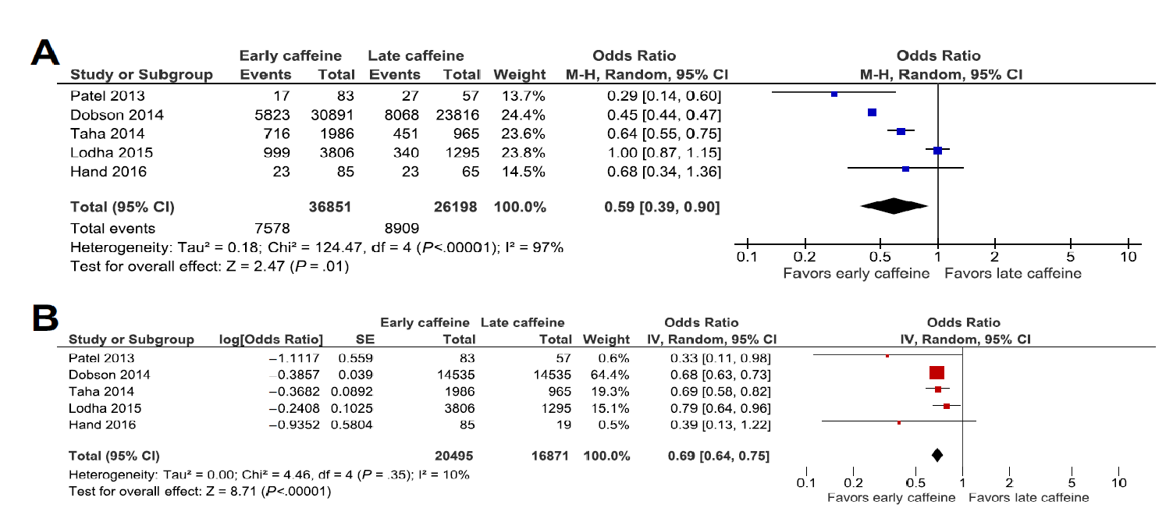
Meta-analysis of studies comparing earlier vs later initiation of caffeine on the risk of BPD.
Clin Perinatol 45 (2018) 273–291
Clin Perinatol 45 (2018) 273–291
Mitali Atul Pakvasa, et al. Optimizing Caffeine Use and Risk of Bronchopulmonary Dysplasia in Preterm Infants. Clin Perinatol 45 (2018) 273–291

Slide 63
Vitamin A
Vitamin A plays an important role in the growth, differentiation, and maintenance of airway epithelial cells
Lower vitamin A concentration is associated with the development of BPD
BPD was reduced by 13% in infants < 1000 g birth weight receiving vitamin A compared with placebo, (Intramuscular vitamin A administration, 3 × 5000 IU/week over 4 weeks)
Meyer S, et al. Neonatology. 2014; 105(3):182–8
Darlow BA, Graham PJ. Cochrane Database Syst Rev 2011:CD000501.

Slide 64
Exclusive breast milk feeding
Data from the German Neonatal Network showed that exclusively formula-fed infants had 2.6-times the risk of developing BPD in multivariate analysis than exclusively breast-milk-fed infants.
In another cohort study, multivariable analysis showed a 9.5% reduction in the odds of BPD for every 10% increase in expressed breast milk.
Spiegler J, et al. Does breastmilk influence the development of bronchopulmonary dysplasia? J Pediatr 2016;169:76–80.
Patel AL, et al. Influence of own mother’s milk on bronchopulmonary dysplasia and costs. Arch Dis Child Fetal Neonatal Ed 2017;102:F256–61

Slide 65
The Future Of BPD Prevention

Slide 66
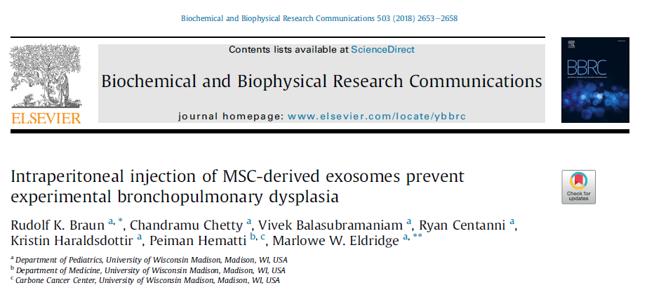
Mesenchymal stromal cell derived exosomes mediate tissue protection and regeneration by protecting from apoptosis, inhibiting inflammation, and increasing angiogenesis.
Daily intraperitoneal injection of MSC derived exosomes protected alveolarization and angiogenesis in a newborn rat model of bronchopulmonary dysplasia induced by 14 days of neonatal hyperoxia exposure (FiO2 85% )
Rudolf K. Braun , et al. Biochemical and Biophysical Research Communications 503 (2018) 2653e2658

Slide 67
Human amnion epithelial cells (hAECs), stem-like cells, derived from placental tissues are able to modulate the inflammatory milieu and, in preclinical studies of BPD-like injury, restore lung architecture and function.
Baker EK, et al. BMJ Open 2019; 9:e026265. doi:10.1136/bmjopen-2018-026265

Slide 68
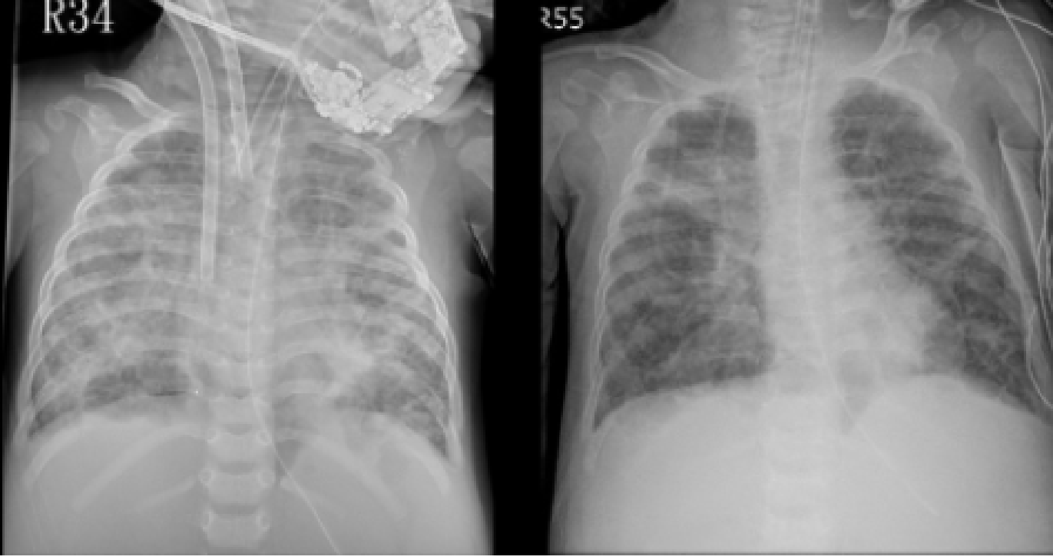
Airway Delivery of Bone Marrow–Derived Mesenchymal Stem Cells Reverses Bronchopulmonary Dysplasia Superimposed with Acute Respiratory Distress Syndrome in an Infant
Case Report
10-Month-old female with BPD
Before and after intratracheal bone marrow–derived mesenchymal stem cell injection
Hsin-Chia Lin et al. Cell Medicine Volume 10: 1-6; 2018

Slide 69
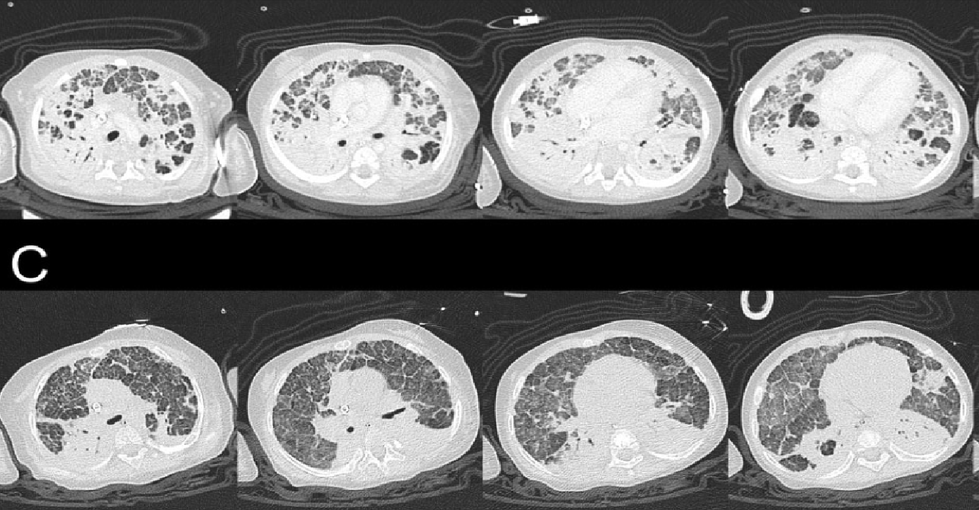
Hsin-Chia Lin et al. Cell Medicine Volume 10: 1-6; 2018

Slide 70
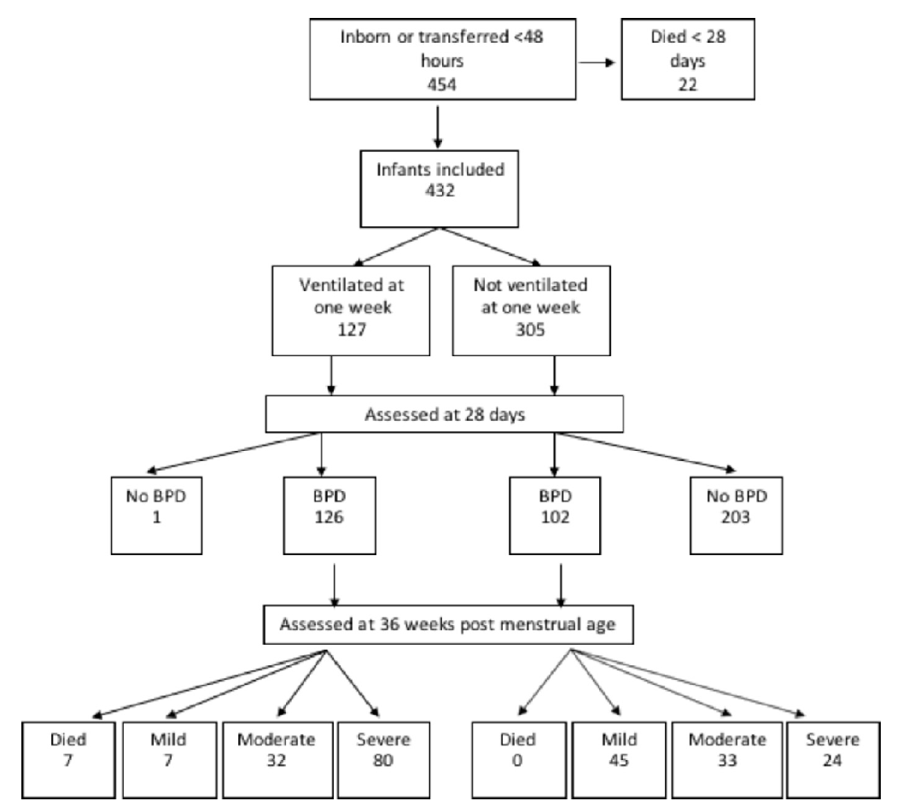
Prediction of BPD development
Infants <32 weeks of gestational age ventilated at 1 week of age on the neonatal unit at King’s College Hospital from September 2012 to August 2017
Mechanical ventilation at 1 week
was the best predictor for the development of BPD and severe BPD in infants <32 weeks
Katie A Hunt et al. Arch Dis Child Fetal Neonatal Ed November 2018 Vol 103 No 6

Slide 71
Take home message
An attempt should be made to extubate infants early (within the first 72 h of life) and to use non-invasive ventilation strategies and LISA whenever feasible.
Early use of low-dose hydrocortisone in an at-risk preterm population showed a decreased incidence of BPD without significant neurodevelopmental impairment on long-term follow-up.
The use of intratracheal surfactant-corticosteroid combination is promising but needs to be evaluated in further large-scale trials.
Prevention of bronchopulmonary dysplasia in extremely low gestational age neonates: current evidence
Christian F Poets, et al. Arch Dis Child Fetal Neonatal Ed 2018;103:F285–F291

Slide 72
Take home message (2)
Use PEEP and moderate PIP (Neopuff) in the delivery room management of preterm Newborns
Start caffeine on postnatal days 1–3.
Give Vitamin A intramuscularly for the first four postnatal weeks
Test tracheal aspirates of all ELGANs requiring mechanical ventilation after birth for Ureaplasma
Prevention of bronchopulmonary dysplasia in extremely low gestational age neonates: current evidence
Christian F Poets, et al. Arch Dis Child Fetal Neonatal Ed 2018;103:F285–F291

Slide 73
Thank you for your attention

