Slide 1
Bringing the past into the future:
Infant formula with post-biotics

Slide 3
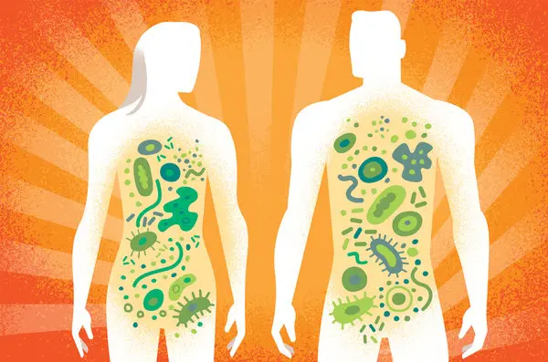
Bringing the past into the present…..
2007
From the fecal microflora…
2019
To the gut microbiome

Slide 4
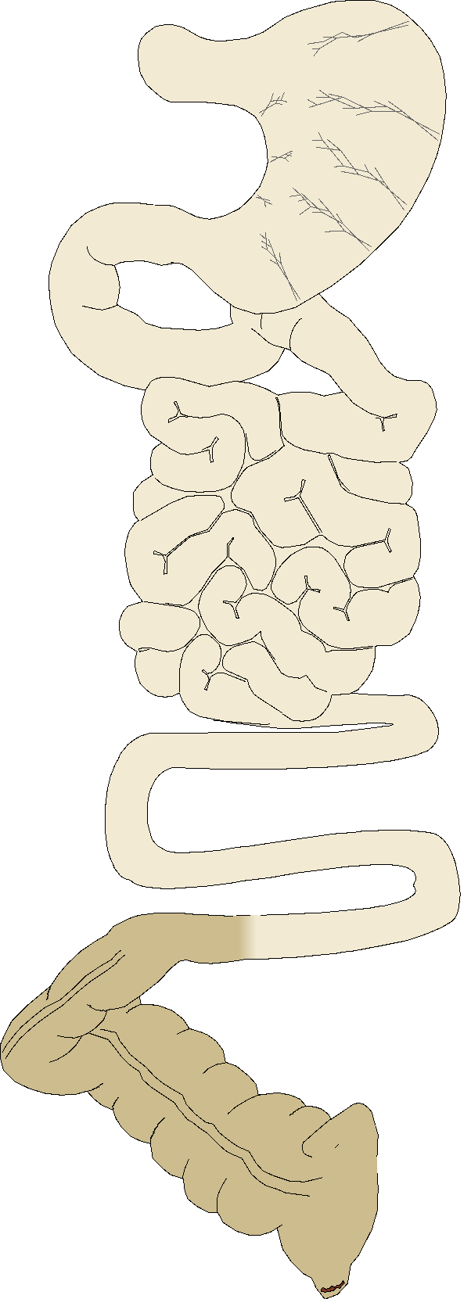
Intestinal flora Cultivable bacteria and microorganisms (30%)
Stomach
10² to 10³
Lactobacilli
Duodenum
<10⁴⁻⁵
Streptococci
Lactobacilli
Jejunum
Enterobacteria
Enterococcus Faecalis
Bacteroides
Bifidobacteria
Peptococcus
Peptostreptococc
Ruminococcus
Clostridia
Lactobacilli
Ileum
10³ to 10⁷
Colon
with
appendix
10⁹ to 10¹²
and….

Slide 5
Intestinal microbiota
Cultivable fraction: 30%
Molecular biology for identifyng phyla and species

Slide 6
Main features of the Microbiome
10¹²⁻¹⁴ of microorganisms in the gut
10 x the number of human cells
1 to 2kg of bacteria in the gut > brain
Few phyla, > 1500 species (~300/individuals)
Other organisms (virus, phages, Archeae, protists…)
Specific of each individual
Diversity of gene expression

Slide 7
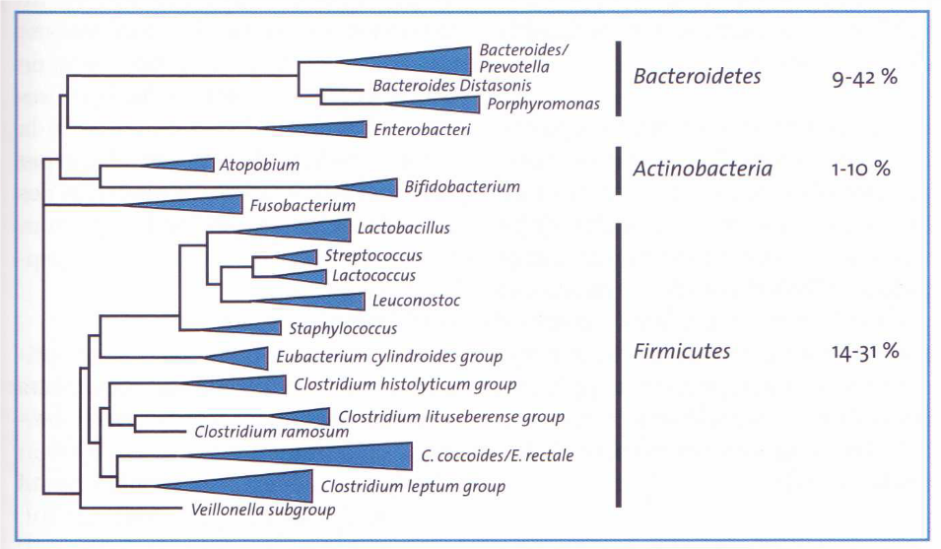
Intestinal microbiota 10¹²⁻¹⁴ microorganisms, > 1500 different species
Bacteroidetes 9-42%
Actinobacteria 1-10%
Firmicutes 14-31%
3 dominant
phyla

Slide 8
The Intestinal Microbiome is a forgotten organ…..
At interface between feeds and epithelium
In contact with the immune system and the neuroenteric system
Huge importance of the microbiome diversity
The concept of protective bacteria
Modulation / transplantation of the microbiota

Slide 9
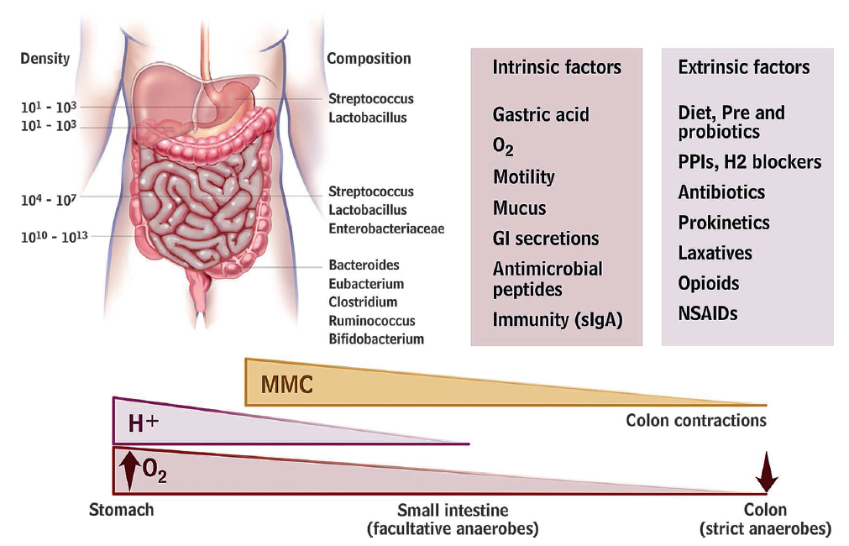
Ecosystem under inner constraints
Simren et al., Gut 2012

Slide 10
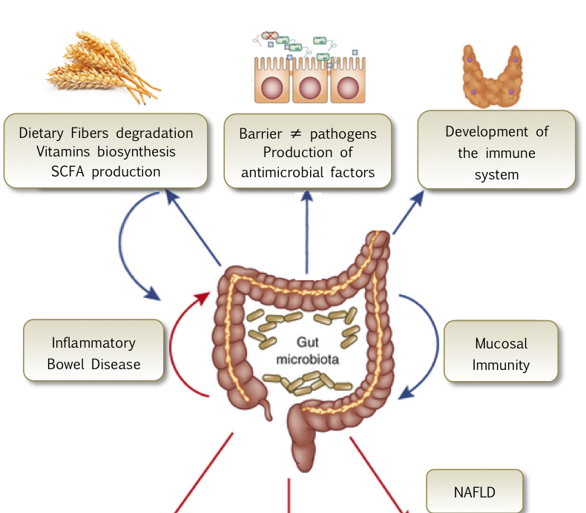
Main functions of the gut Microbiome
Structural
Metabolic
Immunological

Slide 11
Bringing the past into the future:
Infant formula with post-biotics
Outline of the presentation
Implementation of gut microbiota in early life
Gut microbiota & development of GI function
Intestinal dysbiosis and relation to FGIDs
Feeding strategies to influence gut microbiota for immediate and long-term GI health
Role of postbiotics beyond health

Slide 12
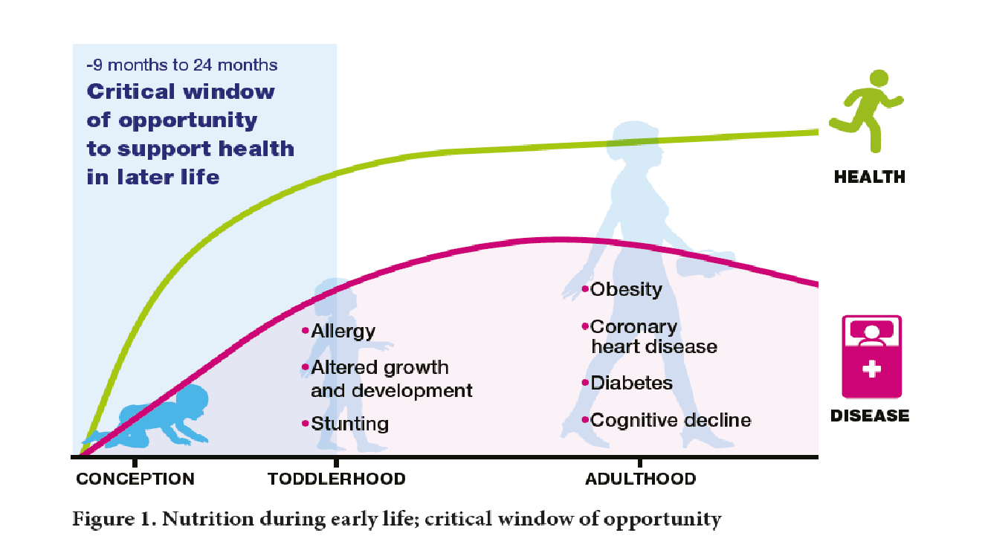
The first 1000 days: the foundation for lifelong health
Godfrey KM et al. Trends in Endocrinology and Metabolism 2010;21:199-205

Slide 13
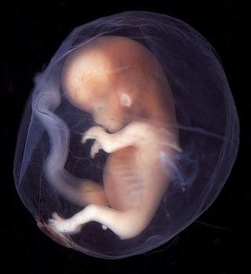
Fetal microbiota
Fetal microbiota ?????
Placenta microbiome
Aagaard K et al, Sci Transl Med 2014
Bacteria in amniotic fluid and cord blood
Gimenez et al 2008; Collado et al 2016
Fetal membranes and colostrum microbiome
Martin et al 2003; Jones et al 2009; Cabrera-Rubio et al 2012;
Meconium harbors a bacterial community
Ardissone et al 2014; Collado et al 2016
Microbes in the nasopharynx of term newborns
Lohmann et al 2014; Galalger et al 2016
The dogma that the fetus resides in a sterile environment
is still debated but the last results from Dominguez-Bello et al
(Nat Med. 2019 May) are not supporting fetal microbiota

Slide 14
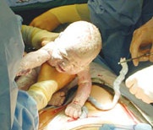
Bacterial colonization of the neonatal gut
More than 1500 anaerobe & aerobe bacteria progressively colonize the human gut
Colonization by bacteria occurs early and may be affected by several factors
Term of pregnancy (prematurity)
Route of delivery (C-section, vaginal)
Hygiene of neonatal environment
Maternal bacterial gut microbiota
Diet of the infant (breast milk/formula)
Drugs (antibiotics, PPI….)
O.Goulet 2019
Notes:
‹#›

Slide 15
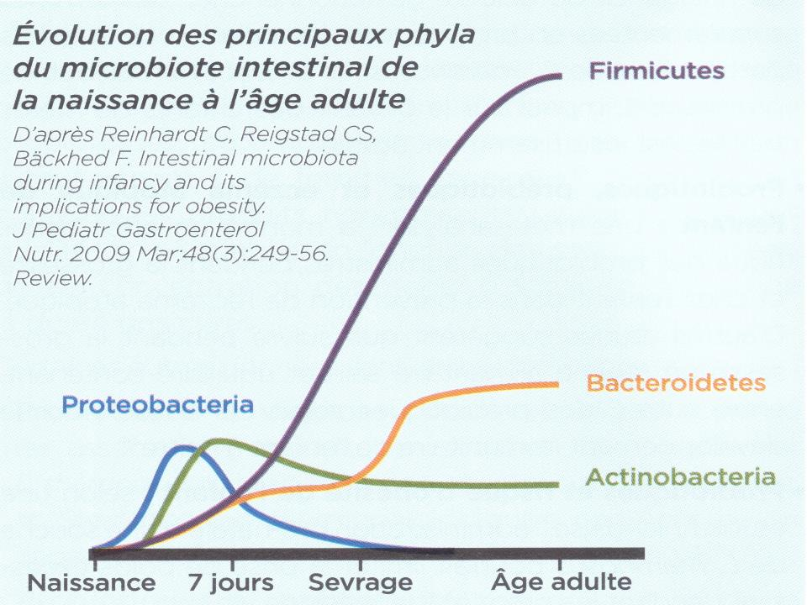
Course of the main phyla from birth to adulthood
Birth 7 days Weaning Adulthood
JPGN 2009; 48: 249-56

Slide 16
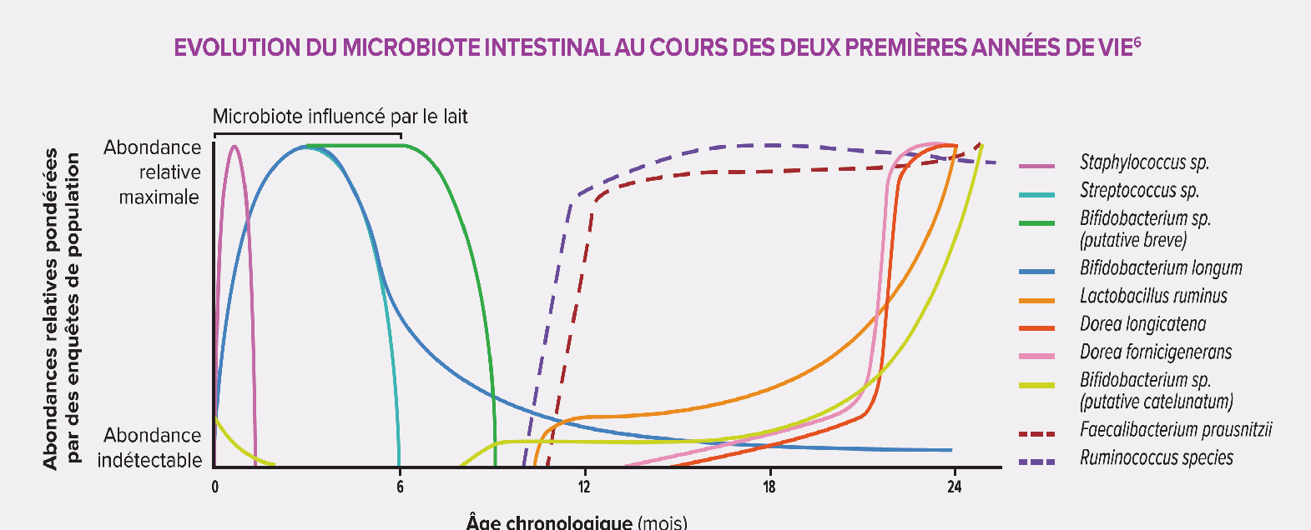
Intestinal microbiota:
Changes during the first two years of life
Influence of breast milk
Chronological age (months)
O.Goulet 2019

Slide 17
Period of
instability
Yatsunenko T et al Nature 2012

Slide 18
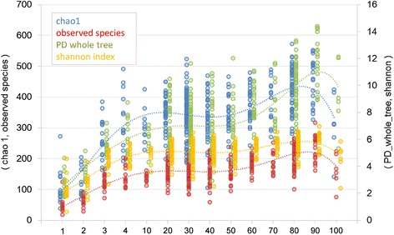
Microbial diversity across lifespan
Microbial diversity increases overtime until old age
Odamaki et al. BMC Microbiology 2016
Notes:
Odamaki2016
Age-related change in alpha-diversities of gut microbiota. Dashed line indicates a polynomial approximation for each alpha-diversity. Each number below the figure indicates a group as shown in Table 1&
UniFrac clustering for each age group. a Unweighted and b weighted UniFrac PCoA of gut microbiota from 371 samples collected from the infant to the centenarian stage. Each number in the legend indicates a group as shown in Table 1

Slide 19
Bacterial diversity according to age and origin
Assessed by Operational, Taxonomic Units (OTUs)
Yatsunenko T et al Nature 2012

Slide 20
Bacterial colonization of the neonatal gut
More than 1500 anaerobe & aerobe bacteria progressively colonize the human gut
Colonization by bacteria occurs early and may be affected by several factors
Term of pregnancy (prematurity)
Route of delivery (C-section, vaginal)
Hygiene of neonatal environment
Maternal bacterial gut microbiota
Diet of the infant (breast milk/formula)
Drugs (antibiotics, PPI….)
O.Goulet 2019
Notes:
‹#›

Slide 21
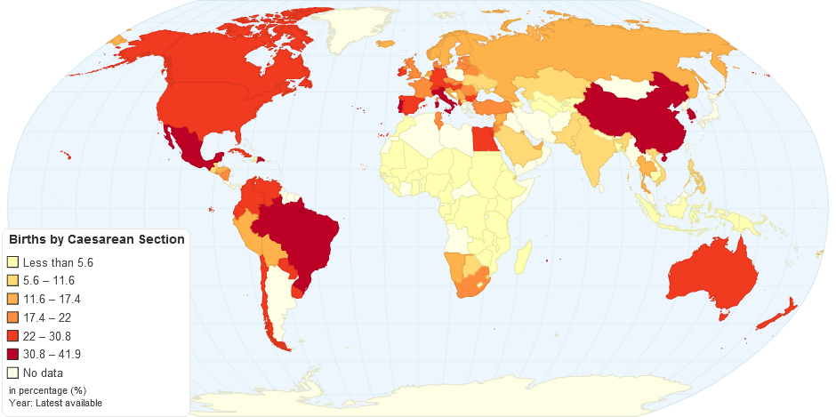
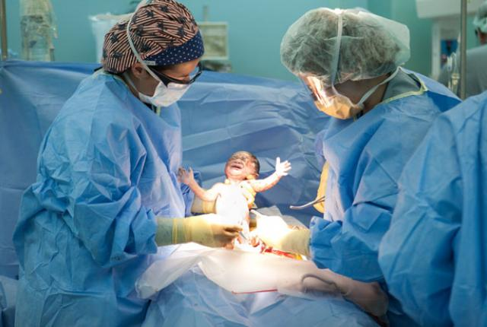

Slide 22
Incidence of C-section for 100 births (2005)
South Korea
Italy
Mexico
Portugal
Australia
USA
France
Netherland
O.Goulet 2019
Brazil CS incidence 50.1% in 2009 Ministerio.

Slide 23
Source : OECD 2013
O.Goulet 2019

Slide 24
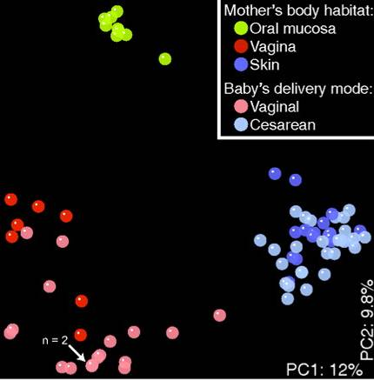
Intestinal microbiota according to the mode of delivery
Dominguez-Bello M G et al. PNAS 2010

Slide 25
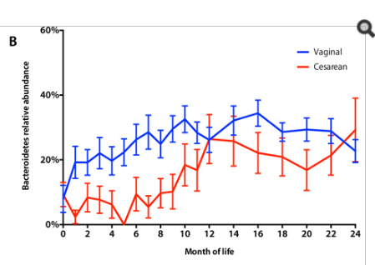
Intestinal microbiota according to the mode of delivery
Bokulich NA et alSci Transl Med 2016; 8 (343)

Slide 26
Intestinal microbiota according to the mode of delivery
Biasucci G et al. Early Hum Dev 2010;86 Suppl 1: 13-5 Azad MB et al CMAJ 2013; 185: 385-94

Slide 27
Bacterial colonization of the neonatal gut
More than 1500 anaerobe & aerobe bacteria progressively colonize the human gut
Colonization by bacteria occurs early and may be affected by several factors
Term of pregnancy (prematurity)
Route of delivery (C-section, vaginal)
Hygiene of neonatal environment
Maternal bacterial gut microbiota
Diet of the infant (breast milk/formula)
Drugs (antibiotics, PPI….)
O.Goulet 2019
Notes:
‹#›

Slide 28
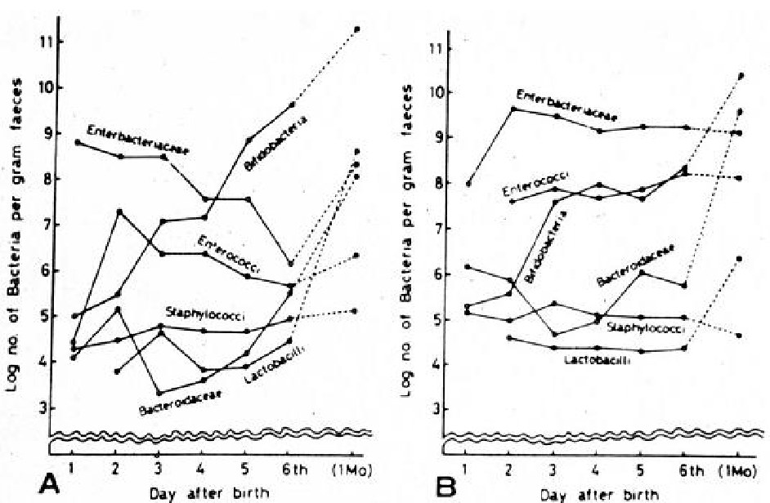
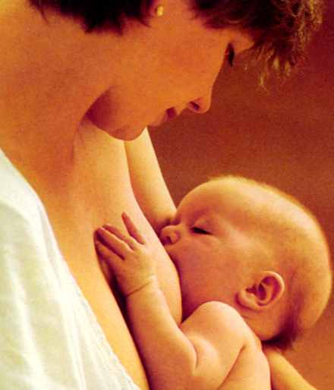
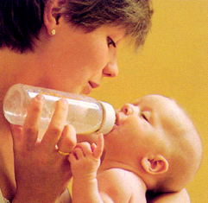
Intestinal microbiota and type of feeding
Breast fed
Formula fed
Pediatrics 1983;72:317-321

Slide 29
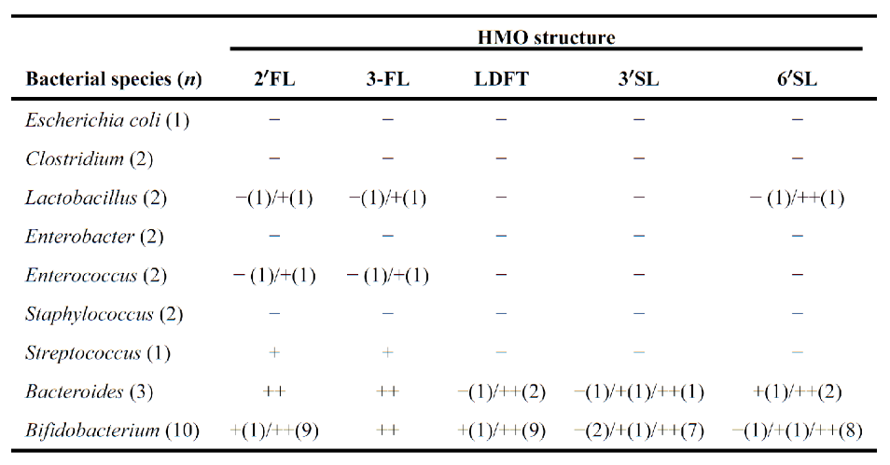
Bifidobacterium longum subspecies infantis
champion colonizer of the infant gut

Slide 30
Intestinal microbiota and type of feeding
Phylogenetic distribution
BF
FF

Slide 31
Intestinal microbiota and type of feeding
Shannon index of bacterial diversity
BF
BF

Slide 32
Bringing the past into the future:
Infant formula with post-biotics
Outline of the presentation
Implementation of gut microbiota in early life
Gut microbiota & development of GI function
Intestinal dysbiosis and relation to FGIDs
Feeding strategies to influence gut microbiota for immediate and long-term GI health
Role of postbiotics beyond health

Slide 33
Development of intestinal functions
and intestinal microbiota
Expression of genes involved
in important intestinal function
Angiogenesis
Nutrient absorption
Mucosal barrier fortification
Xenobiotic metabolism
Intestinal motility
Gut immune system
…../…..
Postnatal intestinal maturation
O.Goulet 2019

Slide 34
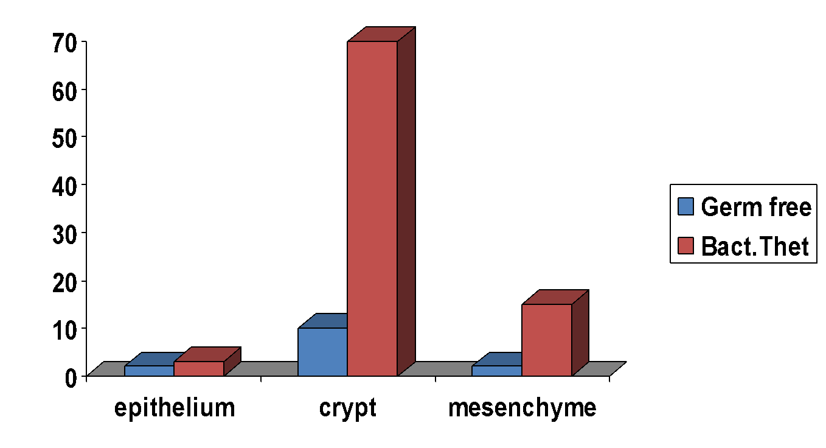
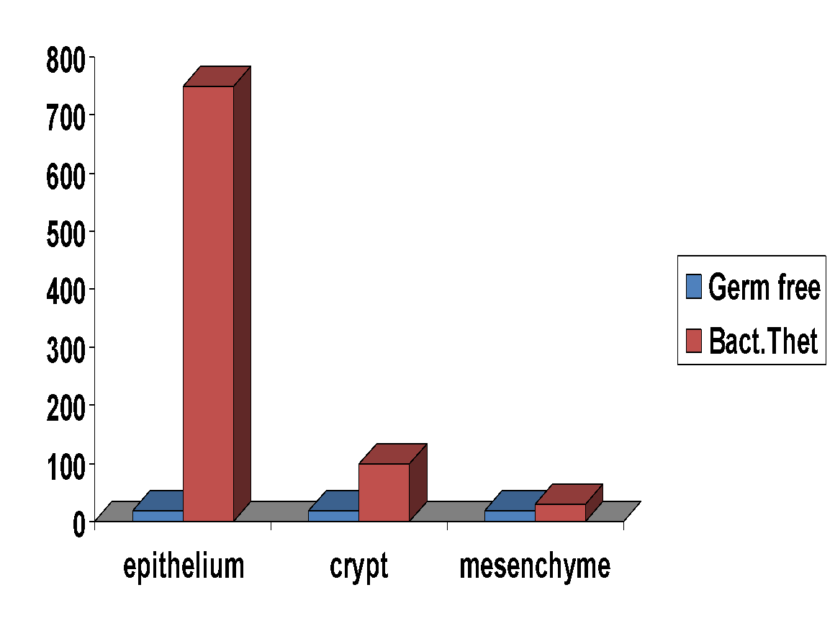
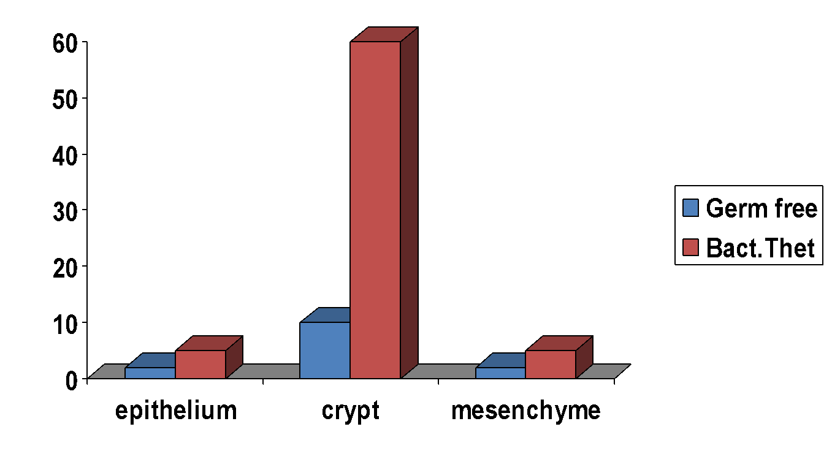
Development of intestinal functions
and intestinal microbiota
Bacteroides thetaiotaomicron (B.theta) component of the normal mouse and human intestinal microflora.
mRNA
mRNA
mRNA
Small proline-rich protein-2
(Sprr2a)
Colipase
Angiogenin-3
Hooper et al Science 2001; 291: 881-4

Slide 35
A: Germ free (GF) mouse
B: Age matched ex-germ-free conventionnalized (CONV) mouse
killed 10 days after colonization
C: Ex-germ-free mouse 10 days after colonization
with B.thetaiotaomicron (B.theta)

Slide 36
Bacterial colonization of the intestine induces the presence of T and B-lymphocytes and the capacity to produce IgAs
Germ free mouse
Mouse colonized
with
intestinal bacteria
Microbiota is implicated in the development of the gut associated immune system as well as in those of the systemic immune sytem
Nature review Immunology 2012

Slide 37
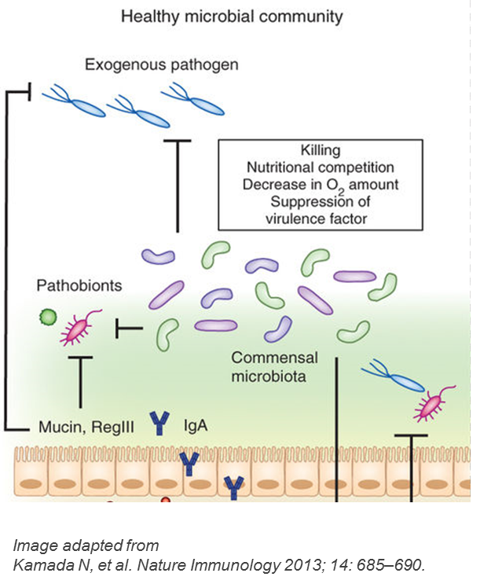
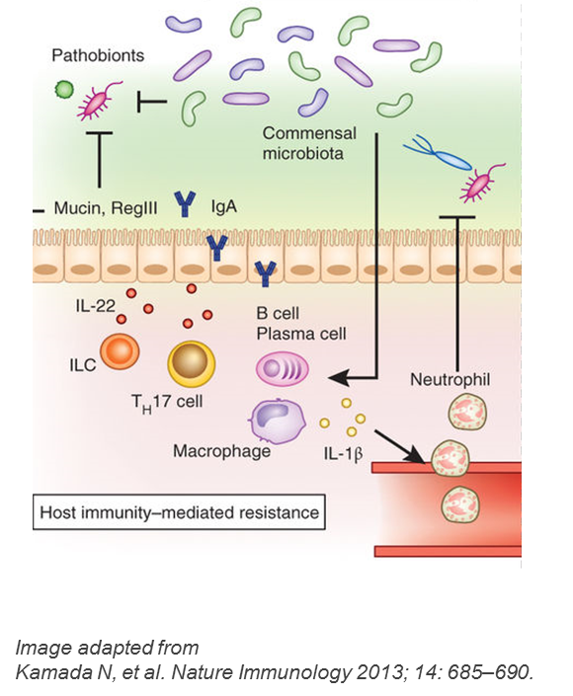
Immune function and gut microbiota
Impact of gut microbiota on immune function
Defense against pathogens
Development of immune system in early life
Development of mucosal an innate immunity in infancy
Development of adaptive immune system
Notes:
Gut microbiota have a direct role in its defense against pathogens, through multiple mechanisms. In addition, the gut microbiota, especially in the early years, evoke host responses that promote the maturation of innate and adaptive immunity.
References:
Oozeer R, Rescigno M, Ross RP, et al. Gut health: predictive biomarkers for preventive medicine and development of functional foods. Br J Nutr. 2010;103:1539–1544.
Wopereis H, Oozeer R, Knipping K, Belzer C, Knol J. The first thousand days - intestinal microbiology of early life: establishing a symbiosis. Pediatr Allergy Immunol. 2014;25:428–438.
McDermott A, Huffnagle B. The microbiome and regulation of mucosal immunity. Immunology. 2013;142:24–31.
Martin R, Nauta AJ, Amor KB, Knippels LMJ, Knol J, Garssen J. Early life: gut microbiota and immune development in infancy. Benef Microbes. 2010;1:367–382.
Tremaroli V, Backhed F. Functional interactions between the gut microbiota and host metabolism. Nature. 2012;489:242–9.
Roy CC, Kien CL, Bouthillier L, Levy E. Short-chain fatty acids: ready for prime time? Nutr Clin Pract. 2006;21:351-366. 🡪 Interaction / crosstalk with immune system⁶

Slide 38
Development of the immune system
The thousand days
Defense
Tolerance

Slide 39
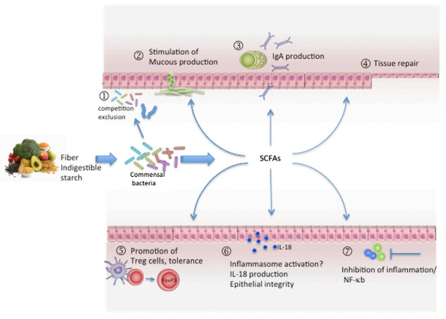
Metabolic effects of the colonic microbiota
Metabolites
with several systemic effects
on human health
Fibers
Short chain fatty acids

Slide 40
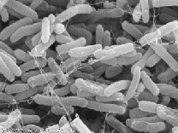
Intestinal microbiota
Neonatal bacterial colonization
Programming for life….?
Initial normal bacterial colonization
Early programming
Term of birth
Mode of delivery
Physical environment
Breast/formula feeding
Antibiotics use
Proton pump inhibitors
Microbiota modulation
Immune tolerance
Intestinal homeostasis
Healthy metabolism
Symbiosis
Intestinal
microbiota
Immune disease
(e.g. atopy, asthma, multiple sclerosis..)
Intestinal disease
(e.g. IBD, NEC, Cancer)
Metabolic diease
(e.g. Diabetes, Obesity…)
Dysbiosis
Two important concepts: microbiota diversity and protective bacteria
O.Goulet Nutr Rev 2015, Goulet et al Acta Pediatr 2019
Notes:
Immune

Slide 41
REVIEW ARTICLE
Paediatricians play a key role in preventing early harmful events that could
permanently influence the development of the gut microbiota in childhood
Olivier Goulet1, Iva Hojsak2,3 , Sanja Kolacek2, Tudor Lucian Pop4 , Fugen Cullu Cokugras5, Gianvincenzo Zuccotti6,
Massimo Pettoello-Mantovani7,8 , Valentina Fabiano (valentina.fabiano@unimi.it)6
1.Department of Paediatric Gastroenterology, Hepatology and Nutrition, Intestinal Failure Rehabilitation Centre, National Reference Centre for Rare Digestive Diseases,
APHP Necker-Enfants Malades Hospital, Paris-Descartes University, Paris, France
2.Children’s Hospital Zagreb, University of Zagreb School of Medicine, Zagreb, Croatia
3.School of Medicine, University J.J. Strossmayer, Osijek, Croatia
4.Second Paediatric Clinic, University of Medicine and Pharmacy Iuliu Hatieganu, Cluj-Napoca, Romania
5.Paediatric Gastroenterology, Hepatology and Nutrition, Cerrahpas_a Medical Faculty, Istanbul University, Istanbul, Turkey
6.Pediatric Department, Vittore Buzzi Children’s Hospital, Universita degli Studi di Milano, Milan, Italy
7.Department of Pediatrics, Scientific Institute ‘Casa Sollievo della Sofferenza’, University of Foggia, Foggia, Italy
8.European Paediatric Association/Union of National European Paediatric Societies and Associations (EPA/UNEPSA), Berlin, Germany
Acta Paediatr. 2019 Jun 14. doi: 10.1111/apa.14900. [Epub ahead of print] Review

Slide 42
Bringing the past into the future:
Infant formula with post-biotics
Outline of the presentation
Implementation of gut microbiota in early life
Gut microbiota & development of GI function
Intestinal dysbiosis and relation to FGIDs
Feeding strategies to influence gut microbiota for immediate and long-term GI health
Role of postbiotics beyond health

Slide 43
Intestinal microbiota the first 1000 days
“All disease begins in the gut” (Hippocrates)
Symbiosis
Balanced microbial composition
Immune regulation allowing homeostasis
Dysbiosis
Disruption or alteration of the microbiota diversity
Immune dysregulation with inflammation,allergy
Microbiota related « programming »
O.Goulet 2019
Notes:
There are various mechanisms by which bacteria regulate the immune system such as increasing the number of T-reg cells in the gut and inducing the production of anti-inflammatory cytokines.¹
Balanced microbial composition may result in symbiosis among the resident bacteria, production of immunomodulatory compounds, and subsequent regulation of the immune response.²
Disruption or alteration of the microbiota may result in dysbiosis and dysregulation of the immune system, leading to inflammation.²
Various factors may disturb the gut microbial composition such as diet, antibiotic use, poor early colonization and infection.²
Examples of inflammatory conditions in which individuals have imbalanced microbiota include:
Nectrotizing enterocolitits (NEC) – Preterm infants with NEC have a low microbial diversity compared to healthy preterm infants.²
Inflammatory bowel disease (IBD) – Intestinal microbial composition differs between healthy individuals and those with IBD, resulting in an inflammatory response in the host as exhibited in Crohn's disease.²
Probiotic strains can ameliorate chronic intestinal inflammation, diarrhea and food allergies among others.³ Prebiotics are also thought to confer clinical benefits such as preventing colorectal cancer and modulating the immune response.⁴
References
Brown K, DeCoffe D, Molcan E et al. Diet-induced dysbiosis of the intestinal microbiota and the effects on immunity and disease. Nutrients 2012:4:1095-1119.
Johnson C, Versalovic J. The human microbiome and its potential importance in pediatrics. Pediatrics 2012;129:950–60.
Wallace T, Guarner F, Madsen K et al. Human gut microbiota and its relationship to health and disease. Nutr Rev 2011;69:392-403.
Hardy H, Harris J, Lyon E et al. Probiotics, prebiotics and immunomodulation of gut mucosal defences: homeostasis and immunopathology. Nutrients 2013;5:1869-1912.

Slide 44
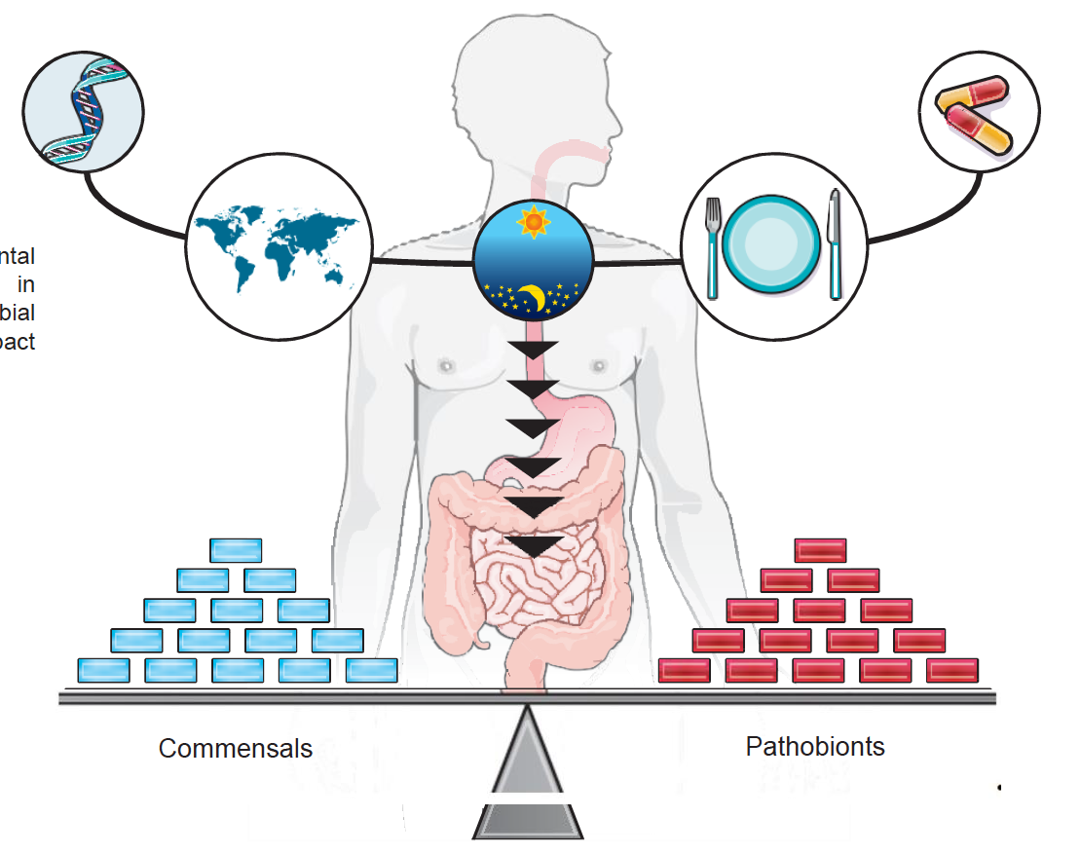
Intestinal dysbiosis
Imbalance between « protective » and « detrimental » bacteria and loss of diversity
Unadapted diet
Acute gastroenteritis
Excess antibiotics
Proton pump inhibitors (PPI)
O.Goulet 2019
Lepage, FB 2015

Slide 45
Intestinal dysbiosis
Potential consequences on the immune system

Slide 46
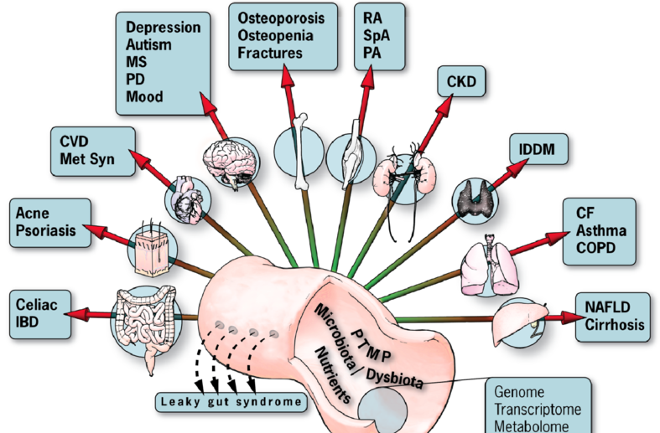
Intestinal dysbiosis and diseases
Imbalanced microbiota
Low diversity / Low robustness
Functional impairment

Slide 47
Intestinal dysbiosis
The term “dysbiosis” is (still) lacking a consented definition and thus implies only some form of dysbalance of the bacterial composition (or abundance or diversity) when a patient group is compared to healthy control subjects.
O.Goulet 2019

Slide 48
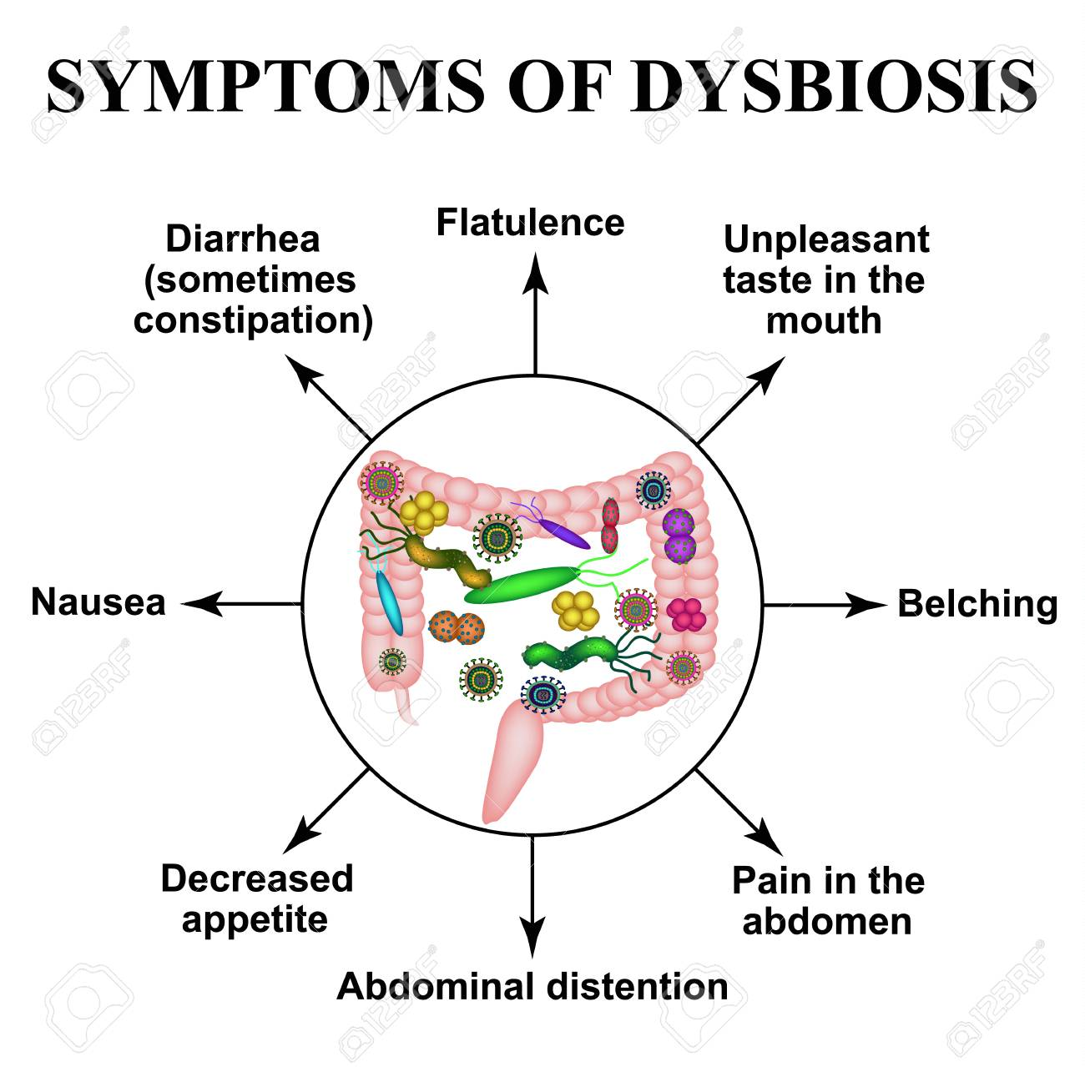
Intestinal dysbiosis causes GIFDs
Intestinal dysbiosis

Slide 49
Gut microbiota and infant colics
Slower
Colonization
(De Weerth 2013)
Clostridia
(Lehtonen 1994,
Pärtty 2013)
Diversity
and
Stability
(Rhoads 2009,
de Weerth 2013,
Roos 2013)
Proteobacteria
(Savino 2004, 2009, Rhoads 2009,
De Weerth 2013)
Lactobacilli
(Pärtty 2012,
De Weerth 2013)
Bifidobacteria
(Pärtty 2012 ,
De Weerth 2013)

Slide 50
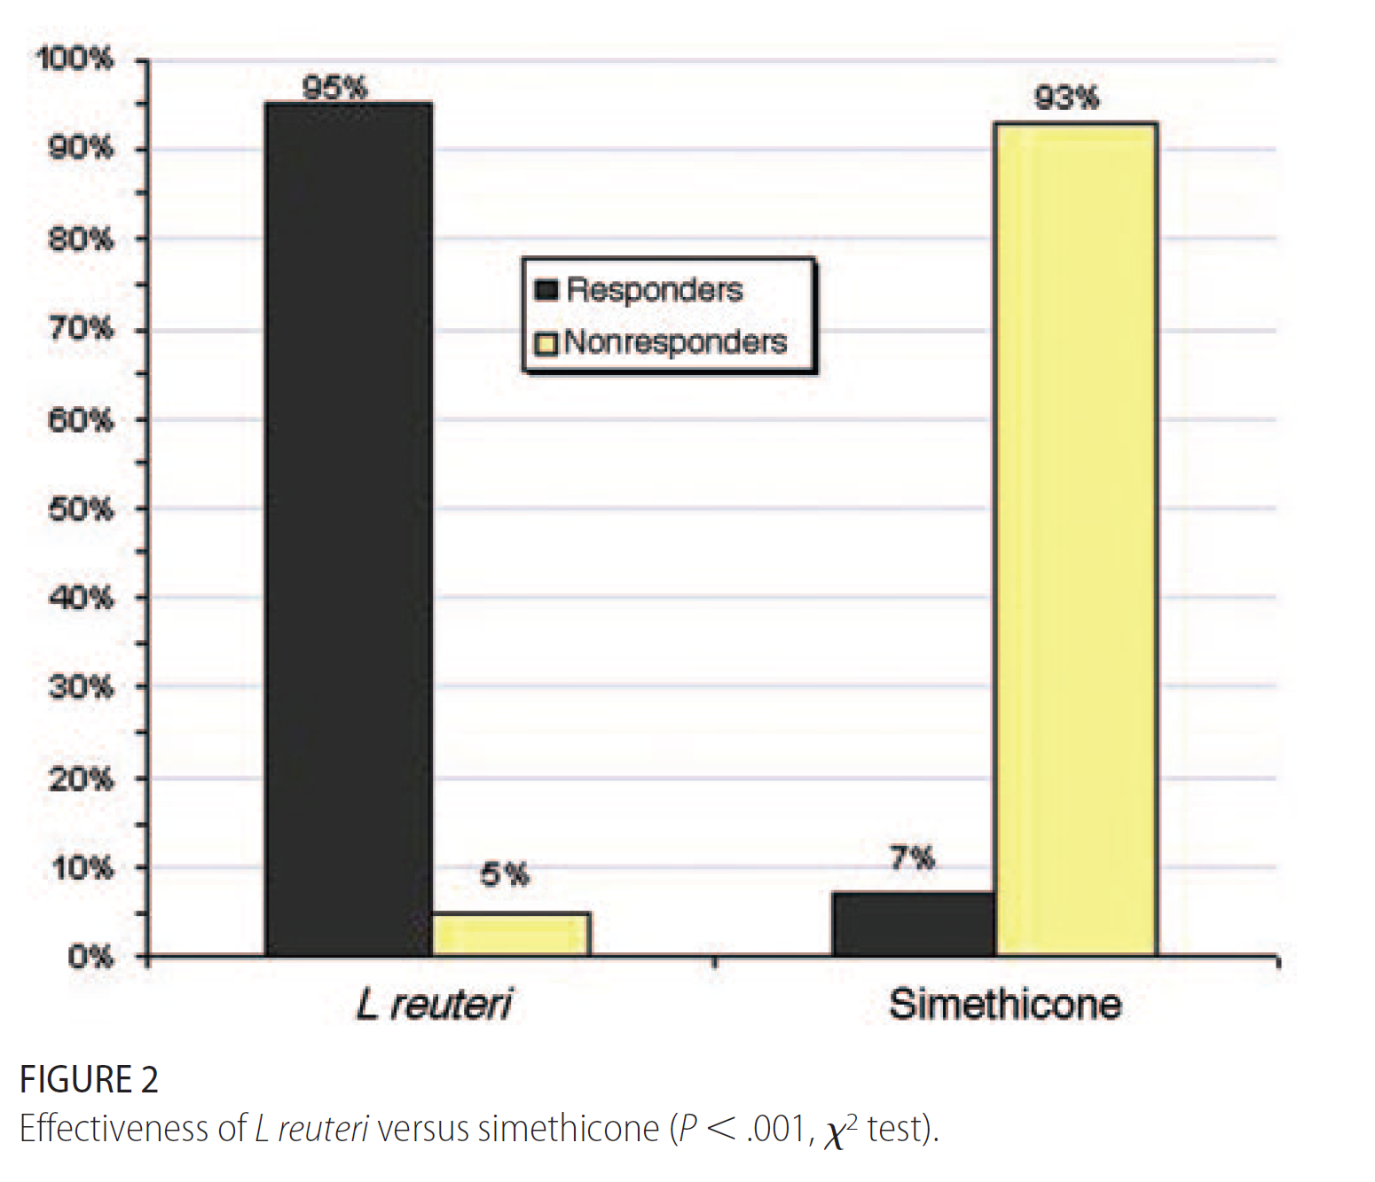

Slide 51
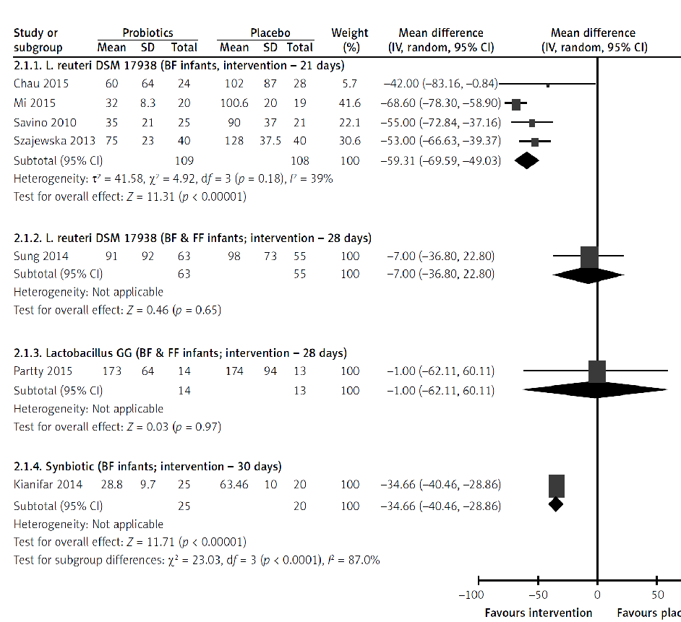
Probiotics in infant colics

Slide 52
Probiotics in infant colics

Slide 53
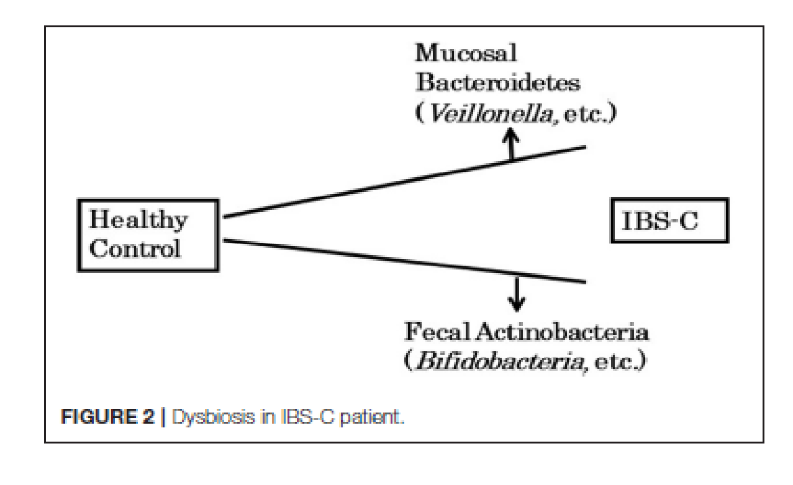

Slide 54
Efficacy of probiotics in children

Slide 55
Efficacy of synbiotics

Slide 56
Efficacy of probiotics

Slide 57
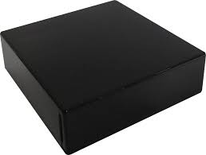

Slide 58
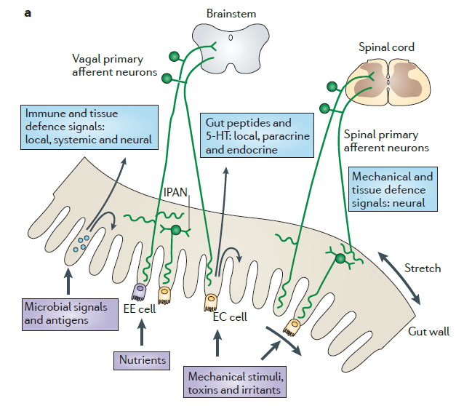
Brain
neurotransmitteurs
peptides, amines
cytokines, LPS
immune
epithelial, endocrin cells
nutrients,
metabolites,

Slide 59
Bringing the past into the future:
Infant formula with post-biotics
Outline of the presentation
Implementation of gut microbiota in early life
Gut microbiota & development of GI function
Intestinal dysbiosis and relation to FGIDs
Feeding strategies to influence gut microbiota for immediate and long-term GI health
Role of postbiotics beyond health

Slide 60
Formula milk is just a food, whereas breast milk is
a complex living nutritional fluid that contains
enzymes, hormones, antibodies, immunoglobulins…..
all of which have health benefits

Slide 61
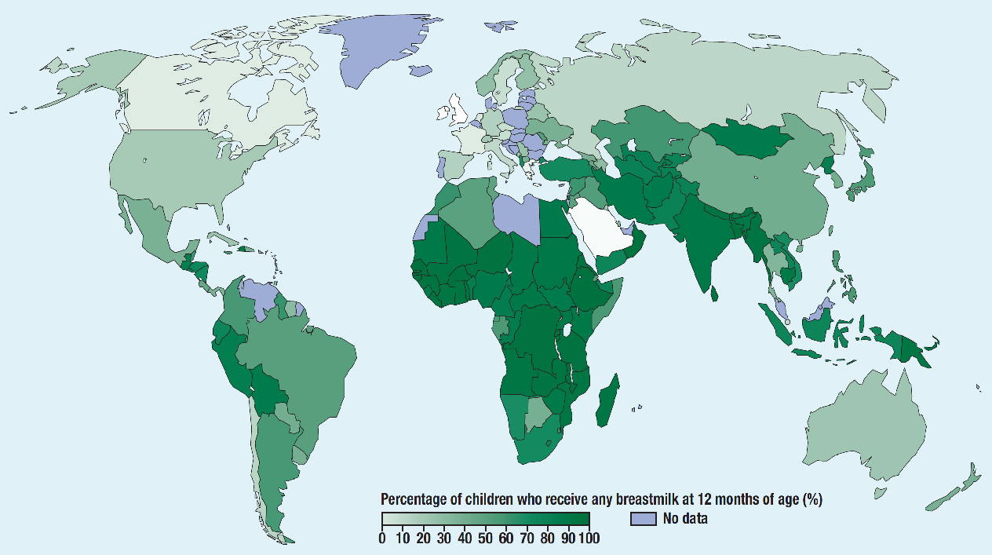
Exclusive breast feeding rate
Data from UNICEF 2018, by regions
World
≈ 41%
There will always be a need for human milk substitutes,
no matter how successful the promotion of breast feeding
Baker RD & Baker SS; J Pediatr Gastroenterol Nutr 2016

Slide 62
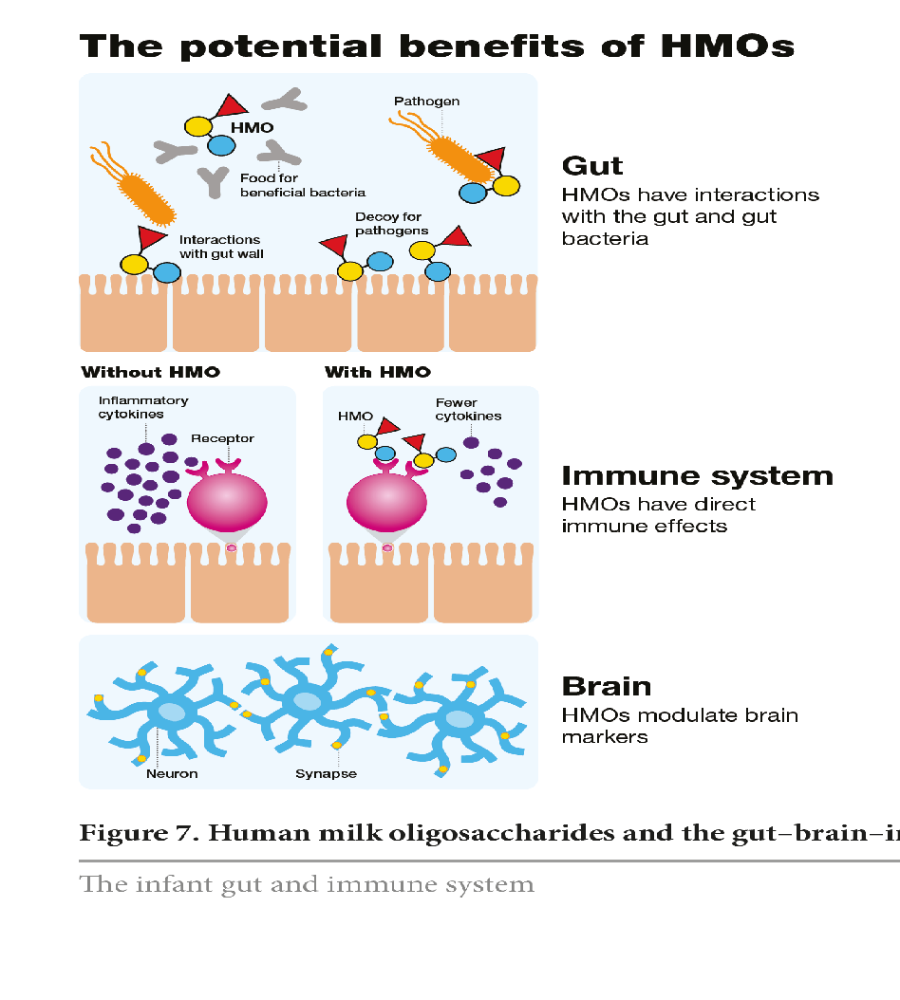
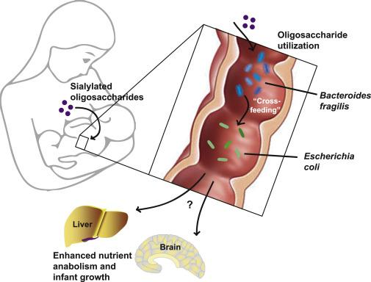
Human milk oligosaccharides (HMOs)
Potential benefits

Slide 63
Modulation of intestinal microbiota
Mimicking intestinal microbiota of normal brest fed infants looks logical
Notes:
‹#›

Slide 64
Progresses in infant formulas composition
Over the past four decades
Whey/casein ratio
Iron fortification
Protein content
Renal solute load
Taurine fortification
LCPUFAs addition
Nucleotides fortification
Lactic ac. producing bacteria
Probiotics addition
Prebiotics: GOS/FOS
HMOs (2-FL with/out LnNT)
Postbiotics

Slide 65
Feeding strategies by
modulating intestinal microbiota
Probiotics
Pasteurization
Prebiotics
> 1900
Symbiotics
> 2000
Postbiotics
(Fermentation Products)
Probiotics
Prebiotics
Symbiotics
Fermentation
products
O.Goulet 2019

Slide 66
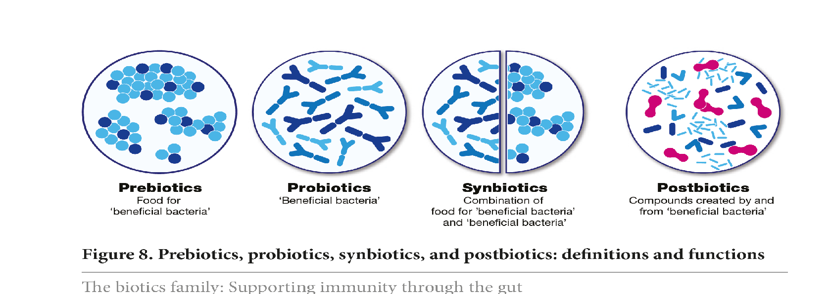
The biotics family
Intestinal microbiota modulation
Prebiotics
Non assimilable
food ingredients
positively influencing
gut microbiota
Probiotics
Live bacteria
positively influencing
gut microbiota
and human health
Synbiotics
Combination of prebiotics
and probiotics
positively influencing
gut microbiota
Postbiotics
Bioactive compounds produced during a fermentation process that are beneficial for health

Slide 67
Probiotic organisms
Probiotics : “live microorganisms which when administered in adequate amounts confer a health benefit on the host”
Various mechanisms of action have been postulated :
Competition with pathogenic bacteria²
Acidification of the colon environment^{2,3}
Production of bioactive molecules^{2,3}
Immunomodulation^{2,3}
FAO/WHO. Health and nutritional properties of probiotics in food 2001
Chermesh I et al. World J Gastroenterol 2006;12:853-7
Mach T. J Physiol Pharmacol 2006;57:S23-33
Notes:
Each strain of probiotic has its own specific properties,¹ and their mechanisms of action may include the following :
Competition with pathogenic bacteria - in the gut, probiotic bacteria are thought to occupy binding sites on the mucosa which prevents pathogenic bacteria from adhering to the mucosa and may also compete with pathogenic bacteria for nutrients.²
Acidification of the colon environment - probiotics may also decrease luminal pH by the production of acids such as lactate or acetate which may inhibit the growth of some pathogens.^{2,3}
Production of bioactive molecules - probiotics may for example produce antimicrobial molecules called bacteriocins, enzymes or vitamins.^{1–3}
Immunomodulation – Some probiotics are also thought to modulate the immune system by increasing IgA production, reducing the production of pro-inflammatory cytokines such as IFN-γ, TNF-α and IL-12, and increasing production of molecules such as IL-10 and TGF-β which downregulate inflammation.^{2,3}
References
Gerritsen J, Smidt H, Rijkers GT, de Vos WM. Intestinal microbiota in human health and disease: the impact of probiotics. Genes Nutr 2011;6:209-40.
Chermesh I, Eliakim R. Probiotics and the gastrointestinal tract: where are we in 2005. World J Gastroenterol 2006;12:853-7.
Mach T. Clinical usefulness of probiotics in inflammatory bowel diseases. J Physiol Pharmacol 2006;57:S23-33.

Slide 68
Probiotic organisms
Live microorganisms, which when consumed in adequate amounts, confer a health benefit on the host
Lactobacillus sp
Bifidobacterium sp
Streptococcus salivarius
Streptococcus thermophilus
Enterococcus faecium
E coli
Clostridium butyricum
Saccharomyces boulardii

Slide 69
Probiotic organisms in clinical practice
Evidence based efficacy in the following settings
V
A
L
I
D
I
T
Y
B
I
A
S
Meta-analysis
of RCTs
Randomised controlled trial (RCT)
Acute infectious diarrhea
(prevention and treatment)
Antibiotic Associated diarrhea
Clostridium difficile diarrhea
Necrotizing enterocolitis
Intestinal functionnal disorders
Inflammatory bowel disease
Allergic disease
Acute infectious diarrhea
(prevention and treatment)
Antibiotic Associated diarrhea
Clostridium difficile diarrhea
Allergic disease
Necrotizing enterocolitis
Inflammatory bowel disease
Acute infectious diarrhea
(prevention and treatment)
Antibiotic Associated diarrhea
Clostridium difficile diarrhea
Allergic disease
Necrotizing enterocolitis
Inflammatory bowel disease
Obserwational studies
(case-control, cohort)
Observational studies
(case report, case series)
Experimental studies

Slide 70
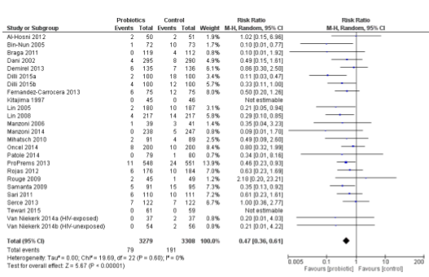
2016

Slide 71
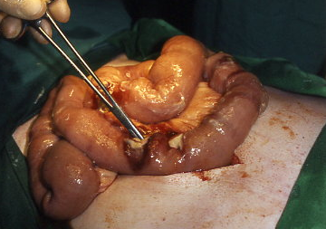
How live bacteria could prevent NEC
Reduced colonization by pathogens (barrier effect)
Increased intestinal barrier (permeability) to translocation of bacteria into the bloodstream
Modification of the host response to microbial products (sensitization/immunization)
Increased bacterial diversity of the microbiota
Antiinflammatory effects of live bacteria (probiotics)

Slide 72
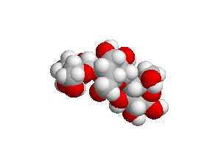
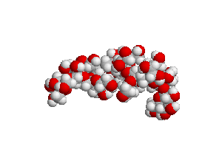
Prebiotics
GOS
FOS
Definition
Non assimilable food ingredient that has a beneficial effect in humans or animals by stimulating selectively one or more bacterial species of the intestinal microbiota
Gibson et Roberfroid 1995

Slide 73
Human milk oligosaccharides (HMOs)
200 different structures
Neutral and acidic HMOs
Only few are available

Slide 74
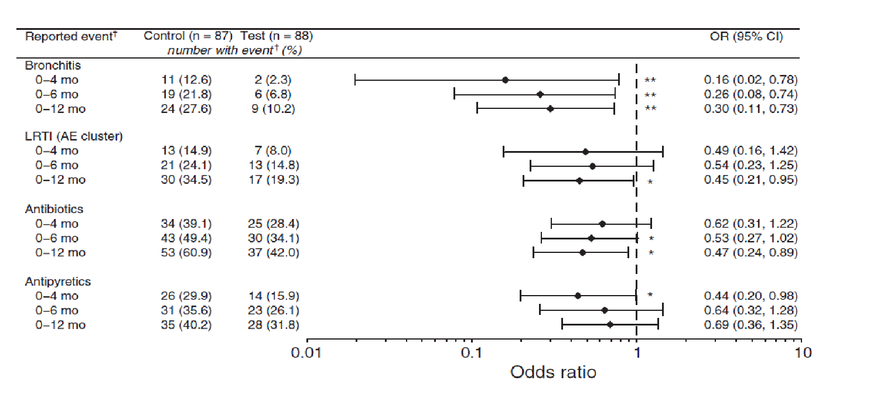
Puccio G et al JPGN 2017

Slide 75
Human milk oligosaccharides (HMOs)
200 different structures
Neutral and acidic HMOs
Only few are available
One or two HMOs cannot mimic
the total pool of human milk

Slide 76
Prebiotic mixture SCGOS/LCFOS
mimicks HMOs
GOS
FOS
90% scGOS
Low molecular weight (short chain)
scGOS
lcFOS
Galacto-oligosaccharides
enzymatic from lactose
851
• [Gal(β1-]₁₋ ₄ 3/4/6)Gal(β1-4)Glc
Int. [arbitrary
2
1400
m/z [Th]
5500
1
1013
1175
10% lcFOS
High molecular weight (long chain)
0
1000 2000 3000 4000
m/z [Th]
Software: Bohne et al. Bioinformatics 1999;15:767-8.
5000 6000
Fructo-oligosaccharides from chicory
• [Frc(β2-]n>8 1)Frc(β2-1)Glc
Reference: 1. Boehm et al. Acta Paediatr Suppl 2003;91:64-7
26

Slide 77
GOS/FOS: Results of metanalysis
GOS
Journal | Pre/Pro/Syn | Studies | RR | CI 95% | Target
Cochrane DBSR 2007 | Prebiotic Full term | 7 studies 2 studies Allergy | 0.42 1.62 | 0.21 – 0.84 0.62 – 4.26 | Positive Eczema NS
Arch Pediatr Adol Med 2009 | Prebiotic Full term | 24 studies N= 1459 | 0.65 | -0.76 - - 0.54 | Increased Bifidobacteria & Lactobacilli
Nur J 2012 | Pre-Pro-Syn | 12 Pre studies N=1563 | NS | NS | Stool frequency
Cochrane DBSR 2013 | Prebiotics | 4 studies | 0.68 | 0.48 _ 0.97 | Allergy/eczema
Clin Nutr 2013 | Prebiotics Preterm < 37s | 5 studies N = 345 | 1.24 | 0.56 – 2.72 | Prevention of NEC & sepsis
J Int Med Res 2013 | Pre-Pro-Syn | 3 studies Prebiotics | 0.80 | 0.54 – 1.18 | Eczema
GOS
FOS

Slide 78
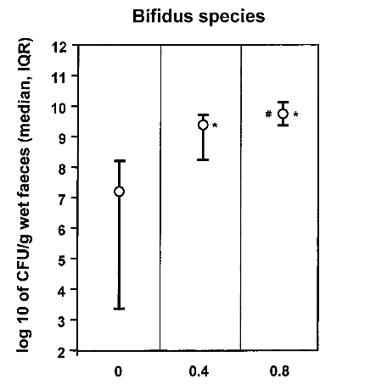
GOS
FOS
GOS and FOS mixture g / dl
GOS and FOS mixture g / dl

Slide 79
Prebiotics (GOS/FOS) in infancy
GOS
FOS
Formula-fed infants with GOS/FOS mixture
Increase Bifidobacteria
Decrease of pathogens
Decrease stool pH
Increase secretory IgA
Reduce atopic disease
Reduce rate of infection
Improve stool consistency
reproducing an intestinal situation very similar to breast fed infants

Slide 80
The biotics family
Intestinal microbiota modulation
Prebiotics
Non assimilable
food ingredients
positively influencing
gut microbiota
Probiotics
Live bacteria
positively influencing
gut microbiota
and human health
Synbiotics
Combination of prebiotics
and probiotics
positively influencing
gut microbiota
Postbiotics
Bioactive compounds produced during a fermentation process that are beneficial for health

Slide 81
The biotics family
Postbiotics process (fermentation)
Bacteria
Milk
Whey
Streptococcus thermophilus 065
Bifidobacterium breve C50
+ minerals and vitamins
Fermentation process (LactofidusTM)
Spray drying
Fermented
Infant formula
Postbiotics: Bioactive compounds
Granier A, Goulet O, Hoarau C. Pediatr Res 2013
Notes:
Nutricia’s Postbiotics are produced by fermentation of infant milk, using two specific types of food-grade lactic acid producing microorganisms (Bifidobacterium breve C50 and Streptococcus thermophilus 065). These microorganisms are metabolically active and transform the formula through a natural fermentation process.
After fermentation this process is followed by spray drying of the product, leading to dried fermented infant formula consisting of POSTBIOTICS.
Further info:
The powdered fermented product is further blended into a final infant formula powder comprising the prebiotic mixture scGOS/lcFOS (9:1).

Slide 82
The biotics family
The postbiotics
Bioactive compounds produced
during a fermentation process
They include
microbial cells,
cell constituants,
metabolites produced by bacteria,
fermentation products
They support health and/or well being
Wong JM et al. J Clin Gastroenterol 2006; Patel RM et al. Clin Perinatol 2013;
Granier A, Goulet O, Hoarau C. Pediatr Res 2013; Aguillar-Toala JE et al. Trends Food Sci Technol 2018

Slide 83
The biotics family
Postbiotics compounds
Wong JM et al. J Clin Gastroenterol 2006
Patel RM et al. Clin Perinatol 2013
Granier A, Goulet O, Hoarau C. Pediatr Res 2013
Aguillar-Toala JE et al. Trends Food Sci Technol 2018
Picture from. Salminen S., Szajewska H., Knol J. The biotics family in early life nutrition. Essential Knowledge Briefing. Wiley, Chichester (2019).

Slide 84
Bifidobacterium breve C50 Streptococcus thermophilus 065
Infant formula with postbiotics
Properties of fermentation
Fermentation process
Cow milk+ B. breve & S. thermophilus/heating
Homogenisation, pasteurization, sterilization
« Double effect » of fermentation
Bacterial fragments
Fermentation products

Slide 85
Bringing the past into the future:
Infant formula with post-biotics
Outline of the presentation
Implementation of gut microbiota in early life
Gut microbiota & development of GI function
Intestinal dysbiosis and relation to FGIDs
Feeding strategies to influence gut microbiota for immediate and long-term GI health
Role of postbiotics beyond health

Slide 86
Postbiotics are bioactive components
produced by micro-organisms in a fermentation process
Fermented milks contain molecules with immune-stimulating effects
Cell wall components such as peptidoglycans, polysaccharide and teichoic acid have immuno-stimulatory properties (Hatcher 1993)
Peptides and free amino acids are generated by proteases from micro-organisms. They may modulate the immune system through direct antimicrobial effects, and by means of anti-inflammatory actions (Meisel 1990, Ménard 2004)

Slide 87
Fermentation products Bifidobacteria and IgA
Bioactive peptides, produced by proteolytic enzymes of LAB, may act as prebiotics, stimulating the growth of Bifidobacteria themselves, with synergistic interactions (Heller 2001, Depeint 2008)
Bifidogenic factors have been shown to promote intestinal bifidobacteria in human microbiota-associated mice as well as in human (Romond 1998).
Peptides derived from milk fermentation with Lactobacillus helveticus increases the number of IgA producing cells in the mouse small intestine (Leblanc 1999).

Slide 88
Lactic acid bacteria secrete metabolites retaining anti-inflammatory properties after intestinal transport (1)
Lactic acid
bacteria
Commensal bacteria
LPS: 10 ng/ml
Decreased TNF-α release
is better achieved
with B. breve
and S. thermophilus
TNF-α
R. gnavus CM
B. bifidum CM
Streptococcus CM
Control
B breve CM
S thermophilus CM
Ménard et al; Gut 2004; 53: 821-8

Slide 89
Effects of BbC50 and its fermentation products on dendritic cell differentiation and cytokine production
Bifidobacterium breve C50 (BbC50)
Isolated from stools of a breast-fed infant
Induces DC maturation and prolonges DC survival with high IL-10 production
Corresponds to a regulatory DC profile limiting Th1 response which might control the excessive Th2 polarization observed in atopic infants
Hoarau et al JACI 2006

Slide 90
The first infant formula with postbiotics
Comparative 6 months study in Chili
Difference in incidence of acute diarrhea (9,7 vs 23,4 %; p<0,001)
Decreased duration of acute episodes (6,8 vs 10,2 days; p<0,001)
No difference in the type of pathogens
Difference in long-term carriage (p<0,001)
Lactobacillus helveticus + Streptococcus thermophilus
Brunser O et al. Acta Paediatr Scand 1989; 78: 259-64

Slide 91
Infant formula with postbiotics (1)
Stimulation of the gut immune system
Increased predominance of Bifidobacteria
Higher titers of anti-poliovirus Immunoglobulins
Bifidobacterium breve C50
Streptococcus thermophilus 065
Mullie Pediatric Research 2004; 56: 791-95

Slide 92
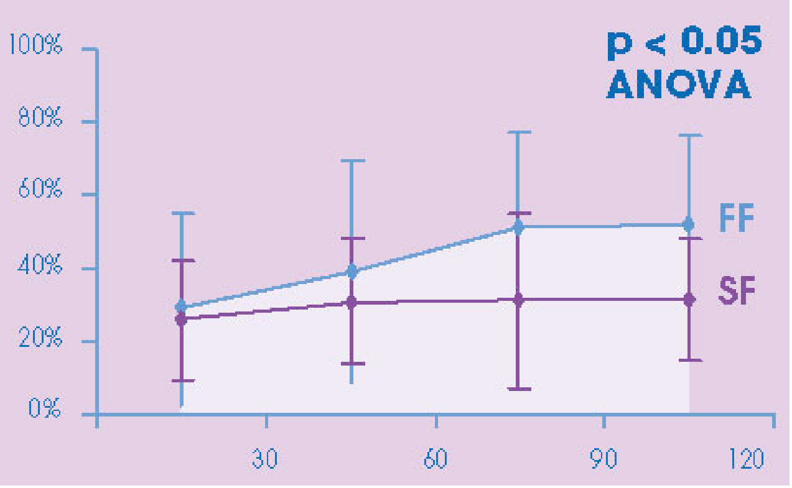
Increased number of bifidobacteria
Infant formula with postbiotics (2)
Changes in intestinal microbiota
FP
SF
Jours
FP = Formula with Postbiotics (n=11)
SF = Standard formula (n=9)
Mullie Pediatric Research 2004; 56: 791-95

Slide 93
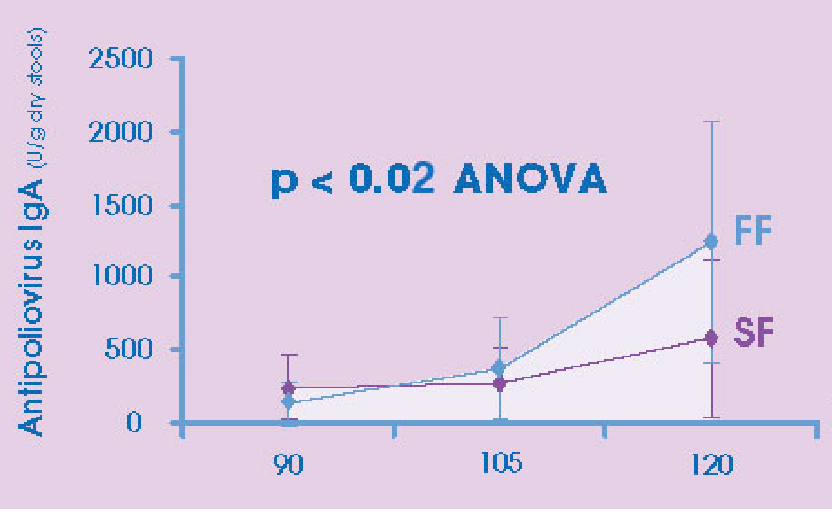
Increased titers of IgA anti-poliovirus
Infant formula with postbiotics (3)
Modulation of intestinal immunity
FP
SF
FP = Formula with postbiotics (n=11)
SF = Standard formula (n=9)
Mullie Pediatric Research 2004; 56: 791-95

Slide 94
Bifidobacterium breve C50 and Streptococcus Thermophilus 065
Effect of infant formula with postbiotics on thymus size and stool pH in healthy term infants (1)
Effects on thymus size and stool pH in normal
gestational age newborns
Breast milk
Standard formula (SF)
Infant formula with postbiotics (FP)
Indrio et al Pediatr Res 2007; 62: 98-100

Slide 95
Effect of infant formula with postbiotics on thymus size and stool pH in healthy term infants (2)
Study design
Thymus
pH
Thymus
pH
Thymus
pH
Thymus
pH
Thymus
pH
Standard
n=30
T0
(birth)
T1
(3 days)
T2
(1 month)
T3
(2 mths)
T4
(3 mths)
T5
(4 mths)
Postbiotics
n=30
Inclusion
Randomization
Breast milk
n=30
Evaluated parameters :
Body weight/length/cranial circumference
Fecal pH
Ultrasonographic thymic index
Indrio et al Pediatr Res 2007; 62: 98-100

Slide 96
Effect of infant formula with postbiotics on thymus size and stool pH in healthy term infants (3)
Impact on the thymic index
BM
FP
SF
T1
(3 days)
T2
(1 month)
T3
(2 mths)
T4
(3 mths)
T5
(4 mths)
Formula with Postbiotics (FP) and Breastmilk (BM) have the same thymic index larger than the SF fed babies
Indrio et al Pediatr Res 2007; 62: 98-100

Slide 97
Effect of infant formula with postbiotics on thymus size and stool pH in healthy term infants (3)
Impact on fecal pH
SF
FP
BM
T1
(3 days)
T2
(1 month)
T3
(2 mths)
T4
(3 mths)
T5
(4 mths)
FP and BM have the same pH around 5
lower than the SF fed babies
Indrio et al Pediatr Res 2007; 62: 98-100

Slide 98
Effect of infant formula with postbiotics on thymus size and stool pH in healthy term infants (4)
Typology of microbiota
% infants carrying B.infantis-longum
FP
Standard
D30
D60
D90
D120
Formula with Postbiotics induce typical colonization of breast fed infants
Indrio et al Pediatr Res 2007; 62: 98-100

Slide 99
Effect of infant formula with postbiotics on thymus size and stool pH in healthy term infants (5)
Microbiota composition
FP
% infants carrying
B. adolescentis B. dentium B. catenulatum
Standard
D30
D60
D90
D120
Postbiotics decrease colonization by Bifidobacteria typical of adult microbiota
Indrio et al Pediatr Res 2007; 62: 98-100

Slide 100
B. breve and S. thermophilus
Infant formula with postbiotics (1)
971 infants aged 4 to 6 months
350 000
Incidence in France
(case/100000 hab./week)
300 000
Bb C50-Study
(new case/week)
250 000
200 000
80
70
150 000
60
50
100 000
40
30
50 000
20
10
0
0
2000 01
2000 05
2000 03
2000 07
2000 11
2000 15
2000 19
2000 23
2000 27
1999 35
2000 09
2000 13
2000 17
2000 21
2000 25
1999 37
1999 39
1999 41
1999 45
1999 43
1999 47
1999 49
1999 51
Prevention of acute diarrhea
J Pediatr Gastroenterol Nutr 2004; 39:147-52

Slide 101
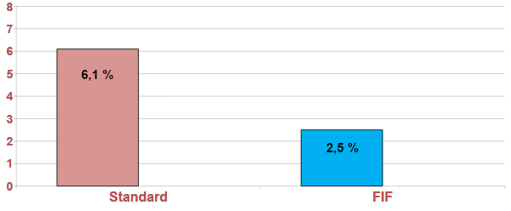
Infant formula with postbiotics (2)
Lower number of dehydration episodes
p = 0,01
FP
J Pediatr Gastroenterol Nutr 2004; 39:147-52

Slide 102
Infant formula with postbiotics (3)
Lower number of formula changes
p = 0,0001
FP
J Pediatr Gastroenterol Nutr 2004; 39:147-52

Slide 103
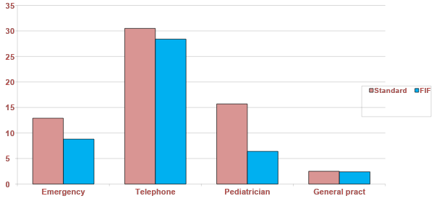
Infant formula with postbiotics (4)
Lower number of medical clinics
p = 0,003
FP
J Pediatr Gastroenterol Nutr 2004; 39:147-52

Slide 104
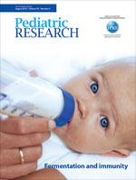
Bifidobacterium breve C50 and Streptococcus thermophilus 065
Beneficial effects of infant formula with postbiotics
Clinical benefits of formula with postbiotics:
Granier M, Hoarau C, Goulet O. Pediatr Res 2013;74: 238-44.
IgA response to polio vaccin (Mullie et al Ped Res 2004)
Prevention of gastroenteritis (Thibault et al JPGN 2004)
Enhance thymus size (Indrio et al Pediatr Res 2007)
Reduce inflammation (Campeotto et al Br J Nutr 2011)
Prevention of allergy (Morisset et al Eur J Clin Nutr 2011)
GI symptoms in infants (van de Heijning et al, Nutrients 2014)

Slide 105
Microbiota modulation in infants formula feeding
Probiotics
Prebiotics
postbiotics
Intestinal microbiota
Bifidobacterium species
Secretory IgAs
Th1/Th2
Dendritic cells
Notes:
‹#›

Slide 106
Infant formula with postbiotics
Postbiotic concept
Bacterial
components
Fermentation
products
Microbiological effects
Immune effects
Immune
competent cells
Dendritic cells
IgA secretion

Slide 107
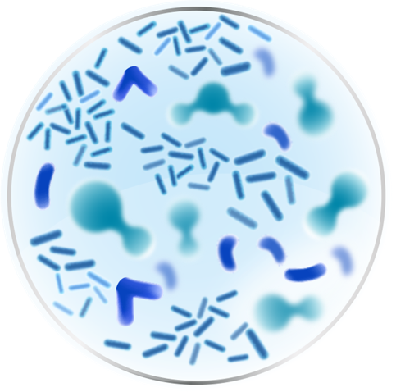
Combination of Prebiotics and Postbiotics
Infant formula with postbiotics (by LactofidusTM process)
Prebiotic mixture scGOS/lcFOS (9:1)
Postbiotics
Prebiotics
>20 years European experience
A unique infant formula combining prebiotics and postbiotics
for gut health benefits
Notes:
In 1994 …
In 2000 …
Recently Nutricia introduced a unique infant formula combining prebiotics and postbiotics for immune through gut benefits

Slide 108
Pre and postbiotics and visceral sensitivity
Abdominal contractions
(Delta: stress-induced – basal value)
NaCl control
Pre/Pro
Pro/no Pro ^{Pre/no Pre}
Only the new combination of prebiotics and postbiotics prevented stress-induced visceral hypersensitivity, an animal model for belly cramps & colic
Collaboration Eutamene et al., INRA France (Renes et al. J Pediatr Gastroenterol Nutr 2018;66:69 Abstract)

Slide 109
Comparison to WHO standards
LIFE study comparing breast milk
and [GOS/FOS + postbiotics]
Weight for age
Length for age
Weight gain and length gain comparable to WHO standards
🡪 Healthy growth for all study arms
Experimental
Control
Breastfed
Rodriguez-Herrera et al J Pediatr Gastroenterol Nutr 2016
Notes:
Say lines closely overlay each otehr

Slide 110
More frequent and more soft stools
LIFE study comparing breast milk
and [GOS/FOS + postbiotics]
Experimental
Control
Breastfed
Experimental
Control
Breastfed
Frequency
Consistency
*
*
*
*
*
*
*
*
*
*
*
*
*
*
*
*
*
*
*
*
*
*
= P0.05 Experimental vs. Control
Medians (Q1-Q3)
Rodriguez-Herrera et al J Pediatr Gastroenterol Nutr 2016

Slide 111
Reduction of the incidence of infant colics
FIPS study comparing formula
With or without GOS/FOS and /or postbiotics
Vandenplas et al, 2015
Notes:
Infaile colic is a natural experience and it passes with age
4weeks: only the blue is significant
8 weeks: Non significant.
The combination of 50% fermented formula (LF) with prebiotic mixture scGOS/lcFOS (9:1) displayed a 60% lower incidence of infantile colic in infants specifically at 4 weeks of age compared to control formulas.

Slide 112
Safe and well-tolerated and ensures growth according to WHO standard z-scores
¹
Group 1: Active: infant formula with prebiotics + postbiotics (n=95)
Group 2: Control: infant formula without prebiotics or postbiotics (n=105)
Group 3: Human milk-fed reference (n=100)
7
6
5
4
3
2
0
-1
-2
-3
Median weight (kg) of girls and boys
0
10
20
30
40
50
60
70
80
90
100
110
120
130
140
Age (days)
Rodriguez-Herrera et al. J Pediatr Gastroenterol Nutr 2016;62:Abstract N-O-010 (p 658-9).
Notes:
Both studies revealed that the unique combination of prebiotics and postbiotics is safe and well-tolerated.
Infants fed the infant formula containing Nutricia’s prebiotics scGOS/lcFOS (9:1) and postbiotics demonstrated equivalence for weight (see Figure), length and head circumference gain comparing the new versus the control formula group.

Slide 113
Stool consistency & frequency* closer to human milk-fed infants
Group 1: Active: infant formula with prebiotics + postbiotics
Group 2: Control: infant formula without prebiotics or postbiotics
Group 3: Human milk-fed reference
Dry, hard pellets
Improved stool consistency & frequency are important
since most infants with regurgitation show multiple FGIDs e.g. in combination with constipation
*) p ≤ 0.005 (group 1 vs. group 2)
Hard, formed
Soft, formed
*
Stool consistency
*
*
*
*
*
*
*
*
*
*
Soft, pudding-like
*) Stool frequency: From nine weeks of age, infants fed the new formula had a significantly higher stool frequency than infants fed the control formula (data not shown).
Watery
Baseline
2
4
6
8
10
12
14
16
18
Age (weeks)
Herrera et al. J Pediatr Gastroenterol Nutr 2015;61:516-7 (OP-18).
Notes:
The average stool consistency of infants fed with the infant formula containing Nutricia’s prebiotics scGOS/lcFOS (9:1) and postbiotics was closer to the human milk-fed reference group, and they had a significantly softer stool consistency than infants fed the control formula, from four weeks of age for the remaining study period (see Figure).
From nine weeks of age, infants fed the new formula had a significantly higher median stool frequency than infants fed the control formula (data not shown).

Slide 114
Microbiote composition
Closer to the microbiota of breast fed infants
Increased Bifidobacteria Reducued Clostridium difficile
Microbiote activity
Reduced fecal pH
Increased sIgA production
Increased SCFA levels
Metabolic profile of the stool, closer to breast fed infants
Prebiotics & Postbiotics:
Tims et al, 2018 (ESPGHAN)

Slide 115
Intestinal microbiota the first 1000 days
Messages
Microbiota implementation is a crucial process, as an early « programming »
Development and maturation of the GI tract are influenced by gut microbiota
In turn, early feeding, by influencing microbiota (Bifidobacteria) is a key issue
O.Goulet 2019

Slide 116
Intestinal microbiota the first 1000 days
Messages
The development of the human infant intestinal microbiota is a sequential process that begins at birth and continues during the ﬁrst 2 to 3 years of life.
Microbial composition and diversity are shaped by host genetics and multiple environmental factors, of which diet is an important contributor
O.Goulet 2019

Slide 117
Intestinal microbiota the first 1000 days
Gut bacteria are known to regulate the gut and systemic immune system via a variety of molecular mechanisms
Disturbances and imbalances in the microbiota may be a contributory factor to immune-mediated disease such as IBD or allergy
Modulation of microbiota is a promising strategy for treating or preventing dysbiosis in infancy and childhood
Wallace TC et al. Human gut microbiota and its relationship to health and disease. Nutr Rev. 2011;69(7):392-403.
Mondot S, et al The human gut microbiome and its dysfunctions. Dig Dis. 2013;31(3-4):278-285.
Weng M, Walker WA. The role of gut microbiota in programming the immune phenotype. J Dev Orig Health Dis. 2013; :203-14.
Arrieta MC et al. The intestinal microbiome in early life: health and disease. Front Immunol. 2014; 5: 427-45
O.Goulet 2019
Notes:
There are various mechanisms by which bacteria regulate the immune system such as increasing the number of T-reg cells in the gut and inducing the production of anti-inflammatory cytokines.¹
Balanced microbial composition may result in symbiosis among the resident bacteria, production of immunomodulatory compounds, and subsequent regulation of the immune response.²
Disruption or alteration of the microbiota may result in dysbiosis and dysregulation of the immune system, leading to inflammation.²
Various factors may disturb the gut microbial composition such as diet, antibiotic use, poor early colonization and infection.²
Examples of inflammatory conditions in which individuals have imbalanced microbiota include:
Nectrotizing enterocolitits (NEC) – Preterm infants with NEC have a low microbial diversity compared to healthy preterm infants.²
Inflammatory bowel disease (IBD) – Intestinal microbial composition differs between healthy individuals and those with IBD, resulting in an inflammatory response in the host as exhibited in Crohn's disease.²
Probiotic strains can ameliorate chronic intestinal inflammation, diarrhea and food allergies among others.³ Prebiotics are also thought to confer clinical benefits such as preventing colorectal cancer and modulating the immune response.⁴
References
Brown K, DeCoffe D, Molcan E et al. Diet-induced dysbiosis of the intestinal microbiota and the effects on immunity and disease. Nutrients 2012:4:1095-1119.
Johnson C, Versalovic J. The human microbiome and its potential importance in pediatrics. Pediatrics 2012;129:950–60.
Wallace T, Guarner F, Madsen K et al. Human gut microbiota and its relationship to health and disease. Nutr Rev 2011;69:392-403.
Hardy H, Harris J, Lyon E et al. Probiotics, prebiotics and immunomodulation of gut mucosal defences: homeostasis and immunopathology. Nutrients 2013;5:1869-1912.

Slide 118
Wopereis H et al.
Pediatr Allergy Imunnol 2014
The first 1000 days establish
a symbiosis
Clarke et al. Pharmacological Reviews 2019

Slide 119
Thank you for your attention
olivier.goulet@aphp.fr

