Slide 1



MEDICAL MANAGEMENT OF
CONGENITAL NEPHROTIC SYNDROEM
13Th ASN & 35th ESNT 2017
NEVEEN A SOLIMAN
Professor of Pediatrics
Kasr Al Ainy School of Medicine
Cairo University
IPNA-ISN Teaching Course
Beirut, June 15, 2019
nsoliman@kasralainy.edu.eg

Slide 2

Overview
Definition and classification of Congenital Nephrotic syndrome (CNS)
Treatment decision making
Treatment strategies:
  Adequate nutrition
  Pharmacologic therapy
  Prophylactic treatment
    Infections
    Thrombotic complications
  Renal replacement therapy
Conclusions
Kasr Al Ainy School of Medicine
Cairo University

Slide 3

Congenital Nephrotic Syndrome

Slide 4

Deep clinical phenotyping
Imaging
Clinical
Laboratory
Pathology
Kasr Al Ainy School of Medicine
Cairo University

Slide 5
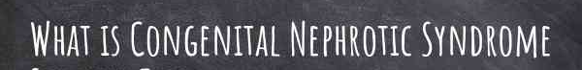

Slide 6
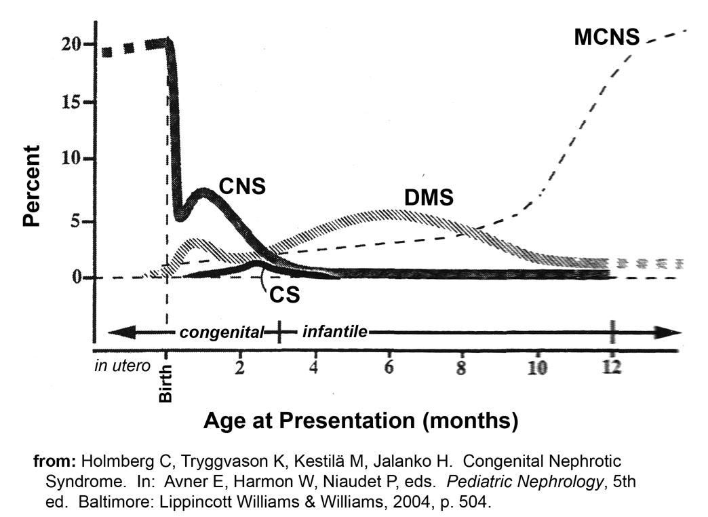
Definition of CNS
CNS: nephrotic syndrome manifesting in the first 3 months of life (often present before birth)

Slide 7
Classification of CNS
Primary / Genetic CNS
Nephrin (NPHS1) gene mutations
Podocin (NPHS2) gene mutations
Phospholipase C epsilon 1 (PLCE1) gene mutations
Wilms tumor suppressor 1 (WT1) gene mutations
(Denys-Drash syndrome, isolated NS)
Laminin β2 (LAMB2) gene mutations
(Pierson syndrome, isolated NS)
Laminin β3 (LAMB3) gene mutations
(Herlitz junctional epidermolysis bullosa)
Integrin alpha-3 (ITGA3) gene mutations
congenital interstitial lung disease with nephrotic syndrome
and epidermolysis bullosa
ARHGDIA gene mutations (RhoGDIA defect)
Mutations in genes encoding mitochondrial
coenzyme Q₁₀ synthesis (COQ2, COQ6, ADCK4)
Galloway-Mowat syndrome (KEOPS complex subunits:
OSGEP, TP53RK, TPRKB, and LAGE3) (Braun et al. Nat Genet 2017)
Secondary CNS
Infectious: syphilis, toxoplasmosis, malaria
CMV, rubella, hepatitis B, HIV
Autoimmune: maternal SLE

Slide 8
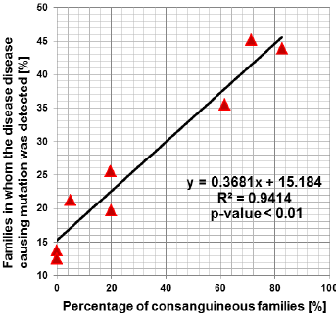

Slide 9
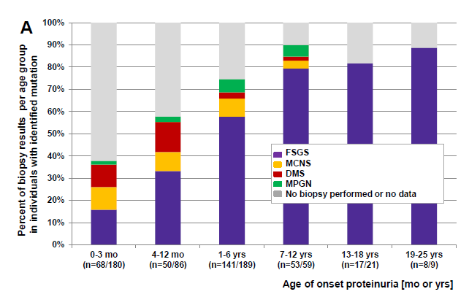
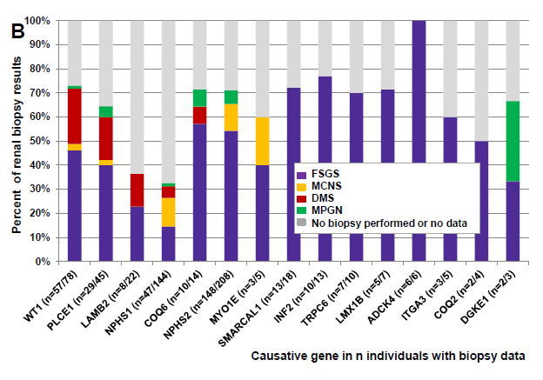
Kasr Al Ainy School of Medicine
Cairo University

Slide 10
Decision making
Multidisciplinary
Life-long therapy:
  Conservative treatment of nephrotic syndrome
  Dialysis
  Transplantation
Are co-morbidities present?
What are the medical and financial resources?
Kasr Al Ainy School of Medicine
Cairo University

Slide 11
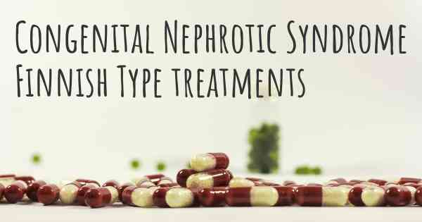

Slide 12

Treatment strategies
Adequate nutrition
Reducing proteinuria & treating edema and other consequences of proteinuria & substitution of vital losses
Preparation of the child for Renal Replacement Therapy:
Dialysis
Transplantation
Prophylaxis against potentially fatal complications:
Infections
Thrombosis

Slide 13
Proteinuria in CNS
Proteinuria in CNS is severe (up to 100 g/l)
Can result in life – threatening edema
Proteinuria leads to losses of diverse proteins and hormones & vitamins & minerals carrier proteins
Immune-suppressive treatment can stabilize podocyte actin network (glucocorticoids, Cyclosporine A) no convincing data on effectiveness in CNS
Kasr Al Ainy School of Medicine
Cairo University

Slide 14
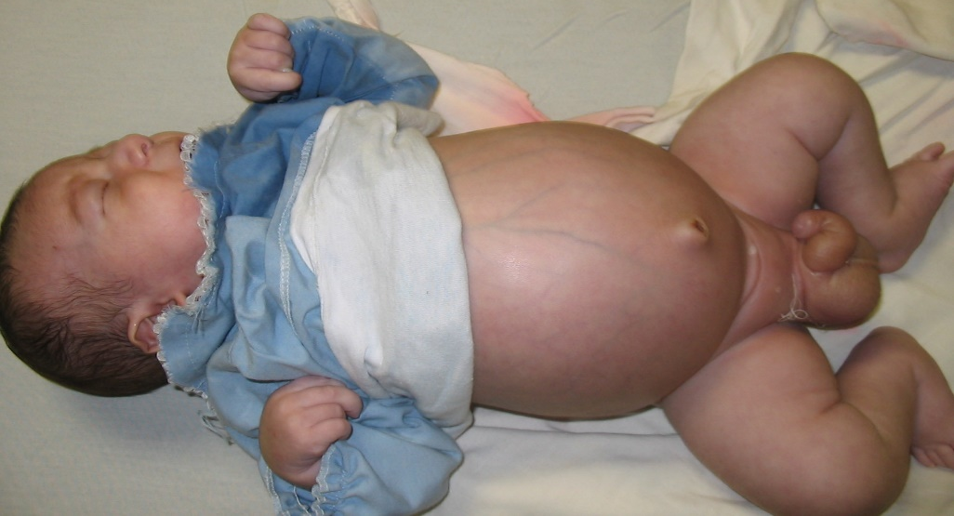
Treatment of edema
Albumin infusions
Furosemide 0.5-1 mg/kg/dose (x 2-4 per day), combined with IV albumin
No target serum albumin (2.5 g/dL usually sufficient)
Clinical parameters to monitor albumin dosing
Kasr Al Ainy School of Medicine
Cairo University

Slide 15
Anti-proteinuric therapy
ACE-inhibitors and angiotensin II receptor blockers
Indomethacin
No/little response in CNS patients with truncating NPHS1 mutations
Kasr Al Ainy School of Medicine
Cairo University

Slide 16
Hormone Substitution
Hypothyroidism
  Low total T3 and T4 due to urinary losses of thyroid binding globulin
Adrenal insufficiency
  Case reports (Pezzuti et al. J Pediatr Endocrinol Metab 2014)
  Replacement not typically required
Kasr Al Ainy School of Medicine
Cairo University

Slide 17
Prophylaxis against infections
Hypogammaglobulinemia
Antibiotic prophylaxis
Vaccinations
Kasr Al Ainy School of Medicine
Cairo University

Slide 18
Prophylaxes of thrombosis
High risk for thrombosis in CNS
  Venous: low level of anti-thrombotic factors (plasminogen, ATIII), elevated levels of pro-thrombotic factors (macroglobulins, fibrinogen, thromboplastin, factors II, V, VII, X, XII)
  Arterial (rare): thrombocytosis, increased platelets activation
Prophylaxis
Treatment of thrombosis
Kasr Al Ainy School of Medicine
Cairo University

Slide 19
Renal replacement therapy in CNS
Finnish recommendations
Bilateral nephrectomy at 7 kg
Peritoneal dialysis
Kidney transplantation at 9-10 kg
Jalanco, Holmberg. In Avner 2016
Kasr Al Ainy School of Medicine
Cairo University

Slide 20
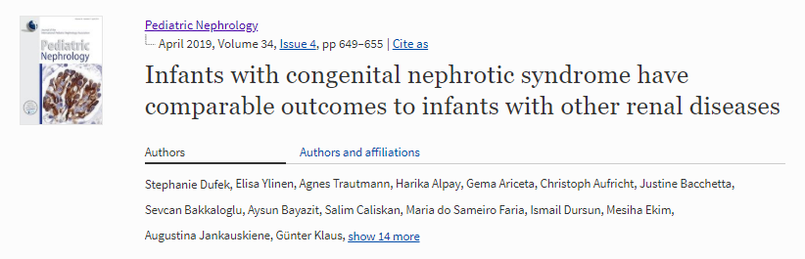
Conclusions
Infants with CNS on dialysis have a comparable mortality, peritonitis rate, growth, and time to transplantation as infants with other primary renal diseases reported in international registry data.
Kasr Al Ainy School of Medicine
Cairo University

Slide 21
Conclusions
CNS – the most severe form of pediatric nephrotic syndrome
Understanding of molecular causes and pathophysiology has dramatically improved outcome
Prognosis in patients after kidney transplantation is equal to patients with other kidney diseases who undergo RRT at similar age
Kasr Al Ainy School of Medicine
Cairo University

Slide 22

Do not give up on CNS
Kasr Al Ainy School of Medicine
Cairo University

Slide 23
Kasr Al Ainy School of Medicine
Cairo University

Slide 24
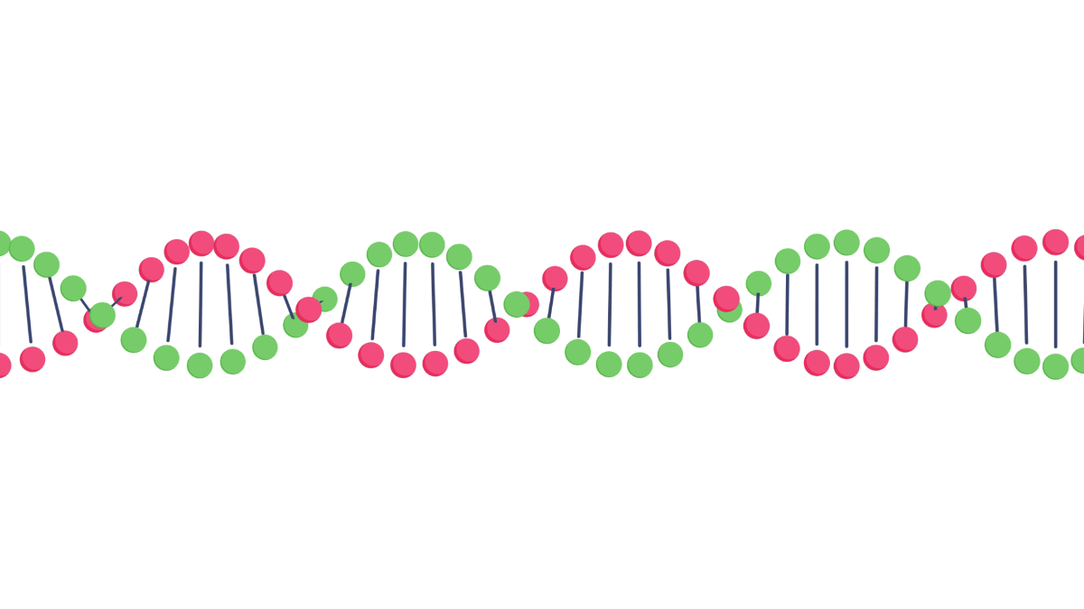


Slide 25


