Slide 1

AKI & CRRT WORKSHOP
Ahmad Kaddourah, MD, MS
Pediatric Nephrology Consultant
Assistant Professor of Clinical Pediatrics
Director of the Center for Acute Nephrologic Extracorporeal Therapies (CANET).
Sidra Medicine
Weill Cornell Medical College in Qatar

Slide 2
History and Definition of Acute Kidney Injury (AKI)

Slide 3

Definition of AKI
Before 2002: The term ARF
After 2002 The term AKI
  Over 30 definitions in published literature
  - Few prospective pediatric studies
RIFLE (2002) by ADQI
AKIN (2004) by AKIN
pRIFLE (2007) by Arikan & Goldstein
2012
In 2017: The term AKD
Notes:
After 2002: The definition was based on SCr and UOP. The problem with RIFLE it is not acute (Loss > 4 weeks, and ESRD > 3 months). ADQI: Acute Dialysis Quality Initiative.

Slide 4
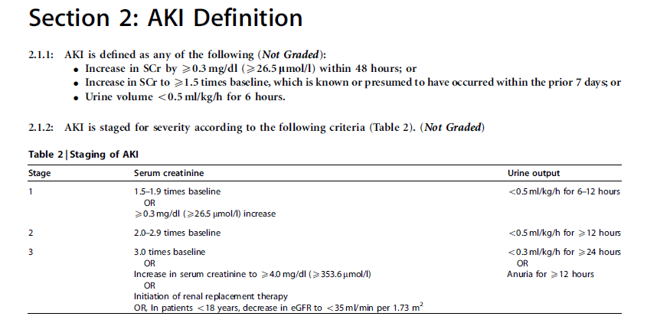
AKI Definition by KDIGO

Slide 5
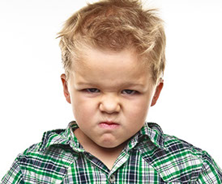
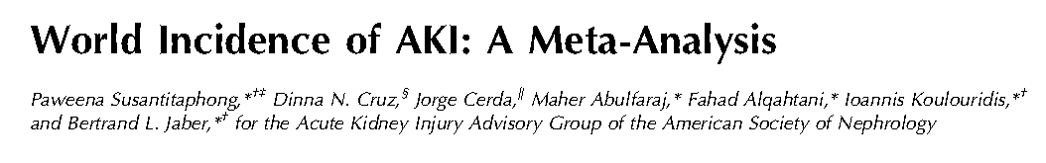
Chances to Get AKI are Equal Between Hospitalized Children and Adults.

Slide 6

AKI Kills !

Slide 8
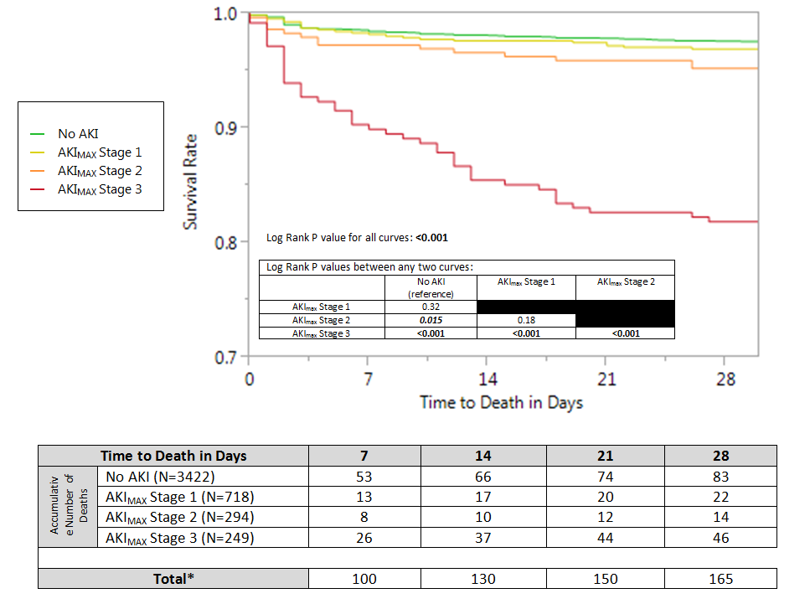

Slide 9


Slide 10
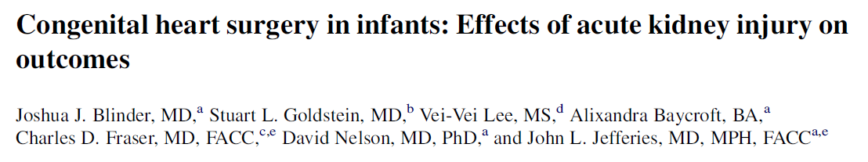
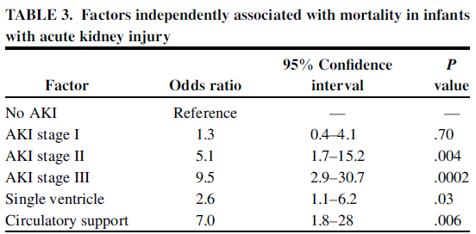
AKI is Worse Than Single Ventricle Physiology

Slide 11
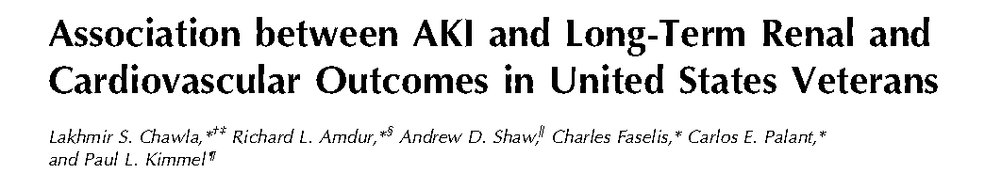
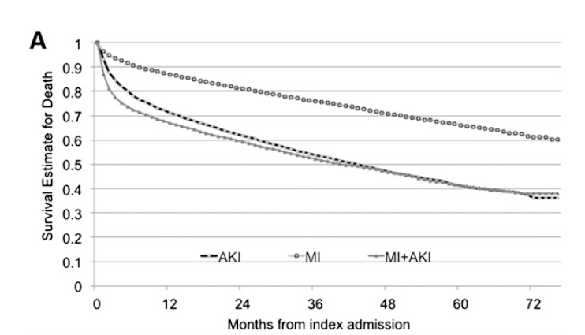
AKI Kills more than MI!

Slide 12
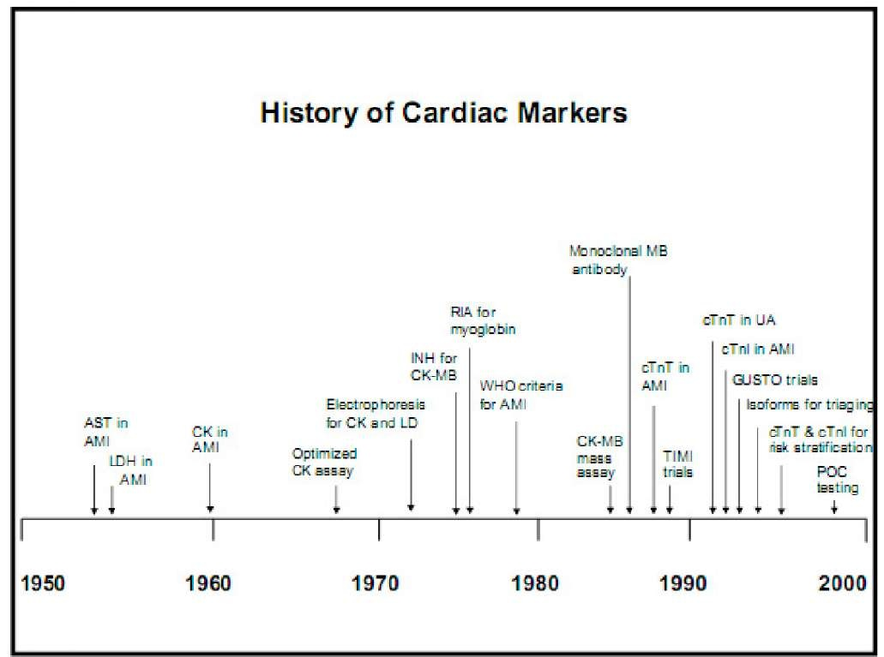
Kidney
Cr
The Era of Novel Kidney Injury Markers

Slide 13
Biomarkers & Renal Angina Index

Slide 14
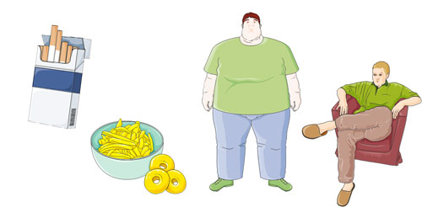
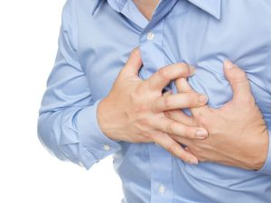
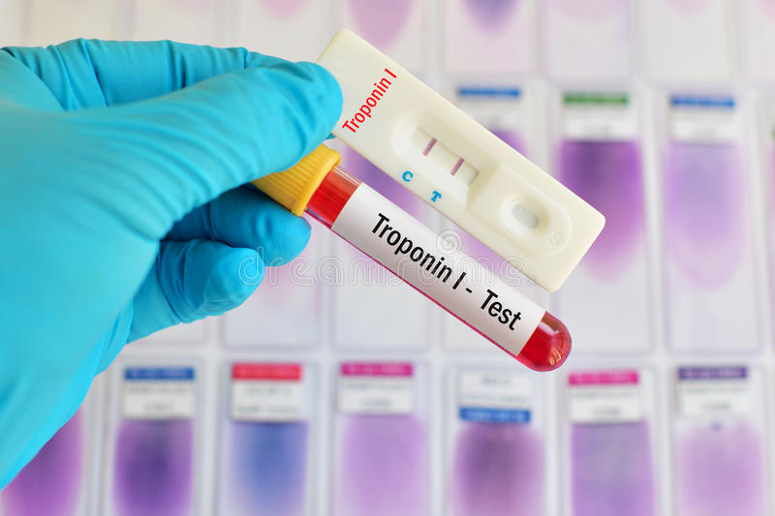
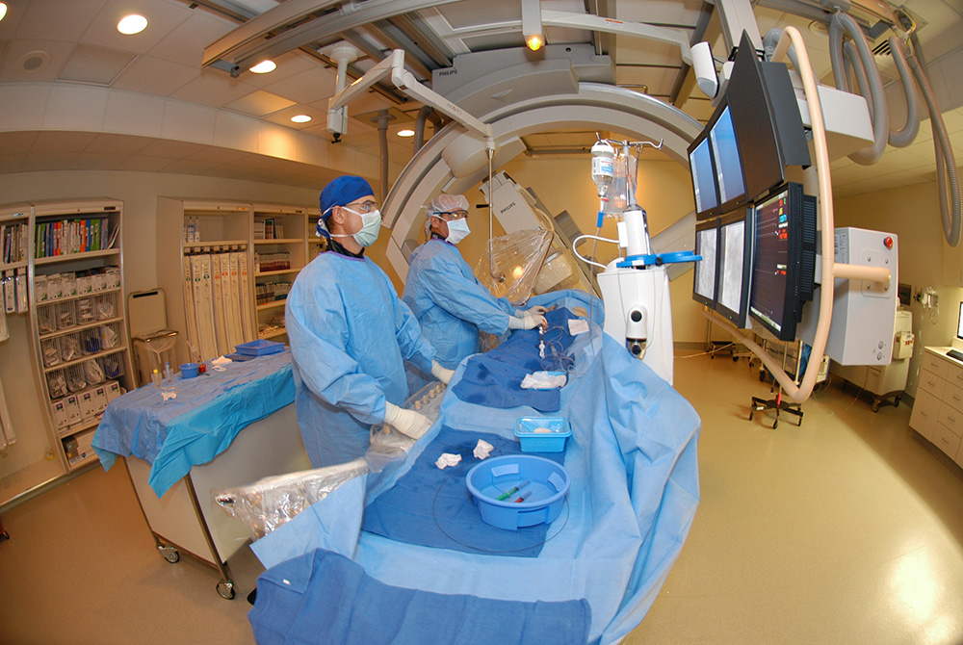
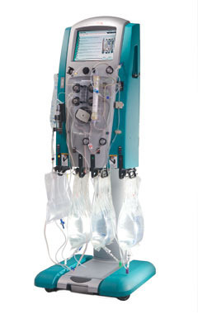
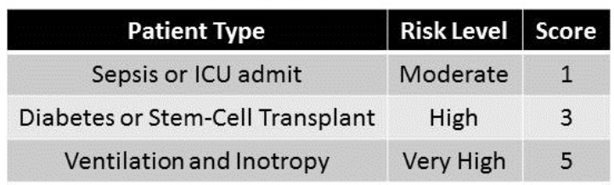
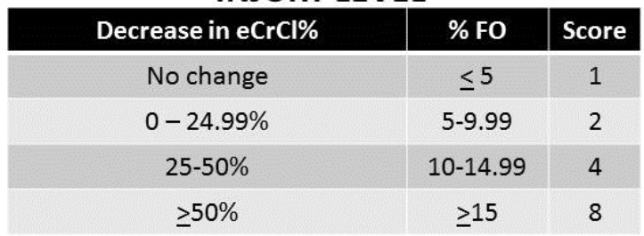
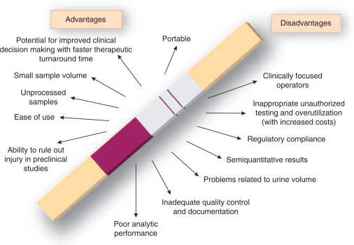
Cardiac VS. Renal Angina
Signs & Symptoms
Risk
+
Test
Treatment
+
+

Slide 15


Slide 19
ABC of Dialysis and CRRT

Slide 20
Diffusion
Small molecules diffuse easily
Larger molecules diffuse slowly
? Better to avoid loss of some molecules (e.g., drugs)?

Slide 21
Convection
Small and large molecules move equally
Limit is cut-off size of membrane
? Advantageous in some settings (e.g., sepsis)?

Slide 22
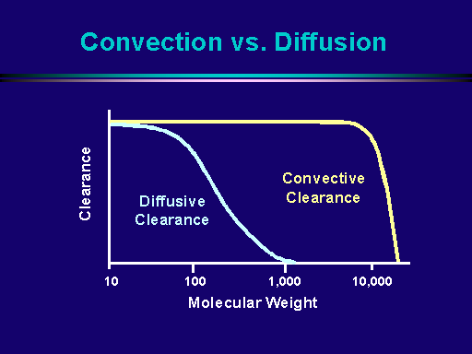
Clearance: Convection vs. Diffusion

Slide 23
Effect of Pore Size on Membrane Selectivity
Creatinine 113 D
Urea 60 D
Glucose 180 D
Vancomycin
~1,500 D
IL-6
~25,000 D
Albumin
~66,000 D

Slide 24
Solute Molecular Weight and Clearance
Solute (MW) Sieving Coefficient Diffusion Coefficient
Urea (60) 1.01 ± 0.05 1.01 ± 0.07
Creatinine (113) 1.00 ± 0.09 1.01 ± 0.06
Uric Acid (168) 1.01 ± 0.04 0.97 ± 0.04*
Vancomycin (1448) 0.84 ± 0.10 0.74 ± 0.04**
*P<0.05 vs sieving coefficient
**P<0.01 vs sieving coefficient

Slide 25
Other Membrane Characteristics: e.g., Charge
-
-
Negative charge on membrane:
Negatively charged particles may be repelled, limiting filtration
-
-
-
-
-
-
-
-
-
-
-
-
-
-
-
-

Slide 26
Other Membrane Characteristics: e.g., Charge
-
-
Negative charge on membrane:
Negatively charged particles may be repelled, limiting filtration
Positively charged particles may have increased sieving
+
-
+
-
+
-
+
-
+
+
+
-
-
+
-
-

Slide 27
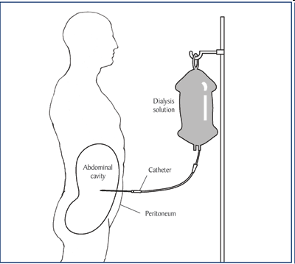
Peritoneal Dialysis (PD)
- Sterile dialysate introduced into peritoneal cavity through a catheter
- Lots of pediatric experience
- Low efficiency system
- Possibly better tolerated by critically ill patients?
- Often preferred in infants, especially with congenital heart dx
Dialysate
Peritoneal Space
Effluent
Collection

Slide 28
Intermittent Hemodialysis (IHD)
- Blood perfuses extracorporeal circuit
- Dialysate passes on opposite side of membrane
- High efficiency system
- May be poorly tolerated by critically ill patients
- High level of complexity
- No devices specifically for children
Time Remaining: 1:30
Blood Flow Rate: 300 ml/min
Dialysate Flow Rate: 500 ml/min
Ultrafiltration Rate: 0.3 L/hr
Total Ultrafiltrate: 1.5 L/hr

Slide 29
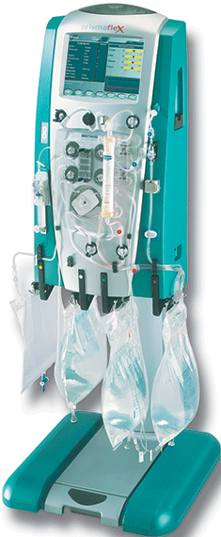
Continuous Renal Replacement Therapy (CRRT)
Continuous hemofiltration technique, often used for critically ill patients
Technically similar to HD
  SLOW: ICU patients may not tolerate rapid ultrafiltration with HD
  CONTINUOUS: Preserve metabolic stability; maintain fluid balance for oliguric patients who require high daily input (IV medications, parenteral nutrition)
Rinse-O-Matic
3000

Slide 30
CRRT Schematic
R
SCUF
CVVH
D
CVVHD
CVVHDF
UF

Slide 31
Major Renal Replacement Techniques
Intermittent
Hybrid
Continuous
IHD
Intermittent haemodialysis
SLEDD
Sustained (or slow) low efficiency daily dialysis
CVVH
Continuous veno-venous haemofiltration
IUF
Isolated Ultrafiltration
CVVHD
Continuous veno-venous haemodialysis
SLEDD-F
Sustained (or slow) low efficiency daily dialysis with filtration
CVVHDF
Continuous veno-venous haemodiafiltration
SCUF
Slow continuous ultrafiltration
SCUF
Slow continuous ultrafiltration

Slide 32
CRRT Indications & Prescription

Slide 33
WHY CRRT?
Reduces hemodynamic instability preventing secondary ischemia
  Precise Volume control/immediately adaptable
  Uremic toxin removal
  Effective control of uremia, hypophosphatemia, hyperkalemia
Acid base balance
  Rapid control of metabolic acidosis
Electrolyte management
  Control of electrolyte imbalances
Allows for improved provision of nutritional support
Management of sepsis/plasma cytokine filter
Safer for patients with head injuries

Slide 34
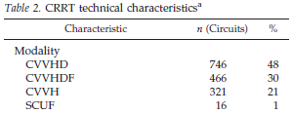
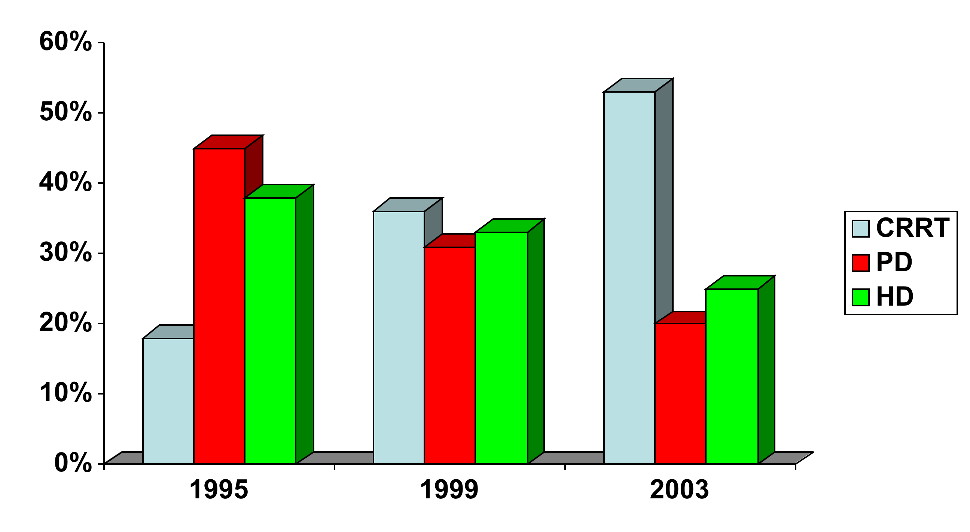
Trends in Pediatric Acute RRT
CRRT trend is increasing
12-US Multicentre ppCRRT
Most include Dialysis
Warady et al, Pediatr Neph 2000, 15:11-3

Slide 36
Indications for Pediatric CRRT
Fluid Overload (hypervolemia with pulmonary edema/respiratory failure)
Electrolyte imbalance
AKI with uremia with bleeding and or encephalopathy
Nutritional support
Intoxications
Inborn errors of Metabolism (IEM)
Indication | Patients | % of cohort
Fluid overload AND electrolyte disturbances | 157 | 46%
Fluid overload | 100 | 29%
Electrolyte disturbances | 44 | 13%
Prevent fluid overload | 11 | 3%
Other | 32 | 9%
78% of patients received CRRT, at least in part, to treat fluid overload

Slide 37
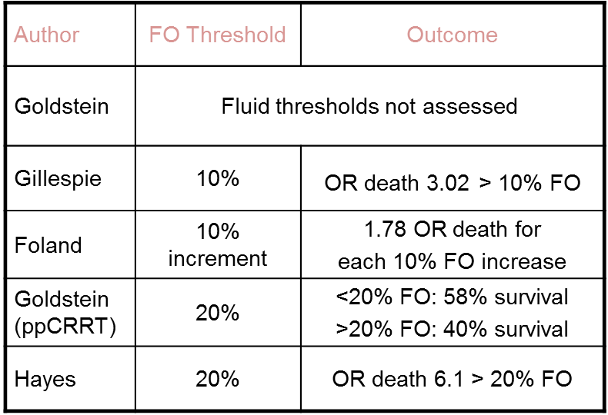
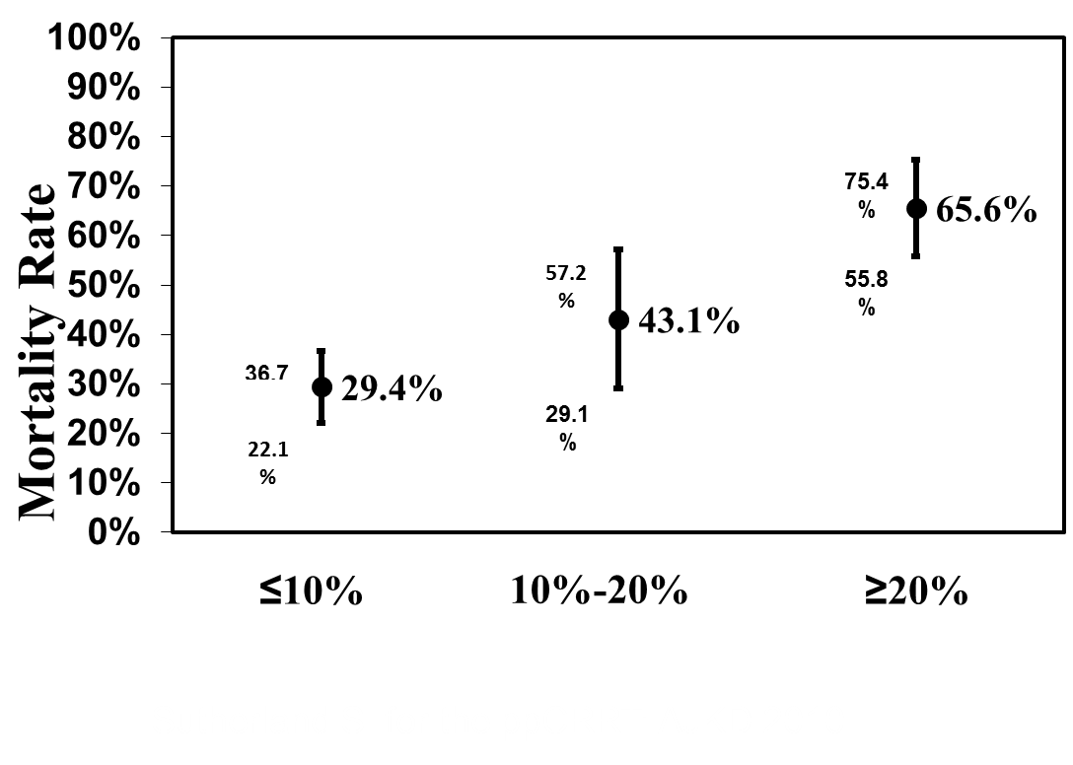
Fluid Overload Thresholds at CRRT Initiation and Mortality

Slide 38
Percent Fluid Overload Calculation
[
]
Fluid In - Fluid Out
ICU Admit Weight
% FO at CVVH initiation =
* 100%
Fluid In = Total Input from ICU admit to CRRT initiation
Fluid Out = Total Output from ICU admit to CRRT initiation
Sutherland S. for the ppCRRT: AJKD 2010

Slide 39
Timing of Pediatric RRT
No adequate definition for “timing of initiation”
Absence of a generally accepted, validated and applied AKI definition has impeded the adequate investigation of this question
The decision to initiate RRT affected by
    - Strongly held physician beliefs
    - Patient characteristics
    - Organizational characteristics

Slide 40
Practical Applications

Slide 41
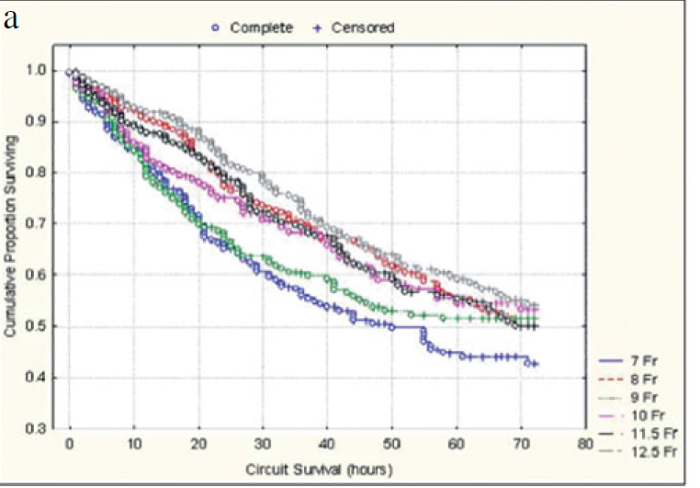
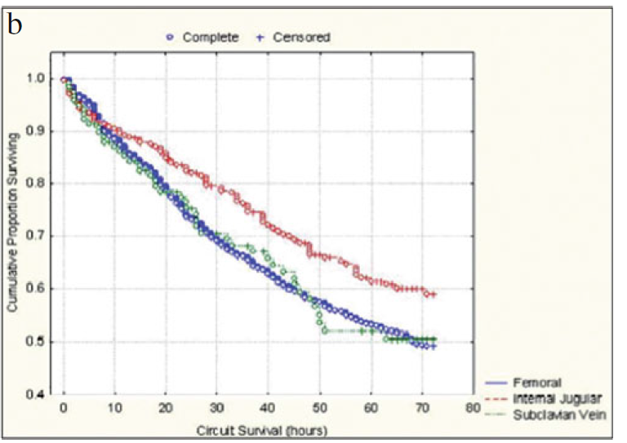
Dialysis Catheters

Slide 42
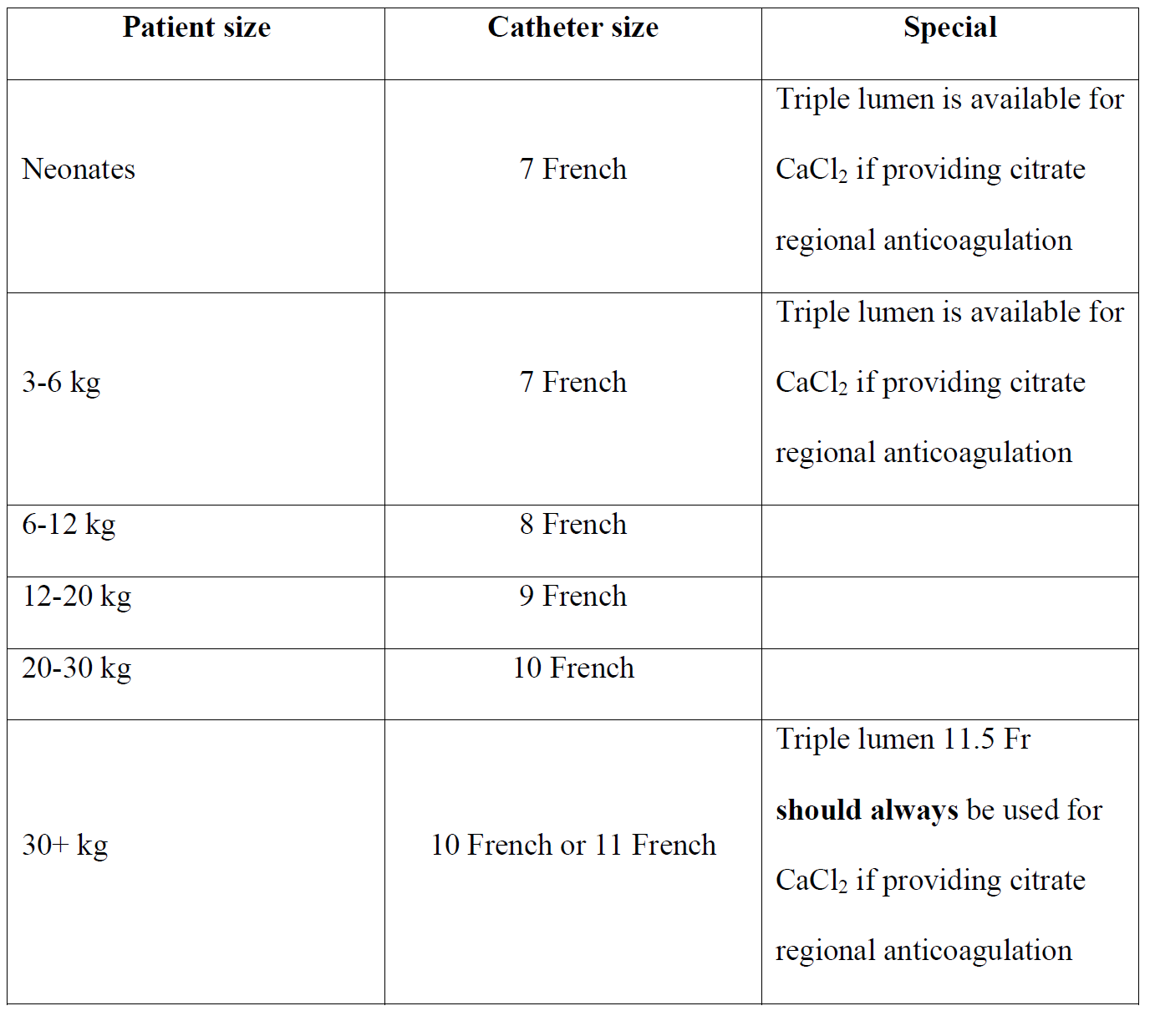
Dialysis Catheters

Slide 43
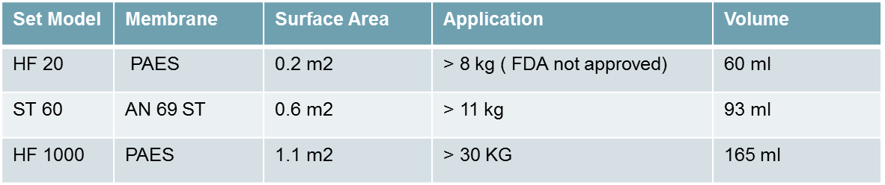
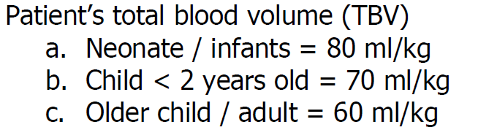

FILTERS / BLOOD PRIMING
To blood prime or not to prime, that is the question?
Rule of thumb: When the circuit and tubing volume exceeds 10-15% of patient’s total blood volume blood TBV, Please prime with blood ( NO EVIDENCE).

Slide 44
Bradykinin Release Syndrome
Mucosal congestion, bronchospasm, hypotension at start of CRRT
Resolves with discontinuation of CRRT
Thought to be related to bradykinin release when patient’s blood contacts hemofilter
  Most common with AN-69 membranes
Exquisitely pH sensitive

Slide 45
Blood Flow Rate
Rule of thumb:
  Neonate/infants: 8-12 ml/kg/min
  Toddlers: 6-8 ml/kg/min
  Older children: 3-6 ml/kg/min

Slide 46
Dialysate and Replacement Fluids
Calcium Containing Fluids
Componenets mmol/l | Phoxilium | Hemosol B0 ® | PrismaSol 2 ® | PrismaSol 4®
HCO3 | 30 | 32 | 32 | 32
Lactate | 0 | 3 | 3 | 3
Citrate | 0 | 0 | 0 | 0
Citric Acid | 0 | 0 | 0 | 0
Na | 140 | 140 | 140 | 140
K | 4 | 0 | 2 | 4
Ca | 1.25 | 1.75 | 1.75 | 1.75
Mg | 0.6 | 0.5 | 0.5 | 0.5
Cl | 116 | 109.5 | 111.5 | 113.5
Phosphate | 1.2 | 0 | 0 | 0
Glucose | 0 | 0 | 6.1 | 6.1

Slide 47
Dialysate and Replacement Fluids
Calcium-Free Fluids
Components of the fluids used CRRT procedure using Citrate – Calcium Protocol.
Components (mmol/l) | PrsimoCitarte 18/0 | PrismaSol BGK 2/0 | Prismasol B22GK 4/0 Or Prism0Cal B22GK 4/0
HCO³ | 0 | 32 | 22
Lactate | 0 | 3 | 3
Trisodium Citrate | 18 | 0 | 0
Citric Acid | 0 | 0 | 0
Na+ | 140 | 140 | 140
K+ | 0 | 2 | 4
Ca++ | 0 | 0 | 0
Mg+ | 0 | 0.5 | 0.75
Cl - | 86 | 108.0 | 120.5
Phosphate | 0 | 0 | 0
Glucose | 0 | 6.1 | 6.1

Slide 48
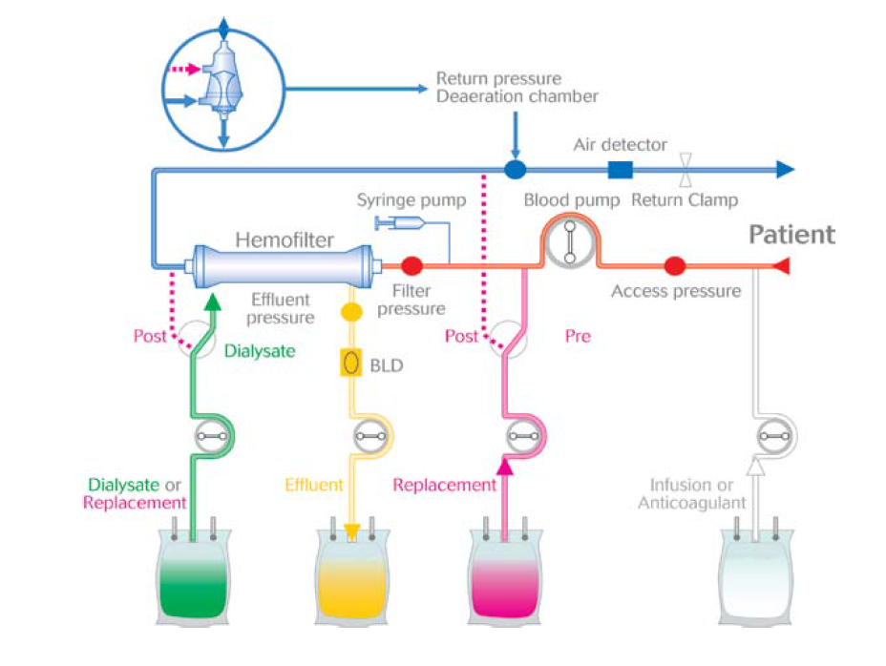
Dialysate and Replacement Rates

Slide 49
Dialysate and Replacement Rates
- Always prescribe same fluids for Pre, post and dialysate fluids.
- Dialysis dose:
- Total dose: 2000 ml/hour/1.73 m2 (Except for hyperammonemia)
- %50 of the above number is the dialysate rate (ml/hr)
- The post-filter replacement fluids should be always 50-100 ml/hr.
- The rest in PBP replacement fluids.

Slide 50
Anticoagulation – Heparin
-

Slide 51
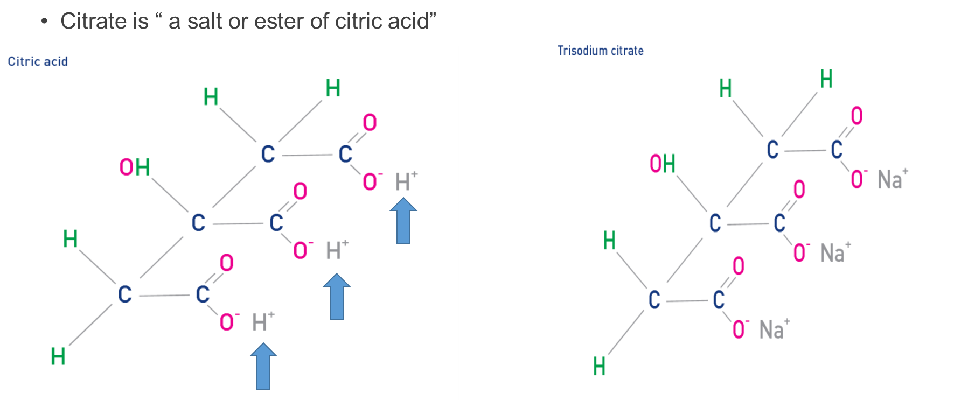
Anticoagulation – Citrate
-

Slide 52
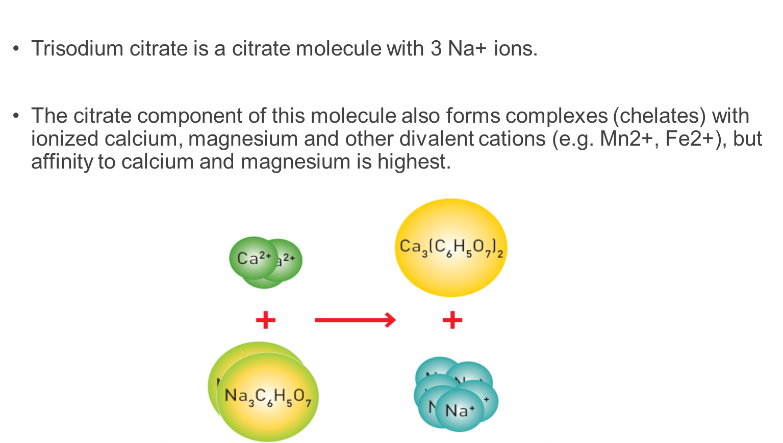

Slide 53
Coagulation factor IV: Calcium!
-
Notes:
Calcium, which is coagulation factor IV, plays an important role in the whole
anticoagulation cascade. Its ionized form participates in each of the three
pathways: intrinsic, extrinsic and common.
• Intrinsic pathway: Factor IXa, together with factor VIII, phospholipid and
ionized calcium convert factor X to its activated form, factor Xa.
• Extrinsic pathway: The combination of tissue factor with factor VIIa and
ionized calcium convert factor X to its activated form, factor Xa.
• Common pathway: The final common sequence involves the combination
of factors Xa and V, phospholipid and ionized calcium into a complex that
converts prothrombin in thrombin.

Slide 54
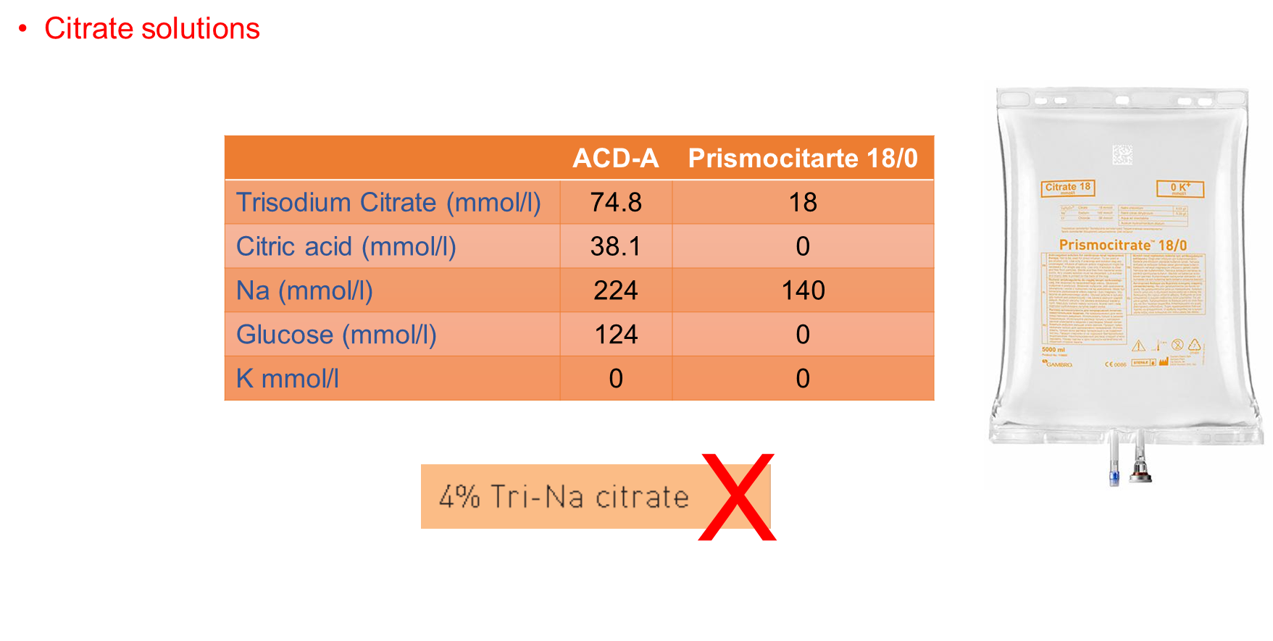
Notes:
4% Tri-Na Citrtae: 136 mmol/l Tri-Na Citrate and 408 mmol/l of Na

Slide 56
CRRT on ECMO

Slide 57
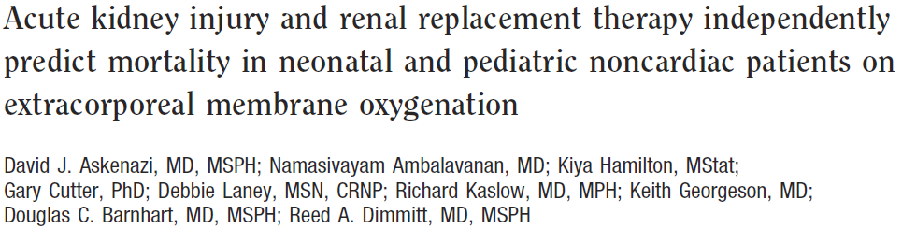
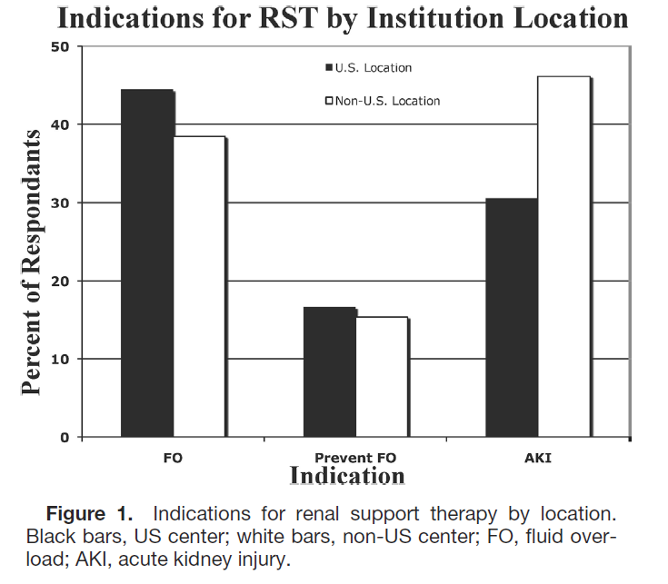

Slide 58
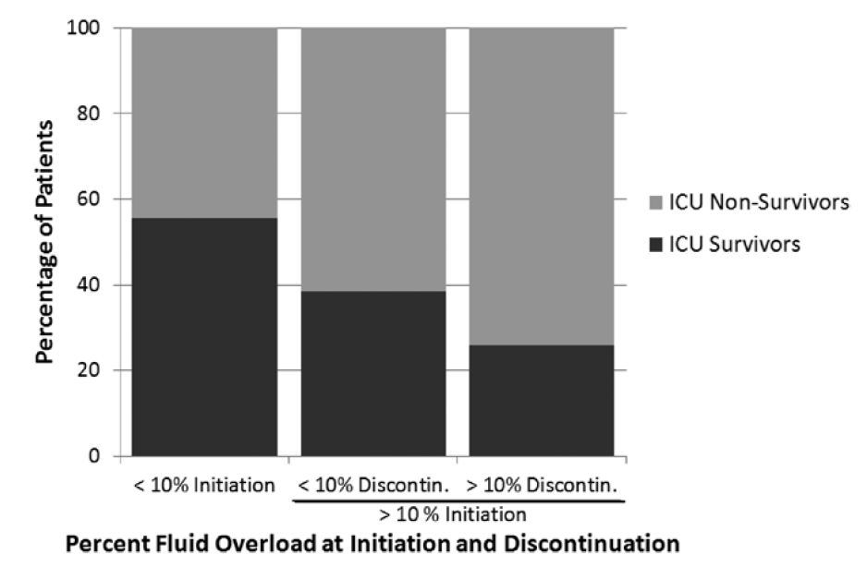

FO and ECMO/RRT
Outcomes:
Cardiac
  Degree of FO at CRRT initiation significantly higher in nonsurvivors
  38% vs 14%, P=.039
Degree of fluid removal and rate of removal:
    NO improvement in outcome

Slide 60
Hands on The Device

