Slide 1
aHUS: Pathology and Treatment, Who will benefit from Eculizumab?
Hala Kfoury Kassouf, MD
Professor of Pathology, Nephropathology
Department of Pathology and Laboratory Medicine
American University of Beirut.
Jean Francis MD
Boston University School of Medicine
Associate Professor of Medicine
Associate Physician Brigham and Women’s Hospital

Slide 2
DISCLOSURES
Relevant Financial Relationships
Advisory Board/consultant: Alexion
Advisory Board: Mallinckrodt
Honoraria: UpToDate
Consultant: Advance Medical
Off Label Usage
None

Slide 3
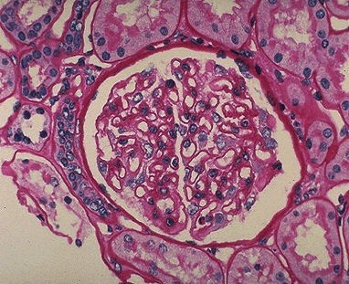
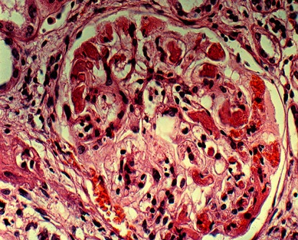
Hemolytic Uremic Syndrome
A thrombotic micrangiopathy manifesting with:
Micro-angiopathic hemolytic anemia
Thromboctytopenia
Acute renal failure
Classic HUS-D⁺ - diarrheal prodrome associated with shiga toxin producing 0157:H7 E.coli; most cases recover.
Atypical HUS - May be associated with mutations in complement regulatory proteins. Poor prognosis, 50% ESRD, may recur after transplantation.

Slide 4
Asif et al, The Open Urology & Nephrology Journal, 2014

Slide 5
The Mimics of aHUS
ADAMTS13
deficiency
Carla M. Nester CM, et al, Mol Immunology, Vol 67, Issue 1, 2015, 31–42

Slide 6
IgM, IgG
Immune complexes
bacteria, bacterial toxin, LPS
Mannose residues
Mele et al, Semin Immunopathol (2014) 36:399–420

Slide 7
COMPLEMENT GENE MUTATION IN aHUS PATIENTS
Regulatory
domain
Recognition
doman
C35X
C35Y (n=3)
R59X (n=4)
48aa del
C3b
proteoglycans
C3b
proteoglycans
proteoglycans
C3b
1
1
2
3
4
5
6
7
8
9
10
11
12
13
14
15
16
17
18
19
20
2
192T>C+193-198del
C99R
(96-129)del+G130I+Y132T+L133X
SCRs
E1172X (n=2)
W1183R
W1183X
S1191L (n=7)
G1194D
V1197A (n=4)
E1198A
V1200L
R1210C (n=9)
R1215Q (n=2)
R1215G
3675-3699del
3
R78G
479X
N516K
Q950H
I970V
1014X
Y155D
S890I (n=2)
Y899X
W920R
2759del15bp
Q1137L
C1163W
Dup(3546-3581)
4
T267fs270X
(858-872)del+D277N+P278S
F242C
CFH 24%
50%
STP
H Chain
L Chain
FIMAC
SRCR
LRDR-1
LRDR-2
S-S
SP
TM
A353V
T72S
A240G
G261D (n=2)
R317W
G349R
I357M
W399R
L484V+Q485G+W486X
E554V
D519N
CT
MCP 10%
CFI 7%
Lectin-Like
domain
A43T
D53G
V81L
β-chain
α-chain
TME1
V81L
TME2
TM 3%
α’NT
MG1
MG2
MG3
MG4
MG5
MG6β
LNK
ANA
MG6α
MG7
CUB g
TED
CUB f
MG8
Anchor
C345C
TME3
T140R
T140K
R570W
K1029M
R1041S
D1093N
I1135T
T1361M
TME4
Q163E
R456L
TME5
C3 6%
TME6
D486Y (n=4)
P495S
P501L
ST-rich
peptide
7
Ba
Bb
TM
CT
SCRs
SCRs
linker
1
linker
VWA
SP
1
2
2
3
3
CFB 1-2%
R138W
Anti-CFH Ab 6%
Notes:
15/06/2019
RemuzziHUSTTPJena051007
7

Slide 8
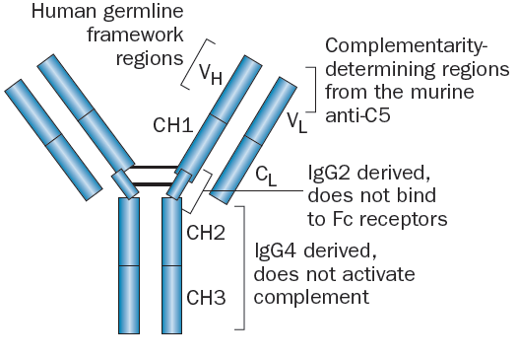
Eculizumab
Recombinant fully humanized hybrid IgG2/IgG4 monoclonal antibody against C5
Prevents formation of C5a and C5b, component of the membrane attack complex
Zuber Nat Rev Neph 2012

Slide 9
aHUS
Trigger
C3
C3a
C3b
CFB
Coagulation
CFH
CFI
C3
convertase
C3
C5
convertase
C5a
TM shedding
Bb
C5b-9
TM
C3b
Bb
C5
C5b
MCP
C3b
C3b
C5b-9
C3b
VWF
P-sel
Endothelial cell
Endothelial cell
Blockade of C5 cleavage to C5a and C5b, protected from microvascular thrombosis and radically improved the outcome of aHUS.
Legendre CM et al., N Engl J Med, 2013
Licht C et al., Kidney Int, 2015

Slide 10
Fluid phase C3
convertase
Alternative pathway activation
(spontaneous hydrolysis,
bacteria, viruses)
CFH
CFB
CFI
CFH
Bb
iC3b
C3
C3b
SCR19-20
N terminal
CFH
CFH
C3b
C3a
CFB
CFI
CFI
iC3b
Bb
C3b
C3b
Glycosaminoglycans
Endothelial cell
Courtesy of Dr. Marina Noris (Modified)

Slide 11
C3b
Fluid phase C3
convertase
spontaneous hydrolysis,
bacteria, viruses
Mutated C terminal
CFH
CFB
C3
CFI
Bb
iC3b
C3b
C3b
C3a
CFB
CFI
Surface bound C3
convertase
C5
Bb
C5 convertase
C3b
iC3b
C3b
C5b-9
Glycosaminoglycans
Endothelial cell
Courtesy of Dr. Marina Noris (with modifications)

Slide 12
C3b
Fluid phase C3
convertase
spontaneous hydrolysis,
bacteria, viruses
Anti CFH antibody
Y
CFH
CFB
C3
CFI
Bb
iC3b
C3b
C3b
C3a
CFB
Y
Y
C5
CFI
Surface bound C3
convertase
Bb
C5 convertase
C3b
iC3b
C3b
C5b-9
Glycosaminoglycans
Endothelial cell

Slide 13
CFH Mutation or Antibody
Fluid phase C3
convertase
Alternative pathway activation
(spontaneous hydrolysis,
bacteria, viruses)
CFH
CFB
CFI
CFH
X
Bb
iC3b
C3
C3b
SCR19-20
C5
N terminal
CFH
C5 convertase
CFH
C3b
C3a
CFB
sC5b-9
sC5b-9
CFI
CFI
iC3b
Bb
C3b
C3b
Glycosaminoglycans
Endothelial cell
Subendothelial space
sC5b-9
sC5b-9
sC5b-9
C3 product
C3 product
C3 product

Slide 14
MCP MUTATIONS IN aHUS
C35X
C35Y (n=3)
R59X (n=4)
48aa del
spontaneous hydrolysis,
bacteria, viruses
1
2
192T>C+193-198del
C99R
(96-129)del+G130I+Y132T+L133X
C3
SCRs
3
Y155D
4
T267fs270X
(858-872)del+D277N+P278S
F242C
STP
C3b
TM
A353V
C3a
CT
MCP 10%
CFB
CFI
CFI
C5
CFH
MCP
C3b
iC3b
C3b
C5 convertase
Glycosaminoglycans
C5b-9
Glycosaminoglycans
Endothelial cell
Loss of function heterozygous mutations
Noris et al, Lancet 2003
Richards et al, PNAS 2003
Caprioli et al., Blood, 2006

Slide 15
C3 MUTATIONS IN aHUS
β-chain
α-chain
α’NT
MG1
MG2
MG3
MG4
MG5
LNK
ANA
MG6α
TED
MG8
C345C
MG6β
MG7
CUB g
CUB f
Anchor
T140R
T140K
Q163E
R570W
K1029M
R1041S
D1093N
I1135T
T1361M
R456L
C3 7-10%
C3
C3b
CFB
CFB
C3a
CFH
C3
convertase
CFI
C5
Bb
MCP
C3b
iC3b
C3b
C5 convertase
C5b-9
Glycosaminoglycans
Endothelial cell
Gain of function C3 mutations: reduced binding to MCP, increased affinity to CFB
Goicoechea et al., PNAS, 2007
Roumenina et al., Blood, 2009
Fremeaux-Bacchi et al, Blood 2008
Courtesy of Dr. Marina Noris (Modified)

Slide 16
aHUS
Trigger
C3
C3a
C3b
CFB
Coagulation
CFH
CFI
C3
convertase
C3
C5
convertase
C5a
TM shedding
Bb
C5b-9
TM
C3b
Bb
C5
C5b
MCP
C3b
C3b
C5b-9
C3b
VWF
P-sel
Endothelial cell
Endothelial cell
Blockade of C5 cleavage to C5a and C5b, protected from microvascular thrombosis and radically improved the outcome of aHUS.
Legendre CM et al., N Engl J Med, 2013
Licht C et al., Kidney Int, 2015

Slide 17
Plasma-Resistant Trial: eGFR
↑ 32 ml/min/1.73 m²
4/5 patients discontinued dialysis
100% with baseline GFR <60 ml/min/1.73 m²
N Engl J Med. 368(23):2169-81, 2013

Slide 18
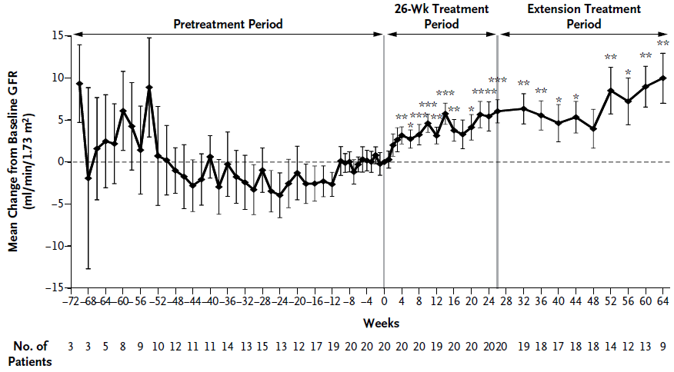
Plasma-Sensitive Trial: eGFR
↑ 6 ml/min/1.73 m² at 26 weeks
90% with baseline GFR <60 ml/min/1.73 m²
N Engl J Med. 368(23):2169-81, 2013

Slide 19
Change in HRQoL
Clinically meaningful increase in 87%
Clinically meaningful increase in 73%

Slide 20
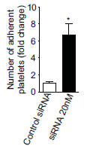
RECESSIVE MUTATIONS IN DGKE CAUSE aHUS SYNDROME
Homozygous or compound heterozygous mutations in DGKE (encoding diacylglycerol kinase ε) were found in 27% of aHUS cases with onset in the first year of life
Peculiar clinical phenotype: recurrent disease in childhood, development of proteinuria sometimes with the nephrotic syndrome
DGKE is not an integral protein of complement and patients did not show complement consumption and one relapsed while on eculizumab
DGKE knock down in endothelial cells up-regulated ICAM-1 and tissue factor expression and resulted in platelet adhesion without inducing complement deposition.
Lemaire M et al, Nature Genet 2013
Consequences of DGKE deficiency
Bruneau et al, Blood, 2015

