Slide 1


Second IPNA Teaching Course
Joint IPNA – ISN Teaching Course
Mohammad J. Khalifeh, MD
FRCP, FACS, FRCS
Professor of Surgery
Chief Division of General Surgery
Director of Liver Transplantation & Hepatobiliary and Pancreatic Surgery at AUBMC

Slide 2
The shortage of cadaveric donor livers is the most significant factor inhibiting further application of liver transplantation for patients with end-stage liver disease.
Pediatric recipients, although they represent only 15% to 20% of the liver transplant registrants, suffer the greatest from the scarcity of size-matched cadaveric organs

Slide 3
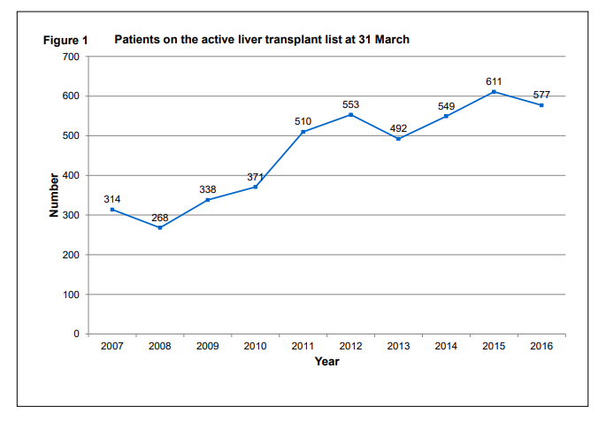
Figure shows the total number of liver patients on the active transplant list at 31 March each year between 2007 and 2016.

Slide 4
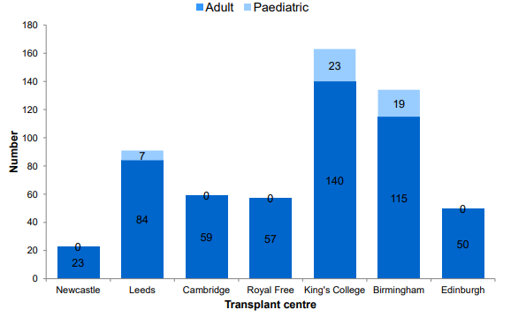
Pediatric pts up to 23%
Patients on the active liver transplant list at 31 March 2016, by center

Slide 5
Reduced-sized orthotopic liver graft in
hepatic transplantation in children
H. Bismuth, M.D., and D. Houssin, M.D., Villejuif, France
Because of the rarity of child donors, in cases of adult donors room requirement for the
liver graft is a major technical obstacle to liver transplantation in children. To
overcome this difficulty in a child, the authors performed an orthotopic transplantation
with an adult liver that had been reduced to the left lobe. The absence of
technically-related complications suggests that this procedure might facilitate the
performance of liver transplantation in children.
From the Unite de Chirurgie hepato-biliaire and Groupe de Recherche de chirurgie hepatique
INSERM U17, Hopital Paul Brousse, Villejuif, France
Surgery 1984

Slide 6
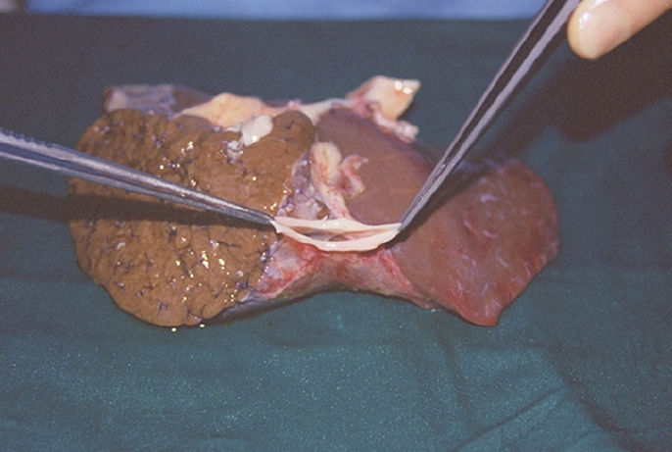

Slide 7
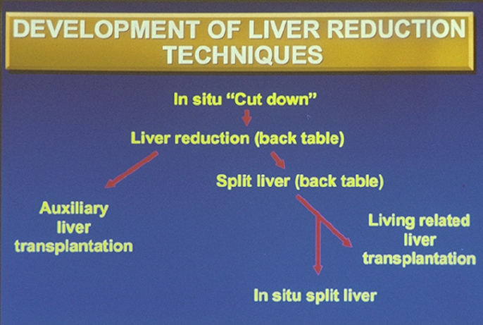

Slide 8
Innovative techniques have been developed to enlarge the donor liver pool
RLT : Reduced liver transplantation
LRLT : Living related liver transplantation
SLT : Split liver transplantation (Insitu, exvivo)

Slide 9
Progress of Split Liver Transplantation
First attempt by Pichlmayr et al., 1988
Second split performed by Bismuth et al., 1989
First series by Broelsch et al., 1990
SLT in Europe, De Ville De Goyet, 1995
In situ modification of ex situ, Rogiers 1995
King’s College Experience, Rela 1998

Slide 10
Expanding Donor Pool
Recent experience with the ex vivo technique, if applied to elective patients, results in patient and graft survival rates comparable to whole-organ transplantation, although postoperative complication rates are higher.
In situ splitting provides two grafts of optimal quality that can be applied to the entire spectrum of transplant recipients:
it is the method of choice for expanding the cadaver liver donor pool.

Slide 11
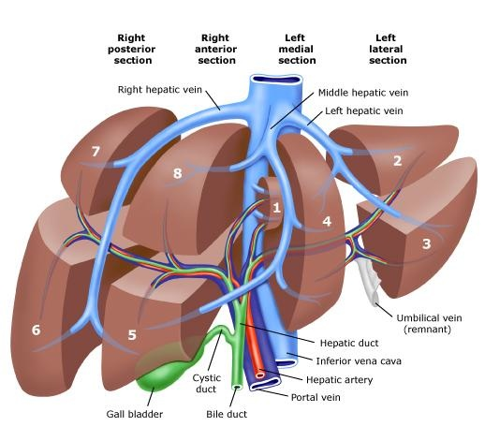
Split liver transplantation

Slide 12
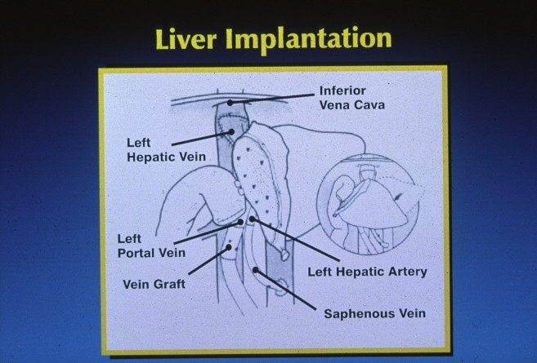

Slide 13
Outcomes of Conventional Split Liver Transplantation
Author | Year | Technique | N | Pt Sr % | Gt Sr %
Reyes | 2000 | Ex / In situ | 54 | 85 | 72
Spada | 2000 | In situ | 39 | 84 | 76
Ghobrial | 2000 | In situ | 110 | 79 | -
Kilic | 2001 | In situ | 24 | 100 | 96
Sauer | 2001 | - | 36 | 93 | 87
Deshpande* | 2002 | Ex situ | 80 | 94 | 90
Girdelli* | 2003 | In situ | 90 | 91 | 83
Yersiz | 2003 | In situ | 163 | 78 | 68
Broering | 2004 | Ex / In situ | 245 | 83 | 75
* Pediatric

Slide 14
Split Versus LDLT in the U.S.
LD
SLT
Merion RM, Am J Transpl 2004

Slide 15
Adjusted† Relative Risk of Graft Failure for Living Donor Recipients
UNOS - 1998-2001 (N=16,595)
2.0
* P <0.05
*
*
1.59
1.5
1.47
1.00
1.0
REF
0.5
Whole Cadaveric
Partial/Split Cadaveric
Living
†Adjusted for recipient age, race, ethnicity, sex, and diagnosis; donor age, race, and sex; recipient medical urgency status, creatinine, bilirubin, medical condition, on life support, on dialysis, on ventilator, and NYHA functional status at transplant; ABO compatibility

Slide 16
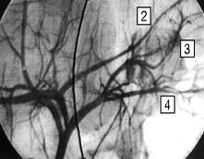
Ex Situ Splitting of the Liver
Back bench cholangiography and arteriography
Hilar dissection:
Celiac axis to left graft
portal trunk usually to left
Main bile duct to right side
Parenchymal transection
“straight along middle of segment IV”
MHV usually to right side
Management of cut surface of liver
Azoulay D, et al. Arch Surg 2001

Slide 17
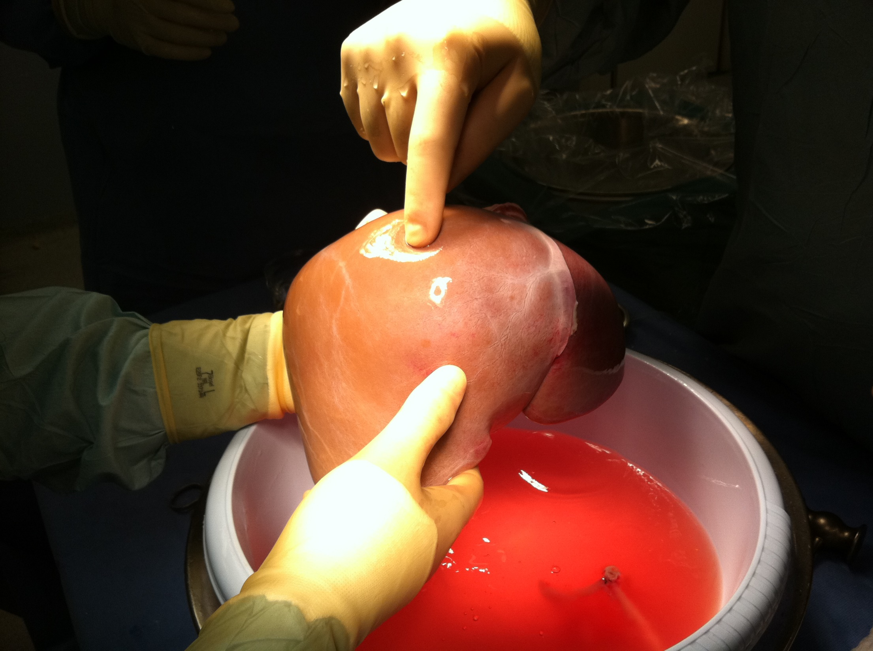

Slide 18
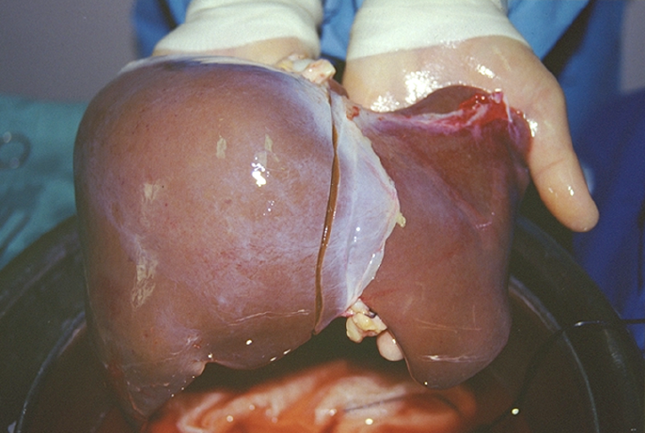

Slide 19
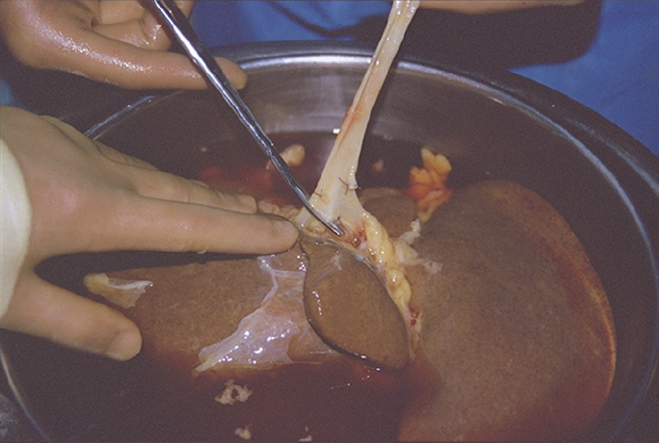

Slide 20
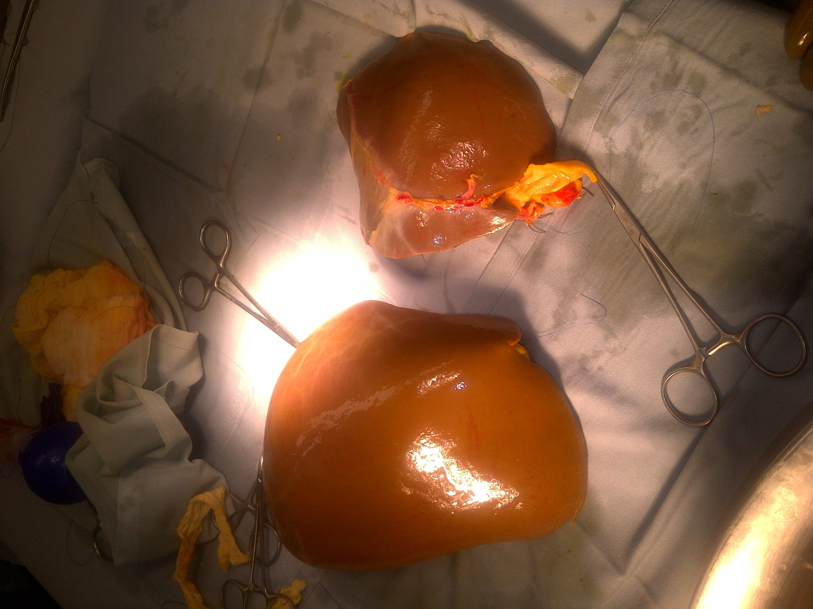

Slide 21
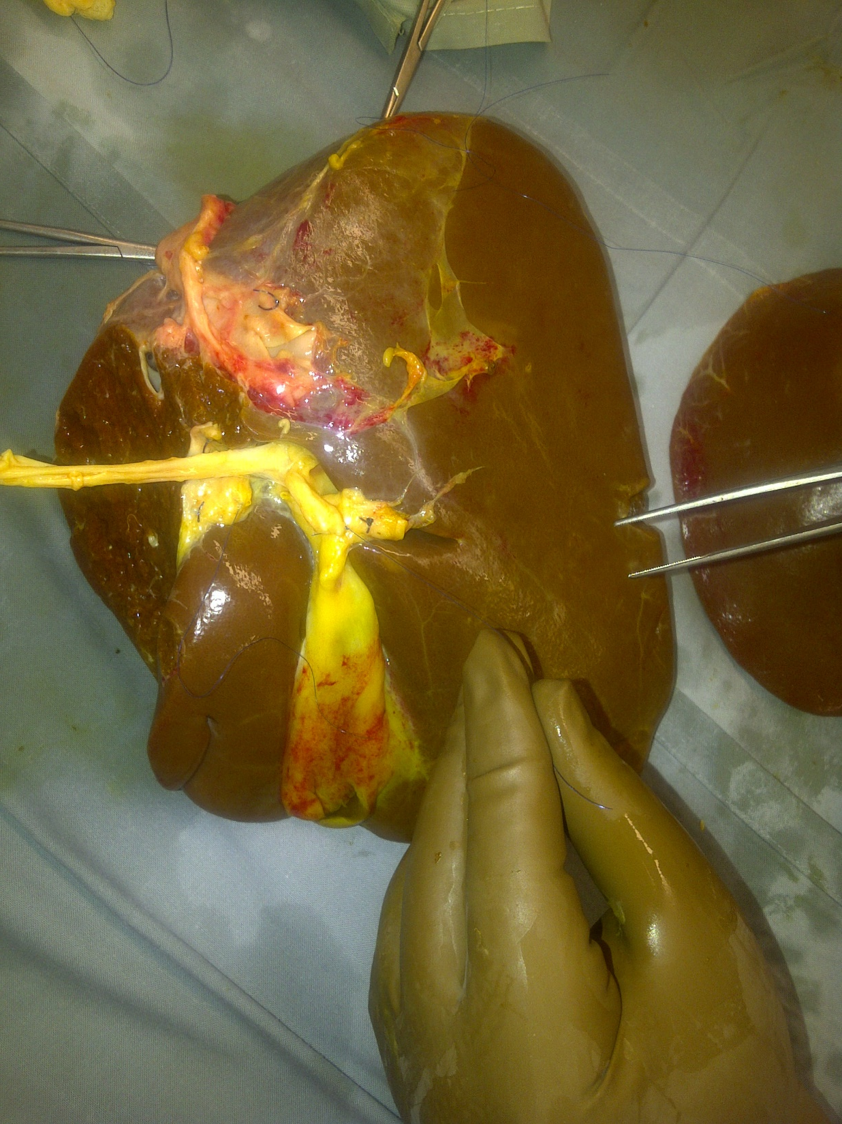

Slide 22
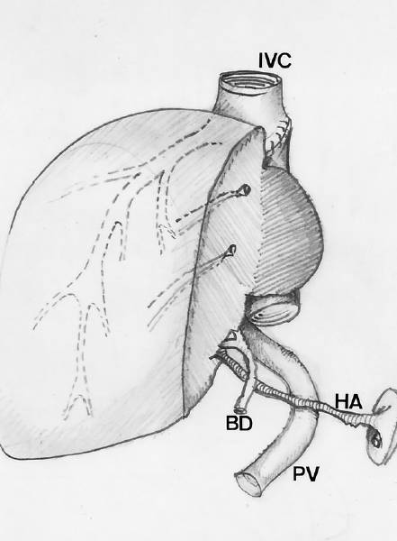
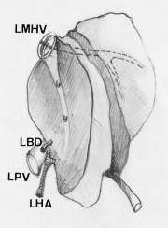
In Situ Splitting of the Liver
Sommacale, et al. Transplantation 2002

Slide 23
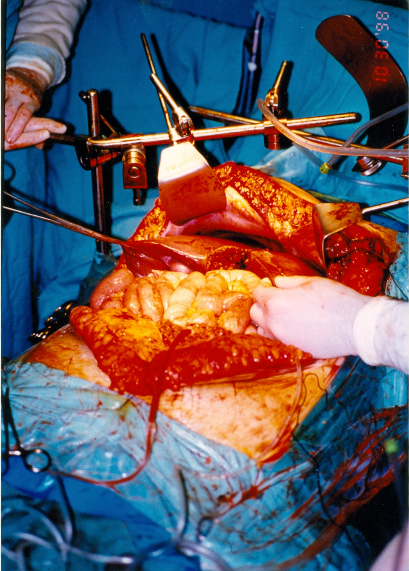

Slide 24
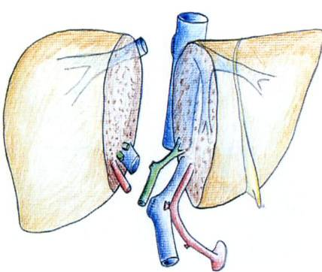
In Situ Splitting of the Liver
V-VIII
I-IV
CBD
celiac
MPV
Humar A, et al. Liver Transpl 2002

Slide 25
Technical Challenges in ASLT
“Small for Size Syndrome”
portal inflow versus venous outflow
GRWR
Avoid sick recipients
Optimize outflow
Reduce inflow

Slide 26
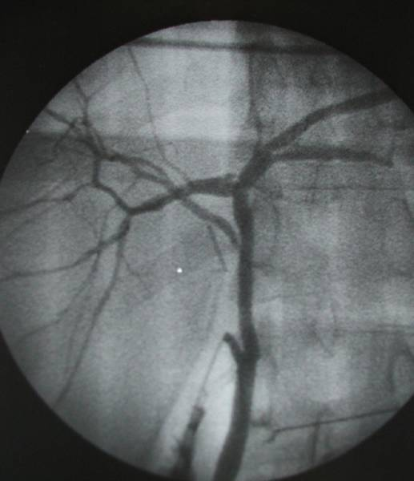
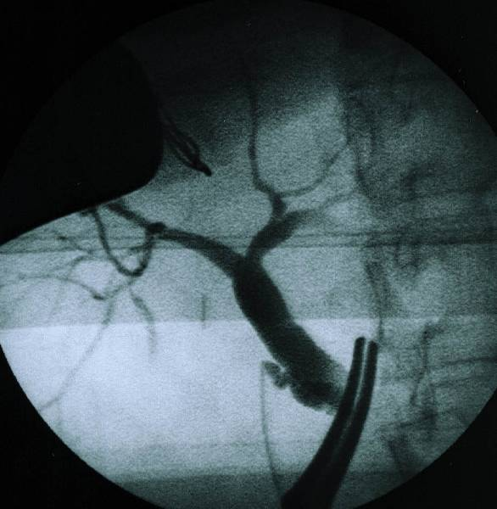
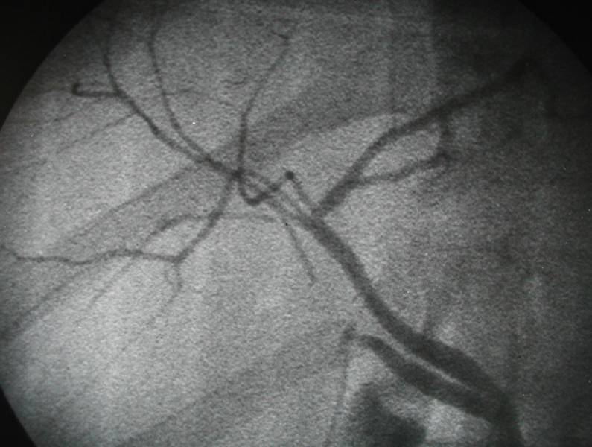
Bile Duct Anatomy in Donors
TWO DUCTS
28 cases (60.9 %)
ONE DUCT
16 cases (34.8 %)
THREE DUCTS
2 cases (4.3 %)
Notes:
The surgical technique was as follows
76 subtotla gast
77 total gastrec. as we can see in the picture
and 3 stump gastrectomies

Slide 27
Venous Drainage Patterns of Right
Lobe Posterior Segments
RHV
RHV
MHV
MHV
6
6
IRHV
IRHV
Type II 37.3 %
Type III 24.1 %
RHV medium small
IRHV 0.5 - 1cm 1- 1.5 cm
Nakamura S and Tsuzuki T, Surg, Gyn & Obst 1981

Slide 28
Right versus Extended Right Lobe Grafts
RHV
MHV
4
5
IVC

Slide 29
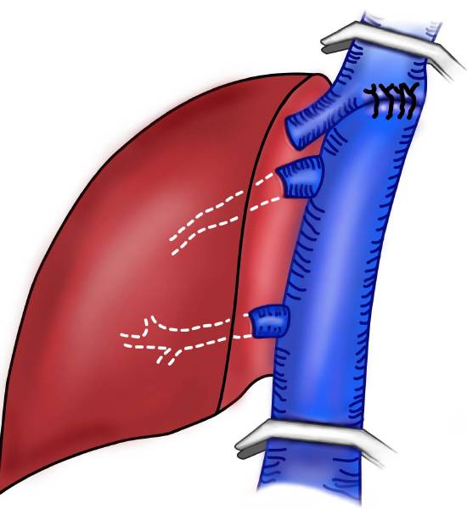
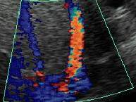
MHV Outflow Reconstruction in
Right Hemigrafts
RHV
MHV
MHV
RHV
IRHV
IVC
IVC
Ghobrial et al., Liver Transpl 2001

Slide 30
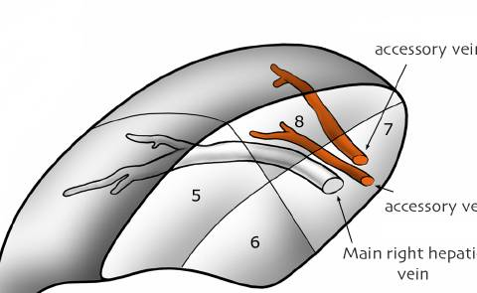
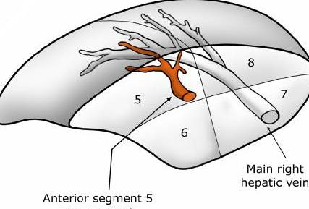
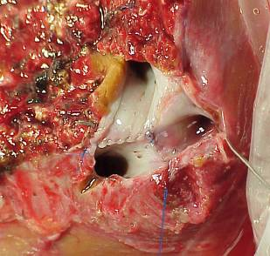
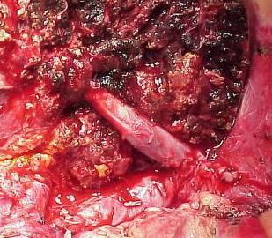
Venous Outflow Reconstruction in
Right Lobe Grafts

Slide 31
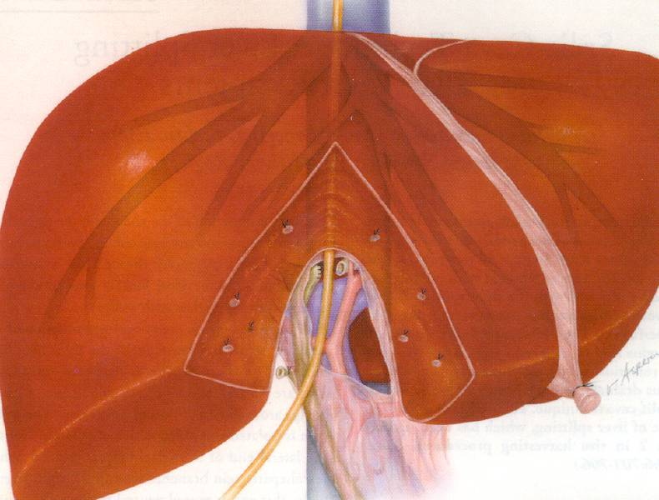
Split-Cava Technique to Optimize Venous
Outflow of Both Hemiliver Grafts
RBD
LBD
Vessel loop
Gundalch et al, Liver Transplantation; 2000

Slide 32
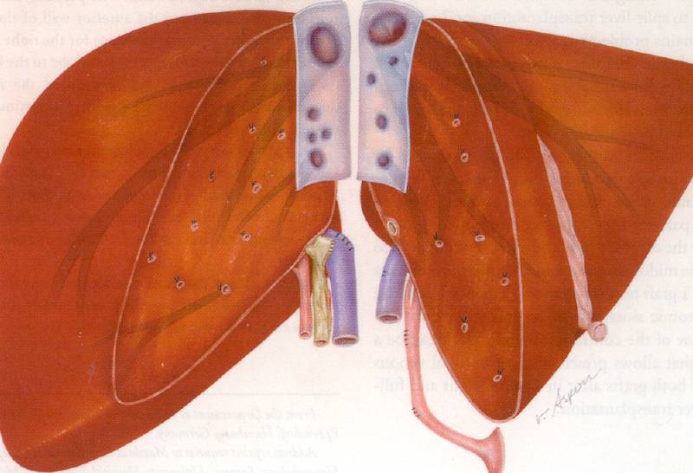
Split-Cava Technique to Optimize Venous
Outflow of Both Hemiliver Grafts
IVC
RHV
LHV
MHV
Gundalch et al, Liver Transplantation; 2000

Slide 33
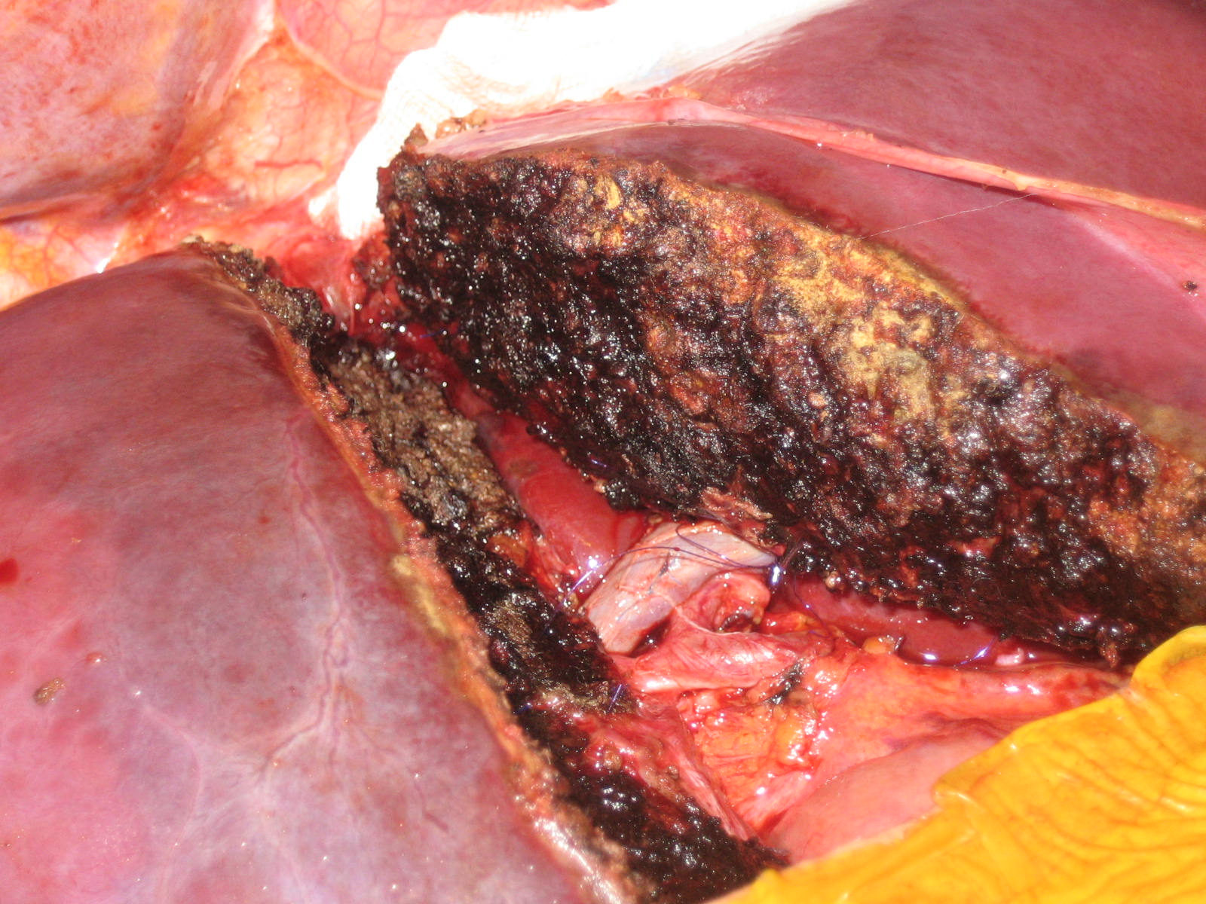

Slide 34
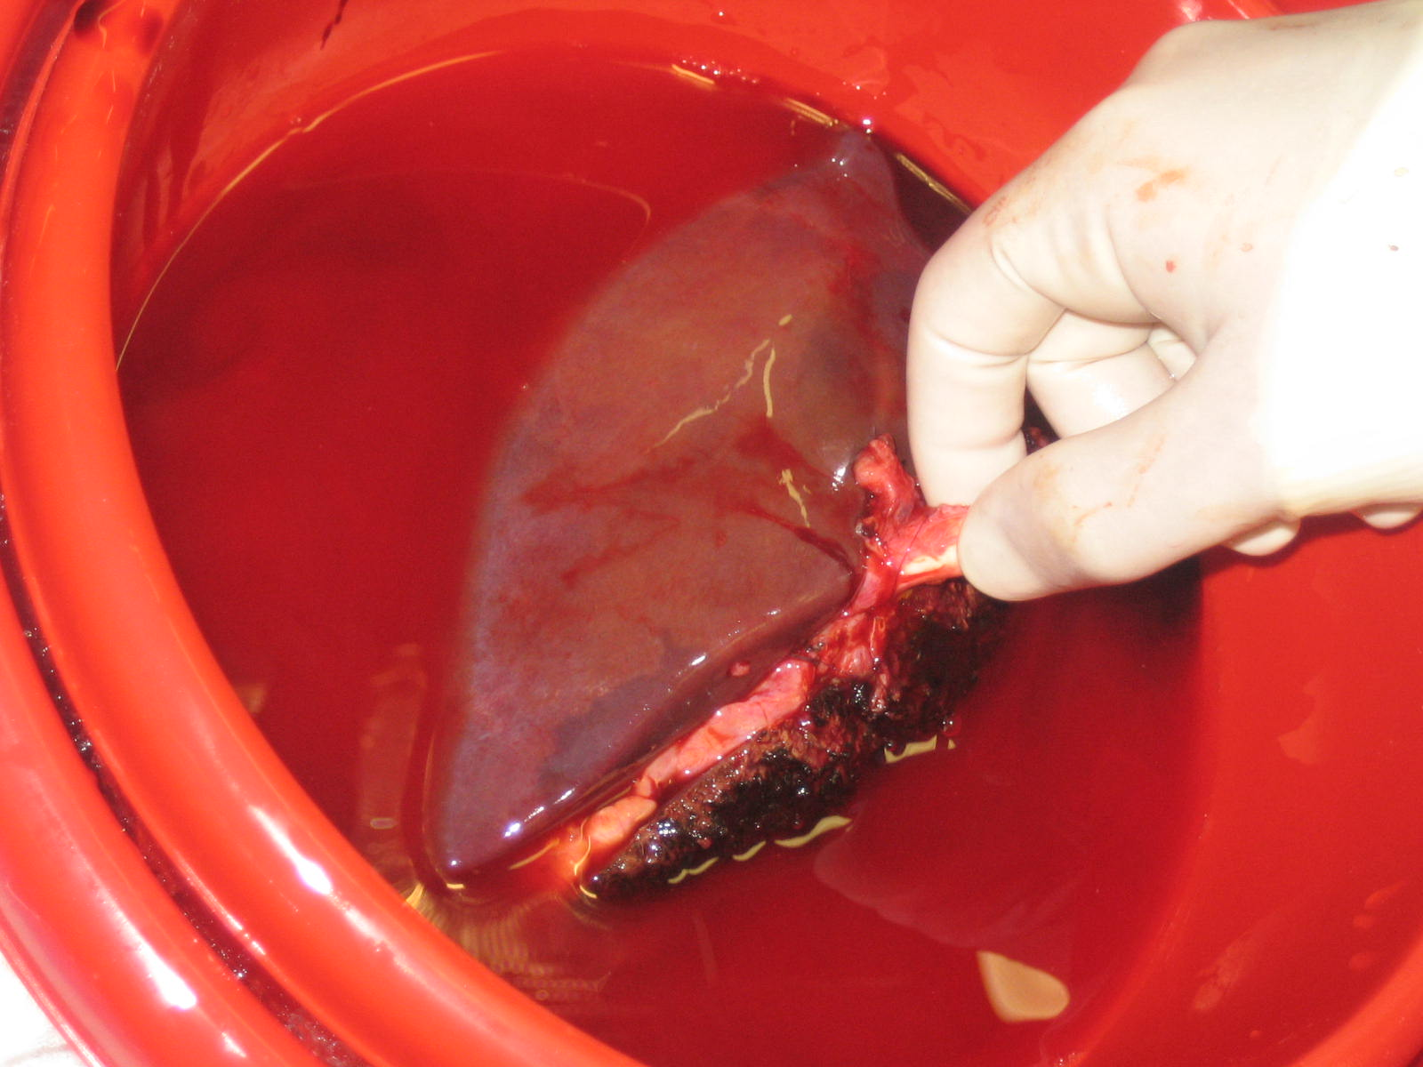

Slide 35
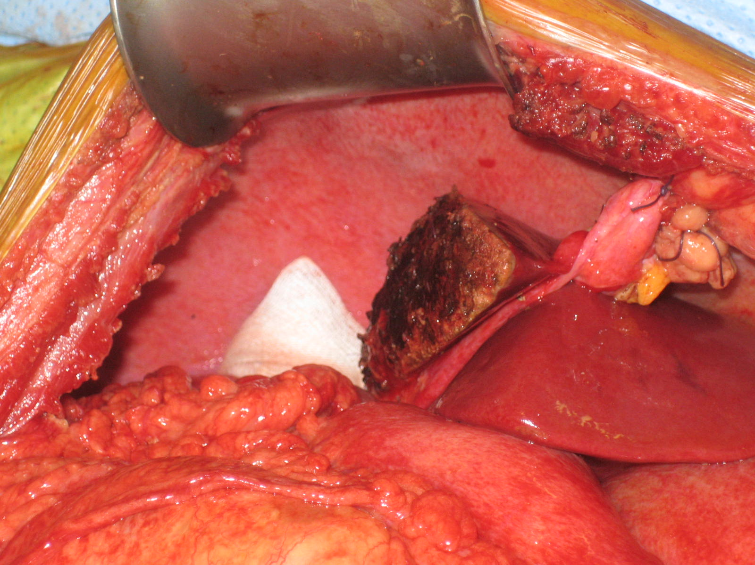

Slide 36
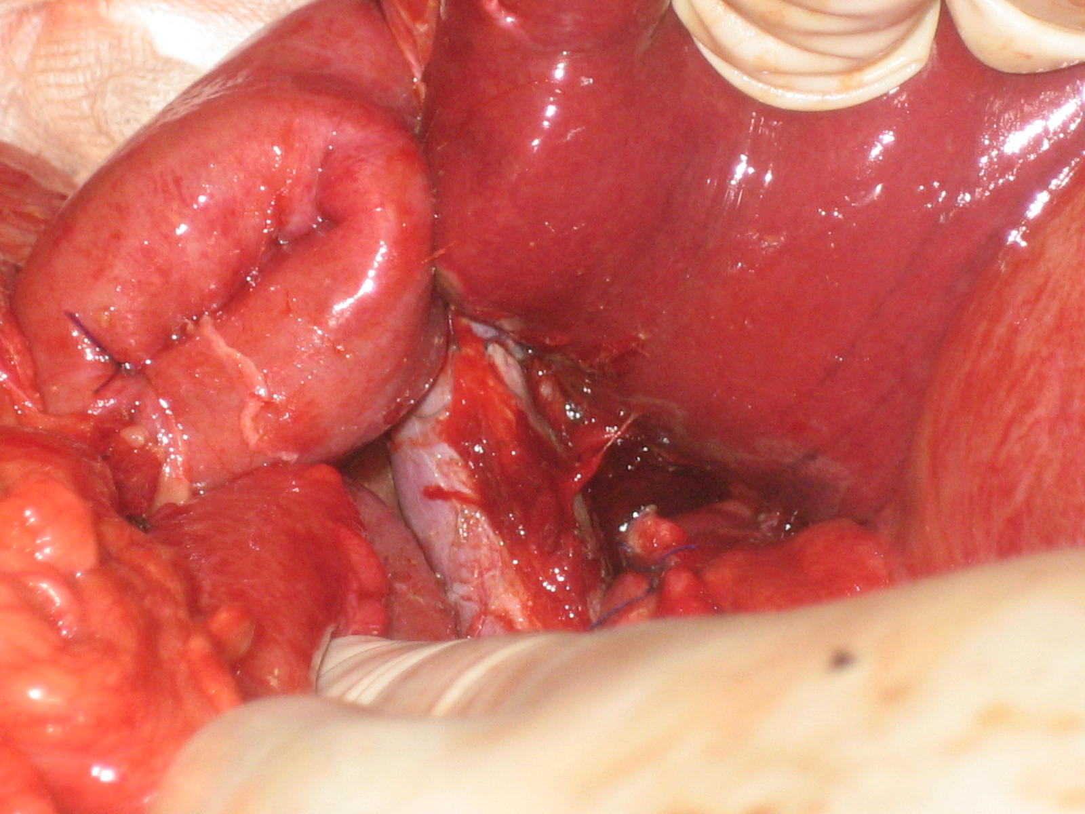

Slide 37
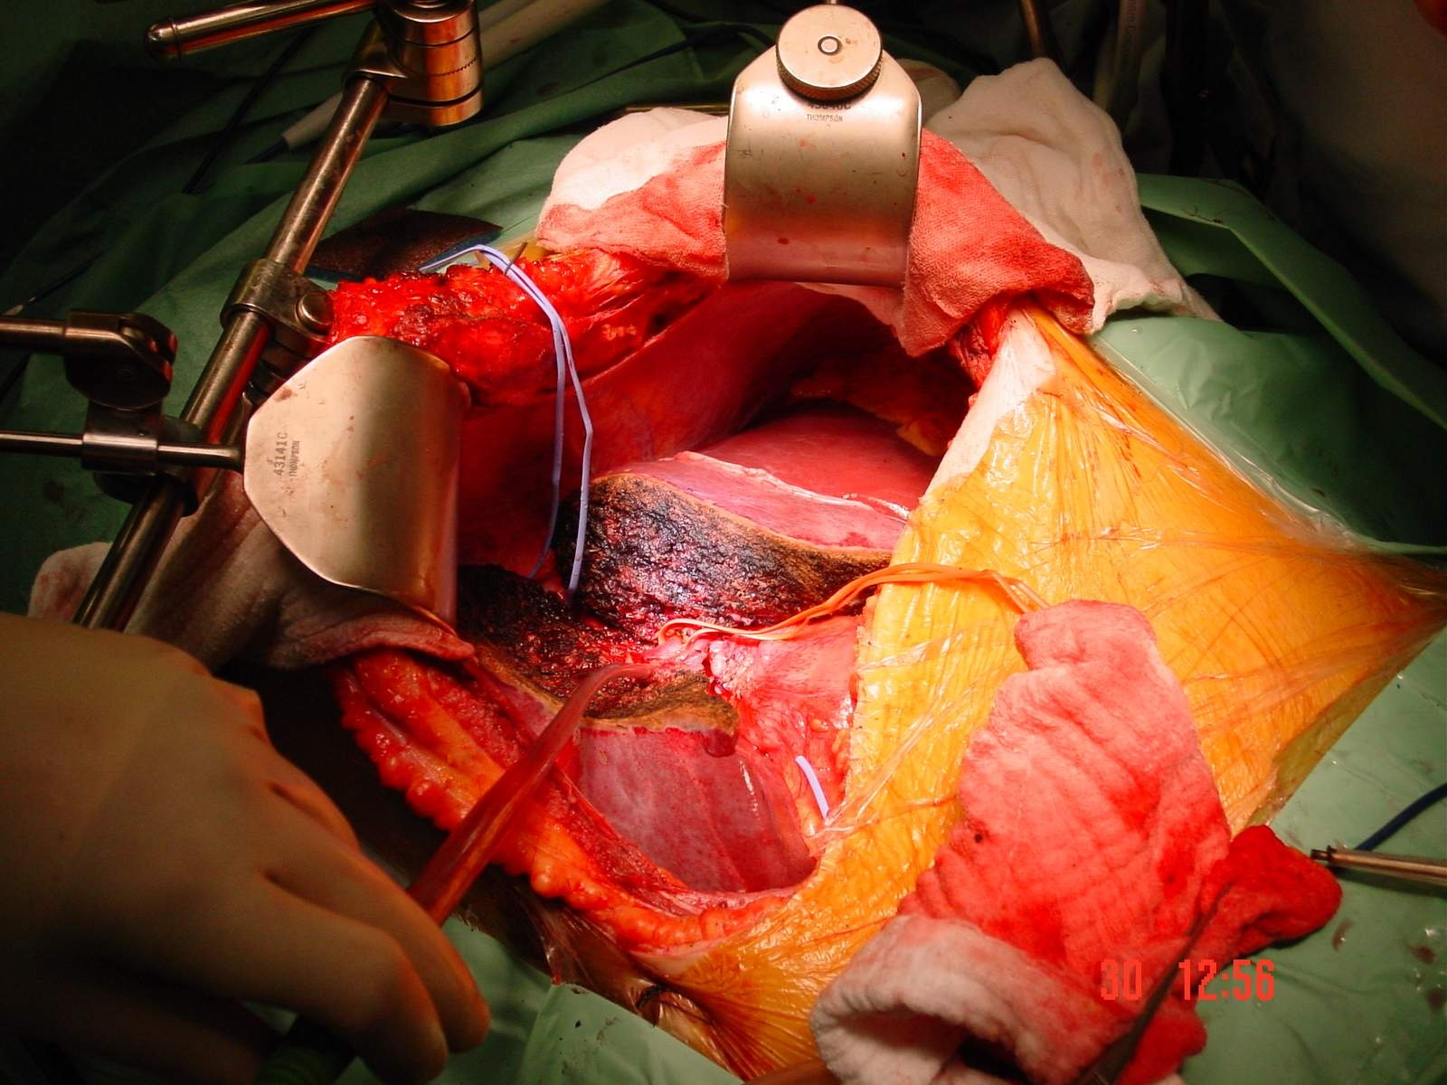

Slide 38
Adult to Adult Split Liver Transplantation
Characteristic | RL Recip (17) | LL Recip (17) | P
Recip Wt (kg) | 72 (35-97) | 50 (40-83) | 0.003
Donor/Recip WR | 1.06 (0.8-2.2) | 1.55 (1.1-2.1) | 0.02
GRWR | 1.6 (1-3.3) | 1.0 (0.7-1.7) | 0.004
CIT (min) | 678 | 515 | NS
Pt Srv (1 yr) | 74% | 87% | NS
Gft Srv (1 yr) | 74% | 75% | NS
Azoulay D, et al Ann Surg 2001

Slide 39
Adult to Adult Split Liver Transplantation
Complications | RLG | LLG | P
PNF | 0 | 3 | 0.07
Bleeding | 1 | 0 | NS
HAT | 2 |  | NS
PVT | 0 | 2 | NS
Biliary | 3 | 4 | NS
Venous outflow | 0 | 0 | NS
Azoulay D, et al Ann Surg 2001

Slide 40
Factors Affecting Survival After ASLT
Univariately
  recipient status
  graft steatosis, donor GGT
  GRWR <1%
  ICU and hospital stay
Multivariately
  recipient status
  graft steatosis
  ICU and hospital stay
Azoulay D, et al Ann Surg 2001

Slide 41
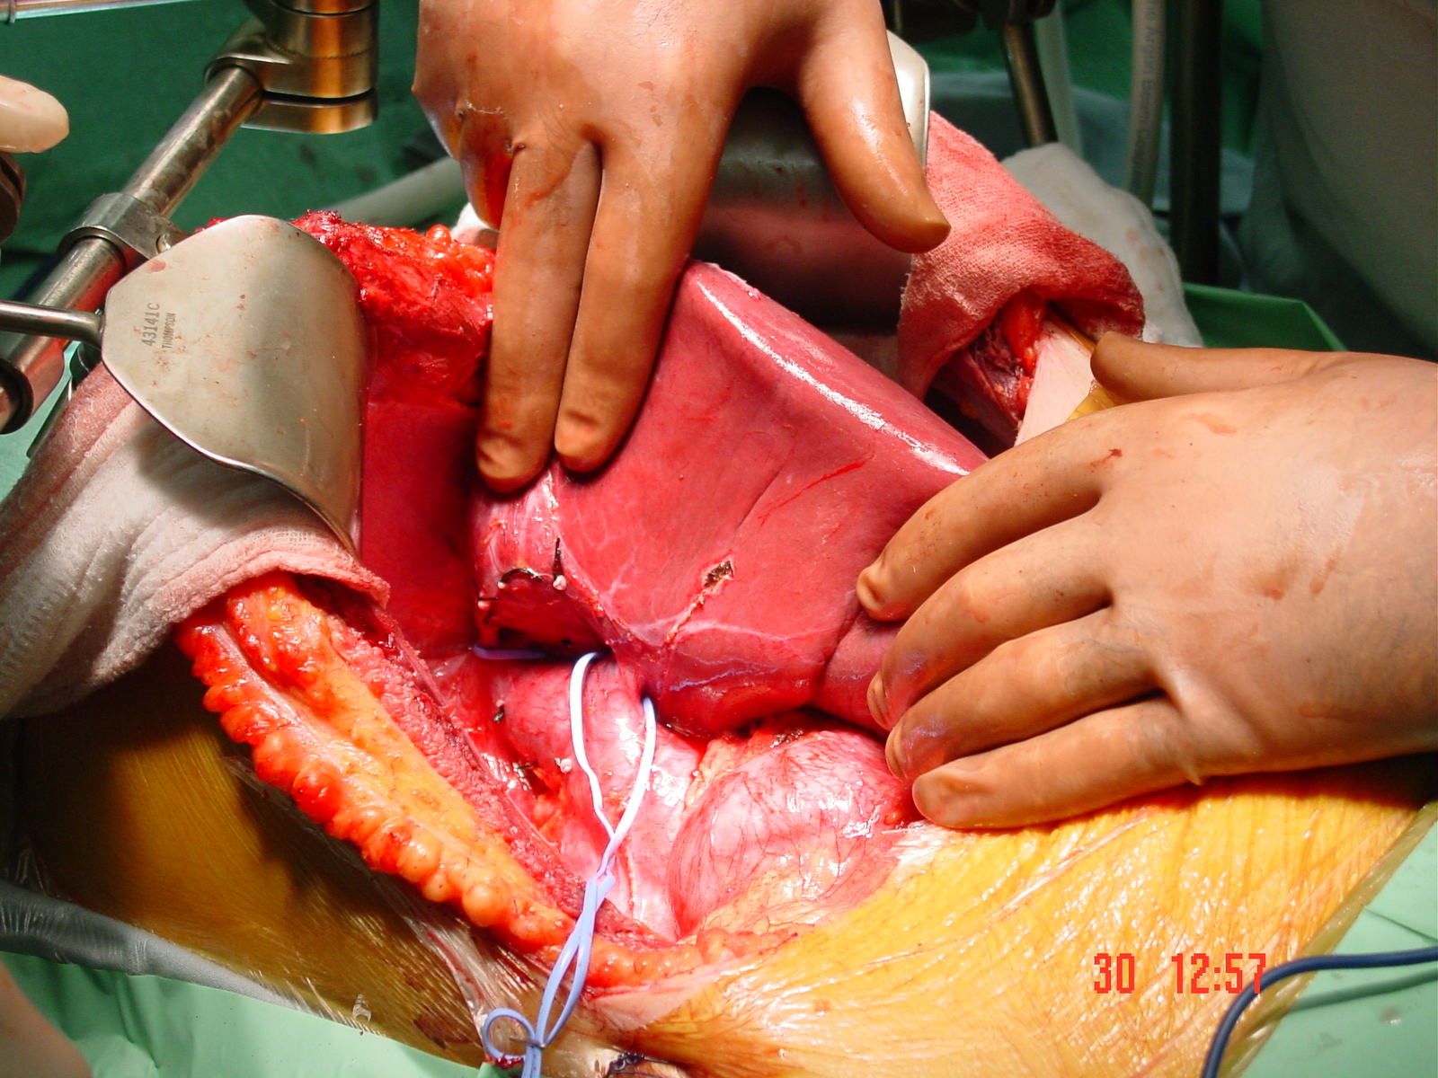

Slide 42
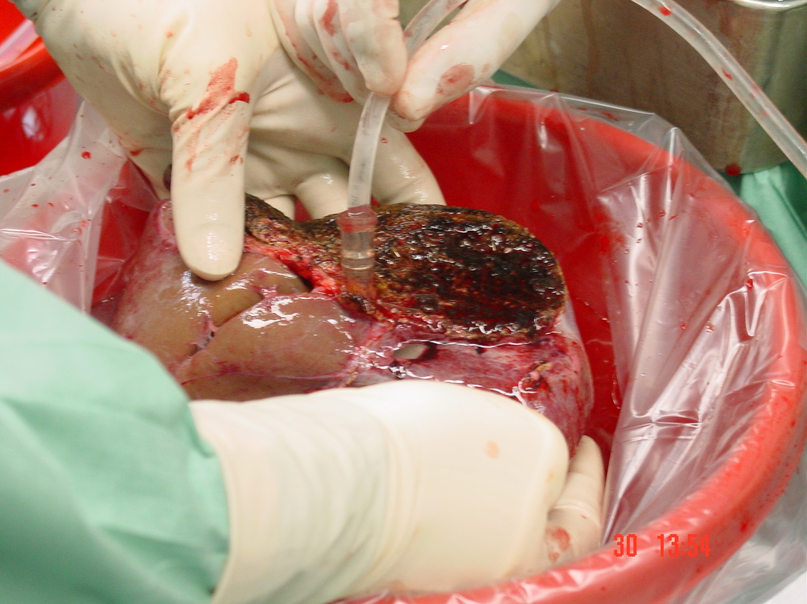

Slide 43
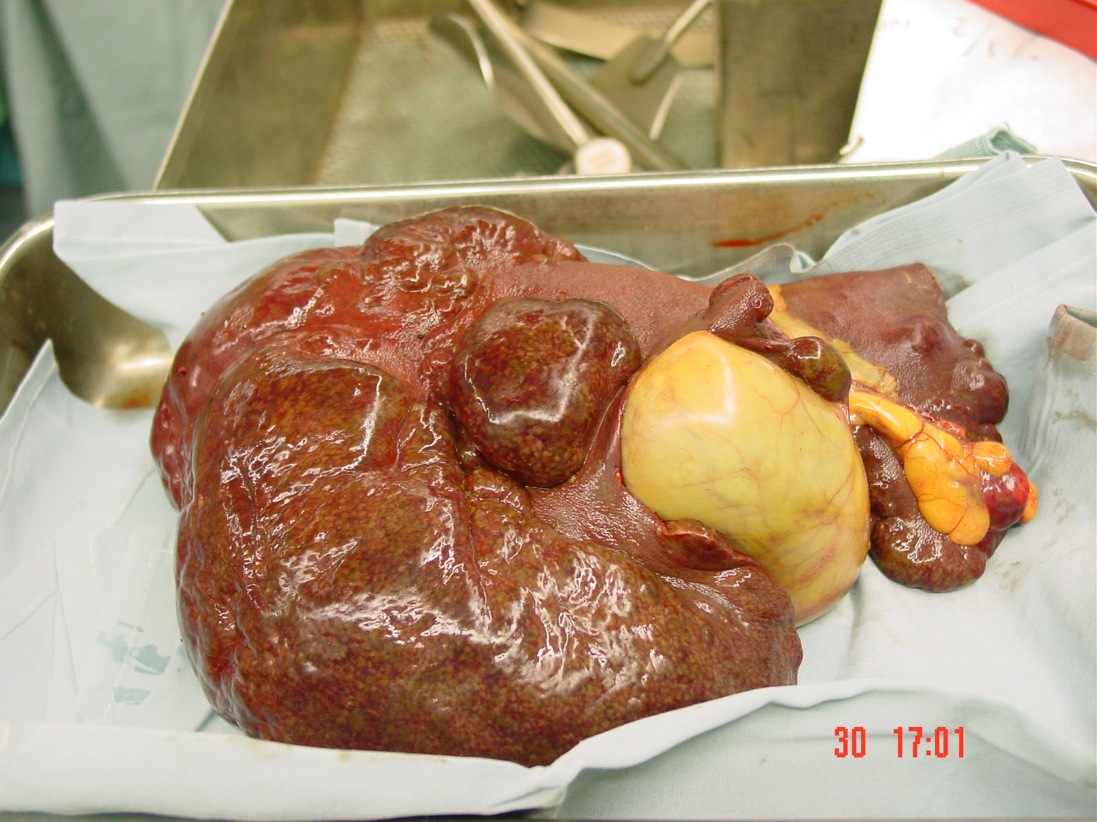

Slide 44
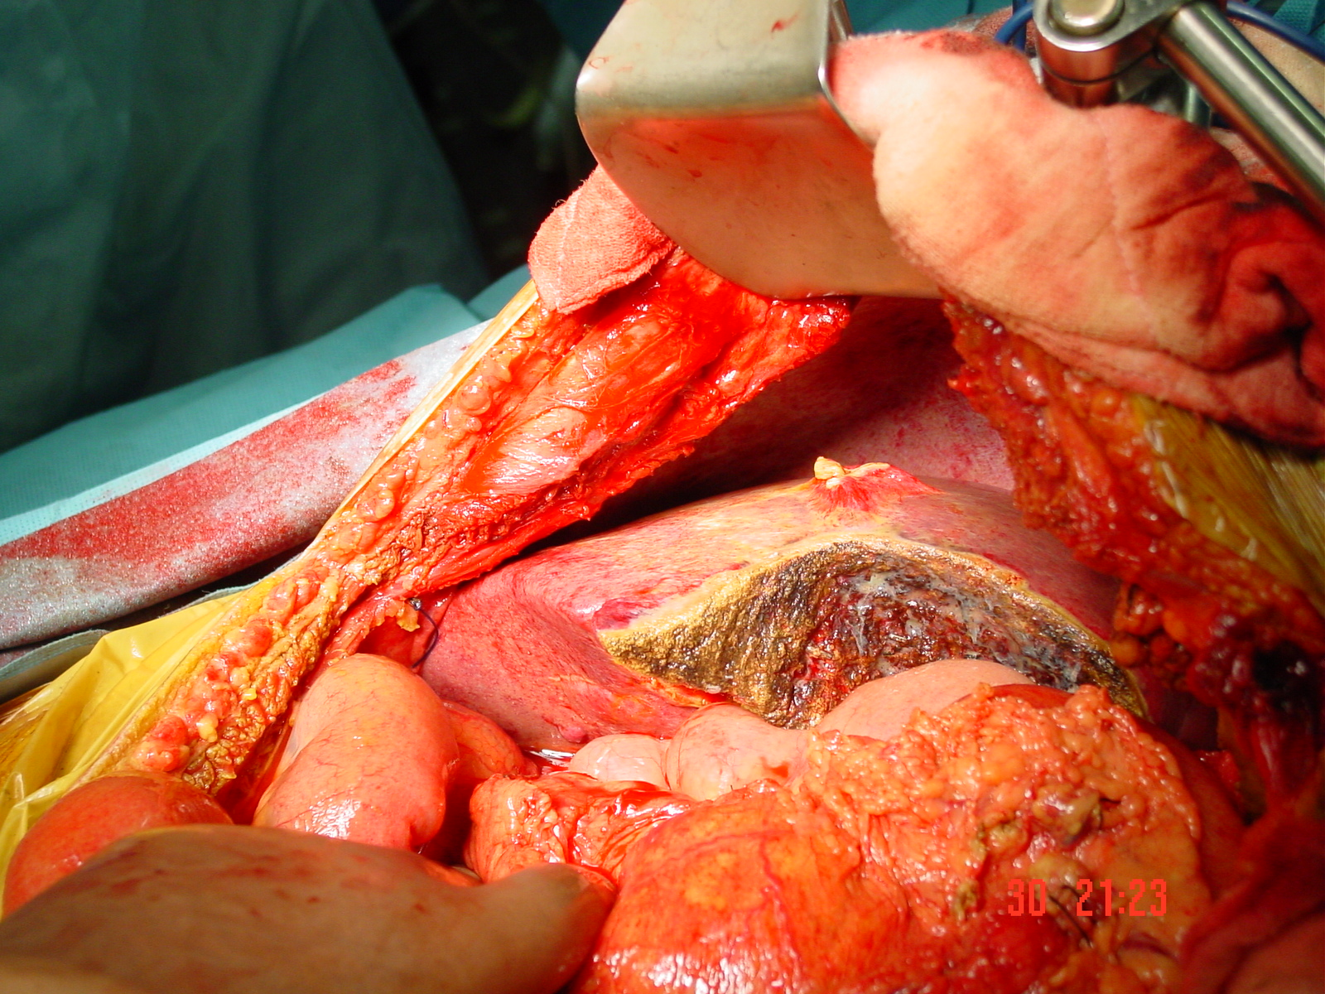

Slide 45
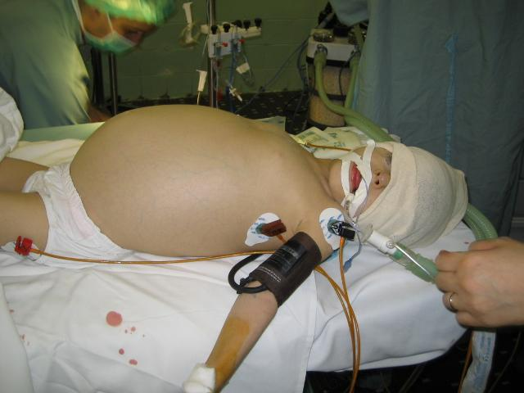

Slide 46
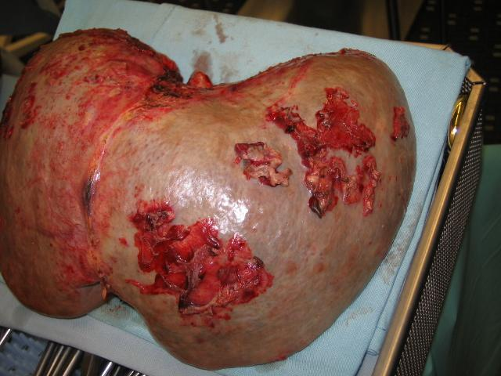

Slide 47
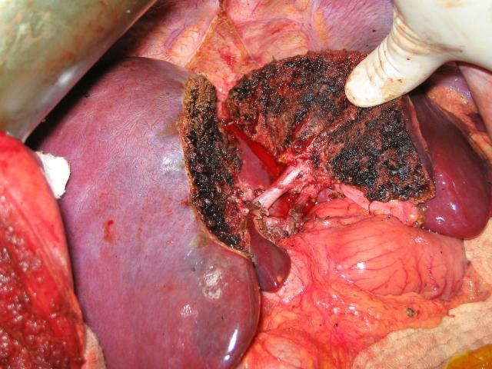

Slide 48
Conclusions
AASLT is the logical approach for expansion of the adult donor pool
Successful splitting requires precise matching of split donor livers with adequately sized recipients
Technical advances that overcome SFSS are critical to successful future implementation of the procedure

Slide 49
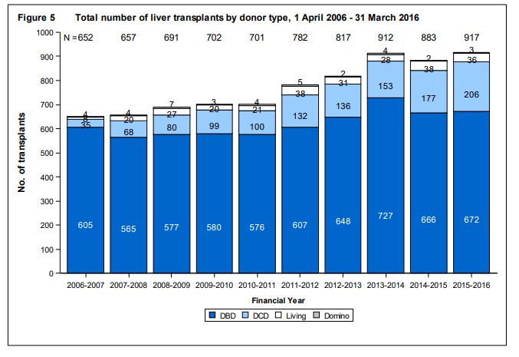
Figure shows the total number of liver transplants performed in the last ten years, by type of donor.

Slide 50
Japanese Registry

Slide 51
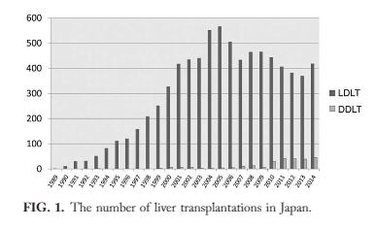

Slide 52
