Slide 1

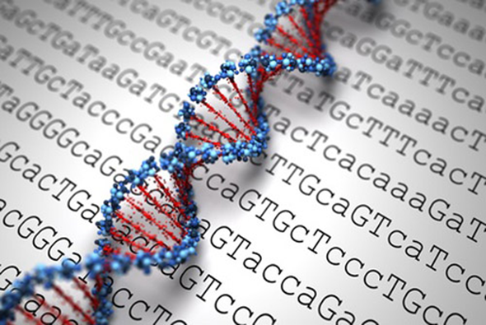
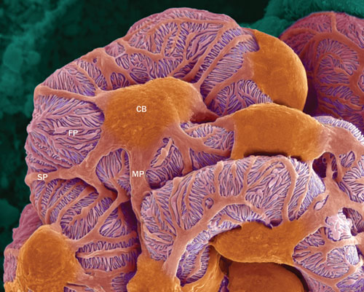
Genetics of Steroid Resistant Nephrotic Syndrome
Marwa Nabhan, MD, MRCP
Assistant prof of paediatrics and paediatric nephrology
Cairo University

Slide 2
Agenda
Introduction to SRNS and hereditary podocytopathies
Podocyte biology
Genes implicated in SRNS
Genotype-phenotype correlation
Potential benefits of genetic testing in nephrotic syndrome
Indications of genetic testing
When to perform genetic testing?
Available approaches

Slide 3
Introduction
Approximately 20% of children with nephrotic syndrome will be resistant to steroids and other immunosuppression either at first presentation or subsequently
SRNS is a common cause of chronic kidney disease in childhood
Significant risk of rapid progression to end-stage kidney disease (ESKD)
50% of SRNS patients will develop ESKD within 15 years
The histological pattern will include mostly FSGS and, to a lesser extent, minimal change disease (MCD) or diffuse mesangial sclerosis (DMS)
Benoit G et al., Pediatr Nephrol (2010) 25:1621–1632

Slide 4
SRNS may occur as an isolated kidney disease or, less frequently, as a syndromic disorder associated with extra-renal manifestations
The onset and clinical course of SRNS show significant heterogeneity
In the past 20 years, mutations in over 50 genes have been identified in patients with hereditary SRNS
This has lead to better understanding of the molecular mechanisms of glomerular filtration and podocyte biology
Children with monogenic SRNS experience higher rates of resistance to immunosuppression and lower rates of disease reoccurrence after renal transplantation
Ha TS, Korean J Pediatr 2017;60(3):55-63

Slide 5
Genetic SRNS
Mutations in genes encoding podocyte-associated proteins have been implicated in about 30% of SRNS cases in children
In familial SRNS and those presenting in the first 2 years of life, identifiable mutations are present in up to 95% of cases
SRNS associated with genetic mutations may progress more rapidly compared with idiopathic disease
Response to steroids or other immunosuppression drops from 40%–50% to 8%
Rood et al., Nephrol Dial Transplant (2012) 27: 882–890

Slide 6
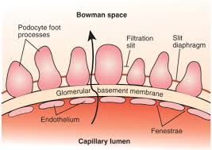

Podocyte Biology
The GFB is composed of 3 interacting layers:
  The fenestrated endothelial cells
  The glomerular basement membrane
  The outer podocyte layer
Podocytes are highly specialised epithelial cells, and their interdigitating foot processes connect to form the slit diaphragm
Büscher and Weber, Eur J Pediatr (2012) 171:1151–1160

Slide 7
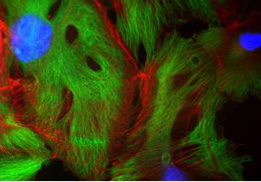
Podocyte FPs contain a dense network of actin filaments
Connected by
Linker proteins to
SD and GBM
Pavenstadt et al., Physiological reviews 2003

Slide 8
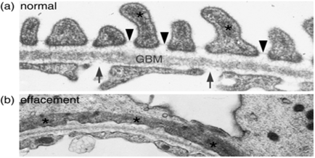

Mathieson, Clin Kidney J 2012
Mutations in the corresponding podocyte genes result in the disintegration of this complex network with:
    Foot process effacement
    Loss of the slit diaphragm
    And subsequent proteinuria
Depending on the mutated protein, podocyte damage is caused by:
  -The alteration of podocyte function
  -Integrity
  -The altered expression of podocyte-specific proteins due to alteration of nuclear transcriptional factors

Slide 9
The slit diaphragm with orchestrating podocyte proteins
Büscher and Weber, Eur J Pediatr (2012) 171:1151–1160

Slide 10
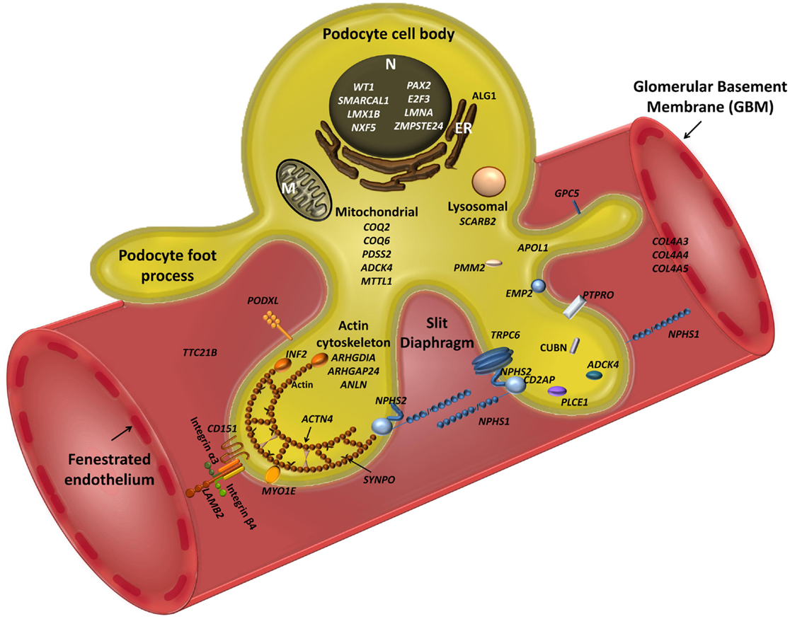

Bierzynska et al. Front Endocrinol (2015) 23;5:226

Slide 11
Preston R et al., Pediatric Nephrology (2019) 34:195–210

Slide 12
Preston R et al., Pediatric Nephrology (2019) 34:195–210

Slide 14
NPHS1
NPHS2
Encodes nephrin
The main gene implicated in CNS
Mutation is responsible for the autosomal recessive Finnish type (CNF)
However, the NPHS1 mutation detection rate remains high amongst non-Finnish cases of CNS
Additionally, NPHS1 mutations have been identified in infants and children presenting with SRNS, with the rarer hypomorphic mutations being associated with a milder late onset phenotype
Encodes podocin
NS in infancy (from 4 to 12 months of life) and during childhood, is most commonly attributed to mutations in the NPHS2 gene
There is a recognised genotype to phenotype correlation that explains this phenotypic variability
It is important to consider NPHS2 mutation as a cause for SRNS in a child of any age
However, there is a low rate of NPHS2 mutations in certain ethnic groups, namely Chinese, Japanese and Korean

Slide 15
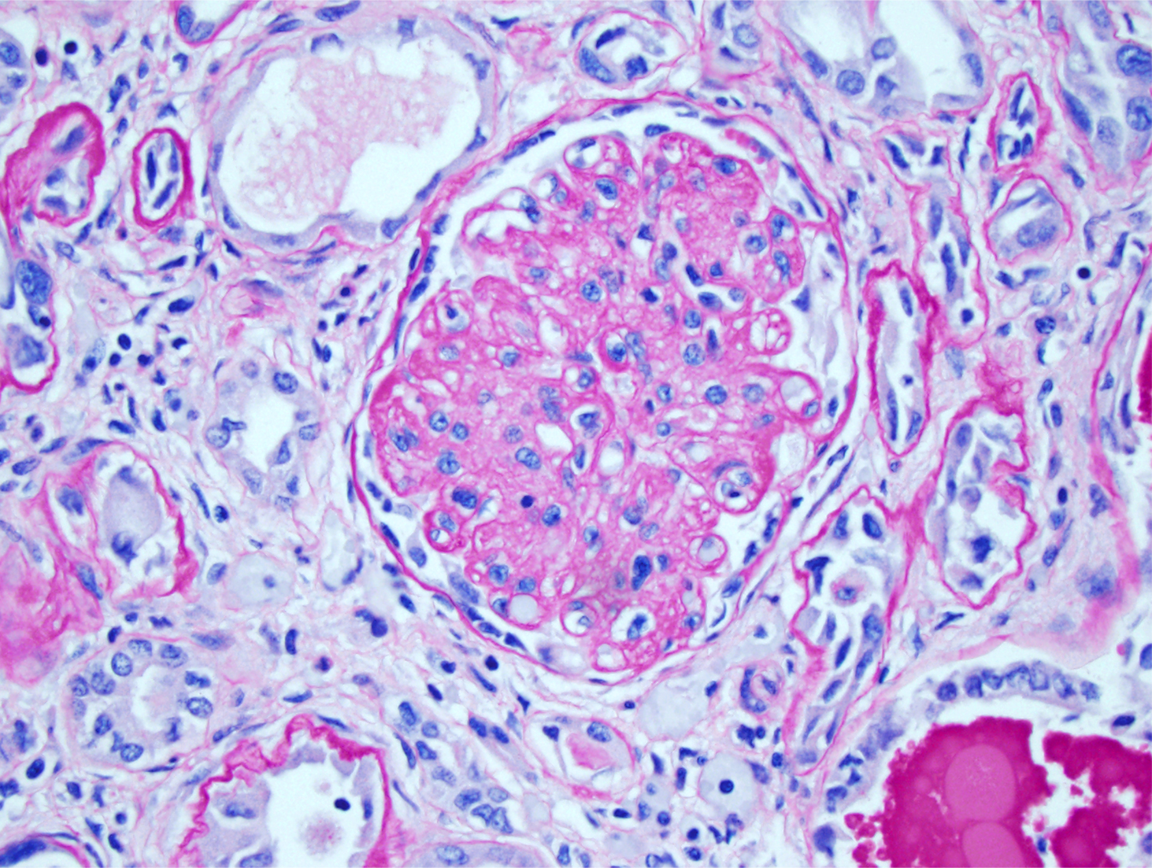
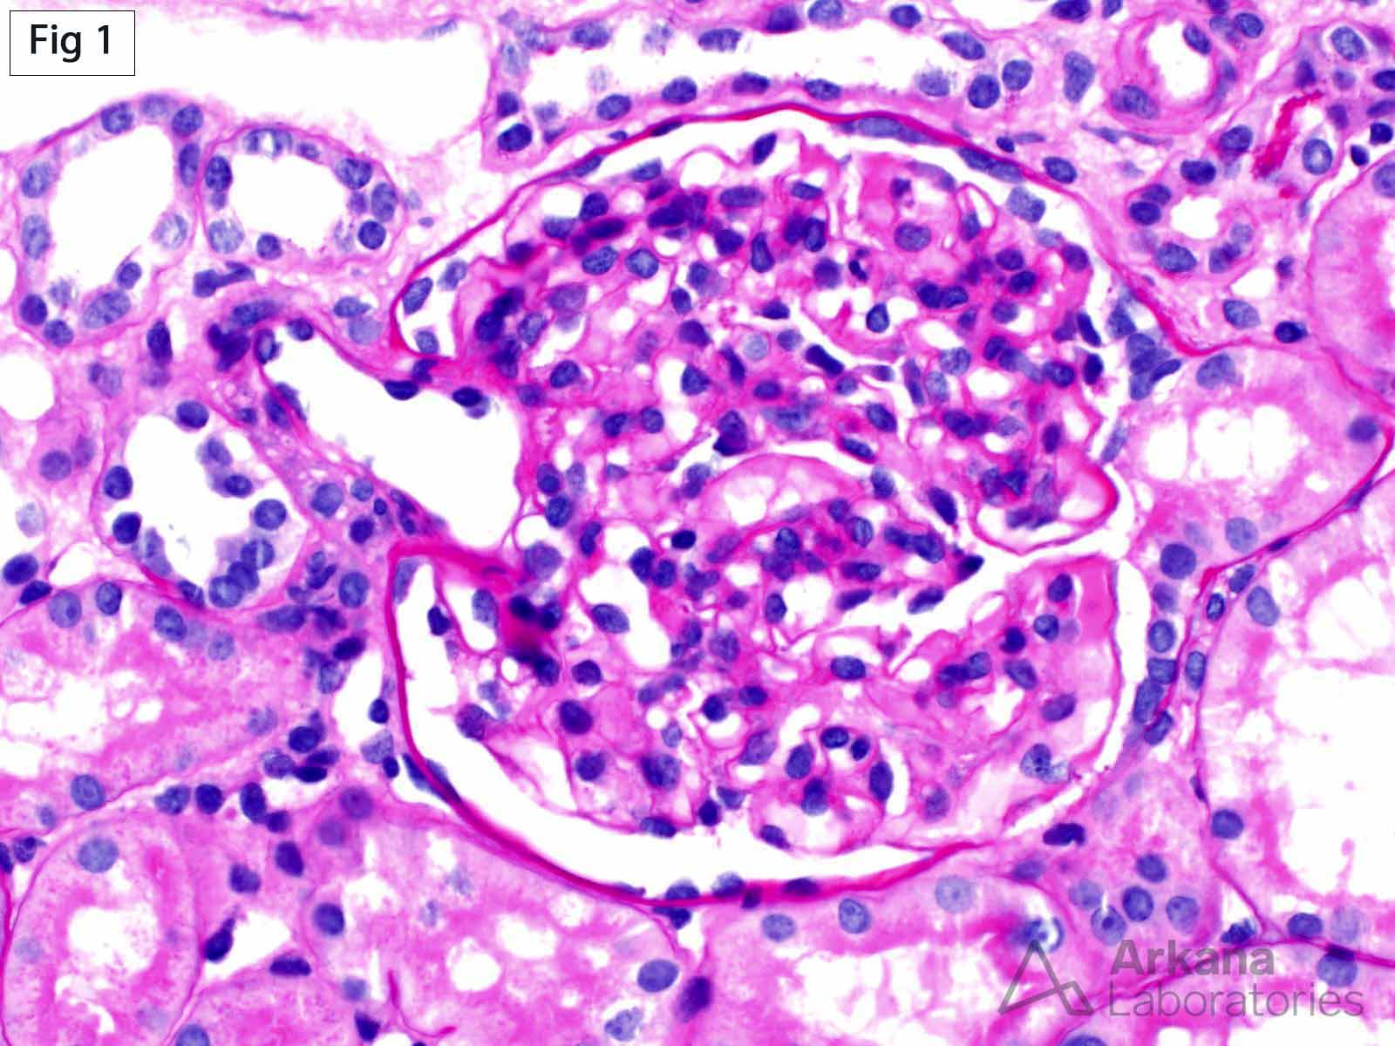
PLCE1
(encoding phospholipase C epsilon-1)
Mutations in typically cause isolated DMS, with patients presenting with severe, early-onset SRNS and rapid progression to ESRD
Significant clinical heterogeneity exists, with PLCE1 mutations manifesting from birth and throughout childhood, with both FSGS or DMS found histologically

Slide 16
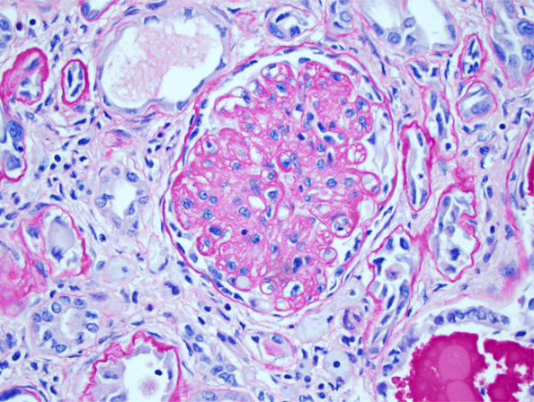
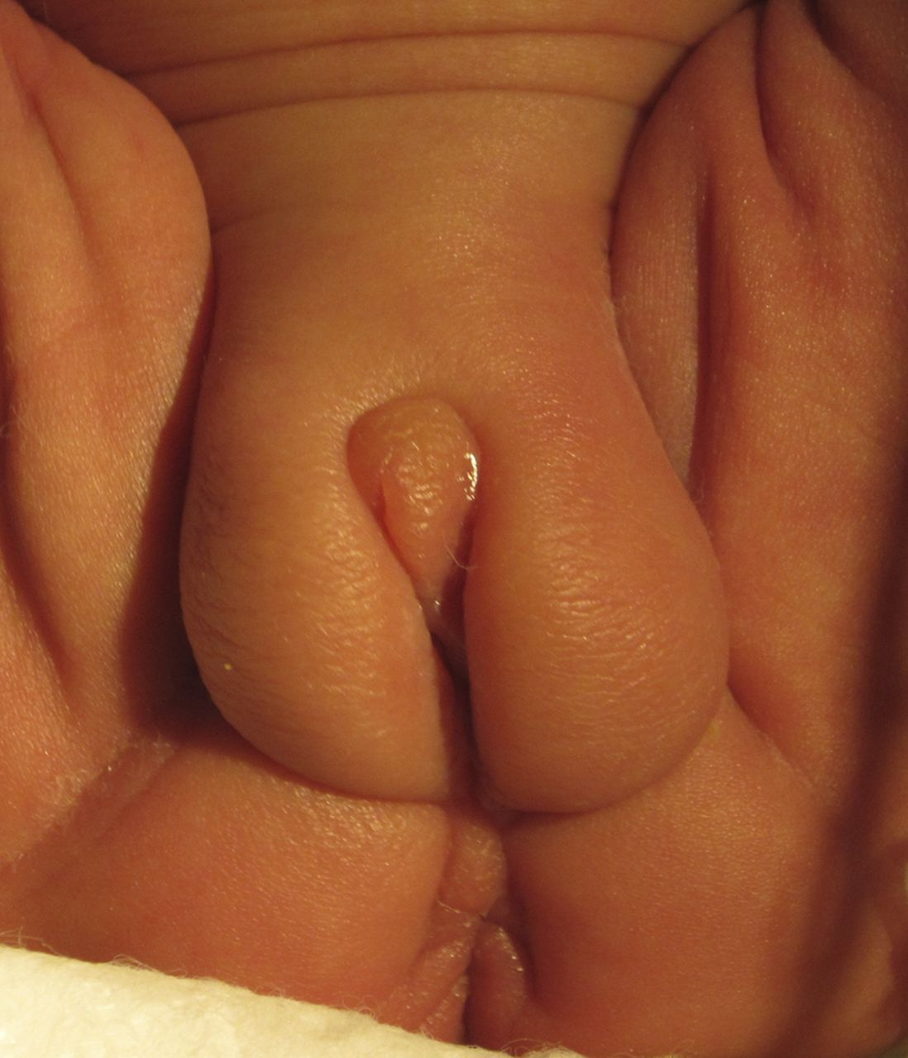
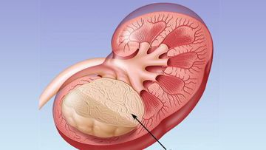
WT1 encodes Wilms’ tumour 1
A transcription factor and key kidney development gene
WT1 mutations to account for approximately 6% of sporadic SRNS cases in childhood, manifesting at any age, depending on the underlying mutation
Genotype–phenotype correlations have been drawn from specific WT1 mutations
Of these, certain mutations cause early-onset, severe disease with DMS histologically
Or alternatively, late-onset SRNS with FSGS histologically and slower progression to ESRD
It is important to stress that WT1-related nephropathy may be an isolated disease with no associated comorbidities or it may be an initial symptom of syndromic SRNS with extra-renal features manifesting later

Slide 17
Genotype-phenotype correlation
Monogenic SRNS can be inherited in an autosomal recessive,
autosomal dominant or mitochondrial manner
Most cases of recessive disease are characterised by:
  an early onset
  high penetrance
  not infrequently associated with extra-renal malformations
In contrast, the main causes of dominant disease are associated with:
  later onset
  incomplete penetrance
  patients may remain asymptomatic

Slide 18
Onset
Congenital NS
one of
5 genes
NPHS1
NPHS2
WT1
LAMB2
PLCE1

Slide 19
Onset
Infantile and childhood NS
NPHS2
NPHS1
WT1
ADCK4
ACTN4
PLCE1
TRPC6
COQ2
COQ6

Slide 20
Onset
Adult-onset NS
Mainly one of
5 genes
INF2
(up to 17%)
TRPC6
(up to 12%)
ACTN4 (3.5%)
SCARB2
PAX2

Slide 21
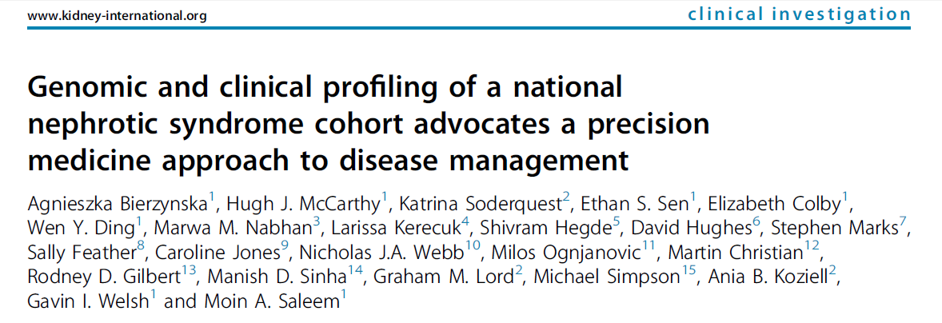
The genotype does not always correlate with expected phenotype
Several patients, who presented overtly with SRNS, had gene mutations usually linked to another renal phenotype
Mutations in OCRL (usually Dent’s disease type 2), COL4A3 (usually familial hematuria) and DGKE (usually atypical hemolytic uremic syndrome), associated with specific syndromes were detected in patients with isolated renal disease
Bierzynska A et al., Kidney Int. 2017 Apr;91(4):937-947

Slide 22
Syndromic SRNS

Slide 23
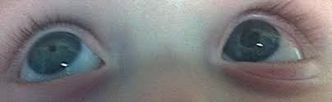
Deep clinical phenotyping
Pierson Syndrome
LAMB2

Slide 24
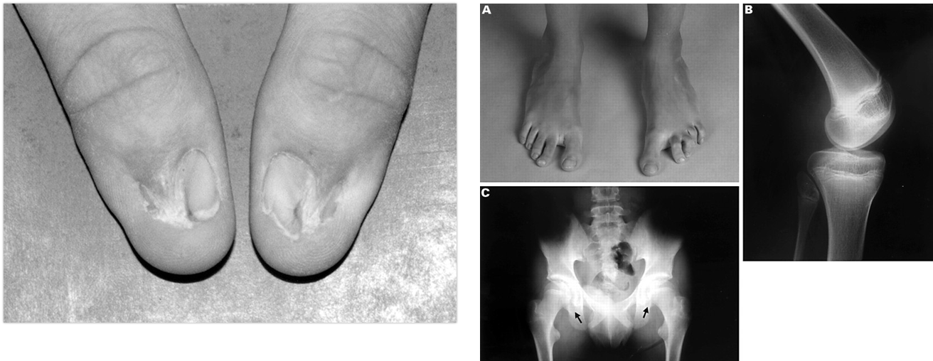
Nail-Patella Syndrome
LMX1B

Slide 25
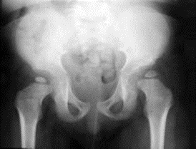
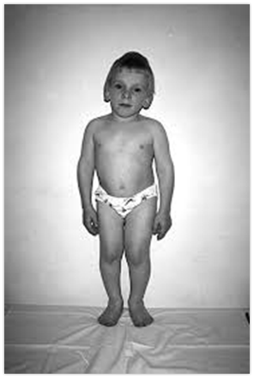
Deep clinical phenotyping
Spondylo-epiphyseal dysplasia
Lymphopenia with defective cellular immunity
SMARCL1
Schimke immuno-osseous dysplasia

Slide 26

Potential benefits of genetic testing in NS
Confirmation of a genetic defect can personalise SRNS management:
  Aids in diagnosis esp in fuzzy phenotype
  Predicting clinical course
  Limiting medication exposure, or identifying a best treatment
  Avoiding renal biopsy
  Helps in determining risk of recurrent disease in kidney transplantation
  Risk assessment in candidate living related kidney donors
  Providing genetic counselling
  Offering potential antenatal and pre-symptomatic diagnosis
Preston R et al., Pediatric Nephrology (2019) 34:195–210

Slide 27
Mutations responsible for CoQ10 deficiency:
Rare as a cause of nephrotic syndrome but are very important to recognise as interventional treatment to modify the disease may be possible
Affect the co-enzyme Q10 biosynthesis pathway, and this enzyme can be orally supplemented
COQ2:
  Codes for a protein involved in the biosynthetic pathway
  May cause isolated nephropathy (collapsing glomerulopathy or crescentic glomerulosclerosis) or with an encephalopathy
  PDSS2:
  Codes for the first enzyme in the pathway
  Has been described in a case of severe Leigh’s syndrome with seizures, hypotonia, cortical blindness and nephrosis
Saleem, Pediatr Nephrol 2013

Slide 28
  COQ6:
    Causes early onset SRNS and sensorineural deafness
    Reports of patients treated with COQ10 supplementation orally and appeared to respond with a lowering proteinuria
ADCK4:
  mutations have been found to cause isolated SRNS with histologically characterised FSGS, manifesting from infancy through early adulthood
  Interventional treatment with COQ10 supplementation has been shown to modify disease progression
Mutations that cause MELAS (mitochondrial myopathy, encephalopathy, lactic acidosis and stroke-like episodes) and CoQ10 deficiency can also cause FSGS in isolation
  Ashraf S et al., J Clin Invest 123:5179–5189
  Yamagata et al., J Am Soc Nephrol 2002

Slide 29
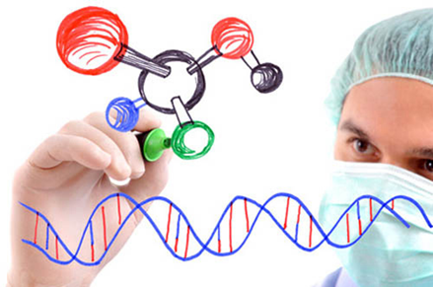
Clinical indications for genetic testing in SRNS
Congenital or infantile-onset
Childhood-onset
Family history of NS
Consanguinity
Extra-renal manifestations
Lack of response to immunosuppressive drugs
Histological findings of idiopathic FSGS or DMS on renal biopsy

Slide 30
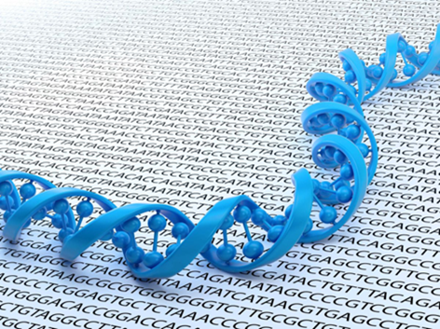
When to perform?
When important clinical decisions need to be made regarding:
  The need for renal biopsy
  The intensity and duration of immunosuppression
Pre-transplantation
When syndromic SRNS is suspected

Slide 31
Available approaches
Conventional Sanger sequencing testing for either specific pathogenic mutations or mutations in a specific list of genes
Exome or genome sequencing using NGS
The intermediate approach through targeted sequencing by using panels of genes

Slide 32

Next Generation Sequencing Era
The recent advent of NGS has unveiled enormous potential, allowing a single advanced sequencing machine to read billions of base pairs within a week
If next-generation sequencing (NGS) technology is accessible, screening should utilise a gene panel including, but not limited to, the most common monogenic causes of SRNS
If NGS technology is inaccessible, genes should be screened in numerical order of frequency per age group
Ethnicity and histological findings should trigger preferential screening of certain genes

Slide 33
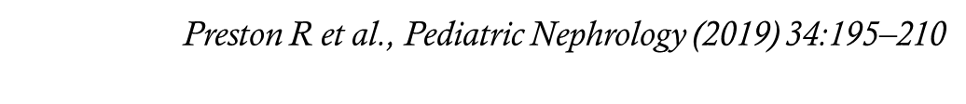
Approach to mutational screening

Slide 34
TAKE HOME MESSAGE
SRNS is a common cause of chronic kidney disease in childhood and has a significant risk of rapid progression to ESKD
The likelihood of identifying a causative mutation is inversely related to age of onset and is increased with a positive family history or the presence of extra-renal manifestations
Precise molecular diagnosis could allow for a personalised treatment approach with weaning of immunosuppressive therapy, avoidance of renal biopsy and provision of accurate, well-informed genetic counselling
Identification of novel causative mutations will continue to puzzle out the pathogenic mechanisms of glomerular disease and provide new insights into podocyte biology and glomerular function

Slide 35
Thank You!
☺

