Slide 1
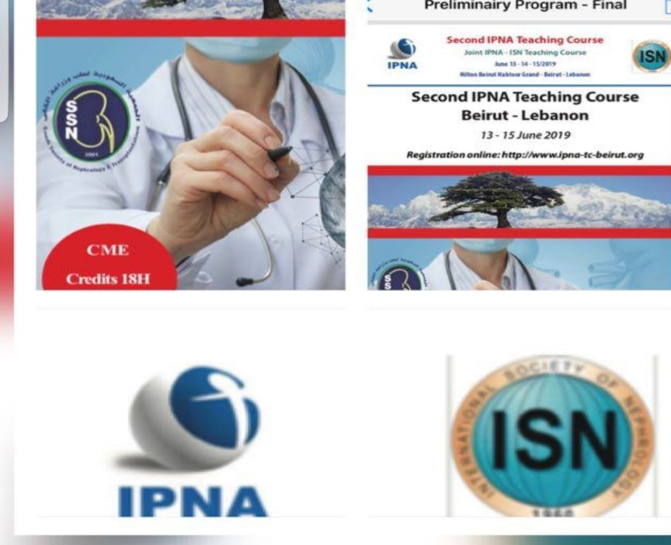
SURGICAL COMPLICATIONS IN LIVER TRANSPLANTATION
MOHAMAD HUSSEIN ALSAYED MD
GENERAL SURGERY
HEPATO PANCREATO BILIARY AND ORGAN TRANSPLANT SURGERY
Al rassoul al azam hospital
Beirut – Lebanon June 13, 2019

Slide 2
SURGICAL COMPLICATIONS IN LIVER TRANSPLANTATION
OVERVIEW OF SURGICAL COMPLICATIONS OF LIVER TRANSPLANT
OUR NEW CENTER SETTING
OUR EXPERIENCE
EXAMPLES OF SURGICAL COMPLICATIONS

Slide 3
SURGICAL COMPLICATIONS Overview
Surgical complications in liver transplantation are categorized to:
Bleeding
Vascular
biliary

Slide 4
SURGICAL COMPLICATIONS vascular complications
inflow:
Hepatic artery thrombosis.
Hepatic artery stenosis
Portal vein thrombosis
Portal vein stenosis.
Outflow:
Hepatic vein stenosis

Slide 5
SURGICAL COMPLICATIONS vascular complications Hepatic artery thrombosis
Hepatic arterial thrombosis (HAT) interrupts the allograft's blood supply and produces early graft loss, long-term dysfunction, or patient death, making these surgical complications life threatening.
Hepatic artery stenosis and HAT both carry high rates of morbidity and mortality.
HAT is a major indication for retransplantation.
HAT is the most common hepatic arterial complication and has been reported in 4% to 11% of adult transplants and 11% to 26% of pediatric transplants.
Arterial thrombosis occurring early after transplantation is more likely to be associated with an aggressive course and a higher rate of allograft loss and patient mortality in comparison to late-onset HAT

Slide 6
SURGICAL COMPLICATIONS biliary complications
Complications involving the biliary tract after orthotopic liver transplantation (OLT) have been a common problem since the beginning.
The use of DCD donors and LDL grafts have been associated with a significant rise in the incidence of ischemic-type biliary lesions.
Rates were reported to be as high as 50% in early publications.
During the last decades a constant decrease has been documented. Currently a range from 5% to 25% is reported.
Incidence varies according to the type of graft, type of donor (DBD versus DCD versus living donor), and the type of biliary anastomosis per- formed.
The most common complications are biliary leaks (bls) and strictures (bss). However, there is a wide range of potential bcs that can occur after liver transplantation

Slide 7
افتتاح مركز الحاج فايز مغنية لجراحة الكبد والبنكرياس وزراعة الأعضاء
18/1/2018
OUR NEW CENTER EXPERIENCE

Slide 8
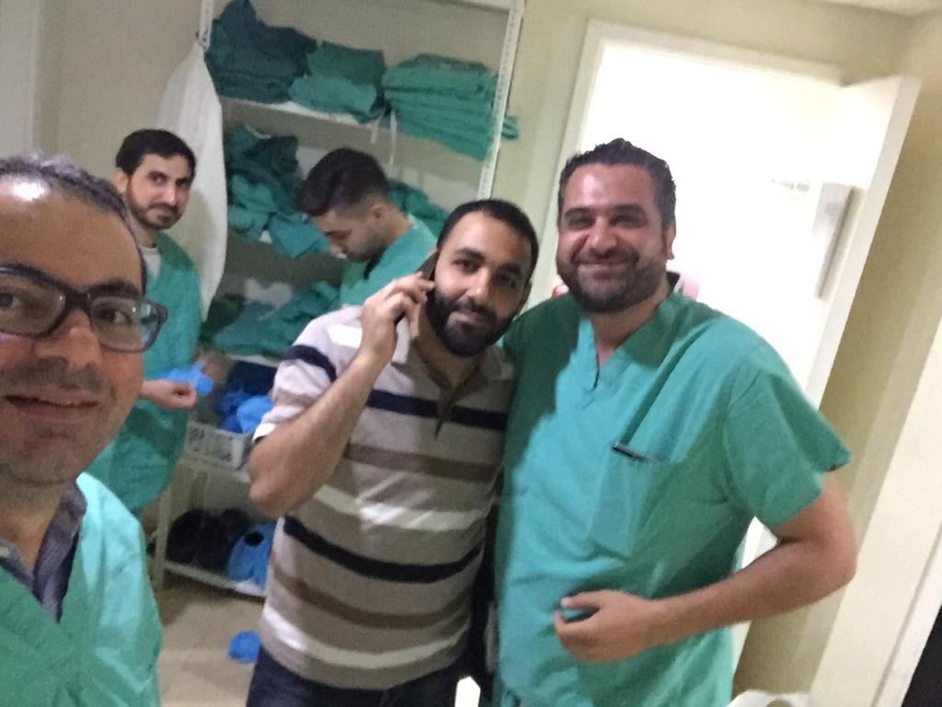
SETTING UP LIVER TRANSPLANT CENTER
coordinator

Slide 9
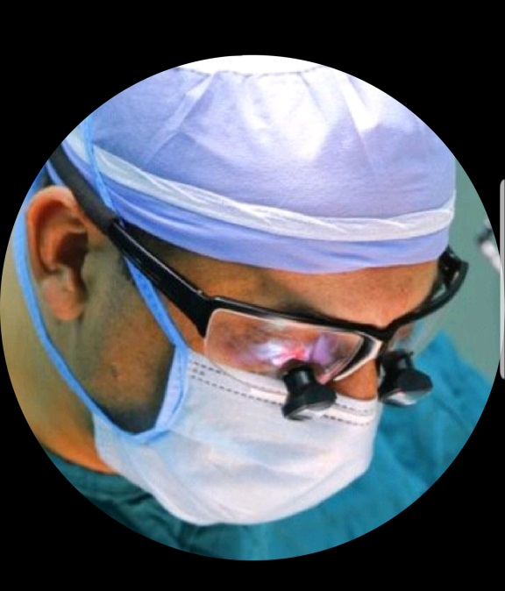
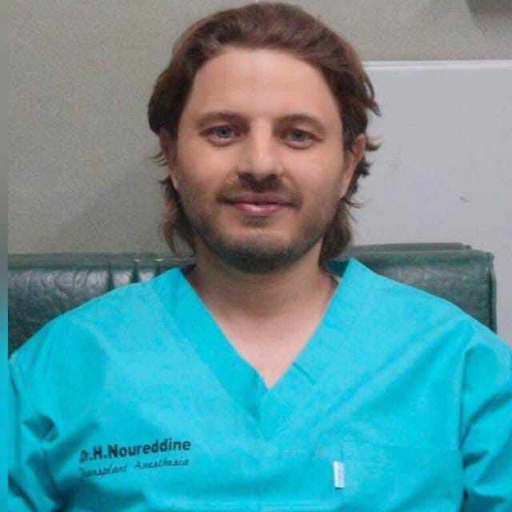
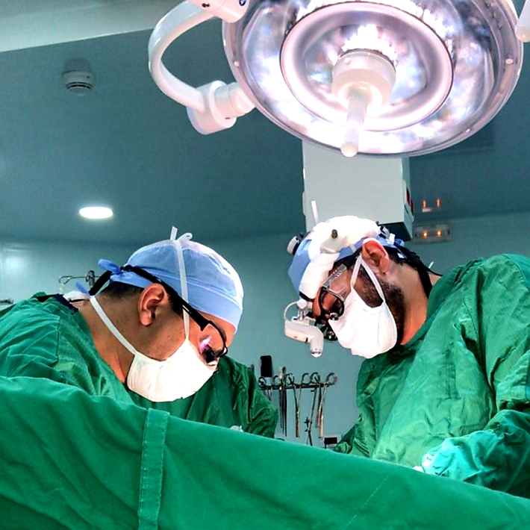
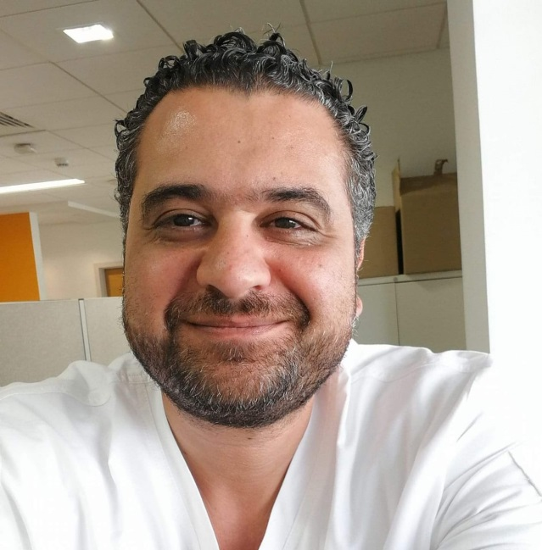
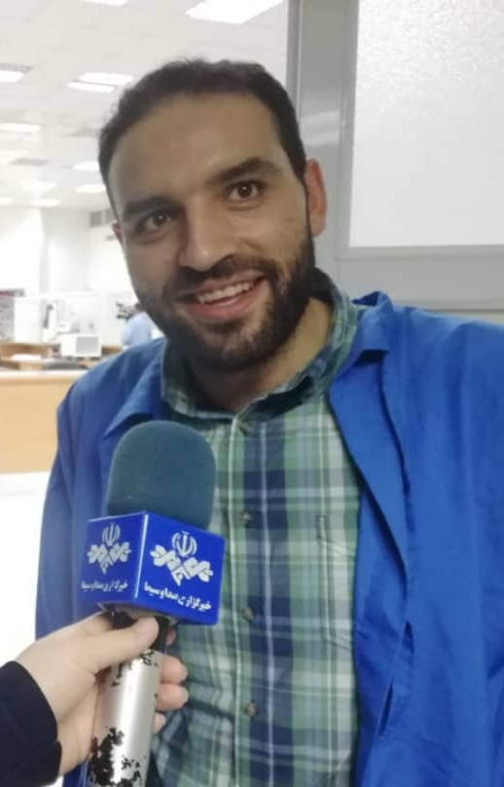
SETTING UP LIVER TRANSPLANT CENTER

Slide 10
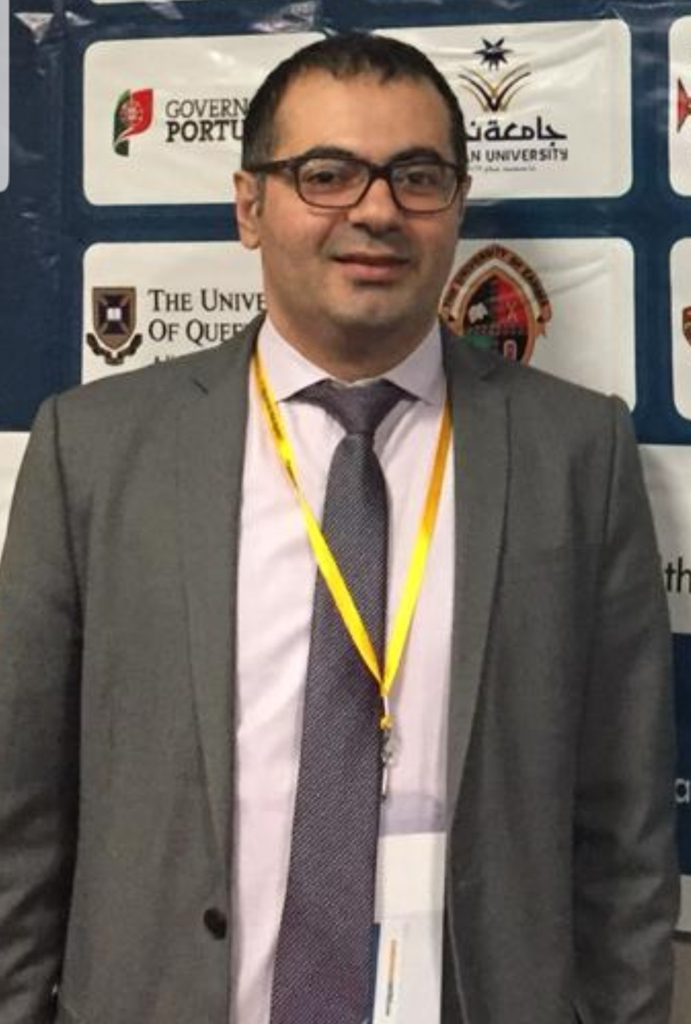
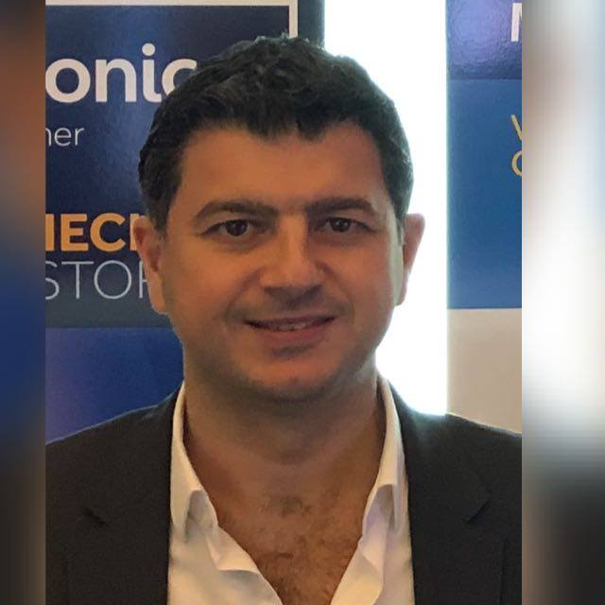
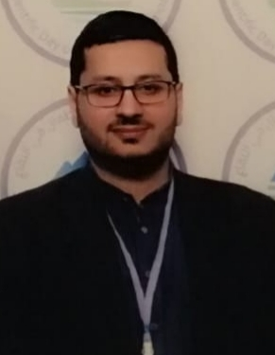

Slide 11
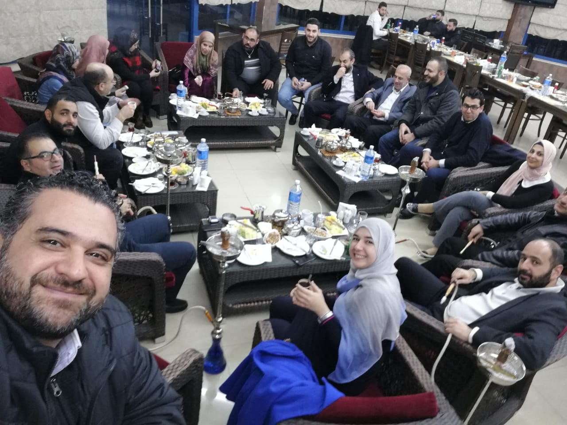
Multidisciplinary Support
ICU
Dialysis Including CRRT.
Blood Bank.
Pathology.
Immunology.
Hematology
Laboratory Services.
Cardiology.
Pneumology.
Nutrition.
Physiotherapy.

Slide 12
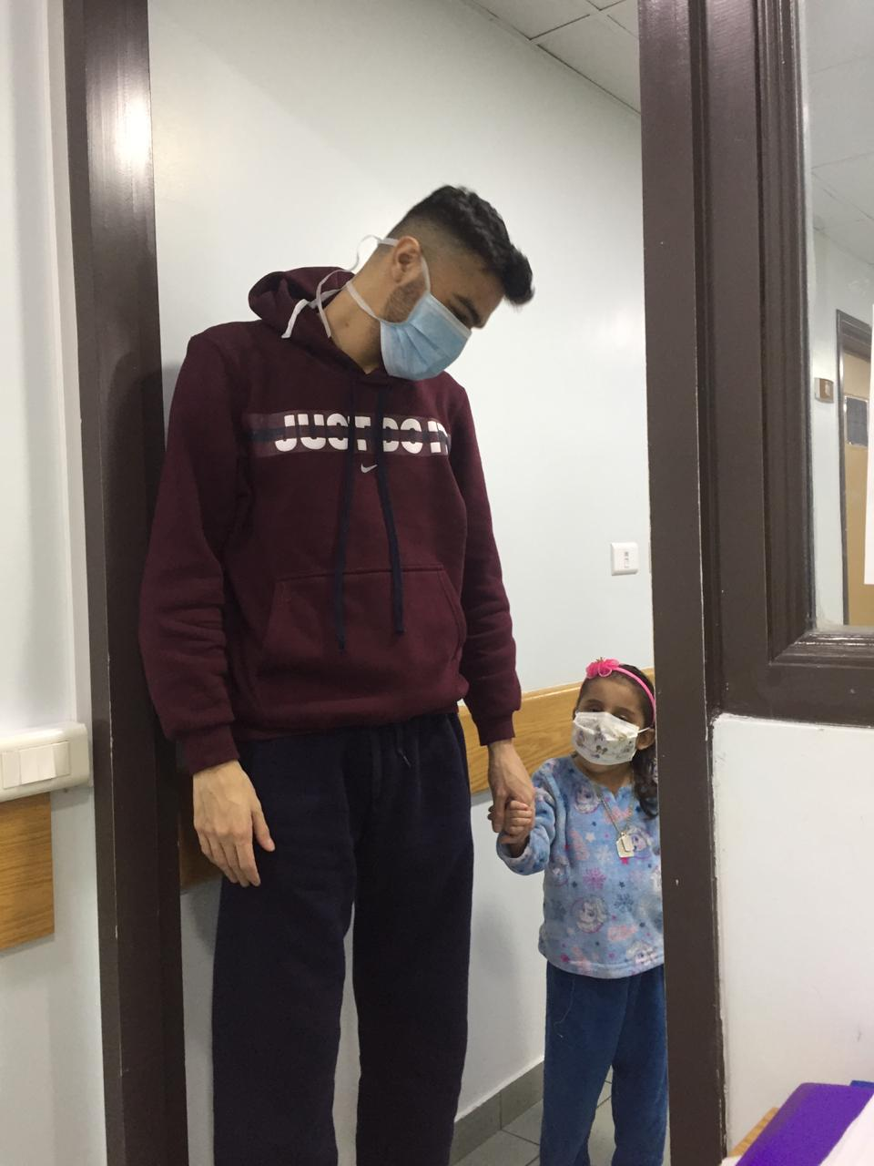
OUR NEW CENTER EXPERIENCE
10 LIVING DONOR LIVER TRANSPLANT
3 PEDIATRIC
3 LEFT LATERAL SEGMENT
2 LEFT LOBE
5 RIGHT LOBE

Slide 13
OUR NEW CENTER EXPERIENCE
# | NAME | AGE | GENDER | WEIGHT kgs | DIAGNOSIS | DATE OF TRANSPLANTATION | DONATION | DONOR RELATION
1 | M.M | 4 Y | F | 10 | biliary atresia | 15/1/2018 | living | mother
2 | M. Y | 33 Y | M | 40 | congenital liver fibrosis | 16/1/2018 | living | brother
3 | Y.M | 28 Y | M | 70 | hyper oxaluria | 17/1/2018 | living | brother
4 | K.M | 3.5 Y | M | 13 | tyrosinemia | 24/5/2018 | living | mother
5 | A.D |  | M |  | HBV cirrhosis | 25/5/2019 | living | brother
6 | E.S | 22 Y | F |  | auto immune hepatitis | 26/5/2018 | living | aunt
7 | M.H | 6 Y | F | 13 | alagyle syndrome | 25/12/2018 | living | father
8 | H.O | 23 Y | F | 60.5 | overlap syndrome | 26/12/2018 | living | father
9 | M.D | 23 Y | M | 81 | auto immune hepatitis |  | living | father
10 | D.A | 19 | F |  | Fulminant Hepatitis | 2/5/19 | living | aunt

Slide 14
# | GRAFT | HEPATECTOMY | OUT FLOW | PORTAL | ARTERIAL | BILIARY | SURGICAL COMPLICATIONS | SURGICAL MANAGEMENT | SURVIVAL
1 | left lateral | piggy back | one (triangular) | one(end to end) | two arteries | reux en y | recurrent uti on atrophic kidney | nephrectomy | alive
2 | left lobe | piggy back | mid left stump to left | one (end to end) |  | duct to duct | bleeding from arterial anastomosis | surgical exploration and one stitch | alive
3 | right lobe | piggy back | right to right | one (end to end) | one artery | reux en y | hepatic artery thrombosis | thrombectomy. Jump graft. Retransplantation in shiraz | alive
4 | left lateral | piggy back | one (triangular) | one (end to end) | two arteries | duct to duct | portal thrombosis and sever gi bleeding | thrombectomy and reanastomosis | dead
5 | right lobe | piggy back | right to right | one (end to end) |  | duct to duct reux en y | small for size | supportive | dead
6 | left lobe | piggy back | one (triangular) | one (end to end) | one artery | reux en y | sepsis | abd. Irregation | dead
7 | left lateral | piggy back | one (triangular) | one (end to end) | two arteries | reux en y | diaphragmatic hernia and biliary leak | surgical primary repair and PTD | alive
8 | right lobe | piggy back | right to right | one (end to end) | one artery | 2ducts to 1duct | none |  | alive
9 | right lobe | piggy back | 2graft veins to right | one (end to end) | one artery | duct to duct | intraoperative low arterial flow(steal syn.) biliary leak | raanastomosis and ligation of splenic artery. ERCP stent | alive
10 | right lobe | piggy back | right to right | one(end to end) | two arteries | 2ducts to 1duct | hepatic artery thrombosis | thrombectomy and reanastomosis | alive

Slide 15
SURGICAL COMPLICATIONS
2 cases of BILIARY COMPLICATIONS managed by ERCP stenting and temporary internal external biliary drainage
1 case of PORTAL VEIN THROMBOSIS followed by sever varecial bleeding despite thrombectomy and re-anastomosis.
2 cases of HEPATIC ARTERY THROMBOSIS one followed by full biliary ischemia despite revascularization and ended up with graft loss and managed by re-transplantation, and the other treated with successful revascularization with saphenous Y graft for two arteries.
1 case of SEPSIS AND SEPTIC SHOCK followed by hepatic artery thrombosis and graft loss.
1 case of SMALL FOR SIZE due to deep jaundice despite good volume .

Slide 16
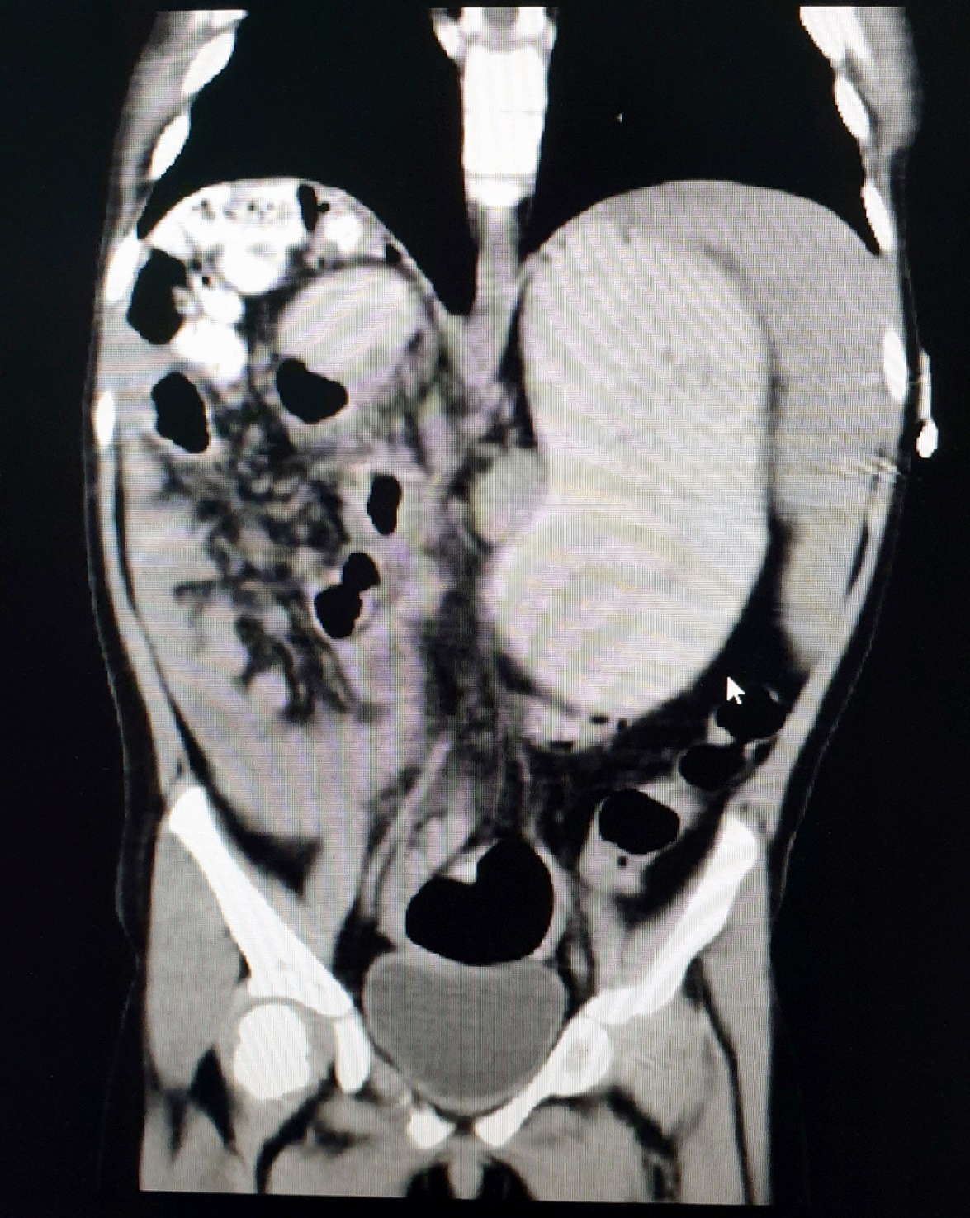
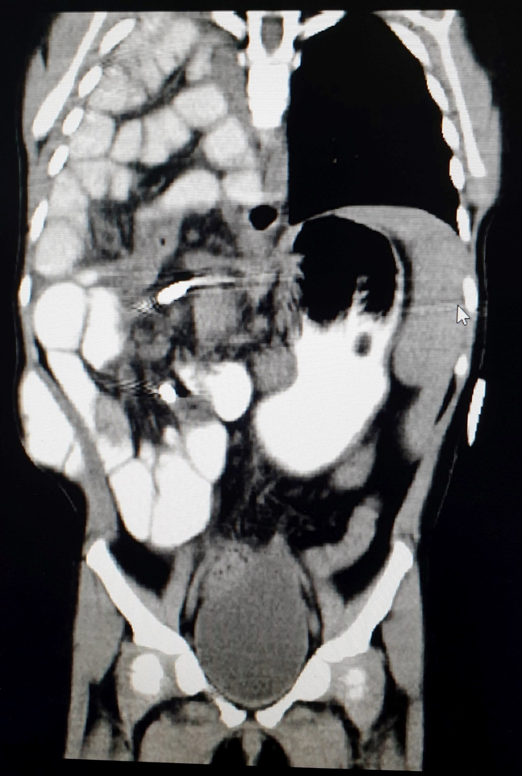
DIAPHRAGMATIC HERNIA

Slide 17
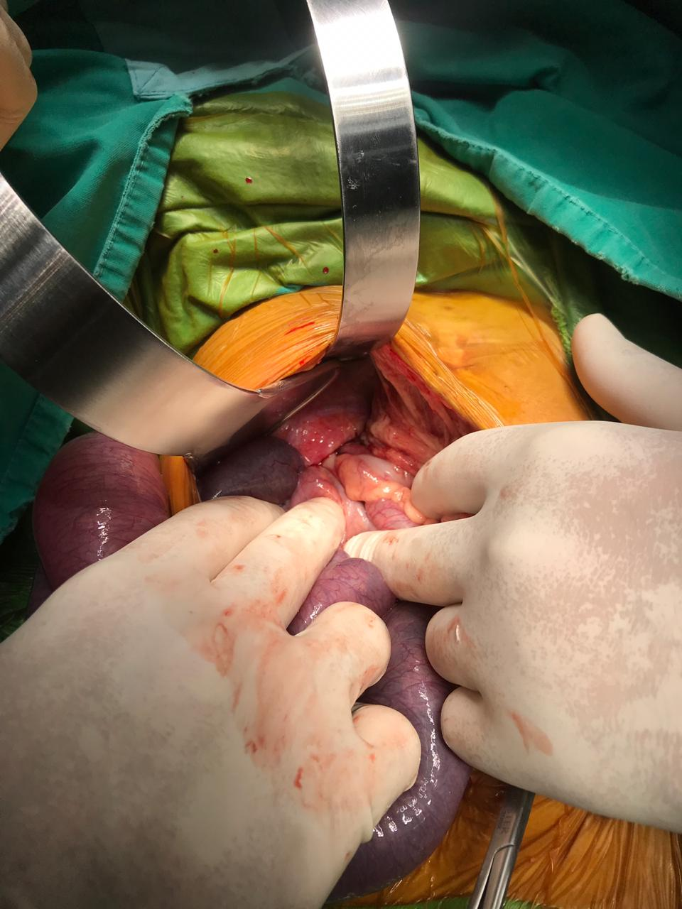
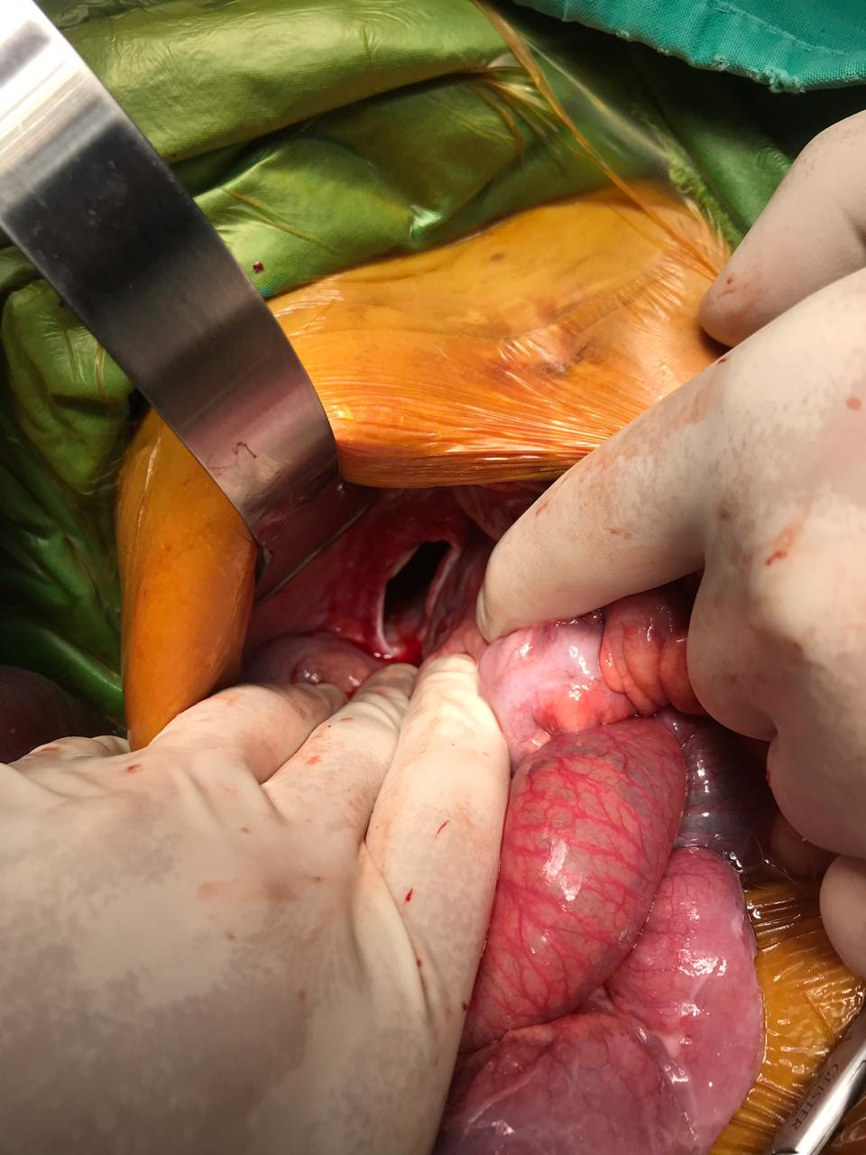
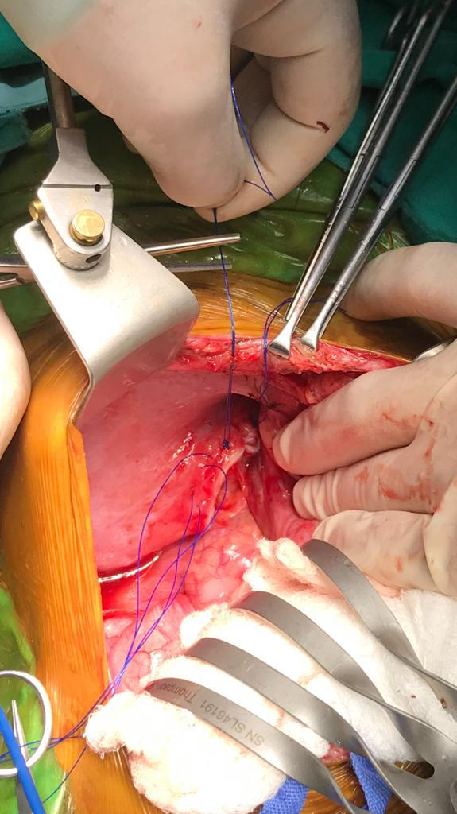
DIAPHRAGMATIC HERNIA

Slide 18
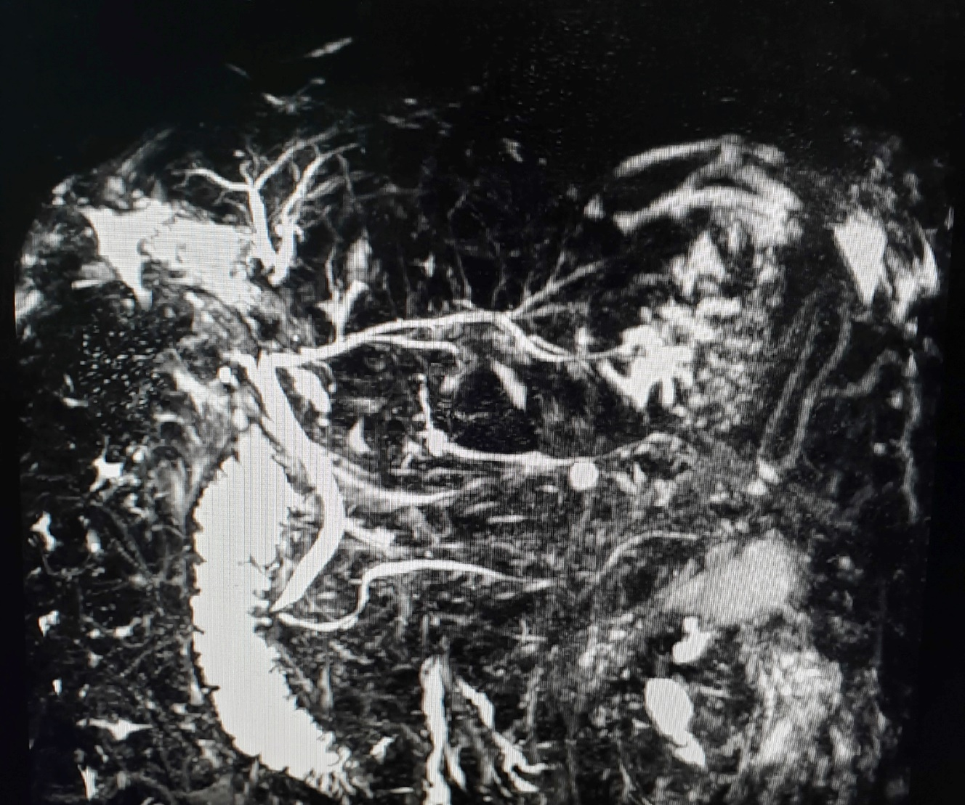
DONOR COMPLICATIONS
case of BILIARY LEAK from segment 8 remnant tissue managed by resection

Slide 19
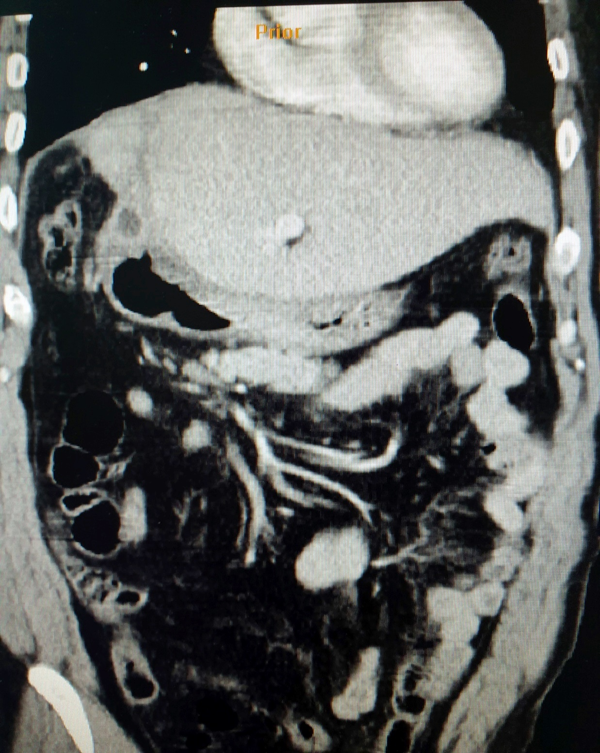
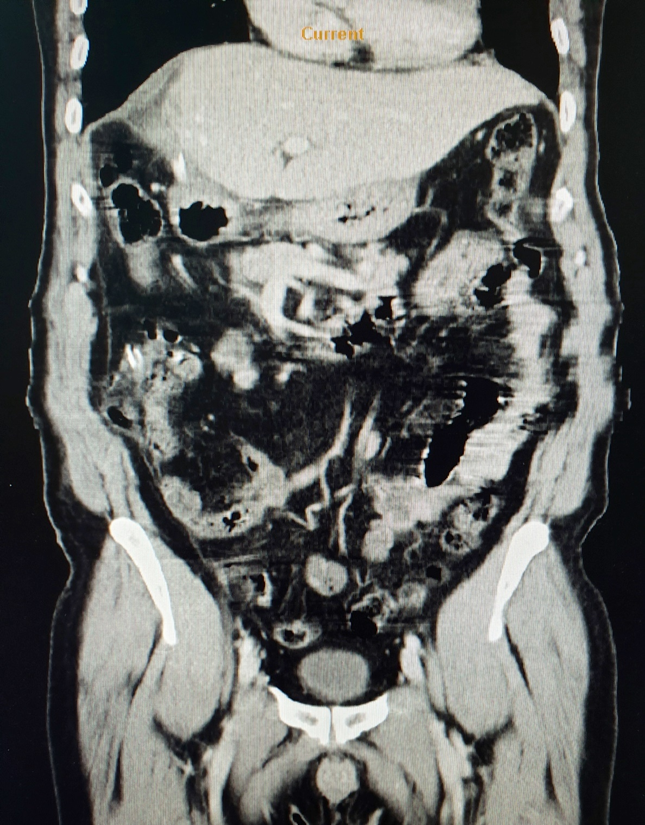

Slide 20
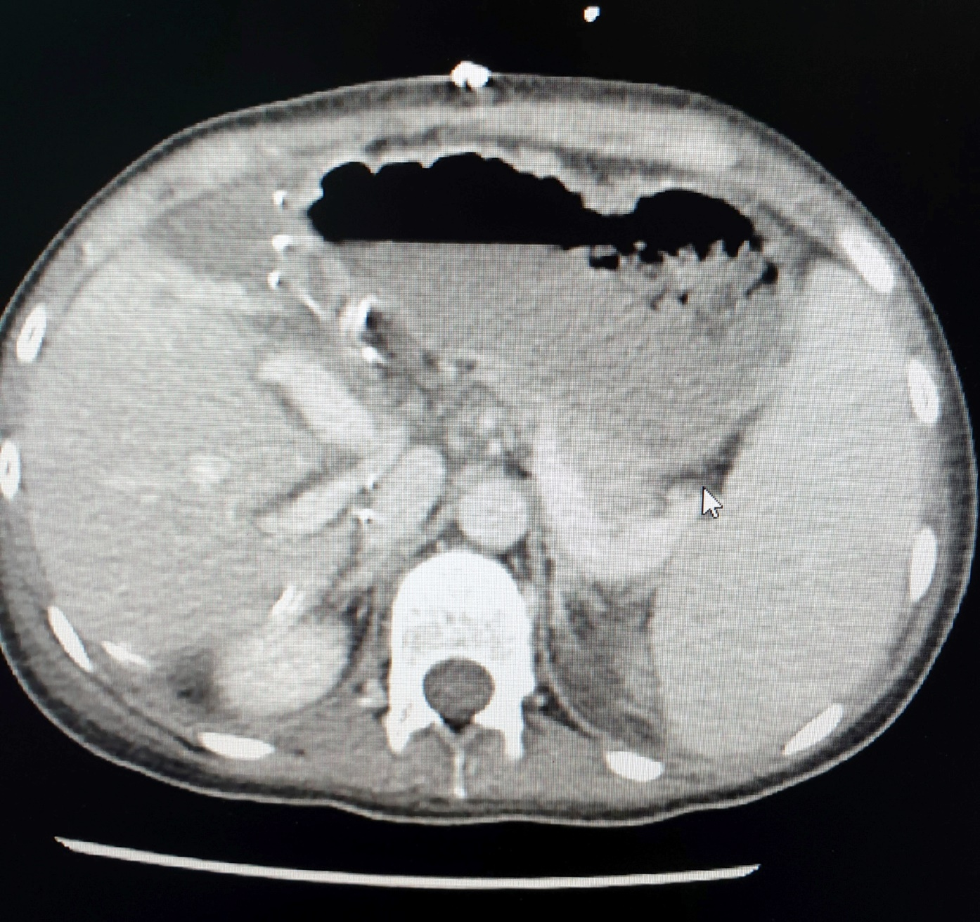
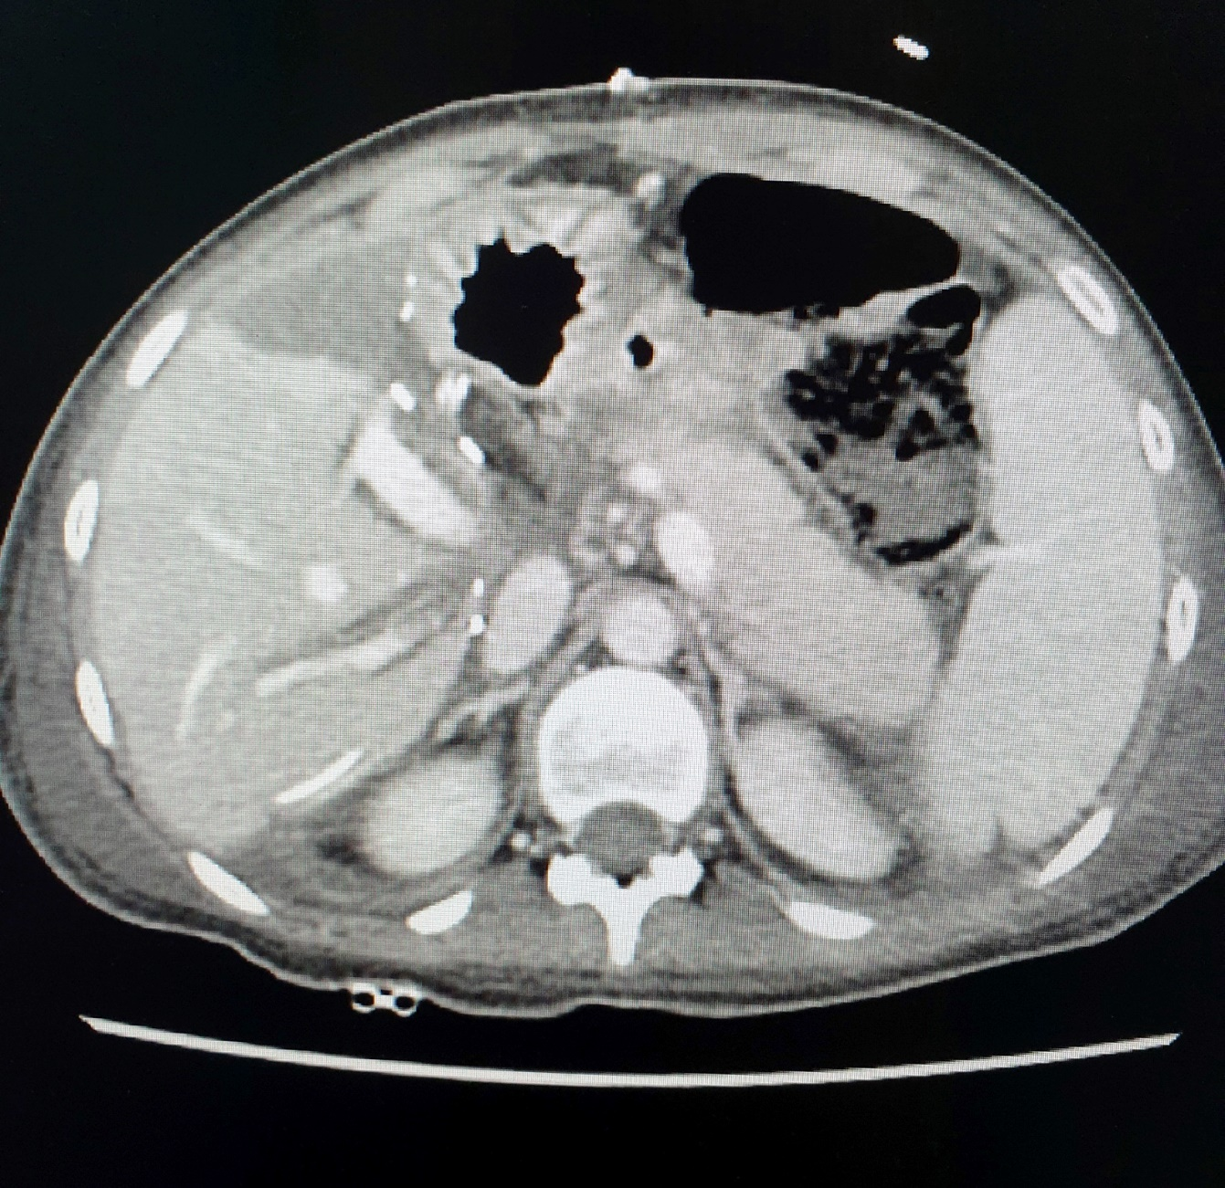
VASCULAR COMPLICATIONS
Hepatic artery thrombosis

Slide 21
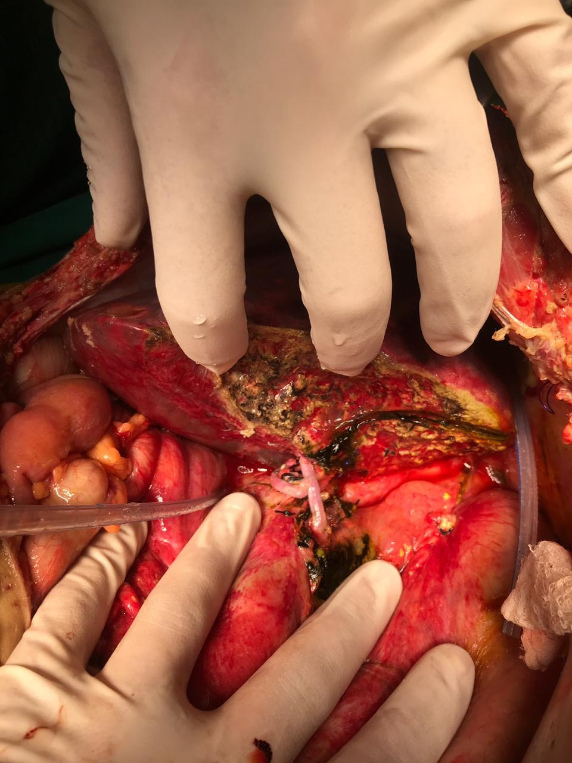
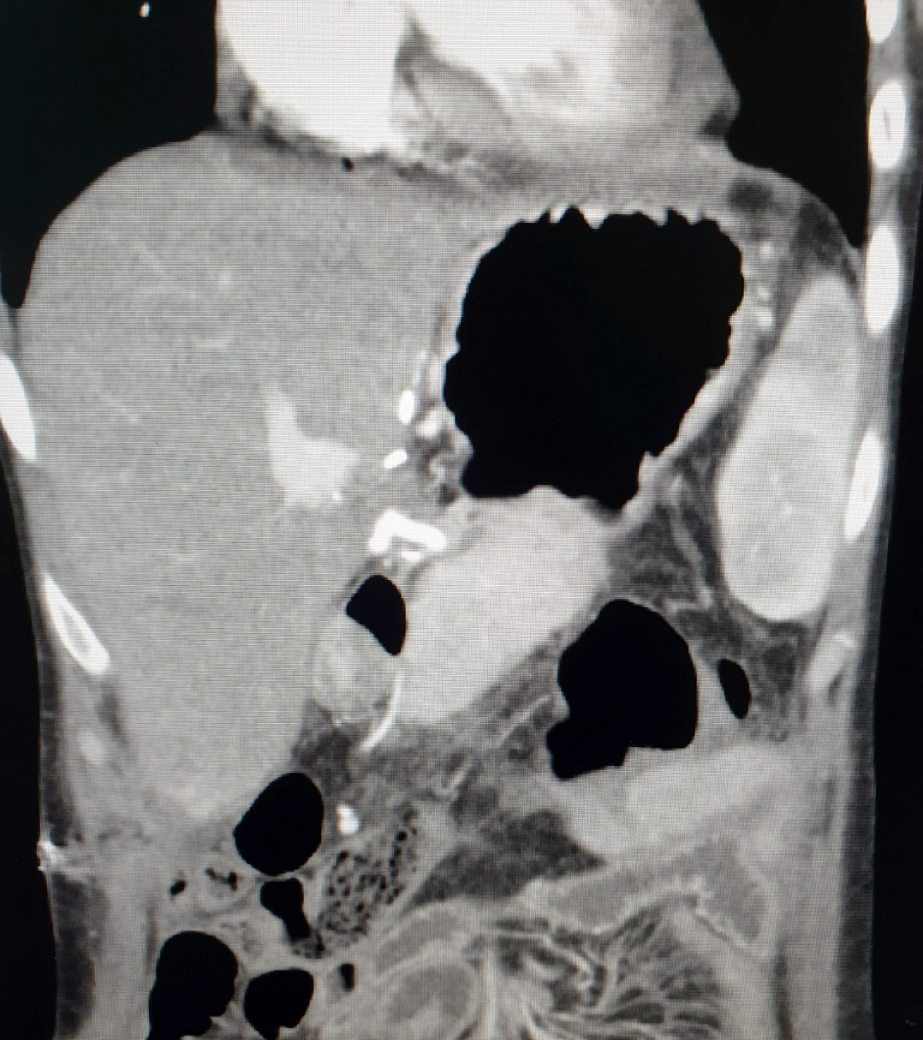

Slide 22
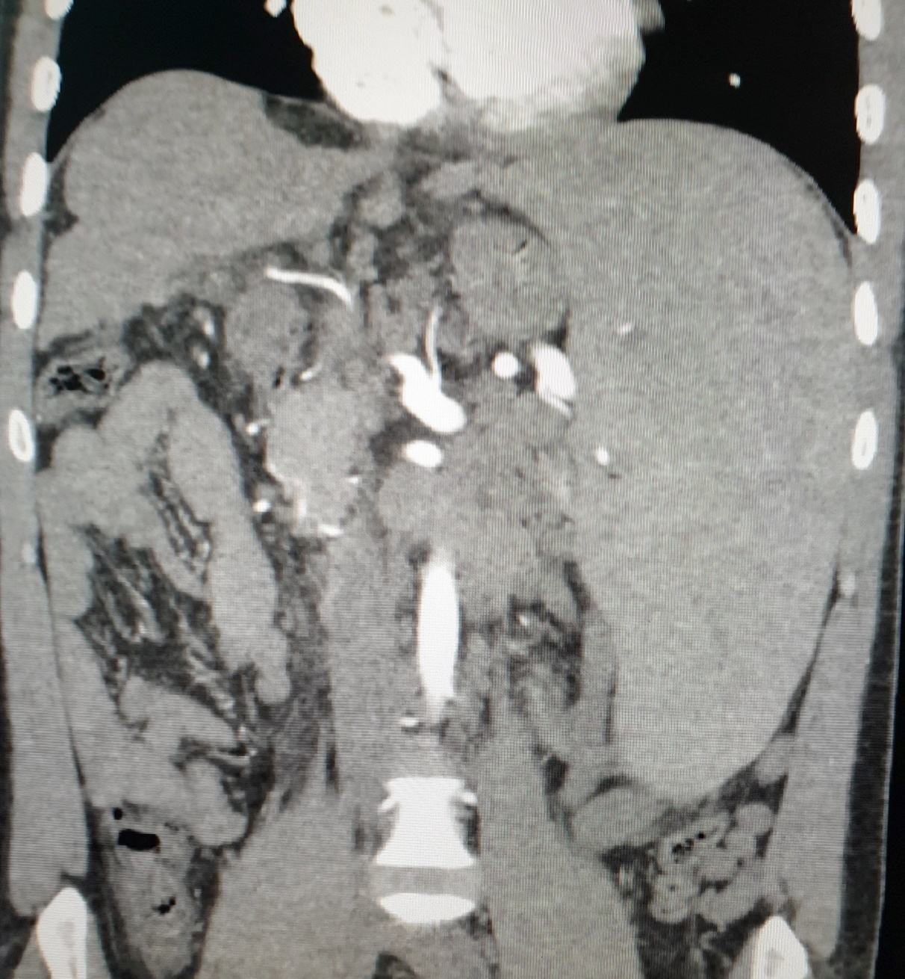
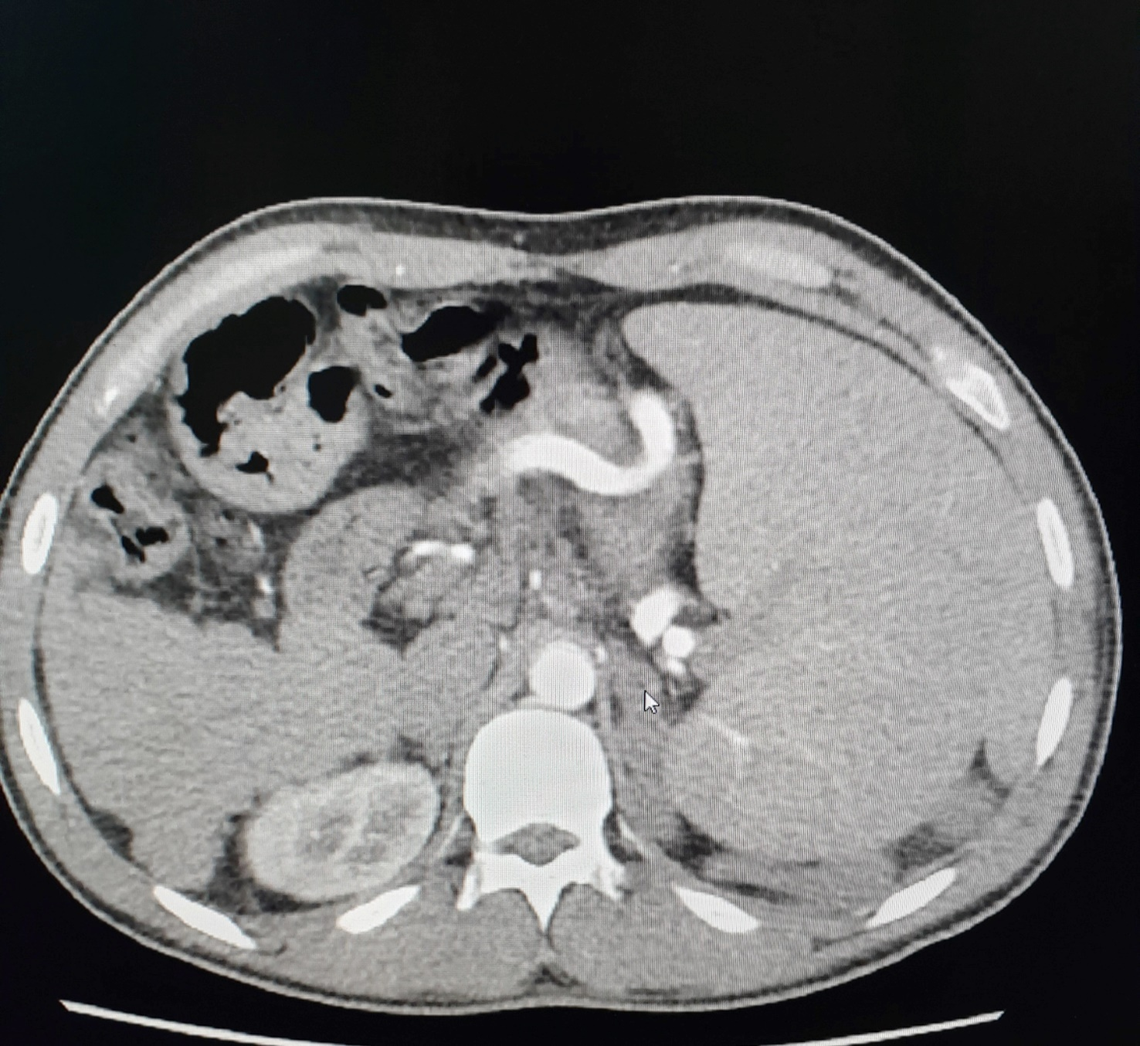
VASCULAR COMPLICATIONS splenic artery steal syndrome

Slide 23
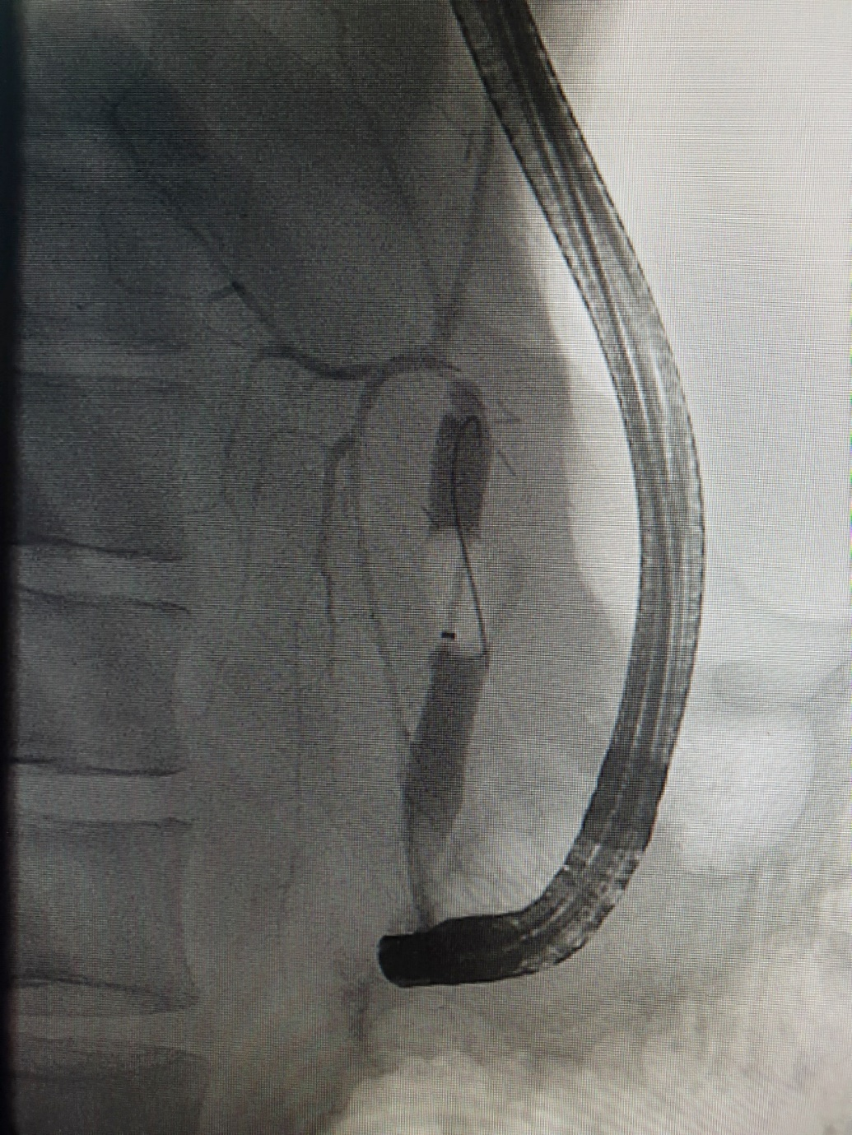
biliary complications biliary stenosis

Slide 24
Overall results
Within 18 months
10 LIVING RELATED DONOR LIVER TRANSPLANTATIONS
7 ADULTS AND 3 CHILDREN
3 MORTALITIES
ONE RETRANSPLANT
NO REJECTION
No outflow complications
No bleeding complications

Slide 25
THANK YOU

