Slide 1

Evaluation of Lower urinary tract dysfunction in children (LUTD)
Anthony KALLAS-CHEMALY, MD, MSc, FEAPU
Department of Pediatric Surgery and Urology
Hôtel-Dieu de France Hospital

Slide 2
PLAN
1- Epidemiology
2- History
3- Clinical exam
4- Assessment
5- Initial treatment
6- Take home message

Slide 3
EPIDEMIOLOGY
LUTD is commonly encountered in daily practice, accounting for
up to 40% of pediatric urology clinic visits annually.
The incidence has been estimated between 5 and 15% in 6 year old children in different epidemiological surveys.
In contrast to the adult population where incontinence is always considered a pathological condition, in children reference point for LUT symptoms is 5 years of age and bowel dysfunction is 4 years according to the ICCS.

Slide 4
HISTORY
LUTD should be assessed following the standardization criteria of the ICCS.
1- LUT SYMPTOMS
STORAGE SYMPTOMS | VOIDING SYMPTOMS | OTHER SYMPTOMS
Voiding frequency (4-7) Urgency Incontinence - Associated or not with urgency - Continuous Vs Intermittent Nocturia Enuresis | Hesitancy Straining Stream characteristics -Weak -Intermittent - Spraying (or splitting) Dysuria (urethral or bladder source) | Post micturition dribble Incomplete bladder sensation.
SEVERITY OF LUTD MAY BE ASSESSED USING THE DVSS SCORE

Slide 5
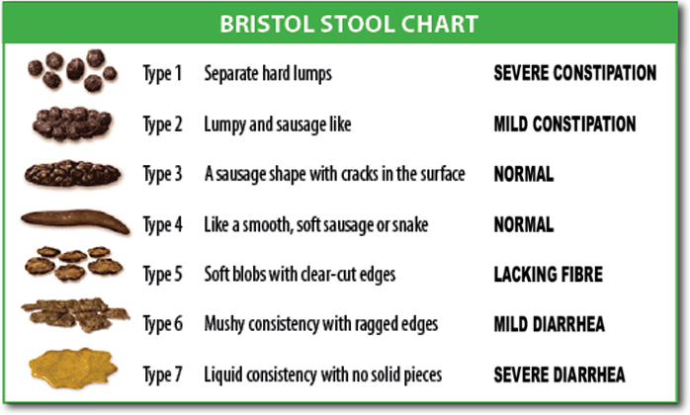
HISTORY
2- History of urinary tract infections
3- History of macroscopic hematuria
4- Bowel dysfunction (Evaluation should me made using the Bristol Score for one complete week)

Slide 6
HISTORY
5- History of LUTD in parents during childhood
6- Personal or familial history of renal or urological disease (Ex: urolithiasis).
7- Methods of learning and acquisition of cleanliness.
8- Modalities of school toilets use (availability, cleanliness, hygienic paper…).
9- Psychomotor and statural development of the child, his lifestyle, his daily water regime (soft drinks, soda).
10- Potential use of pads and the psychosocial impact.

Slide 7
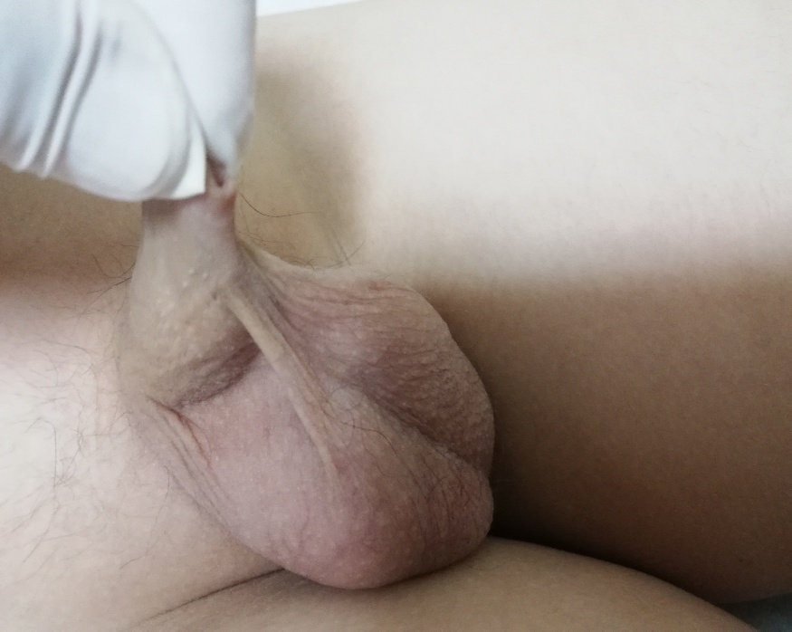
CLINICAL EXAM
1- Inspection of the pants in search of stigmas of urine leakage or stool.
2- Examination of the external genitalia :
  In boys : pathological phimosis, aspect of the meatus
  In girls : vulvitis, aspect of the meatus

Slide 8
CLINICAL EXAM

Slide 9
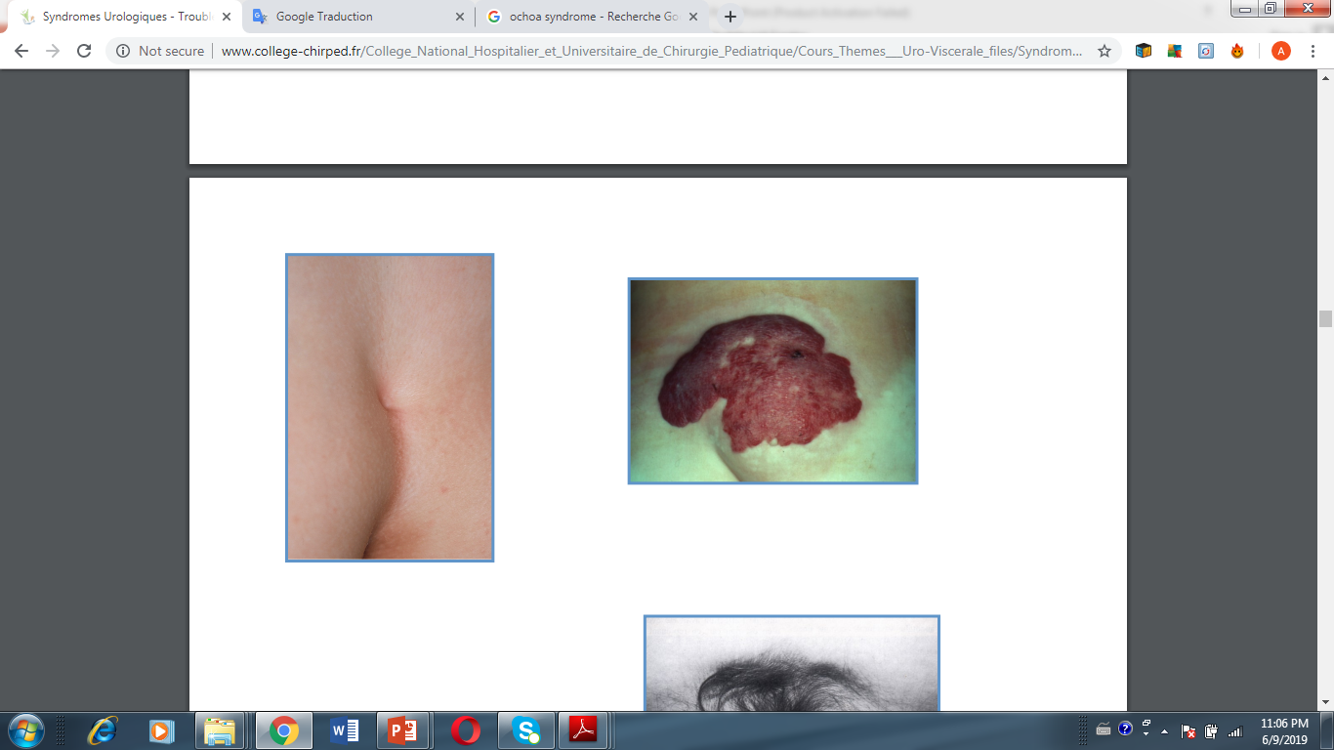
CLINICAL EXAM
3- Abdominal palpation looking for stercoral crowding and bladder globe.
4- Neuro-orthopedic examination (cutaneous signs of occult spinal dysraphism, hollow foot, unequal length of the lower limbs, scoliosis, trophic disorders).

Slide 10
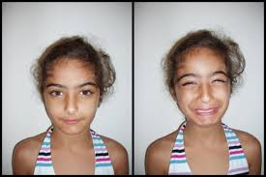
CLINICAL EXAMINATION
5- Make the child smile !

Slide 11
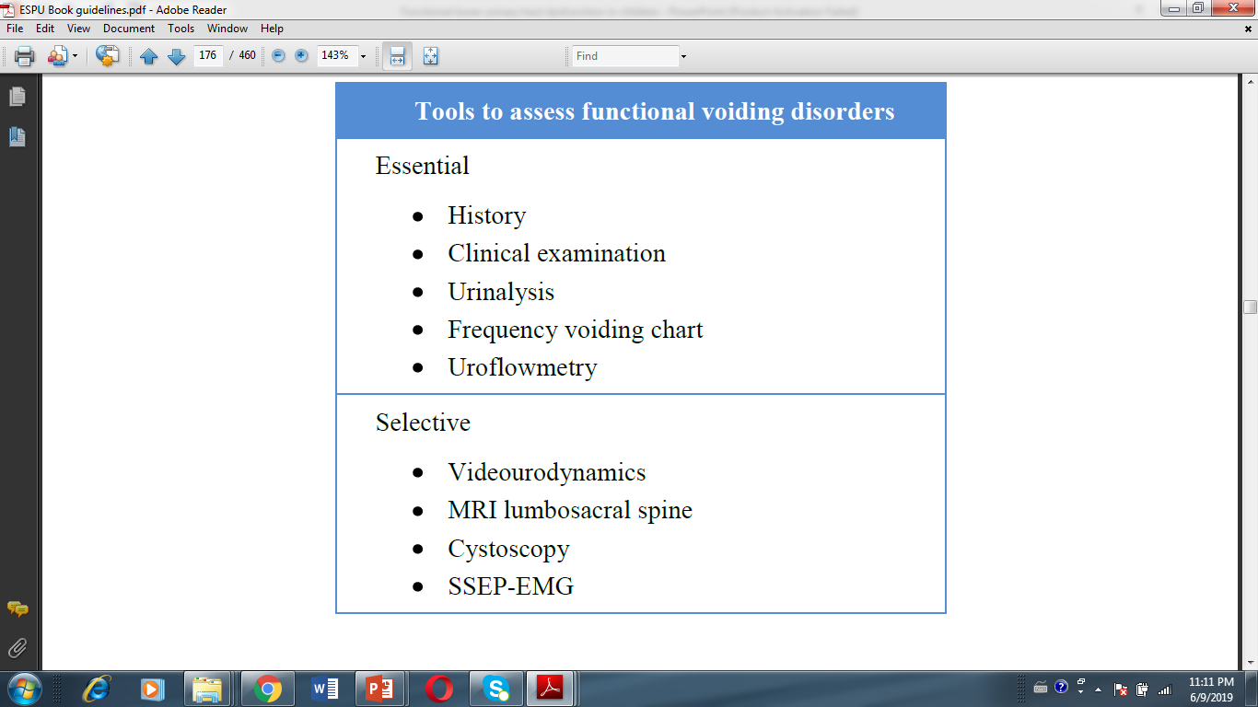
ASSESSMENT
ESPU/EAU GUIDELINES

Slide 12
URINALYSIS
It helps detecting an organic disease :
  Glycosuria
  Proteinuria
  Hematuria
  Urinary tract infection (leucocyturia , positive nitritis)
Renal and bladder ultrasound are indicated when urinalysis is abnormal

Slide 13
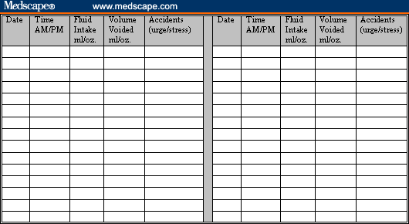
Frequency voiding chart
It consists of recording daytime frequency and voided volume during 48 hours (not necessarily on 2 consecutive days).
Is an excellent test for the follow-up after treatment.
Expected Bladder capacity (BC) in children :
EBC= (Age+1)*30

Slide 14
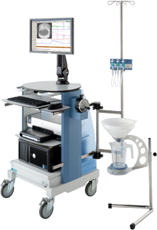
Uroflowmetry
It is the least invasive of all urodynamic methods.
It is therefore perfect for pediatric use.
It measures the urinary stream during the emptying phase of micturition.
It gives an idea about bladder function and outlet function. It gives quantification about the volume of fluid expelled through the urethra per unit time.

Slide 15
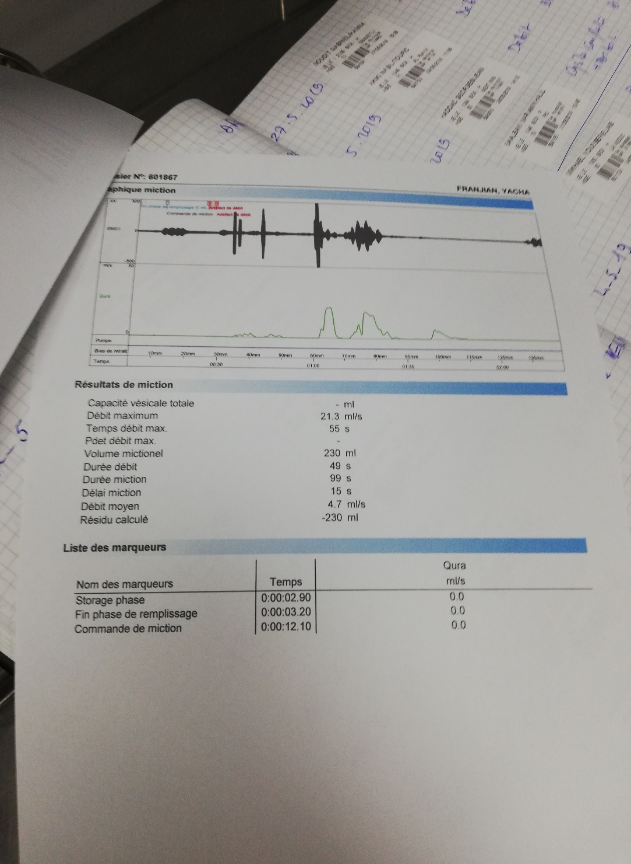
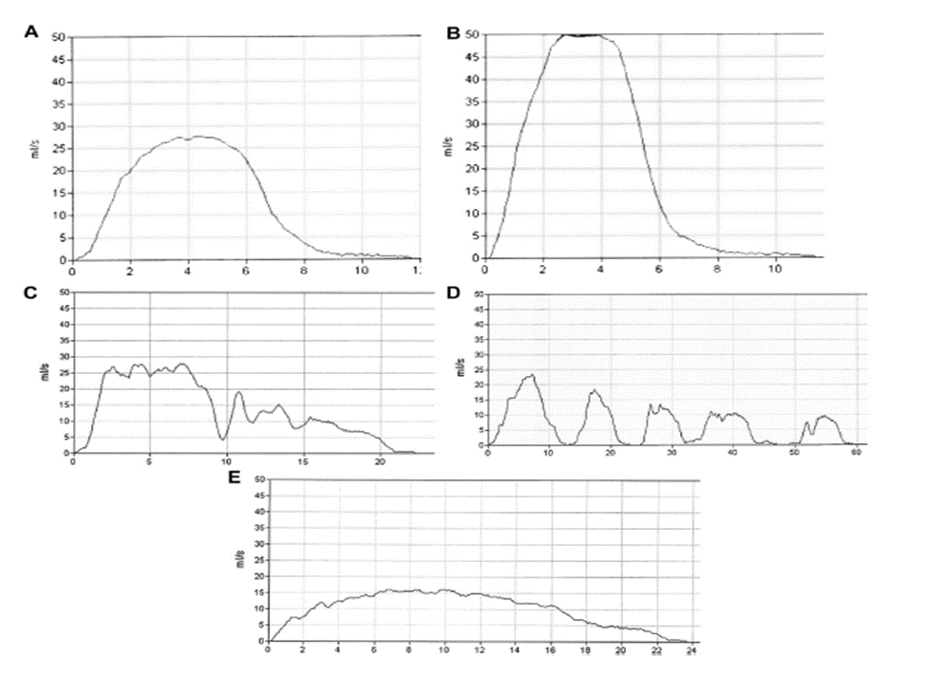
Uroflowmetry

Slide 16
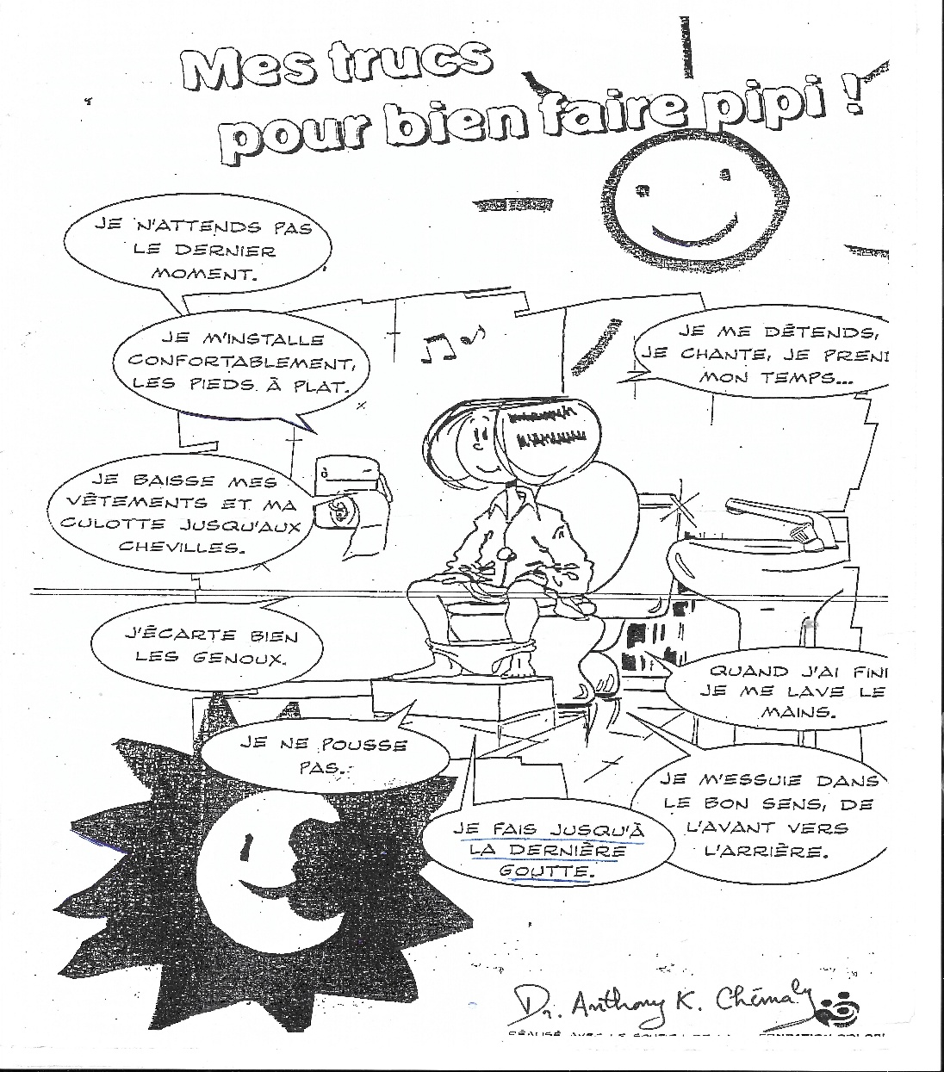
INITIAL TREATMENT

Slide 17
TAKE HOME MESSAGE
Lower urinary tract conditions are very common in children.
Minimal invasive assessment can be proposed (History, Clinical Exam, Urinalysis, Voiding Diary and Uroflowmetry).
Urotherapy is the initial treatment of choice for this condition.
For therapy resistant patients treatment with a specialized pediatric urologist and nephrologist is advised (Invasive urodynamic studies, lumbar MRI, cystoscopy, advanced urotherapy…).
Childhood conditions is not a trivial condition and can recur in adulthood and are bad prognostic factors if left untreated.

Slide 18
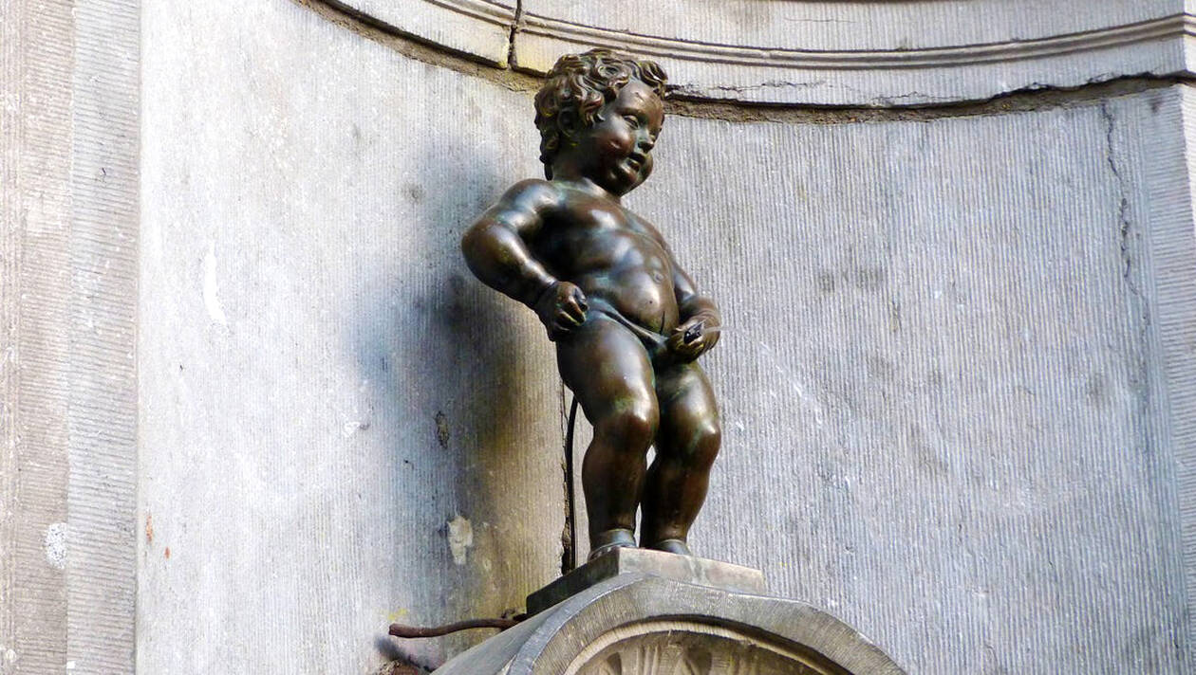
THANK YOU !

