Slide 1
The Most Common Congenital Urological Malformations
Fadi Iskandarani, md
Pediatric surgeon

Slide 2
Embryology of the Urinary Tract

Slide 3
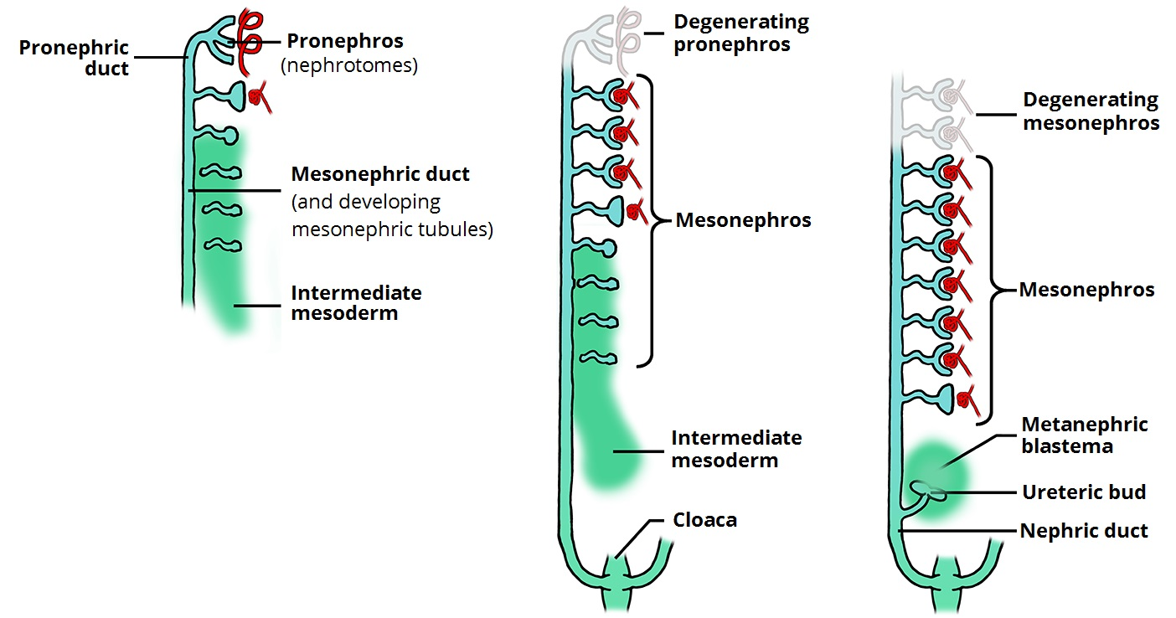

Slide 4
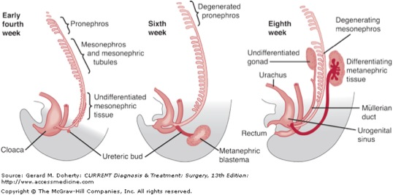

Slide 5
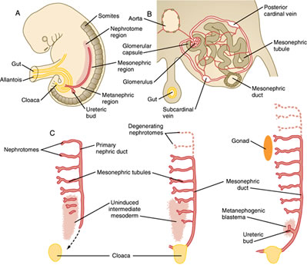

Slide 6
Congenital Anomalies of the Kidneys and Urinary Tract
(CAKUT)

Slide 7
Introduction
1% of healthy infants have some type of CAKUT
25% of CAKUT require surgical intervention
Calulo VA, Calulo S, Cargasole C, et al., Mass Screening for Congenital Anomalies of the Kidneys and Urinary Tract, Pediatr. Nephrol. 2012, 27: 949-953

Slide 8
CAKUT
Anomalies of Renal Parenchyma:
  Renal dysplasia / hypoplasia /agenesis
  Cystic renal diseases
Disruption of the normal embryologic migration of the kidneys :
  Renal ectopia (pelvic kidney)
  Fusion anomalies (horseshoe kidney)
Anomalies of the collecting system:
  Complete/partial duplication of the collecting system
  UPJ/VUJ obstructions
  Ureteral abnormalities: Megaureter/ectopic ureter/ureterocele/VUR
  Bladder exstrophies
  PUV

Slide 9
The Most Common
Vesicoureteral reflux: 0.4-1.8% of the pediatric population ^{[1,2]}
Hypospadias: 1 in 200 boys ^{[3]}
Ureteropelvic junction obstruction (UPJO):
  Hydronephrosis:1 in 500 ^{[4]}
  UPJO: The most common obstructive uropathy ^{[4]}
1. Ransley PG, Vesicoureteric Reflux: Continuing Surgical Dilemma, Urology 1978: 12:246-55
2. Bailey RR. Vesicoureteric reflux in Healthy Infants and Children in Hodson CJ, Kinkaid- Smith P, eds., Reflux nephropathy< New York Masson, 1979, 59-61
3. CDC [Centers for Disease Control and Prevention], NCBDDD. Atlanta: CDC, www.cdc.gov.ncbddd/birthdefects/data.html
4. Thomas D. Fetal Uropathy, Br. J. urol 1990, 66: 225-31

Slide 10
Vesicoureteral Reflux
(vur)

Slide 11
Incidence and Demographics
Discovered after investigation for:
  UTI
  Antenatal hydronephrosis
Incidence:
  0.4-1.8% in the overall pediatric population
  30-50% in children with UTI, even higher in infants with UTI
  20-35% of children evaluated for bacteriuria
  15-38% of the fetuses with antenatal hydronephrosis (highest in infants with persistent postnatal anomalies)
  Varies among races

Slide 12
Demographics
In those who are diagnosed:
  Antenatally:
    Boys > Girls
  After UTI:
    Girls > Boys

Slide 13
In Boys
Younger age at presentation
More severe, especially when diagnosed in infancy
High voiding pressure and small functional capacity:
  More common in boys
  May be due to transient urethral obstruction leading to high intravesical pressures

Slide 14
Heredity
Appears to be a heritable disorder
80-100%-concordance rate in twins
Occurs in 40-50% of (non-twin) siblings of affected children
Incidence of parent-to-child-transmission: Up to 60%
May be a dominant trait with variable penetrance

Slide 15
Embryology
Normally:
  The common nephric duct and the distal ureter: incorporated into the bladder wall to form the trigone
Functional disorganization of the trigone during development:
  Lateral displacement of the ureteral orifice
    Abnormal ureteral bud origin
    Correlates with the degree of renal dysplasia/hypoplasia
  Abnormal ureteral anchoring

Slide 16
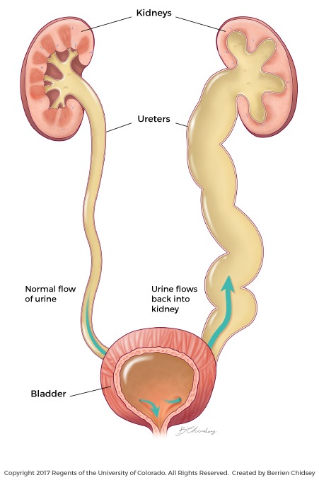
VUR vs Normal UVJ

Slide 17
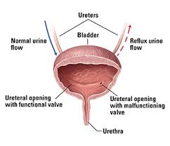

Slide 18
VUR and UTI
Does not cause UTI in the absence of bacteriuria
  Exception: Massive VUR with significant postvoid residue
Found to have VUR after their first UTI:
  >60% of children < 1 year
  30% of children 2-3 years
  5% of adults

Slide 19
VUR resolution
Intravesical ureteral length increases:
  Neonate: 0.5cm
  Adult: 1.3cm
Filling and voiding pressures change along with bladder dynamics and voiding patterns as the child grows
Submucosal length-to-ureteral diameter ratio increases

Slide 20
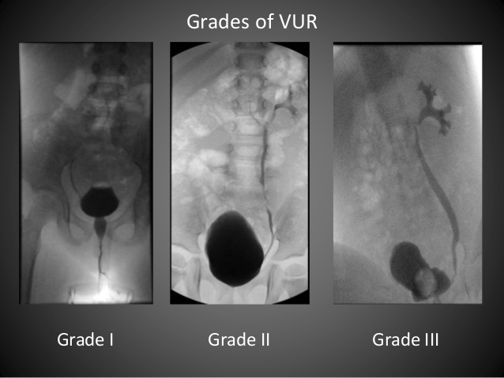
VUR on VCUG

Slide 21
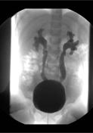
VUR on VCUG
Grade IV

Slide 22
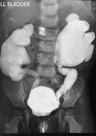
VUR on VCUG
Grade V

Slide 23
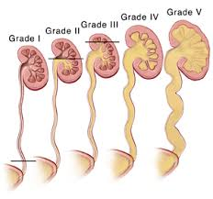

Slide 24
Hypospadias

Slide 25
Definition
Arrest in the normal development of
  The urethra
  Foreskin
  Ventral aspect of the penis

Slide 26
Embryology of the Male Urogenital System
By 12 weeks:
  Coronal sulcus: Separates the glans from the penile shaft
  Urethral folds: Completely fused in the midline, on the penile ventrum
16 weeks:
  Glandular urethra appears
  2 possible explanations
    Old theory: Primary intrusion of ectodermal tissue from the glans
    New theory, supported by anatomic studies and immunohistochemistry: Endodermal differentiation

Slide 27
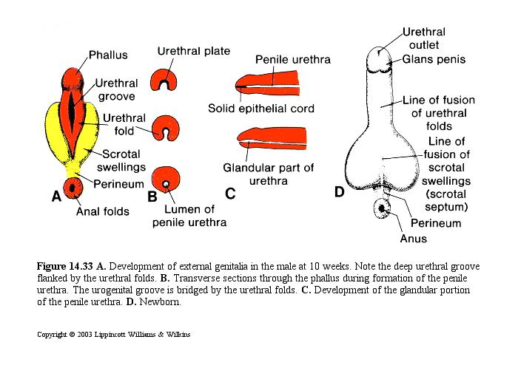

Slide 28
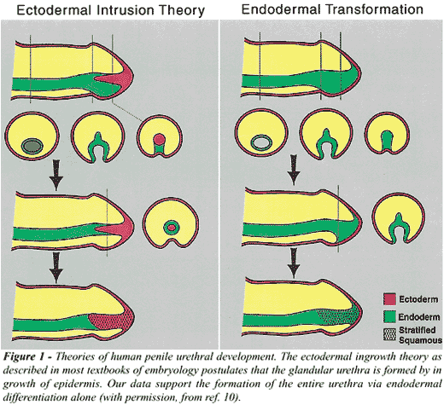

Slide 29
The Male Urethra
Entirely formed by:
  Dorsal growth of the urethral plate into the genital tubercle
  Ventral growth and fusion of the urethral folds
Proper mesenchymal induction:
  Urothelium differentiates into stratified squamous epithelium

Slide 30
The Prepuce
Growth of the mesenchyme between the preputial fold and glandular lamella Preputial fold transported distally until the whole glans is covered
After birth:
  Fusion of the glans and prepuce
  THEN: Desquamation of the epithelial fusion allows the prepuce to retract

Slide 31
The Prepuce
Genital folds fail to fuse
Preputial tissue does not form ventrally
In hypospadias:
No preputial tissue ventrally
Excessive preputial tissue dorsally

Slide 32
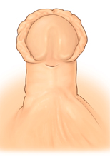
Hypospadias
Foreskin

Slide 33
Hypospadias
No sound understanding of its etiology:
  Genetic impairment
  Hormone receptor impairment
  Enzyme impairment
  Environmental factors and endocrine disruptors

Slide 34
Incidence
1 in 200 boys and increasing
Each year:
  10000 new cases per year in the US
  27 new cases per day (More than Down Syndrome, cleft lip and spina bifida)
Proximal hypospadias: 1000 new cases per year in the US

Slide 35
Associated Malformations
90%: Isolated
Suspect syndromic hypospadias when associated with other non-genital anomalies
VUR: In 10%
Renal abnormalities:
  In 20 %
  Mostly:
    Ureteral duplications
    Malrotations
    Minor hydronephrosis not requiring surgical intervention

Slide 36
Associated Malformations
Enlarged utricle:
  In proximal hypospadias
  Almost always asymptomatic
  Can be bypassed using a coudé-tipped catheter or a guidewire +/- urethroscopy if encountered intraoperatively

Slide 37
Associated Malformations
Not correlated to the severity of hypospadias
No need to image boys with hypospadias regardless of its severity

Slide 38
Hypospadias and DSD
Palpable genitalia: Exclude DSD even in the setting of a perineal hypospadias
Genetic testing:
  Only when hypospadias is associated with undescended testes
  Abnormal karyotype: In < 33%

Slide 39
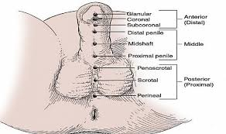
Classification

Slide 40
Anatomic Differences
Normal Penis
Hypospadiac Penis
Well-defined small capillaries around the urethra, fanning into the glans
Large endothelium-lined vascular channels filled with RBC’s on the abnormal ventral shaft
Urethral plate:
  No fibrosis or scarring
  Well vascularized
  Rich nerve supply
  Extensive muscular and tissue backing

Slide 41
Physical Exam
Few patients have micropenis
Boys with proximal hypospadias have smaller penile measurements that are within the normal range (< 2SD below average)
Ventral curvature
Spraying or deflected urinary stream:
  If the glans encloses the meatus over a distance < 2.5mm
  May go unnoticed in infants
  Become more apparent after toilet training

Slide 42
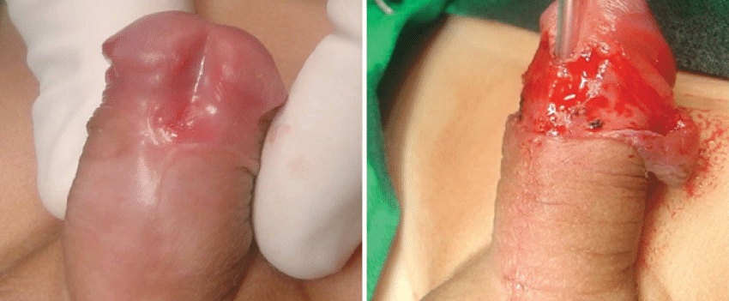
Hypospadias
Coronal

Slide 43
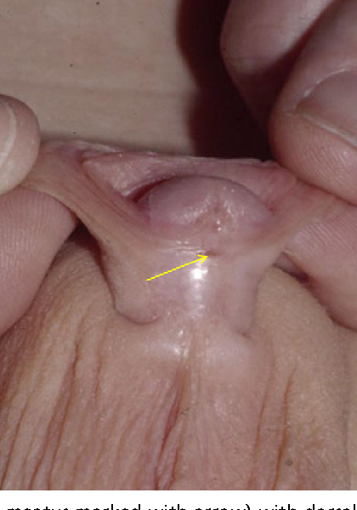
Hypospadias
Distal Penile

Slide 44
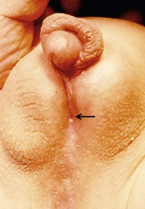
Hypospadias
Scrotal

Slide 45
Major Anatomic Defects
Abnormal urethral meatus
  Abnormal location
  Abnormal configuration:
    Elasticity
    Form
    Diameter
    May be covered with delicate skin

Slide 46
Major Anatomic Defects
Penile curvature
  Cause: Deficient ventral penile structures:
    Skin
    Dartos fascia
    True fibrous chordee with a tethered ventral shaft
    Deficient corpora cavernosa on the ventral side

Slide 47
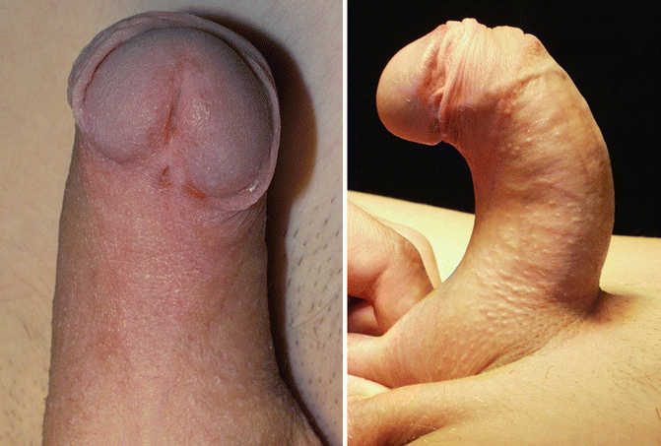
Coronal Hypospadias + Chordee

Slide 48
Skin Defects
Paucity of ventral skin distal to the meatus
Absent frenulum
The skin proximal to the meatus may be very thin
The urethral plate: May be
  Well developed Normal artificial erection
  Underdeveloped Ventral curvature on artificial erection

Slide 49
Major Anatomic Defects
Foreskin defect
Scrotal anomalies (in severe cases)

Slide 50
Hydronephrosis
Ureteropelvic junction obstruction (UPJO)

Slide 51
Hydronephrosis
The most common abnormality detected on prenatal ultrasound (1:100 – 1:500 pregnancies)
UPJO:
  The most common pediatric renal obstructive disorder
  50% of prenatally detected uropathies

Slide 52
Hydronephrosis
Dilation of the renal collecting system
Cause:
  Obstruction
  Reflux
Typically discovered on antenatal U/S
0.5-0.6% of all neonatal uropathies
Spontaneous resolution in 20%

Slide 53
Persistent Hydronephrosis
44% are due to UPJO
UPJO: The leading cause of postnatal hydronephrosis

Slide 54
UPJO
High Grade
Low Grade
Hydrostatic distension
Increased intrapelvic pressure
Poor urine outflow
Irreversible kidney damage
Temporal growth and improvement
Normal kidney

Slide 55
Incidence
I = 1:500 – 1: 1250
2♂:1♀
Left-sided: In 66% (≠ adults)
Bilateral: In 10-36%, esp. in the younger patients

Slide 56
Types
Intrinsic
Extrinsic
The most common
Adynamic segment:
  Interferes with peristalsis
  Poorly distensible
  Probe-patent
  Disorganized and dysmorphic circular muscle fibers
Due to a mechanical factor
  Crossing vessels
  Adhesive bands
  AVM’s
  Ureteral folds
Abrupt angulation by kinking or compressing the UPJ
Progressive hydronephrosis

Slide 57
Types: Intraluminal
Ureteral valves
Fibroepithelial polyps
Partial intermittent obstruction
Require surgery

Slide 58
Embryology
3 sequential and interdependent kidney systems:
  Pronephros:
    The earliest and most transient
  Mesonephros:
    Starting the 3rd week
    Caudal end of the mesonephric (Wolffian) duct
  Metanephros

Slide 59
Embryology: The Ureteric Bud
5th week
Dorsomedial outgrowth of the mesonephric duct
Bidirectional inductive role:
  Initiation of metanephros development
  Differentiation of the mesonephric duct into the:
    Trigone
    Posterior bladder neck
    Proximal urethra

Slide 60
Embryology
The mesonephric system moves into the bladder to form the:
  Trigone
  Posterior bladder neck
  Urethra
The ureteric bud moves in an ascending direction toward the metanephros
Nephrogenesis

Slide 61
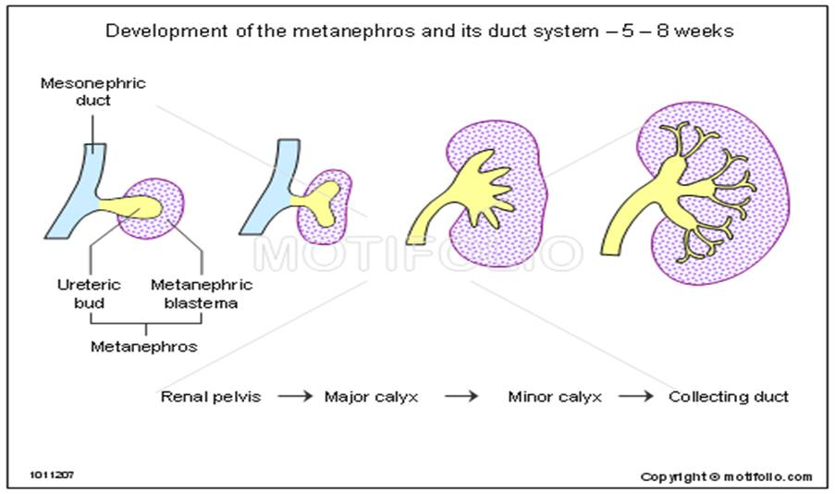

Slide 62
Embryology
Ureteric Bud
Ureter
Calyceal System
Renal Pelvis

Slide 63
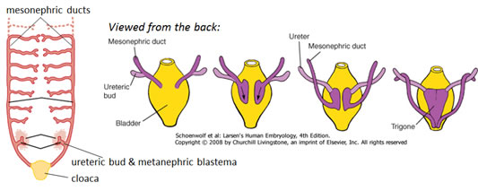

Slide 64
Embryology
Three possible sites of mechanical obstruction that represent the confluence of 2 or more embryologic structures (ureter-bladder or ureter-kidney)
  Pelvicalyceal
  UP
  UV

Slide 65
Embryology
Complex cellular crosstalk and induction
  Any imprecision VUR/UPJO
Recanalization: Only in the middle portion of the ureter
No theories to explain why the UPJ is the most common site of congenital ureteral obstruction

Slide 66
Clinical Presentation
Infants
Children
Asymptomatic
Diagnosed by prenatal ultrasound
Before the advent of prenatal ultrasound:
  Palpable abdominal mass at birth
  Less often: Work-up for:
    UTI
    FTT
    Poor feeding
    Kidney stones
Symptomatic/Asymptomatic
Variety of signs and symptoms:
  Episodic flank pain
  Episodic abdominal pain +/- vomiting
  Cyclic vomiting
  UTI
  Nephrolithiasis
  Hematuria
  Anorexia

Slide 67
Antenatal Manifestations
Starting 8 weeks: Mesonephros Urine
Fetal U/O:
  5mL/hr at 20 weeks
  50mL/hr at 40 weeks
Perform U/S at 16-20 weeks, when adequate U/O is established
Normal kidneys can be detected at 17-19 weeks
Markedly dilated collecting systems can be detected at 12-14 weeks

Slide 68
U/S Features
Pelviectasis
  Usually unilateral
  Less frequently: Bilateral
Normal amniotic fluid volume
No ipsilateral ureteral dilation
Normal bladder wall thickness
Normal cycling of the bladder

Slide 69
U/S Limitations
Can detect hydronephrosis and abnormal anatomy but cannot differentiate between disease processes
Cannot distinguish between:
  True obstructive uropathy and transient hydronephrosis of the neonate
  UPJO and MCDK
May need sequential renal U/S and other complementary imaging for follow-up

Slide 70
Special Situation
Male Fetus
Bilateral Hydronephrosis
R/O Bladder Outlet Obstruction (PUV)

Slide 71
Grading of Hydronephrosis
Grade | Features
1 | Slight splitting of the central renal complex w/o calyceal involvement Normal parenchyma
2 | Splitting of the central renal complex w/ extension to non-dilated calyces
3 | Wide splitting of the renal pelvis, dilated outside the renal border Calyces uniformly dilated Normal parenchyma
4 | Large, dilated calyces (may appear convex) Thinning of the parenchyma to ≤ 50% of the contralateral, non-hydronephrotic kidney

Slide 72
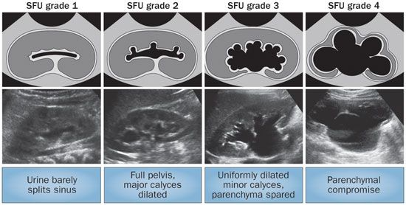

Slide 73
Prenatal Counseling
1-25% of prenatally detected genitourinary abnormalities require surgical intervention
Prenatal referral
Survival of fetuses with unilateral obstructive hydronephrosis: 100%
Postnatal follow-up

Slide 74
Postnatal Manifestations
Symptomatic / Asymptomtic
Symptoms:
  Episodic abdominal / flank pain
  Less commonly: UTI
  Dietl crisis:
    Cyclic abdominal pain, usually associated with vomiting

Slide 75
Postnatal Manifestations
Can be diagnosed while evaluating vague, chronic abdominal symptoms
Nephrolithiasis:
  Incidence = 17 times higher in UPJO
Left-sided hydronephrosis
  Mass effect on stomach
  Early satiety, anorexia and vomiting
  FTT

Slide 76
Postnatal Manifestations: UTI
Initial presentation:
  In 30%
  Beyond the neonatal period
May have profound urosepsis

Slide 77
Differential Diagnosis
Obstructive
Non-Obstructive
OPJO (I=44%)
UVJO (I=21%
Duplicated collecting system (I=12%)
PUV (I= 9%)
MCDK
Ureterocele
Ectopic ureter
Sacrococcygeal teratoma
Hydrometrocolpos
VUR (I=14%)
Physiologic dilation
Prune-belly syndrome
Renal cystic disease
Megacalicosis

Slide 78
Differential Diagnosis
It is easy to diagnose hydroneohrosis
It is difficult to:
  Prove obstruction
  Differentiate significant from insignificant obstruction in an infant
No single imaging study can predict progressive kidney damage

Slide 79
Thank You!

