Slide 2
Organ transplantation program in the Kingdom started in 1979 when the first kidney from a living donor was transplanted in Riyadh Military Hospital.
By the end of 2017 a total of 11,509 kidneys were transplanted; 7,838 were from living related donors, 3,108 from deceased donors and 563 from living unrelated donors.

Slide 3
The program received a big boost with the inception of the National Kidney Foundation in 1984 and further in 1993 when the organization was upgraded and renamed as Saudi Center for Organ Transplantation (SCOT)

Slide 4
Pancreas transplantation was started at Al-Shaty Teaching Hospital-Jeddah.
A total of 64 pancreas were transplanted since the inception of the program in 1990.
In this year 18 pancreas transplantations were done, 16 at KFSHRC-Riyadh

Slide 5
Liver transplantation program in the Kingdom was started in 1990 and by the end of 2017 a total of 2,233 livers were transplanted.
1,133 livers from living related donors, 95 from living unrelated donors and 1,005 form deceased donors.

Slide 6
The first heart transplant operation in the Kingdom was performed in 1986 at Riyadh Military Hospital.
In this year, 37 whole hearts were transplanted and 21 hearts were recovered to be used as source for valves

Slide 7
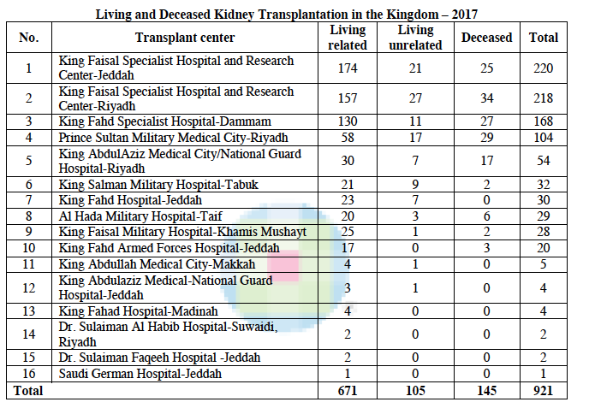

Slide 8
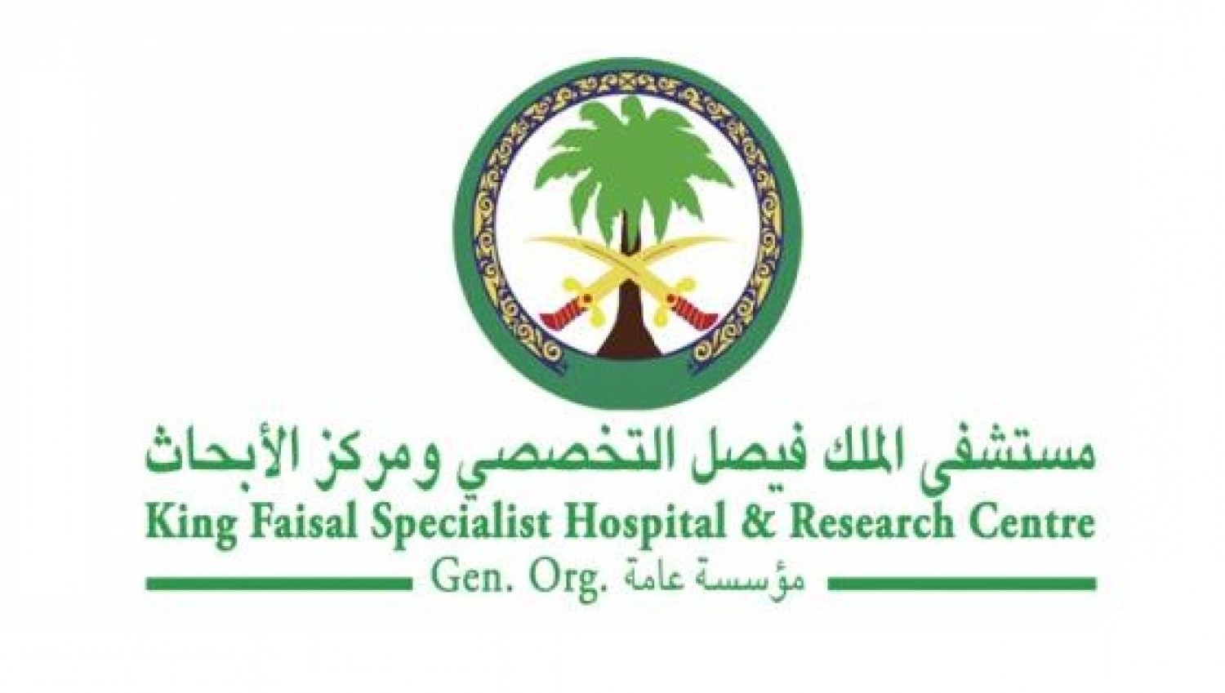
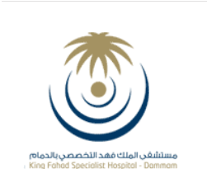

Slide 9
 | 2018 | 2017 | 2016 | 2015 | 2014
Total Pediatric Kidney Transplant | 40 | 40 | 38 | 39 | 38
Deceased Donor | 10 | 11 | 7 | 8 | 7
Living Donor | 30 | 29 | 31 | 31 | 31

Slide 10
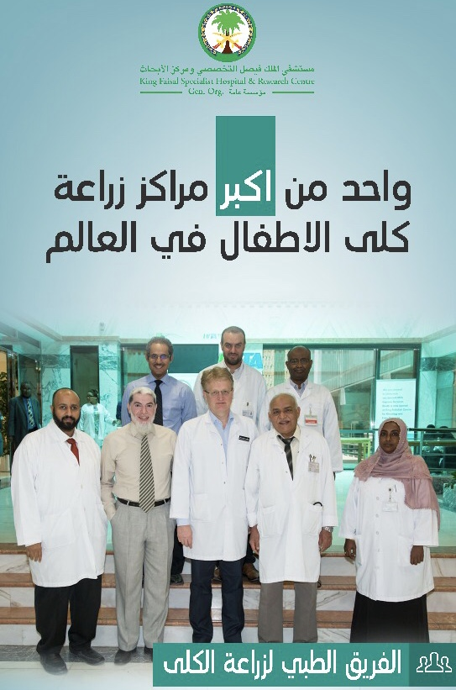

Slide 12
PH1: - 3- 4 per year
- 1-2 per year as Sequential Liver- Kidney Tx
Chloride Losing Diarrhea: 5 cases have been genetically confirmed and all of them transplanted
Cystinosis: more than 60 cases have been genetically confirmed ,and almost ½ of them been transplanted

Slide 13
FHHN : 6 cases have been genetically confirmed and all of them transplanted
aHUS

Slide 14
