Slide 1
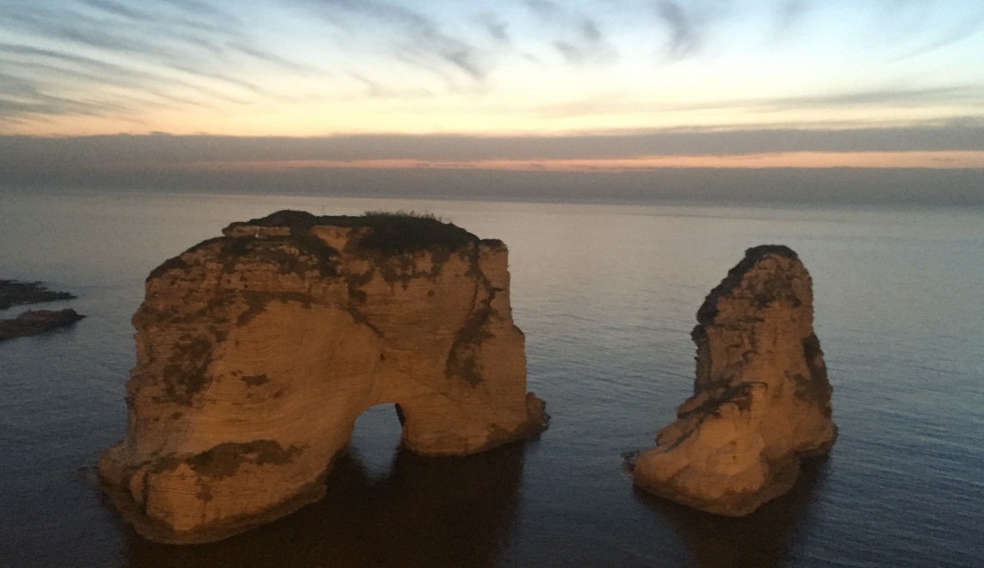
Cystinosis in the Middle east
NEVEEN A SOLIMAN
Professor of Pediatrics
Kasr Al Ainy School of Medicine, Cairo University
Egyptian Group for Orphan Renal Diseases (EGORD)
IPNA-ISN Teaching Course, Beirut June 15, 2019
nsoliman@kasralainy.edu.eg

Slide 2
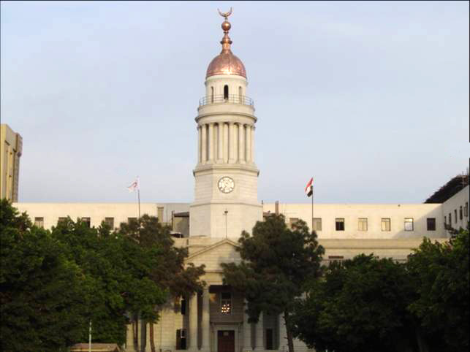
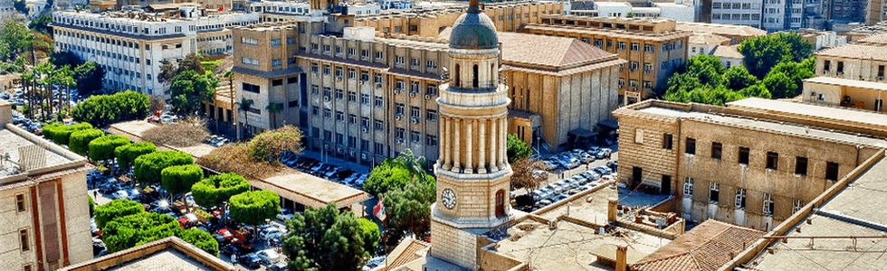
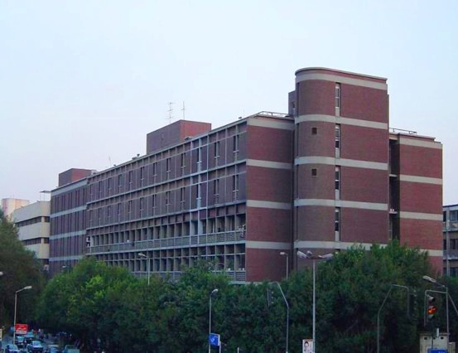
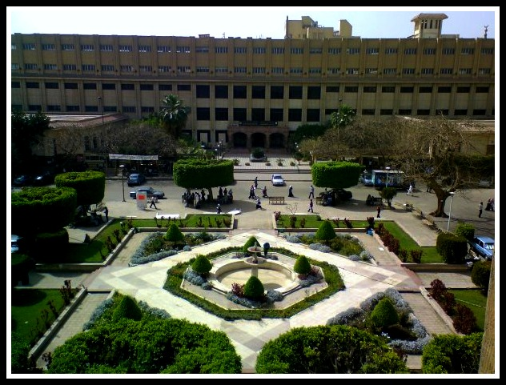

Slide 3
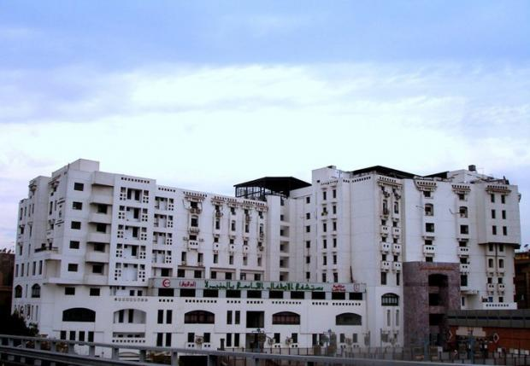
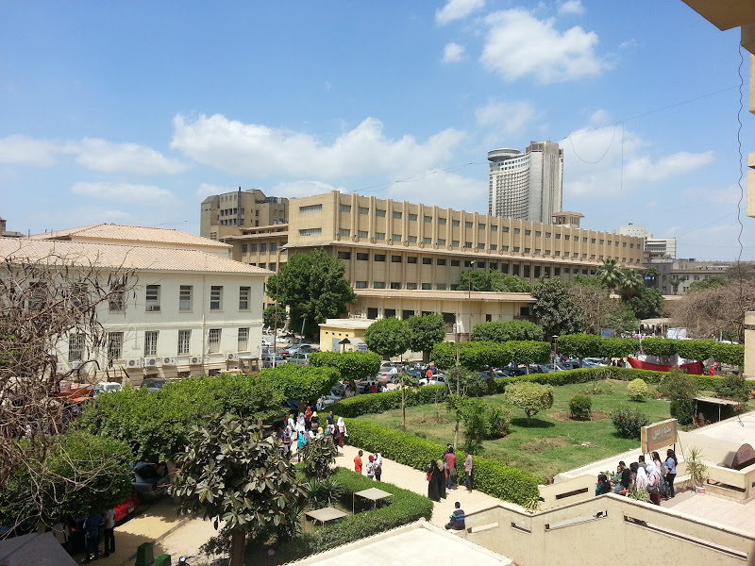
Cystinosis Clinic

Slide 4
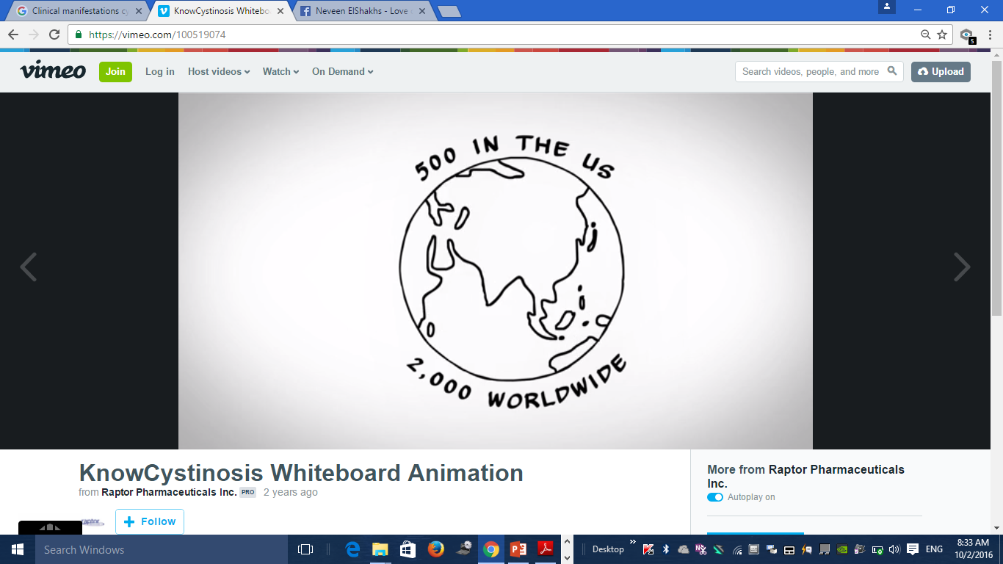


Kasr Al Ainy School of Medicine
Cairo University

Slide 5
How many in the region?
Kasr Al Ainy School of Medicine
Cairo University

Slide 6
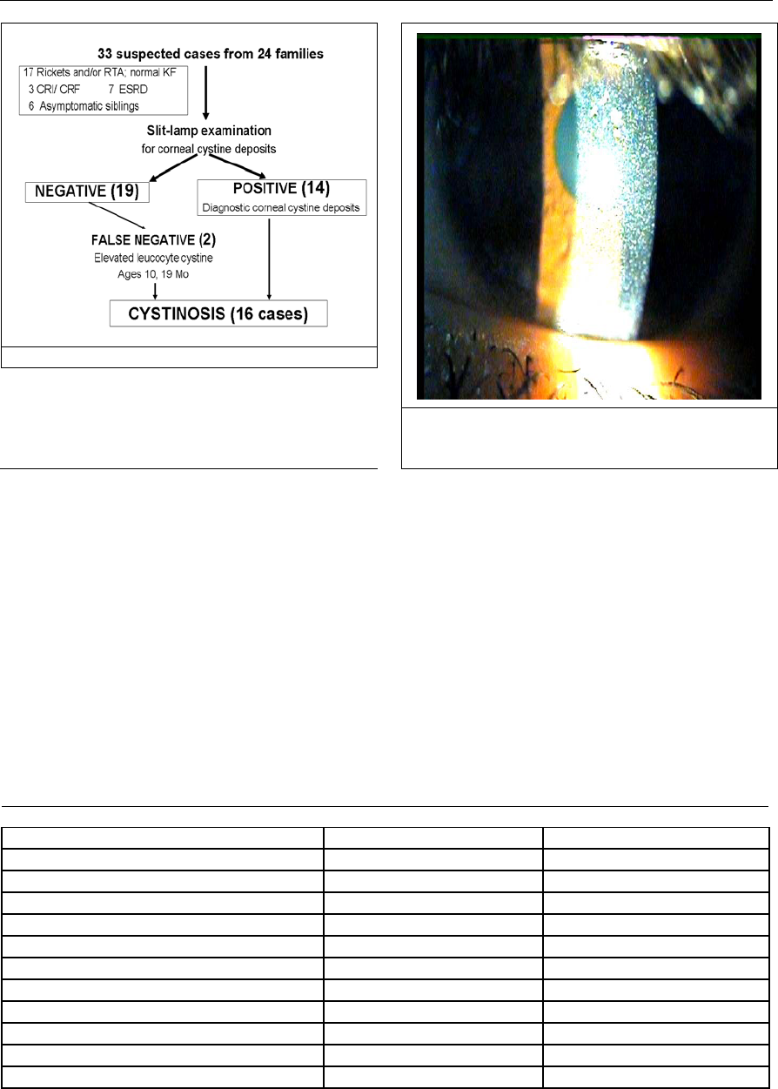
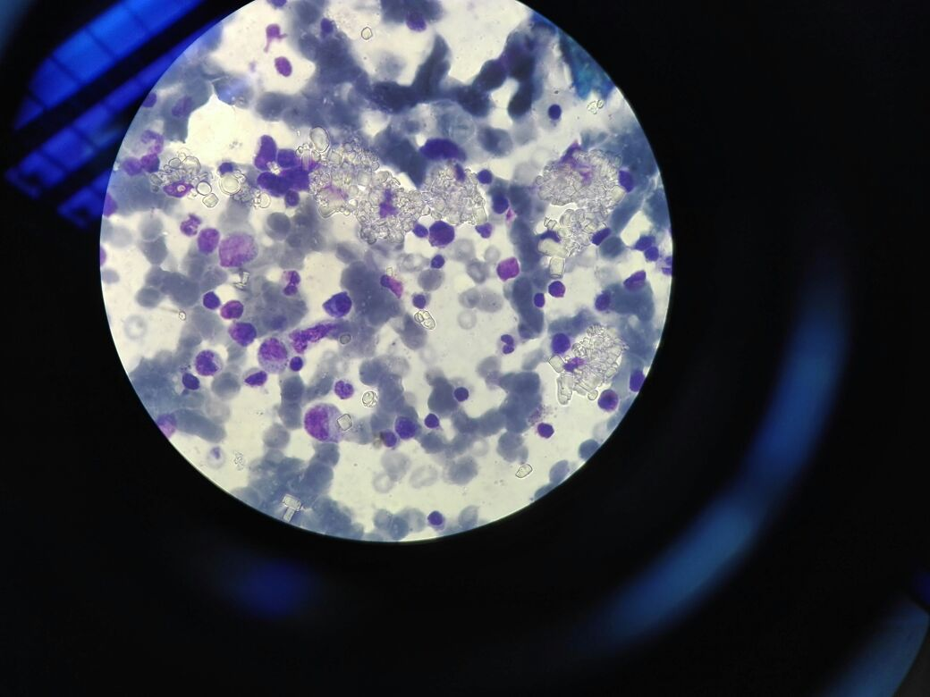
Cystinosis
Metabolic disease characterized by an accumulation of cystine in different organs and tissues, leading to potentially severe organ dysfunction
Kasr Al Ainy School of Medicine
Cairo University

Slide 7
Intermediate form
MIM #219900
Adult form
MIM #219750
MIM #219800
Nephropathic form
Kasr Al Ainy School of Medicine
Cairo University

Slide 8
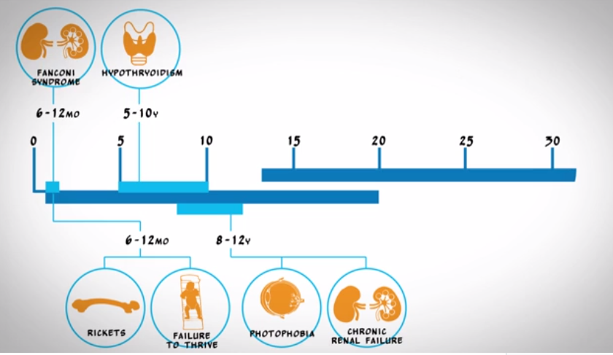
Nephropathic
Cystinosis
Clinical manifestations are age dependent
Early
Kasr Al Ainy School of Medicine
Cairo University

Slide 9
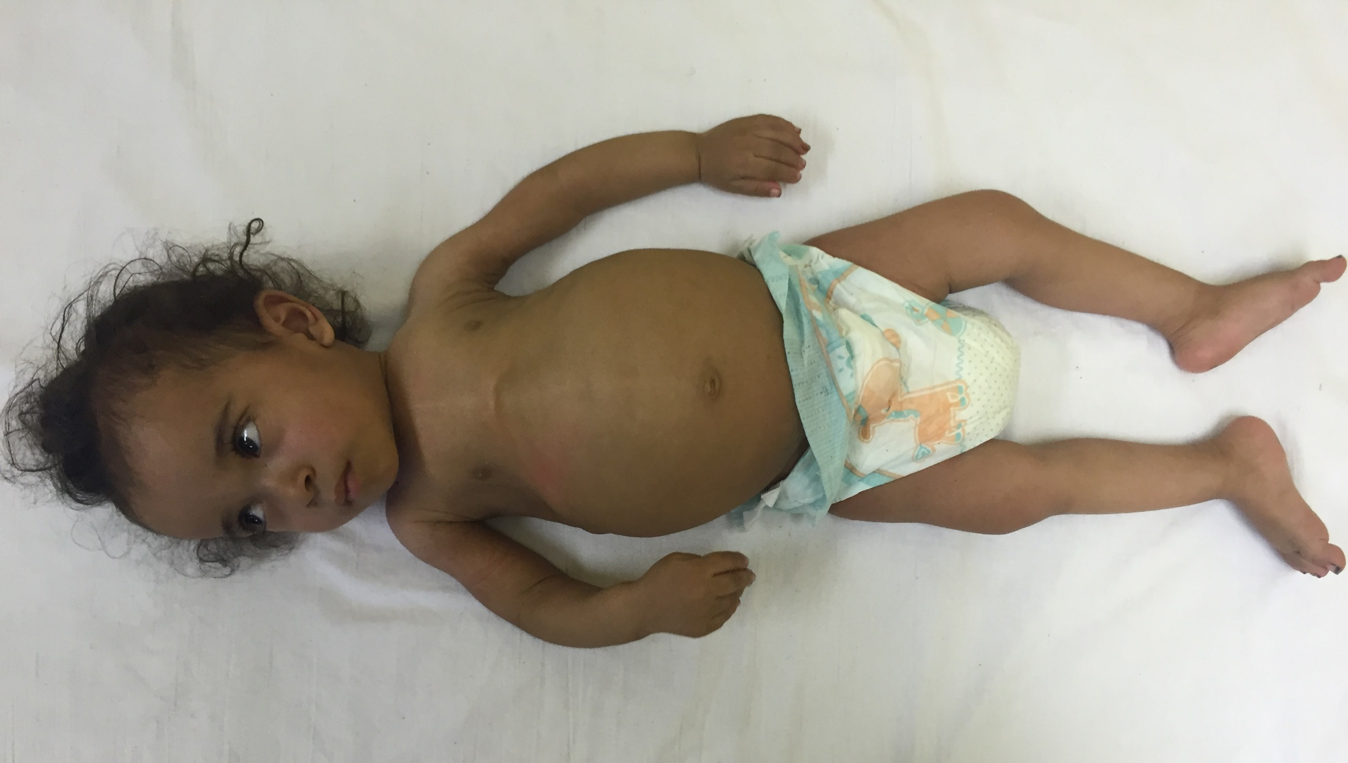
Kasr Al Ainy School of Medicine
Cairo University

Slide 10
Elmonem et al., Orphanet J Rare Dis, 2016
Kasr Al Ainy School of Medicine
Cairo University

Slide 11
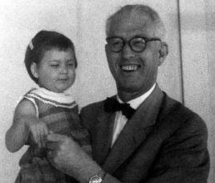
Guido Fanconi 1892-1979
Kasr Al Ainy School of Medicine
Cairo University

Slide 12
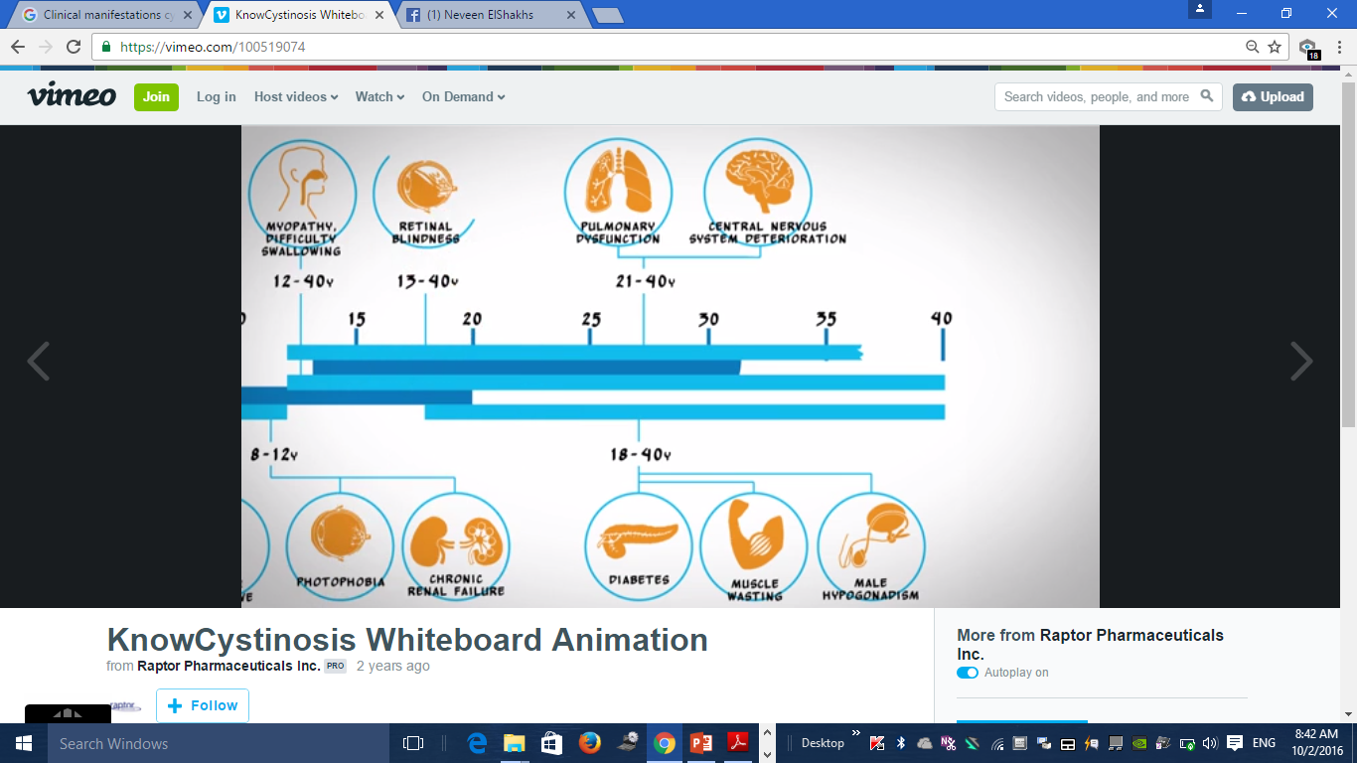
Nephropathic
Cystinosis
Clinical manifestations are age dependent
Late
Kasr Al Ainy School of Medicine
Cairo University

Slide 13
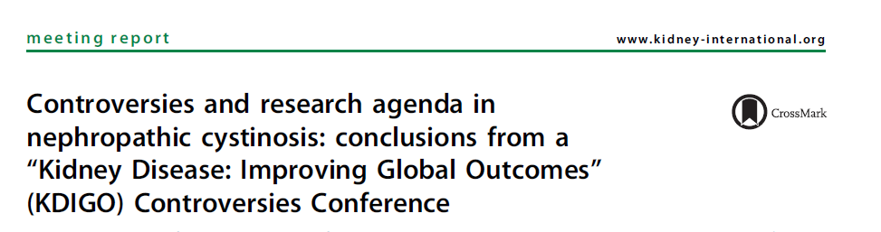
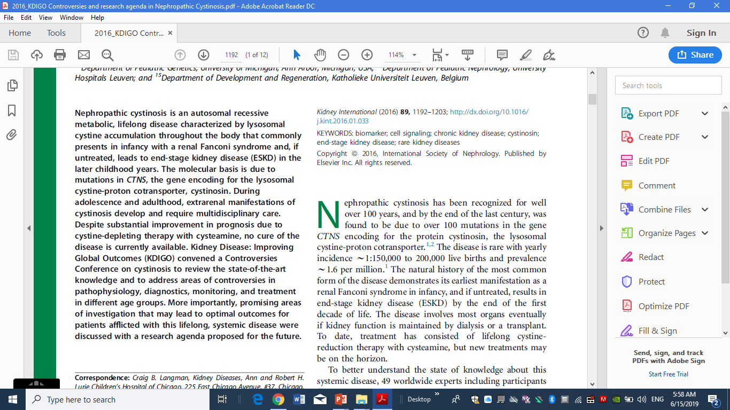
Kasr Al Ainy School of Medicine
Cairo University

Slide 14
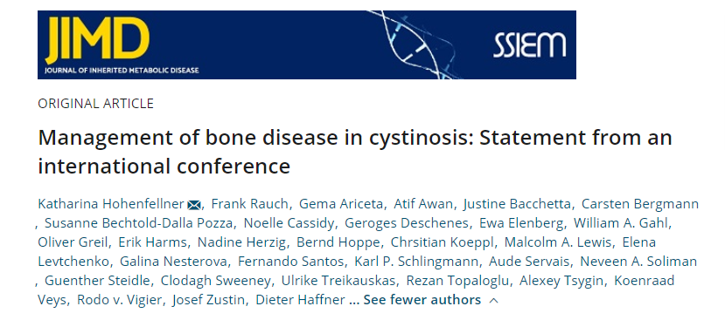
Kasr Al Ainy School of Medicine
Cairo University

Slide 15

Cystinosis
Kasr Al Ainy School of Medicine
Cairo University

Slide 16
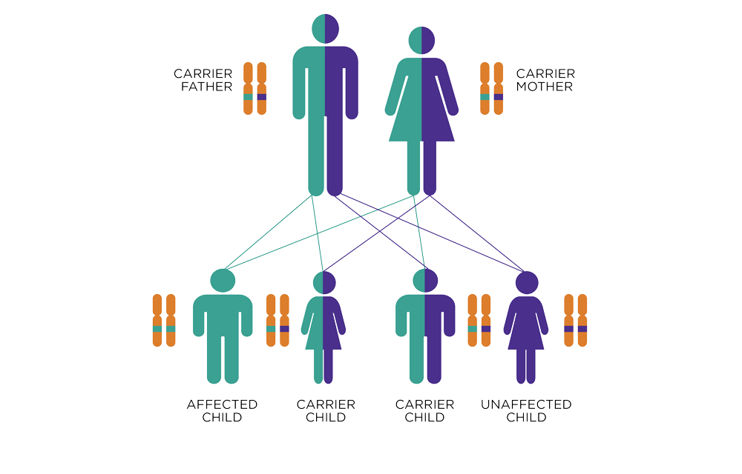
Kasr Al Ainy School of Medicine
Cairo University

Slide 17
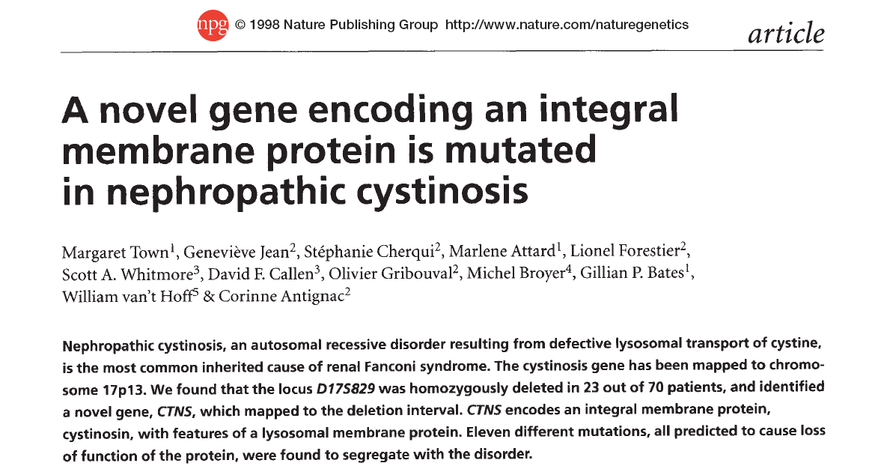
Kasr Al Ainy School of Medicine
Cairo University

Slide 18
Elmonem et all., Orphanet Journal of rare diseases, 2001
Kasr Al Ainy School of Medicine
Cairo University
Notes:
A large number of mutations have been described in patients with cystinosis, with the clinical phenotype segregating with specific defects

Slide 19
Global total consanguinity rates
Hammamy et al, Genetics in Medicine 2011

Slide 20
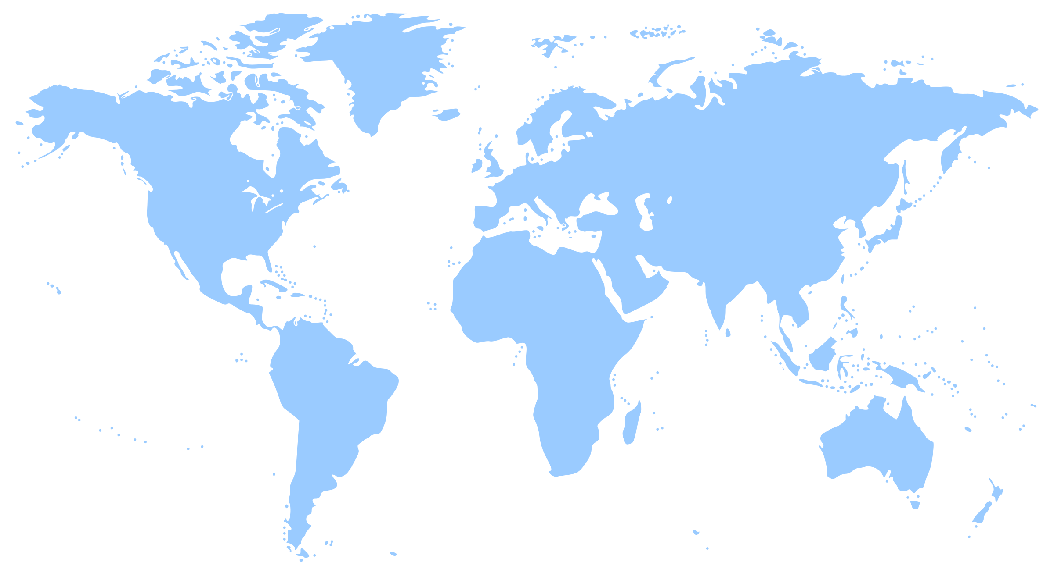
Kasr Al Ainy School of Medicine
Cairo University
Notes:
A large number of mutations have been described in patients with cystinosis, with the clinical phenotype segregating with specific defects

Slide 21
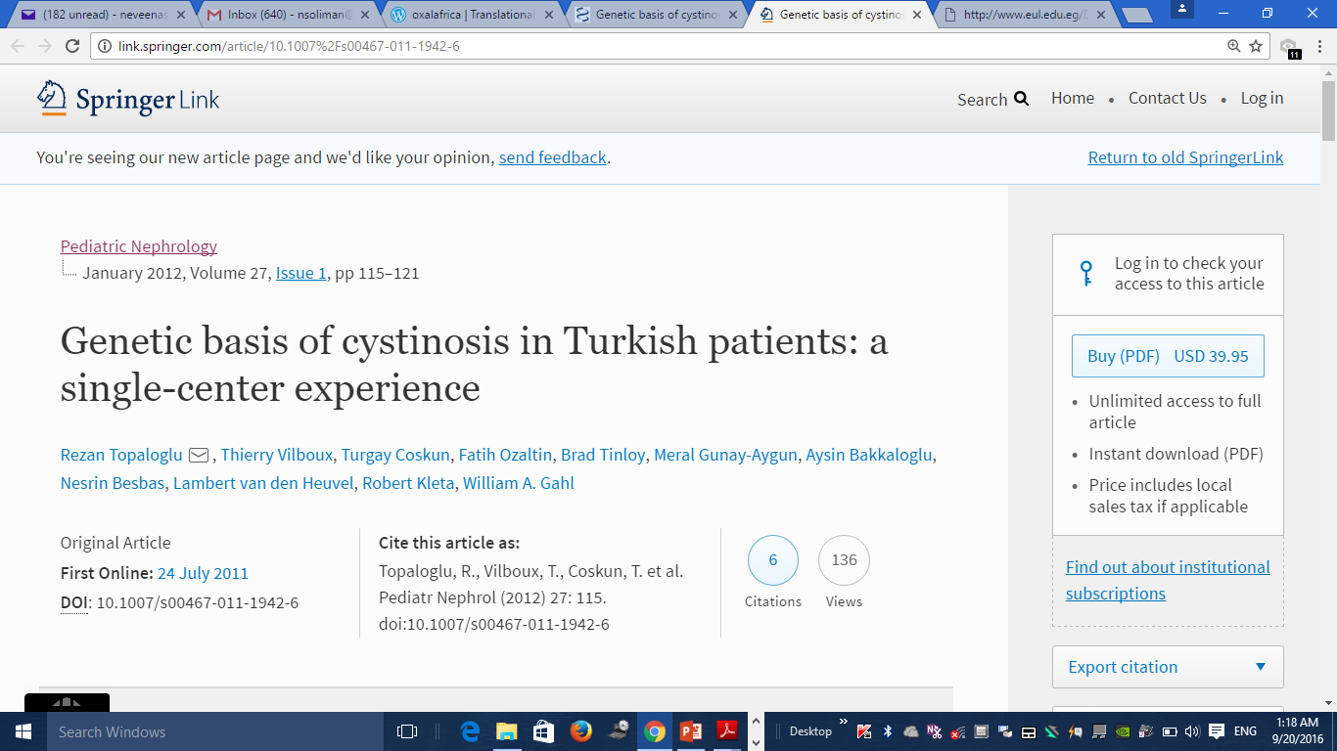
Twelve cystinosis patients from ten families
None had the 57-kb deletion
Thirteen different variants
Newly identified missense variations:
      c.451A>G
        c.518A>G
          c.470 G>A
Kasr Al Ainy School of Medicine
Cairo University

Slide 22
Kasr Al Ainy School of Medicine
Cairo University

Slide 23
Kasr Al Ainy School of Medicine
Cairo University
Notes:
A large number of mutations have been described in patients with cystinosis, with the clinical phenotype segregating with specific defects

Slide 24
Kasr Al Ainy School of Medicine
Cairo University

Slide 25
Fifteen cystinosis patients from 13 unrelated families
None had the 57-kb deletion
10/15 had homozygous mutations
Twenty-seven mutant alleles and 12 pathogenic mutations were detected including six novel mutations
Soliman et al., JIMD Reports , 2014
Kasr Al Ainy School of Medicine
Cairo University

Slide 26
Kasr Al Ainy School of Medicine
Cairo University

Slide 27
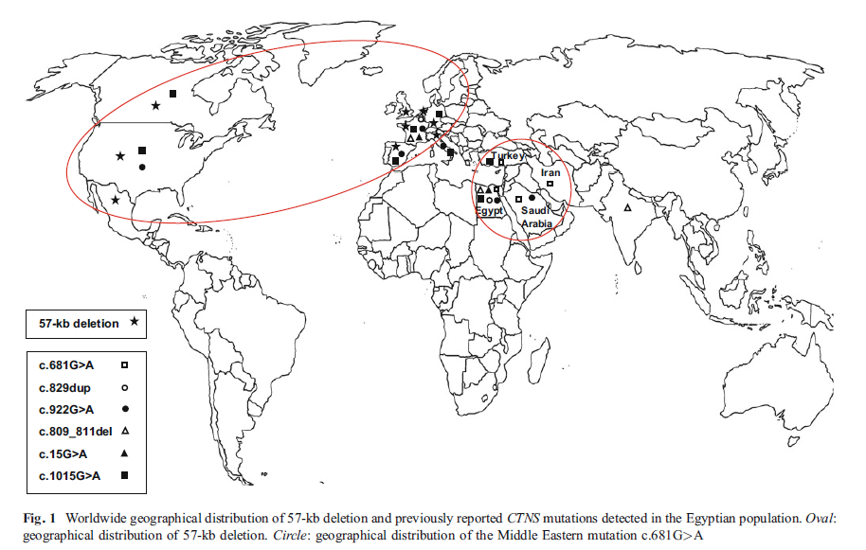
Nephropathic Cystinosis
Soliman et al., JIMD Reports 2014

Slide 28
Kasr Al Ainy School of Medicine
Cairo University
Notes:
A large number of mutations have been described in patients with cystinosis, with the clinical phenotype segregating with specific defects

Slide 29
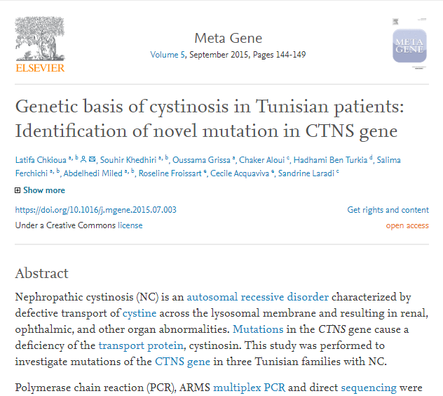
Kasr Al Ainy School of Medicine
Cairo University

Slide 30
Kasr Al Ainy School of Medicine
Cairo University
Notes:
A large number of mutations have been described in patients with cystinosis, with the clinical phenotype segregating with specific defects

Slide 31
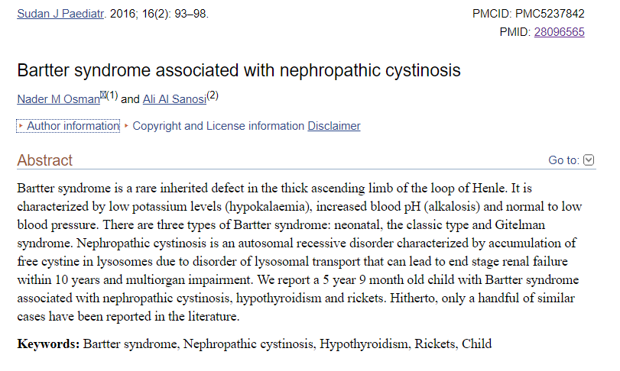
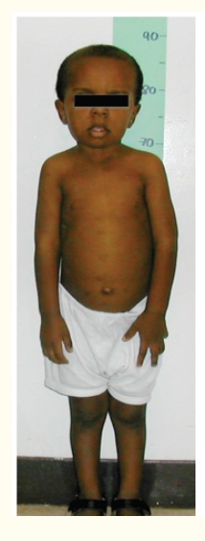
Kasr Al Ainy School of Medicine
Cairo University

Slide 32
Kasr Al Ainy School of Medicine
Cairo University
Notes:
A large number of mutations have been described in patients with cystinosis, with the clinical phenotype segregating with specific defects

Slide 33
Kasr Al Ainy School of Medicine
Cairo University

Slide 34
Kasr Al Ainy School of Medicine
Cairo University
Notes:
A large number of mutations have been described in patients with cystinosis, with the clinical phenotype segregating with specific defects

Slide 35
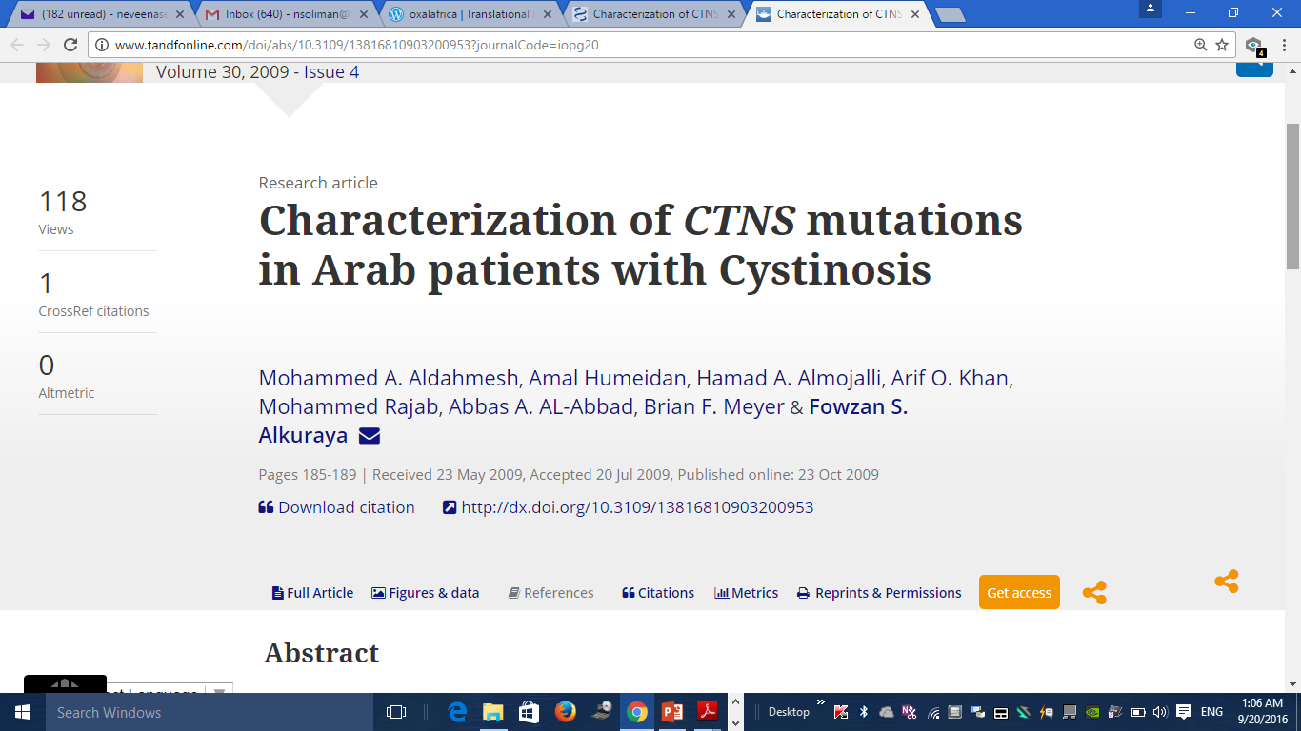
Reported CTNS mutational spectrum in 21 patients from 13 families of Arab origin
All but one mutation were homozygous for their respective mutations
Eight mutations were identified, four of which were novel
Kasr Al Ainy School of Medicine
Cairo University

Slide 36
Kasr Al Ainy School of Medicine
Cairo University
Notes:
A large number of mutations have been described in patients with cystinosis, with the clinical phenotype segregating with specific defects

Slide 37
CTNS mutations in 25 patients/24 unrelated families
Exons 3,5,9,11 & 12 in Southwestern Iran
Shahkarami et al., Nefrologia, 2013
CTNS gene mutations of 28 Iranian patients with nephropathic cystinosis
Age 1-17 years
None had the 57-kb deletion
Mutations were observed in exons 6 and 7 in 50% of patients
50% of the sixteen mutations were novel
Ghazin et al., Nefrologia, 2017
Kasr Al Ainy School of Medicine
Cairo University

Slide 38
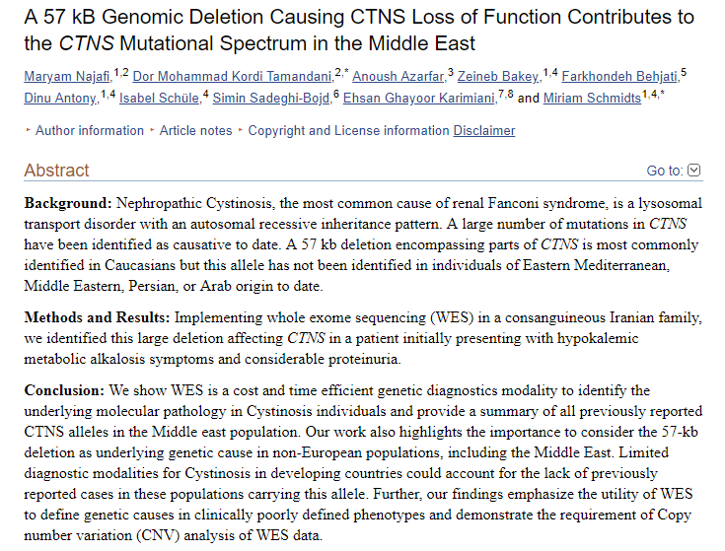

Kasr Al Ainy School of Medicine
Cairo University

Slide 39


Slide 40
Awareness
& Education
Research
Clinical Care
Kasr Al Ainy School of Medicine
Cairo University

Slide 41
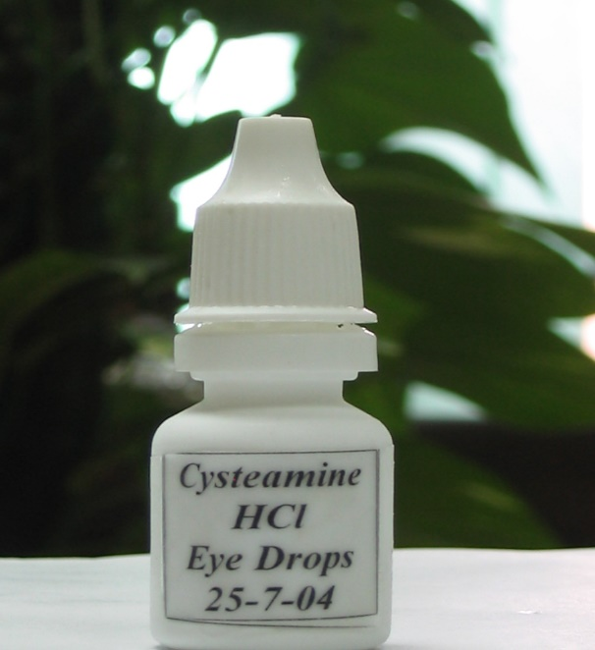
Challenges
Identifying patients
Diagnostic tools: cysteine essay & mutational analysis
Access to therapy: oral & topical
Multidisciplinary management
Genotyping
Clinical Registry
Follow up and monitoring
Kasr Al Ainy School of Medicine
Cairo University

Slide 42
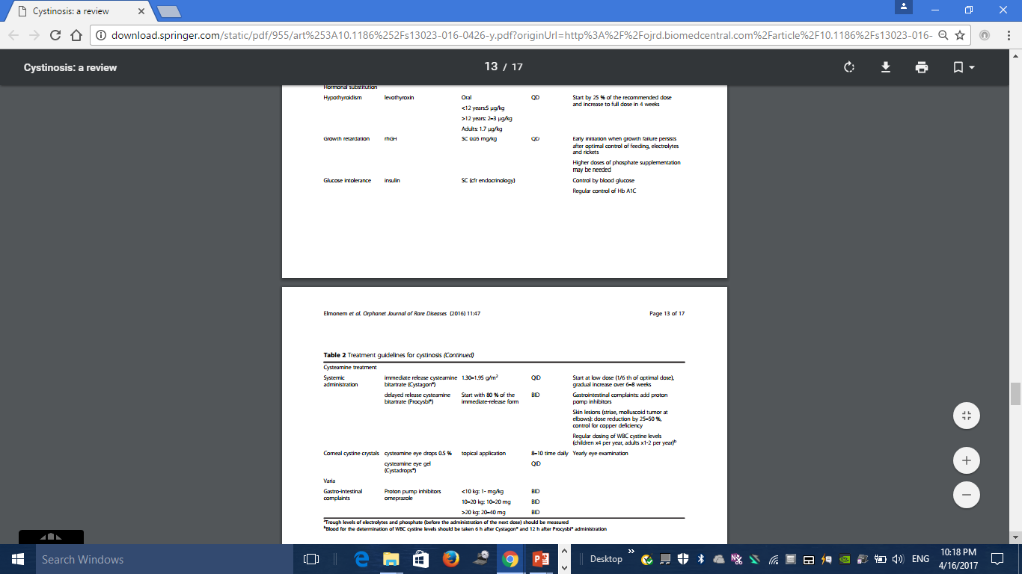
Kasr Al Ainy School of Medicine
Cairo University

Slide 43
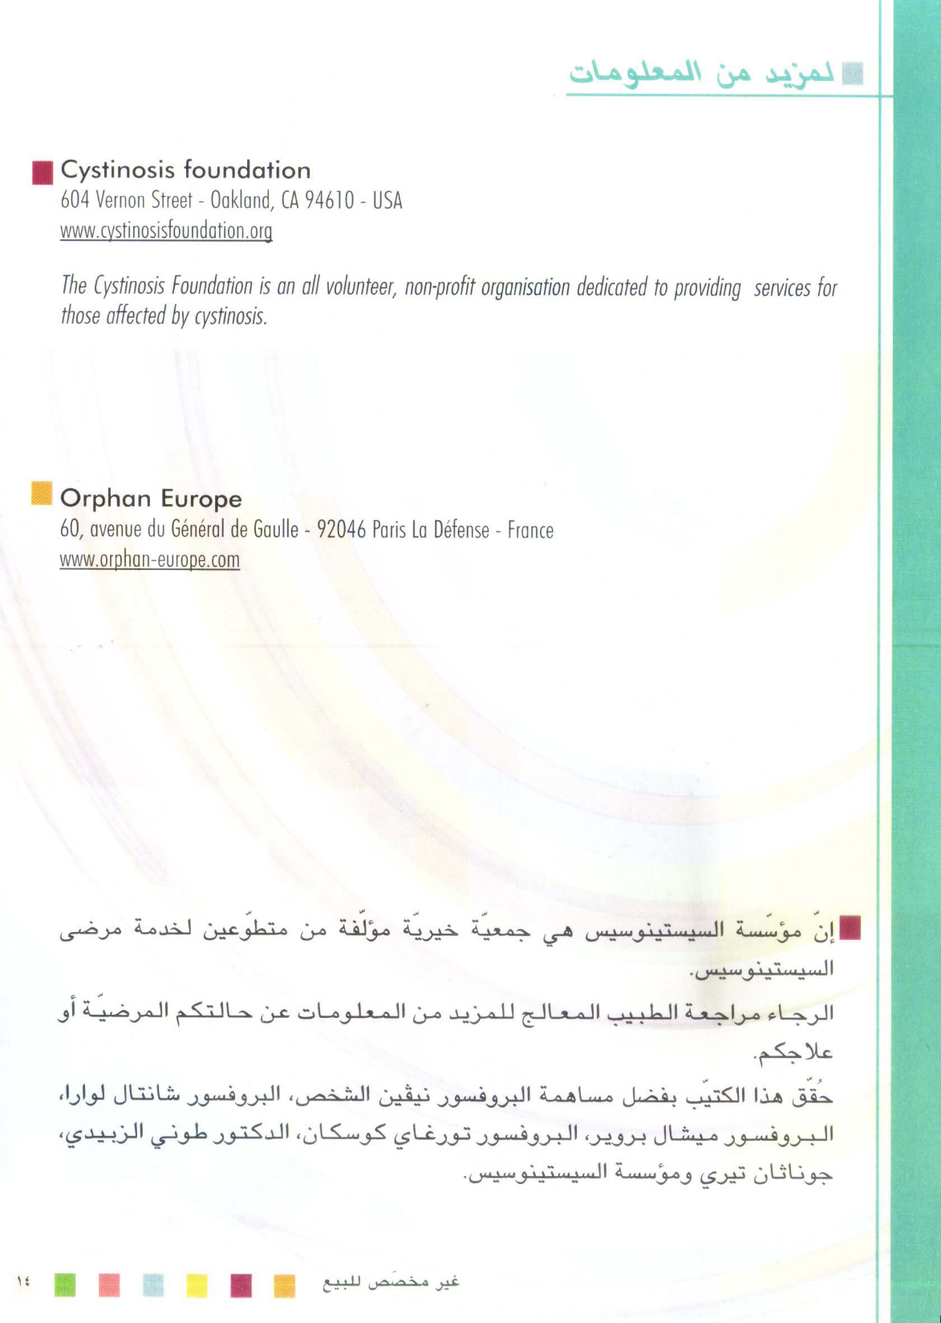
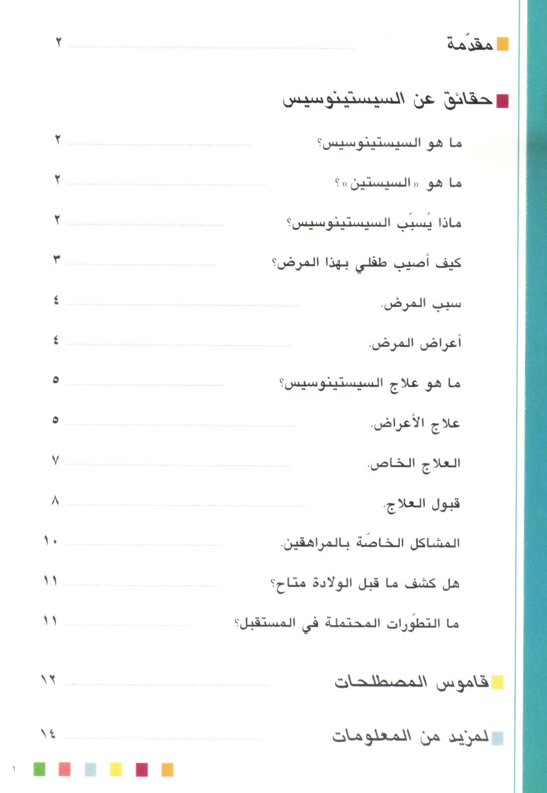
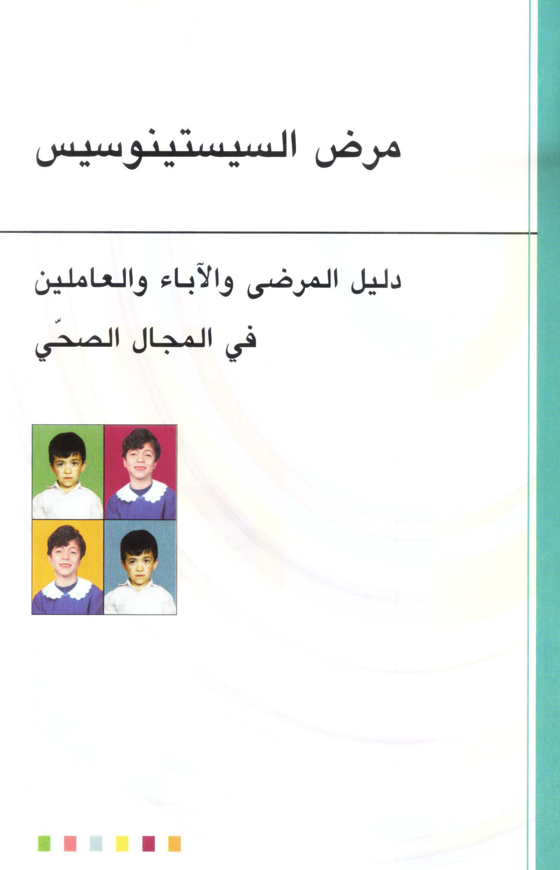

Slide 44
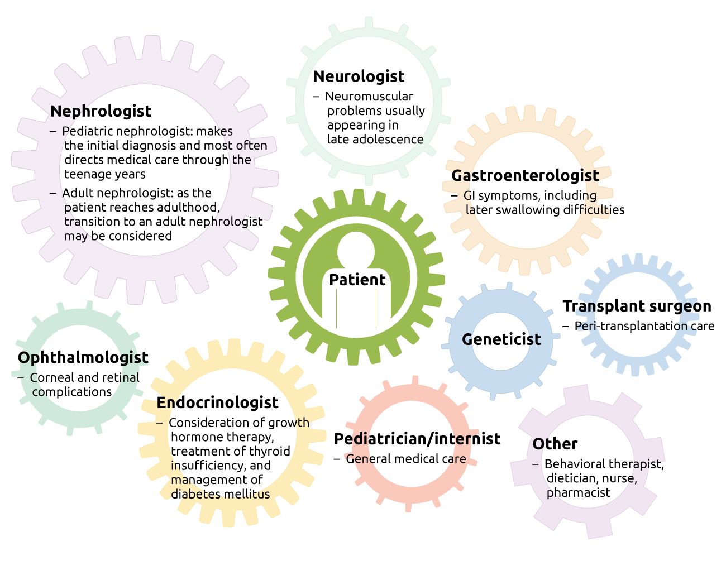

Slide 45

Nephrologists
Geneticists
Ophthalmologists
Radiologists
Chemical pathologists
Patients & families
Health policy making authorities
Society
are partners in the ongoing challenge of caring for cystinosis, noting that the impact of such diseases
should not be measured by numbers alone!
Kasr Al Ainy School of Medicine
Cairo University
Notes:
These hurdles should not be viewed as insurmountable because there are compelling social and ethical reasons to address the needs of patients with rare diseases.

Slide 46
Similar worldwide rate of diagnosis of nephropathic cystinosis before the age of 2 years
Yet
Clear disparities in cysteamine prescription rate between developed and developing countries
Bertholet-Thomas J, Bacchetta, J, Tasic V, Cochat P. NEJM, 2014
Notes:
This is an alarming reminder of the challenges facing cystinosis patients and their health care providers.

Slide 47
Think Cystinosis
Regional registry linked to international registry
Conclusion
Kasr Al Ainy School of Medicine
Cairo University

Slide 48
Cystinosis is a treatable genetic disorder
Diagnosis is still frequently delayed (rare – incomplete presentation)
High index of clinical suspicion -exclude renal Fanconi
syndrome in all infants with FTT
Timely diagnosis and multidisciplinary management
Early initiation of therapy is crucial
(organ damage & poor QOL if left untreated/partially treated)
Kasr Al Ainy School of Medicine
Cairo University

Slide 49
Elmonem et al., Orphanet J Rare Dis, 2016
Kasr Al Ainy School of Medicine
Cairo University

Slide 50
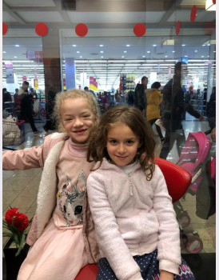
Kasr Al Ainy School of Medicine
Cairo University

Slide 51
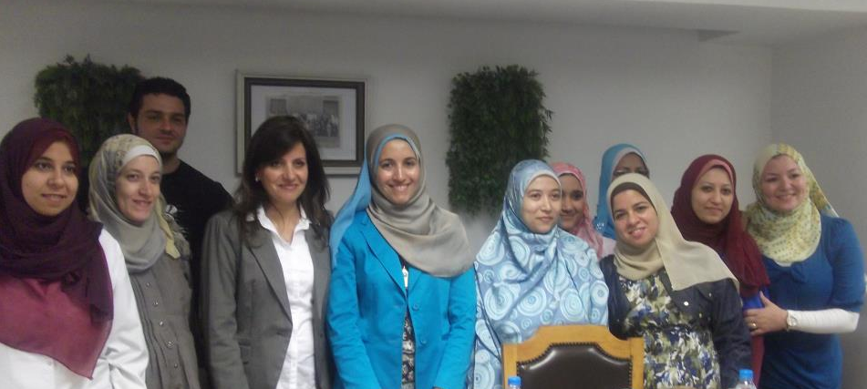
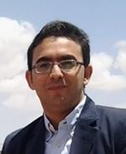
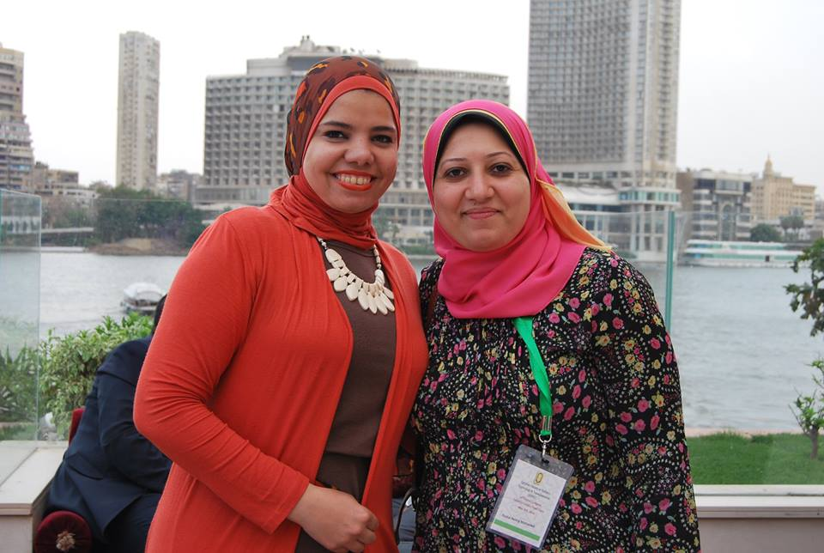
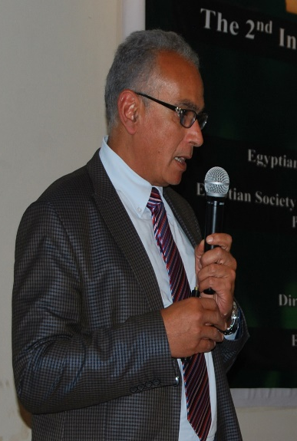

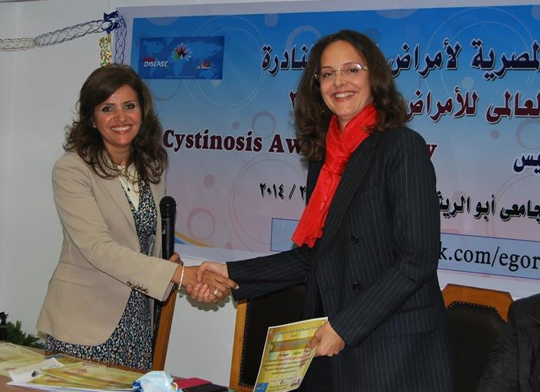

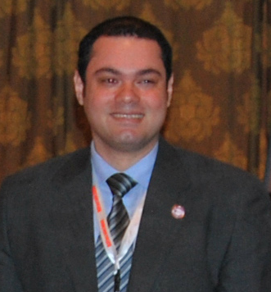

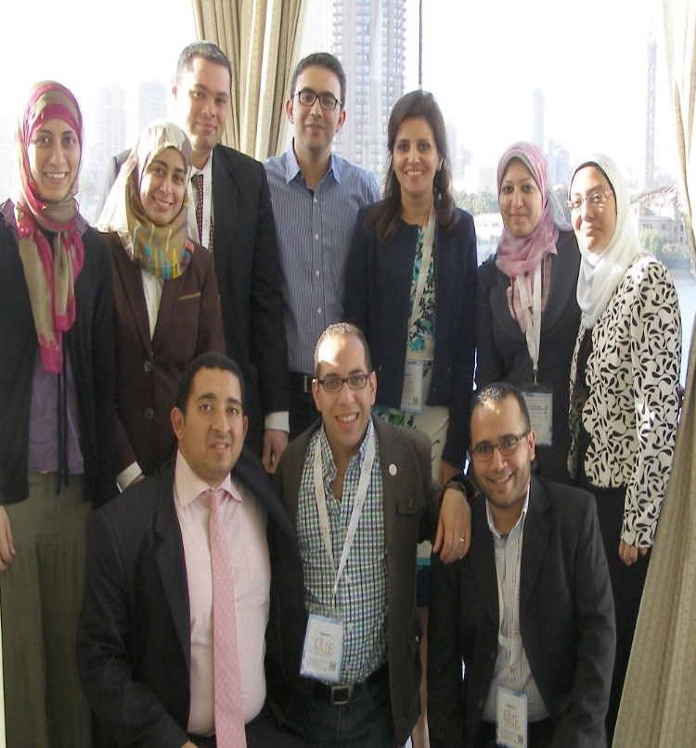
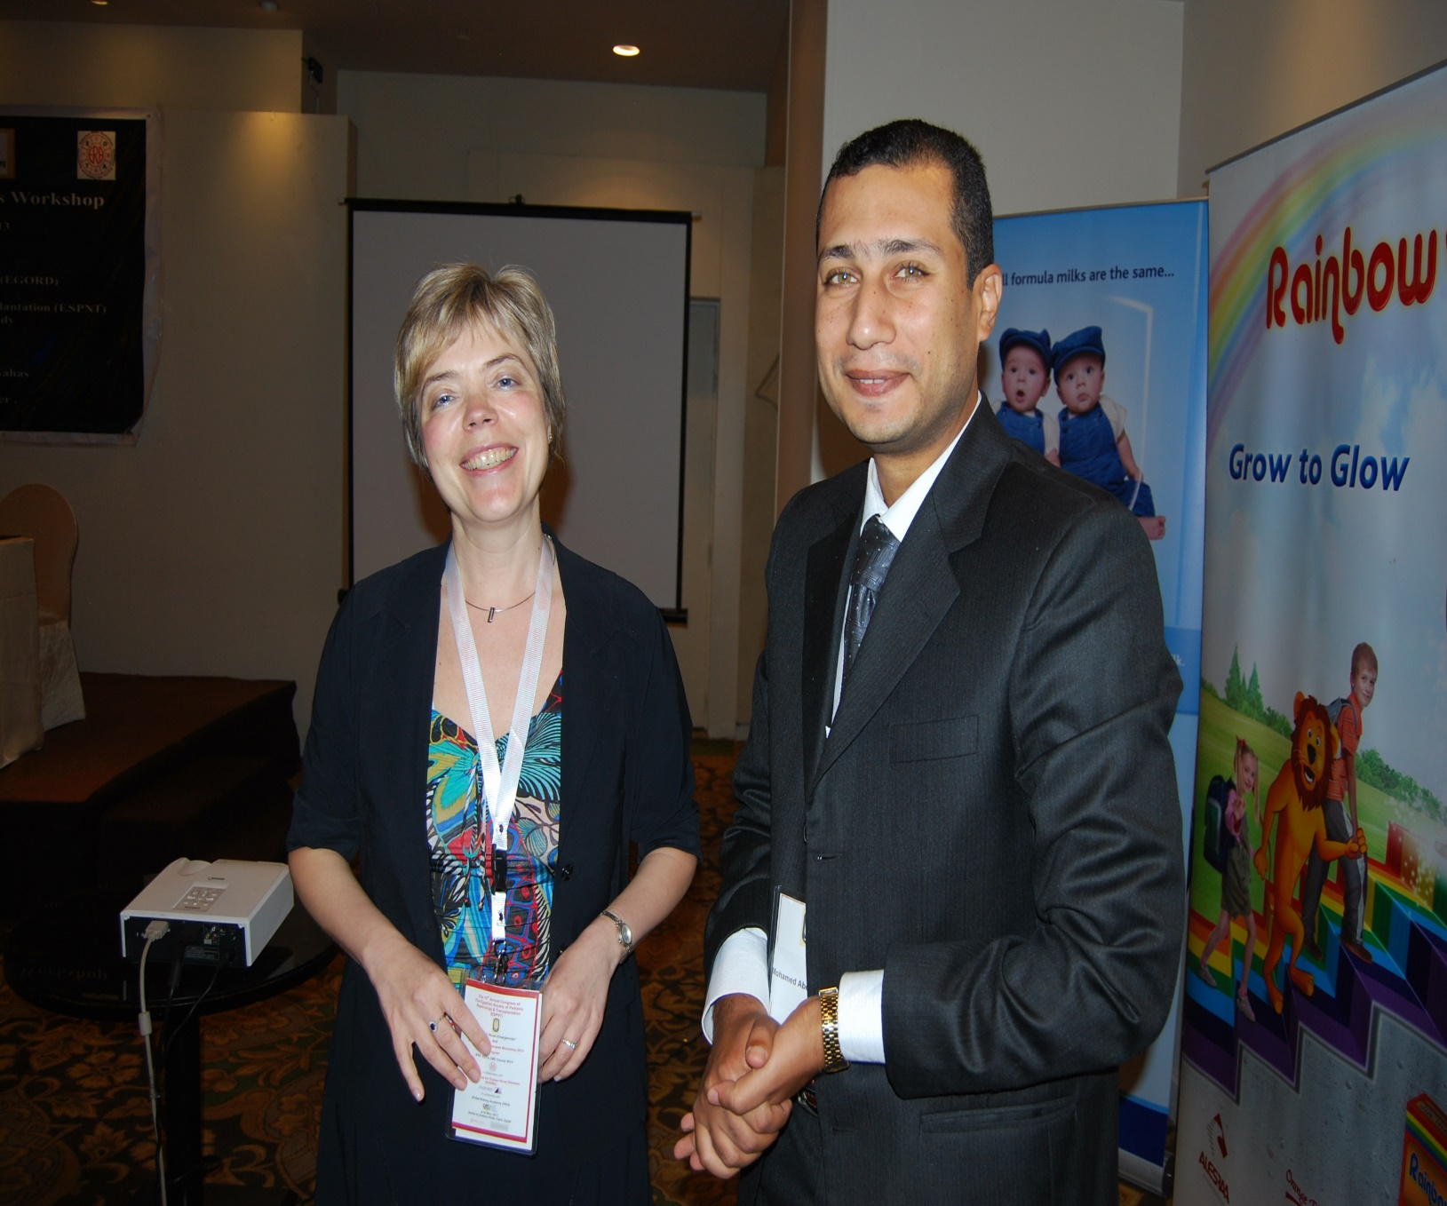
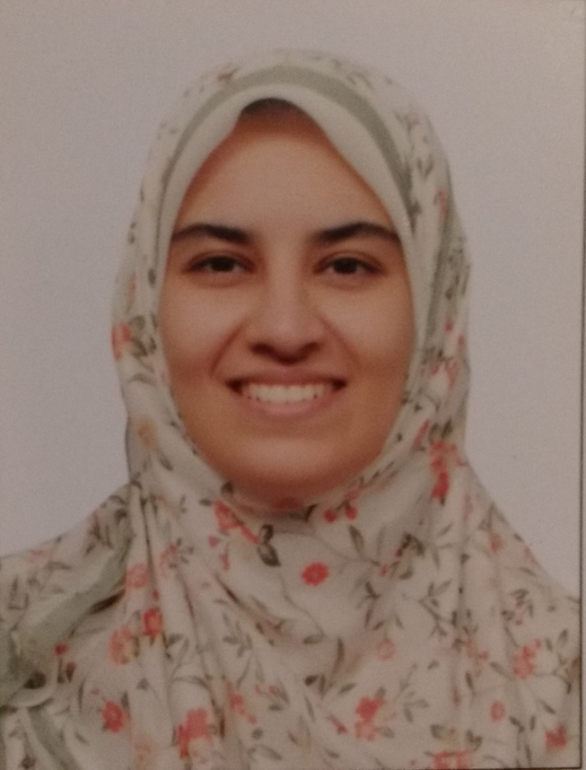
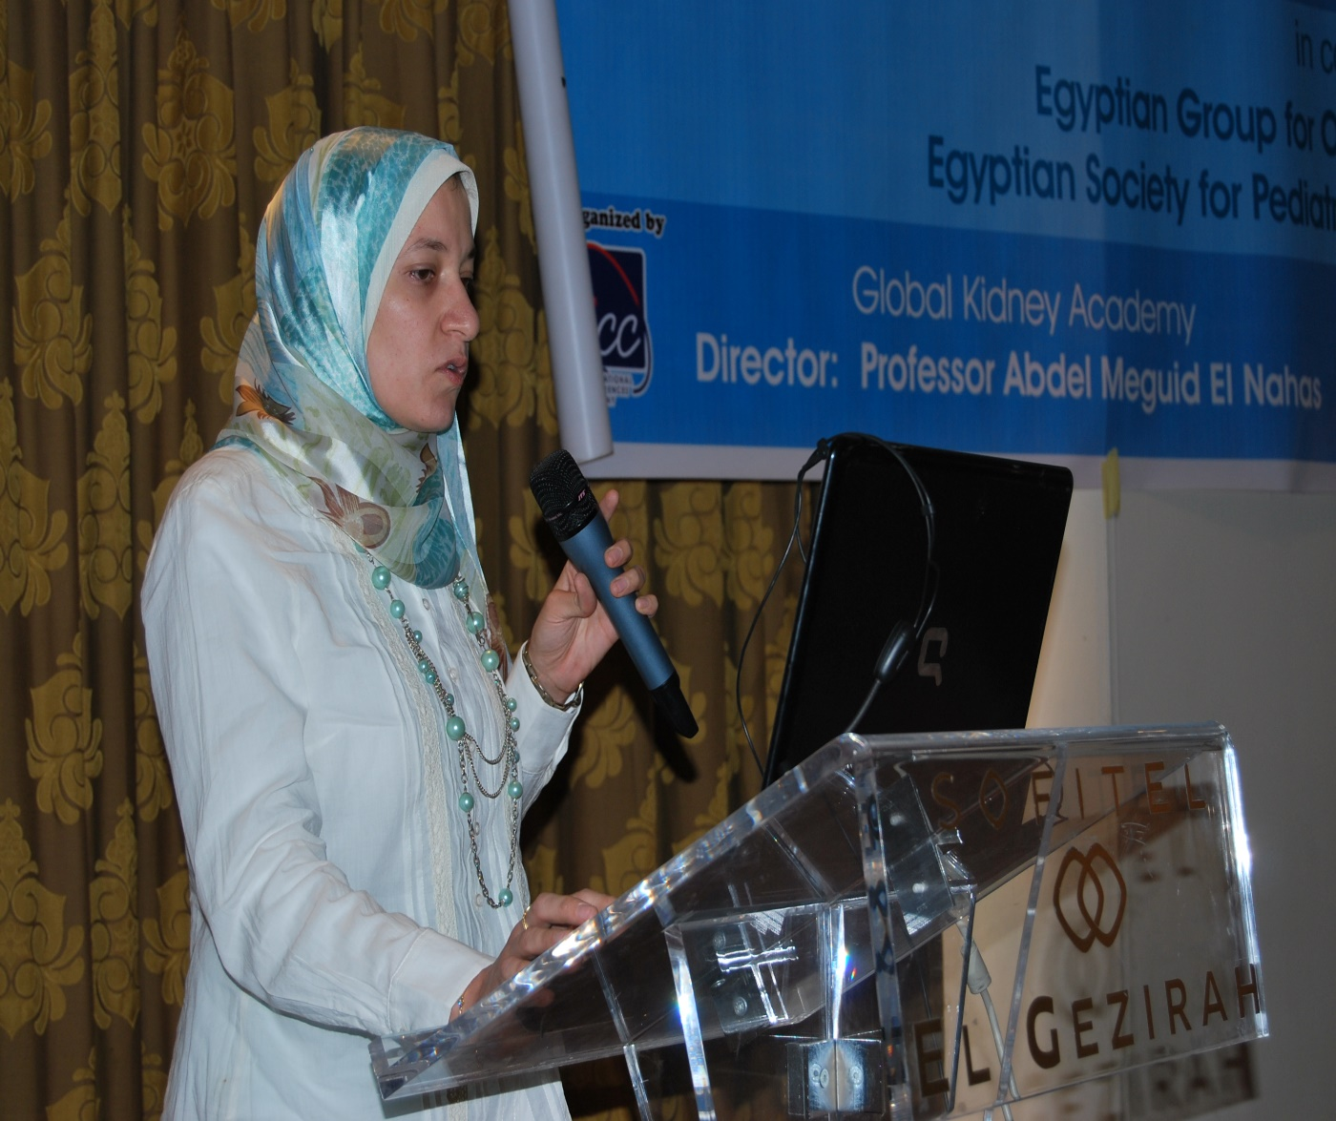
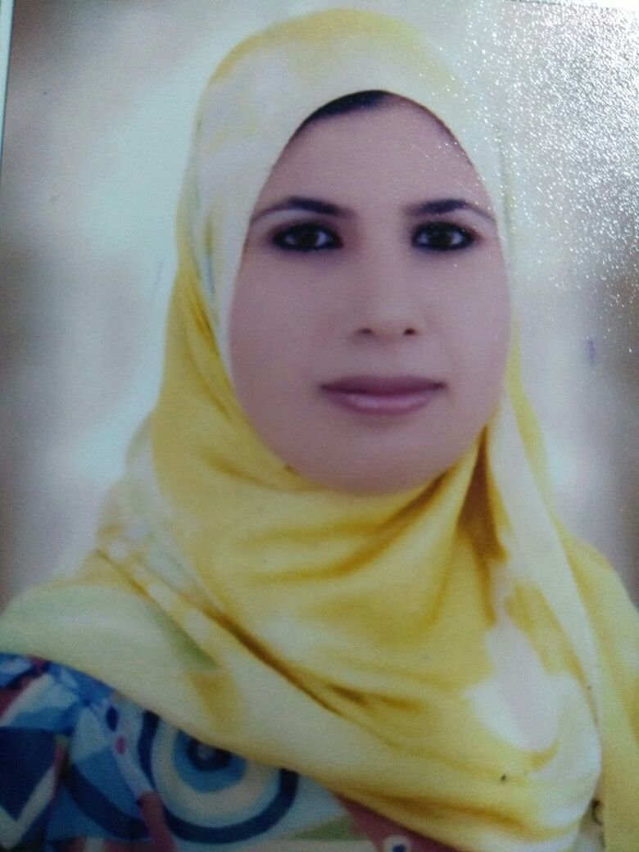
Prof. Magdi Amin
Faculty of Pharmacy Cairo University

Slide 52
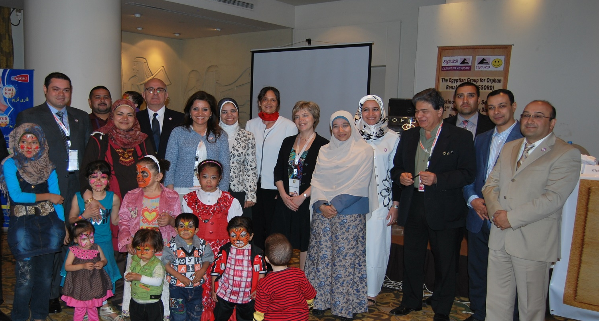
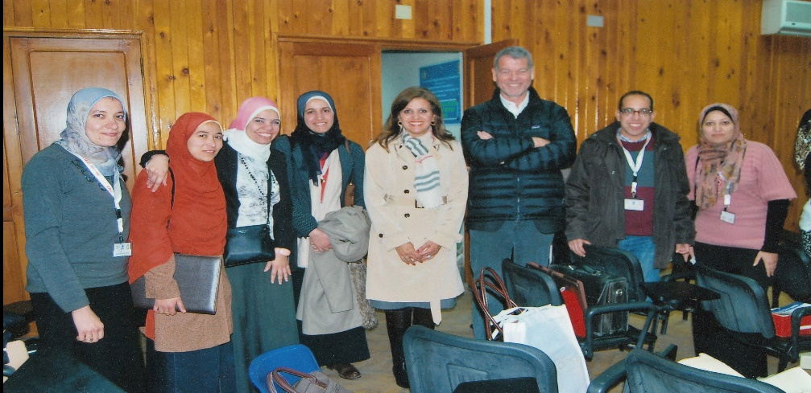
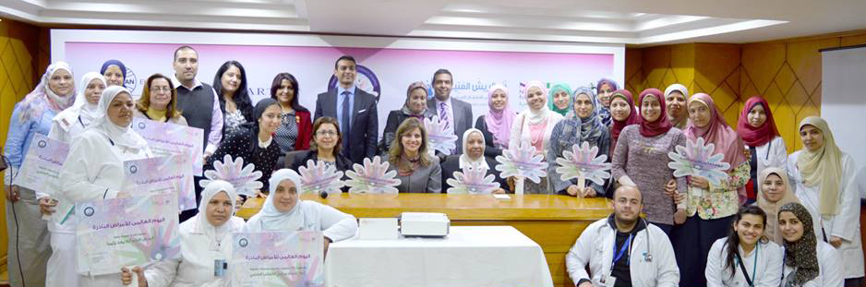


Slide 53
