Slide 1
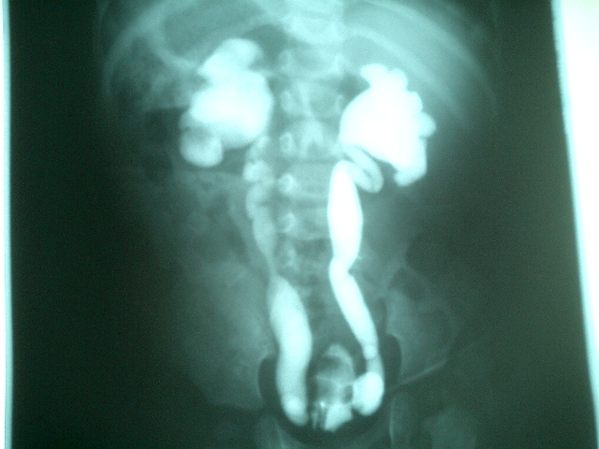
DEFLUX VERSUS SURGERY IN VESICO-URETERAL REFLUX IN CHILDREN
Professor Paul Daher
Chief of department of pediatric surgery-Faculty of Medicine-St joseph University
IPNA-ISN 2019

Slide 2
During the last decade, the endoscopic treatment of vesicoureteral reflux has become an accepted method with a cure rate of 60 to 80%...Various foreign materials have been used for subureteral injection…

Slide 3
The concept of subureteral injection was introduced by O’Donnell and Puri in the 1980s to create a less invasive treatment for VUR…

Slide 4
The basic principle is to buttress beneath the ureteral orifice, thereby allowing the ureteral mucosa to coapt during bladder filling and prevent reflux…

Slide 5
The ideal substance…
1- Durable
2- Effective
3- Safe
4- Inert
5- Easily injectable
6- Stable with time
7- Does not extrude or migrate
8- Biocompatible, nonantigenic, noncarcinogenic

Slide 6
POLYTETRAFLUOROETHYLENE (TEFLON)
Has been the most commonly used
Success rate as high as 85%
Consists of a 50% suspension of polytetrafluorourethane particles in glycerin
These particles vary in size from 5 to 100 microns

Slide 7
Our experience with Teflon was one of the first to be published worldwide (LMJ,1992)…

Slide 9
Can be injected directly into capillaries and embolized to distant organs
May cause granulomas
Difficulty to inform parents of the risk of failure
Failure rate increases in high grade VUR. These high grade VUR are candidates for surgical correction.
WITHDRAWAL…

Slide 10
SILICONE
Physical properties similar to Teflon
Larger particle size which abolishes the risk of migration
But, risk of autoimmune reactions and possible risk of malignancy in the long term

Slide 11
In light of the potential danger of injecting foreign materials, the search for alternative biological tissue materials has been intensive…

Slide 12
COLLAGEN
Cross-linked bovine protein
Success rate from 62 to 83%
But need for skin testing: it can provoke cellular and humoral response
Biodegradation and contraction lead to VUR recurrences…
Cure rate is somewhat lower than after injection of Teflon or Silicone…

Slide 13
SILICONE
TEFLON
COLLAGEN
FOREIGN MATERIALS
BIOLOGICAL TISSUE

Slide 14
WHAT IS DEFLUX?...

Slide 15
Dextranomer microspheres
Non –Animal Stabilized Hyaluronic Acid
DEFLUX
Cultured bacteria then stabilization process
Dextran polymers, microspheres of 80 to 120 µm, no migration

Slide 16
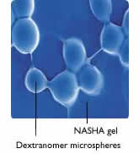
No fragmentation
No migration
No allergic reactions
No contraction

Slide 17
TECHNIQUES OF INJECTION…

Slide 18
« STING »
Subureteric transurethral injection
Deflux standard injection procedure
Position the implant just below the ureteral orifice…

Slide 19
« HIT »
Is a modification of the standard sting procedure
Hydrodistention-implantation technique
Uses a pressurized stream of fluid directed into the ureter to aid visualization and injection into the submucosa within the ureteric tunnel to improve coaptation of the ureter…

Slide 20
STING Procedure:
HIT Procedure:

Slide 21
HOW TO DO IT?

Slide 22
General anesthesia
10 F pediatric cystoscope with an offset lens
3.7 Fr needle passed in line with the ureter without bending the needle
Bladder is filled with half to three-fourths volume
The needle is placed within the submucosa of the ureter at the 6 o’clock position

Slide 23
A small volume is injected (< 0.1ml) to confirm implant location
The cystoscope is pulled back to the bladder neck to visualize subsequent injection
The ureter should appear to be completely coapted with proper injection
Deeper injection of an additionnal 0.1 to 0.2 ml in order to anchor the superficially injected implant.Usually we have to inject 0.5 ml and more.

Slide 25
RESULTS…

Slide 26
Minimally invasive alternative to open surgery or conservative treatment with antibiotics
A success rate of 68% to 86%
Outdoor patient
Possibility of repeated injections if failure

Slide 27
But…

Slide 28
The success rate of open surgery is reported to be as close as 98%...
Decreased success of Deflux with higher grades of VUR* and with VUR associated to duplicate ureter.
Decreased success of Deflux with bilaterality
* Minimally invasive treatment of vesico-ureteral reflux with endoscopic injection of dextranomer/hyaluronic acid copolymer: the children’s hospitals of atlanta experience, The journal of Urology, vol 170, july2003

Slide 30
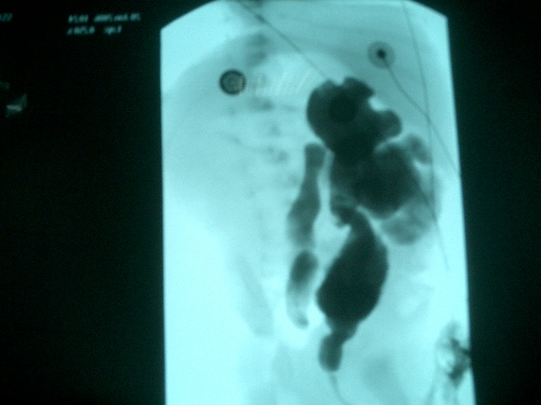
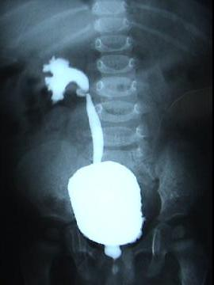

Slide 31
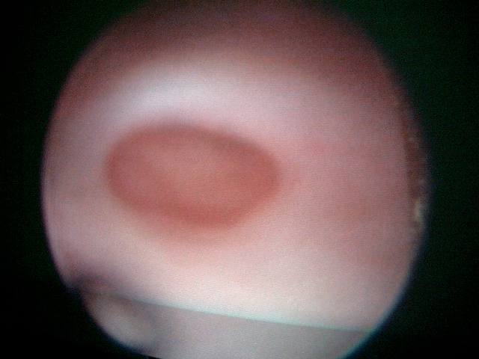

Slide 32
In our experience the surgical indications consist of grade 4 and 5 VUR. The lower grades are usually controlateral VUR. In these cases surgery, especially the “Cohen” technique, gives a definitive correction of the reflux (98%).
The cost of STING technique for bilateral VUR using Deflux is the same as the cost of surgery, with a relapse rate as high as 45% in high grades VUR.
Usually parents prefer a radical correction of VUR…

Slide 33
Boston Children Hospital –Dr David Diamond pediatric urologist in Chief and colleagues (2018) :
High failure rate
Long -term complication rate
High retreatment rate
High and rising cost

Slide 34
No Deflux for Reflux ( Urology,04 june 2015)
Confirm high failure rate and retreatment of 54% at one year.
WANT and al.2015 AUA/SPU 12 fold increased retreatment rate .
Misleading calcifications of deflux

Slide 35
Before operating VUR, always keep in mind “vesico-urethral dysfunction” …
This complexe pathology is very frequent in children, and should be always thought of before discussing Deflux or Surgery…
While treating VUR, always search for incontinence, frequency , vulvo-vaginitis , recurrent cystitis , constipation , soiling etc…

Slide 36
SURGICAL TECHNIQUE…

Slide 37
Transtrigonal ureteral reimplantation (Cohen)

Slide 38
REFERENCES
« A new bioimplant for the endoscopic treatment of vesicoureteral reflux: experimental and short-term clinical results », The Journal of Urology, Vol 154, August 1995
« Endoscopic Deflux injection for pediatric transplant reflux: A feasible alternative to open ureteral reimplant », Journal of Pediatric Urology, 2008
« Minimally invasive treatment of vesicoureteral reflux with endoscopic injection of dextranomer/hyaluronic acid copolymer: the children’s hospitals of atlanta experience », The journal of Urology, vol 170, july2003

Slide 39
THANK YOU…

