Slide 1
CRRT: A “Cute” Dialysis for the Critically Ill
Sahar H. Koubar, MD
Assistant Professor of Clinical Medicine
American University of Beirut Medical Center
2nd IPNA Teaching Course
Beirut –Lebanon
June 15th, 2019

Slide 2
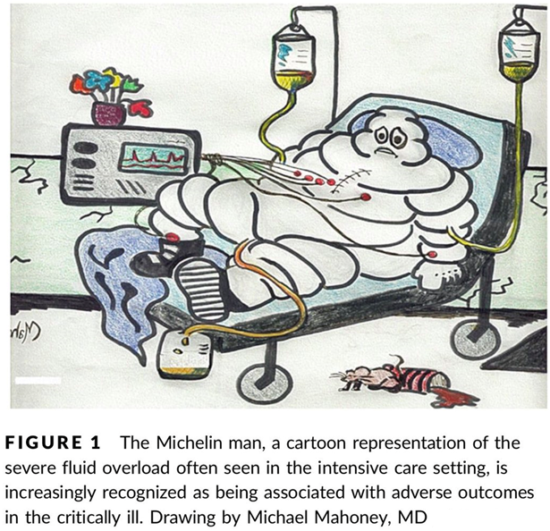
Notes:
This is a frequent scene in the ICU. A patient connected to many IV lines for resuscitation, on vasopressors, and more often than none on ventilator support. Patients with significant volume overload; called the Michelin man. And now, Having little urine output and developing AKI.

Slide 3
AKI in ICU
AKI requiring RRT in the ICU 13.5 %
High hospital mortality rate of 60%
Dialysis dependence upon discharge 14%
Notes:
It is no surprise that AKI is a major complication in critically ill patients: high mortality, high morbidity and high economic burden
Acute kidney injury (AKI) occurs in about half of critically ill patients ; up to 13.5 require RRT. It is associated with high hospital mortality and a high rate of dialysis dependence upon discharge.
As far as the causes, sepsis is the major contributing factor; responsible for 41% of AKI

Slide 4
Initiating Renal Replacement Therapy in ICU
Avoid intra-dialytic hypotension
Decrease the need for long term dialysis
Decrease ICU length of stay
Decrease Mortality
Notes:
When I am thinking about RRT in the ICU, Many things come to my mind.
I want to avoid intra-dialytic hypotension and avoid further ischemic injury.
Because I am hoping to decrease the need for long term dialysis, decrease length of ICU stay and most importantly decrease mortality
So in that regards, Continuous renal replacement therapy with 24 hour slow and gentle dialysis seems an appealing option

Slide 5
CRRT Modalities

Slide 6
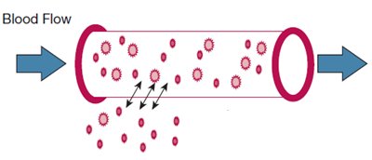
Basic Concepts of Dialysis:
Diffusive Clearance
Notes:
Before describing the different types of CRRT modalities, I will mention briefly the basic concepts of dialysis FOR THE NON-NEPHROLOGISTS IN THE GROUP.
We have the diffusive clearance: where solutes move from one compartment to the other compartment according to concentration gradient
So how does dialysis work? There are 2 mechanism by which we remove toxins
The first one is clearance by diffusion
Diffusion is the Movement of solutes across a semipermeable membrane from a compartment of high solute concentration to a compartment of low concentration. What I mean is, solutes are removed from the blood driven by the concentration difference between the blood and the dialysate solution which is flowing across the dialysis filter.

Slide 7
Basic Concepts of Dialysis: Convective Clearance
Replacement Fluid
Notes:
Another type of clearance is Convection. Where solutes are dragged with the bulk flow of solvent across the membrane down a hydrostatic pressure gradient.
So, we need to remove large amount of solvent in order to remove the needed amount of wastes.
Therefore, clean replacement fluid must be given to replace the volume of removed solvent and prevent volume depletion.
Clears middle molecules; remember that because we will come to it later in the talk

Slide 8
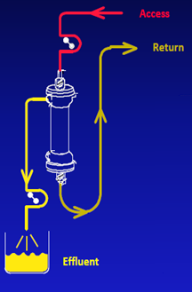
Modalities of CRRT: Slow Continuous Ultra-Filtration
CRRT
SCUF
CVVHD
CVVH
CVVHDF
Modality | Dialysate | Replacement Fluid | Urea Clearance
SCUF | no | no | -
Courtesy of Dr . Ashita Tolwani-UAB
Notes:
is used to treat isolated fluid overload only mainly in cases of HF because solute removal is negligible. SCUF can safely remove up to 8 L of fluid per day.
what I want to emphasize on this slide that this is a modality where we do no clearance of solutes basically, just removal of fluid that’s why Neither replacement fluid nor dialysate fluid is used.

Slide 9
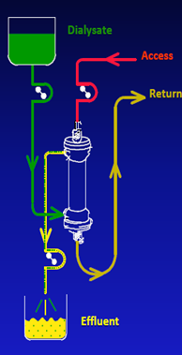
Modalities of CRRT: Continuous Veno-Venous Hemodialysis
CRRT
SCUF
CVVHD
CVVH
CVVHDF
Modality | Dialysate | Replacement Fluid | Urea Clearance
SCUF | no | no | -
CVVHD | yes | no | ++
Courtesy of Dr . Ashita Tolwani-UAB
Notes:
Depends, on diffusion therefore a dialysate fluid is used that create the concentration gradient btwn it and the blood. What you see here in yellow as effluent is basically the waste and fluid excess that we get rid of.

Slide 10
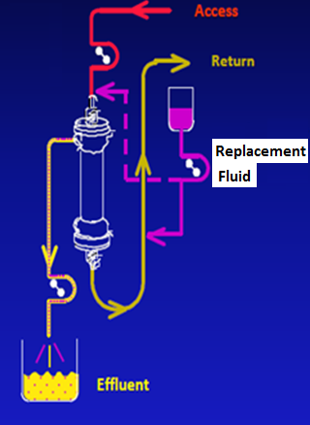
Modalities of CRRT: Continuous Veno-Venous Hemofiltration
CRRT
SCUF
CVVHD
CVVH
CVVHDF
Modality | Dialysate | Replacement Fluid | Urea Clearance
SCUF | no | no | -
CVVHD | yes | no | ++
CVVH | no | yes | ++
Courtesy of Dr . Ashita Tolwani-UAB
Notes:
removes solutes entirely by convection. solutes are dragged with the blood and therefore we need replacement fluid to prevent volume depletion.

Slide 11
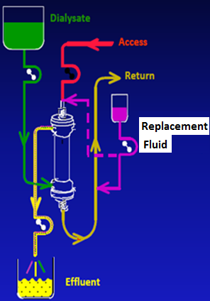
Modalities of CRRT: Continuous Veno-Venous Hemodiafiltration
CRRT
SCUF
CVVH
CVVHD
CVVHDF
Modality | Dialysate (Diffusive Clearance) | Replacement Fluid (Convective Clearance) | Urea Clearance (L/D)
SCUF | no | no | -
CVVHD | yes | no | ++
CVVH | no | yes | ++
CVVHDF | yes | yes | ++
Courtesy of Dr . Ashita Tolwani-UAB
Notes:
combines both diffusion with convection and hence requires infusions of both replacement fluid and dialysis fluid.

Slide 12
Advantages of Continuous Renal Replacement Therapy (CRRT) over Intermittent RRT
Hemodynamic Stability
Avoid Fluctuations in Intracranial Pressure
Optimal Fluid Balance
Unlimited Alimentation
Possible Elimination of Septic mediators
Notes:
In the next 15 minutes, I will go over the proposed advantages of CRRT over IRT

Slide 13
Proposed Advantages of CRRT over IRRT
Hemodynamic Stability

Slide 14
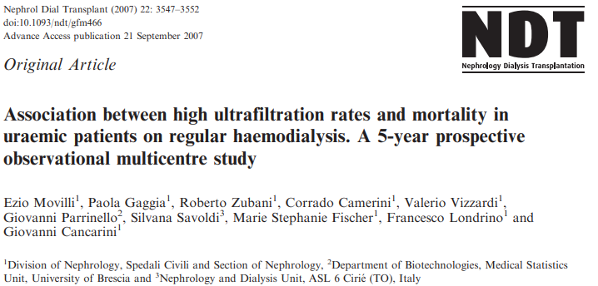

Slide 15
Hemodynamic Stability
Vascular refilling
Ultrafiltration rate
Notes:
Hemodynamic stability during dialysis is maintained by a balance between Ultrafiltration rate and vascular refilling.

Slide 16
Hemodynamic In-Stability
Vascular refilling
Ultrafiltration rate
Notes:
Once this balance is tipped by excessive Ultrafiltration that exceeds vascular refilling, a drop in mean arterial pressure and hemodynamic instability result.
This is a common scenario in critically ill patients with low oncotic pressures; also in cases of high venous hydrostatic pressure such as cases of heart failure.

Slide 17
To Remove 3 L in a 60 Kg patient
Continuous RRT
Intermittent RRT
Continuous fluid removal over 24 hours
we need a rate= 125 ml/hr
2 ml/hr/kg
If a dialysis session to be done over 4 hours
we need a rate= 750 ml/hr
12.5 ml/hr/kg
Notes:
Lets look at this example: in order to remove 3 L in a 60 KG patient; to do that by CRRT
However, removing a 3L over a 4 hr dialysis session in this 60 kg pt

Slide 18
Consequences of Intradialytic Hypotension
Early discontinuation of dialysis
Prevent achievement of fluid balance
Delay or prevent kidney recovery
Repetitive ischemic insults
High venous pressure and decrease renal perfusion pressure
Decrease blood flow to vital organs
Acute complications:
Risk of cardiovascular events
Chronic complications
Myocardial stunning
Notes:
But why we are stressing about this?
So higher rates of intradialysis hypotension?
Which can ------
Is this important? It is because intradialysis hypotension

Slide 19
Proposed Advantages of CRRT over IRRT
Avoid Fluctuations in Intracranial Pressure
Notes:
A very serious problem in neuro icus in brain injury and risk of increased ICP. The kdigo guidelines recommend CRRT for patients with acute brain injury

Slide 20
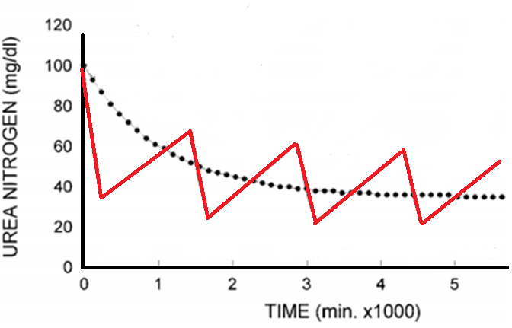
Avoid Fluctuations in Intracranial Pressure
IHD
CVVHD
Notes:
Can CRRT change the scenario? Can CRRT help?
If we look at the pattern of urea clearance with IHD, it follows a “saw tooth” appearance with large fluctuations in the concentration between two IHD sessions.
However the advantage of CRRT is that it causes slow continuous removal of urea; thus avoiding undesirable ‘‘saw tooth’’ fluctuations and more closely mimicking the native kidney function.

Slide 21
Reduction in Serum Osmolality during Each Treatment Modality
mosmo/kg
Osmolality
Notes:
But it is not all about urea; it is the plasma osmolality; . As you can see the rate of drop in plasma osmolality with Intermittent dialysis is more rapid than CRRT. And that’s what make CRRT a more appealing modality in patients with ABI

Slide 22
Reduction in Serum Osmolality during Each Treatment Modality
mosmo/kg
Osmolality
Notes:
And thus is more likely to worsen cerebral edema via the shift of water to the intracellular brain space and increase intracranial pressure toward the end of IHD.

Slide 23
Reduction in Serum Osmolality during Each Treatment Modality
mosmo/kg
Osmolality
Notes:
CRRT avoid these fluctuations; hence, CRRT is beneficial in patients with increased intracranial pressure or acute brain injury who have AKI.
Kdigo Guidelines

Slide 24
Proposed Advantages of CRRT over IRRT
Optimal Fluid Removal and Unlimited Alimentation
Notes:
Because of its 24 hrs nature, it can provide more fluid removal; this is a big advanntage

Slide 25
Survival in Critically ill Patients with Acute Kidney Injury (Program to Improve Care in Acute Renal Disease (PICARD) Study Group)
After adjusting for APACHE III and dialysis modality, fluid overload at dialysis initiation remained associated with a 2.07 fold increase in the odds of death
Notes:
Why is this important? It has been shown that Fluid Overload is a Major Contributor to Mortality. This is the PICARD study. Patients with AKI was divived into 2 groups; one with volume overload which was defined as more than 10% increase in body weight and the other without fluid overload. THOSE WITH FLUID overload at dialysis initiation had worse survival; this remained true after adjusting for severity score and dialysis modality with an odds ratio of 2.
• 396 patients with AKI requiring dialysis • PICARD study – Prospective cohort – 5 teaching U.S. hospitals – Between 1999 and 2001
*2 groups: AKI with fluid overload and AKI without fluid overload
*Fluid overload was defined as more than a 10% increase in body weight relative to baseline;
*AKI with fluid overload had higher APACHE and SOFA and # MOF, lower creat and BUN values
*Mortality at 30 days (37 vs 25%, P=0.02), 60 days (46 vs 32%, P=0.006), and at hospital discharge (48 vs 35%, P=0.01) was significantly higher in patients with fluid overload (that is, percentage fluid accumulation >10%)
*After adjusting for APACHE III and dialysis modality, fluid overload at dialysis initiation remained associated with a 2.07 fold increase in the odds of death (95% CI 1.27-3.37)
Fluid overload was independently associated with mortality. Whether the fluid overload was the result of a more severe renal failure or it contributed to its cause will require clinical trials in which the role of fluid administration to such patients is directly tested.
-Kaplan–Meier survival estimates by fluid overload status at dialysis initiation. There was a significant difference in survival among patients with or without fluid overload at dialysis initiation (P=0.005).
*Fluid overload at AKI diagnosis was not associated with recovery of kidney function

Slide 26
Net ultrafiltration intensity and mortality in critically ill patients with fluid overload
≤25ml/kg/day
>25 ml/kg/day
Notes:
This is a more recent study by the pittsburg group: Joh kellum; it involved both CRRT and IHD patients

Slide 27
Effect of Dialysis Modality on Fluid Balance:
IHD
CRRT provides constant fluid removal over time
CRRT
Notes:
So CRRt is beneficial in that regards. It provides constant fluid removal over time
This graph shows the fluid accumulation over time in patients on CRRT and on IHD.
This result was duplicated in many other studies, where bouchard et al showed that additional ultrafiltration sessions were necessary to address volume overload in patients undergoing IRRT indicating the inadequacy of volume removal in contrast to CRRT that provides a constant platform for fluid removal.

Slide 28
Unlimited Alimentation
90% of patients during CRRT received the prescribed
nutrition as opposed to only
54% of patients during IHD.
Notes:
Because CRRT is a continuous therapy leading to unlimited fluid removal, we thus can be more liberal in administering total parenteral nutrition.

Slide 29
Is There a Role for CRRT in SEPSIS?
Notes:
The interest in middle molecule removal led to the interest in using CRRT for removal of inflammatory cytokines in sepsis

Slide 30
High-Dose Versus Conventional-Dose CVVHDF and Patient and Kidney Survival and Cytokine Removal in Sepsis-Associated Acute Kidney Injury: A Randomized Controlled Trial
Decrease in Cytokines
No Difference in Mortality
Notes:
In spite of all that, studies of CRRT and sepsis has been conflicting.
This is an RCT by Park et al. inspite of the reduction of cytokine level, this did not translate into a survival advantage

Slide 31
High-volume versus standard-volume Haemofiltration for septic shock patients with AKI (IVOIRE study): a multicenter randomized controlled trial
70ml/kg/hr
VERSUS
35ml/kg/hr
Notes:
People looked at higher dialysis doses with better clearance in sepsis. This is the IVOIRE study which is prospective, randomized, open, multicentre clinical trial conducted at 18 intensive care units in France, Belgium and the Netherlands. Participants underwent haemofiltration at 70 mL/kg/h and 35 mL/kg/h. But again no difference in survival between the 2 groups.
A total of 140 critically ill patients with septic shock and AKI for less than 24 h were enrolled from October 2005 through March 2010.

Slide 32
Is CRRT Nephron Sparing?
Notes:
Now we come to a very important topic us nephrologists.? Are we able to save our beloved kidneys?

Slide 33
Notes:
Most of the literature that showed improved renal recovery and lower rates of dialysis dependence upon discharge come from OBSERVATIONAL DATA.
Unfortunately as you can see, randomized controlled trials had conflicting results and the metaanalysis did not show improved renal recovery

Slide 34
Dialysis Dependence Comparing CRRT and IHD/SLED
Notes:
This is another meta-analysis in 2017

Slide 35
CRRT and Mortality

Slide 36
In-hospital mortality Comparing CRRT and IHD/SLED
Notes:
Why?
-increased removal of antibiotics
-elimination of phosphate and potassium
-Depletion of micronutrients
-the profile of larger molecules removed by convection is relatively non-specific and may also include molecules that dampen inflammation

Slide 37
A “Cute” Kidney Injury Treatment
A: Avoid hemodynamic instability & avoid fluctuations in intracranial pressure
C: Continuous 24 hours treatment
U: Unlimited Fluid and Waste Removal & unlimited alimentation
T: Team Work
E: Elimination of Septic Mediators (Possible)
Notes:
Since its first description [1] continuous hemofiltration, or
‘continuous renal replacement therapy’ (CRRT) as it is now called, has undergone remarkable growth
Our approach to ICU patients might be changing over time; we will rather incorporate the concept of demand-capacity imbalance and maybe start thinking about renal support therapy rather than renal replacement therapy.

Slide 38
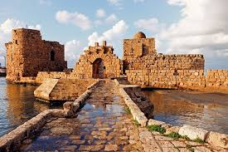
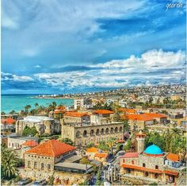
Thank You
Welcome to Lebanon

