Slide 1
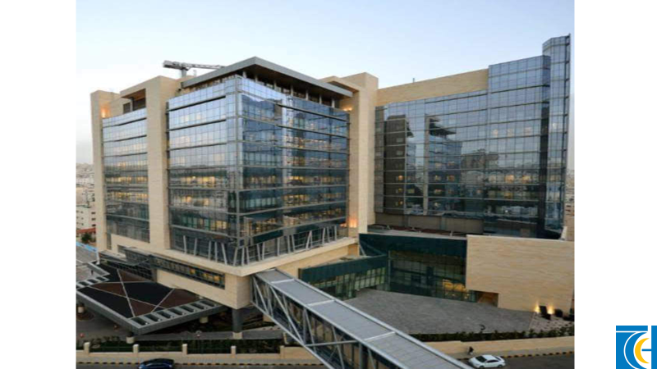
Acute Kidney Injury Establishing an in Center Registry
Edward Saca MD, MSc / Nephrology
Pediatric Nephrologist

Slide 2
18th ADQI International Conference Consensus
AKI is a preventable and treatable disorder
More than 13.3 million people world wide / year
Affects all ages
Multiple different clinical settings
Multiple causes
Significant short and long term burden
Death of more than 2.3 million people world wide
Increase of cost of care by three folds
Development of CKD in more than 30% of survivors

Slide 3
Risk assessment scores and training for recognition in 3-tiered service model
Peripheral village health center
Secondary district hospital or clinic
Tertiary care hospital
5 Rs
Rehabilitation
Follow up post AKI locally by the same group that educates and train
Recognition
Training and tools that can be deployed in the periphery
Clinical
Point of care testing
Telemedicine accessibility
Renal support
Protocol driven management adapted to local resources and customs
Telemedicine enabled protocol driven transfers to tertiary centers
Peritoneal dialysis, hemodialysis, CRRT
Standard of care and quality metrics
Response
Protocols for care
Point of care testing
Development of tertiary hospital centers that are telemedicine enabled

Slide 4
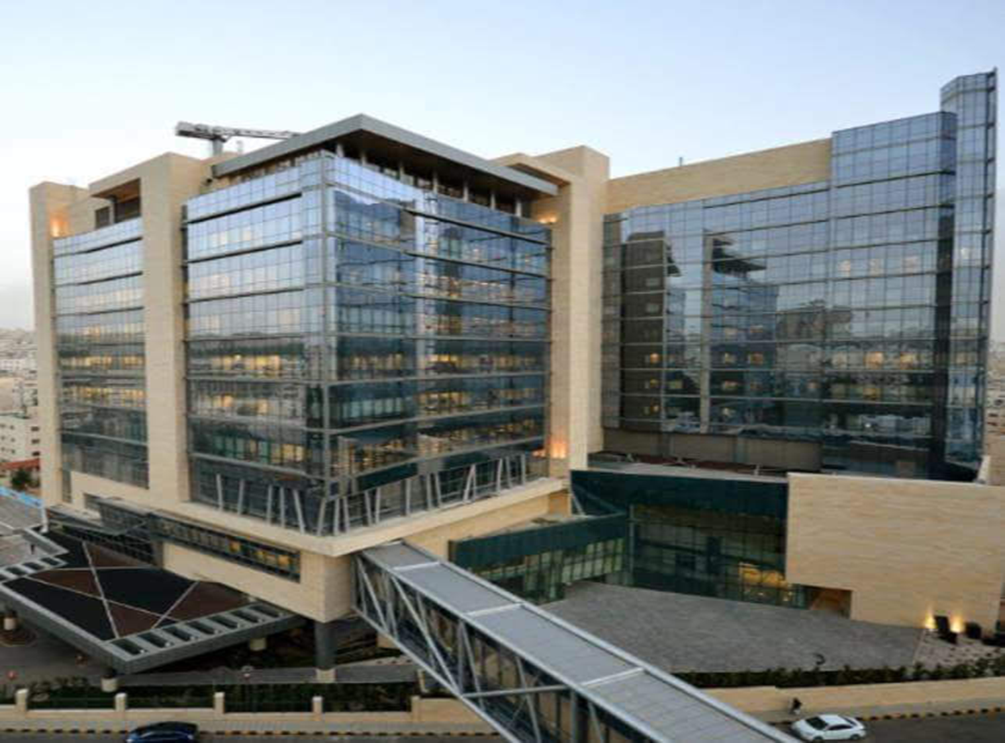
Establishing The Registry

Slide 5
Primary objective:
Detection and tracing patients who develop AKI
Determine the incidence, prevalence and natural history of AKI among hospitalized patients at KHCC
Secondary objectives:
Assess the relationship between timing, severity and number of risk factors including therapeutic agents
Assess demographics, clinical factors, illness severity and process of care associated with favorable and adverse outcomes among ICU, and BMT patients
Determine current practice patterns for RRT management of AKI

Slide 6
AKI Registry
Launched on January 2018
Includes all the necessary demographics
Most recent chemotherapy
Most recent drugs taken
Anticipated risk factors
Previous history of AKI
Stage at diagnosis
Final AKI stage
Follow up data

Slide 7
Diagnostic Criteria
AKIN
Absolute increase in serum creatinine of
more than or equal to 0.3 mg/dl
Percentage increase in serum creatinine
of more than or equal to 50%
Reduction in urine output oliguria of less than
0.5 ml/kg per hour for more than six hours

Slide 8
Staging of AKI
Urine output | Serum creatinine | Stage
< 0.5 ml/kg/hr for 6–12 hrs | 1.5 – 1.9 times baseline Or > 0.3 mg/dl increase | 1
< 0.5 ml/kg/hr for > 12 hrs | 2 – 2.9 times baseline | 2
< 0.3 ml/kg/hr for > 24 hrs Or Anuria for > 12 hours | 3 times baseline Or Increase in Cr to > 4mg/dl Or Initiation of RRT Or eGFR to < 35 ml/min/1.73m2 | 3

Slide 9
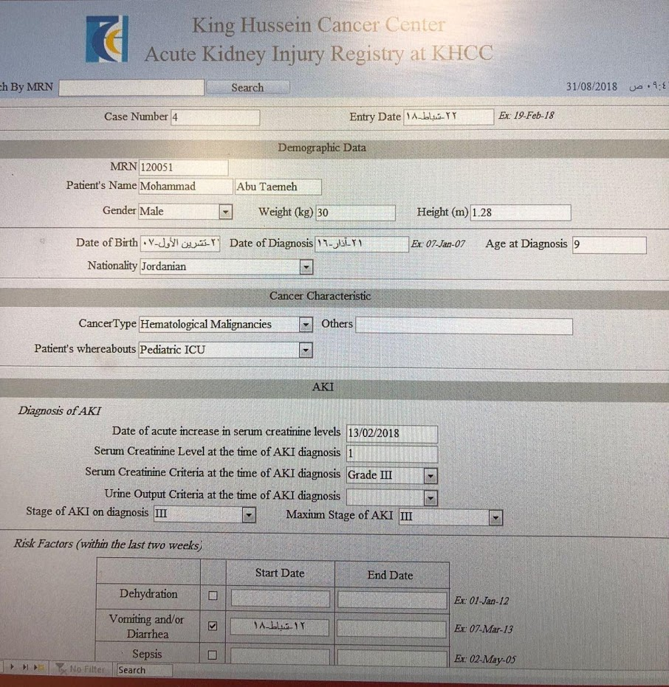

Slide 10
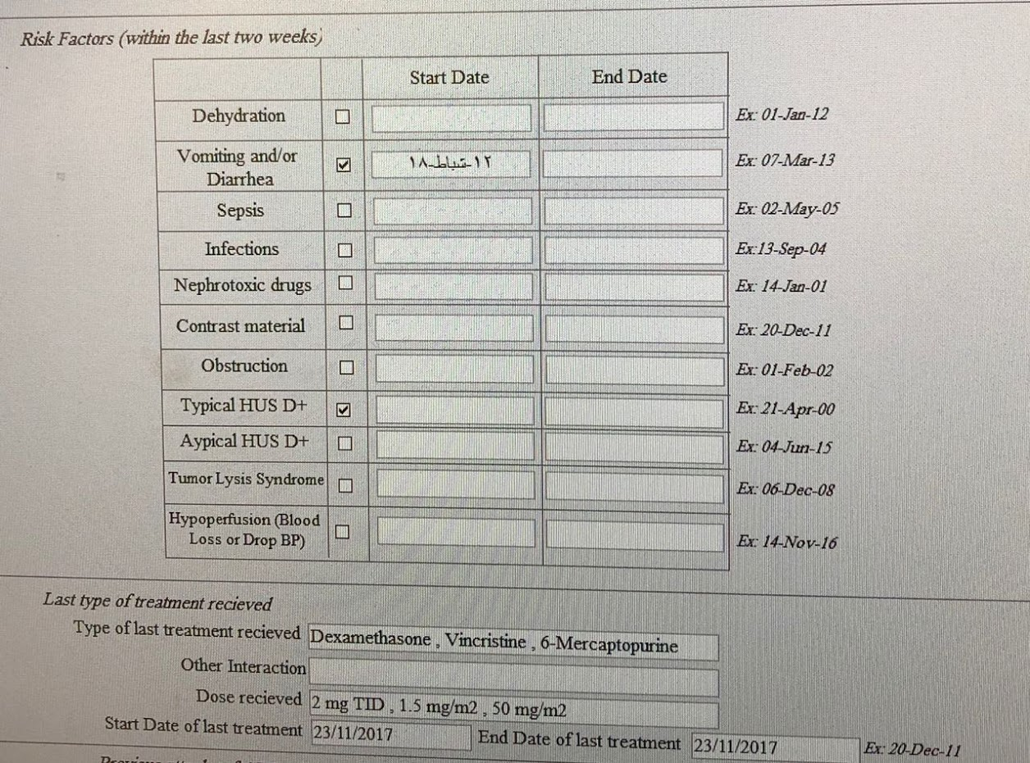

Slide 11
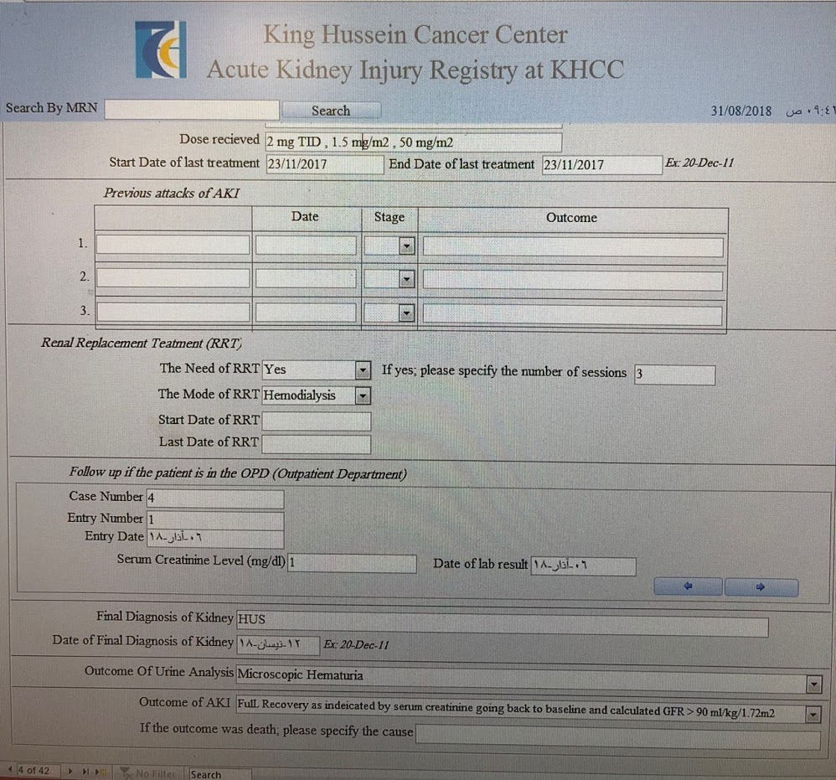

Slide 12
AKI TEAM
Pediatric Nephrologist
Hospitalist / Pediatrician
Chief Pediatric Resident
Pediatric Resident
Clinical Pharmacist
Dietitian

Slide 13
FLAG
AKI
Text messages
AKI team
Confirm AKI
Register patient on AKI registry
Confirm stage at diagnosis and follow up
Maintain euvolemia
BP
Maintain urine output
Check electrolytes
Acid-base status
Adjust / Stop nephrotoxic medications
Maintain proper nutrition
Appointment with nephrology clinic one week after discharge
Stage 1
Stage 2
Stage 3
Nephrologist
AKI Team
AKI Team
Nephrologist

Slide 14
Service | Admission No.
Pediatric Oncology Team Service | 3106
Ped BMT | 415
Ped ICU | 122
Total | 3643
KHCC is a 254 bed hospital
Pediatric ward 38 beds
BMT unit 24 beds
Pediatric ICU 9 beds

Slide 15
98 patients had AKI
Mean age
12.5 ± 6.0 years
Mean age for males 12.7 ± 5.7 years
Mean age for females 12.3 ± 6.3 years

Slide 16
55

Slide 18
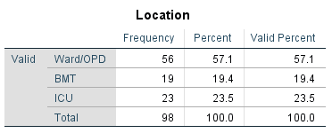
23.5%
57.1%
19.4%

Slide 19
1.3%
4.6%
19%

Slide 20
4.6%

Slide 21
19%

Slide 22
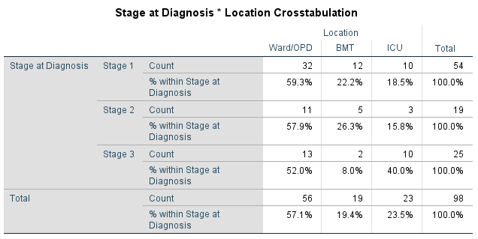

Slide 25
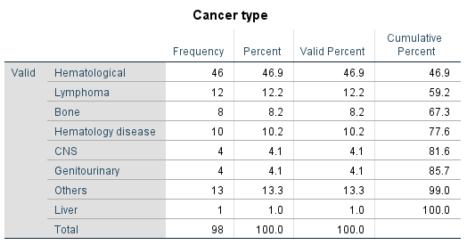

Slide 30
Drug induced AKI among cancer patients
Acute vascular disease
TMA
Vasculitis
Calcineurin inhibitors
Acute glomerular disease
MCD
FSGS
Crescentic ANCA positive GN
LN
Acute tubular injury necrosis
Methotrexate (Tubular obstruction and inflammation)
Acute interstitial nephritis

Slide 31
8.1%

Slide 32
15.3%
22.4%
62.2%

Slide 33
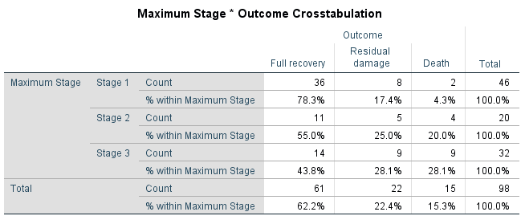

Slide 34
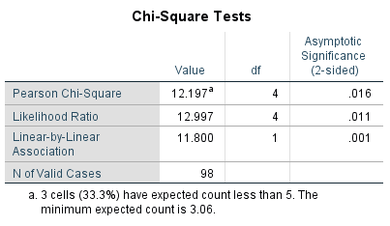

Slide 35
Outcome

Slide 36
Detecting AKI is of paramount importance
Tracing and maintaining long term follow up for children with AKI is undoubtedly necessary
Establishing a registry is a very successful way of identifying and tracing AKI
Establishing a registry helps define risk factors and then adjust policies accordingly
HDMTx and Tacrolimus are risk factors at KHCC
Nephrology consult for all children scheduled to receive HDMTx for proper renal evaluation prior to giving the drug
Tighter blood level control on tacrolimus in the BMT unit
If you are not seeing AKI in any tertiary hospital then mostly you are not detecting AKI

Slide 37
Thank you

