Slide 1






A CHANGE FOR A BETTER WORLD
CONFERENCE
May 4th 2019
Animal Agriculture & the Environment
Prepared by Roland Azar

Slide 2

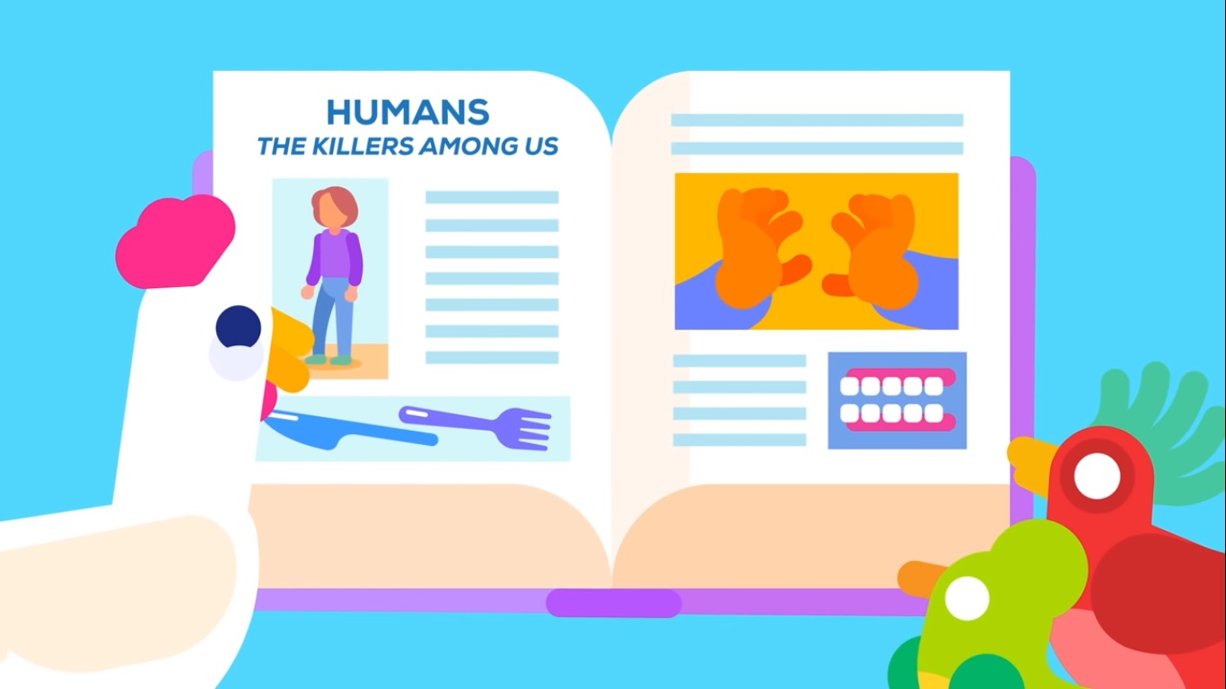
Worldwide, more than 70 billion land animals are killed for food every year.

Slide 3
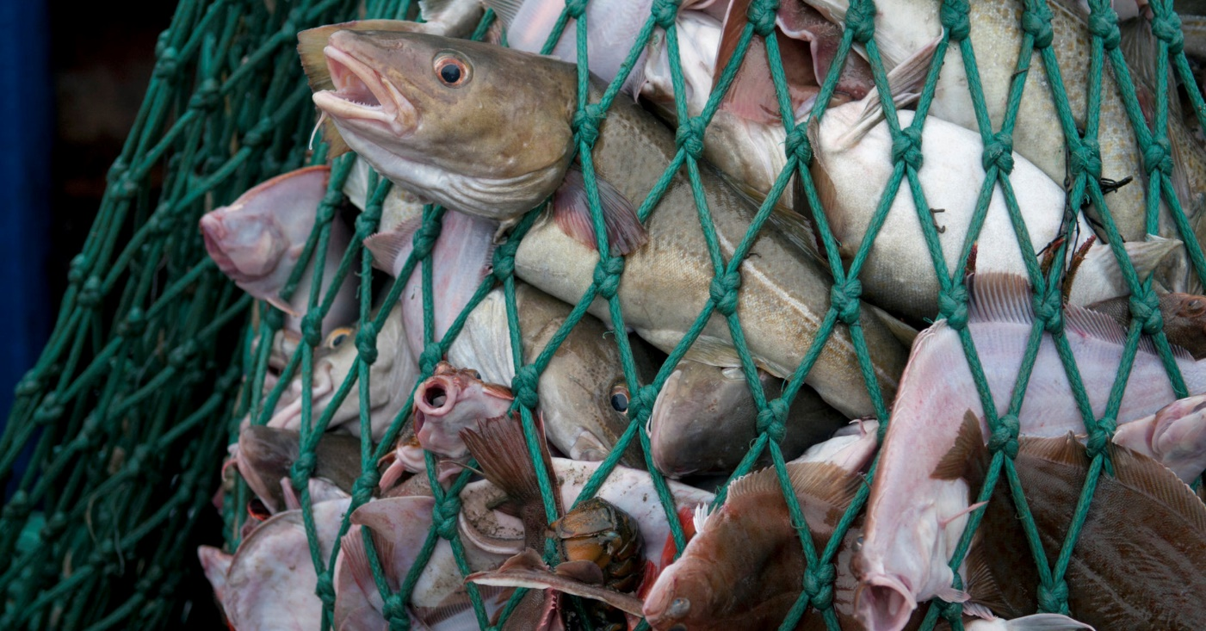
Anywhere between 37 and 120 billion fish are killed on commercial farms each year, with another 2.7 trillion caught and killed in the wild.

Slide 4
Environmental Impact of Animal Agriculture

Slide 5
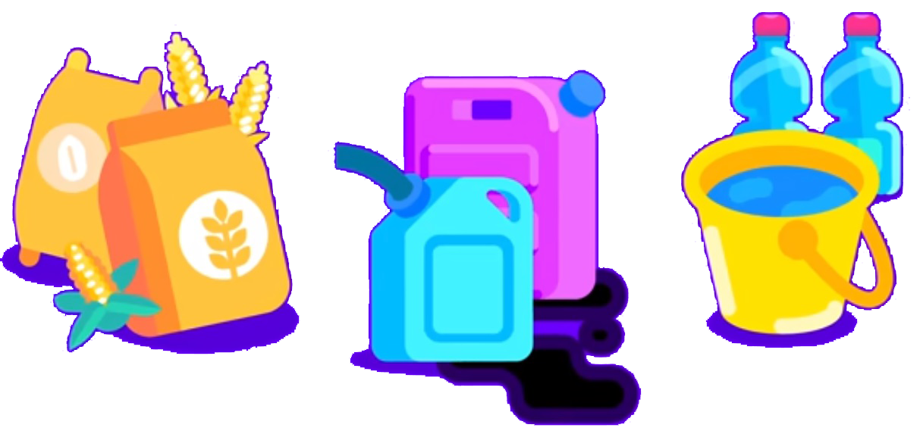

Animals raised for dairy, meat, and eggs require tons of natural resources and cause air and water pollution

Slide 6
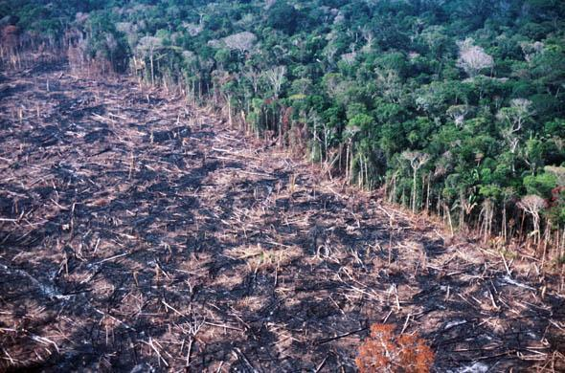
Land
91% of amazon land deforested since 1970, is used for livestock pasture. FAO Report 2006

Slide 7
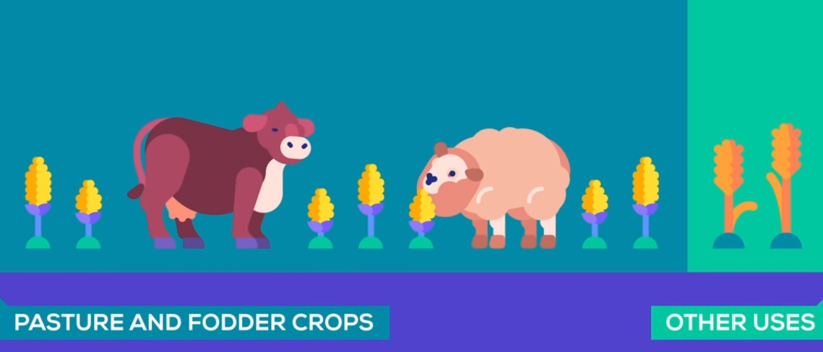
Land
80% of all agriculture land is used for livestock - FAO

Slide 8
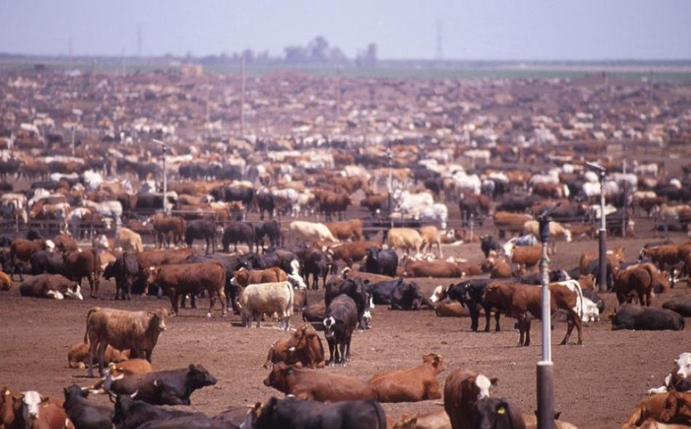
Land
Livestock covers 45% of the earth’s total land

Slide 9
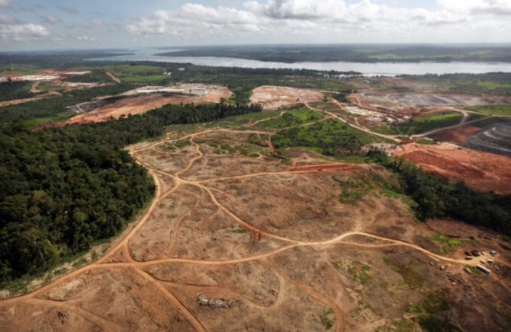
Land
1/3 of land is desertified due to livestock

Slide 10
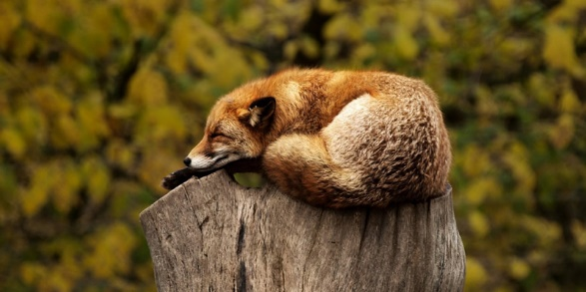
Land
Animal agriculture is the leading cause of species extinction and habitat destruction. Species are dying out of a rhythm 1,000 faster than the natural rate. We have entered the Sixth Mass Extinction of life on earth, causing a biological annihilation of wildlife

Slide 11
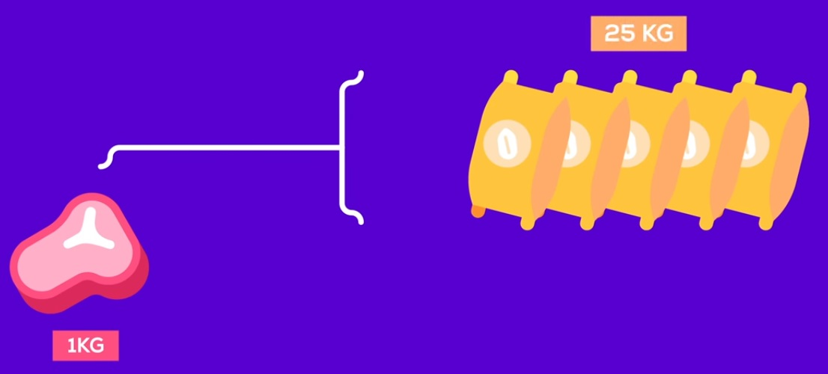
Grains & Water
Worldwide at least 50% of grain is fed to livestock
To create 1KG of steak, a cow needs to eat up to 25KG of grain

Slide 12
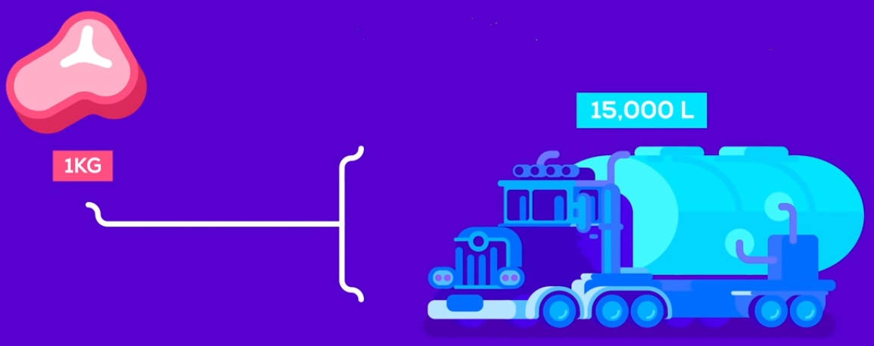
Grains & Water
15,000 Liters of water are needed to produce 1 Kg of beef
3,700 Liters of water are required to produce 1 gallon of milk

Slide 13
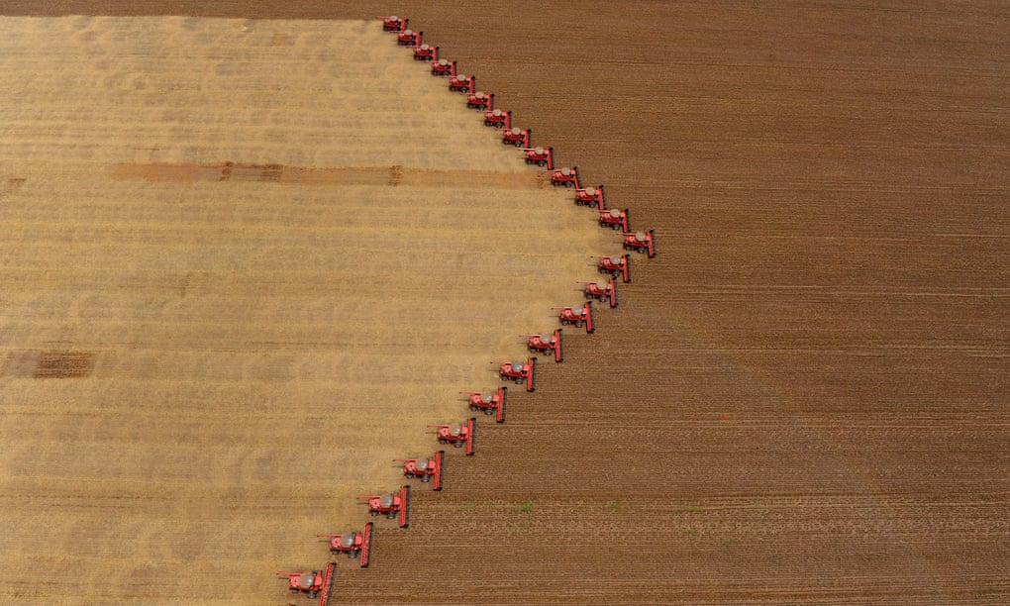
Grains & Water
80% of the soybeans grown worldwide are fed to livestock

Slide 14
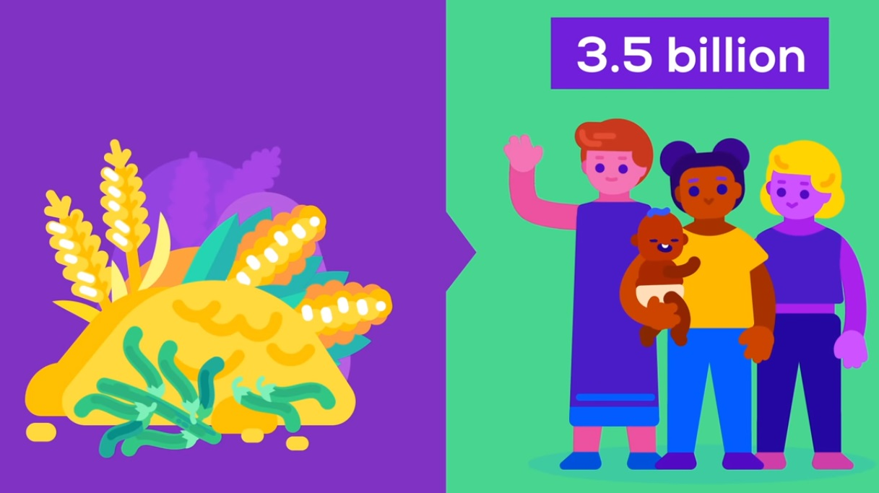
Grains & Water
We are currently growing enough food to feed 10 billion people…and still can’t end hunger. We only have 7 billion people.

Slide 15
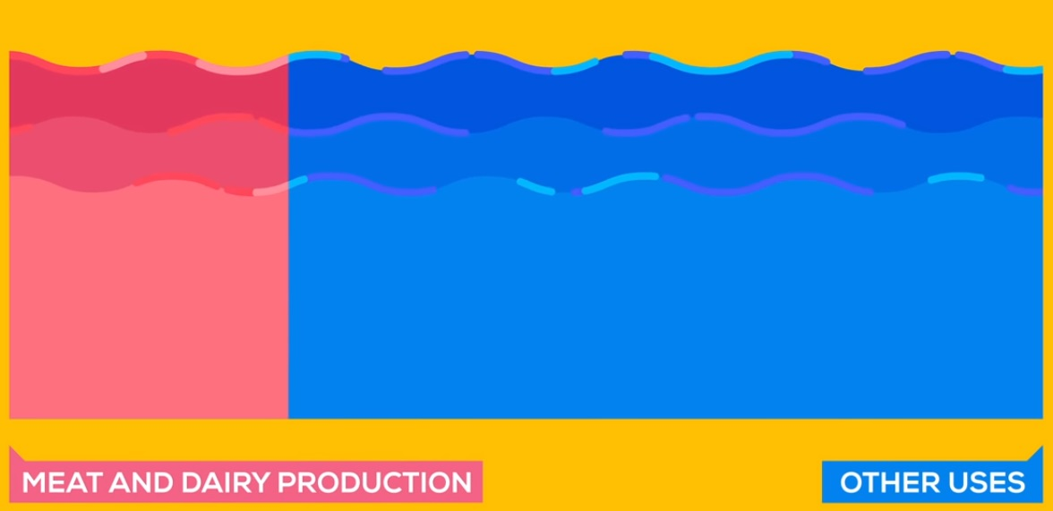
Grains & Water
Animal Agriculture is responsible for 20%-33% of all fresh water consumption in the world today

Slide 16
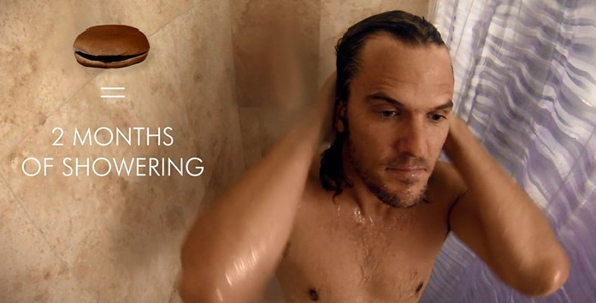
Grains & Water
Eating one Ham burger is the equivalent of showering two entire months

Slide 17
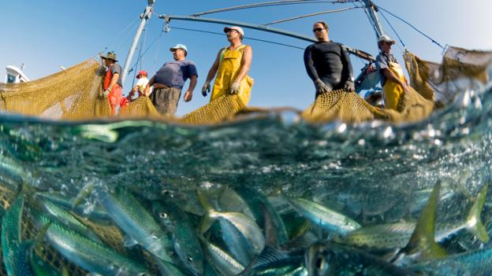
Oceans
Overfishing: A Threat to Marine Biodiversity
As many as 2.7 trillion animals are pulled from the ocean each year. - National Geographic
3/4 of the world’s fisheries are exploited or depleted

Slide 18
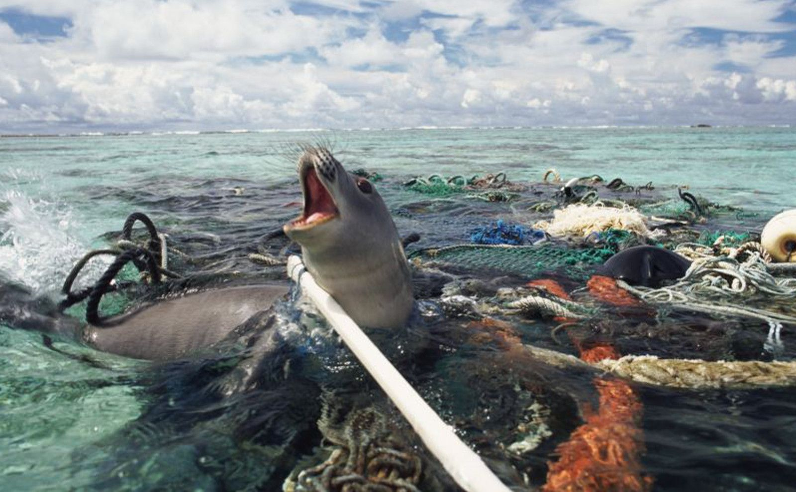
Oceans
For every 1 pound of fish caught, up to 5 pounds of unintended marine species are caught and discarded as by-kill.
Scientists estimate as many as 650,000 whales, dolphins and seals are killed every year by fishing vessels

Slide 19
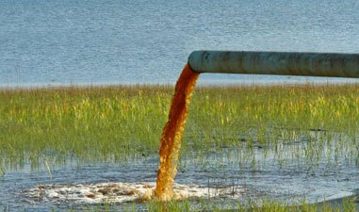
Waste
A farm with 2,500 dairy cows produces the same amount of waste as a city of 411,000 people
Chickens, turkeys, pigs and cows on factory farms produce waste that frequently spills over into waterways, killing millions of fish and contributing to biodiversity loss in marine ecosystems
Fish farms produce a slurry of toxic run-off – manure – which fertilises algae in the oceans, reducing the oxygen available to other species and creates dead zones.

Slide 20
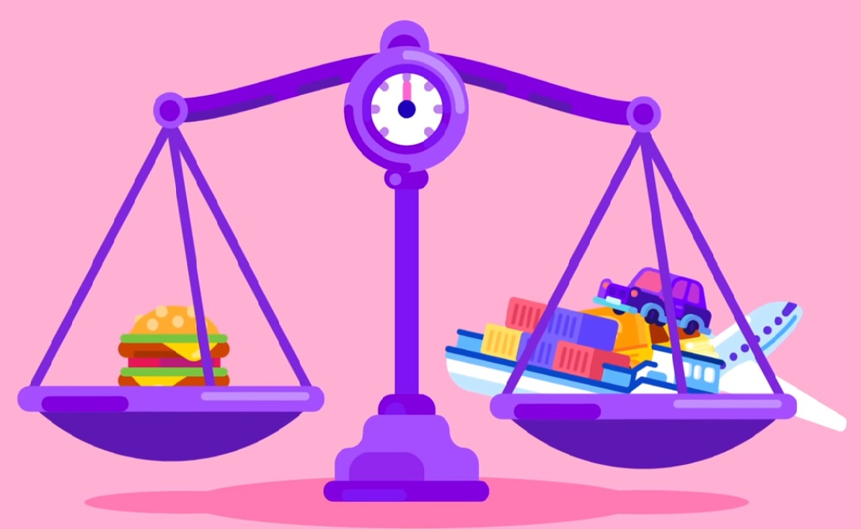
Greenhouse Gases
Animal agriculture is responsible for 18 percent of greenhouse gas emissions, more than the combined exhaust from all transportation – FAO 2006
Livestock and their byproducts account for at least 51% of all worldwide greenhouse gas emissions

Slide 21
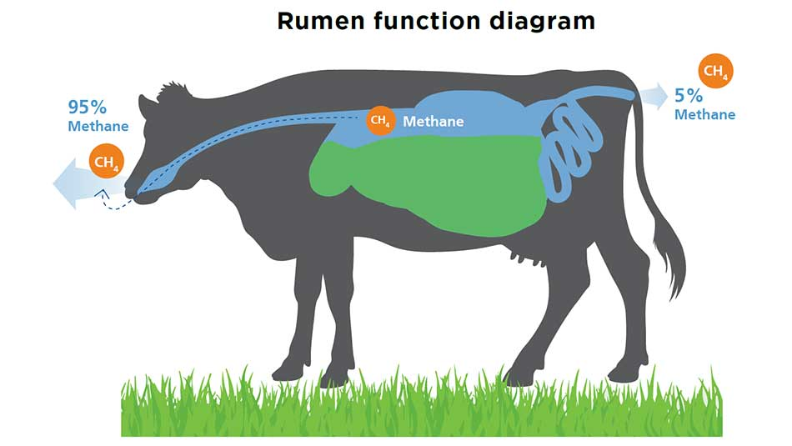
Greenhouse Gases
Cows worldwide (1.5 Billion) produce 570 Billion liters of methane per day. FAO
Methane is 28 times more destructive than CO2 on a 20 year time frame.

Slide 22
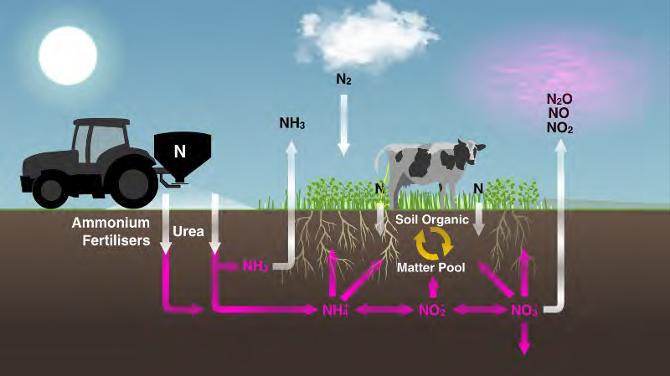
Greenhouse Gases
Livestock is responsible for 65% of all human-related emissions of nitrous oxide. Most of this comes from decomposing manure.

Slide 23
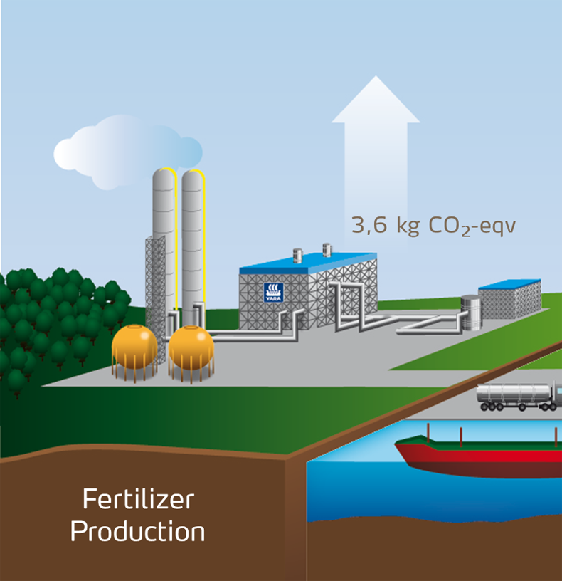
Greenhouse Gases
Carbon dioxide (CO2) emissions arise from manufacture of fertilizers and pesticides for feed crops and from feed transportation and processing. FAO

Slide 24
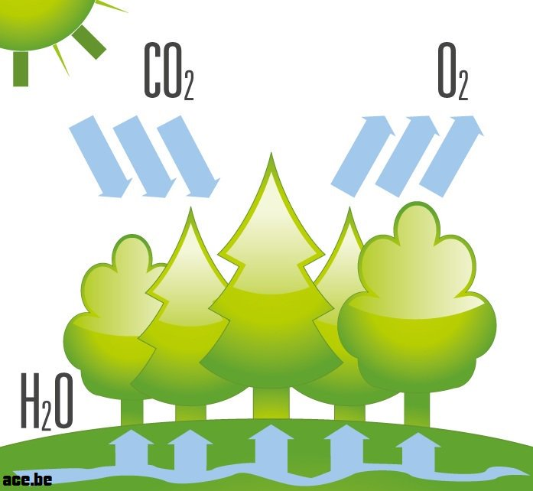
Greenhouse Gases
Earth’s photosynthetic capacity has declined sharply as forest has been cleared.

Slide 25
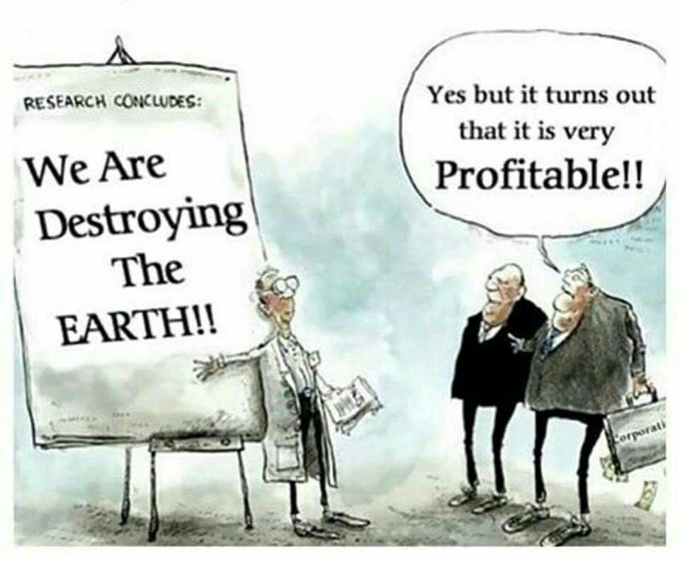

Slide 26
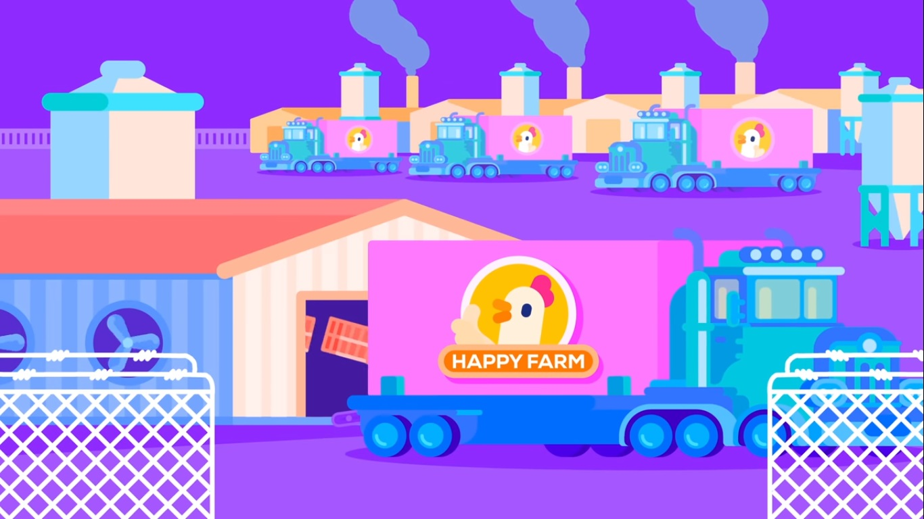
Over the last 80 years, factory farming of animals has become a multi-billion dollar industry and it is being ruled by few stakeholders

Slide 27

A massive industry that’s full of dark secrets
BLOOD, MONEY AND DAMAGE

Slide 28
20,000 Scientists Have Now Signed 'Warning to Humanity‘
A Second Notice“ was published in November 2017 in the journal Bioscience
"Human beings and the natural world are on a collision course."

Slide 29
A 2018 report by the UN Intergovernmental Panel on Climate Change (IPCC) declared that we have just over a decade to prevent irreversible climate catastrophe.

Slide 30
Why Vegan?

Slide 31
Eating a vegan diet could be the “single biggest way” to reduce your environmental impact on earth - Researchers at the University of Oxford 2018

Slide 32
A significant reduction in livestock raised worldwide would reduce GHGs relatively quickly compared with measures involving renewable energy and energy efficiency.
It can also reverse the ongoing world food and water crises.
The percentage of the land used for agriculture could then be reduced by more than 75 percent and still feed the planet

Slide 33
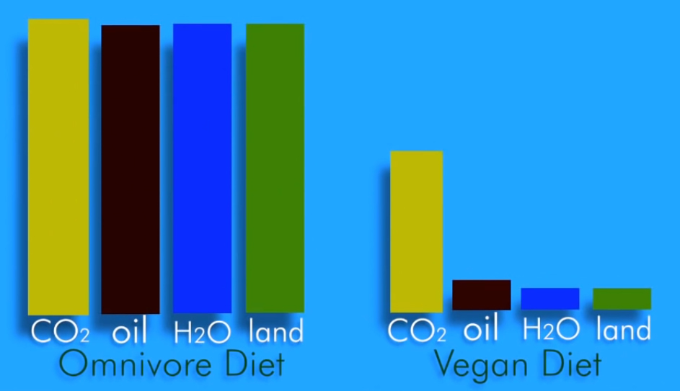
Vegan Diet
A person who follows a vegan diet produces the equivalent of 50% less carbon dioxide, uses 1/11th oil, 1/13th water, and 1/18th land compared to a meat-lover for their food

Slide 34

Why can't we build meat directly from plants?

Slide 35
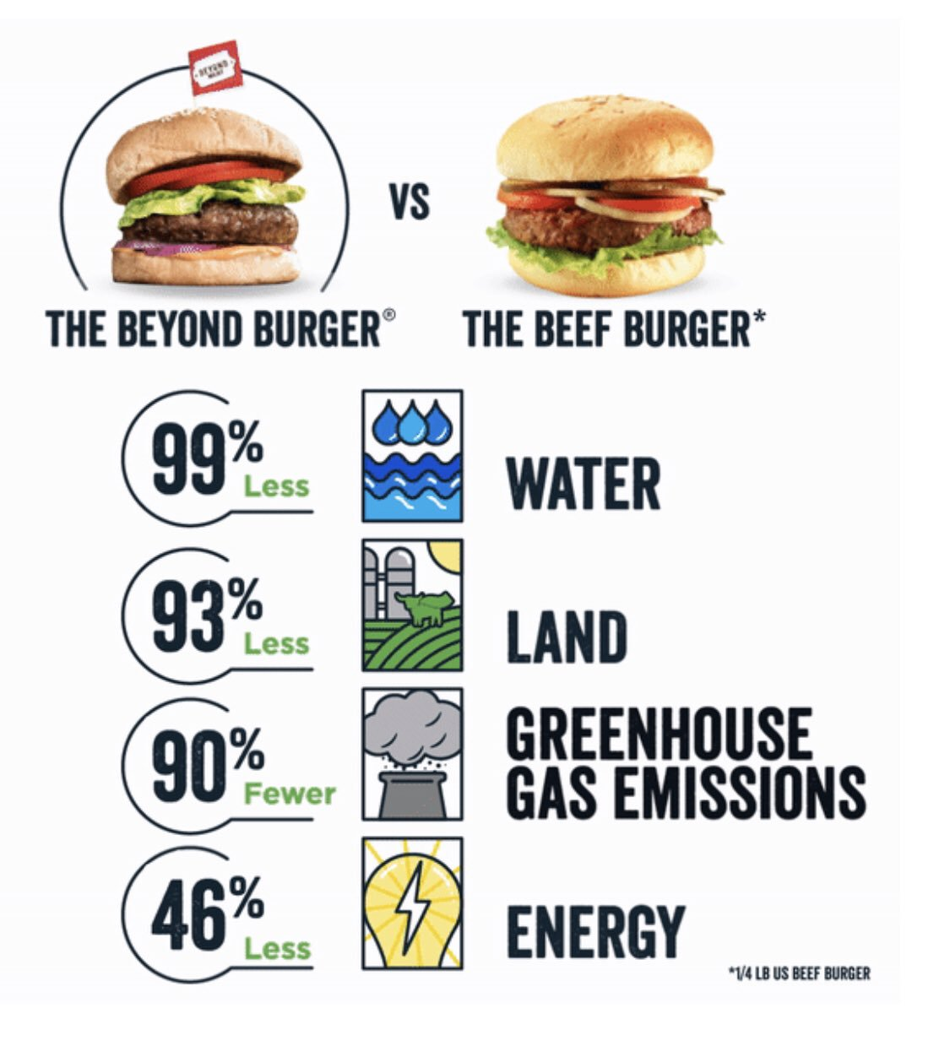
Plant-based patties

Slide 36
Plant-based patties
Beyond Meat received the United Nations’ “Champion of the Earth” recognition for creating a sustainable alternative to beef.
Compared with power and transportation projects, analog projects can be implemented quickly
Another option might be Lab-grown meat and might compete with analogs in cost and taste as well as health and environmental impact

Slide 37
“I Believe we will look back and be shocked at what was the accepted way we killed animals for food.
I think that in the future, clean and plant-based meat will be the norm and in 30 years it is unlikely animals will need to be killed for food anymore”
Richard Branson

Slide 38
Majority of global consumers will not eat meat from slaughtered animals by 2040,
According to a report published by Chicago-based business consulting firm A.T. Keany - 2019

Slide 39
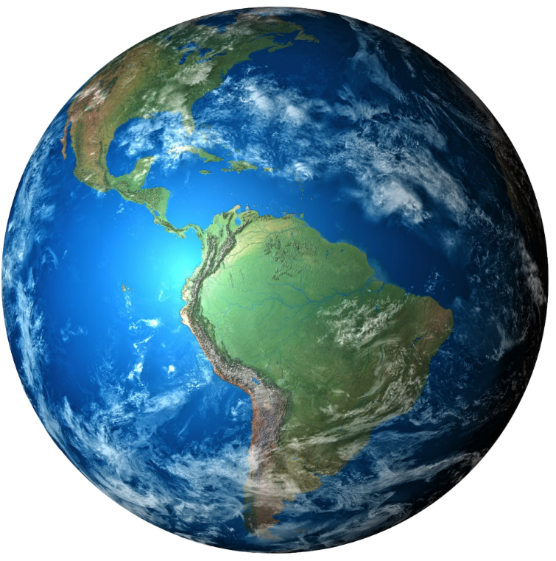
Be the change you want to see in the world!

