Slide 1

HABTOOR HILTON– BEIRUT – LEBANON
“INCREASING DONOR POOL BY ACCEPTING SUB-OPTIMAL KIDNEYS”
DONORS
FAISSAL A.M. SHAHEEN, MD, MBBCH, FACHARTZ, FRCP, FACP
Consultant Physician and Nephrologist
Head of Nephrology Department, DSFH

Slide 2

OUTLINE
Features of Kidney Transplantation
The ever increasing need for:
      Living Kidney Transplant
      Deceased Kidney Transplant

Slide 3

GLOBAL VIEW OF ESRD PATIENTS
ESRD Patients | 3,200,000
Thereof HD | 2,250,000
Thereof PD | 272,000
Thereof Tx | 678,000
World Population | 7.1 Billion
Annual Growth Rates
World Population | 1.1%
ESRD | ~6%
HD | 6-7%
PD | ~8%
Tx | 4-5%
ESRD Patients 2013
A Global Perspective

Slide 4
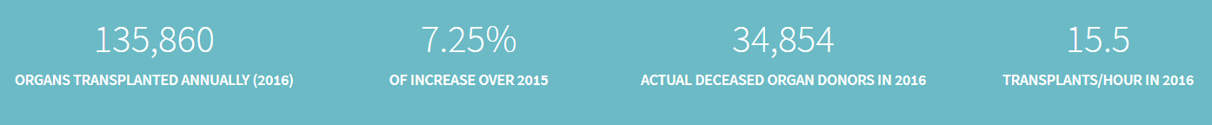
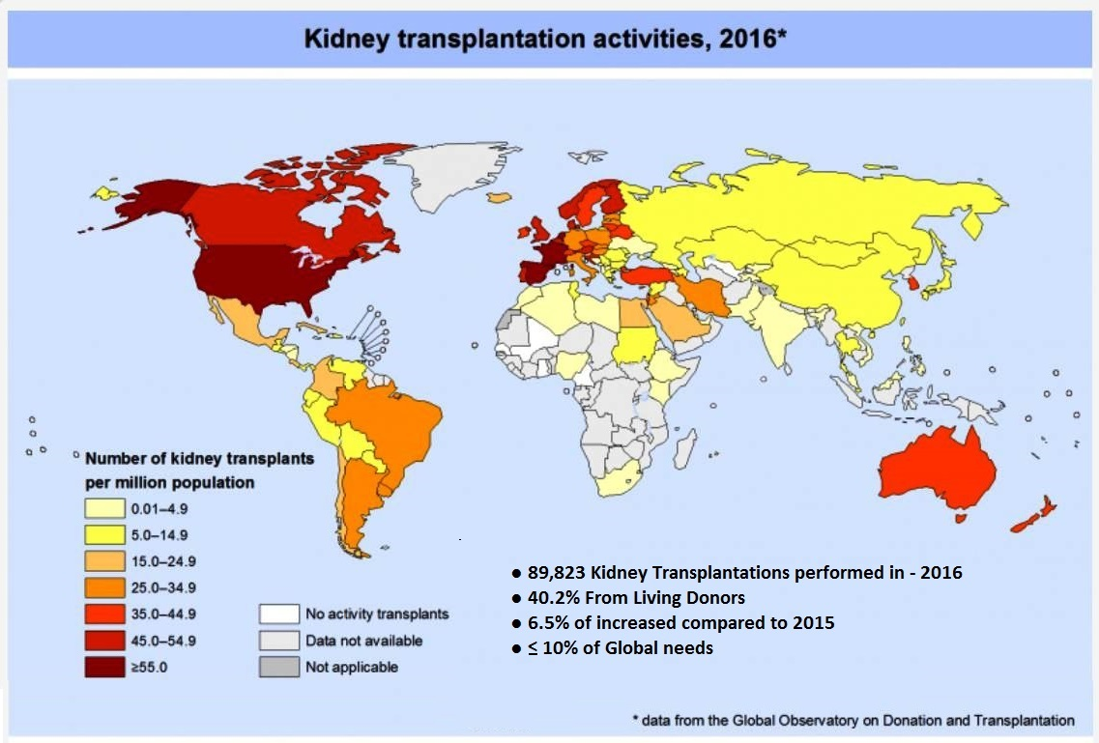

Slide 5
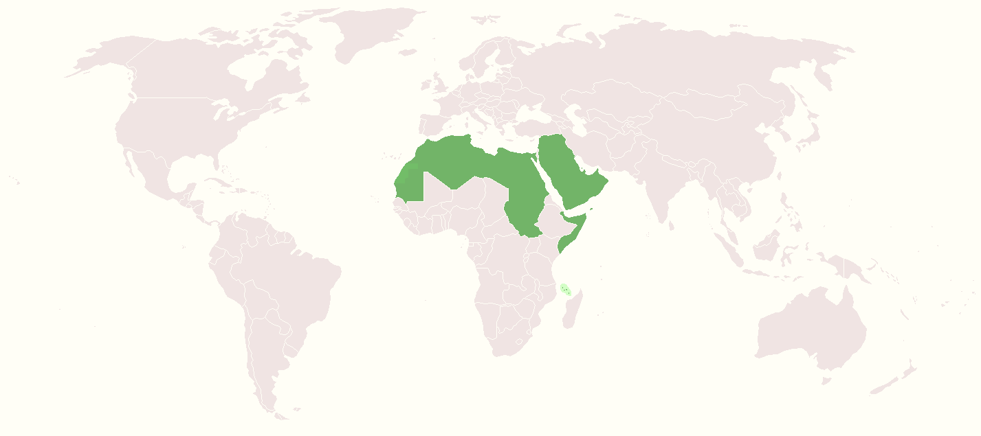
ARAB WORLD ACTIVITIES IN ORGAN TRANSPLANTATION
Kidney | Liver | Lung | Heart | Pancreas
2667 (3.42%)* | 446 (1.85%)* | 26 (0.59%)* | 25 (0.42%)* | 5 (0.2%)*
Of the 114,690 reported global solid organ transplants, 3,169 (2.76%) were from the Arab world
*Percentage from global solid organ transplant activities. Adapted from GODT 2014, and SCOT Survey 2012

Slide 6
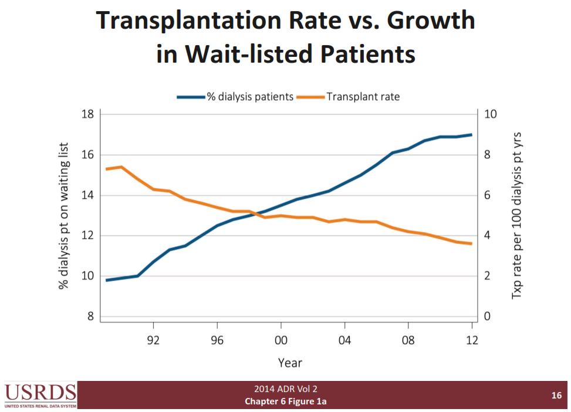
Transplantation Rate vs. Growth in Wait-listed Patients
Notes:
Data from US shows the significant increase in the dialysis population vs. the number of patients benefited from transplantation year wise (the rate of transplant patients decreased from 16% in 1990 to 12% in 2012).

Slide 7
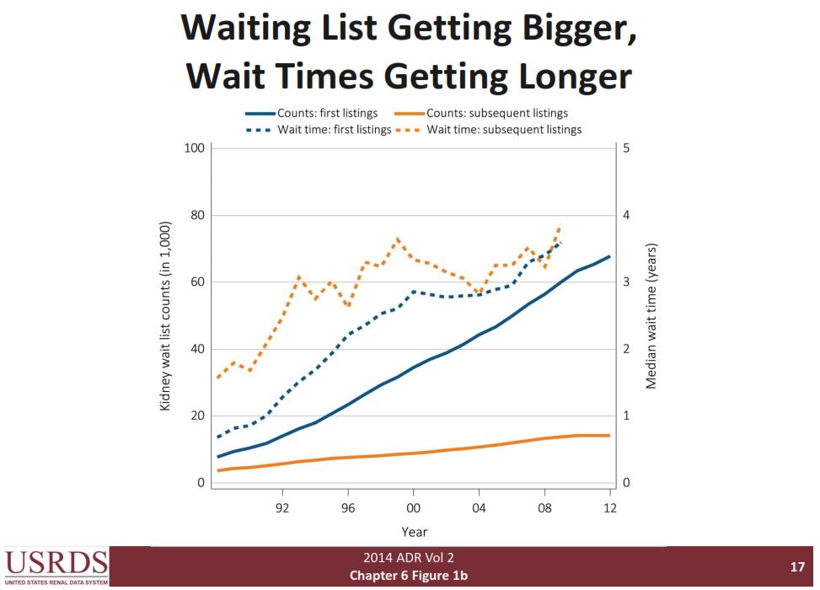
Waiting List Getting Bigger, Wait Times Getting Longer

Slide 8
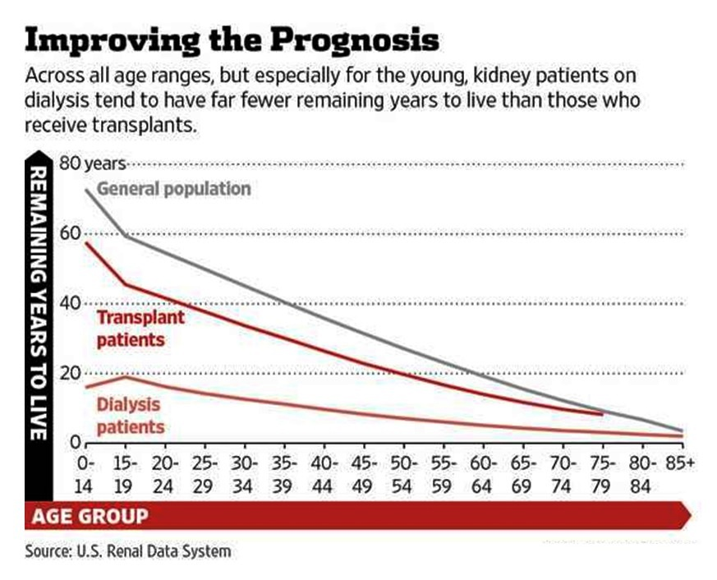
Notes:
Many of those waiting for kidneys are on dialysis, and life expectancy while on dialysis isn't long. For example, people age 45 to 49 live, on average, eight additional years if they remain on dialysis, but they live an additional 23 years if they get a kidney transplant. That is why in 2012, almost 4,500 persons died while waiting for kidney transplants. Although some of those waiting would have died anyway, the great majority died because they were unable to replace their defective kidneys quickly enough.
The toll on those waiting for kidneys and on their families is enormous, from both greatly reduced life expectancy and the many hardships of being on dialysis. Most of those on dialysis cannot work, and the annual cost of dialysis averages about $80,000. The total cost over the average 4.5-year waiting period before receiving a kidney transplant is $350,000, which is much larger than the $150,000 cost of the transplant itself.
Individuals can live a normal life with only one kidney, so about 34% of all kidneys used in transplants come from live donors. The majority of transplant kidneys come from parents, children, siblings and other relatives of those who need transplants. The rest come from individuals who want to help those in need of transplants.

Slide 9
What is the risk of ESRD?
Post donation Diabetes: worse in one kidney?
DONOR’S RISK
Incidence of post donation Hypertension
GFR change over time: faster than non-donors?
The Young donor: Should we require a higher GFR?
The Old donors: Should we accept their donations?
Can we predict the risk accurately?
% of live donation: France 10%
USA 40%
Saudi Arabia 80%

Slide 10
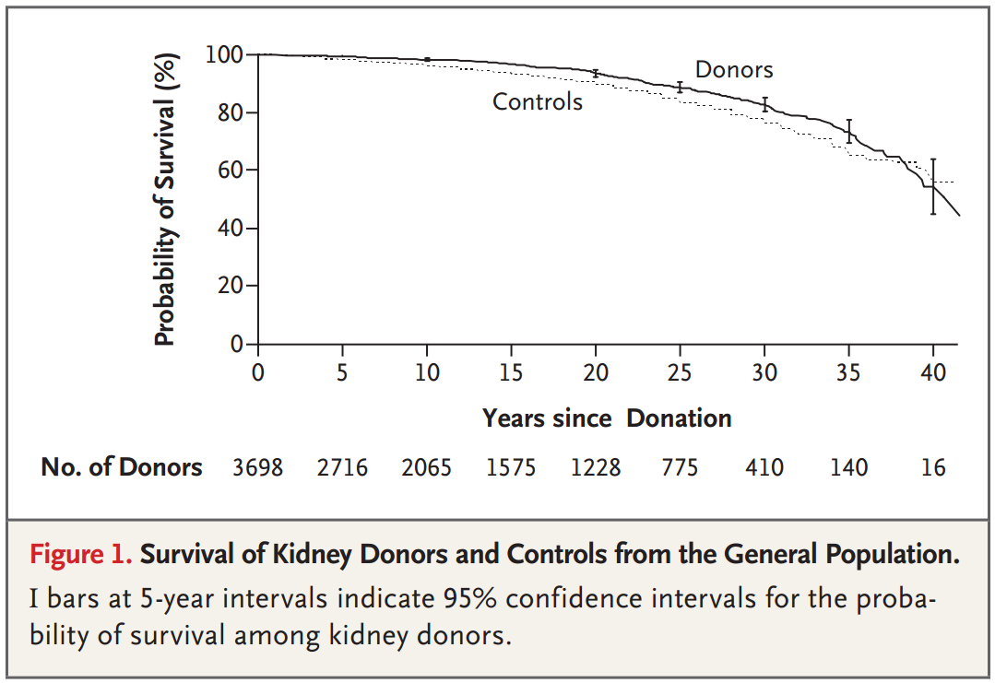
DONORS LIVE AS LONG
Ibrahim et al, NEJM 2009

Slide 11
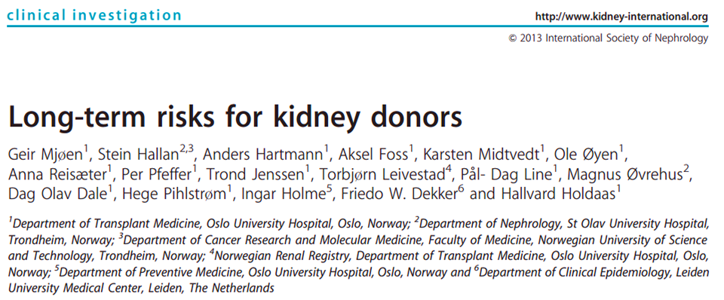
9/1901 after 15 years; 0.47%
18.7 years after donation
Mean age at ESRD 64.7 years
7/9 had an immune mediated cause of ESRD
ALL were biologically related
Mjøen et al, KI 2013

Slide 12
So, who develops ESRD?

Slide 13

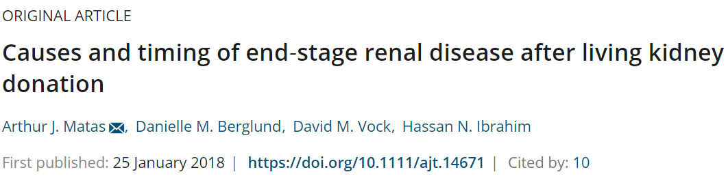
The majority of ESRD developing after living kidney donation is due to new-onset disease that would have affected both kidneys. Immunologic diseases, among others, are likely inevitable;

Slide 14
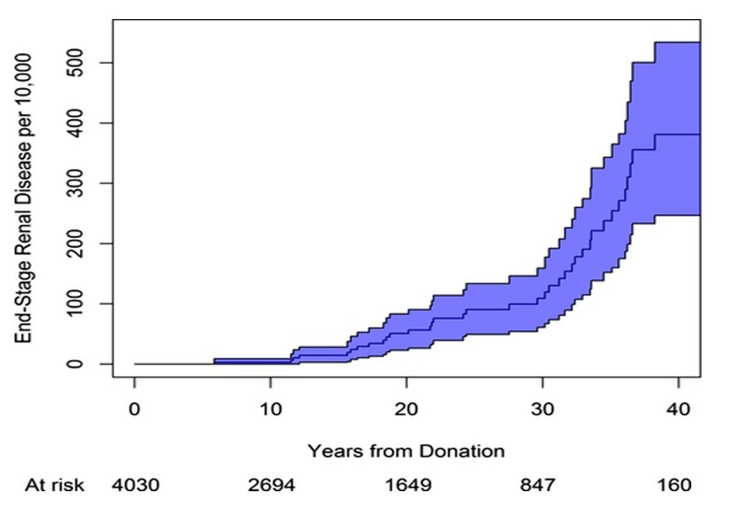
ESRD approaches the general population only after 30 years from donation
Causes and timing of end‐stage renal disease after living kidney donation
Causes and timing of end‐stage renal disease after living kidney donation, First published: 01 March 2018, DOI: (10.1111/ajt.14671)
Notes:
Estimated cumulative incidence of ESRD postdonation with 95% pointwise confidence intervals
IF THIS IMAGE HAS BEEN PROVIDED BY OR IS OWNED BY A THIRD PARTY, AS INDICATED IN THE CAPTION LINE, THEN FURTHER PERMISSION MAY BE NEEDED BEFORE ANY FURTHER USE. PLEASE CONTACT WILEY'S PERMISSIONS DEPARTMENT ON PERMISSIONS@WILEY.COM OR USE THE RIGHTSLINK SERVICE BY CLICKING ON THE 'REQUEST PERMISSIONS' LINK ACCOMPANYING THIS ARTICLE. WILEY OR AUTHOR OWNED IMAGES MAY BE USED FOR NON-COMMERCIAL PURPOSES, SUBJECT TO PROPER CITATION OF THE ARTICLE, AUTHOR, AND PUBLISHER.

Slide 15
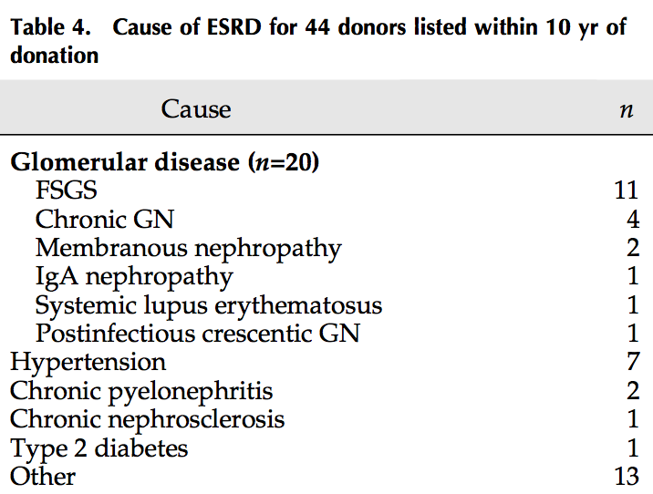

Slide 16
GFR AFTER DONATION
Is the GFR change with aging faster than those with two kidneys?
Do related donors lose GFR faster than unrelated donors?

Slide 17

Measured Glomerular Filtration Rate After Kidney Donation: No Evidence of Accelerated Decay
Danielle M. Berglund, BS¹ Lei Zhang, ScM² Arthur J. Matas, MD³ Hassan N. Ibrahim, MD⁴
Nearly 2 decades post donation GFR declined at a rate similar to that seen in the general population and in one-third GFR continues to increase.
GFR after donation

Slide 18
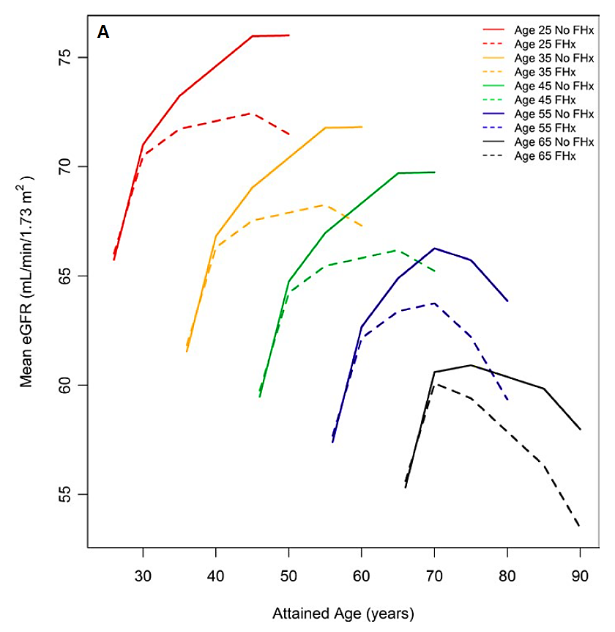
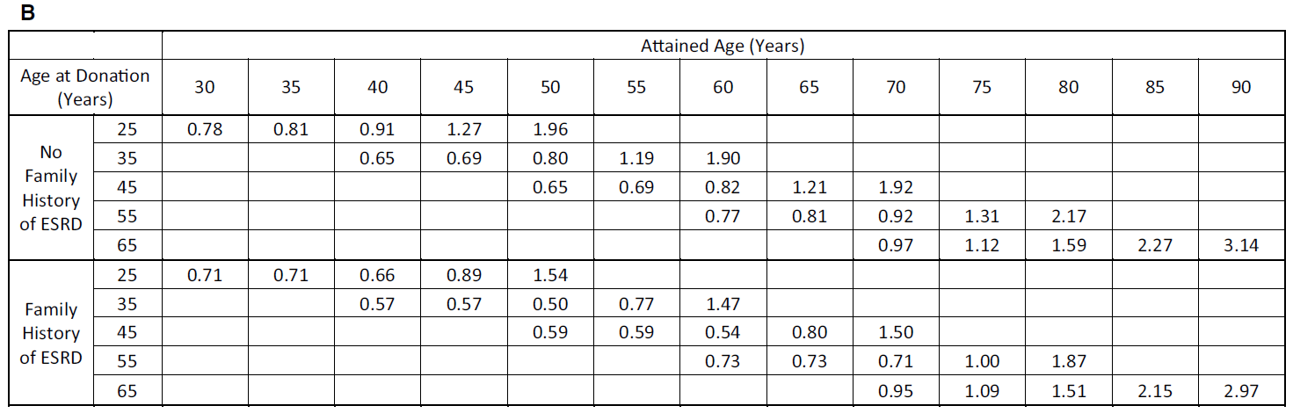
GFR change is similar in related and unrelated donors
GFR ≤25 years postdonation in living kidney donors with (vs. without) a first‐degree relative with ESRD, Volume: 18, Issue: 3, Pages: 625-631, First published: 05 October 2017, DOI: (10.1111/ajt.14525)

Slide 19
So, how do Diabetes and Hypertension behave after donation?

Slide 20
A COMMONLY RAISED CONCERN!
Does the hyperfiltration that occurs in diabetes worsens the hyperfiltration after donation and therefore diabetes in one kidney is worse than that in a person with two kidneys?

Slide 21

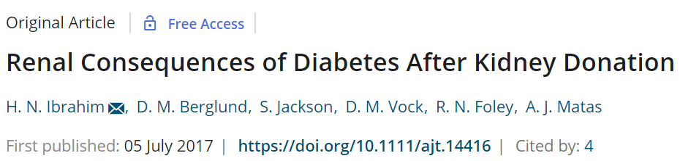
DM was not associated, with an increased risk of ESRD

Slide 22
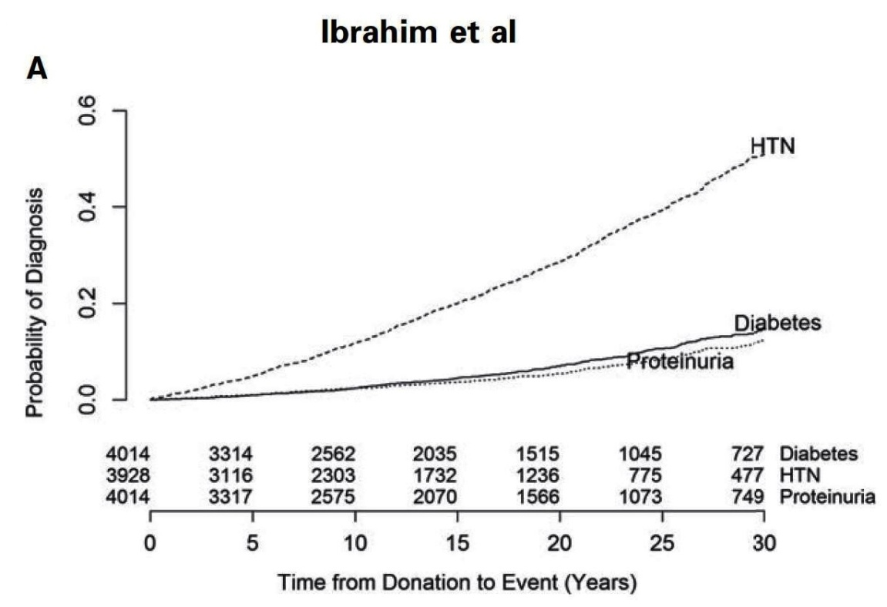
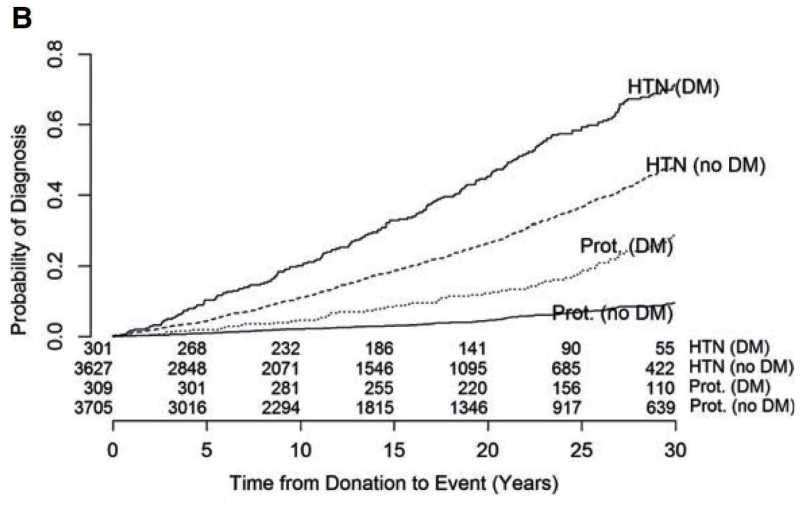
Diabetic donors’ proteinuria and hypertension similar to diabetics with 2 kidneys
Ibrahim et al, AJT 2017

Slide 23
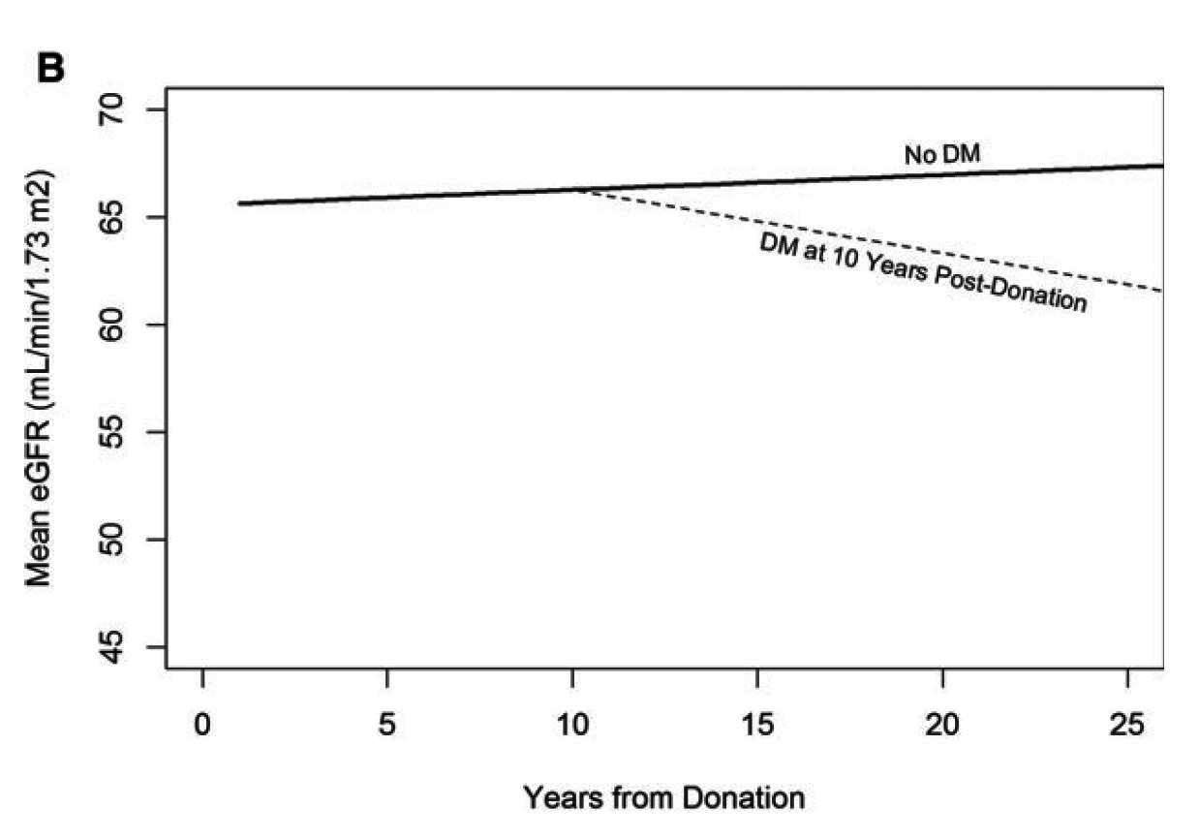
Annual GFR change: less than 1ml/min
Ibrahim et al, AJT 2017

Slide 24
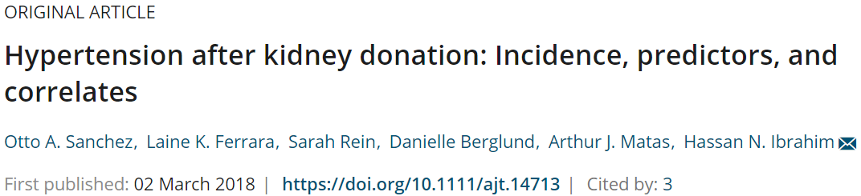

Slide 25
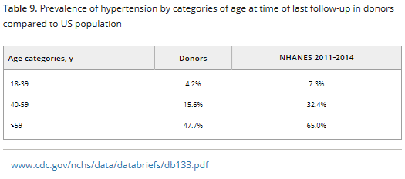
Minimal rise in BP after donation
Less than the general population

Slide 26
INCOMPATIBLE PATIENTS
WITH A
LIVING DONOR

Slide 27
50% of potential living donors are either blood group or HLA incompatible with the recipient
To Overcome this:
  Desensitization
  Kidney paired donation
  Combination of both
  Incompatible kidney donation have higher survival rates over remaining on dialysis, but there is the risk of rejection.
Kidney Paired Donation and Desensitization / Case Vignette, Jayme Locke; Kidney Week 2016, Chicago IL, Nov 15-20,

Slide 28
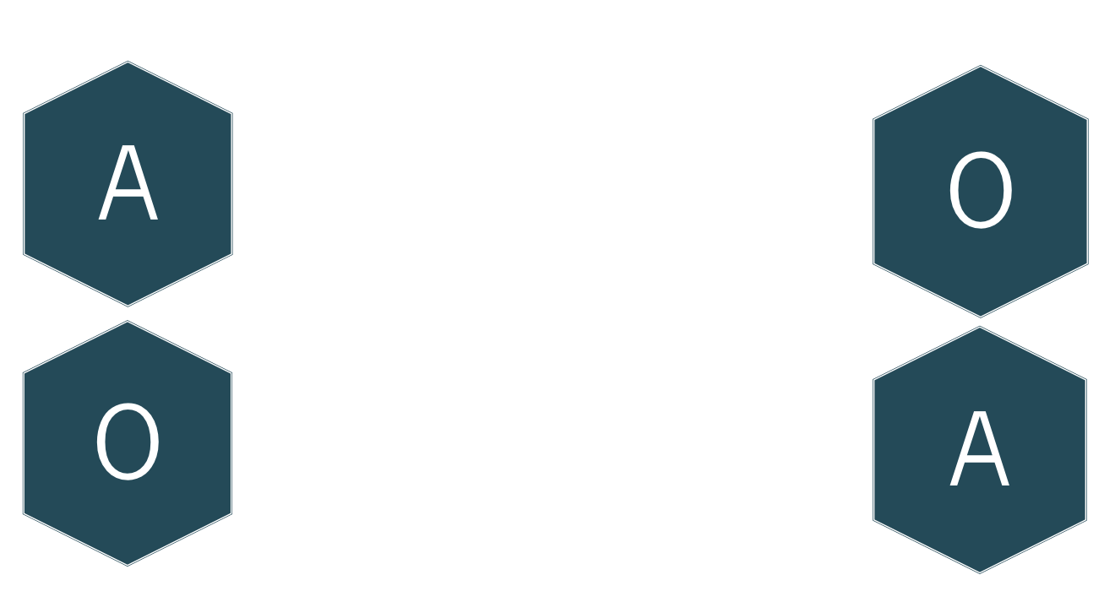
KIDNEY PAIRED DONATION
Donor
Recipient
ABO INCOMPATIBLE
X
X
POSITIVE CROSSMATCH
Kidney Paired Donation and Desensitization / Case Vignette, Jayme Locke; Kidney Week 2016, Chicago IL, Nov 15-20,

Slide 29
Should we refuse donors with IFG or IGT?
Unpublished Observations

Slide 30
AN EXPERIMENT IN NATURE!
The definition of diabetes and hypertension have changed over the years
What was considered normal blood sugar in the 1960-1990 is now considered frank diabetes
What was considered normal blood pressure is now hypertension
How are these donors doing now?

Slide 31
Higher Risk of DM

Slide 32
Risk of eGFR<30 or ESRD

Slide 33
Risk of ESRD is minimal!

Slide 34
THE YOUNG DONOR

Slide 35
THE ISSUE
Younger donors have to contend with consequences of a single kidney longer
Younger donors have not reached the age at which hypertension, DM and other kidney diseases develop
Older donors have the lowest likelihood of ESRD post-donation

Slide 36
GENERAL APPROACHES BY TRANSPLANT CENTERS
Accept young donors with a higher GFR
Deny young donors, particularly those from ethnic minorities and / or extensive family history of CKD
Not accept donors < 18 years of age

Slide 37
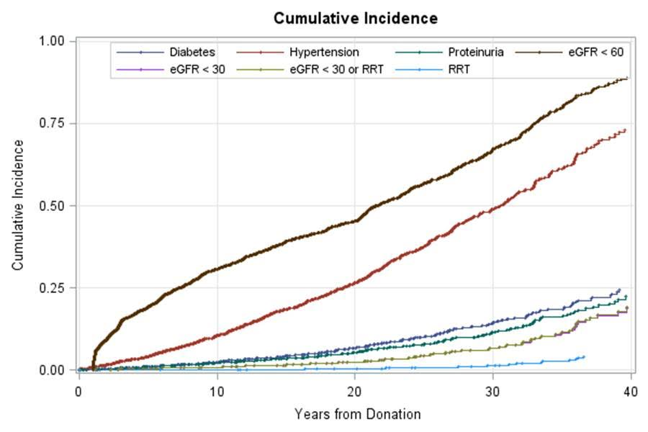
Long term risks can be reasonably predicted
Ibrahim et al, JASN 2015

Slide 38
THE OLDER LIVING DONORS

Slide 39
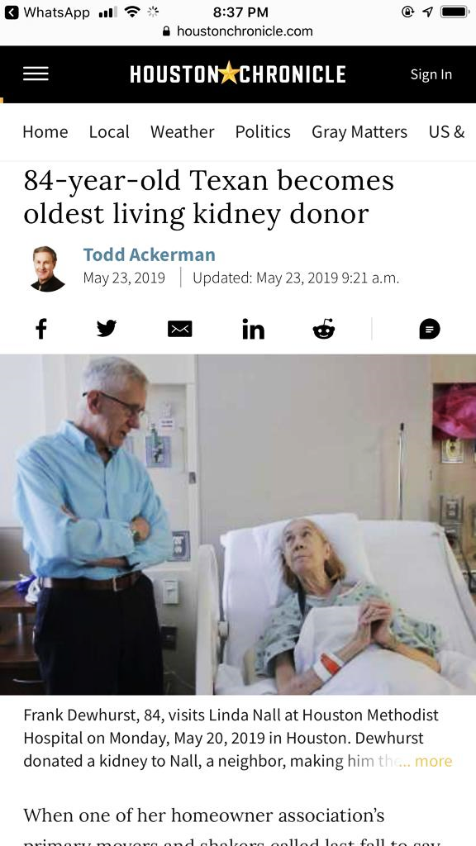
84 Year old Texan becomes oldest living kidney donor

Slide 40
ACCEPTING KIDNEYS FROM OLDER LIVING DONORS
Older living kidneys versus SCD deceased kidneys
The adjusted hazard of total graft loss was not significantly different for recipients of older living kidneys compared to recipients of SCD deceased kidneys.
There was also no difference between groups for death or death-censored graft loss.
A. Younga,b,*, S. J. Kimc, M. R. Speechleyb, A. Huangd, G. A. Knolle, G. V. Ramesh Prasadc, D. Treleavenf, M. Diamant,a,b and A. X. Garga,b for the Donor Nephrectomy Outcomes Research (DONOR) Network

Slide 41
Kidney Donation: the 99%!
Hassan N. Ibrahim, MD⁴
99% will Never develop ESRD!
99% have a quality of life that is average or above average!
99% DO NOT regret having donated!
95-99% describe their donation experience as positive!
The prehypertensive/prediabetic can be safely considered for donation
Young donors do well but the older healthier donor is preferred

Slide 42
DONOR’S RISK
What is the risk of ESRD? NO
Post donation Diabetes: worse in one kidney? NO
Incidence of post donation Hypertension ACCEPTABLE
GFR change over time: faster than non-donors? NO
The Young donor: Should we require a higher GFR? YES
Can we predict the risk accurately? YES
Can old donor donate? YES

Slide 43
IN SUMMARY
There is an ever increasing demand for kidney transplantation
Need to increase donor pool from both living and deceased donors
Increasing the rate of acceptance of kidney donors would benefit the patients in the waiting list for kidney transplant
Revising guidelines is mandatory to improve the practice taking into consideration patient survival and outcome

Slide 44
CONCLUSION
Any one of us can have renal impairment at any stage of his life
Kidney donors are the same and the donation will not protect them from getting renal impairment
Donors are by definition those that have normal kidney and organ function and have normal BP, so the risk of kidney failure could be less

Slide 45
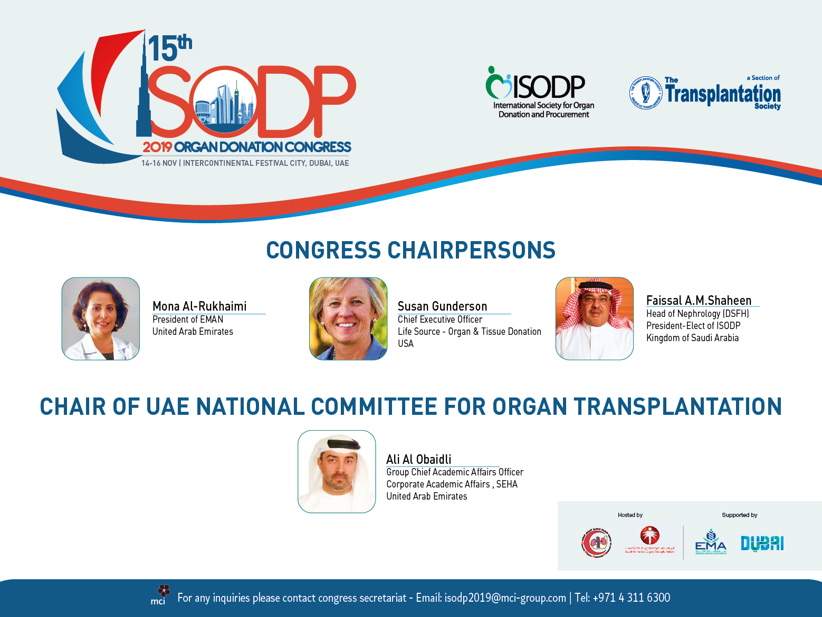

Slide 46
Thank you

