Slide 1
Hemodiafiltration,
better than “simply” hemodialysis,
Hemodiafiltration,
a complete/determined dialysis dose
- Purity of the dialysis fluids (endotoxins “free”)
- Diffusive dose (“HD” : Kt/Vurea)
- Convective dose (“HF” :volume and toxins per session)
Fischbach Michel
Professor Éméritus
University hospital Strasbourg France

Slide 2
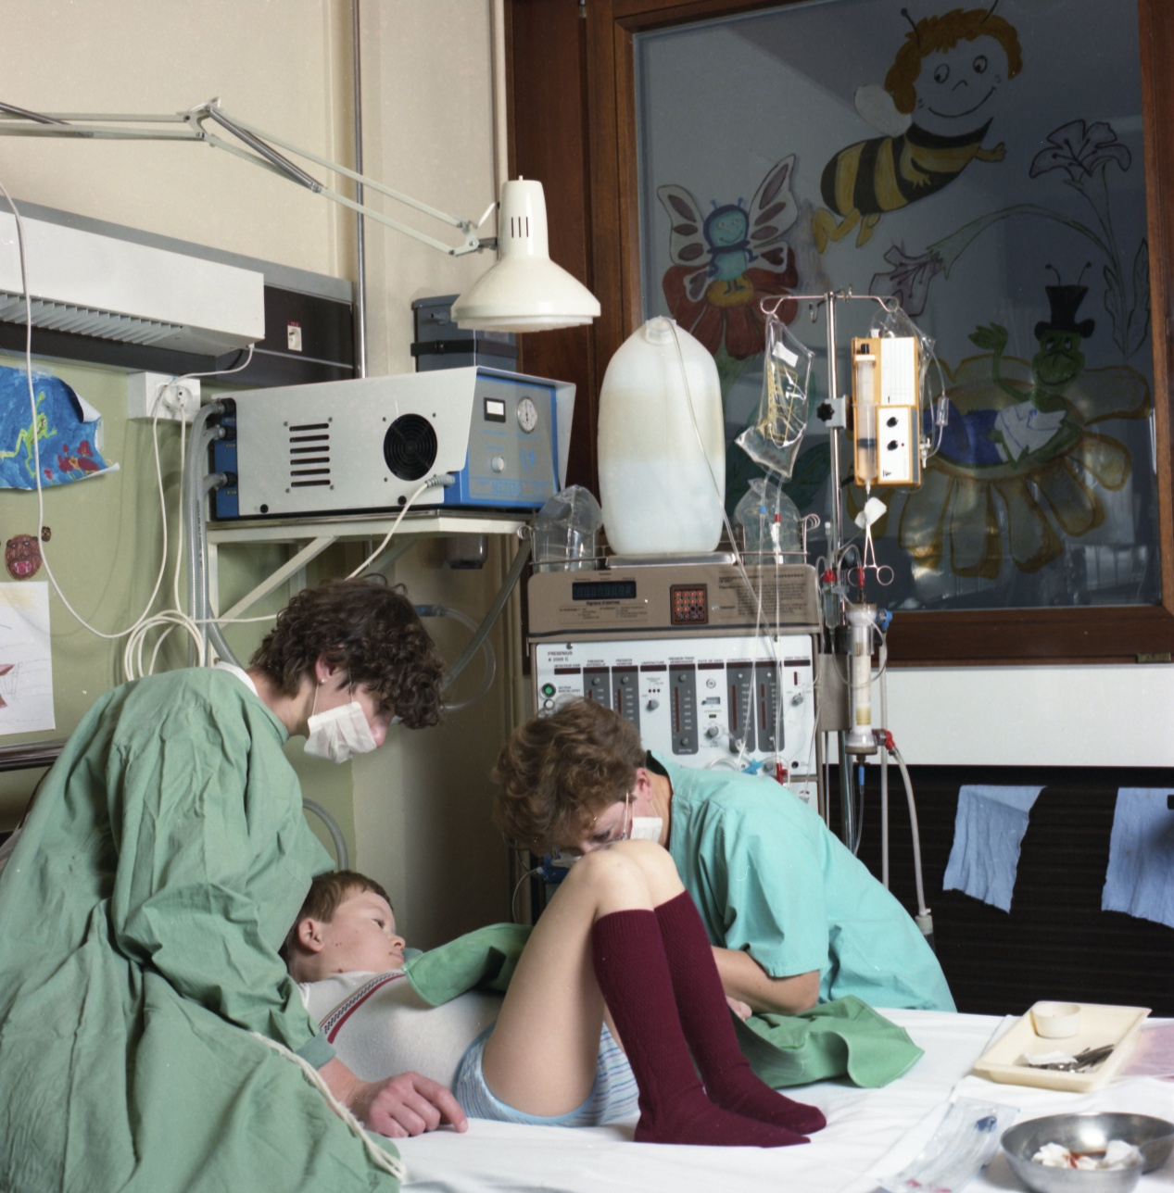
> 35 years HDF experience in children
July 1981
Start of HDF
STRASBOURG
1) HDF (acetate) with bags (lactate)
2) water treatment: individual bedside reverse osmosis
3) Conventional heparin
4) heating of the substitution fluid
5) membranes…
March 2002
Start of daily intensive HDF
(6 days a week)

Slide 3
Why did we start HDF in 1981 ?
Hemofiltration effects, improved weight loss tolerance (cardiovascular stability, “iso-osmotic” blood purification, “cooling”)
Beyond urea blood purification:diffusive process (urea) and convective mass transport (Ph, beta2microglobulin)
one minute of HDF « is equal» to two minutes of purification,
one of HD and another one of HF
K_{HDF} = K_{HD} + K_{HF} – (K_{HD}xK_{HF}/K_{max})
Phosphate, the “silent” killer and beta2microglobulin
convective removal

Slide 4
HDF versus HD : advantages
Hemodynamic stability over the session, that is both increased tolerance to weight loss and blood pressure control improvement (hemofiltration effects: osmotic stability, compartiment preservation, peripheral vascular resistances, myocardial contractility)
Optimal blood purification capacities both for urea and middle molecular weight compounds: high level of dialysis dose easely achieved . A high dialysis dose usually induce a good nutrition status, especially with an increased caloric intake (apetite)

Slide 5
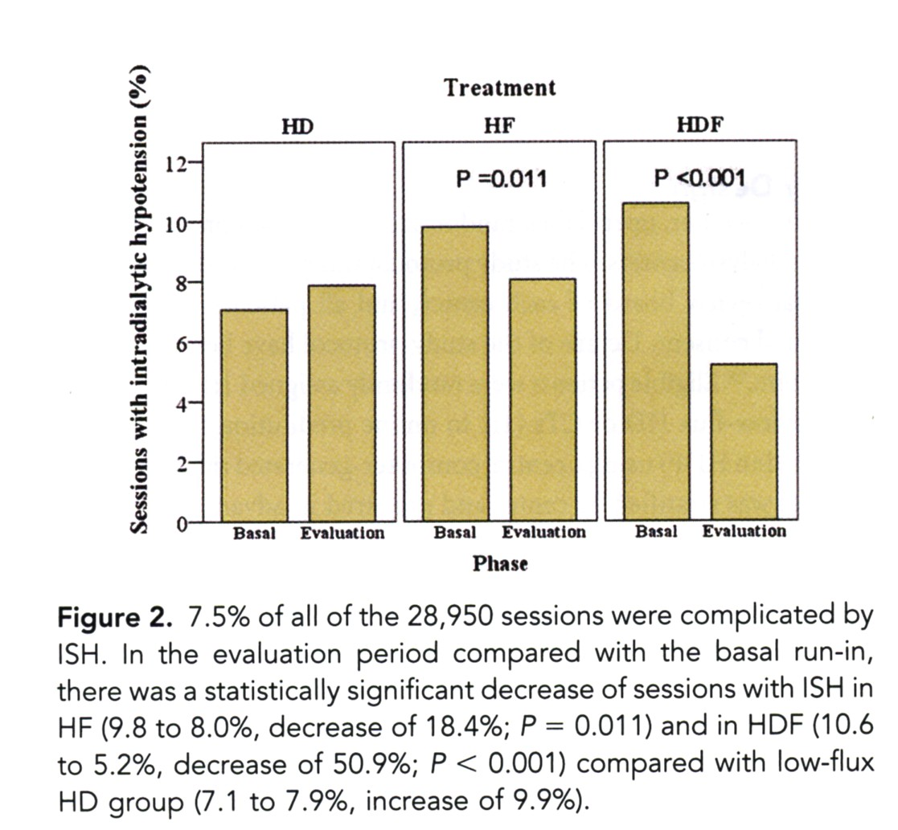
HF and HDF predilution, reduce intradialytic hypotension in ESRD
F. Locatelli et al. J Am Soc Nephrol 2010; 21:1798-1807
Intradialytic symptomatic hypotension occurrence was reduced in on line predilution HF and HDF
This lower frequency of ISH was associated in HDF, with a significant increase in predialysis SBP values (from 137.3 to 141.3 mmHg)
Minus 50%

Slide 6
Why did we start HDF in 1981 ?
Hemofiltration effects, improved weight loss tolerance (cardiovascular stability, “iso-osmotic” blood purification, “cooling”)
Beyond urea blood purification:diffusive process (urea) and convective mass transport (Ph, beta2microglobulin)
one minute of HDF « is equal» to two minutes of purification,
one of HD and another one of HF
K_{HDF} = K_{HD} + K_{HF} – (K_{HD}xK_{HF}/K_{max})
Phosphate, the “silent” killer and beta2microglobulin
convective removal

Slide 7
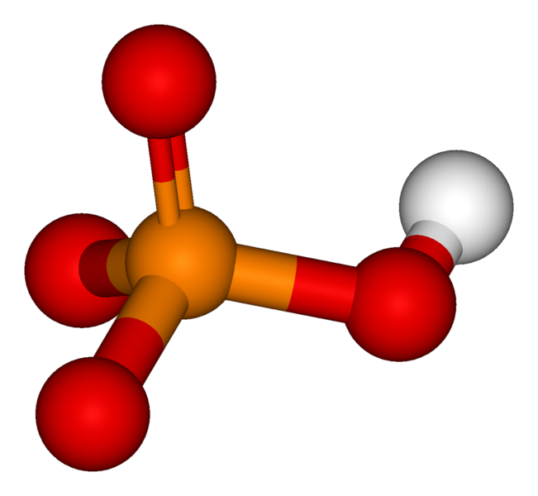
The Chemistry of Inorganic Phosphate need for convective purification (superiority of HF/HDF over HD)
Molecular weight: 96 Da (urea 60, creatinine 130)
Molecular radius 2.8Ǻ (urea 1.8, creatinine 3.0)
Hydrophilic molecule surrounded by aqueous cover
Distribution: Total body water, mainly intracellular
Slow ICF/ECF transfer rate
Not freely diffusible through plasma membranes

Slide 8
Hemodiafiltration
with high permeable membranes in children
M Fischbach, G Hamel, E Tarral, J Geisert. Blood purification 1984; 2:203-206
HF effect
convection

Slide 9
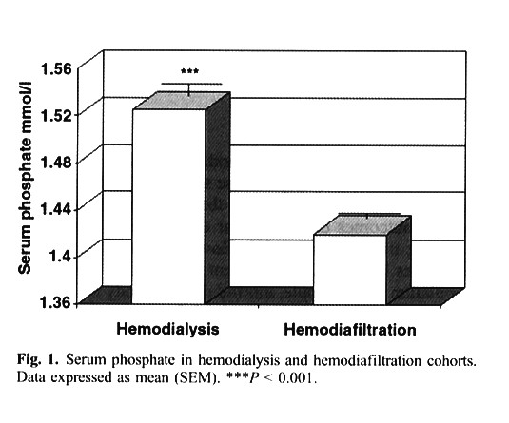
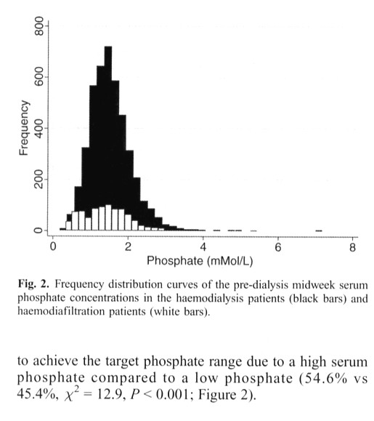
The effect of dialysis modality on phosphate control : HD compared to HDF.
The Pan Thames Renal Audit
A. Davenport et al. Nephrol Dial Transplant 2010; 25:897-901
HDF offers improved phosphate control compared to HD
HDF
HD
HDF

Slide 10
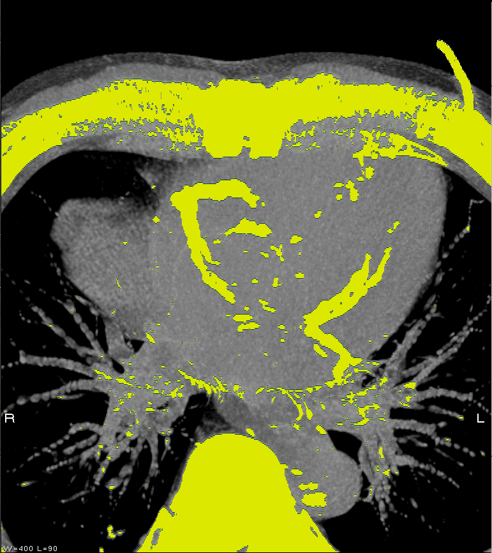
Premature atherosclerosis in young adults and childhood onset chronic renal failure
OH J. et al. J Am Soc Nephrol 2000; 11:A857 and Circulation 2002; 106:100-105
coronary calcification : Ca x P
17 young adult patients with childhood onset of CRF (median 26 years at screening time): coronary calcifications were found in 7 out of 17 patients
Hyperphosphatemia,
a « silent killer »
(FGF23;Klotho) of patients with renal failure
K. Amann, M.C. Gross, G.M. Landon, E. Ritz Nephrol Dial Transplant 1999;14:2085-87

Slide 11
Increased cardiovascular risk for children on ESRF : predialysis, dialysis, transplantation
Conventional risks factors : BP, BMI, cholesterol, sedentarity, BP, tabacco..
Specific ESRF factors : CKD-MBD (calcium/phosphate/ PTH/vit D), volume control
(BP and uremic cardiomyopathy), inflammation/protein wasting….
All together conducting to atherosclerosis (cholesterol) and mediacalcosis (CaxP)
«starting ESRF as a child» conducts at the age of 25 years to the same cardiovascular death risk as elderly over 85 years
Foley RN, Parfrey PS, Sarnak MJ 1998 Epidemiology of cardiovascular disease in chronic renal disease. J Am Soc Nephrol 9:S16-23

Slide 12
Hemodiafiltration
with high permeable membranes in children
M Fischbach, G Hamel, E Tarral, J Geisert. Blood purification 1984; 2:203-206

Slide 13
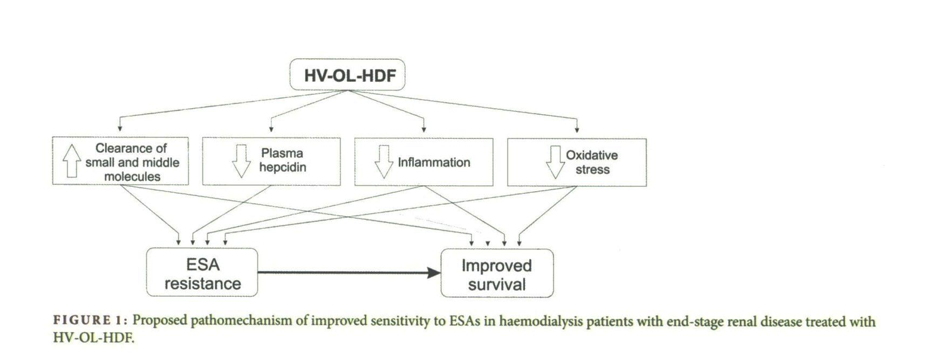
High-volume online haemodiafiltration improves erythropoiesis-stimulating agent (ESA) resistance in comparison with low-flux bicarbonate dialysis: results of the REDERT study
Panichu V, Scaletta A, Rosati A et al. Nephrol Dial Transplant 2015; 30:682-689
A significant reduction in hepcidine and β2microglobulin, and higher Kt/V
Is HDF more favourable than HD for treatment of renal anaemia ?
A. Wiẹcek and G. Piecha. Nephrol Dial Transplant 2015; 30:523-525

Slide 14
Hemodiafiltration in children 1981-2002: 3 times/week
Reduced intradialytic symptoms (tolerance to weight loss, hemodynamic stability, enhanced osmotic clearance tolerance)
Lowered TAC_{urea} (Ku ml/min/kg increased): Kt/V>>1.4
Phosphate managment improved, less phosphate chelators
Transfusions rate decreased, anemia control
From 1989: on line HDF, ultrapure dialysis fluids
From 2002: “daily” intensive HDF normal growth

Slide 15
On-line HDF: a combination of solute removal, « purification » and dialysis fluids purity
Maduell F. Hemodialysis International 2005 ; 9:47-55
HDF and blood purification impacts
Nutrition, uremic toxins and anorexia (leptin)
Anemia, improved erythropoietin response
Cardiovascular disease, AGE removal
Infectious complications, complement factor D removal
Joint pain, dialysis related amyloidosis
HDF and ultrapure dialysis fluid impacts
Amyloidosis
Anemia
Nutrition
Joint pain, dialysis related amyloidosis

Slide 16
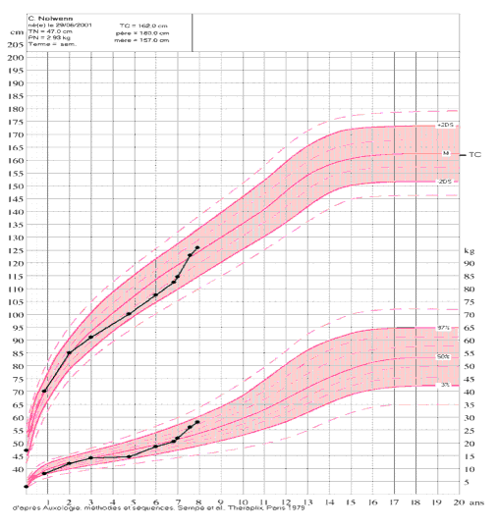
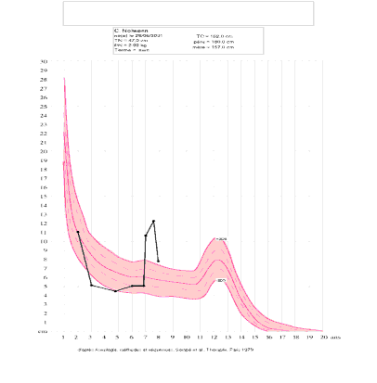
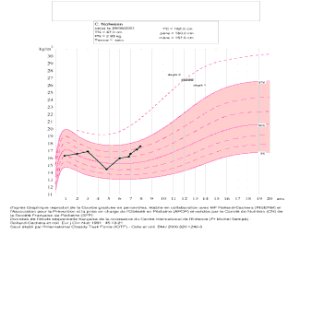
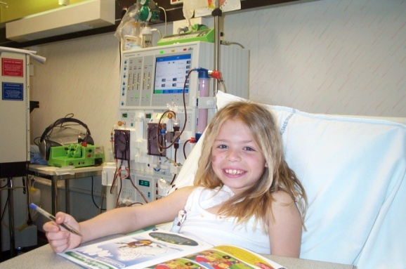
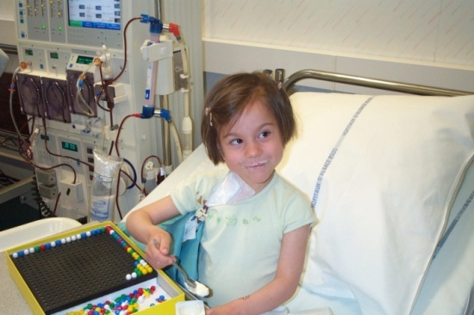
Daily on line HDF (high efficiency HDF) promotes catchup growth in children on chronic dialysis
FISCHBACH M, TERZIC J, MENOUER S, DHEU C, SEUGE L, ZALOSCZIC A.
Nephrol Dial Transplant 2010; 25: 867-73

Slide 17
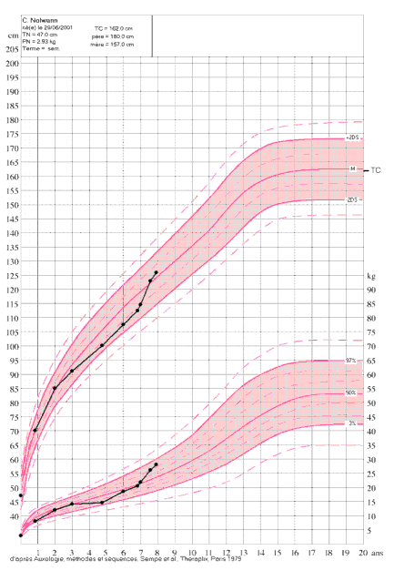

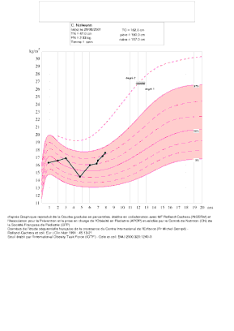
Results: catch up growth
Mean time on daily OL-HDF (untill KTP): 20.5+/-8 months
Growth velocity:
the year before daily: 3.8+/-1.1 cm/y
first year of daily: 14.3+/-3.8 cm/y
mean over daily: 8.9+/-2.2 cm/y
Height (SDS)
start: -1.5+/-0.3
end: +0.2+/1.1
target parental height: -0.3
end- target: +0.5

Slide 18
Daily on line hemodiafiltration : the perfect « stimulus package » to induce growth
F. Schaefer. Editorial comments. Nephrol Dial Transplant 2010; 25:658-660
35 % to 50 % of children with ESRD still grow up to became small adults with a final height below the third percentile of the general population
Growth failure is a common end point of a variety of abnormalities associated with CKD :
  Protein energy malnutrition due to anorexia and chronic inflammation (cachexia)
  Metabolic acidosis via the UPS and direct suppression of endogenous GH secretion
  Partial resistance to GH, multifactorial (somatomedin inhibitors ; accumulation of IGFBP ; decreased IFG1 response to GH and deficit of IGF1 action ; activation of the post GH receptor intracellular signalling : JAK2-STAT5; activation and upregulation of the S0CS family (inflammation+++)

Slide 19
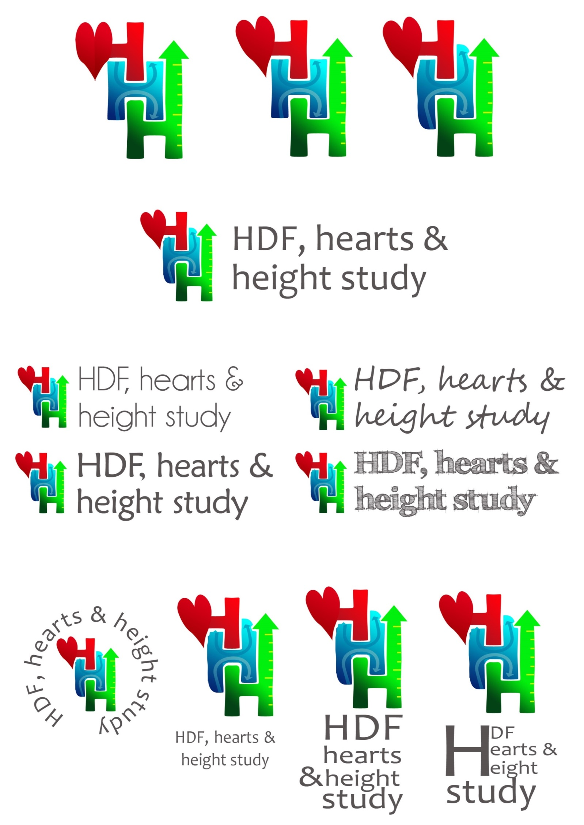
The effects of HDF vs conventional HD on growth and cardiovascular markers in childrenn
3H multicenter study
(HDF, Hearts and Height)
Shroff R and al CJASN 2019 in press
Hypothesis, based on “Strasbourg results” and a survey:
children on HDF compared with HD have improved:
  cardiovascular risk profile
  growth and nutritional status
  quality of life

Slide 20
IPHN 2016 survey: Preliminary findings: superiority of HDF
 | cHD | HDF | P
Hemoglobin* (g/dl) | 10.5 | 11.5 | <0.001
Serum phosphate (mmol/l) | 1.75 | 1.60 | n.s.
CrP (g/dl) | 12.1 | 5.7 | <0.01
BMI SDS | -0.30 | 0.08 | <0.01
Height SDS | -2.40 | -1.03 | <0.001
Delta Height SDS /year** | 0.13±0.51 | -0.22±0.96 | 0.05
* Epo dose n.d. between groups
** observation time: 10.8 (3.6-39) months
Independent of dialysis dose (time per week / frequency and blood flow/m²)
(52 children HDF, 209 conventional HD)

Slide 21
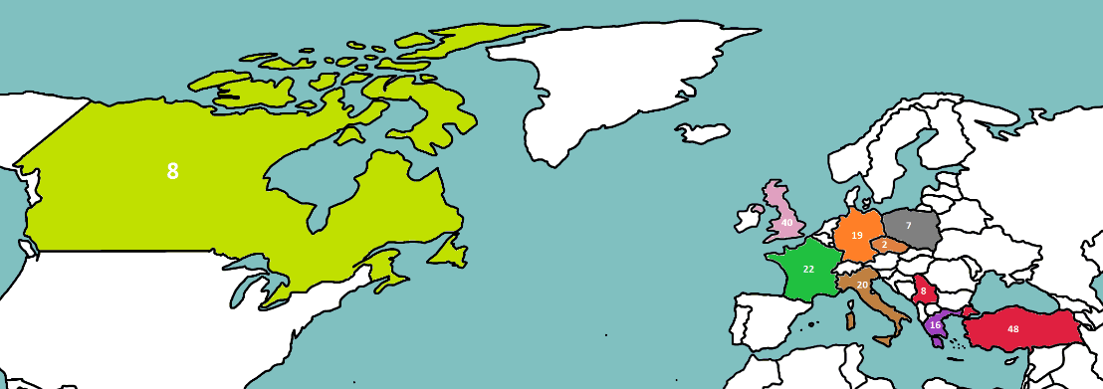

Recruitment: 3 sessions per week
29 centres in 10 countries screened
28 centres included
190 children recruited
HD versus HDF

Slide 22
Conclusions: 3 “H” study 2017
HDF, Hearts, Height: HDF>>HD
Shroff R and al. CJASN 2019 in press
Children on HDF have a small but significant increase in height SDS over 1-year
HDF is associated with a significant and early improvement in “cardiovascular preservation”:
  Fluid status
  Reduced inflammation and oxidative stress
  Improved endothelial function
  Children on HD have a significant increase in cIMT over 1-year, whereas there is no change in cIMT in children on HDF

Slide 23
Optimal Hemodialysis Prescription:
Do children need more than a urea dialysis dose?
Fischbach Michel, Zaloszyc Ariane, Schaefer Betti, and Schmitt Claus Peter
International Journal of Nephrology
Volume 2011, Article ID 951391, 5 pages doi:10.4061/2011/951391
If economically feasible, high-flux membranes should be used in combination with ultrapure disposable dialysate for all patients, but their use in HD procedure only achieve a very small convective volume, that is both backfiltration risks and low efficiency HDF…for the same cost/price !
2) High efficiency Hemodiafiltration (high convective volume), is a safe routine replacement therapy : a “complete” use of a high flux membrane, with a large determined convective volume (no more cost, but more efficiency)

Slide 24
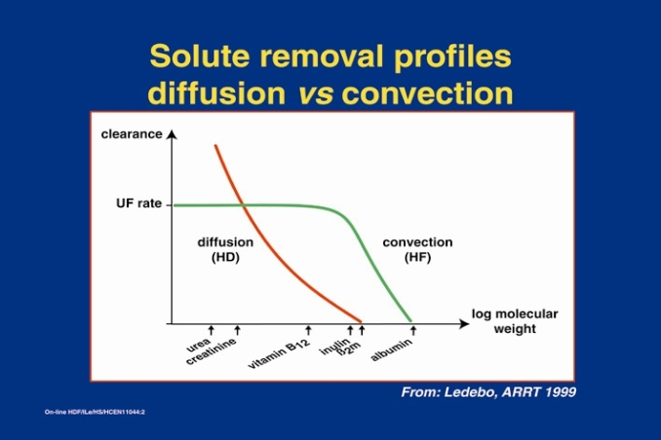
Move from HD to HD + HF = HDF
Every HD is in fact more than “only” a diffusive purification process (Kt/V urea). Every HD is in fact an HDF with “only” a very low convective volume (that are both the weight loss = “UF”, which is a convective process, and the “undetermined” retrofiltration volume occuring in the capillary, called “internal” HDF, )
A determined high convective volume, exceeding the weight loss (need for substitution fluid) is prescribed in HF/HDF, impacting on outcome and quality of life

Slide 25
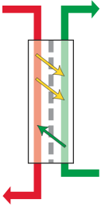
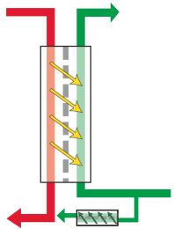
High-flux dialysis: how to limit backfiltration, apply HDF
High-flux HD
On-line HDF
internal convective flow, compenstate by backfiltration
high convective flow « without »
backfiltration
dialysis fluid
purity?
blood
ultrapure
dialysis
fluid
blood
uncontrolled and unknown
convective removal
controllable and measurable
convective removal
Ref: Ledebo, NDT Plus, 2010
Lebedo I, Blankestijn PJ (2010) Haemodiafiltration – optimal efficiency and safety. Nephrol Dial Transplant Plus 3:8-16

Slide 26
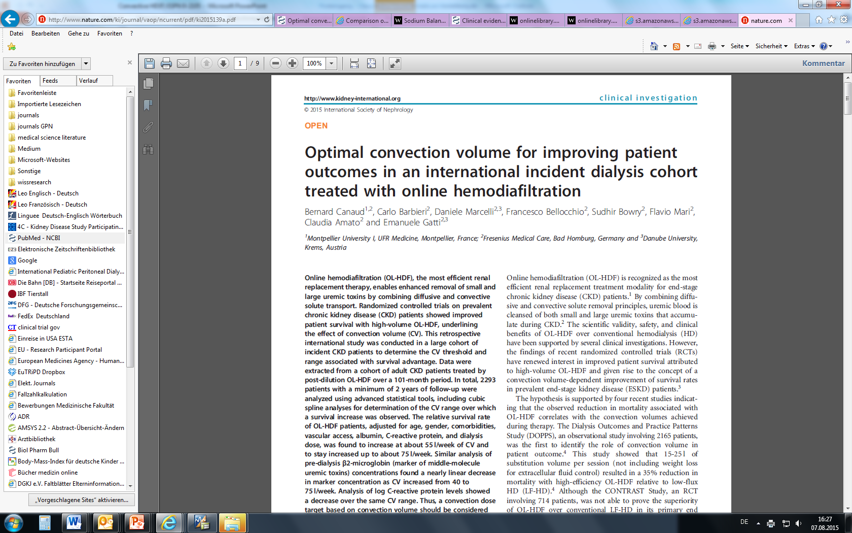
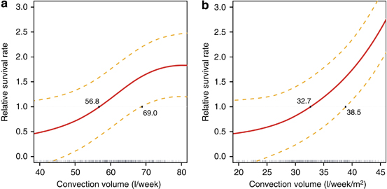
Improvement becames significant: over 32.7 L/week/m2 BSA (56.8 L/week), and shows a linear increase until 45 L/week/m2 BSA (75 L/week = 25 L/session/3times per week)
optimal postdilution convective volume
a « surrogate » for larger uremic toxins
15L/m²/session or 25L / session
three times a week

Slide 27
Dialysis adequacy today: on line HDF, a European perspective : morbidity,mortalty,cardiovascular outcome, nutrition
Locatelli F, Canaud B. Nephrol Dial Transplant 2012; 27:3043-8
Highly permeable membranes for « all »
Assessing and correcting underlying chronic inflammation: purity of the dialysis fluids, the Japanese experience (Endotoxin <0.001 U/ml)
One should consider as minimal treatment time 270 min = 4.5 h, (depending on the patient’s weight or V)
UF rate of no > 13 ml/h/kg (applied for patients treated as a thrice weekly schedule. Movelli E et al. NDT 2007;Flythe J et al.Kidney Int 2011; Assimon M et al. Am J Kidney Dis 2016 )
The volume of substitution (>25L/session), a surrogate of the convective dialysis dose, should be considered as a critical factor for patient survival.
Technological improvement will never replace neither the expertise of caregivers or individualized care: doctor time, nurse competence, good material

Slide 28
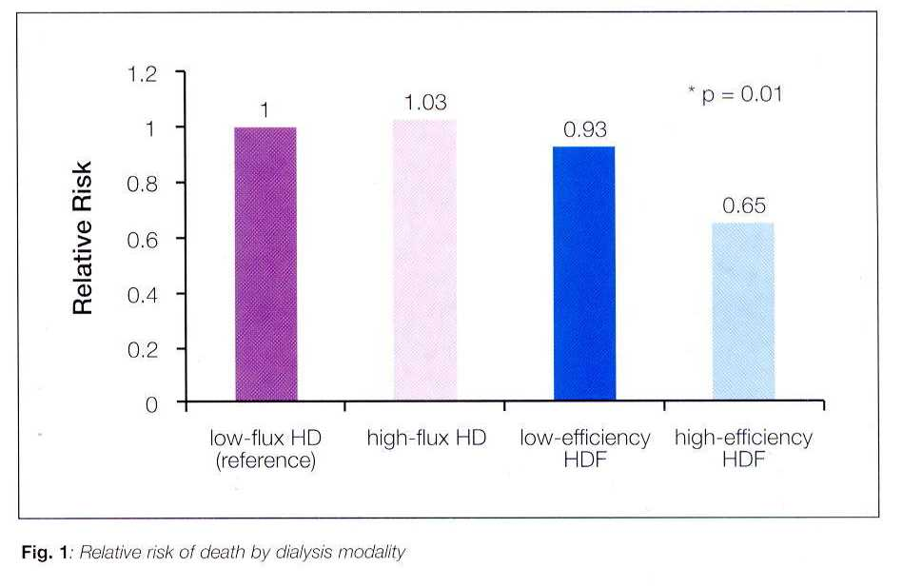
Mortality risk for patients receiving HDF versus HD:
European results from the DOPPS
Canaud B et al. Kidney Int 2006
The relative risk of mortality after adjustments for several variables (age, comorbid conditions, haemoglobin, Kt/V) was significantly reduced by 35 % for patients receiving high efficiency HDF compared to low flux HD or high flux HD
Several explanations: HDF « package »
  improved removal of small and larger molecules solutes (Phosphate), « surrogates » of the achieved convective volume
  enhanced intradialytic hemodynamic stability
  reduced inflammation due to better biocompatibility (β2 microglobulin): purity of the dialysis fluids
  regulation of calcification inhibitors, like : fetuin-A, matrixGLA protein, osteoprotegrin
less mortality - 35%

Slide 29
On-line HDF: a combination of solute removal, « purification » and dialysis fluids purity
Maduell F. Hemodialysis International 2005 ; 9:47-55
HDF and blood purification impacts
Nutrition, uremic toxins and anorexia (leptin)
Anemia, improved erythropoietin response
Cardiovascular disease, AGE removal
Infectious complications, complement factor D removal
Joint pain, dialysis related amyloidosis
HDF and ultrapure dialysis fluid impacts
Amyloidosis
Anemia
Nutrition
Joint pain, dialysis related amyloidosis

Slide 30
From the blood flow to the dialysis prescription: urea and more
Diffusive dose proportional to the blood flow for urea and low molecular weight uremic toxins
Convective dose, from the weight loss and the “retrofiltration” to a determined convective dose (convective volume and high extraction coefficient of beta 2 microglobulin)
Purity of the dialysis fluids (and dialysate composition)
Limited loss of albumin
Efficient anticoagulation (clotting, residual blood volume)
Membrane performances and extracorporeal blood volume
Risks of a high weight loss or a high interdialytic weight gain

Slide 31
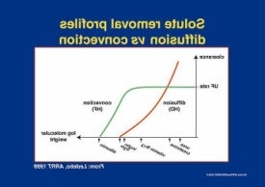
Blood purification dialysis modalities : diffusion versus convection
Diffusive Process
(hemodialysis)
Small molecules
Membrane area
Mass transport coefficient
Concentration gradient
Blood flow x extraction coefficient (<1)
c_{i} - c_{o}
K_{HD} = Q_{B} x
c_{i}
i, o : in outlet solute concentrations
Convective mass transport
(hemofiltration)
Ultrafiltrate flow (Q_{UF})
Hydraulic permeability
Transmembrane pressure (TMP ; mmHg)
Sieving coefficient (S)*
Molecular permeability (MW): <1
2 C_{UF}
*S =
c_{i}+c_{o}
C_{UF} : ultrafiltrate solute concentration
K_{HF} = Q_{UF} x S
Q_{UF} < 1/3 Q_{B} (in postdilution, and even oftently lower)
Q_{UF} = or > Q_{B} (in predilution, in fact « not limited »)

Slide 32
Diffusive Process: small molecules purification like urea
(hemodialysis or HDF : Kt/Vurea)
Small molecules
Membrane area
Mass transport coefficient
Concentration gradient
Blood flow x extraction coefficient (<1)
c_{i} - c_{o}
K_{HD} = Q_{B} x ---------
c_{i}
i, o : in outlet solute concentrations

Slide 33
Adequacy of dialysis in children: does small solute clearance really matter ?
Goldstein SL. Pediatr Nephrol 19: 1-5, 2004
Dialysis and outcome: dialysis dose, dialysis time, specific impact of convection
A minimum Kt/V urea (equilibrated) level of 1.2-1.4 (URR 65 to 75 %) is thought to be desirable
Only « small solute urea clearance » prescription ? Dialysis prescription should be not only a « urea dialysis dose » : phosphate and β2 microglobuline clearances +++ (convective flow)
Dialysis and residual renal small-solute clearance are not equivalent
Optimal Hemodialysis Prescription: Do children need more than a urea dialysis dose?
Fischbach Michel, Zaloszyc Ariane, Schaefer Betti, and Schmitt Claus Peter.International Journal of Nephrology.Volume 2011, Article ID 951391, 5 pages doi:10.4061/2011/951391
Hemodiafiltration: The addition of convective flow to hemodialysis: “a complete dialysis dose”. M. Fischbach, H. Fothergill, A. Zaloszyc, L. Seuge Pediatr Nephrol 2012, 27: 351-6
Kt/Vurea (diffusion) and a “high” effective convective volume (HDF)

Slide 34
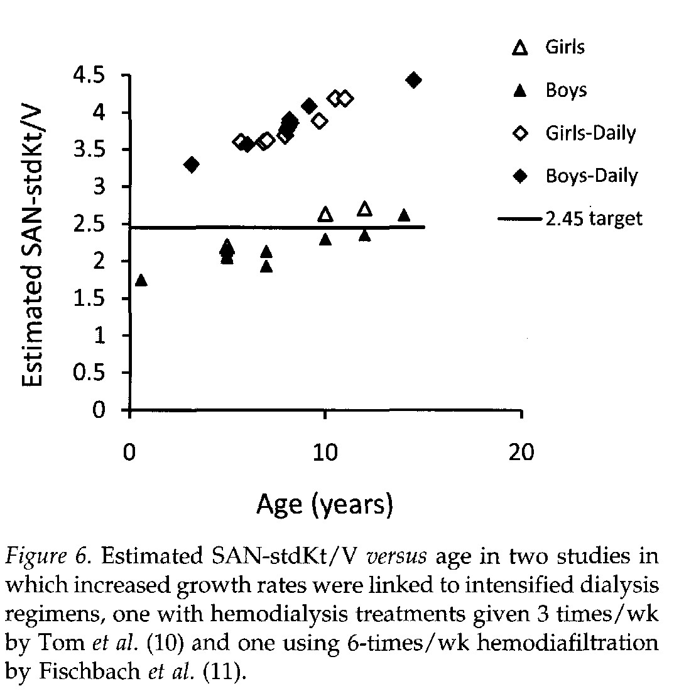
Dialysis dose and growth
(Surface area normalized standard Kt/Vurea: SAN Kt/V)
Daugirdas JT et al. Clin J Am So Nephro 2010, 5:821-827
Could Kt/Vurea a marker of dialysis adequacy?
Yes, as a surrogate
(mainly of diffusion capacity)
Fischbach et al. NDT 2010
Adequacy of dialysis in children:
does small solute clearance really matter ?
Goldstein SL. Pediatr Nephrol 19: 1-5, 2004
Dialysis and outcome: dialysis dose, dialysis time, specific impact of convection

Slide 35
Adequacy of dialysis in children: does small solute clearance really matter ?
Goldstein SL. Pediatr Nephrol 19: 1-5, 2004
Dialysis and outcome: dialysis dose, dialysis time, specific impact of convection
A minimum Kt/V urea (equilibrated) level of 1.2-1.4 (URR 65 to 75 %) is thought to be desirable
Only « small solute urea clearance » prescription ? Dialysis prescription should be not only a « urea dialysis dose » : phosphate and β2 microglobuline clearances +++ (convective flow)
Dialysis and residual renal small-solute clearance are not equivalent
Optimal Hemodialysis Prescription: Do children need more than a urea dialysis dose?
Fischbach Michel, Zaloszyc Ariane, Schaefer Betti, and Schmitt Claus Peter.International Journal of Nephrology.Volume 2011, Article ID 951391, 5 pages doi:10.4061/2011/951391
Hemodiafiltration: The addition of convective flow to hemodialysis: “a complete dialysis dose”. M. Fischbach, H. Fothergill, A. Zaloszyc, L. Seuge Pediatr Nephrol 2012, 27: 351-6
Kt/Vurea (diffusion) and a “high” effective convective volume (HDF)

Slide 36
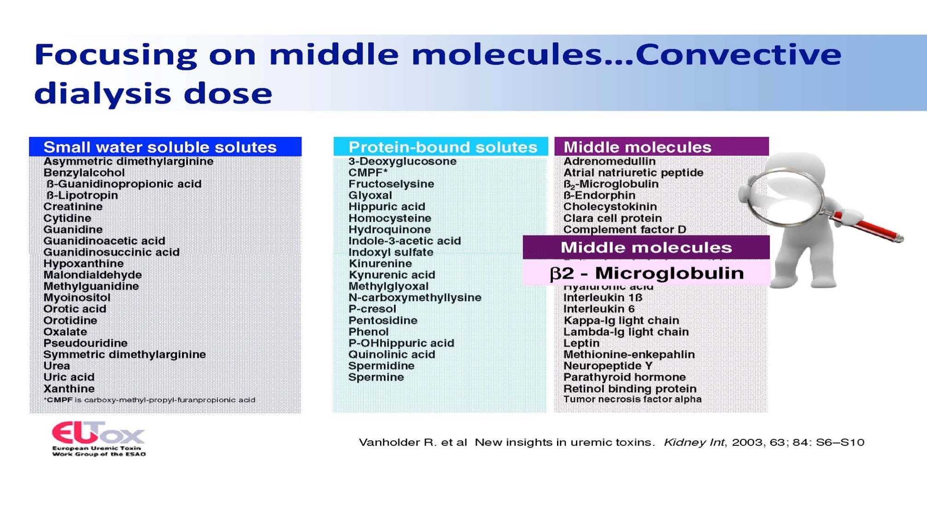
Uremic toxins: which to dose?
1) Urea Kt/V as surrogate for the diffusion process and
2) β2 microglobulin or the convective volume as surrogate for the convective mass transport
Diffusion
urea
Convection
Phospate and
β2 microglobulin

Slide 37
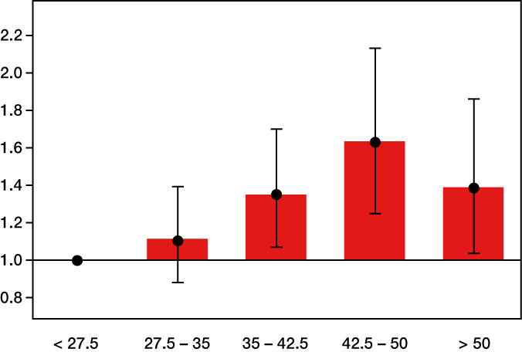
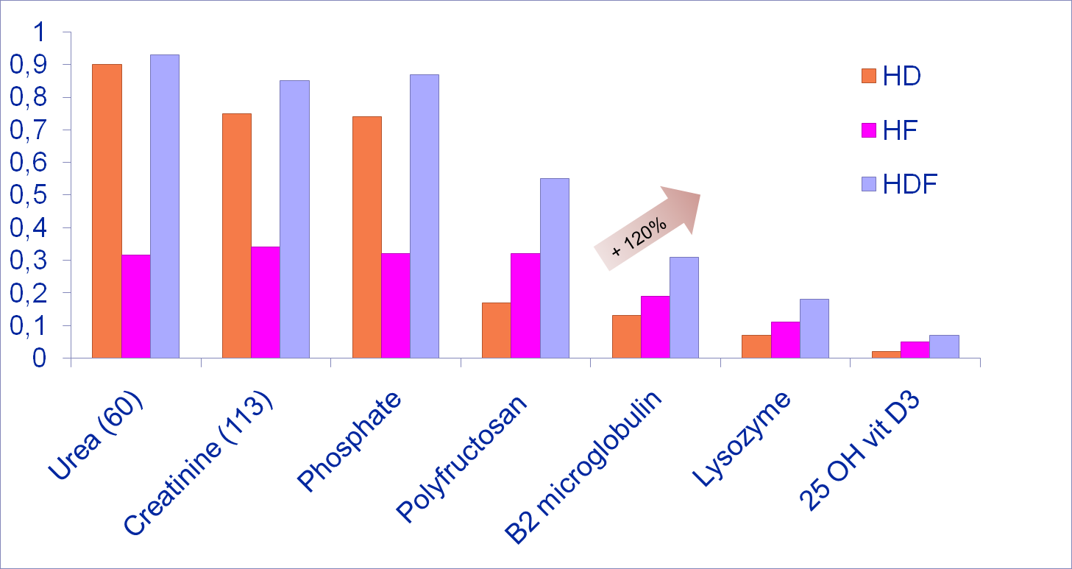
Do we need indicators of dialysis adequacy based on middle molecule convective removal ?
R. Vanholder, S. Elot, W. Van Biesen. Nature Clinical Practice. Nephrology 2008; 4:174-5
From urea to MMW toxins purification : major importance of the convective flow/volume (HDF)
At present, the most valid candidate is β₂ microglobulin, a threshold of < 27.5 mg /l (predialysis) might be proposed
Phosphate should be considered as a MMW uremic toxin in terms of dialysis purification : water molecular environment
The need for high flux membranes and the importance of a high convective volume (HDF)
Predialysis ß₂m level significantly correlated with all-cause mortality (p= 0.001) Cheung et al, JASN 2000
Notes:
37

Slide 38
Convective mass transport : middle molecules purification like phosphate and beta 2 microglobulin
(hemofiltration or HDF : convective volume)
Ultrafiltrate flow (Q_{UF})
Hydraulic permeability
Transmembrane pressure (TMP ; mmHg)
Sieving coefficient (S)*
Molecular permeability (MW): <1
2 C_{UF}
*S = -------------
c_{i}+c_{o}
C_{UF} : ultrafiltrate solute concentration
K_{HF} = Q_{UF} x S
Q_{UF} < 1/3 Q_{B} (in postdilution, and even oftently lower)
Q_{UF} = or > Q_{B} (in predilution, in fact « not limited »)

Slide 39
Uremic toxins: which to dose?
1) Urea Kt/V as surrogate for the diffusion process and
2) β2 microglobulin or the convective volume as surrogate for the convective mass transport

Slide 40
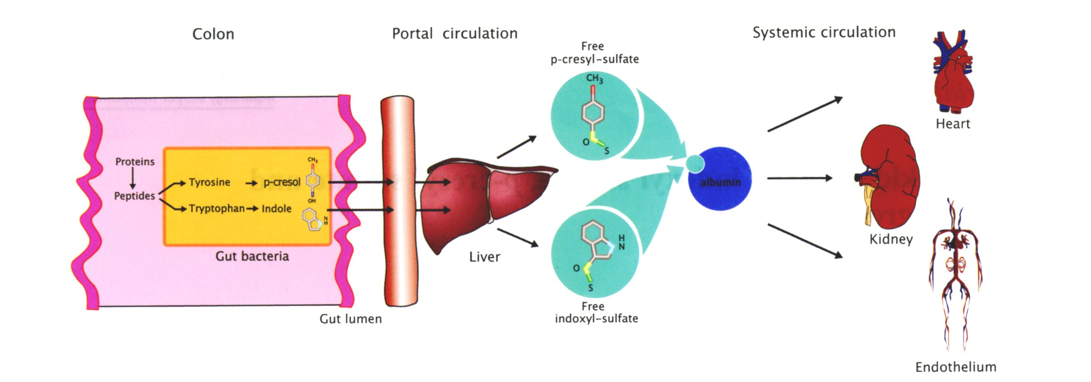
The gut-kidney axis: indoxyl sulfate, p-cresyl sulfate, endotoxins and CKD progression
Björn KI Meijers and Pieter Evenepoel.
Nephrol Dial Transplant 2011; 26:759-761
Endotoxins from the gut
CKD : a systemic disease with cross talk between the gut and the “body” (CKD-MBD-CardioVascular)
  Uremic toxins production
  “leaky” gut (endotoxins)

Slide 41
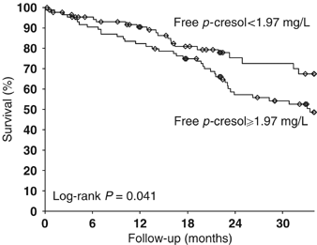
P-cresol , a protein-bound uremic toxin impact on survival
Bammens et al, AJKD 2004 and Kidney Int 2006
Total solute removal (mg)
Improved survival
N= 175 HD patients, prosp. obs. study
14 patients treated w the same high-
flux filter 2 wks on each modality
Ref: Bammens et al, K I 2006

Slide 42
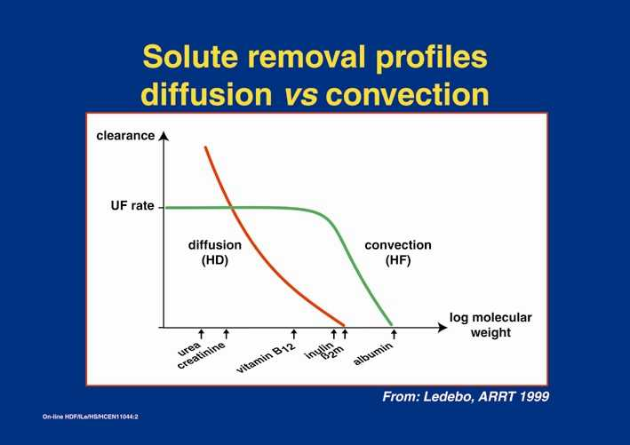
Simultaneous purification: diffusion process and convection mass transport i.e. hemodiafiltration
one minute of dialysis « is equal» to two minutes of purification,
one of HD and another one of HF
K_{HDF} = K_{HD} + x Q_{UF} x 0.46
K_{HDF} = K_{HD} (1 - Q_{UF} x S/Q_{B}) + K_{HF} (Granger)
with Q_{UF} x S = K_{HF} and Q_{B} = K_{max}
K_{HD} x K_{HF}
K_{HDF} = K_{HD} + K_{HF} --
K_{max}
If K_{HD} is equal to K_{max} then Q_{HDF}= K_{HD}

Slide 43

+ 30%
HDF allows an optimal blood purification not only for urea, but also for the middlemolecular weight compounds ( Babb theory )
From M Fischbach et all .Contr Nephrol1985

Slide 44
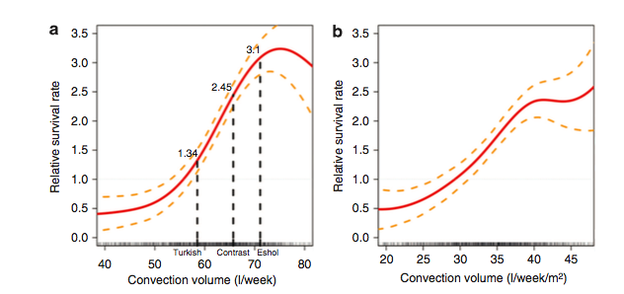
Impact of high convective volume
(high efficiency dialysis)
Study name | Threshold volume for suvival benefit (observational studies)
DOPPS (Canaud) 2006 | > 15 L
Riscarid (Panichi) 2008 | > 23 L
Contrast (Grooteman) 2012 | > 21.95 L
Turkish (Ok) 2012 | > 17.4 L
ESHOL (Madrid) 2013 | > 23.1 L
post dilution or predilution (easier to achieve?) « Minimal » convective volume | 15L/m²/session = 25 L/session 18 - 27 L/m²/session

Slide 45
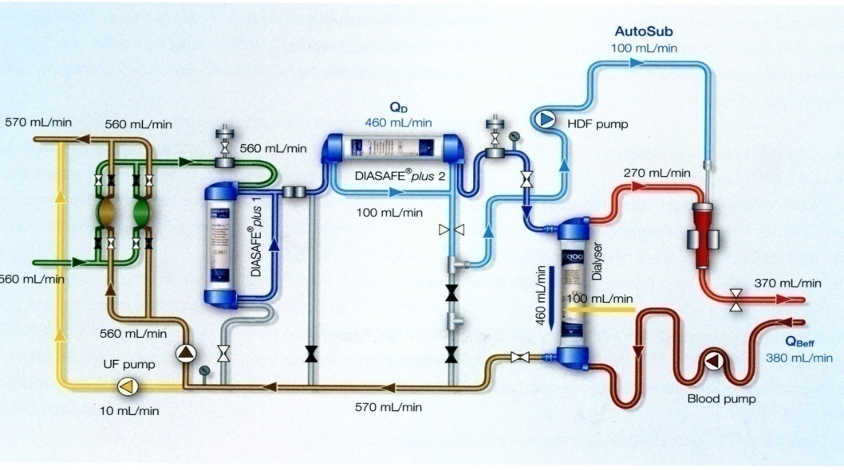
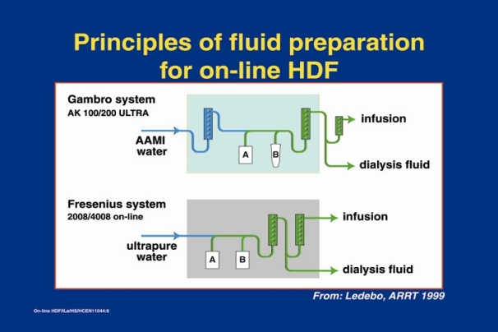
On line HDF: substitution fluid produced on line the ultrapure dialysis fluids a complete dialysis dose
On-line HDF
blood
ultrapure
dialysis
fluids
Cold sterilization of the dialysis fluids
controllable and measurable
convective removal

Slide 46
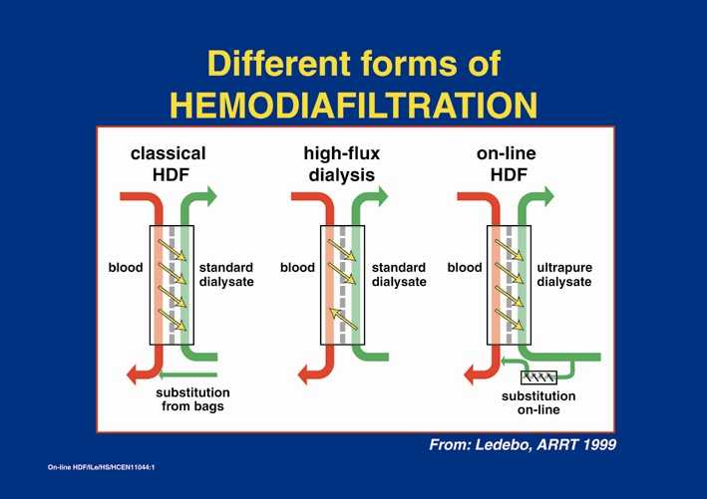
Principles of blood purification
Diffusive Process (HD) : low MW uremic toxins removal i.e.urea
Convective mass transport (HF) : middle Mw uremic toxins removal i.e.phosphate
Membrane adsorption (+++/PMMA/Torray ?)

Slide 47
Adequate HDF prescription: « quality » of a high convective volume importance of the membrane
Hydraulic permeability : high convective volume
(> 15-25 L for adults or 12- 15L/m²/session in postdilution)
Molecular permeability : extraction coefficient (phosphate and β₂ m 80 %)
Loss of albumine (< 5 gr in adults)
Purity of the dialysis fluids

Slide 48
Dialysis adequacy today, a European perspective : morbidity,mortalty,cardiovascular outcome, nutrition,
Locatelli F, Canaud B. Nephrol Dial Transplant 2012; 27:3043-8
Highly permeable membranes for « all »
Assessing and correcting underlying chronic inflammation: purity of the dialysis fluids, the Japanese experience (Endotoxin <0.001 U/ml)
One should consider as minimal treatment time 270 min = 4.5 h, (depending on the patient’s weight or V)
UF rate of no >10 - 13 ml/h/kg (applied for patients treated as a thrice weekly schedule. Movelli E et al. NDT 2007;Flythe J et al.Kidney Int 2011; Assimon M et al. Am J Kidney Dis 2016 )
The volume of substitution, a surrogate of the convective dialysis dose, should be considered as a critical factor for patient survival.
Technological improvement will never replace neither the expertise of caregivers or individualized care.

Slide 49
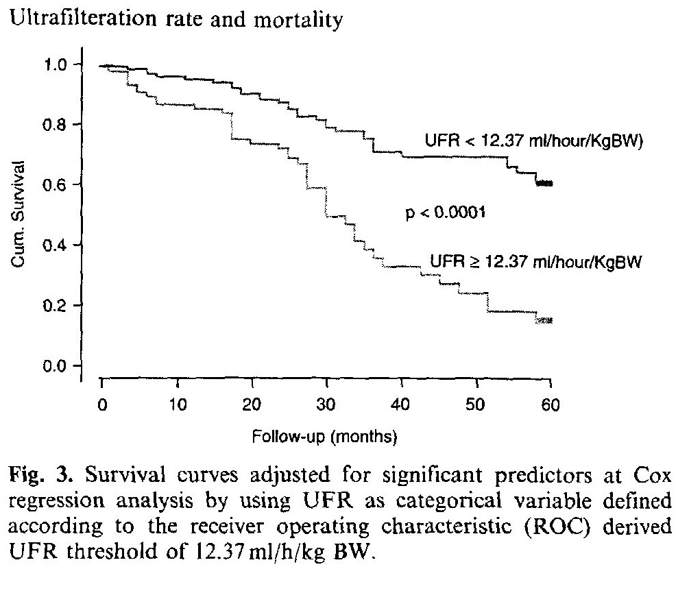
Association between high ultrafiltration rates and mortality in uraemic patients on regular haemodialysis. A 5-year prospective observational multicentre study
E. Movilli et al. NDT 2007; 22:3547-3552
Mortality increased
From 65% to less than 20% survival at 5 years
if BW loss per hour (UF rate) was over 12mL/H/kgBW
(>1.2% BW loss/h)
Importance of dialysis time
Reduction in UF demands per session
Notes:
49

Slide 50
UF rate< 1.25%/h BW (floating dry weight : daily dialysis)
IDWG<4% ? Cooling T_{D}=36°
M Fischbach et al Pediatr Nephrol 2015 (editorial comments)
Huang SH, Filler G, Lindsay R, McIntyre CW (2014) Euvolemia in hemodialysis patients: a potentially dangerous goal? Semin Dial doi: 10.1111/sdi 12317: “cooling” T_{D} 36°
Flyth JF, Brunelli SM (2011) The risk of high ultrafiltration rate in chronic hemodialysis : implications for patient care. Semin Dial; 24:259-265
Paglialonga F, Consola S, Galli, MA, Testa S, Edefonti A (2015). Interdialytic weight gain in oligo anuric children and adolescents on chronic haemodialysis. Pediatr Nephrol 2015: IDWG<4%
Movilli E, Gaggia P. Zubani R, Camerini C, Vizzardi V, Parrinello G, Savoldi S, Fischer MS, Londrino F, Cancarini G (2007) Association between high ultrafiltration rates and mortality in uraemic patients on regular haemodialysis. A 5-year prospective observational multicentre study. Nephrol Dial Transplant; 22:3547-3552: UF demand< 1.23%/h BW loss

Slide 51
Writing a HDF prescription for children
The dialysis prescription (blood flow, duration of the session and dialysate flow) should be individually adapted to achieve an urea dialysis dose of Kt/V≥1.4, which is a surrogate for predominantly diffusive clearance as well as the highest possible convective clearance (blood flow/convective flow: maximal UF <<<blood flow; <1/3 in postdilution).
The following points should be considered when writing an HDF prescription for children and in first “line” the blood flow
HDF requires an optimal arterial blood flow of 5 to 8 ml/min/kg body weight or 150 to 200 ml/min/m² body surface area. This can be achieved through either a fistula (+++) or a central venous line.

Slide 52
A high flux membrane with surface area equal to the child’s body surface area is used.
Dialysate flow of 1.5 times the blood flow is sufficient and adequate to optimize the diffusive blood purification process using highly permeable membranes for HDF
Convective flow is equal to total ultrafiltration flow i.e. the sum of the weight loss and the replacement fluid (convective dialysis dose per session; L/m²/session or per week)

Slide 53
Replacement fluid that is generated on-line from the dialysate must be ‘ultra-pure’ as discussed above. The microbiological purity (bacterial count and endotoxin level) should be determined regularly at 1-3 monthly intervals. Ultrapure dialysis fluids improve outcome (morbidity and mortality: less inflammation; “Japanese experience)

Slide 54
Hemodiafiltration : pre/post dilution
The convective transport requires ultrafiltration (UF) of fluid, i.e. the convective flow
If the convective flow exceeds the desired/prescribed weight loss, the fluid balance has to be maintained by an infusion of replacement fluid either in pre or post or mixed dilution, as applied in HF.
pre
-dilution
post-dilution
Substitution solution
Q
B
in
Q
B
out
In HDF addition of substitution solution can be made before the filter called predilution mode, after the filter, postdilution mode, or mixed

Slide 55
Post-dilution HDF - the convective flow is ≤1/3 of the blood flow, and limited by the risk of filter clotting. It typically decreases over the dialysis session (TMP should be limited less than 300 mm Hg)
Pre-dilution HDF - the convective flow is set at ≥ 50% of blood flow, but optimally should be increased to 75 - 100% of blood flow ; despite the dilution of the blood potentially impacting negatively on urea clearance, β2 microglobulin and phosphate dialytic removal is optimized as is the clearance of uremic protein bounded toxins (without majored albumine loss)

Slide 56
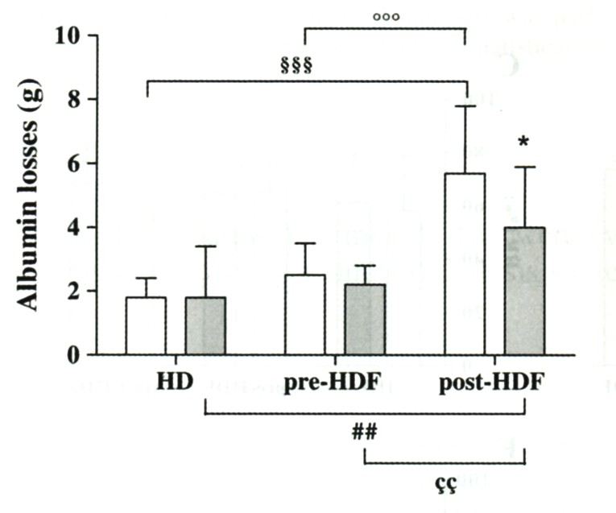
Comparison of removal capacity of two consecutive generations of high flux dialysers during different treatment modalities
Meert N and Vanholder R. Nephrol Dial Transplant 2011; 26:2624-30
Albumine loss appears reduced in predilution HDF, despite the enhanced convective volume
Alb loss
 | Pre HDF | Post HDF
Qb eff (mL/min) | 300 | 300
Q_{D} (mL/min) | 800 | 800
Qinf (mL/min | 145 | 70
Fig. 3 : when comparing strategies, post dilution HDF induced more albumin losses (5.7±2.1 g/session) than the two other modalities (1.8±0.6 g/session)

Slide 57
HDF optimization of convective volume
With the new dialysis machines, the convective flow is automatically optimized either as a pressure or a volume control tool (Gambro) or as a viscosity control tool (Fresenius Medical Care; Autosub+) and is directly dependent on the achieved blood flow.
In case (“oftently” in children) of low blood flow or of a risk of clotting (high haematocrit or high protein levels in the blood) pre-dilution is more effective than post-dilution as it preserves an effective convective flow throughout the dialysis session.

Slide 58
Predilution HDF
To improve efficiency in the pre dilution mode, the convective flow should be high enough to ensure increased solute clearance despite blood dilution. In practice, this is a convective flow at least superior to 50 % of the blood flow, and “ideally” should be two thirds of or equal to the blood flow.
In cases of high hematocrit levels or blood conditions that limit the filtration capacity e.g. elevated blood protein concentration, or in patients with low blood flow (as is often the case in children), predilution compared to postdilution modalities HDF, have been proven to be more efficient with both:
  less risk of membrane clotting and
  regular achievment of the prescribed convective volume.

Slide 59
Optimal anticoagulation is necessary so as to prevent filter clotting, particularly in post-dilution HDF. A single dose of low molecular weight heparin is effective for a 4 hour session. Alternatively, a continuous heparin infusion can be used.
The dialysate composition is similar to that used in HD, but careful attention to dialysate sodium concentration is important, particularly when high convective volumes are infused, as with pre-dilution HDF. To avoid the risk of a positive sodium balance the dialysate sodium concentration required is lower than in conventional HD.

Slide 60
HDF: a complete dialysis dose
Diffusive dose, on-line Urea Kt/V > 1.4, V from « Morgenstern or impedancemetry
Convective dose, the convective volume (25L/session or 15L/m²/session) but also the « quality of the UF » (impact of the membrane) :
  ultrafiltration coefficient > 20 mL/h/mm Hg/m²
  Β2-microglobulin extraction coefficient >80% (Sieving C > 0.6)
  myoglobin>65%
« loss » of albumin (more impacted by the membrane than by the amount of convective volume, check for albumin loss < 5gr/session for « adults »)
Dialysis fluids :
  Purity (endotoxin « free »)
  Temperature control (BTM) of the dialysate/replacement fluid (« cooling for « all »: 36° »)
  Dialysate/replacement fluid, importance of the composition: NaD, Ca++, HCO₃⁻

Slide 61
Conclusions: 3 “H” study 2017
HDF, Hearts, Height: HDF>>HD
Shroff R and al. CJASN 2019 in press
Children on HDF have a small but significant increase in height SDS over 1-year
HDF is associated with a significant and early improvement in “cardiovascular preservation”:
  Fluid status
  Reduced inflammation and oxidative stress
  Improved endothelial function
  Children on HD have a significant increase in cIMT over 1-year, whereas there is no change in cIMT in children on HDF

Slide 62
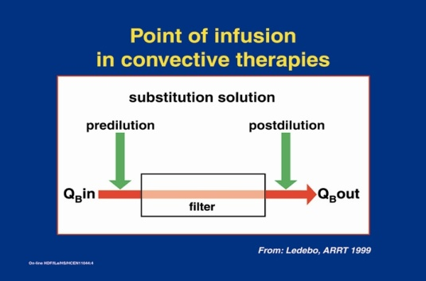
« more » for children in center daily on-line HDF
In center daily on line/high efficiency HDF (since september 2002)
6 times per week (18h/week; 3 hour session )
“floating” dry weight
ultrapure dialysate, highly permeable membrane (polysulphone),
Kt/Vurea of at least 1.4 per session; Kt/Vurea assessed at each session by the on line clearance monitoring, quality tool
Convective volume 27 L/m²/session, predilution reinfusion ( equivalency of 9 to 15 L/m²/session in postdilution)

Slide 63
Daily on line HDF (high efficiency HDF) promotes catchup growth in children on chronic dialysis
FISCHBACH M, TERZIC J, MENOUER S, DHEU C, SEUGE L, ZALOSCZIC A.
Nephrol Dial Transplant 2010; 25: 867-73

Slide 64
Patients
15 children in the « growth »study : sept 2004 to sept 2007
mean age : 7 years 4 months (2 y 10 m to 16 y 8 m)
7/17 converted from at home chronic peritoneal dialysis to in center daily on-line hemodiafiltration ; 5/12 from hemodiafiltration (3 times weekly; 3 x 4/5hours)
GFR was less than 3 mL/min/1.73 m² at study entry
Vascular access was a fistula (n=13) or a catheter (n=4)
End point of DIH was kidney transplantation

Slide 65
Dialysis tolerance : « normal feeling » during and between the sessions
During the sessions : no symptoms of intolerance, no dyscomfort, optimal UF tolerance and dry weight easely reached over the weekly dialysis procedure, adhesion to school working during the sessions (no « fatigue »)
Post dialysis : no recovery time, less sleep disturbances, normal feeling out of the dialysis center, « natural » compliance to whole therapy (dialysis, diet and medications in attempt to be kidney transplanted)
No interdialytic fatigue, no washout/restlessness:
  quality of social life,
  school participation

Slide 66
Results: catch up growth
Mean time on daily OL-HDF (untill KTP): 20.5+/-8 months
Growth velocity:
the year before daily: 3.8+/-1.1 cm/y
first year of daily: 14.3+/-3.8 cm/y
mean over daily: 8.9+/-2.2 cm/y
Height (SDS)
start: -1.5+/-0.3
end: +0.2+/1.1
target parental height: -0.3
end- target: +0.5

Slide 67
Daily hemodiafiltration in children in center, from CKD5 to CKD3
Normal diet ; no add of « unprogrammed » session
No intradialytic symptoms; no recovery time
BP, LVH : improved, nearly disappeared
Ph: « no » need for chelators despite PCRn>2gr/kg BW
K, potassium: day off dialysis, chelators ?
Β₂ m, CRP: reduced inflammation, despite frequent dialysis
« never » acidosis, TAD_{bicarbonate}
Cardiovascular preservation
No cachexia, no protein wasting, catch up growth

Slide 68

As a patient, which is your choice, waiting for kidney transplantation ?
Normal GFR | > 9O ml/min (120…with possibility of “hyperfiltration”/functionnal reserve
Kidney transplant | > 60 ml/min (?, at the best…)
Daily (6/7days) intensive HDF (in center 30-40/168 hours per week) from CKD5 to CKD3 Dialysis without “stress” “Free” at home, normal life | > 3O-35 ml/min - diffusive and convective blood purification(a determined large convective volume) - ultrapure dialysis fluids=less inflammation
HDF (3 times/week), a complete dialysis dose, diffusive Kt/Vurea and convective (convective volume) and ultrapure dialysis fluids | - 10 -15 ml/min (urea and « more ») - diffusive and convective blood purification(a determined large convective volume) - ultrapure dialysis fluids=less inflammation
conventional HD | 10 -15 ml/min (urea)
Daily peritoneal dialysis (all the day, all days) | +/- 8 - 10ml/min

Slide 69
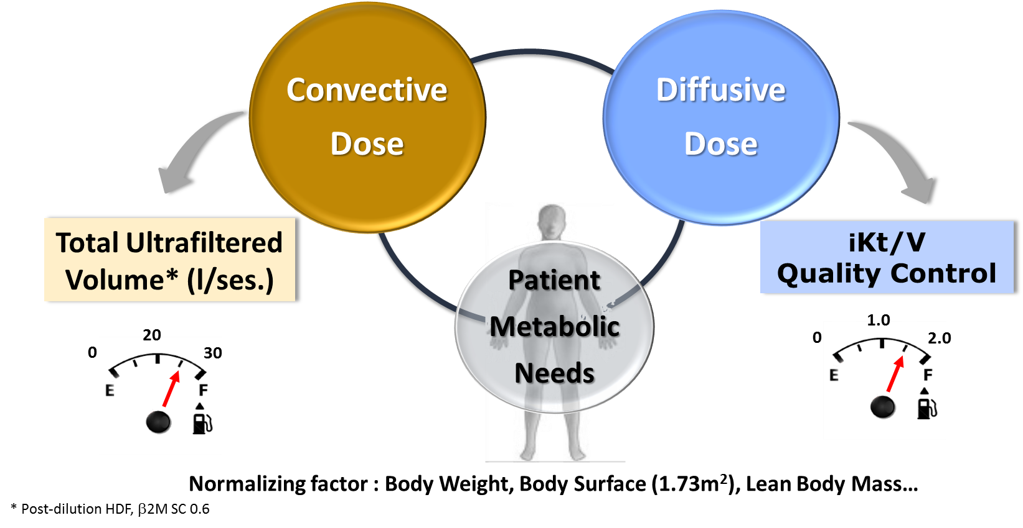
HDF, the optimal dialysis dose today:
- a complete dialysis dose with ultrapure dialysis fluids
- needs to be adapted to patient characteristics
Endotoxins « free » dialysis fluids

Slide 70
HDF the « right » prescription in children
Vascular access: fistula (double/single puncture) or central line
Blood flow: 150-200mL/min/m² ; dialysate flow Q_{D} ≥ 1 to1.5 Q_{B}
Kurea >1.4 (osmotic syndrom risk/initially: 3-5 mL/min/kg BW)
Convective volume: in predilution 27- 45L/m²/session or in postdilution 9-15L/m²/session
Anticoagulation: low molecular weight heparin (4-5hours/session; no need in predilution?)
Lines and filter volume: 10-15 mL/kg BW extracorporeal blood volume
Filter (molecular permeability and water permeability): square meter theory, urea clearance>blood flow, beta-2- microglobulin extraction (>80%), high water permeability (Cuf;PTM), « limited » dialysate loss (albumine)
Purity of the dialysis fluids

Slide 72

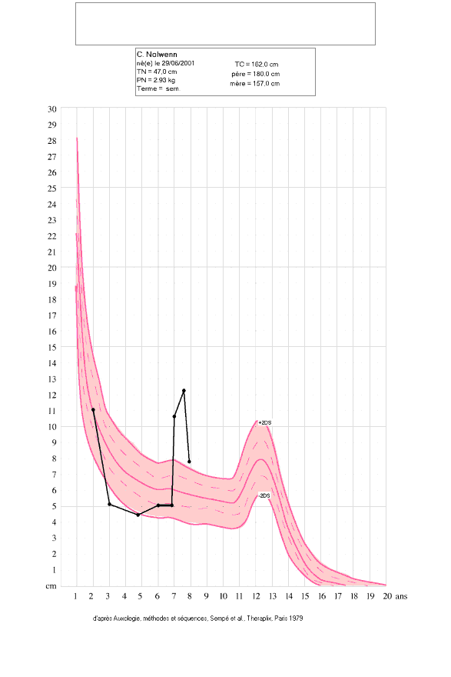
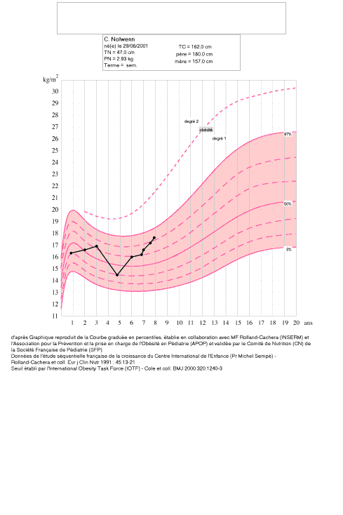
Patient 1 on daily OL-HDF
PDI (g/kg/d) : 2.7 ± 0.2
nPNA (g/kg/d) : 1.44 ± 0.15
Mean growth velocity (cm/year) : 10.4
Achieved height versus familial expected height (SDS) : +0.2
1
2
3
1 growth in SD 2 growth velocity 3 BMI

Slide 73
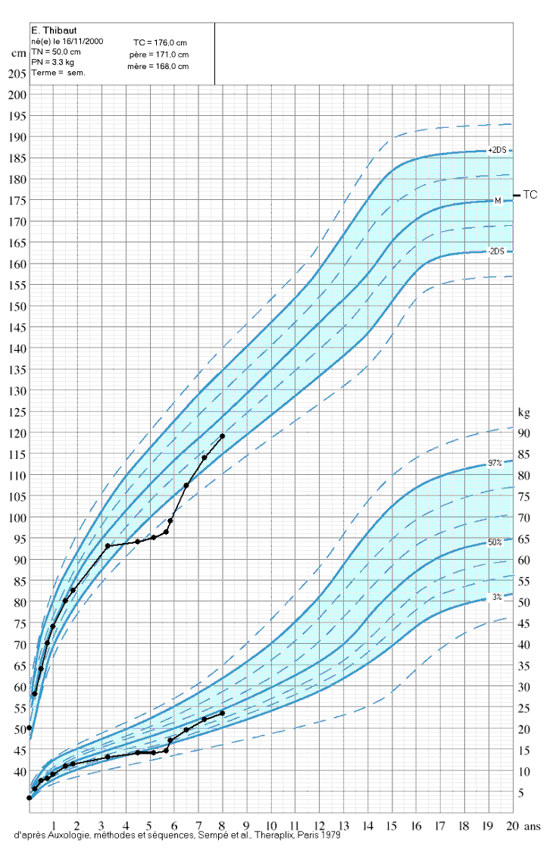
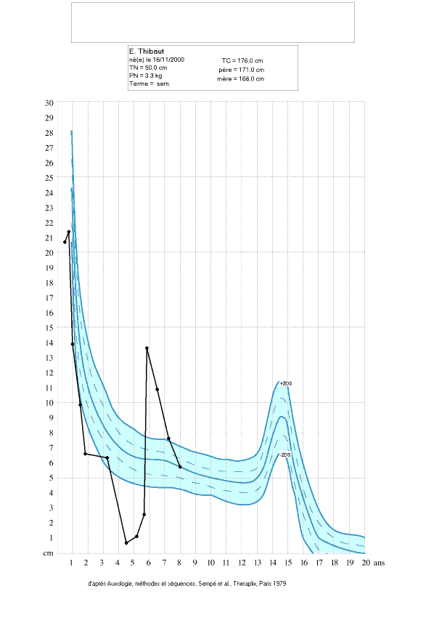
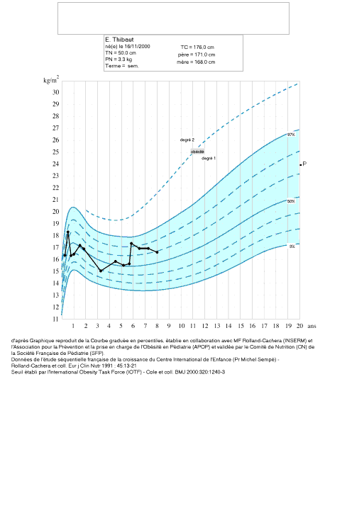
Patient 2 on daily OL-HDF
PDI (g/kg/d) : 2.9 ± 0.3
nPNA (g/kg/d) : 1.31 ± 0.11
Mean growth velocity (cm/year) : 8.1
Achieved height versus familial expected height (SDS) : -1.3
1
2
3
1 growth in SD 2 growth velocity 3 BMI

Slide 74
Conclusions: anabolic impact of daily high efficiency HDF
Comfort, tolerance : reduced (suppressed?) dialysis morbidity; no/less recovery time, no/few medications
Improved nutrition, more appetite, less diet restrictions, less fatigue , more physical activity
Optimized uremic detoxification, better acidosis correction, limited inflammation : less protein wasting, less cachexia
Cardiovascular protection : BP, hydration, inflammation
Anabolisme, catch up growth

Slide 75
On line HDF is not a self-fulfilly prophecy: it must be used wisely
Kuhlmann MK. J Am Soc Nephro 2012; 23: 974-5
(CONTRAST « commentaries »)
Advantages of OL-HDF both « purity and purification »:
  higher removal of creatinine, phosphate, β2 m and some protein bound uremic compounds
  lower incidence of intradialytic hypotension, nutritional status, prevention of inflammation and better preservation of residual renal function
However, it remains a matter of debate whether these latter effects may have been related primarily to the treatment made itself or secondary to improved dialysis purity.
Significantly improved outcome observed (Contrast/Turkish HDF study) in the subgroup of patients treated with the highest convection volumes: OL-HDF is easy to apply, high efficiency HDF i.e. large convective volumes need more practical implication (fistulla quality, session time, membrane)

Slide 76
Implementing Best Clinical Practices Keys of Success: doctor time, nurse competence and good material
Right Blood Flow (>300mL/min; large sized needles, less than 17 gauge)
Right Anticoagulation (low molecular weight heparin loading dose, bolus at initiation in the venous needle or venous circuit)
Right dialysis fluids (purity, composition)
Right Hemodiafilter (Low Internal Backtransport Phenomenon; hydraulic and molecular permeability without “loss” of albumin)
Right HDF Machine (Automated Ultrafiltration Control: autosub+ with on line clotting/viscosity control)
Right treatment time (UF demand < 1.3% BW loss per hour)
Right nurses (Motivated, Committed, Skilled team)
Daily on line HDF (high efficiency HDF) promotes catchup growth in children on chronic dialysis FISCHBACH M, TERZIC J, MENOUER S, DHEU C, SEUGE L, ZALOSCZIC A.
Nephrol Dial Transplant 2010; 25: 867-73

Slide 78
As a result, there is a growing interest, a “need” in the delivery of more intensive hemodialysis, that is:
OL-HDF (purity of the dialysis fluids),
high efficient convective volume (hydraulic permeability; autosub+: viscosity control)
titrating treatment length (4.5 hours ?; reduction in UF demands per dialysis session; UF rate< 1.25%/h BW; IDWG<4%; Cooling T_{D}=36°; Euvolemia ? )
daily “optimyzed” dialysis (floating dry weight; BCM®; diffusible Napl on-line; Kt/V on-line; BVM®; BTM®)
A complete and determined dialysis dose at every session

Slide 79
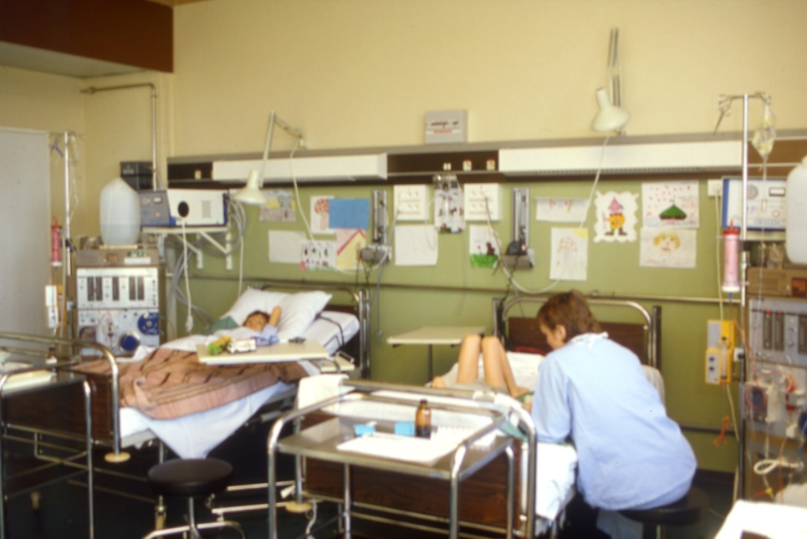
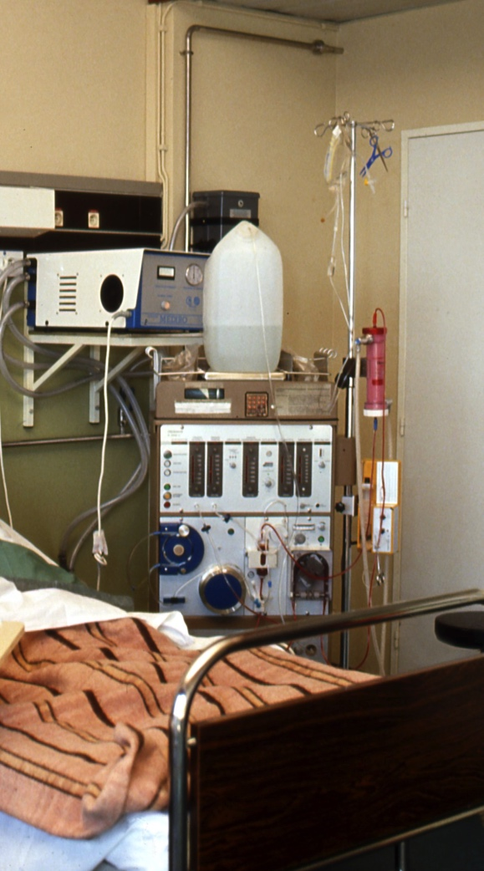
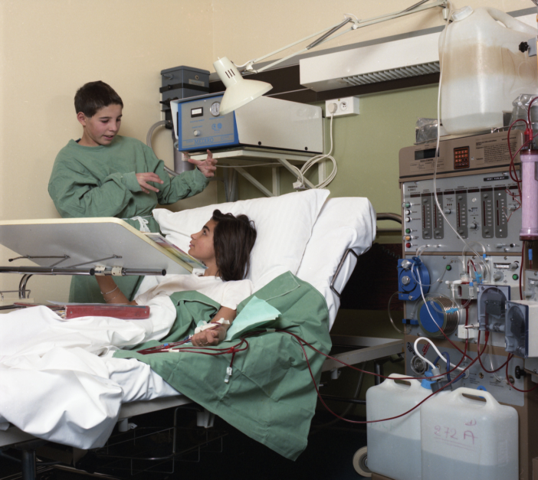
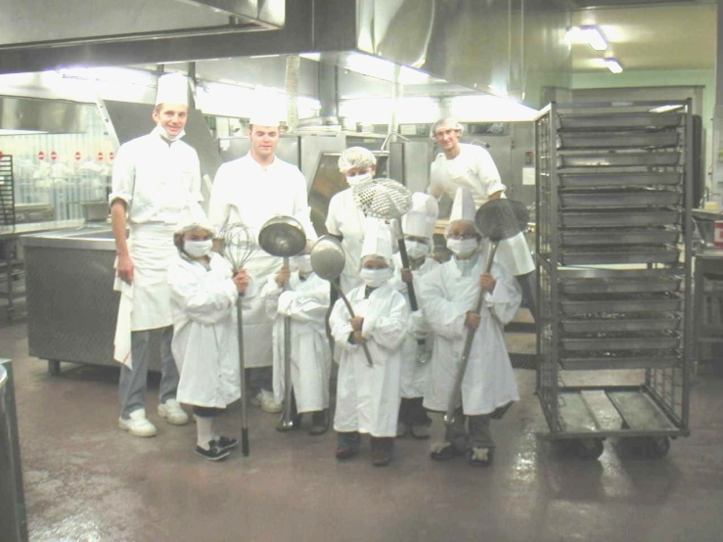
High technollogy, and life

Slide 81
Patients’perspective of hemodialysis- associated symptoms
Caplen B, Kurmar S and Davenport A. Nephrol Dial Transplant 2011; 26:2656-63
morbidity rates of patients treated by conventional hemodialysis have remained alarmingly high, despite advances in HD
Fatigue 82 %
  Intradialytic hypotension 76 %
  Cramps 74 %
  Dizziners 63 %
  Headache 54 %
  Pruritus 52 %
  Backache 51 %
intradialytic symptoms were frequently reported by patients with a median frequency of > 50 % of conventional HD sessions
(N=550; mean age 64 y)

Slide 82
Patients’perspective of hemodialysis- associated symptoms
Caplen B, Kurmar S and Davenport A. Nephrol Dial Transplant 2011; 26:2656-63
Recovering time post dialytic varied:
  Within minutes 23 %
  Time they returned home 34 %
  Bed time 16 %
  Following morning 24 %
  Just before the next dialysis session 3 %
There is place for improvement : « addition » of a convective dialysis dose to the ureaKt/V, and hydration/dry weight/BP optimal control (Na « balance »)
Just over half of the patients
Nearly half of the patients « wash out » postdialysis

Slide 83
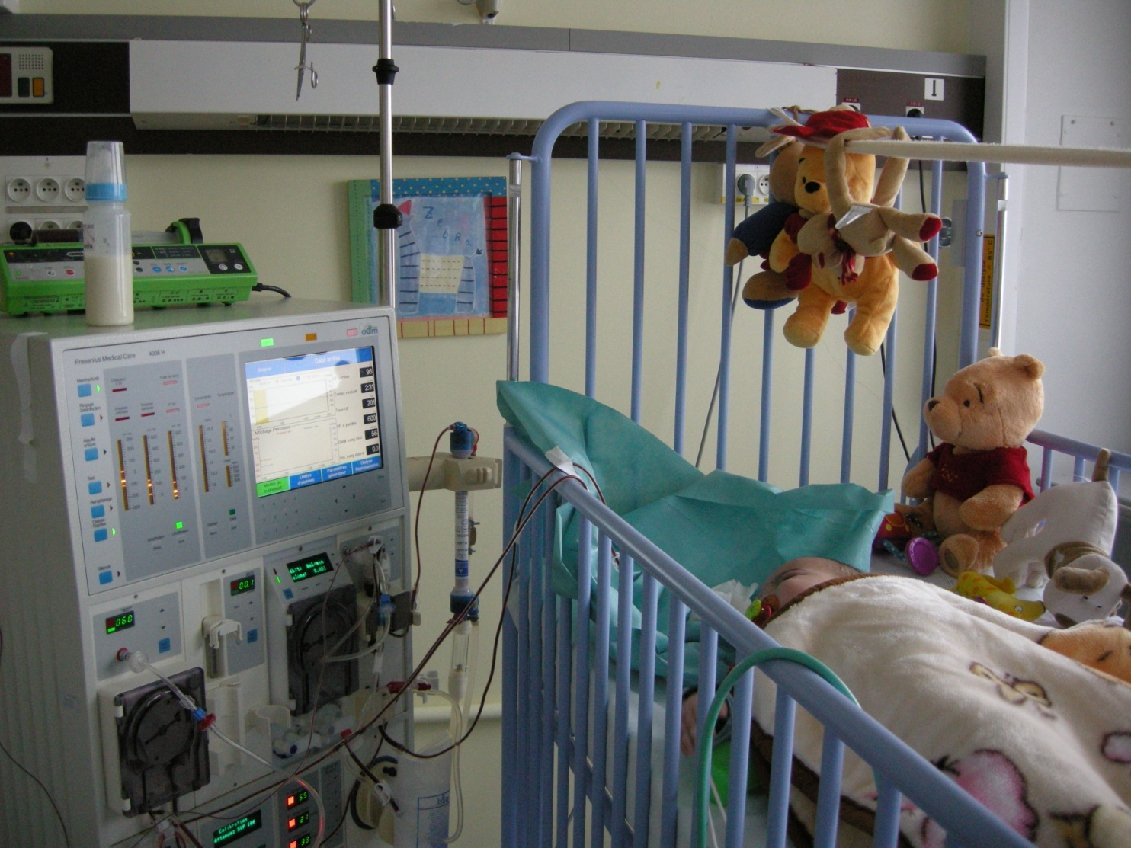
OL-HDF infants> 7/10 kg :
FX Paed/FX40 (18/32mL), baby-lines for 4008 but only postdilution (54mL), infant lines for 5008 (75mL) predilution
FX PAED
18mL
C_{UF} 7 mL/H/mmPTM
FX 40
32mL
C_{UF} 20 mL/H/mmPTM
Sieving microglobulin 80%
° 4008 HDF machine with “baby”lines
° 5008
° 6008…the future

Slide 84
High-flux dialysis: backfiltration risks
1) purity of the dialysate ?
2) not determined and low-dose convective volume
High-flux HD
Not determined and internal convective flow, that is « internal » hemodiafiltration compenstate by backfiltration, from dialysate : need for « purity » (endotoxines free ?)
dialysate backfiltration, risk of patient endotoxins contamination
i.e. more inflammation
blood
uncontrolled and unknown
convective removal
Ref: Ledebo, NDT Plus, 2010
Lebedo I, Blankestijn PJ (2010) Haemodiafiltration – optimal efficiency and safety. Nephrol Dial Transplant Plus 3:8-16

Slide 85
Recommandations for a « standard » dialysate
Endotoxines
FRANCE < 0,25 UI / ml
ISO 23500 < 0,5 UI / ml
JAPON < 0,05 UI / ml
Recommandations for an « ultrapur » dialysate
Endotoxines
FRANCE < 0,25 UI / ml
ISO 23500 < 0,03 UI / ml
JAPON < 0,001 UI / ml
Recommandations for the substitution fluid (convective volume)
Endotoxines
FRANCE < 0,05 UI / ml
ISO 23500 < 0,03 UI / ml
JAPON < 0,001 UI / ml
A.Ragon, P.Brunet, D.Jaubert, G.Lebrun, A.Duval-Sabatier
Pôle Urologie – NéphrologieAssistance Publique – Hôpitaux de Marseille. Décembre 2012

Slide 86
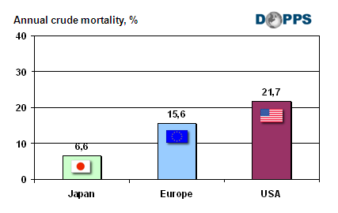
Purity of the dialysis fluids
Masakane Ikuto ASN 2008:
mortality risk and dialysis fluids purity
1)Endotoxines in the dialysat < 0,05 UI/ml
in 93,6 %dialysis center from Japan
2) Mortality risk correlate to the endotoxin level in the dialysate:
RR 1 if < 0.001 ET/ml versus RR 1.48 if 0.1 à 0.25 ET/ml

Slide 87
Mortality is frequent in the adult dialysis population
All together, “only” a mean survival chance of
6 years (Adult European Patients) compared to 15 years (Adult Japanease Patients)

Slide 88
The effect of on-line hemodiafiltration on improving the cardiovascular function parameters in children on regular dialysis
FI Fadel et al., Saudi J Kidney Dis Transplant 2015; 26(1):39-46
Converting from HD to OL-HDF predilution, there was:
a significant decrease in hs-CRP (from 7.9±8.9 to 3.4±3 µg/mL) (P=0.01)
a significant decrease in frequency of diastolic dysfunction (P=0.04), while systolic function (FS and EF) improved significantly (P=0.007 and 0.05, respectively),
but LVMI and MBPI pre or post dialysis did not change

Slide 89
β2 microglobulin removal with HDF
(what is purity of the dialysate ?)
M.Fischbach Nephron 1989; 53:110-4
HDF > HF > HD in terms of β2 microglobulin dialytic removal
Highly permeable membrane optimal use: HDF (limited retrofiltration)
Despite enhanced removal of β2 microglobulin during conventional HDF, no decrease over time of the β2 microglobulin serum level in children: retrofiltration of conventional dialysate (endotoxins / inflammation / β2microglobulin enhanced production) ? : need for dialysis fluids purity, not only germs but also endotoxins (from conventional HDF, bags and « normal » dialysate to OL-HDF)

Slide 90
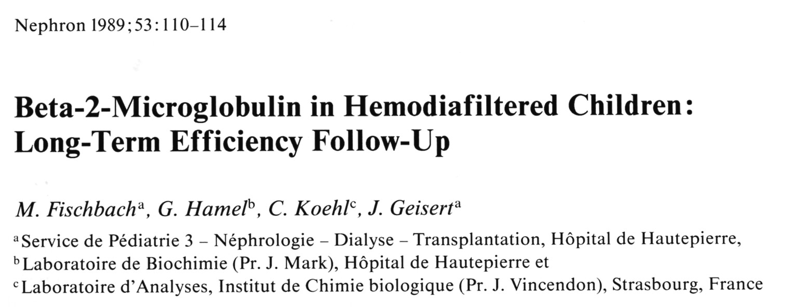




Slide 91




Slide 92
IPHN: Preliminary findings: superiority of HDF
 | cHD | HDF | P
Hemoglobin* (g/dl) | 10.5 | 11.5 | <0.001
Serum phosphate (mmol/l) | 1.75 | 1.60 | n.s.
CrP (g/dl) | 12.1 | 5.7 | <0.01
BMI SDS | -0.30 | 0.08 | <0.01
Height SDS | -2.40 | -1.03 | <0.001
Delta Height SDS /year** | 0.13±0.51 | -0.22±0.96 | 0.05
* Epo dose n.d. between groups
** observation time: 10.8 (3.6-39) months
Independent of dialysis dose (time per week / frequency and blood flow/m²)
(52 children HDF, 209 conventional HD)

Slide 93
The effects of HDF vs conventional HD on growth and cardiovascular markers in childrenn
3H multicenter study
(HDF, Hearts and Height)
Shroff R and al CJASN 2019 in press
Hypothesis
Children on HDF compared with HD have improved:
Cardiovascular risk profile
Growth and nutritional status
Quality of life

Slide 94
Conclusions: 3 “H” study 2017
HDF, Hearts, Height
Children on HDF have a small but significant increase in height SDS over 1-year
HDF is associated with a significant and early improvement in “cardiovascular preservation”:
  Fluid status
  Reduced inflammation and oxidative stress
  Improved endothelial function
  Children on HD have a significant increase in cIMT over 1-year, whereas there is no change in cIMT in children on HDF

Slide 95
Recruitment
29 centres in 10 countries screened
28 centres included
190 children recruited

Slide 96
HDF patients have less fluid overload
Children on HDF required fewer rescue sessions
(4.1% HDF vs 19.9% HD; p=0.008)
No difference in dialysate sodium (mean dNa 138mMol)
Notes:
On bioimpedance spectroscopy children on HDF were less likely to have fluid overload compared to HD (Rel OH 4.2 vs 9.8%; p=0.003)
Dialysate sodium ≤138 – HD = 49 (62.8%) vs HDF 43 (=76.8%); p = 0.0857

Slide 97
HDF patients have lower mean arterial pressure on ABPM
Notes:
HDF had lower 24 hour mean arterial pressure (MAP, 93 vs 87.5 mmHg; p=0.04).

Slide 98
HDF patients have lower LVMI
HDF patients had a lower LVMI (30.7 vs 43.5; p=0.001).

Slide 99
Lower pulse wave velocity in HDF
PWV correlated positively with MAP, ultrafiltration and the blood flow rate.

Slide 100
Fluid status in prevalent dialysis patients in 3H

Slide 101
1-year follow-up cardiovascular improvement
HDF =
cardiovascular
preservation
in children

Slide 102
Change in cardiovascular markers over 1-year
 | HD | HDF | p
Change from study entry | Mean (SD) | Mean (SD)
cIMT | 0.023 (0.035) | 0.0028 (0.037) | 0.0019
cIMT SDS | 0.476 (0.795) | 0.013 (0.839) | 0.0018
PWV | 0.102 (0.726) | 0.035 (0.680) | 0.6051
PWV SDS | 0.035 (1.445) | -0.130 (1.186) | 0.5023
LVMI | 1.783 (14.014) | -1.837 (17.762) | 0.2034
Inter-dialytic weight gain % (IDWG) | 0.157 (1.835) | -0.219 (1.689) | 0.2296
24-hour MAP-SDS | -0.886 (15.512) | -0.133 (11.970) | 0.8296

Slide 103

Determinants of cIMT change

Slide 104
Height and change in Height SDS
Notes:
HDF have a small but significant improvement in height SDS over 1 year (from -1.66 to -1.5)

Slide 105
Conclusions: 3 “H” study 2017
HDF, Hearts, Height
Children on HD have a significant increase in cIMT over 1-year, whereas there is no change in cIMT in children on HDF
Children on HDF have a small but significant increase in height SDS over 1-year
HDF is associated with a significant and early improvement in “cardiovascular preservation”:
  fluid status
  Reduced inflammation and oxidative stress
  Improved endothelial function

Slide 106
Dialysis prescription : adequate, before optimal
Dialysis modality should permit the achievement of the blood pressure control (without antihypertensive medications for the majority of children), normal myocardial morphology and function
The « at bedside » concept that an elevated blood pressure should benefit from enhanced ultrafiltration (increased weight loss/UF per session) could be inaccurate in some cases, even at risk
Only 40%

Slide 107

Hydration measurement by bioimpedance spectroscopy and blood pressure management in children on hemodialysis. Zaloszyc A…Fischbach M (2013). Pediatr Nephrol; 28:2169-2177
39% high BP, but only 36% of them « overhydrated » (>7%)
35% overhydrated (>7%), but only 40% of them with high BP
36 % : normo OH
The relation BP versus hydration in children on chronic hemodialysis :
« far from clear »: to probing dry weight we need to add sodium balance

Slide 108
Blood Pressure versus hydration in patients on dialysis : « box plot », importance of the BCM evaluation
Volume dependent high BP (natural relation) needs an UF prescription in mL (water and/or water and sodium)
Volume non dependent BP vascular reactivity ?, complex situation: needs more than a «weight loss/water» prescription, importance of sodium balance, nutrition, non osmotic sodium (Tietze)…

Slide 109
BP management in dialysed children : the vicious cercle
Elevated BP is mostly correlated by the doctors as “overweight”. Therefore, the usual prescription adaptation is more UF: “a water prescription”.
Being hypertensive, children on dialysis received antihypertensive drugs. Therefore, the achievement a the fixed dry weight is at hypotensive risk, balanced by increased sodium dialysate, and/or stopped UF.
“High” sodium dialysate concentration (NaD>Napl) (post dialytic thirst) and/or stopped UF are factors of too elevated interdialytic weight gain, inducing a high BP

Slide 110
Dry-weight: A concept revisited in an effort to avoid medication-directed approaches for blood pressure control in hemodialysis patients
R. Agarwal, MR. Weir. Clin J Am Soc Nephrol 2010; 5:1255-1260
Restricting dialysate sodium is a simpler but underexplored strategy that can reduce thirst, limit interdialytic weight gain, and assist the achievement of dry-weight. It is likely that too much medication may actually limit the opportunity to probe dry-weight and lead to BP resistance through expanded volume.
Conclusions : Avoiding medication-directed control of BP may enhance the opportunity to probe dry-weight, facilitate removal of volume (water and sodium), and limit the risk for pressure-volume overload, which may be a significant concern leading to myocardial remodeling in the hemodialysis patient. Probing dry-weight among patients with ESRD has the potential to improve dismal, miserable and depressing cardiovascular outcomes.

Slide 111
UF rate< 1.25%/h BW (floating dry weight)
IDWG<4% ? Euvolemia ? Cooling T_{D}=36°
M Fischbach et al Pediatr Nephrol 2015
How to achieve BP control:
Euvolemia, no overhydration but also no underhydration: importance of body composition assessment (BCM, bioimpedance)
Only probing a lowered dry weight could be risky, and in nearly 40% of the hypertensive patients is ineffective : importance of the sodium balance (sodium diet control; dialysis sodium removal: UF and NaD to Napl gradient)
Restrict the UF demand to 1.25% BW loss per hour, apply “cooling” technollogy ( T_{D}=36°) to preserve from cardiac and cerebral ischemia (Chris W. McIntyre)
Limit the IDWG<4%: more sessions

Slide 112

The Janus-faced aspect of « dry weight »
C. Chazot, B. Charra, C. Vo Van et al. Nephrol Dial Transplant 1999; 14:121-124
anabolism
The anabolic effect of the optimal control of fluid overload ( Tassin,Lyon,France)
Contolled BP
After the second month of dialysis treatment, the simultaneous increase of post-dialysis body-weight and decrease of pre-dialysis MAP are related to the effects of two processes, i.e. increased weight as the result of anabolism induced by the HD treatment on the one hand and normalization of blood pressure by fluid removal on the other

Slide 113
HDF and Na_{D} (sodium in dialysate)
The substitution fluids (convective volume/dose) have the same sodium concentration as the dialysate (Na_{D}): « on-line »
Napl : the diffusible sodium
Na_{D} versus Napl, BCM®, BVM® , on line « Na diffusable »
In predilution Na_{D} 134 – 138 mmol/L
In postdilution Na_{D} 138 – 142 mmol/L

Slide 114
Optimal Hemodialysis Prescription: Do children need more than a urea dialysis dose?
Fischbach Michel, Zaloszyc Ariane, Schaefer Betti, and Schmitt Claus Peter.International Journal of Nephrology.Volume 2011, Article ID 951391, 5 pages doi:10.4061/2011/951391
Hemodiafiltration: The addition of convective flow to hemodialysis: “a complete dialysis dose”. M. Fischbach, H. Fothergill, A. Zaloszyc, L. Seuge Pediatr Nephrol 2012, 27: 351-6
Kt/Vurea > 1.4 (mainly diffusion),
a “high” effective convective volume (HF efficiency)
and dialysis fluids purity (inflamation/protein wasting)

Slide 115
HDF: a complete dialysis dose
On-line Urea Kt/V > 1.4 (V « Morgenstern or BCM)
High convective volume (autosub+) but also of « quality » (impact of the membrane) :
  beta-2-microglobulin extraction coefficient >80%
  myoglobin>65%
« loss » in the dialysate and convective volume (check for albumin, Vit C)
Dialysis fluids : temperature control (« cooling »; BTM), NaD (on-line diffusive sodium), Ca++, HCO₃⁻
Volume control (BCM), BP, IDWG…

Slide 116
From adequate to optimal dialysis
« adequacy » assessment : outcomes (morbidity/mortality/cachexia/growth) or surrogates like urea kinetics (diffusion process) and more (β2 microglobuline or convective volume?),
How to improve conventional HD:
high flux membrane for « all »
biocompatibility/purity of the dialysis fluids (endotoxin’s level),
volume control (dry weight/BP/LVH): interest of an objective assessment (bioimpedancemetry, BCM), reduction in UF demands per dialysis session
should HDF become the standard for in center dialysis ?
More dialysis, more frequent/longer sessions: « daily » dialysis, daily in center high efficiency hemodiafiltration

Slide 117
Principles of blood purification
Diffusive Process (HD) : low MW uremic toxins removal i.e.urea
Convective mass transport (HF) : middle Mw uremic toxins removal i.e.phosphate
Membrane adsorption (+++/PMMA/Torray ?)

Slide 118
Blood purification dialysis modalities : diffusion versus convection
Diffusive Process
(hemodialysis)
Small molecules
Membrane area
Mass transport coefficient
Concentration gradient
Blood flow x extraction coefficient (<1)
c_{i} - c_{o}
K_{HD} = Q_{B} x
c_{i}
i, o : in outlet solute concentrations
Convective mass transport
(hemofiltration)
Ultrafiltrate flow (Q_{UF})
Hydraulic permeability
Transmembrane pressure (TMP ; mmHg)
Sieving coefficient (S)*
Molecular permeability (MW): <1
2 C_{UF}
*S =
c_{i}+c_{o}
C_{UF} : ultrafiltrate solute concentration
K_{HF} = Q_{UF} x S (postdilution)
Q_{UF} < 1/3 Q_{B} (in practice oftently lower)

Slide 119
Simultaneous purification: diffusion process and convection mass transport i.e. hemodiafiltration
one minute of dialysis « is equal» to two minutes of purification,
one of HD and another one of HF
K_{HDF} = K_{HD} + x Q_{UF} x 0.46
K_{HDF} = K_{HD} (1 - Q_{UF} x S/Q_{B}) + K_{HF} (Granger)
with Q_{UF} x S = K_{HF} and Q_{B} = K_{max}
K_{HD} x K_{HF}
K_{HDF} = K_{HD} + K_{HF} --
K_{max}
If K_{HD} is equal to K_{max} then Q_{HDF}= K_{HD}

Slide 120
+ 30%
HDF allows an optimal blood purification not only for urea, but also for the middlemolecular weight compounds ( Babb theory )
From M Fischbach et all .Contr Nephrol1985

Slide 121
On line HDF: substitution fluid produced on line the ultrapure dialysis fluids a complete dialysis dose
On-line HDF
blood
ultrapure
dialysis
fluids
Cold sterilization of the dialysis fluids
controllable and measurable
convective removal

Slide 122
HDF, the « right » prescription in children
Vascular access: fistula (double/single puncture) or central line
Blood flow: 150-200mL/min/m² ; dialysate flow Q_{D} ≥ 1 to1.5 Q_{B}
Kurea >1.4 (osmotic syndrom risk/initially: 3-5 mL/min/kg BW)
Convective volume: in predilution 27- 45L/m²/session or in postdilution 9-15L/m²/session
Anticoagulation: low molecular weight heparin (one dose for 4-5hours/session; no need in predilution?)
Lines and filter volume: 10-15 mL/kg BW extracorporeal blood volume
Filter (molecular permeability and water permeability): square meter theory, urea clearance>blood flow, beta-2- microglobulin extraction (>80%), high water permeability (Cuf;PTM), « limited » dialysate loss (albumine)
Purity of the dialysis fluids (endotoxins « free »)

Slide 123
From adequate to intensified dialysis
1) « adequacy », dialysis dose assessment :
outcomes (morbidity/mortality/cachexia/growth) and surrogates like urea kinetics (diffusion process) and more (β2 microglobulin level or the convective volume achieved per session),
2) How to improve conventional HD:
high flux membrane for « all »
biocompatibility/purity of the dialysis fluids (endotoxin’s level),
volume control (dry weight/BP/LVH): interest of an objective assessment (bioimpedancemetry, BCM), reduction in UF demands per dialysis session
should HDF become the standard for in center dialysis ?
3) More dialysis, more frequent/longer sessions: « daily » dialysis, daily in center high efficiency hemodiafiltration

Slide 124
From adequate to optimal dialysis
« adequacy » assessment : outcomes (morbidity/mortality/cachexia/growth) or surrogates like urea kinetics (diffusion process) and more (β2 microglobuline or convective volume?),
How to improve conventional HD:
high flux membrane for « all » (a low, « not determined » convective volume)
biocompatibility/purity of the dialysis fluids (endotoxin’s level),
volume control (dry weight/BP/LVH): interest of an objective assessment (bioimpedancemetry, BCM), reduction in UF demands per dialysis session
should HDF become the standard for in center dialysis ?
More dialysis, more frequent/longer sessions: « daily » dialysis, daily in center high efficiency hemodiafiltration

Slide 125

DOPPS study – HDF vs HD:
“ clear effect of the amount of the convectif volume” no gain with high-flux HD: purity of dialysis fluids ?
No gain with
High flux

Slide 126

High-efficiency postdilution Ol-HDF reduces all-cause mortality in hemodialysis patients (ESHOL)
Maduell F et al. J. Am Soc Nephrol 2013; 24:487-497
They found that high-efficiency OL-HDF (>24L) in patients with ESRD on hemodialysis was associated with a 30 % reduction in all-cause mortality compared with conventional high-flux hemodialysis

Slide 127
Impact of high convective volume high efficiency hemodiafiltration
Study name | Threshold volume for suvival benefit (observational studies)
DOPPS (Canaud) 2006 | > 15 L
Riscarid (Panichi) 2008 | > 23 L
Contrast (Grooteman) 2012 | > 21.95 L
Turkish (Ok) 2012 | > 17.4 L
ESHOL (Madrid) 2013 | > 23.1 L
post dilution or predilution (easier to achieve?) « Minimal » convective volume | 15L/m²/session = 25 L/session 18 - 27 L/m²/session

Slide 128



Convective Dose in Europe
Results from the 4 RCTs Studies
EuDial Pooling Project
Peters SA et al, HDF Pooling Project Investigators. Nephrol Dial Transplant. 2015 Oct 22 ePub

Slide 129



HDF European Pooling Project
Pooled Individual Patient Analysis of 4 RCTs
2793 prevalent
ESKD pts
Pooled individual patient analysis of four prospective trials compared thirds of delivered convection volume with hemodialysis. Convection volumes were either not standardized or standardized to weight, body mass index, body surface area, and total body water. Data were analyzed by multivariable Cox proportional hazards modeling from 2793 patients.
Peters SAE et al, Nephrol Dial Transplant 2016;31(6):978-84.
Notes:
Mortality remains high for hemodialysis patients. Online hemodiafiltration (OL-HDF) removes more middle-sized uremic toxins but outcomes of individual trials comparing OL-HDF with hemodialysis have been discrepant. Secondary analyses reported higher convective volumes, easier to achieve in larger patients, improved survival. Here we tested different methods to standardize OL-HDF convection volume on all-cause and cardiovascular mortality compared with hemodialysis. Pooled individual patient analysis of four prospective trials compared thirds of delivered convection volume with hemodialysis. Convection volumes were either not standardized or standardized to weight, body mass index, body surface area, and total body water. Data were analyzed by multivariable Cox proportional hazards modeling from 2793 patients. All-cause mortality was reduced when the convective dose was unstandardized or standardized to body surface area and total body water; hazard ratio (95% confidence intervals) of 0.65 (0.51–0.82), 0.74 (0.58–0.93), and 0.71 (0.56–0.93) for those receiving higher convective doses. Standardization by body weight or body mass index gave no significant survival advantage. Higher convection volumes were generally associated with greater survival benefit with OL-HDF, but results varied across different ways of standardization for body size. Thus, further studies should take body size into account when evaluating the impact of delivered convection volume on mortality endpoints.

Slide 130

Risk Ratio benefit for HDF All-Cause Mortality and Cause-Specific Mortality
A Pooled Meta-Analysis of Individual Participant Data* from four randomized controlled trials
Improved outcome
Cohort 2793 prevalent ESKD pts
*Riley RD et al, BMJ 2010;340:c221
Peters SAE et al, Nephrol Dial Transplant 2016;31(6):978-84.
Notes:
Mortality remains high for hemodialysis patients. Online hemodiafiltration (OL-HDF) removes more middle-sized uremic toxins but outcomes of individual trials comparing OL-HDF with hemodialysis have been discrepant. Secondary analyses reported higher convective volumes, easier to achieve in larger patients, improved survival. Here we tested different methods to standardize OL-HDF convection volume on all-cause and cardiovascular mortality compared with hemodialysis. Pooled individual patient analysis of four prospective trials compared thirds of delivered convection volume with hemodialysis. Convection volumes were either not standardized or standardized to weight, body mass index, body surface area, and total body water. Data were analyzed by multivariable Cox proportional hazards modeling from 2793 patients. All-cause mortality was reduced when the convective dose was unstandardized or standardized to body surface area and total body water; hazard ratio (95% confidence intervals) of 0.65 (0.51–0.82), 0.74 (0.58–0.93), and 0.71 (0.56–0.93) for those receiving higher convective doses. Standardization by body weight or body mass index gave no significant survival advantage. Higher convection volumes were generally associated with greater survival benefit with OL-HDF, but results varied across different ways of standardization for body size. Thus, further studies should take body size into account when evaluating the impact of delivered convection volume on mortality endpoints.

Slide 131

How to prescribe hemodialysis or hemodiafiltraiton in order to ameliorate dialysis-related symptomes and complications
Ikuo Masakane. Kawanishita H, Yamashita AC, (eds):Hemodiafiltration – A new Era. In Contrib Nephrol. Basel, Karger; 2011, vol 168, pp 53-63.
    Higher albumin loss was observed when HPM dialyzers were used for post dilution HDF. Thus, elevation of the efficiency of high molecular solutes removal while controlling albumin loss by employing pre dilution HDF has become actively performed.
    The excessive plasma dilution in pre dilution HDF could be an important factor for enhancing the efficacy of protein bound uremic toxins removal
    Pre dilution HDF using HPM dialyzer has become the main trend in Japan

Slide 132
Choice of modality with the use of High-Performance Membrane and evaluation for clinical effects
Ikuo Masakane. Saito A, Kawanishita H, Yamashita AC, Mineshima M (eds):High-Performance Membrane Dialyzers. In Contrib Nephrol. Basel, Karger; 2011, vol 173, pp 84-94.
The golden target for dialysis therapy should be to guarantee longer survival and to give a higher quality of life without dialysis-related complications.
Generally, we choose a dialysis modality for better solute removal and better biocompatibility. In this issue we would like to propose that the patients preference for dialysis therapy is a useful parameter in prescribing the dialysis modality.
In our recent experience chronic dialysis patients have had preferences on a dialysis modality and membrane and pre dilution online HDF.

Slide 133
Is three times a week HD “sufficient” for children waiting for transplantation ?
HF>HD; HDF>HD and daily>3/week
Dialysis tolerance: nausea/vomiting, cramps, low BP, headaches/fatigue/wash-out feeling, recovery time (fatigue)
BP/volume control: UF/BW loss per hour, NaD, T_{D}, dialysis time, volume overload and protein wasting: apply floating dry weight
Statural growth: “malnutrition” that is food intake and protein wasting

Slide 134
Dialysis tolerance :
During the sessions : no symptoms of intolerance, no dyscomfort, optimal UF tolerance and dry weight easely reached over the weekly dialysis procedure, adhesion to school working during the sessions (no « fatigue »)
Post dialysis : no recovery time, less sleep disturbances, normal feeling out of the dialysis center, « natural » compliance to whole therapy (dialysis, diet and medications in attempt to be kidney transplanted)

Slide 135
There is a growing interest in the delivery of more intensive dialysis than “conventional HD”, that is:
determined dialysis dose
OL-HDF, a complete,
  purity of the dialysis fluids (endotoxin “free”),
  diffusive dose (Kt/V urea >1.4) and
  convective dose (convective volume per session, in post dilution >25L/session)
With “respect” of treatment length, titrated for “UF”
>4 - 4.5 hours/session (at least 3 sessions/week)
reduction in UF demands: UF rate: < 1.3% body weight loss/h or < 13mL/kg/hour or IDWG < 4%

Slide 136
Dialysis adequacy today: on line HDF, a European perspective : morbidity,mortalty,cardiovascular outcome, nutrition
Locatelli F, Canaud B. Nephrol Dial Transplant 2012; 27:3043-8
Highly permeable membranes for « all »
Assessing and correcting underlying chronic inflammation: purity of the dialysis fluids, the Japanese experience (Endotoxin <0.001 U/ml)
One should consider as minimal treatment time 270 min = 4.5 h, (depending on the patient’s weight or V)
UF rate of no > 13 ml/h/kg (applied for patients treated as a thrice weekly schedule. Movelli E et al. NDT 2007;Flythe J et al.Kidney Int 2011; Assimon M et al. Am J Kidney Dis 2016 )
The volume of substitution (>25L/session), a surrogate of the convective dialysis dose, should be considered as a critical factor for patient survival.
Technological improvement will never replace neither the expertise of caregivers or individualized care: doctor time, nurse competence, good material

Slide 137
Mortality risk for patients receiving HDF versus HD:
European results from the DOPPS
Canaud B et al. Kidney Int 2006
The relative risk of mortality after adjustments for several variables (age, comorbid conditions, haemoglobin, Kt/V) was significantly reduced by 35 % for patients receiving high efficiency HDF compared to low flux HD or high flux HD
Several explanations: HDF « package »
  improved removal of small and larger molecules solutes (Phosphate), « surrogates » of the achieved convective volume
  enhanced intradialytic hemodynamic stability
  reduced inflammation due to better biocompatibility (β2 microglobulin): purity of the dialysis fluids
  regulation of calcification inhibitors, like : fetuin-A, matrixGLA protein, osteoprotegrin
less mortality - 35%

Slide 138
Improvement becames significant: over 32.7 L/week/m2 BSA (56.8 L/week), and shows a linear increase until 45 L/week/m2 BSA (75 L/week = 25 L/session/3times per week)
optimal postdilution convective volume
a « surrogate » for larger uremic toxins
15L/m²/session or 25L / session
three times a week

Slide 139
Dialysis membranes: practical parameters
Capillary membrane, biocompatible (EO free), high flux (polysulfone, PAN); area= BSA in m²
Priming blood volume, ie area related, quality of restitution+++
Molecular permeability : urea clearance=blood flow other uremic toxins, ie phosphate and beta-2-microglobulin (>60%, better 80%) ; osmotic risk (limited by iso-osmotic substitution fluid)
Hydraulic permeability/UF coefficient: use for HF or HDF procedure (20-40 mL/h/mm Hg/m²); back filtration risk if applyed for HD
« Loss » of substances in the dialysate (albumin; vit C)
Cost, cost effectiveness: more effective in HDF than in HD (cardiovascular preservation/reduced protein wasting)

Slide 140
HDF: a complete dialysis dose
On-line Urea Kt/V > 1.4 (V « Morgenstern or BCM)
High convective volume (autosub+)(25L/session or 15L/m²/session) but also of « quality » (impact of the membrane) :
  ultrafiltration coefficient > 20 mL/h/mm Hg/m²
  Β2-microglobulin extraction coefficient > 80% (Sieving > 0.6)
  myoglobin>65%
« loss » in the dialysate and convective volume (check for albumin loss < 5gr/session for « adults »)
Dialysis fluids :
  purity (endotoxins « free »)
  temperature control (« cooling for « all »: 36° »; BTM)
  Dialysate/ HF reinjection composition: NaD, Ca++, HCO₃⁻

Slide 141
HDF : substitution fluid optimization (convective volume)
Pressure control (Gambro) : maximal efficient PTM assessed to obtain a gain of convective volume (PTM « pulses »)
Filtration fraction (Fresenius ) : inititally based on on line hematocrite (and historically on total proteins given by the medical prescription…), improved by viscosity (« doppler ») on line assessment : autosub +
Conclusion : importance of the total amount of water, not only related to the proteins (filtration fraction <50%) but also to the blood cells (hematocrite « outlet » <50%); interest of « viscosity » assessment (Fesenius/autosub+)

Slide 142


HDF Machine
Automated Ultrafiltration Control based on blood viscosity control (clotting risk)
Signal analysis
Maximize Ultrafiltration
UF
AutoSub Plus
Optimize Filtration Fraction
FF
QUF QB

Slide 143


Although progress of achieving normal final adult stature have been made towards this goal during the past decades, it is obvious that ongoing improvement is necessary
mean Z-score was -1.46, a good result for 65% children
NAPRTCS (February 2007) n= 1,073 patients aged 19 years mean height SDS : - 1.5 DS and 25 % : - 2.4 DS and10 % : - 3.4 DS
Fine R. Nature Clinical Practice. Nephrology 2007; vol 3, n°6:318-24

Slide 144
Predilution HF-HDF with AutoSub plus
Q_{inf} / Q_{b} | Q_{inf} / Q_{pw} | Indoxyl-Sulfate free-fraction f_{pre}
0,0 | 0,0 | 10%
0,7 | 1,0 | 18%
1,0 | 1,5 | 22%
4,0 | 6,0 | 44%
Q_{inf} : Infusion rate
Q_{b} : blood flow rate
Q_{pw} : plasma flow rate
Protein-bound uremic-toxins removal rises with increasing Qsub

