Slide 1
Clinical data concerning Syrian children with PH1
Ass Prof. Hala Wannous
Pediatric nephrologist
Damascus university
Children’s hospital

Slide 2
Primary Hyperoxaluria in Syria
Our study has been conducted on Syrian patients from
different cities all over Syria.
The study started in January 2017, and it is still running.
We do genetic study in collaboration with Dr. Hossam
MURAD who is Senior Researcher in The Molecular
Biology and Biotechnology department in Atomic
Energy Commission of Syria

Slide 3
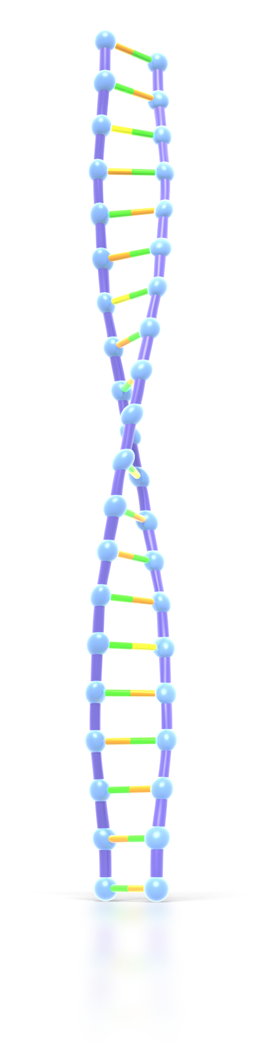
Primary Hyperoxaluria in Syria
University Children's
Hospital - Damascus
Atomic Energy Commission
of Syria

Slide 4
Atomic Energy Commission of Syria
Departments:
Physics
Chemistry
Molecular Biology & Biotechnology
Radiation Medicine
Nuclear Engineering
Radio Technology
Agriculture
Geology
Scientific Services
Radioisotope
Technical Service
Radiation Protection

Slide 5
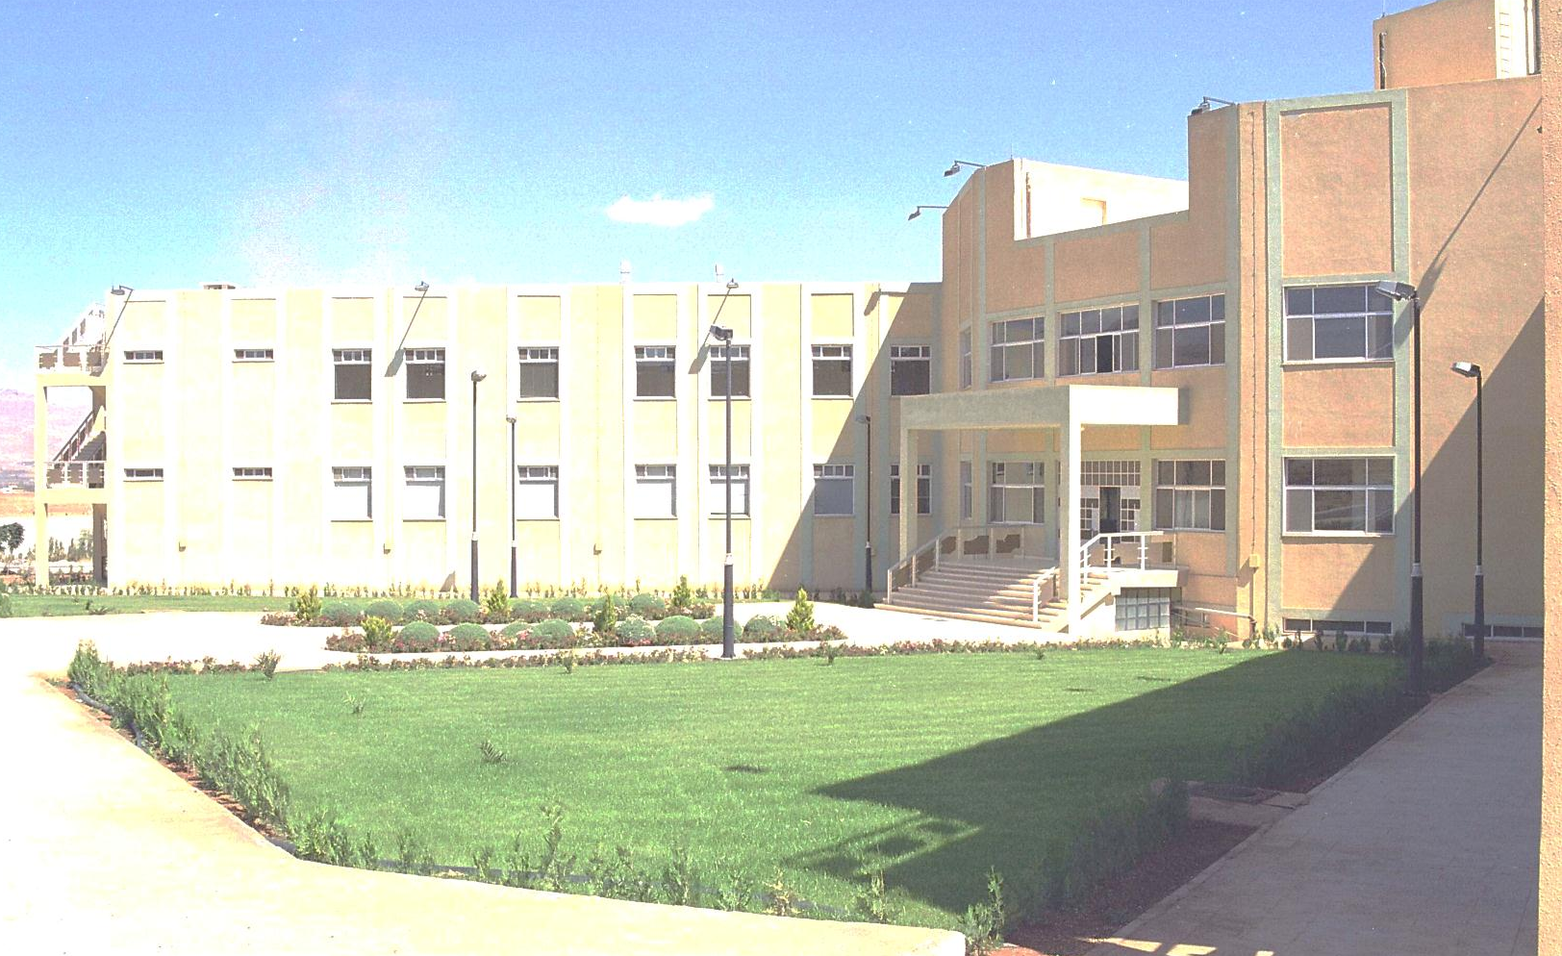
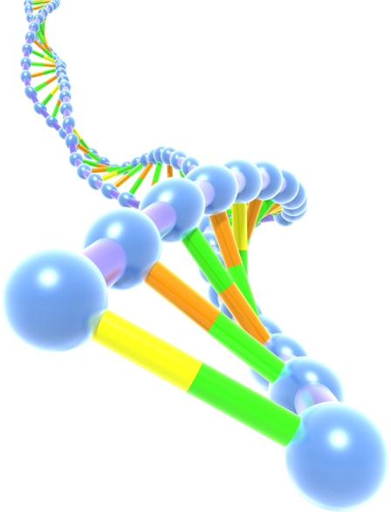
Molecular Biology & Biotechnology Dept:
Has been established at the beginning
of 2000 in Damascus
Type of institution: Governmental.
Number of Scientific staff: 200
Senior Researchers (PHDs): 30
Research assistants: 60

Slide 6
Primary Hyperoxaluria in Syria
The genetic study (for AGXT mutations only) has been done in patient (and parents when it was possible) with:
1- Nephrocalcinosis or kidney stones with hyperoxaluria:
(Urine Oxalate >45mg (0.5mmol)/1.73m²/24h).
2- Nephrocalcinosis or kidney stones with CKD.
Note: Unfortunately ( Plasma oxalate, Urine glycolate, Urine L- glycerate, Plasma glycolate) are not available in our laboratories.

Slide 7
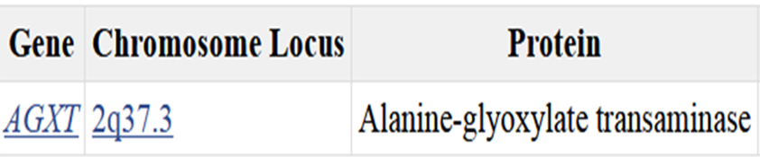
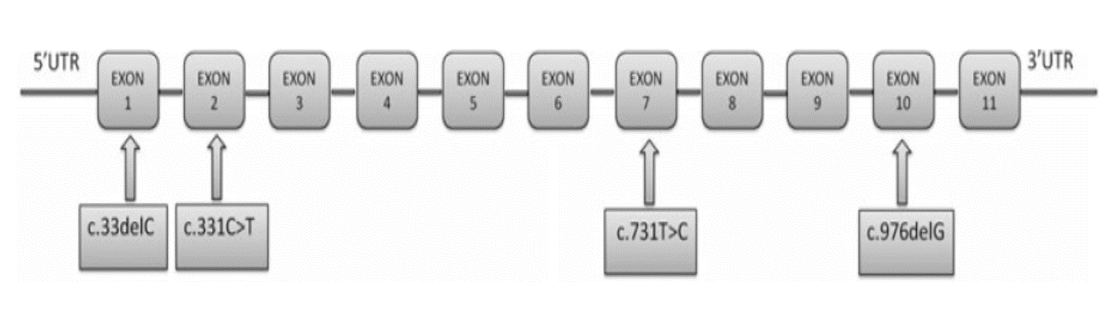
AGXT gene

Slide 8
Primary Hyperoxaluria-1 in Syria
Percent | Number | Studied Patients
37.2% | 29 | AGXT Mutations (Homozygosity or Compound Heterozygosity)
62.8% | 49 | No AGXT mutations
100% | 78 | Total
New mutations | Detected mutations | Studied Patients
4 | 13 | 78

Slide 9
Primary Hyperoxaluria-1 in Syria
The age of diagnosis:
- In PH1 patients: 1 month – 15 years.
- In all studied patients: 1 month – 13 years.
Consanguinity:
- In PH1 patients: 23/29 (79.3%)
- In all studied patients: 41/78 (52.5%)
Family History:
- In PH1 patients: 16/29 (55.2%)
- In all studied patients: 28/78 (35.9%)

Slide 10
Primary Hyperoxaluria-1 in Syria
Clinical and radiological manifestation at presentation in PH1 patients:
Renal failure: 19/29 (65.5%)
Nephrocalcinosis: 19/29 (65.5%)
Kidney stones: 10/29 (34.5%)
Systemic Oxalosis (Skeletal and eye involvement):
2/29 (7%)

Slide 11
Primary Hyperoxaluria-1 in Syria
Outcome in PH1 patients:
Death (after a period on Peritoneal Dialysis in infants with terminal renal failure since birth): 9/29
ESRD/Hemodialysis: 3/29
Renal Failure/Conservative Management: 3/29
No Renal Failure/Conservative Management: 6/29
No Follow up: 8/29

Slide 12
Future Work
We are still collecting data for AGXT mutations in
other patients.
In the patients with no AGXT mutations (49 patients),
we are going to do genetic study searching for GRHPR
mutations ( PH2 ) and HOGA1 ( PH3).

Slide 13
Thanks for your listening

