Slide 1
Hemodialysis in primary hyperoxaluria type 1
Francesco Emma
Division of Nephrology and Dialysis
Bambino Gesù Children’s Hospital - IRCCS, Rome, Italy
Beirut, June 13-14-15, 2019

Slide 2
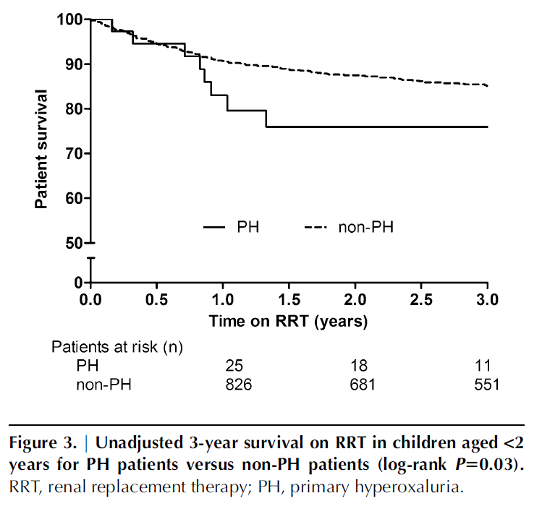
Primary hyperoxaluria: ESPN/ERA-EDTA Registry
1st year on dialysis
Harambat et al, Clin J Am Soc Nephrol, 2012

Slide 3
Primary hyperoxaluria
Oxalate clearance
Oxalate production:
Control population
Time

Slide 4
Primary hyperoxaluria
Oxalate clearance
Oxalate production:
Primary hyperoxaluria
Time
Primary hyperoxaluria
Oxalate plasma levels
Threshold plasma levels
for oxalate deposition
Oxalate deposition
Time

Slide 5
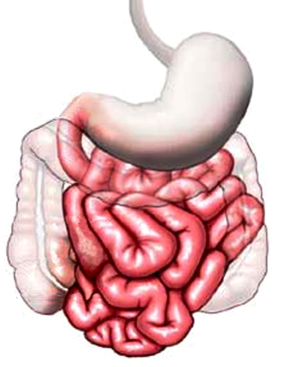
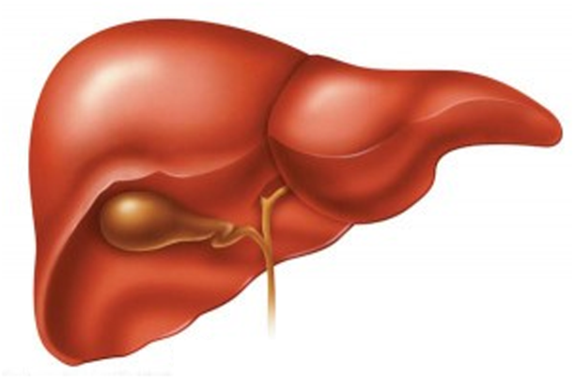
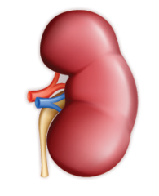
Oxalate mass balance
G₂
G₁
C
V
●

Slide 6
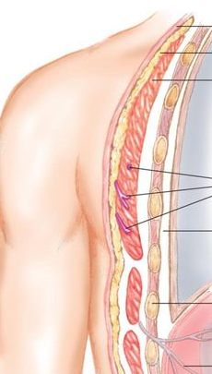
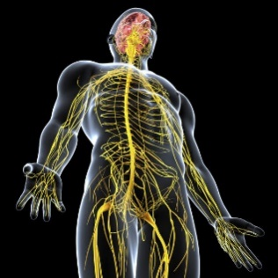
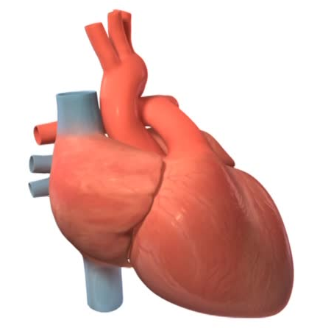
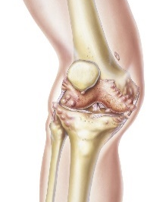
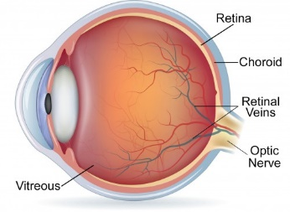
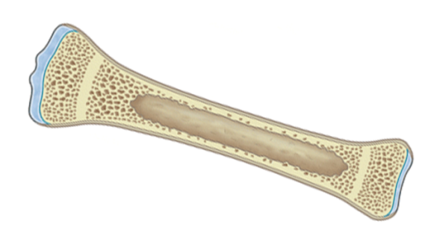
Oxalate mass balance
G₂
G₁
C
V
●
Systemic oxalosis
Kidneys
Heart
Bones
Joints
Retina
Soft tissues
Peripheral nerves

Slide 7
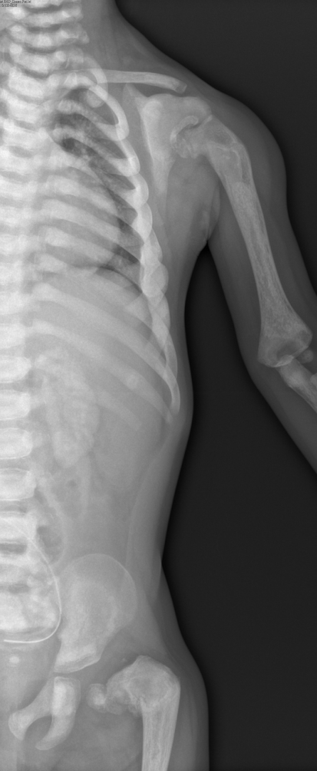
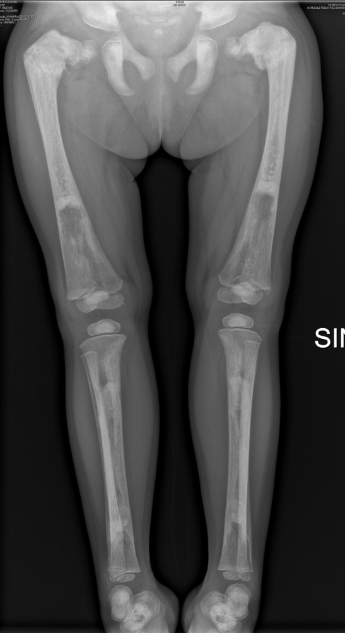
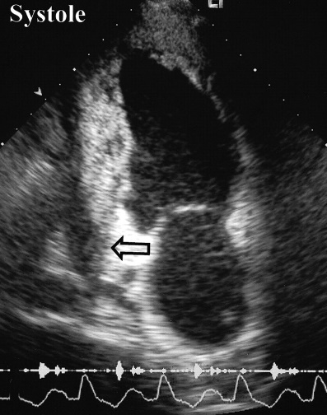
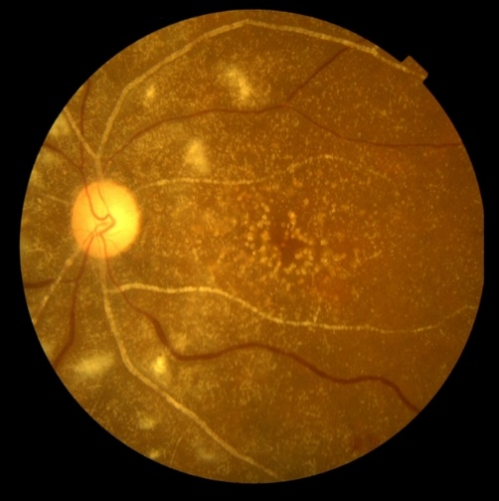
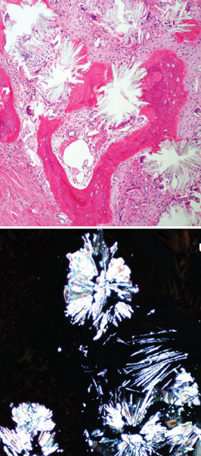
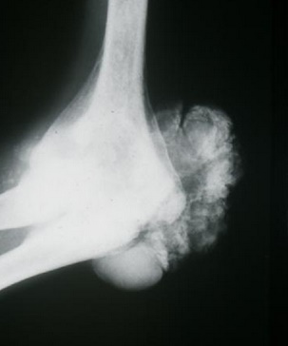
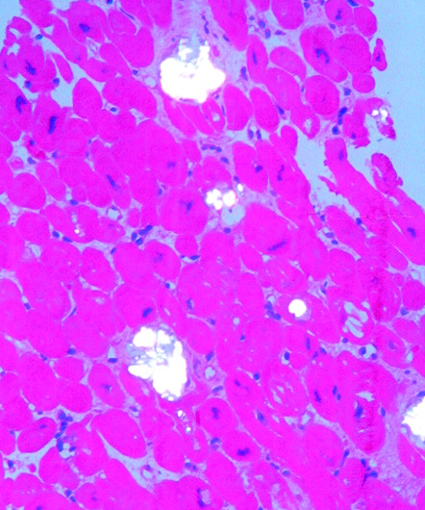

Systemic oxalosis
Kidneys
Bones
Bone morrow
Heart
Retina
Joints

Slide 8
Oxalate mass balance
G₂
G₁
C
V
●
Systemic oxalosis
Kidneys
Heart
Bones
Joints
Retina
Soft tissues
Peripheral nerves

Slide 9
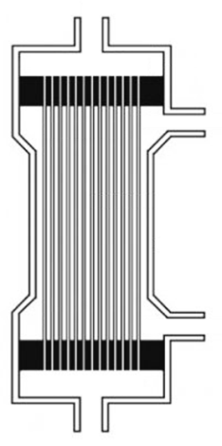
Oxalate mass balance
G₂
G₁
C
C
V
K
●
●
Systemic oxalosis
Kidneys
Heart
Bones
Joints
Retina
Soft tissues
Peripheral nerves

Slide 10
Oxalate accumulation on dialysis
Oxalate generation : 4-7 mmol/1.73 m²/24h
Removal by conventional dialysis : 1-2 mmol/1.73 m²/24h
Cochat et al, Ped Nephrolol, 2006

Slide 11
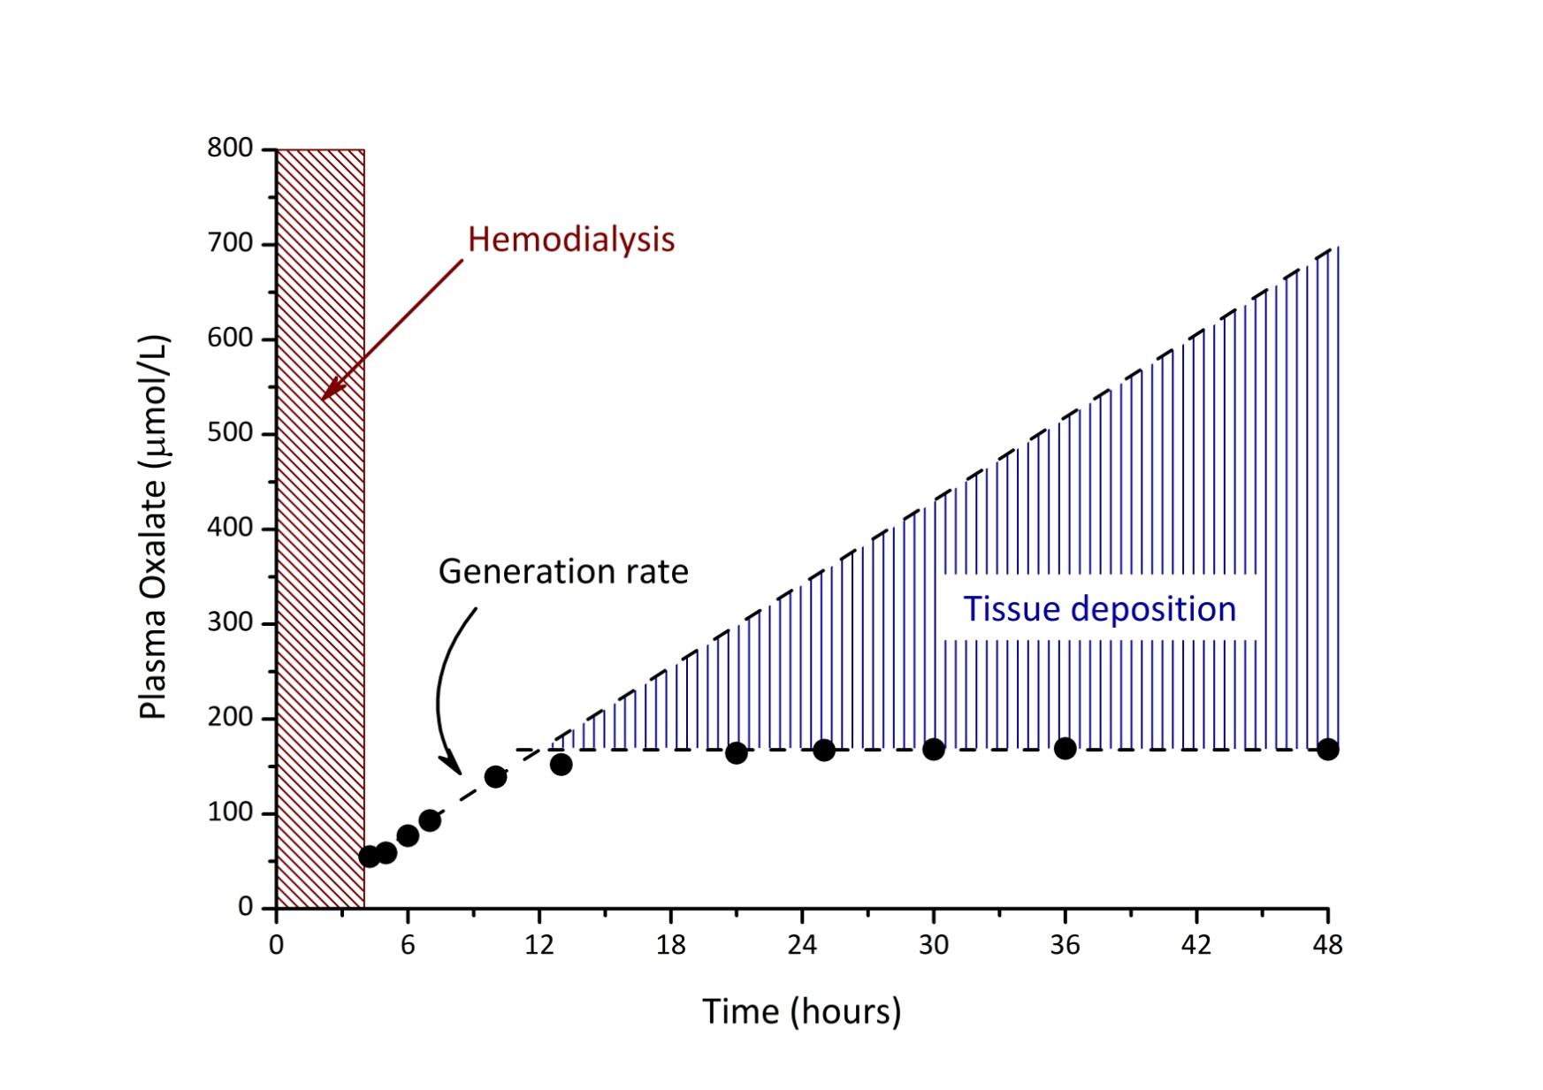
Oxalate tissue deposition on dialysis
Adapted from Marangella et al, Am J Kid Dis, 1992

Slide 12
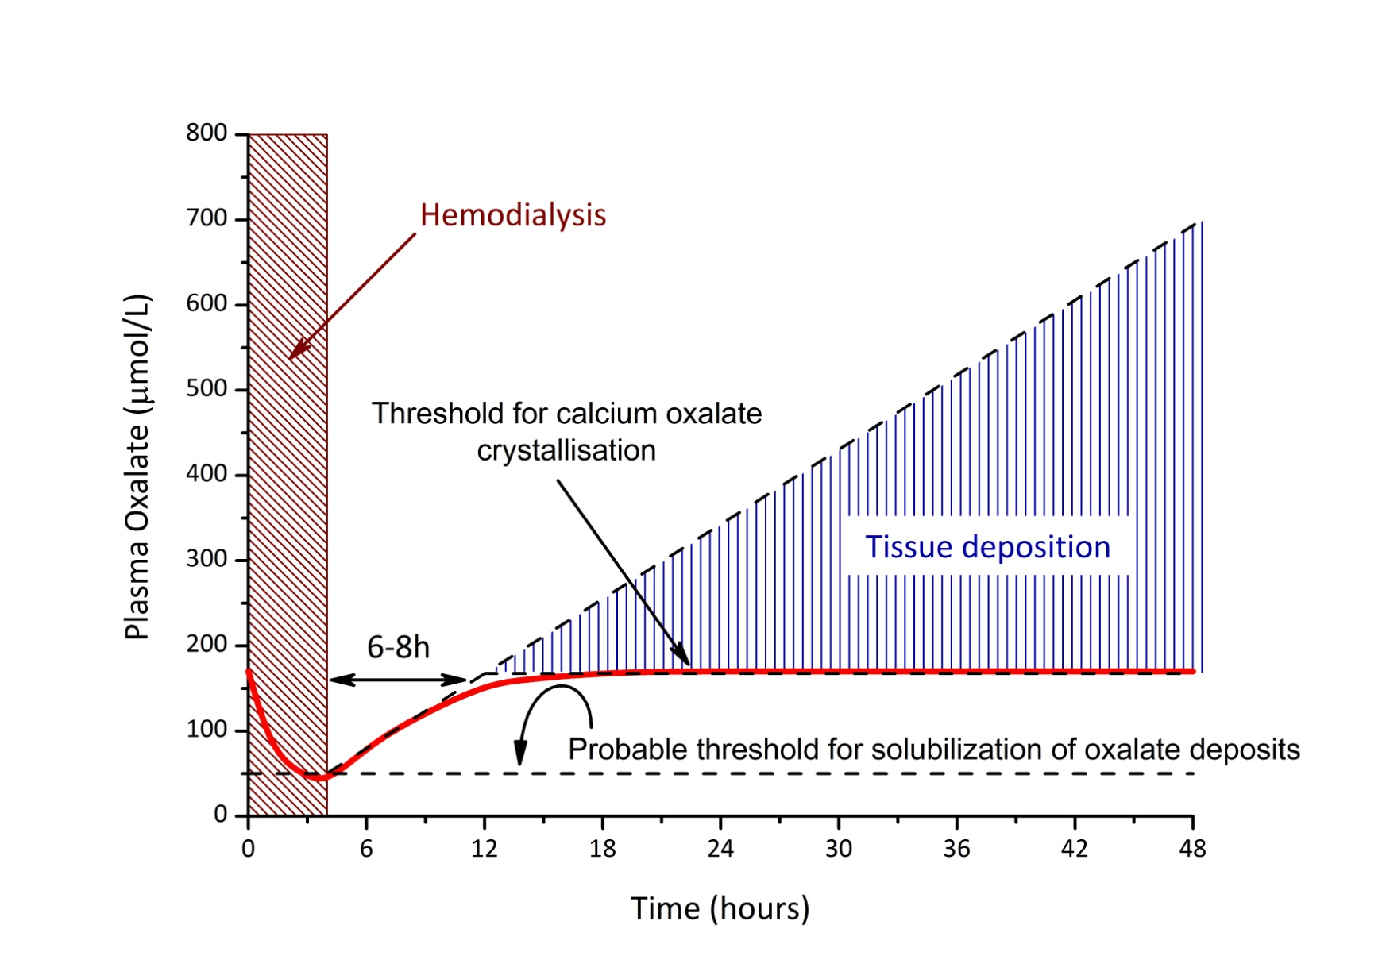
Oxalate tissue deposition on dialysis

Slide 13
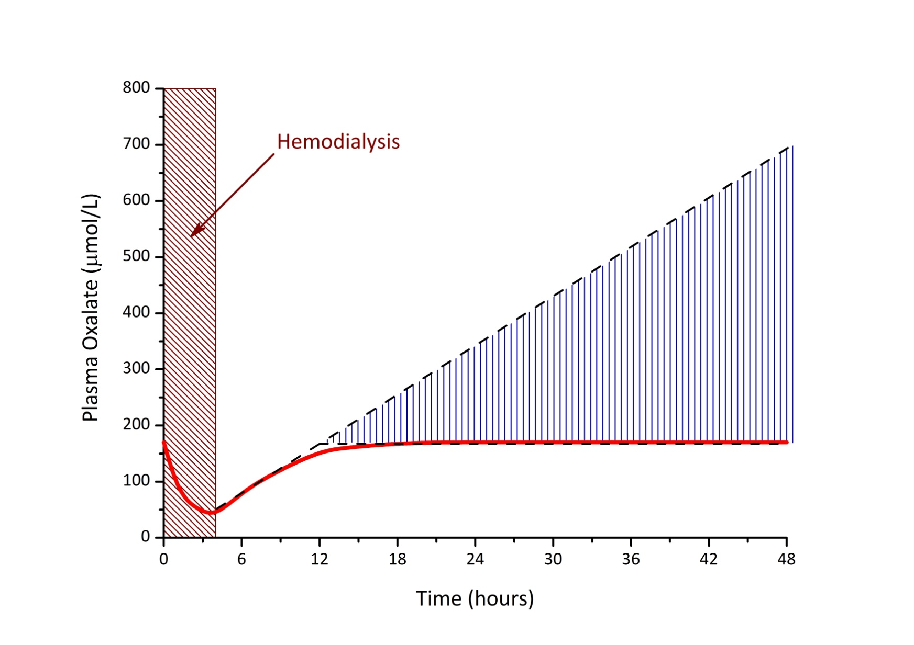
Oxalate tissue deposition on dialysis

Slide 14
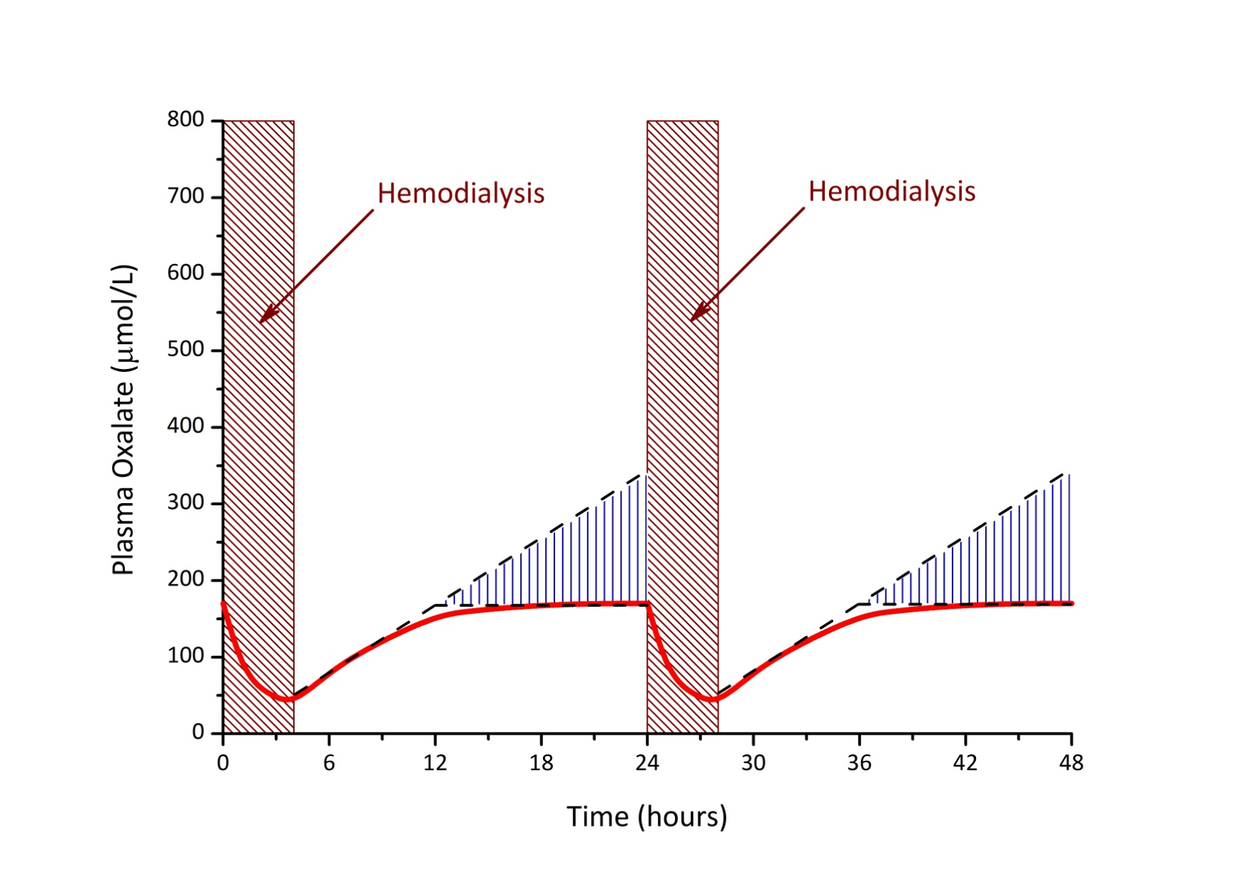
Oxalate tissue deposition on dialysis

Slide 15
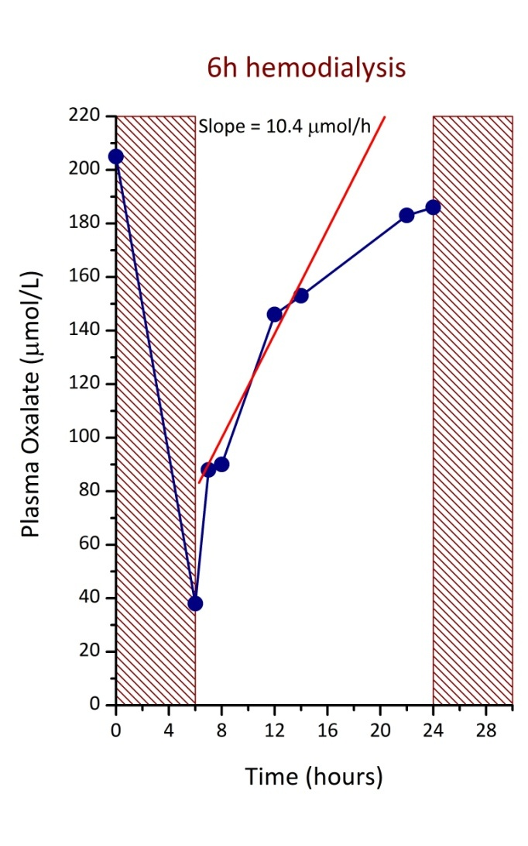
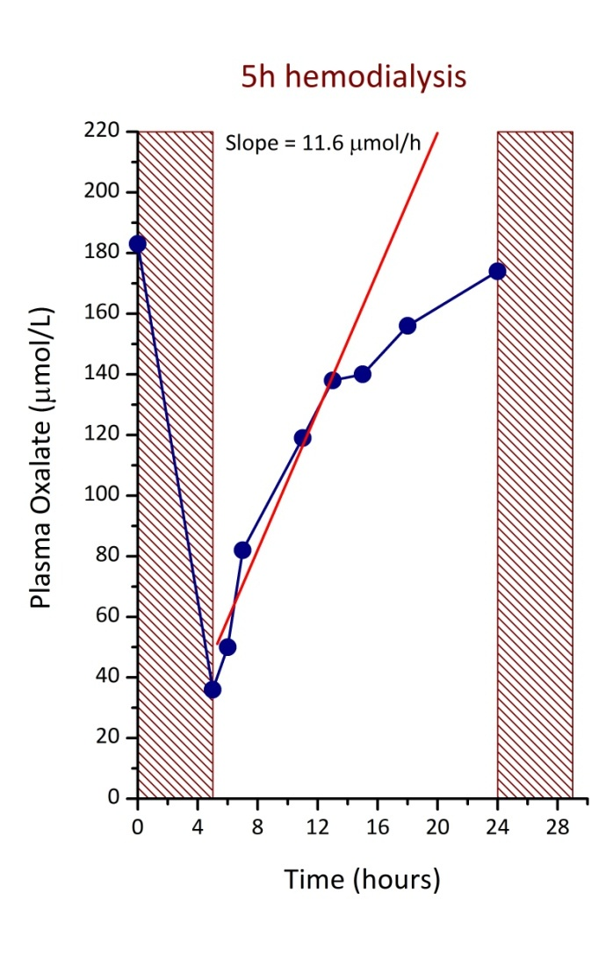
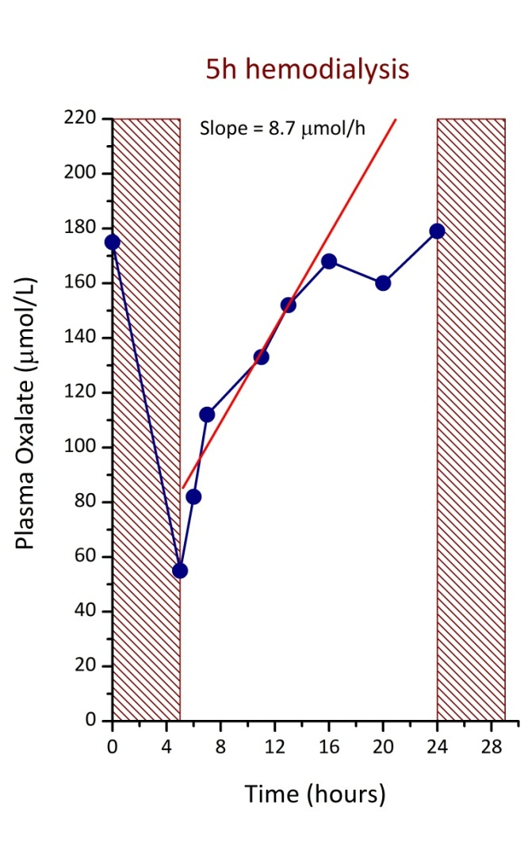
Daily dialysis for primary hyperoxaluria
Patient #1
Patient #1
Patient #2

Slide 16
Even intensive dialysis cannot completely prevent oxalate depositions
Patient age, body weight
HD setting, blood flow
Plasma
Oxalate,
μmol/l
Mass
Removal,
μmol
Generation
Rate,
μmol/l/h
Distribution
Volume,
L (% of BW)
Tissue
Deposition,
μmol/24h/kg
Oxalate
clearance,
l/week/1.73 m²
6 months, 5.0 kg
daily CVVHD, Qb 40 ml/min
PreHD: 205
PostHD: 31
644
10.0
2.84 (56.8)
5
228
8 months, 6.5 kg
daily CVVHD, Qb 50 ml/min
PreHD: 178
PostHD: 41
615
9.14
3.68 (56.7)
19
167
30 months, 12.3 kg
HDx6/week, Qb 110 ml/min
PreHD: 102
PostHD: 28
812
4.81
8.28 (67%)
12
185
Calculations adapted from Marangella, 1992 and Yamauchi, 2001

Slide 17
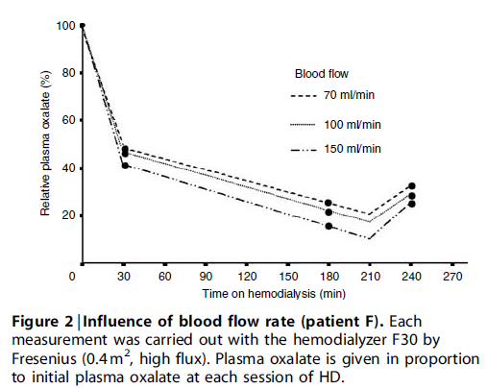
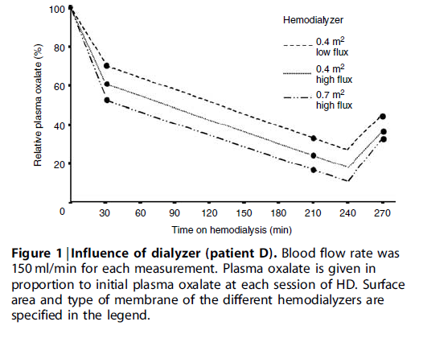
Maximizing dialysis
Illies et al, Kidney Int, 2006

Slide 18
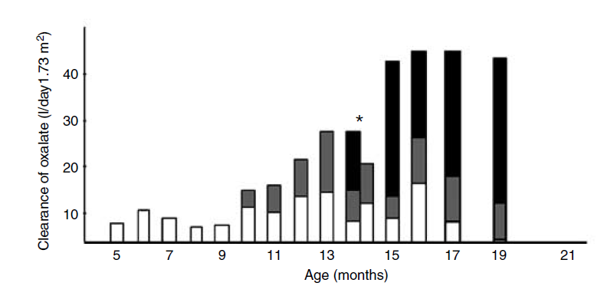
Maximizing dialysis
[HD+PD] > HD >>> PD
HD
PD
Urine
Illies et al, Kidney Int, 2006

Slide 19
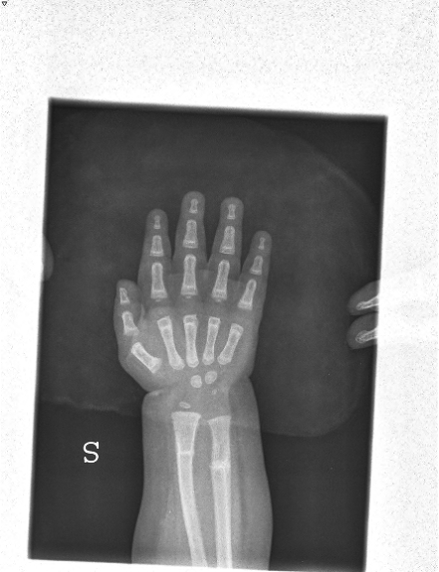
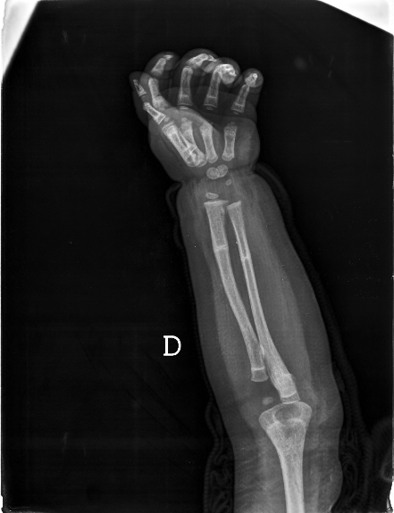
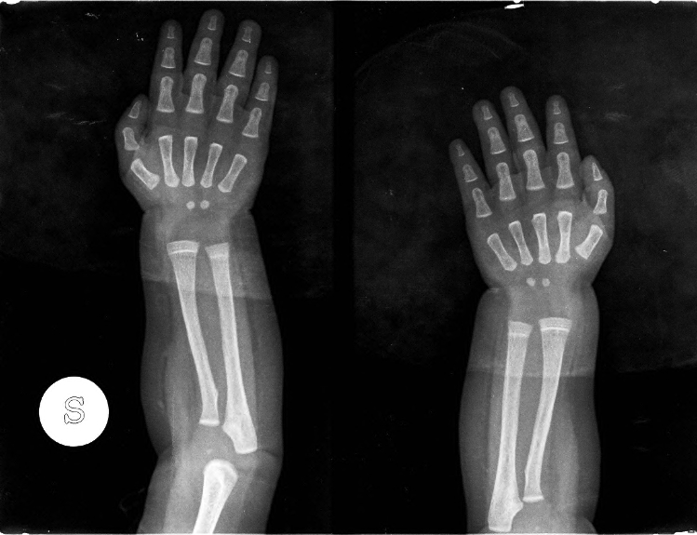
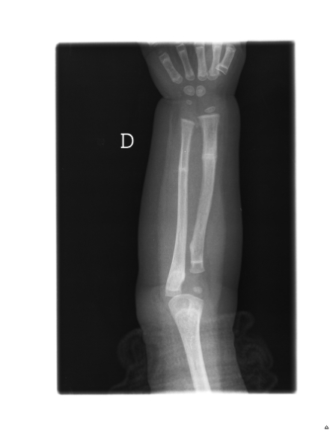
Intensive dialysis can limit oxalate deposition
Patient #1: migration of a single translucent band
6 months
12 months
16 months
18 months

Slide 20
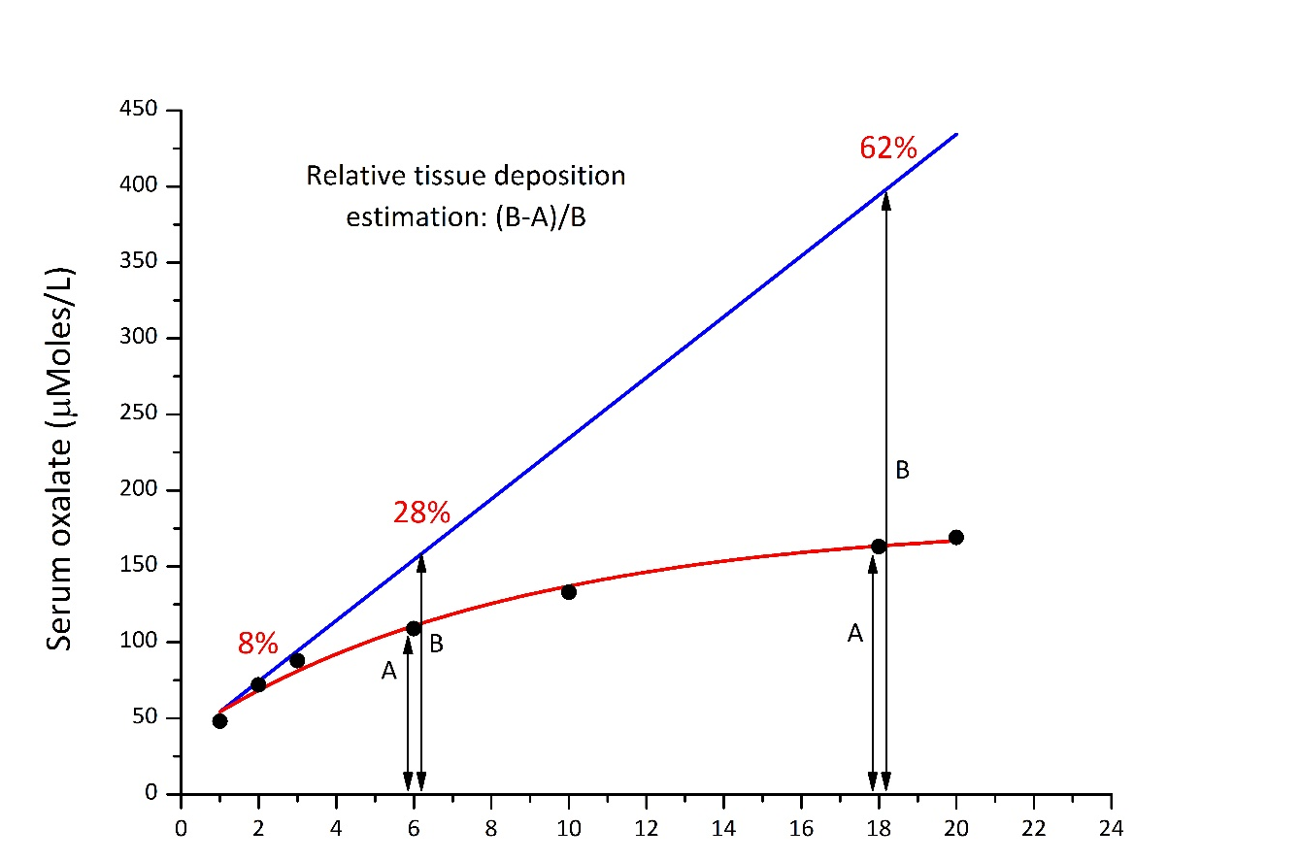
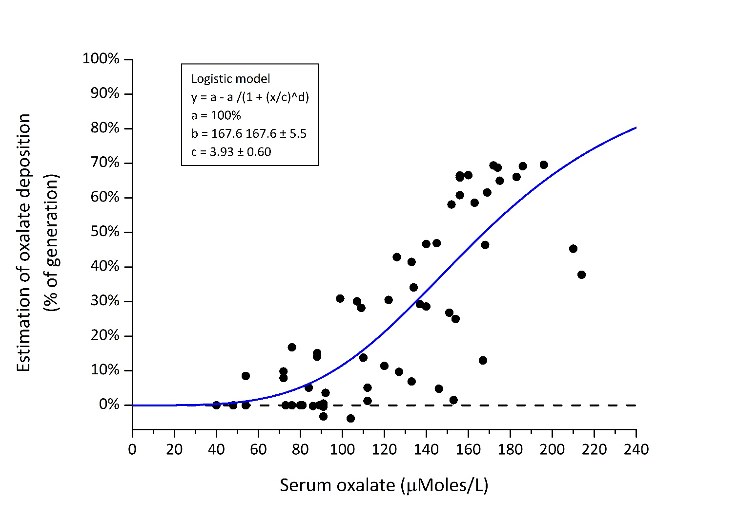
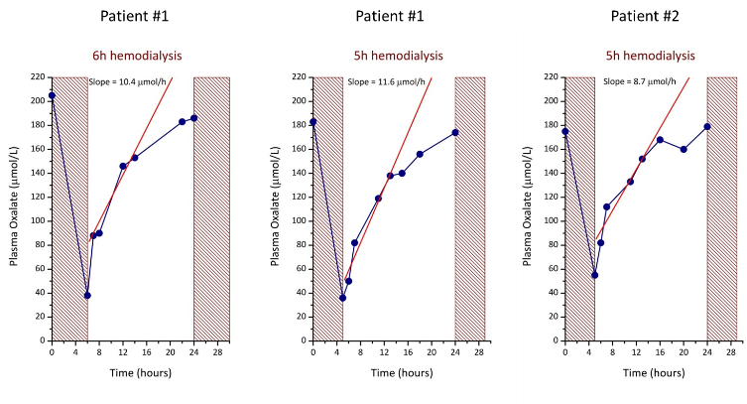
Modeling oxalate deposition

Slide 21
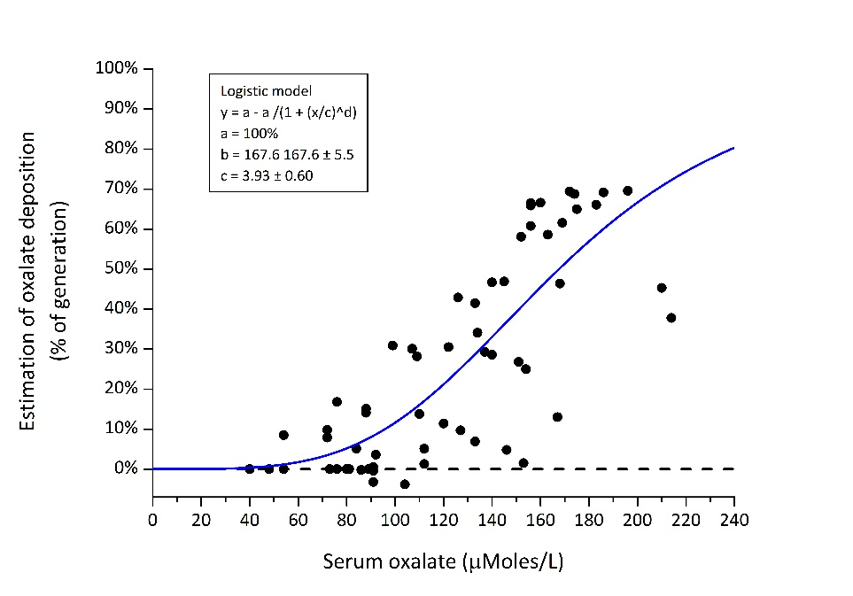
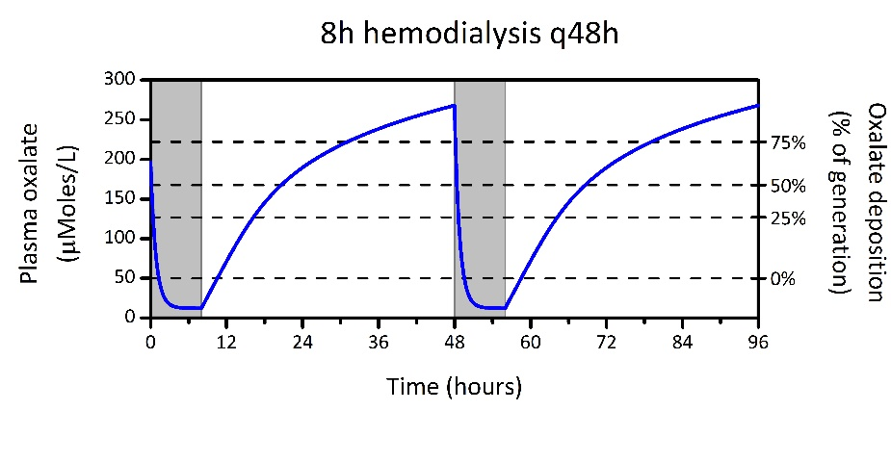
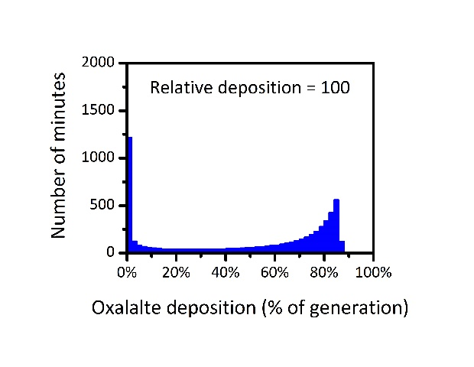
Modeling oxalate dialysis efficacy in preventing oxalate deposition

Slide 22
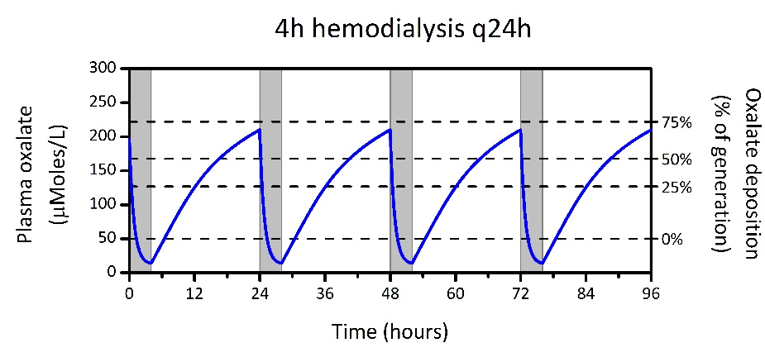
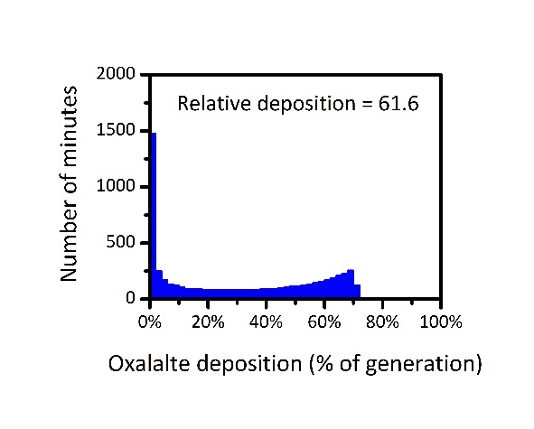
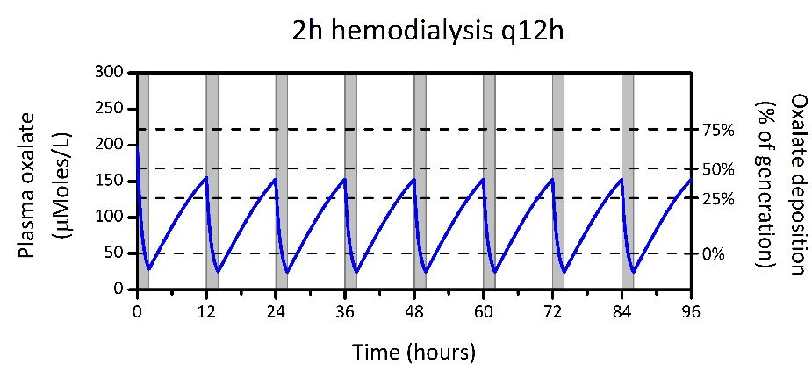
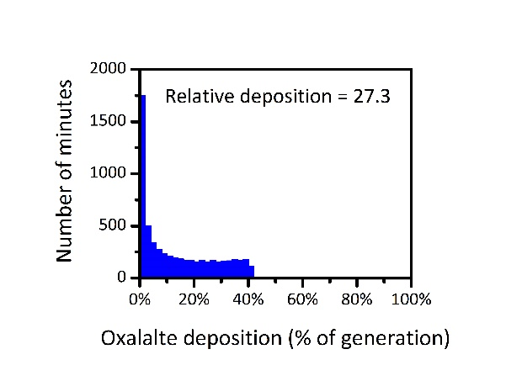
Modeling oxalate dialysis efficacy in preventing oxalate deposition

Slide 23
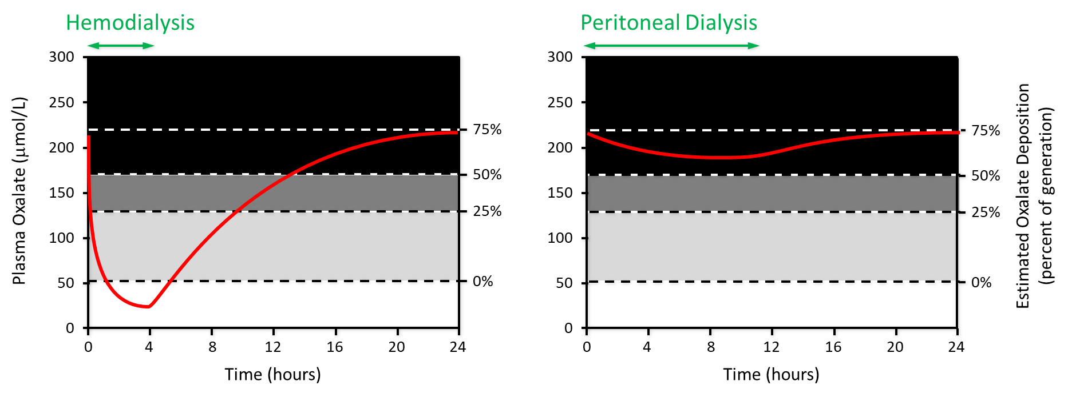
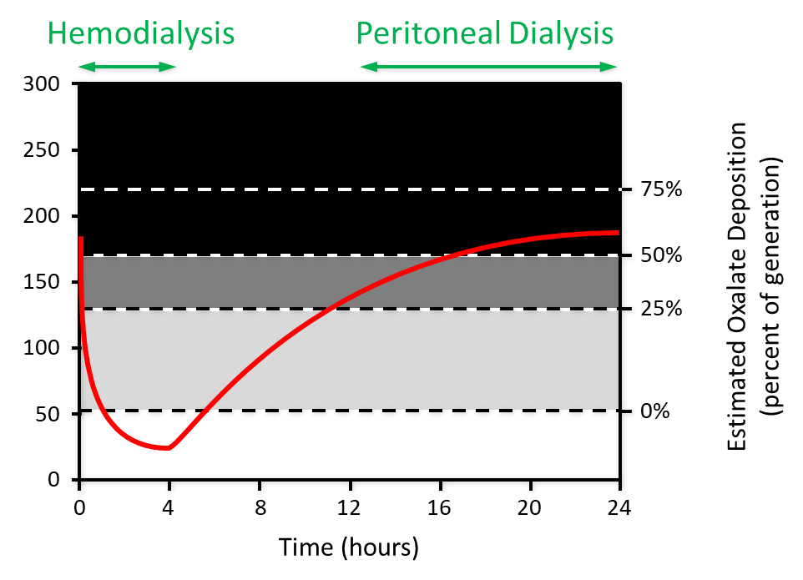
Oxalate tissue deposition on dialysis

Slide 24
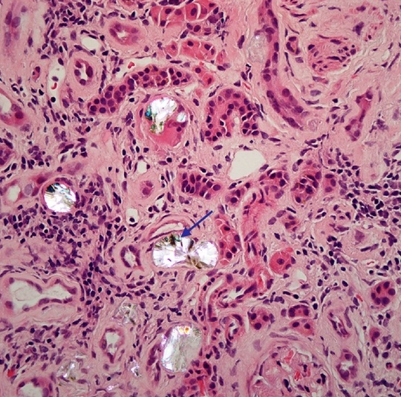
Oxalate crystal cause inflammation
High risk for renal Ox precipitation:
low tubular flow
high tubular lumen Ox concentration
Martin-Higueras et al, Nephrol Dial Transpl, 2019

Slide 25
Oxalate crystals induce inflammation
Plos One, 2019

Slide 26
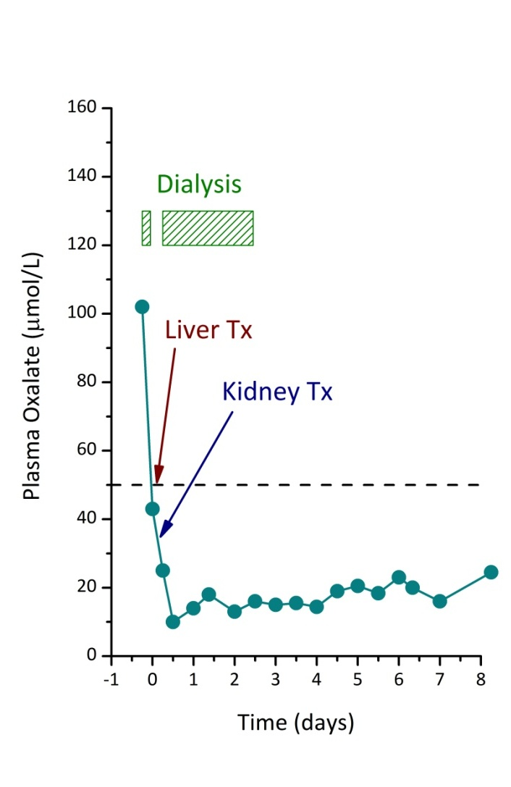
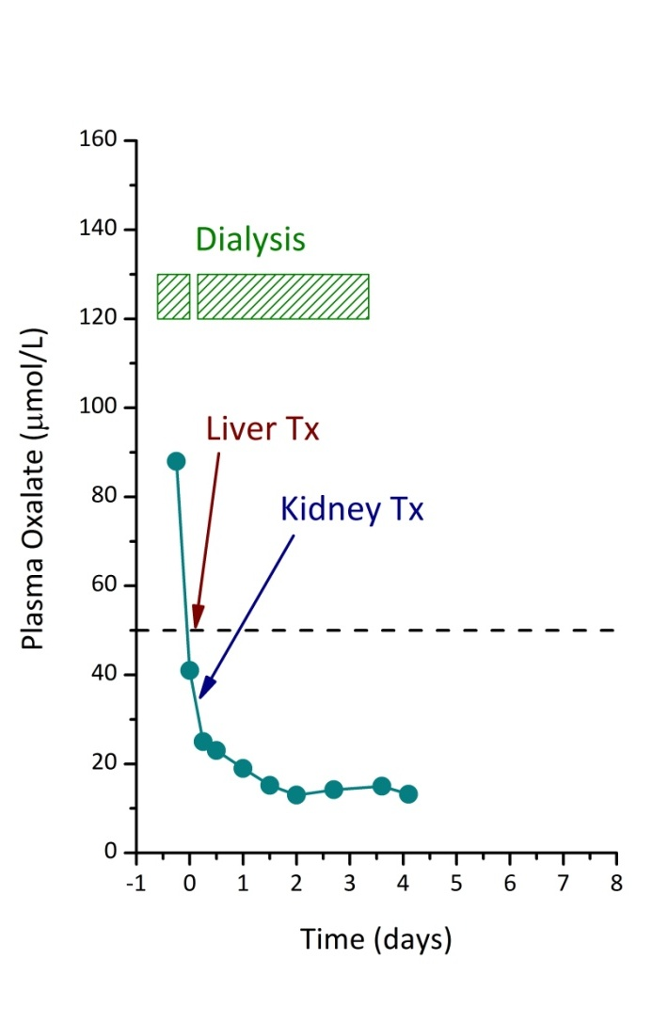
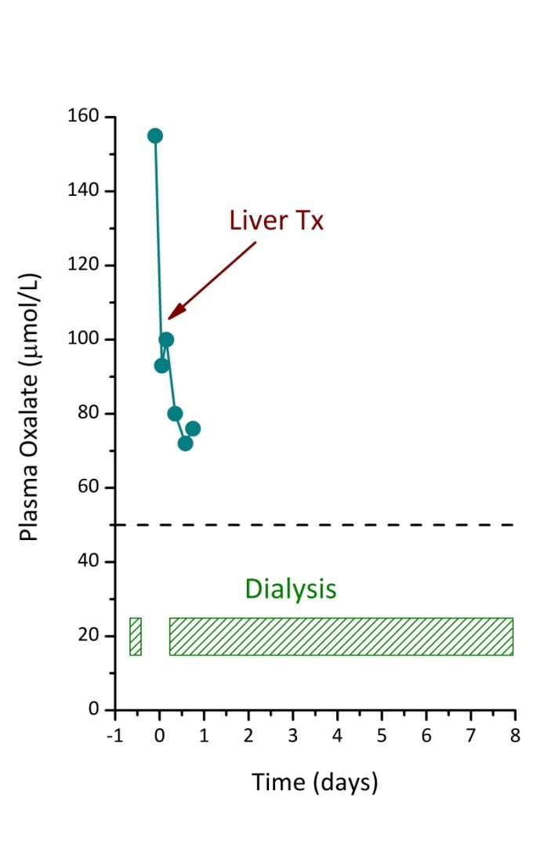
Oxalate levels during transplantation
Patient #1
Patient #2
Patient #3

Slide 27


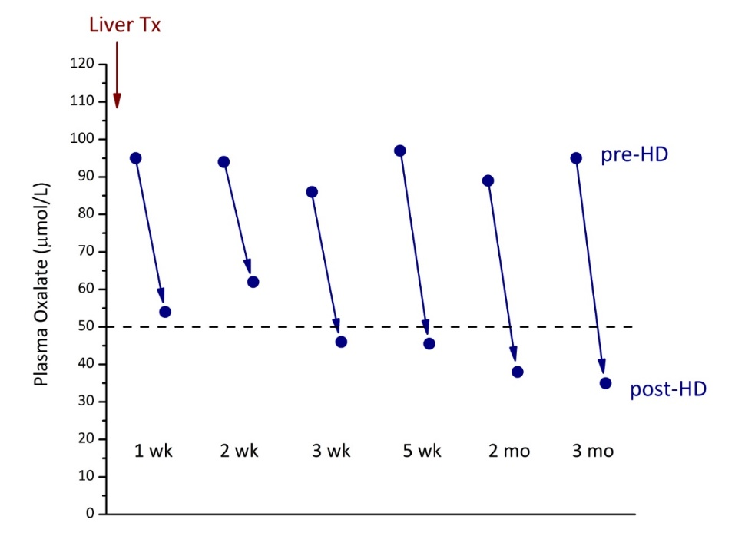
Prolonged dialysis causes extensive oxalate depositions
Oxalate accumulation after 3 years of PD
Oxalate levels after isolated liver Tx

Slide 28
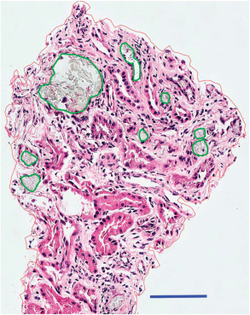

Oxalate nephropathy
2D
3D
1 serial section
x 70 serial sections
∼6.8% of the tissue volume
Ward et al. Kidney Int 2015
Notes:
Renal biopsy, hematoxylin and eosin stain. Oxalate crystals segmented before volume rendering (one of ∼70 serial sections shown). Scale bar=50 μm.
Three-dimensional construct of renal oxalate crystals created from the same region seen inFigure 1 using ∼70 serial sections and representing a total tissue volume of ∼2.7 mm3. The crystals occupy ∼6.8% of the tissue volume. (The three-dimensional structure of the crystals is best appreciated in a movie included as Supplementary Material S1 online.)

Slide 29
ESKD kidneys contain a lot of oxalates…
Pediatric transplantation 2017

Slide 30

Thank you!

