Slide 1
Hemodialysis:concept and membranes
Elias Gemayel,M.D.

Slide 2
HISTORY:
Willem Kolff was the first to construct a working dialyzer in 1943.
The first successfully treated patient was a 67-year-old woman in uremic coma who regained consciousness after 11 hours of hemodialysis with Kolff's dialyzer in 1945.
At the time of its creation, Kolff's goal was to provide life support during recovery from acute renal failure.

Slide 3
HISTORY:
After World War II ended, Kolff donated the five dialyzers he had made to hospitals around the world, including Mount Sinai Hospital, New York.
The next stainless steel dialyzer generation were made by with name.

Slide 4
First dialyzer applied on a patient:

Slide 12
INTRO:
The dialysis solution that is used must be a sterilized solution of mineral ions. Urea and other waste products,potassium,and phosphate diffuse into the dialysis solution.
However, concentrations of sodium and chloride are similar to those of normal plasma to prevent loss.
Sodium bicarbonate is added in a higher concentration than plasma to correct blood acidity. A small amount of glucose is also commonly used.

Slide 13
INTRO:
The newest dialysis machines on the market are highly computerized and continuously monitor an array of safety-critical parameters, including:
*blood and dialysate flow rates; dialysis solution conductivity, temperature, and pH; and analysis of the dialysate for evidence of blood leakage or presence of air.

Slide 14
INTRO:
Any reading that is out of normal range triggers an audible alarm to alert the patient-care technician who is monitoring the patient.
Manufacturers of dialysis machines include companies such as: Nipro, Fresenius, Gambro, Baxter, B. Braun, NxStage and Bellco.

Slide 15
Conductivity alarm:
Before dialysate reach to dialyzer
To guard against excessive diluted or concentrated dialysis solution
Sodium is measured by conductivity on dialysis:
*14.0 mS/cm = 140mEq/l
*Exposure of the blood to hyposmolar dialysate can lead to hyponatremia and rapid hemolysis.
*conductivity measurment by a dialysis machine is 10 x more precise than sodium measurment by laboratory.

Slide 16
Conductivity can be used to measure clearance:
The size of ionized sodium is 58.5 daltons and urea is 60 daltons.Therefore these 2 substances will have the same ability to cross the dialyzer membrane,

Slide 17
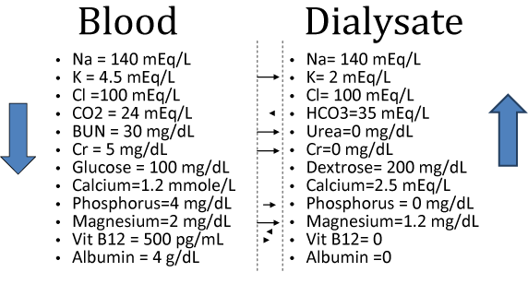

Slide 18
The dialyzer

Slide 19
The dialyzer
is the piece of equipment that actually filters the blood. Almost all dialyzers in use today are of the hollow-fiber variety.
A cylindrical bundle of hollow fibers, whose walls are composed of semi-permeable membrane, is anchored at each end into potting compound (a sort of glue).
This assembly is then put into a clear plastic cylindrical shell with four openings.

Slide 20
THE DIALYZER:
One opening or blood port at each end of the cylinder communicates with each end of the bundle of hollow fibers.
*This forms the "blood compartment" of the dialyzer.
Two other ports are cut into the side of the cylinder.
*These communicate with the space around the hollow fibers, the "dialysate compartment.“

Slide 21
Dialyzer membranes
Come with different pore sizes. Those with smaller pore size are called "low-flux" and those with larger pore sizes are called "high-flux." Some larger molecules, such as beta-2-microglobulin, are not removed at all with Lo flux membranes.
However, such AK require newer dialysis machines and high-quality dialysis solution to control the rate of fluid removal properly and to prevent backflow of dialysis solution impurities into the patient through AK.

Slide 22
Dialyzer membranes
were made primarily of cellulose (derived from cotton linter).
The surface of such membranes was not very biocompatible, because exposed hydroxyl groups activate complement in the blood passing by the Mb.
One change was to cover these groups with acetate (cellulose acetate); another was to mix in some compounds that would inhibit complement activation at the Mb surface (modified cellulose).

Slide 23
SO!
The original "unsubstituted cellulose" membranes are no longer in wide use, whereas cellulose acetate and modified cellulose dialyzers are still used.
Cellulosic membranes can be made in either low-flux or high-flux configuration, depending on their pore size.

Slide 24
Another group of membranes:
Is made from synthetic materials, using polymers such as polysulfone, polyethersulfone (trending), polyamide, polycarbonate, and polyacrylonitrile.
These synthetic membranes activate complement to a lesser degree than unsubstituted cellulose membranes.

Slide 25
Nanotechnology
is being used in some of the most recent high-flux membranes to create a uniform pore size.
The goal of high-flux membranes is to pass relatively large molecules such as beta-2-microglobulin (MW 11,600 daltons), but not to pass albumin (MW ~66,400 daltons)..

Slide 26
More on High Flux:
THE HEMO study did not show a mortality benefit between high flux and low flux dialysis.
Howevwer,the posthoc study,MPO trial and EGE trial showed a survival benefit (especially cardiovascular) for high flux dialysis in subset of patients with albumin<4mg/dl,dialysis vintage >3.7 years,diabetes and those with AV fistula.
KDOQI Adequacy Work group recommends use of high flux dialyzers routinely as long as appropriate water treatment is available.

Slide 27
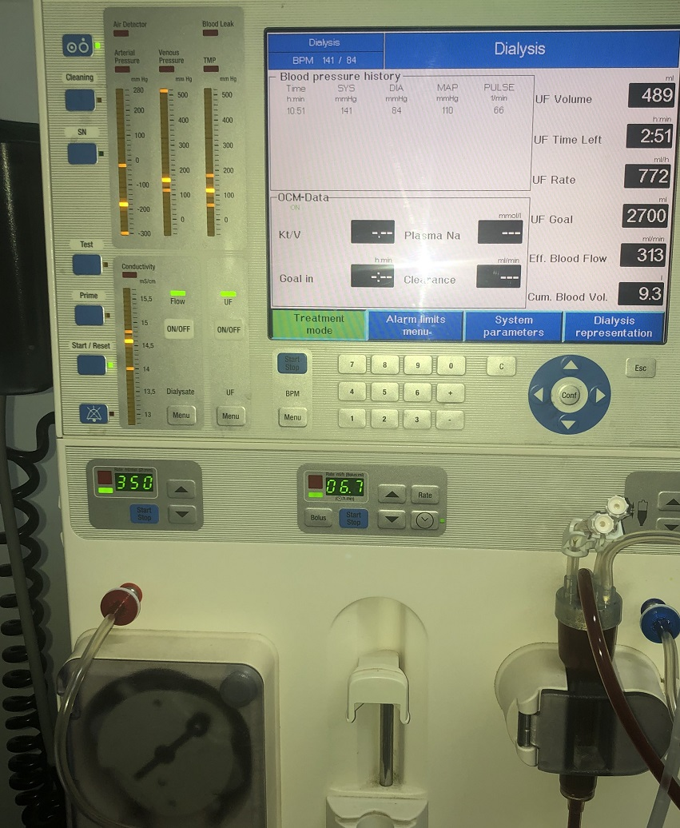

Slide 28
TMP:
Is the Trasmembrane Pressure or the pressure difference between blood and fluid compartment.
In modern dialysis machines,TMP monitors the volumetric control of ultrafiltration:
A drop in TMP indicate leakage of fluid in system or rupture of membrane(which can be changed)
A rise indicate clotting of blood.

Slide 29
SIZE MATTERS(filter):
Dialyzers come in many different sizes. A larger dialyzer with a larger membrane area (A) will usually remove more solutes than a smaller dialyzer, especially at high blood flow rates.
This also depends on the membrane permeability coefficient K₀ for the solute in question.

Slide 30
size
So dialyzer efficiency is usually expressed as the K0A – the product of permeability coefficient and area. Most dialyzers have membrane surface areas of 0.8 to 2.2 square meters, and values of K0A ranging from about 500 to 1500 mL/min.
K0A, expressed in mL/min, can be thought of as the maximum clearance of a dialyzer at very high blood and dialysate flow.
Is K0A equal to efficiency?in argot,yes

Slide 31
For example:
K0A for UREA:
F5:614ml/min
F7:874ml/min
F10:976ml/min
FOR HIGH FLUX DIALYSIS:
1)Clearance of b2 Microglobulin >20 ml/min.
2)Kuf of dialyzer > 15ml/h/mmHg
Kuf=volume of fluid transferred across membrane per mmHg of pressure gradient.

Slide 32
High efficiencyy vs High flux
Urea Cl >210 ml/min
Kuf is variable
Clearance of middle weight molecules variable
K0A(efficiency) urea is usullay >800ml/min
High blood flow > 350
Bicarbonate dialysate (avoid acetate intolerance symptoms)
Kuf is high.
Ultrapur water
Automated UF control to avoid errors in TMP calculation resulting in massive flux and hemodynamic instability.

Slide 33
THANK YOU!

