Slide 1
How to Approach Secondary Hypertension?
Sola aoun bahous, md, phd
Professor of medicine
Lau school of medicine
Second IPNA teaching course
June 13-15, 2019

Slide 2
Conflict of Interest
Nothing to declare

Slide 3
Outline
Definition and prevalence of 2^{ary} hypertension
Etiologies of 2^{ary} hypertension by age groups
Who to screen?
How to screen?
Screening of most important causes of 2^{ary} hypertension
Conclusion

Slide 4
Definition and Prevalence of 2^{ary} Hypertension
Increased arterial BP secondary to an identifiable cause
Overall, 5-10% of hypertensive patients have 2^{ary} forms but prevalence is dependent on many factors:
  Age
  Controlled vs. resistant
  Emergency and urgency hypertension
The prevalence of 1^{ary} HTN is similar in subjects with 2^{ary} HTN and in the general population raising the concept of ‘Residual Hypertension’ and the necessity of early diagnosis

Slide 5
In Resistant HTN Cases
In Essential HTN Cases
Rimoldi S, EHJ 2014, 35

Slide 6

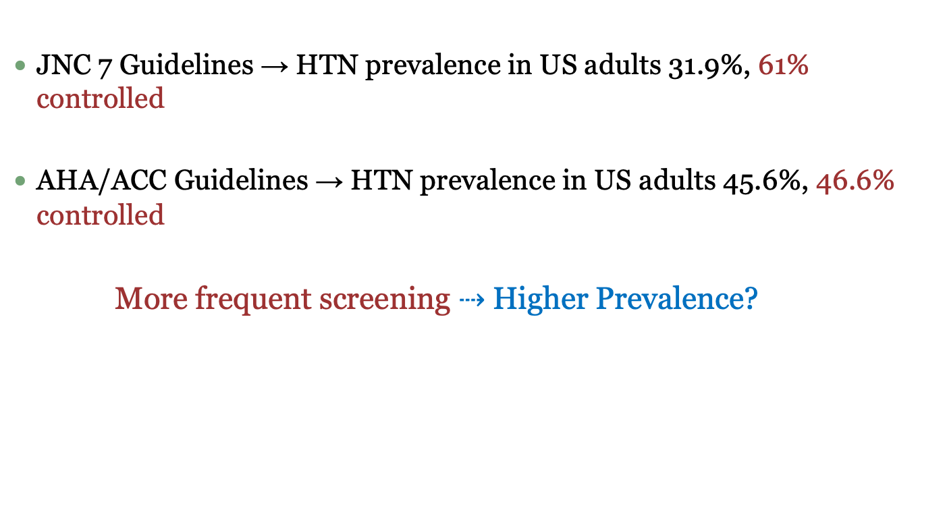
Guideline Impact
JNC 7 Guidelines → HTN prevalence in US adults 31.9%, 61% controlled
AHA/ACC Guidelines → HTN prevalence in US adults 45.6%, 46.6% controlled
More frequent screening $⇢$ Higher Prevalence?
$$⟹$$

Slide 7
Resistant vs. Uncontrolled Hypertension
Resistant Hypertension:
BP not at goal despite 3 anti-HTN drugs in optimal doses, AND
A diuretic is ideally one of the 3, OR
Controlled BP on > 3 drugs
12% of hypertensive patients
Uncontrolled hypertension:
BP not at goal
Causes = Pseudoresistance (poor BP technique, poor adherence, white coat effect), lifestyle factors (obesity, dietary salt, alcohol), drugs (NSAIDs, steroids, stimulants, Epo, sympathomimetics, oral contraceptives, cyclosporin, licorice, herbal compounds) and resistant hypertension

Slide 8
Etiologies of 2ary Hypertension by Age
Age
Child/adolescent (birth-18y)
Young adult
(19-39y)
Middle-aged adult (40-64y)
Older adult
(>65y)
Renal parenchymal disease
Coarctation of the aorta
Thyroid dysfunction
RAS 2ary to fibromuscular dysplasia
Hyperaldosteronism
OSA
Cushing
Pheochromocytoma
RAS 2ary to atherosclerosis
CKD

Slide 9
Who to Screen?
Rimoldi S, EHJ 2014, 35

Slide 10
Who to Screen?
Clinical and Biological Clues:
Elderly with diastolic HTN [RAS, hypothyroidism]
Hypokalemia and/or metabolic alkalosis [mineralocorticoid HTN, RAS]
Asymmetric kidney size and/or abdominal bruit [RAS]
Severe atherosclerosis [~ 15–30% of patients with arterial hypertension and diffuse atherosclerotic disease (i.e. coronary, peripheral, cerebrovascular disease) have a significant RAS]
Resistant HTN with overweight [OSA, Cushing, Hypothyroidism]
Non-dipping [OSA, RAS]
Sudden BP drop or eGFR drop after RAAS blockers [RAS]
Unexplained recurrent pulmonary edema [RAS]

Slide 11
What Should be Done Before Screening?
Exclude:
  Pseudo-hypertension
  Pseudoresistance
  Poor compliance
  White coat HTN
  Drug-related HTN
Pseudo-hypertension:
  Cuff diastolic BP at least 15 mmHg higher than simultaneously measured intra-arterial BP
  Found in elderly patients with calcified and rigid arteries who present with little or no target organ damage despite very high BP readings
  Assessment of brachial arterial stiffness may help
Notes:
In these patients, excessive cuff pressure is needed to compress the artery resulting in falsely high readings. This entity may be identified using the Osler manoeuvre. However, this manoeuvre has a large intra- and inter-observer variability.

Slide 12
Should We Use ABPM?
Advantages:
Correlates better with outcome compared to office BP
Excludes white coat HTN
Confirms resistant HTN
Helps assessing treatment adherence
Provides more information about BP pattern (dipping status, morning surge, arterial stiffness, BP variability)
Disadvantages:
May cause discomfort
May cause sleep deprivation that affects nocturnal assessment of BP
Notes:
While reference values for office BP measurements
aim to distinguish between normotensive and hypertensive
subjects and are therefore ‘diagnostic’ cut-off values, reference
values for 24 h ABPM in adults have been defined as outcome-driven
thresholds and are considerably lower than clinical ones

Slide 13
Rimoldi S, EHJ 2014, 35

Slide 14
Role of Echocardiography?
Central in the assessment of resistant hypertension
Indicates target organ damage
Key = LVH is disproportionate to the duration of HTN
Allows the diagnosis of coarctation
Notes:
In patients with
OSA, LVH is a very common finding and may be accompanied by
left atrial enlargement and right ventricular hypertrophy

Slide 15
How to Screen?
Rimoldi S, EHJ 2014, 35

Slide 16
Should We Do All Tests?
Clinical clues → directed investigation
  For example, abdominal bruit → screening for RAS
  Disproportionate hypokalemia after a diuretic for example → screening for RAS, mineralocorticoid HTN
  Snoring → screening for OSA
Resistant HTN:
  Exclude pseudoresistance
  Exclude pseudo-hypertension
  Exclude white coat HTN
  Identify contributing lifestyle factors: obesity, excessive alcohol, physical inactivity, high salt diet, etc.
  Full work-up for 2^{ary} HTN

Slide 17
Screening of OSA
One of the most common causes of 2^{ary} HTN
Recurrent episodes of apnea/hypopnea caused by collapse of upper airway during sleep
Characteristics include:
  Exaggerated daytime sleepiness
  Snoring
  Morning headache
  Lack of concentration
  Irritability
  Obesity, large neck, macroglossia can be seen
  Nocturnal non-dipping
  Increased daytime BP
  Increased sympathetic activity

Slide 18

Screening of OSA
Severity scale
Polysomnography if AHI $≥10$
Rimoldi S, EHJ 2014, 35
Notes:
In this questionnaire, patients have to rate their probability to fall asleep during eight different situations of daily life [between 0 (would never doze) to 3 (high chance of dozing)]. Patients with an Epworth score ≥10 (indicating the presence of excessive daytime sleepiness) and a high clinical suspicion of OSA need to be assessed by polysomnography. We recommend that patients with OSA undergo echocardiography to assess systolic left and right ventricular function, left ventricular mass, and estimate pulmonary artery pressure.

Slide 19
Screening of Renal Parenchymal Disease
Most common cause of 2^{ary} HTN in children
Second most common cause of 2^{ary} HTN in adults
Serum creat > 1.5 mg/dl = strong predictor of failure to achieve goal BP
Screening = serum creatinine and urinalysis
Renal ultrasound: second step

Slide 20
Screening of Renal Artery Stenosis/Fibromuscular Dysplasia
Children and young adults: fibromuscular dysplasia
Screening = ultrasound doppler
Angiography = confirmatory test
If diagnosis confirmed, other vascular beds (cerebrovascular) should be screened

Slide 21
Atherosclerotic Renal Artery Stenosis: To Screen or Not To Screen?
Doubt in the benefit of interventional treatment
RAS may be a complication of pre-existing HTN
No test with sufficient sensitivity and specificity to assess the contribution of the stenosis to BP
Contribution of stenosis to BP is assessed only post hoc
Benefit in specific situations:
  Pickering syndrome
  Progressive renal failure

Slide 22
Atherosclerotic Renal Artery Stenosis: To Screen or Not To Screen?
In adults, atherosclerosis is the most common cause
RAS prevalence = 1-8% in general hypertensive patients, 25-35% in generalized atherosclerosis
Screening = ultrasound doppler
MRA and/or angiogram: confirmatory tests
Predictors of effective revascularization

Slide 23
Mineralocorticoid Hypertension
Mineralocorticoid HTN
HTN caused by ↑ Na⁺ and H₂O retention by the kidney and expansion of the ECF

Slide 24
Rimoldi S, EHJ 2014, 35

Slide 26
Conclusion
2^{ary} hypertension affects 5-10% of the hypertensive population
Screening is expensive and should be guided by clinical suspicion
Etiologies are variable by age group
Despite appropriate treatment of 2^{ary} hypertension, BP rarely returns to normal indicating concomitant essential hypertension or vascular remodeling related to longstanding 2^{ary} hypertension
Early detection and treatment are essential to avoid permanent vascular damage

