Slide 1
The Evolution of Pediatric Continuous Renal Replacement Therapy
Abubakr Imam, MD, FAAP, CHCQM
Chief, Division of Nephrology & Hypertension
Sidra Medicine
Associate Professor of Clinical Pediatrics
Weill Cornell Medicine-Qatar

Slide 2
Disclosure
No conflict of interest
No financial relationship pertinent to the presentation

Slide 3
History
1970s: Continuous Arteriovenous Hemofiltration “CAVH era”
1981: 1st infant was treated
1988: Introduction of pump-assisted Continuous Venovenous Hemofiltration (CVVH)
1990s: “Adaptation era” for pediatric patients
Late 1990s-current:
CRRT is widely used in children

Slide 4
One of the first neonates treated in Vicenza in the early 1980s.
The arterio-venous circuit was achieved either by connecting the radial
artery to the basilical vein and/or by connecting the femoral artery to
the femoral vein
Pediatr Nephrol (2012) 27:1203–1211

Slide 5
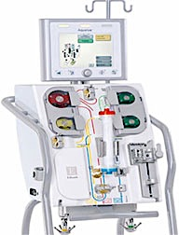
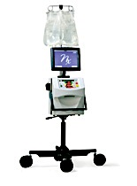
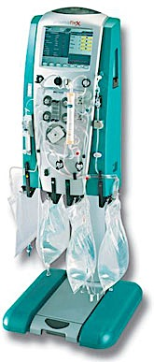
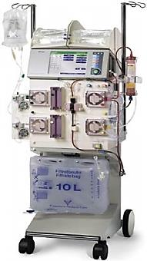

Slide 6
What was faced during these stages of development?

Slide 7
CAVH era: The Vascular Access
Critical for successful CRRT
Short and large cannulas
Sustainable blood flow
Avoiding unnecessary pressure losses
Umbilical vessels
Brachial artery or femoral artery cannulation

Slide 8
Pre-pump era: The Filter
Membranes and filters were specifically designed to obtain low-resistance extracorporeal circuits and ultrafiltration rates in the range of 1–3 ml/min
Purification was mainly achieved via convection with a substitution solution as a replacement of the ultrafiltrate

Slide 9
Adaptation era: The Vascular Access
Guarantee a blood flow capable of generating adequate access and return pressures
Single-lumen catheter using a ‘single needle’ for very low birth weight infants
2 single-lumen catheters in different central veins
Use of the umbilical vein in babies <5 kg)
Weight-related catheter size was suggested

Slide 10
Post-pump: The Filter
Treatment performance (CVVH, CVVHD, CVVHDF)
Individual optimization of the ‘dose therapy’
Filter survival and “Filter life”:
Catheter size (>6.5 F)
Filters surface area (>0.4 m 2 )
Hemodiafiltration
Anticoagulation (Heparin levels above 10 IU/kg/h, Citrate)

Slide 11
The Extracorporeal Circuit Volume
Large extracorporeal volume will impact the infant/child
Use blood or colloids to prime the extracorporeal circuit when its volume is greater than 10% of the child’s circulating blood volume
The rapid infusion of citrated, hyperkalemic banked donor blood
Acid-base and electrolyte imbalances and significant hemodynamic complications
AN-69 membrane:
Bradykinin release syndrome

Slide 12
Accuracy of the treatments
Dimension of the pumps and the accuracy of the UF
Upper limits were set for the fluid balance error related to the patient’s weight
Newborn and infants are very sensitive to fluid balance

Slide 13
Pediatric-Specific Machine for Newborns and Infants
In 2012: Cardio-Renal Pediatric Dialysis Emergency Machine (CARPEDIEM) was launched
Weight range of 2.0–10 kg
BSA of 0.15–0.5 m 2
Fluid balance:
Gravimetric controls combined with scale sensitivity of 1 g for both infusion and effluent bags

Slide 14
CA.R.PE.DI.E.M. (Cardio–Renal Pediatric Dialysis Emergency
Machine): evolution of continuous renal replacement therapies
in infants. A personal journey
Claudio Ronco & Francesco Garzotto & Zaccaria Ricci
Received: 12 January 2012 / Revised: 4 April 2012 / Accepted: 4 April 2012 / Published online: 26 May 2012

Slide 15
Combined Therapies

Slide 16
CRRT & ECMO

Slide 17
CRRT & MARS

Slide 18
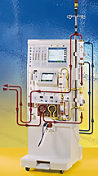
CRRT & Prometheus

Slide 19
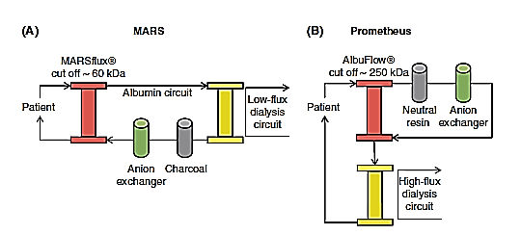
Fractionated Plasma Separation and Adsorption
Liver International 2011

Slide 20
Summary
Pediatric Continuous Renal Replacement Therapy has required adaptation of adult machines and prescription to fit the infants and children
The physiology of children in health and disease vary significantly from adults
The clinical conditions for which this therapy can be used as well as size of the infants and small children pose significant challenges for the treating team
Understanding the needs and challenges of CRRT in children is pivotal to a successful utilization of such therapy with appropriate safety measures
Future directions:
Wider implementing Pediatric-Specific CRRT machines for newborns and infants
Wider use of CRRT for cardiac/respiratory failure (ECMO) and liver failure (MARS, Prometheus)

Slide 21
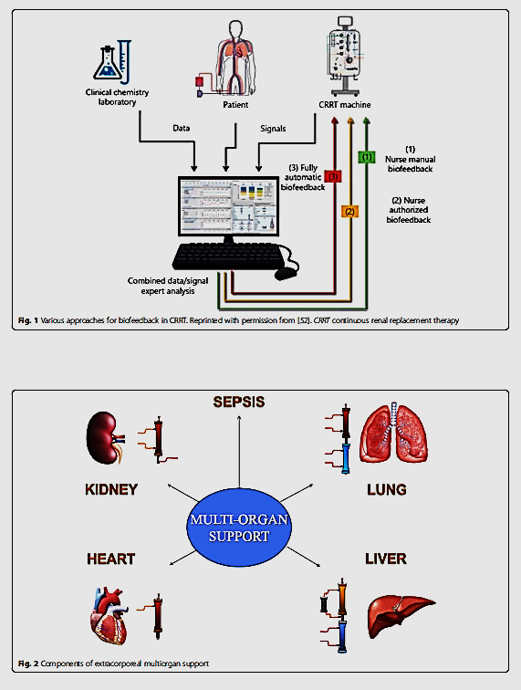

Slide 22
Thank You

