Slide 1
Maintenance Immunosuppressive Agents in Kidney Transplantation
Jean Francis MD
Associate Professor of Medicine
Boston University School of Medicine
Associate Physician at Brigham and Women Hospital

Slide 2
I have no conflict of interests related to this talk
I will be discussing off label use of some medications

Slide 3
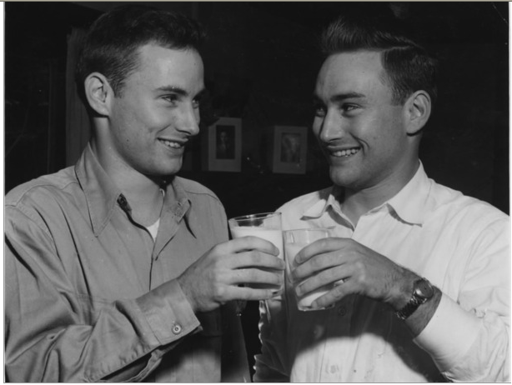
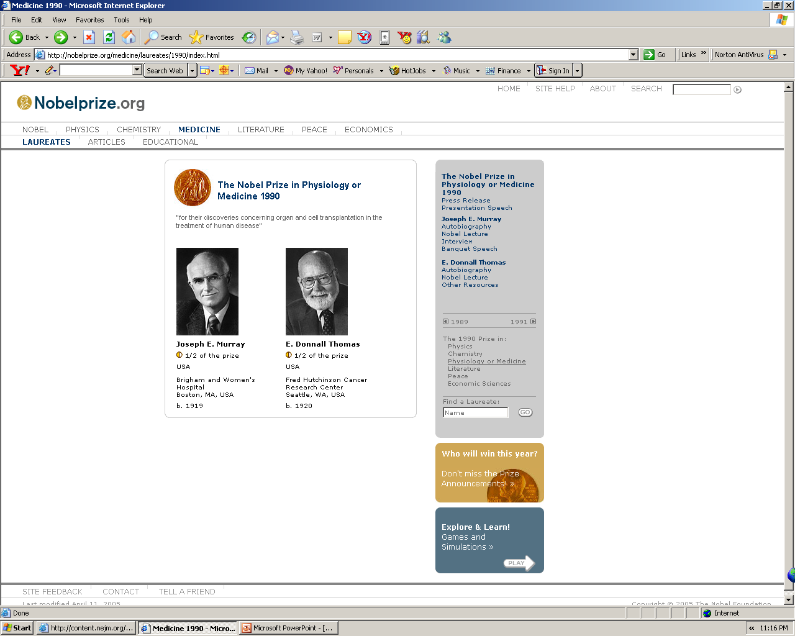
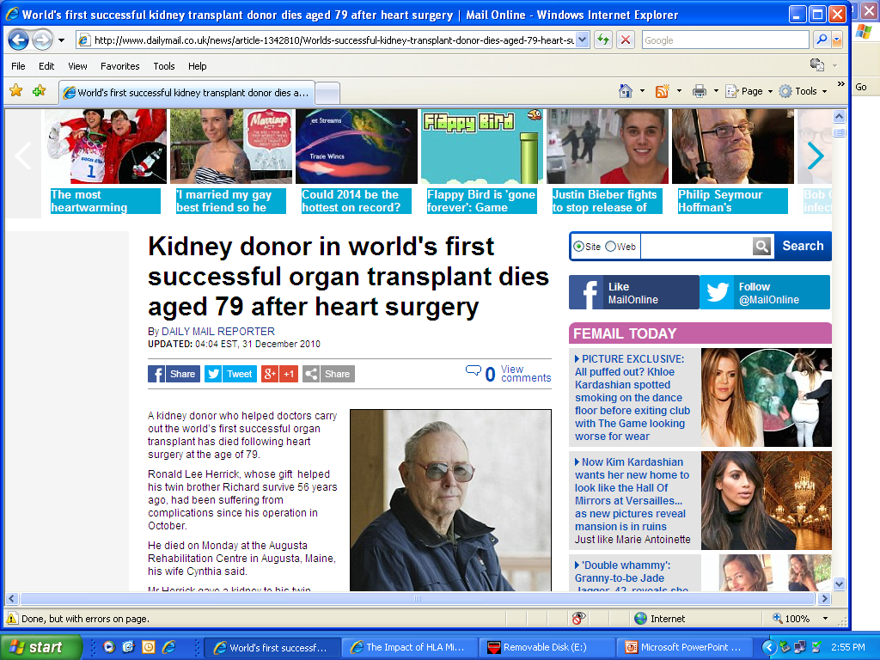
KT is Treatment of Choice for ESRD
1954- Joseph Murray and his group performed the first successful kidney transplantation identical twins (Boston)

Slide 4
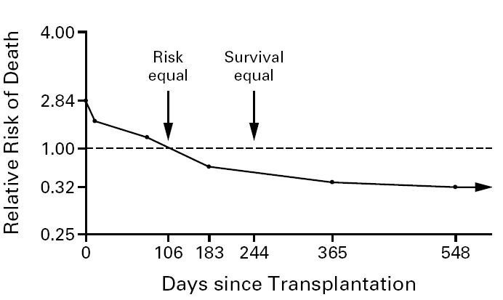
Dialysis vs. Transplant mortality: USA Data
46,164 pts
23,275 pts
(N Engl J Med 1999; 341:1725-30)

Slide 5
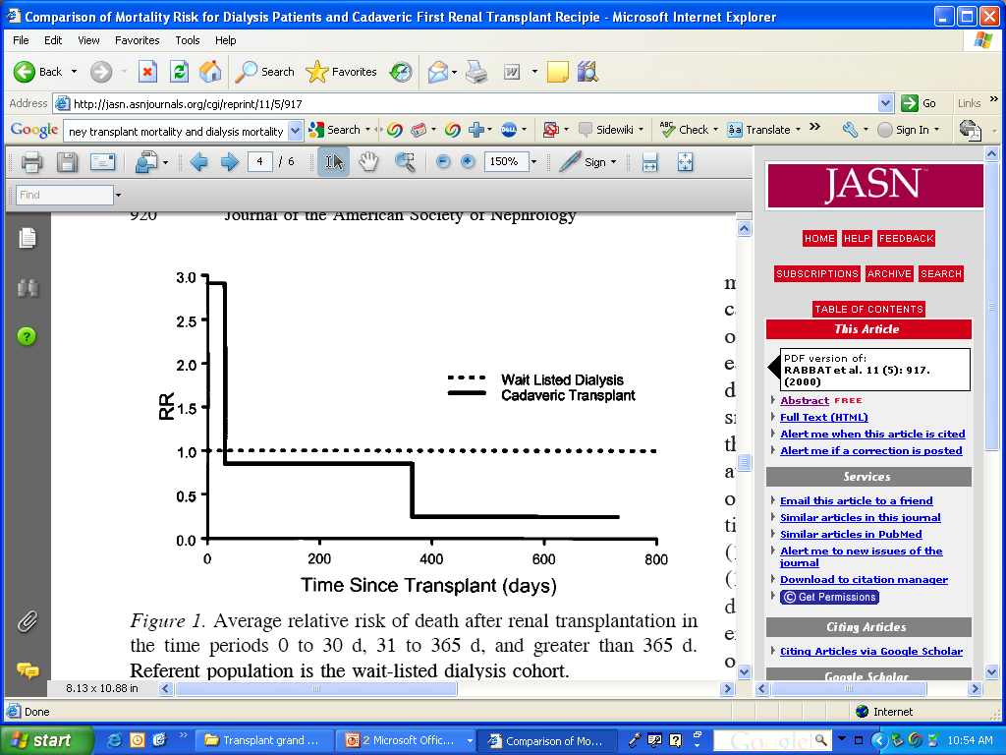
Dialysis vs. Transplant mortality: Ontario, Canada
1156 patients
722 patients
J Am Soc Nephrol 11: 917–922, 2000

Slide 6
Dialysis vs. Transplant mortality: USA Data
46,164 pts
23,275 pts
(N Engl J Med 1999; 341:1725-30)

Slide 7
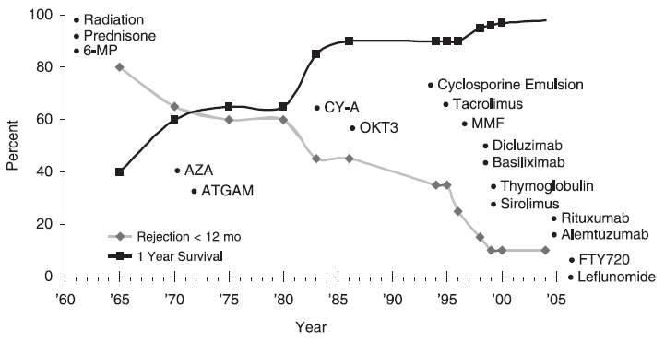
Timeline of Immunosuppressive Drugs

Slide 8
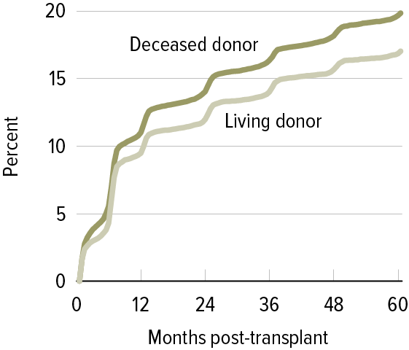
Incidence of First Acute Rejection Among Adult Patients Receiving a Kidney Transplant in 2005–2009
Early detection of rejection ➔ successful treatment in more >90%
SRTR 2011

Slide 9
Three Signals Model and Immunosuppressive Therapy
Anti-CD25
mAb
ATG
Sirolimus
Everolimus
Anti-CD154
mAb
CTLA-4-Ig
Anti-CD52
mAb
OKT3
MPA
AZA
Tacrolimus
Cyclosporine
N Engl J Med. 2004 Dec 23;351(26):2715-29
Notes:
9

Slide 10
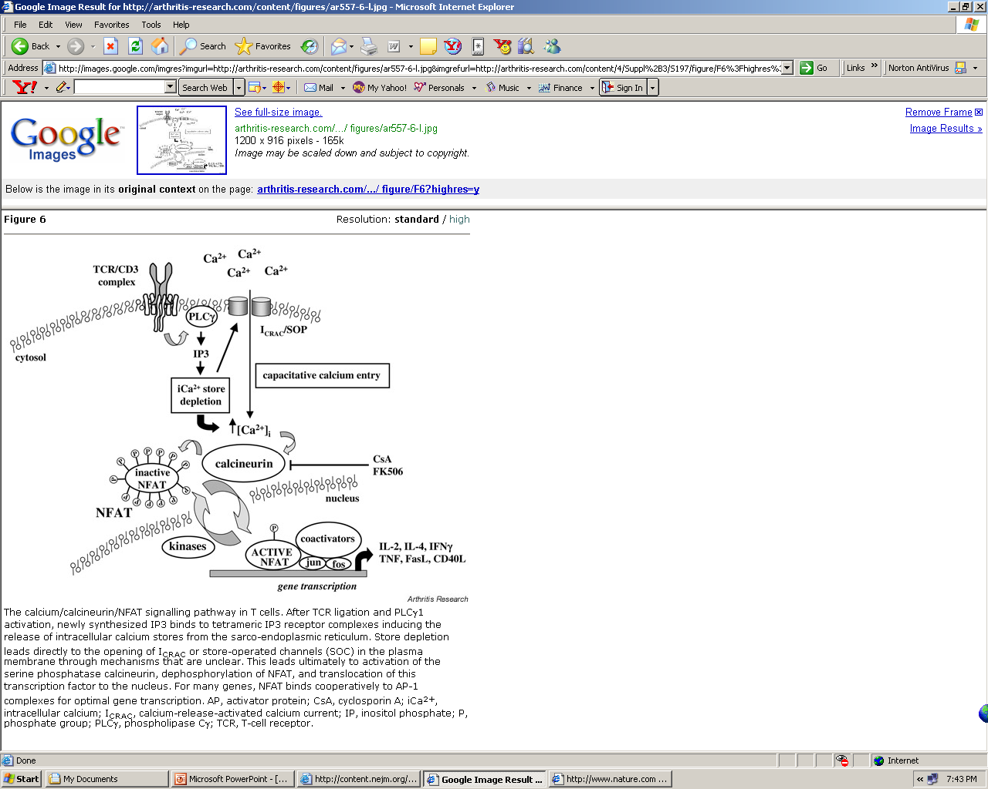
Calcineurin Pathway: Cyclosporine and Tacrolimus

Slide 11
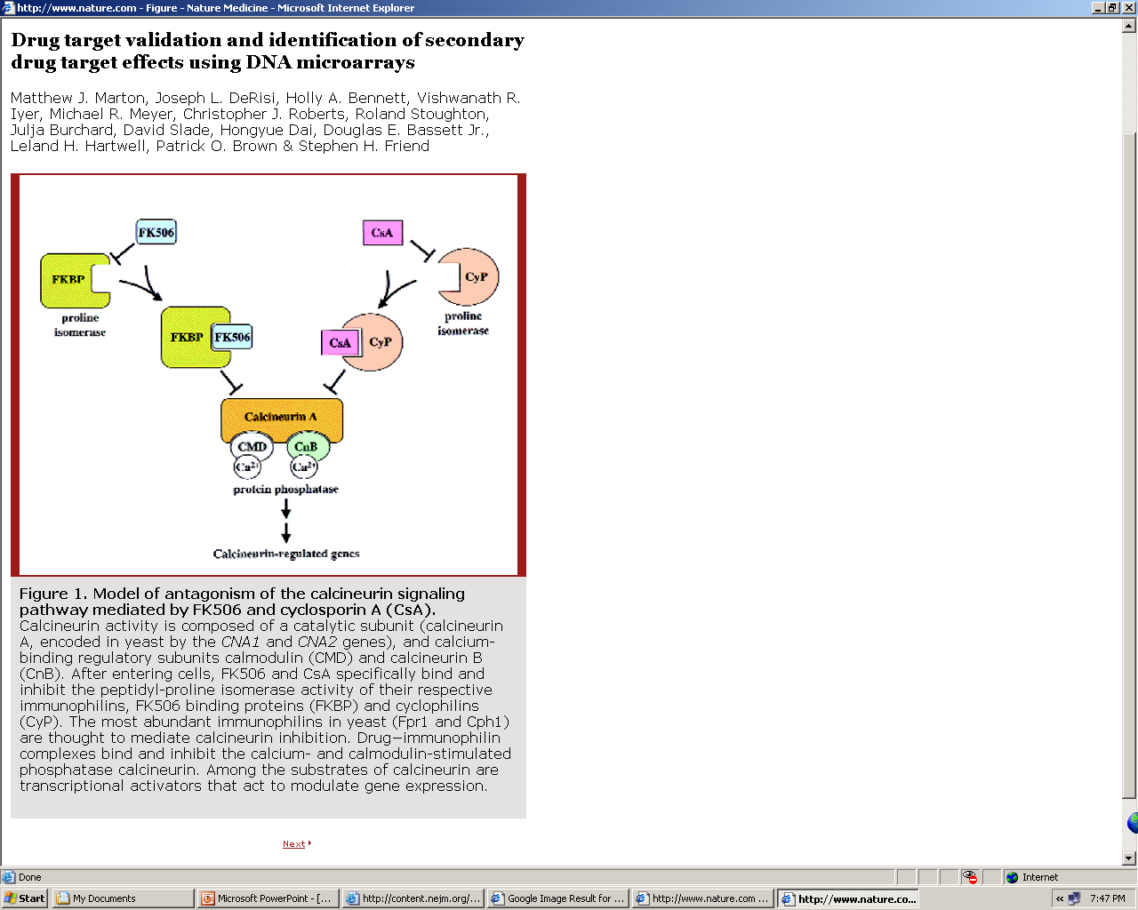
Calcineurin Inhibitors: Cyclosporine or tacrolimus
Nature Medicine 4, 1293 - 1301 (1998)

Slide 12
Major Side Effect
DM: Tac >>>> CSA
HTN: both
Hyperkalemia, hypomagnesemia and acidosis
Dyslipidemia: CSA >>>>Tac
Hair loss: Tac
Hirsutism: CSA
Gum hyperplasia: CSA
TMA: CSA > Tac
Nephrotoxicity: both

Slide 13
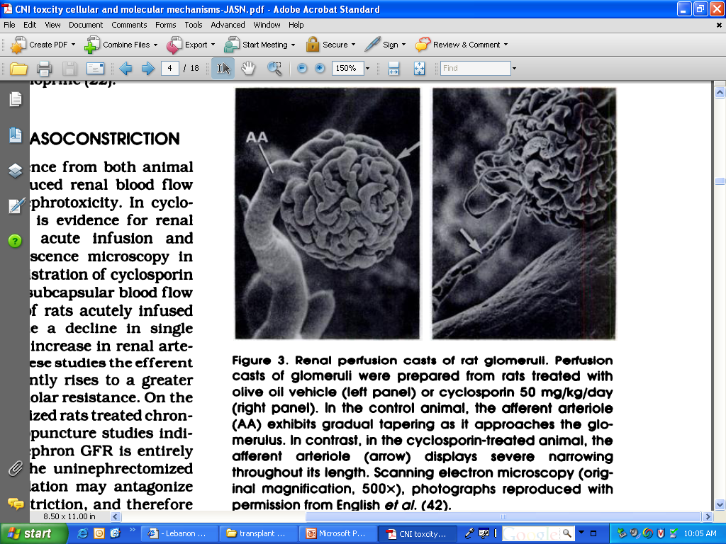
Journal of the American Society of Nephrology, Volume I ‘Number 2’ 1990

Slide 14
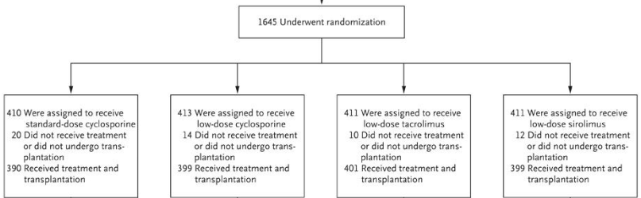
ELITE–Symphony Study
daclizumab, mycophenolate mofetil, and corticosteroids
N Engl J Med 2007; 357:2562-2575

Slide 15
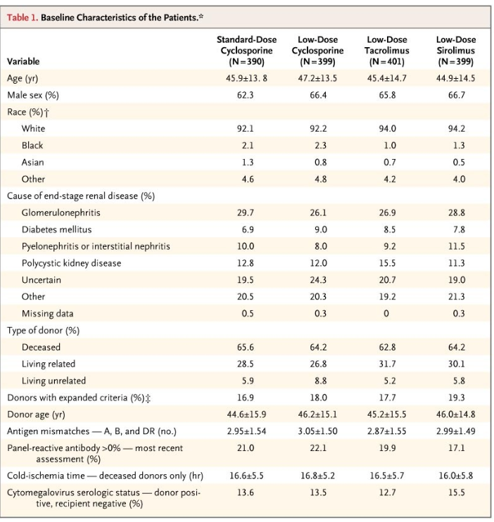
ELITE–Symphony Study
N Engl J Med 2007; 357:2562-2575

Slide 16
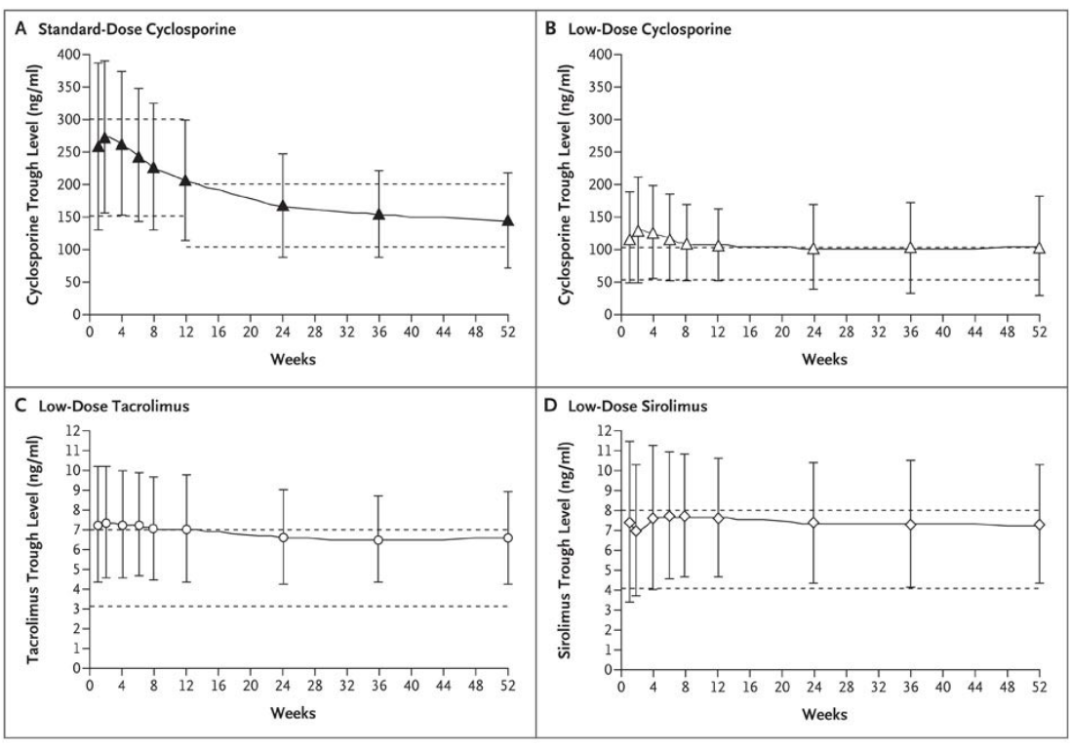
ELITE–Symphony Study
N Engl J Med 2007; 357:2562-2575

Slide 17
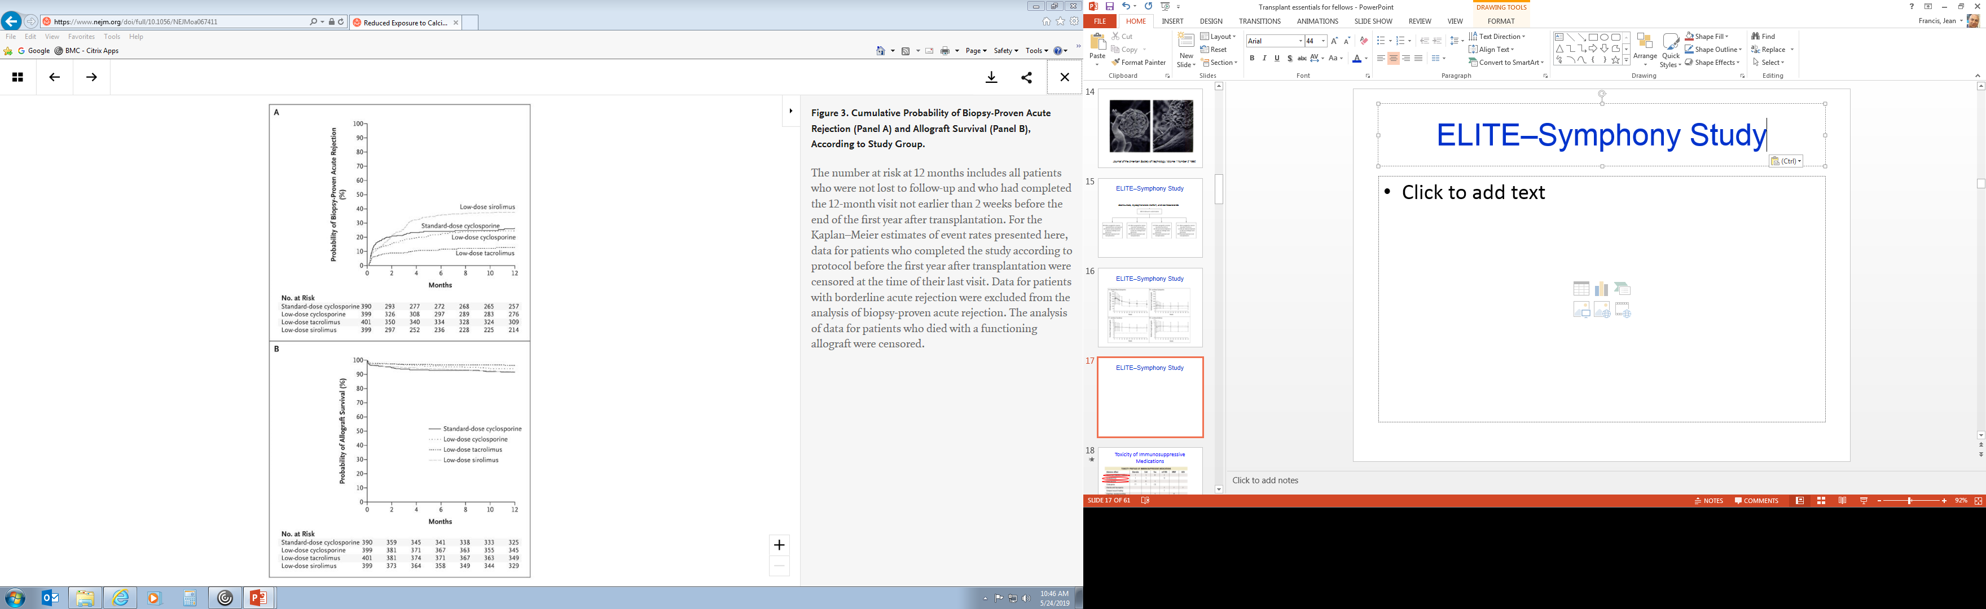
ELITE–Symphony Study
N Engl J Med 2007; 357:2562-2575

Slide 18
mTOR inhibitors
N Engl J Med 2004; 351:2715-2729, Dec 23, 2004

Slide 19
mTOR Inhibitors: Sirolimus, Everolimus
Probably less potent than CNI
No kidney scarring!!!! (proteinuria)
25-30% can’t tolerate the drug
Higher risk of anemia
Sirolimus once a day (Measure 24 hours trough)
Other side effects: Ulcers, DM, HTN, edema, delayed wound healing
Drug of choice if cancer

Slide 20
Antimetabolites: MPA and MMF
Mycophenolic acid (MPA) and Mycophenolate mofetil (MMF)
Used twice a day
Suppress both B and T cells
Inhibit IMPDH and decrease nucleotids synthesis
Major side effects: Myelosuppression, GI, Ulcers, PML

Slide 21
Antimetabolites: AZA
Azathioprine is less often used, potency< MPA or MMF
Used once a day mainly if intolerance or allergy to MPA or MMF
Inhibits cell cycle in both B and T cells
Monitor LFT and CBC
Do not use with allopurinol

Slide 22
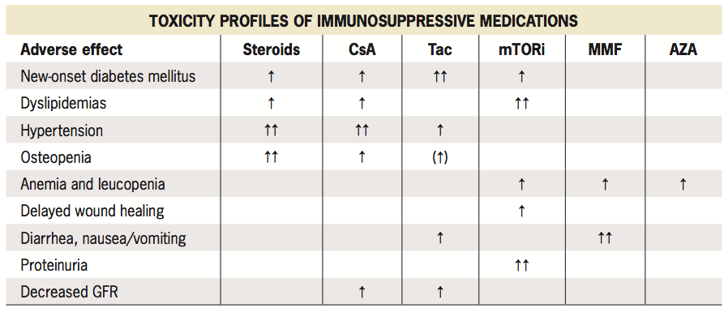
Toxicity of Immunosuppressive Medications
Pregnancy is an absolute CI on MPA
NKF 2014

Slide 23
Important!
Drugs that increase levels of tacrolimus, CSA and mTOR inhibitors →Toxicity
Cimetidine clarithromycin(H.Pylori) erythromycin, Azoles, diltiazem and verapamil
Drugs that decrease levels of tacrolimus, CSA and mTOR inhibitors → rejection
Rifabutin, rifampin and dilantin
Avoid using azathioprine with allopurinol!!!!
Please check or call when starting new drug!!
Notes:
23

Slide 24
Costimulatory Pathway Inhibition:
Belatacept
N Engl J Med 1998; 338:1813-1821, Jun 18, 1998

Slide 25
Thank you!!!!
Questions

