Slide 1
Posterior Urethral Valves: Diagnosis, Treatment and Follow-Up
L. Raffoul, MD
Paediatric Urology
Hôtel-Dieu de France, Beirut
Second IPNA Teaching Course, Beirut, 13-15 June 2019

Slide 2
What are PUV?
The most common congenital cause of bladder obstruction in boys.
The most common obstructive cause of end-stage renal disease in children.
Small leaflets of tissue in posterior urethra, with a narrow opening that impedes urine outflow.

Slide 3
Young’s Classification of PUV
95%
5%

Slide 4
Embryology
Gonzales, Posterior Urethral Valves and Other Urethral Abnormalities. Campbell’s Urology.

Slide 5
Prenatal Management

Slide 6
Prenatal Diagnosis: US
Hydronephrosis and ureteral dilation
Distended bladder
Distended posterior urethra
Variable amniotic fluid
Renal cysts
Pulmonary hypoplasia in severe cases
Differential diagnosis: Prune Belly and urethral atresia

Slide 7
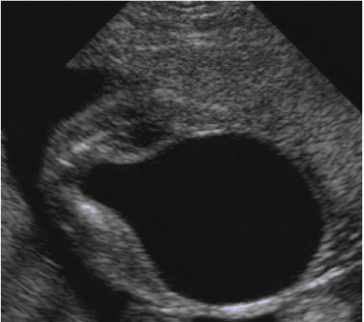
The “keyhole” sign
Dilated urethra
Dilated bladder

Slide 8
Is hydronephrosis always bilateral?
“Pop-off” valves:
1- Massive unilateral vesico-ureteral reflux into a non-functioning kidney
2- Bladder diverticulum
3- Urinary ascites

Slide 9
Renal function: Is it predictable?
Fetal urine analysis:
Sodium > 100 mmol/L
β2 microglobuline > 2mg/L
LONG-TERM renal function cannot be predicted!
Kidney’s aspect on US:
Dysplastic kidneys
Echogenicity of parenchyma
Gestational age at diagnosis:
Less than 24 WG
El Ghoneimi A et al. Long term outcome of prenatally detected posterior urethral valves: single center study of 65 cases managed by primary valve ablation. The Journal of Urology, 2008.

Slide 10
Prenatal Treatment
Vesicoamniotic shunting
Fetal endoscopic ablation of valves
Fetal surgery should be reserved to cases with severe oligoamnios and “normal” renal function…
30% might develop end-stage renal disease despite prenatal treatment!
Holmes N et al.Fetal surgery for posterior urethral valves:long-term postnatal outcomes. Pediatrics. 2001

Slide 11
Postnatal Management
If diagnosis is suspected prenatally
If diagnosis is not suspected prenatally
Confirm the diagnosis
Palpable mass (dysplasia, urinoma)
Urinary infection, sepsis
Respiratory distress

Slide 12
Postnatal Diagnosis: US
At birth!
Experimented radiologist!
Bilateral hydroureteronephrosis
Or unilateral dilation with dysplastic kidney
Renal parenchyma, cysts
Dilated bladder
Dilated posterior urethra (“keyhole” sign)

Slide 13
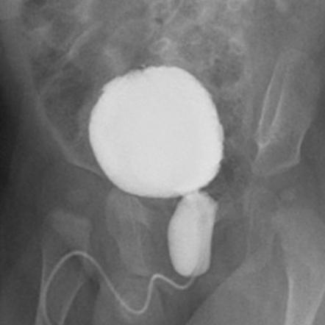
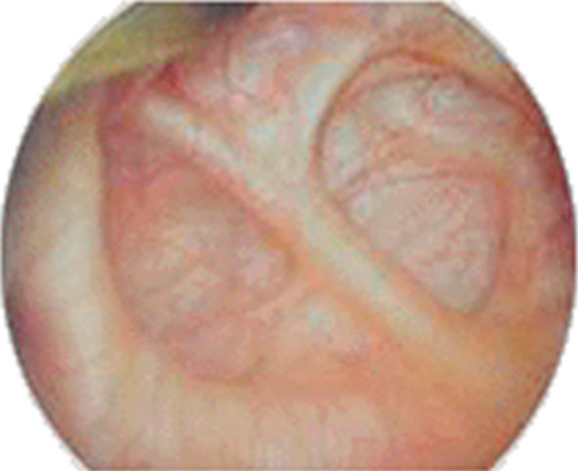
Postnatal Diagnosis: VCUG

Slide 14
What should we do next?
Call the paediatric nephrologist!
Urinary diversion (transurethral or supra-pubic).
Start prophylactic antibiotics.
Surgery.
PLURIDISCIPLINARY APPROACH IS A MUST!

Slide 15
Postnatal Treatment

Slide 16
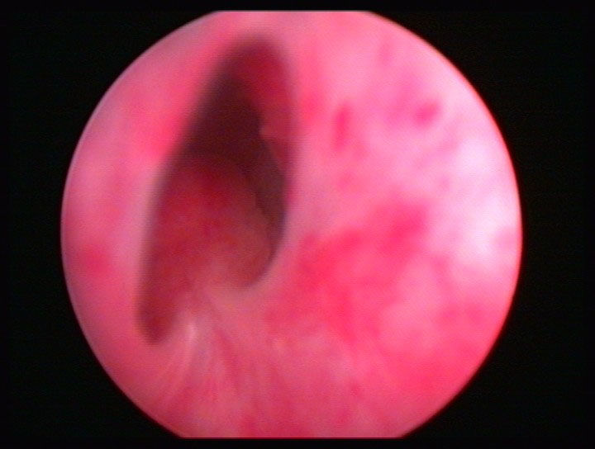
Surgical Treatment
Endocopic valve ablation
Temporary urinary diversion
Bugbee
Cold-knife
Laser
Small weight babies
Inadequate material
12h
7h
5h
Minimum time, Minimum trauma, Minimum irrigation

Slide 17
Follow-Up
Creatinine
VUR
Bladder valve
RENAL TRANSPLANTATION

Slide 18
Creatinine
7 days after relieve of obstruction, and at 1 year.
<80μmol/l = good prognosis
>80-105μmol/l = end-stage renal disease bound to happen!
Sarhan OM et al.Posterior urethral valves: multivariate analysis of factors affecting the final renal outcome. J Urol 2011

Slide 19
Vesico-Ureteral Reflux (VUR)
50% of PUV.
25% will resolve spontaneously.
Surgery if persistent or if recurrent UTIs.

Slide 20
The Bladder Valve
Non compliant, high pressure
Compliant, big capacity, acontractile
Urodynamics
Anticholinergic and CIC
Bladder augmentation
Empty the bladder: CIC, Mitrofanoff
INCONTINENCE

Slide 21
Conclusion
PUV is more a medical condition than a surgical one!
PUV is a chronic disease!
Multidisciplinary approach is a must!

Slide 22
“Do you believe in love at first sight, or should I stop by again?”

