Slide 1
What happens to a child with renal failure
Francesco Emma
Division of Nephrology and Dialysis
Bambino Gesù Children’s Hospital - IRCCS, Rome, Italy
Beirut, June 13-14-15, 2019

Slide 2
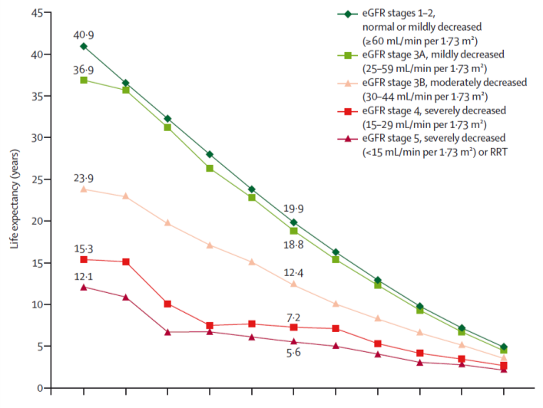
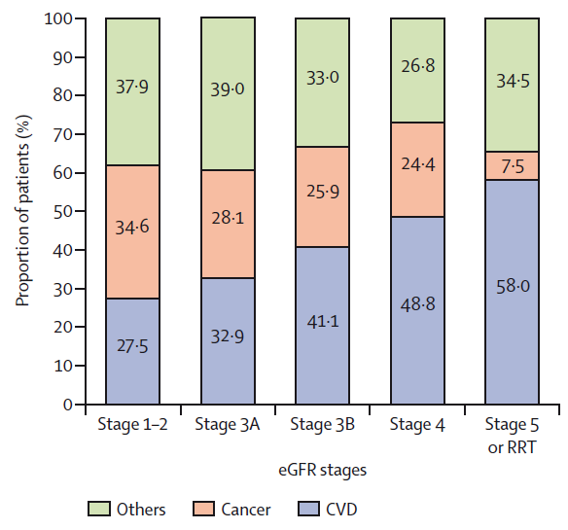
Life expectancy and causes of death in patients with CKD (Canada)
Gansevoort et al. Lancet 2013

Slide 3
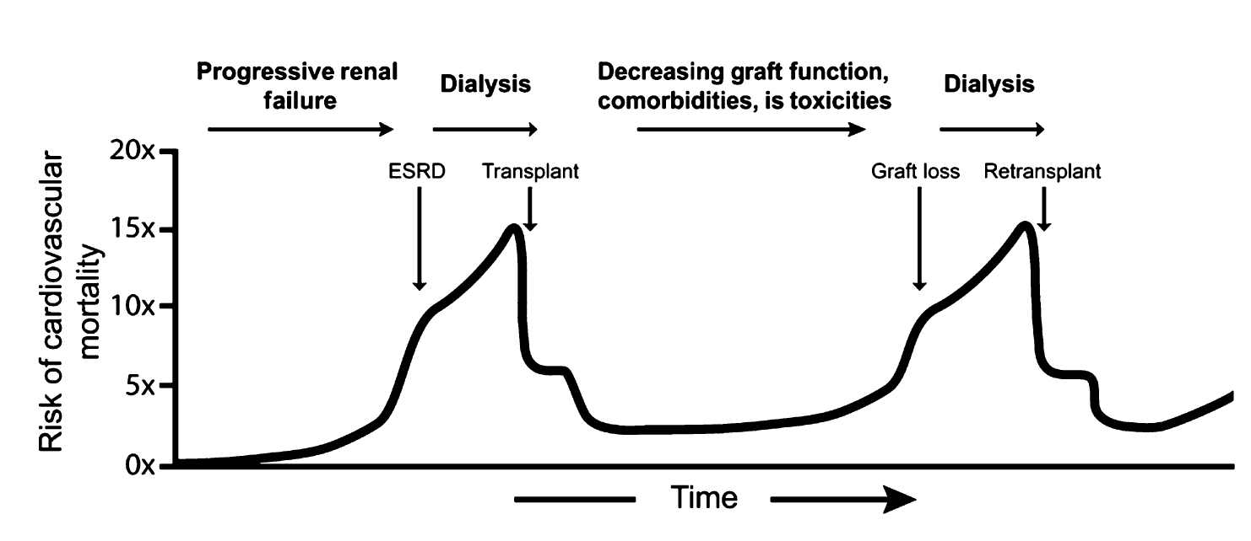
Natural history and cardiovascular risk of a child with ESKD
Dégi et al, Pediatr Transpl 2012

Slide 4
What is the life expectancy of a child with ESKD?

Slide 5
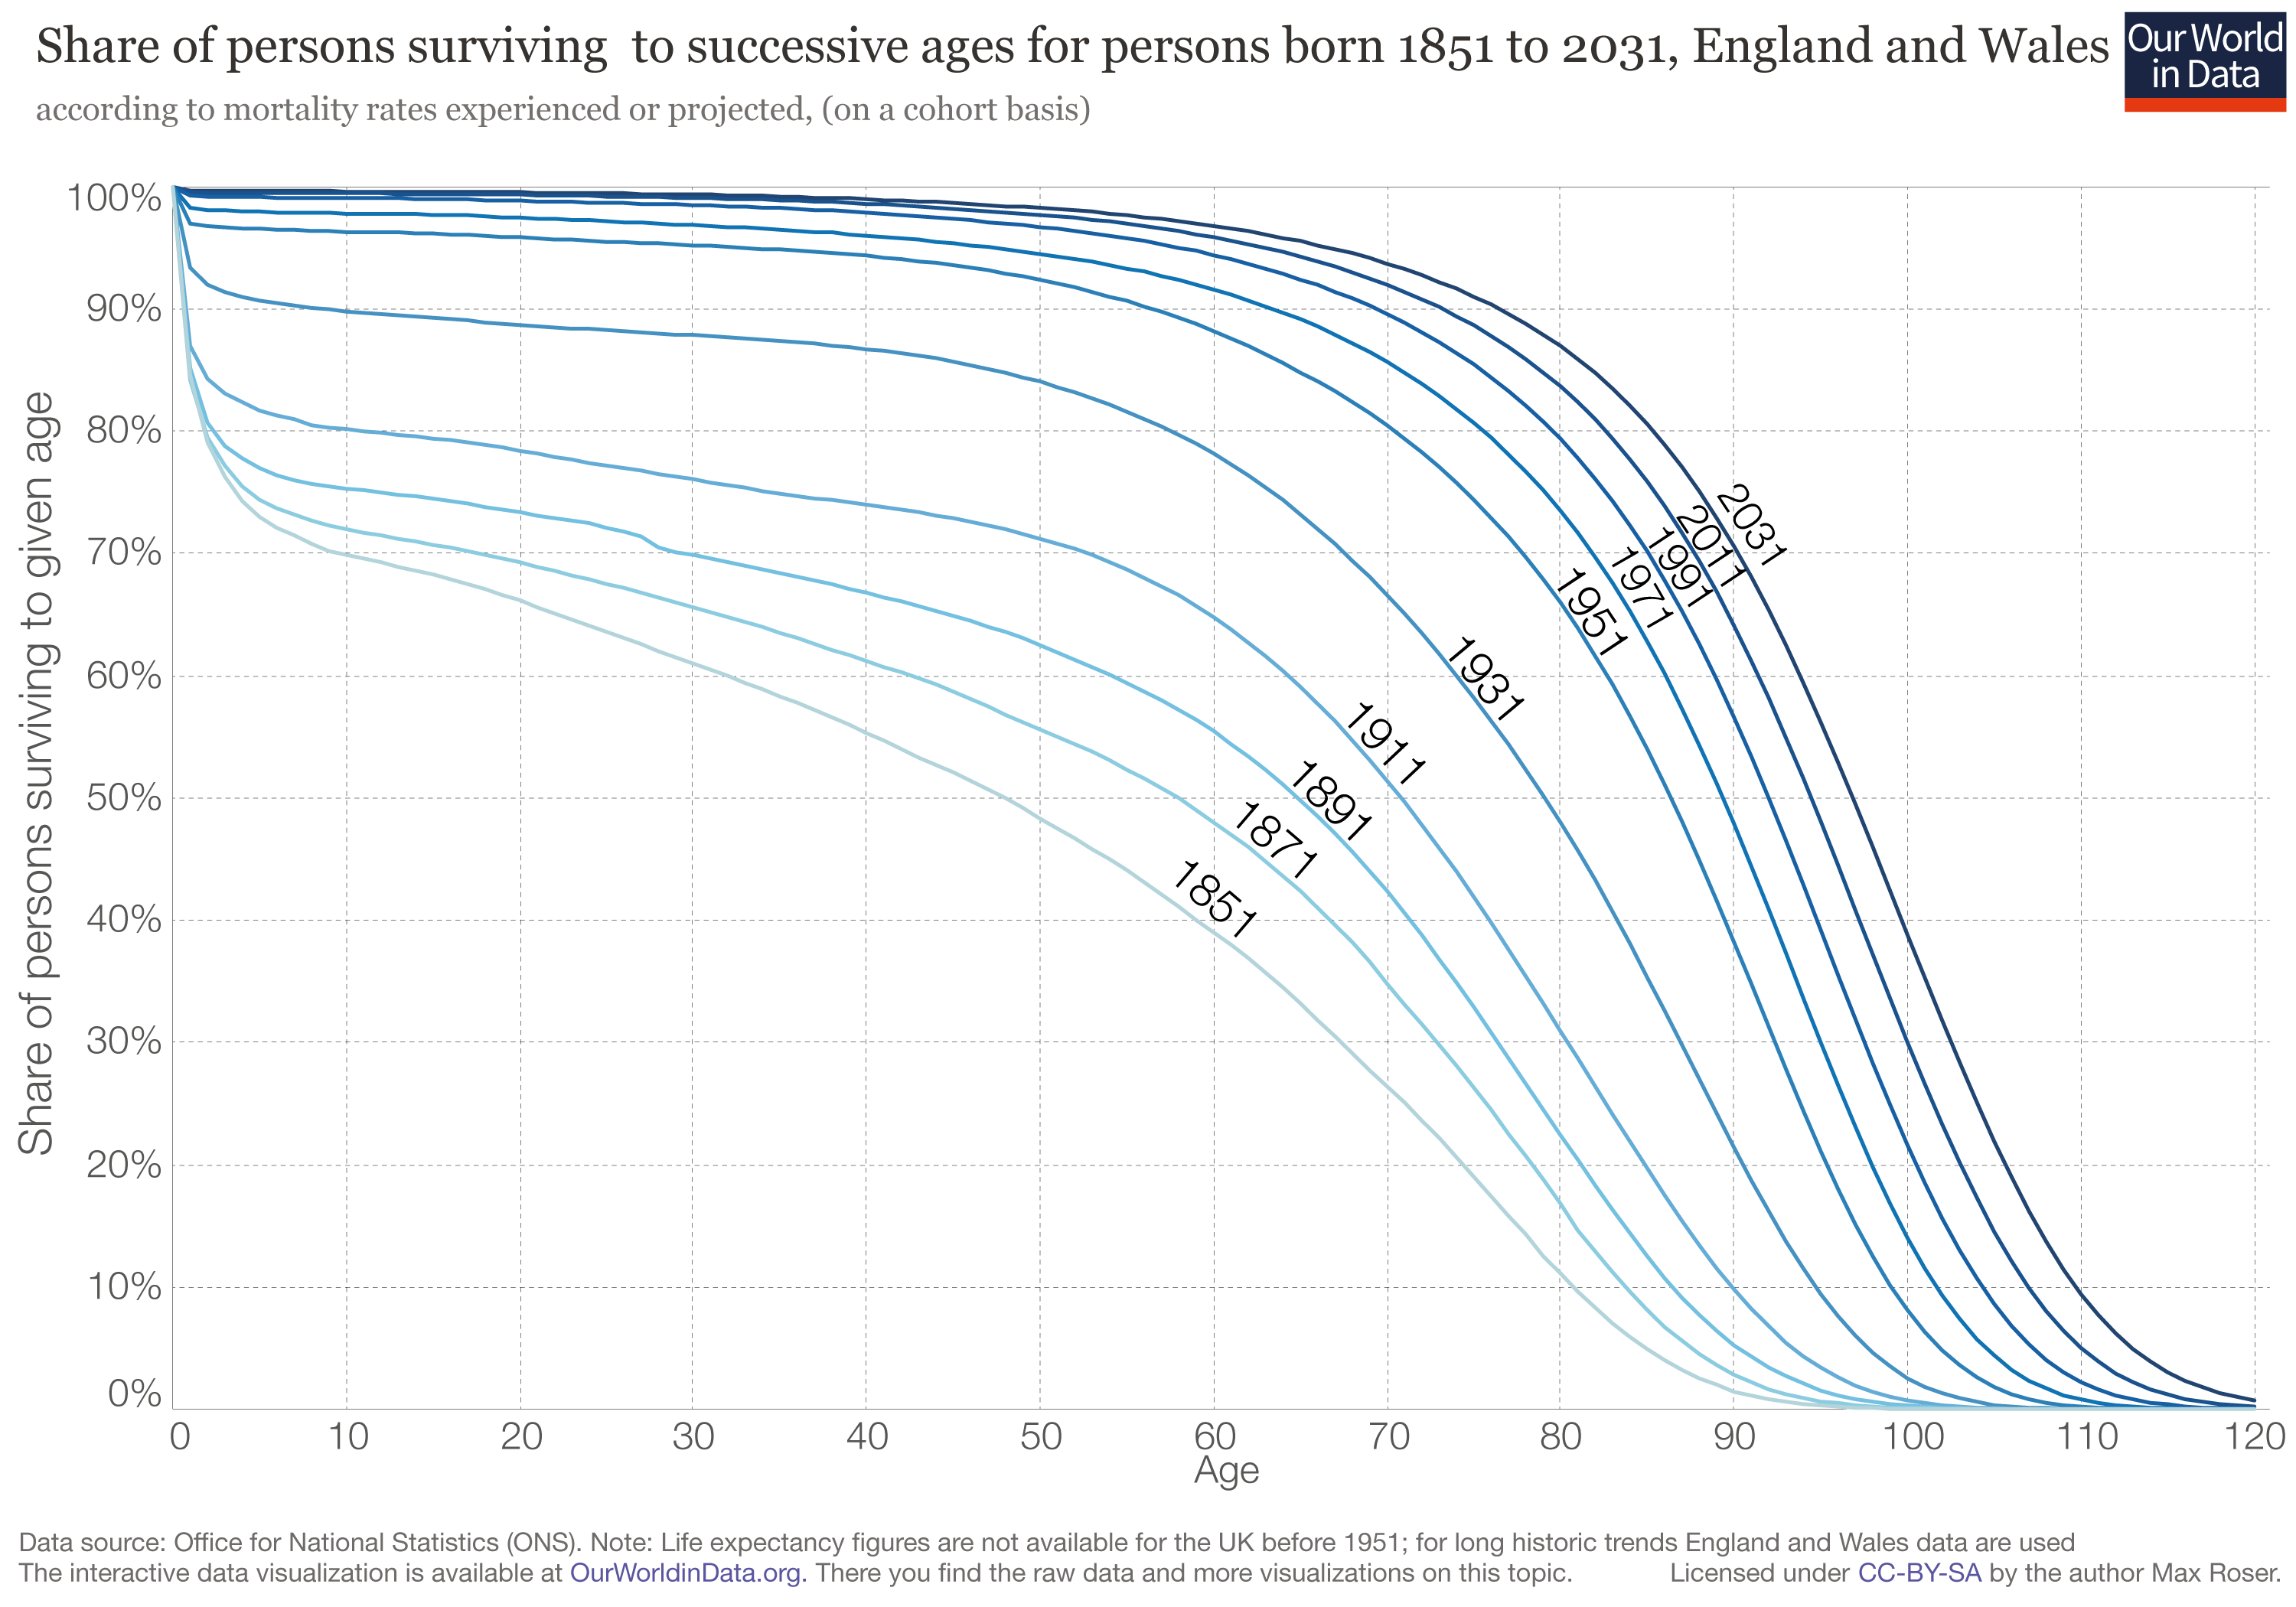
Late Effects of Renal Insufficiency in Children (LERIC)
1972-1992: all Dutch patients with onset of ESRD <15y 249
1999-2000: survivors aged 20-40 63 had died (25%)
2010: survivors aged 30-50 97 had died (39%)
Mortality rates > 30 x

Slide 6
ANZDATA: long-term follow-up of children with ESKD
Patient survival after 20 years:
Approximately 80% of
transplanted children
Less than 50% of
children on dialysis
McDonald et al. N Engl J Med 2004

Slide 7
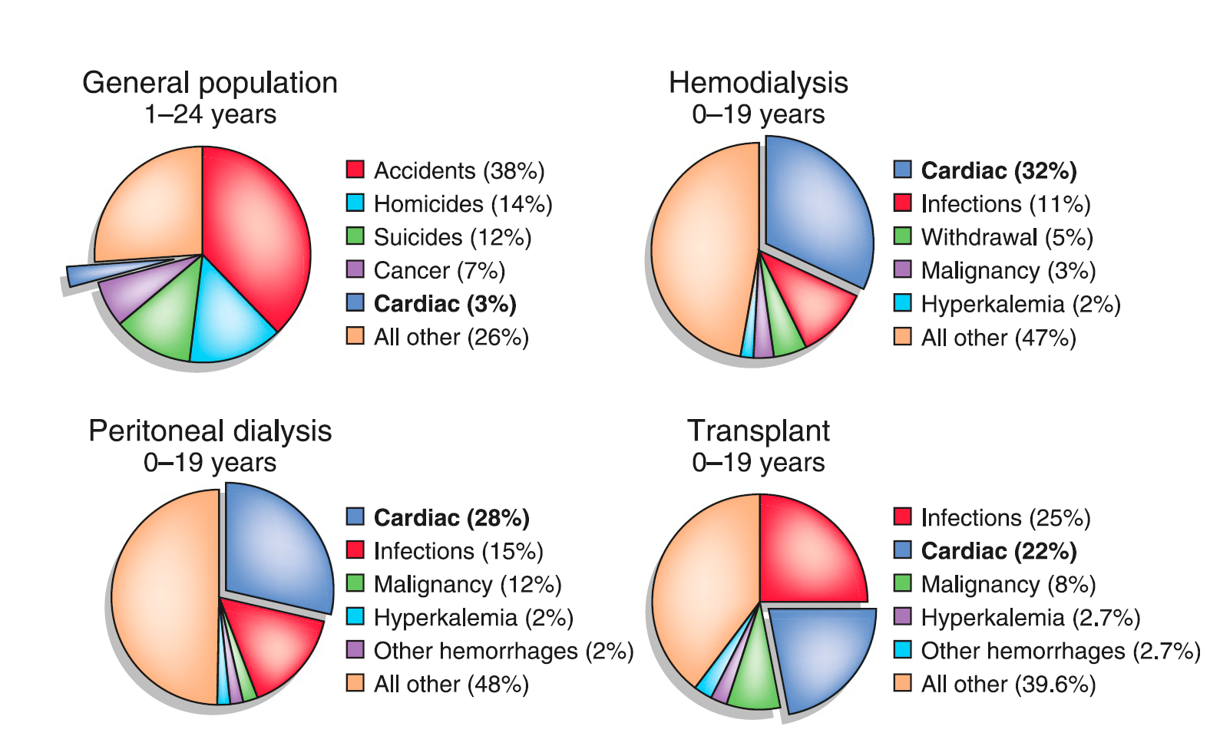
Causes of death in children and in children with ESKD
Mitsnefes, JASN 2012

Slide 8
How long will the transplant last?

Slide 9
Graft survival in children
Approximately 70%
1990-2009
Wühl et al, Clin JASN 2013
Dharnidharka et al. N Engl J Med 2014

Slide 10


Expected outcome of children transplanted in Rome
Expected patient survival at 30 years: 70-80%
Kidney survival:
After 10 years: ∼ 85%
Last check: 84%
After 20 years: ∼ 70%
Last check: 75%
After 30 years: ∼ 30%
Expected
Most patients will have or will need another transplant in mid-adulthood

Slide 11
Cardiovascular disease

Slide 12
CV death
Country | Cohort | Reference | % CV death | Risk factors, comments
Australia / New Zeeland | ANZDATA | McDonald et al 2004 | 45% | Prolonged dialysis
US | USRDS | Mitsnefes et al 2013 | 34% | RRT before age of 5 years Improving over time
The Netherlands | LERIC | Groothoff et al 2002 | 41% | Long standing dialysis Long standing hypertension
Germany | University of Heidelberg | Oh et al, 2002 | 50% | Vascular calcifications
US | University of Minnesota | Serrano et al 2018 | 50% | Pre-transplant CVD Graft failure

Slide 13
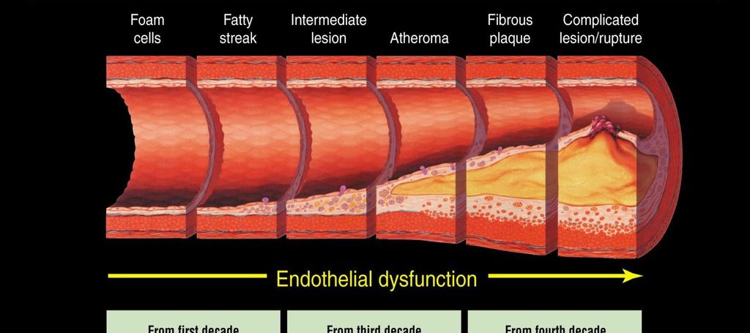
Atherosclerosis timeline
10
20
30
40
50
60
(years)
Children with ESKD
5
10
15
20
25
30
(years)
Adapted from Pepine et al. Am J Cardiol 1998
Notes:
Studies performed on a murine model of DDD, the complement factor H-deficient (Cfh-/-) mouse (Pickering Nat Gen 2002), which spontaneously develops DDD, have proved that C5 activation plays a crucial role in the induction of renal lesions, as Cfh-/- mice deficient in C5 present a significantly less severe renal disease, while in Cfh-/- mice treated with anti-murine C5 antibody the renal injury is entirely reversed (Pickering PNAS 2006).

Slide 14
Vascular calcifications
Hruska et al. Kidney Int suppl 2011
Atherosclerotic calcification is more important in cardiovascular mortality risk
Tunica media calcification is more important in vascular stiffness
Notes:
Studies performed on a murine model of DDD, the complement factor H-deficient (Cfh-/-) mouse (Pickering Nat Gen 2002), which spontaneously develops DDD, have proved that C5 activation plays a crucial role in the induction of renal lesions, as Cfh-/- mice deficient in C5 present a significantly less severe renal disease, while in Cfh-/- mice treated with anti-murine C5 antibody the renal injury is entirely reversed (Pickering PNAS 2006).

Slide 15
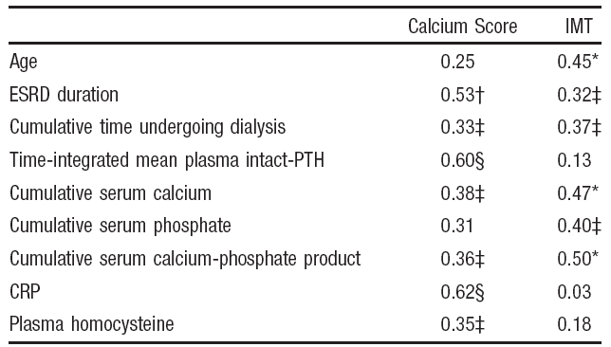
Vascular calcifications
Coronary and aortic calcifications in a 27 y/o man
with ESKD in childhood
Oh et al, Circulation 2002

Slide 16
LERIC cohort: cardio-vascular disease in 2000
(mean age 29 years; at time investigation: 80% transplant - 20% dialysis)
 |  | Male patients (N 75) |  | Female patients (N 65)
Mean systolic blood pressure | mm Hg | 135 | (range 81 to 179) | 120 | (range 65 to 186)
Mean diastolic blood pressure | mm Hg | 83 | (range 45 to 112) | 79 | (range 43 to 116)
Interventricular septal thickness | mm | 10.9 | (SD 2.4) | 9.7 | (SD 2.9)
Posterior wall thickness | mm | 10.8 | (SD 2.0) | 9.3 | (SD 1.8)b
Left ventricular end-diastolic diameter | mm | 50.7 | (SD 6.0) | 47.0 | (SD 5.2)
Left ventricular mass | g | 257 | (SD 91) | 186 | (SD 65)b
Left ventricular mass index | g/m2 | 150 | (SD 45) | 119 | (SD 43)b
Left ventricular hypertrophy | number | 35 | 47% | 25 | 39%
Left ventricular mass/left ventricular volume ratio | g/mL | 2.1 | (range 1.0 to 3.4) | 1.8 | (range 1.0 to 4.6)
E/A ratio |  | 1.5 | (range 0.5 to 3.6) | 1.6 | (range 0.9 to 3.2)
E/A ratio _1.0 | number | 9 | -12% | 9 | -14%
Aortic valve regurgitation | number | 17 | -23% | 15 | -23%
Mitral valve regurgitation | number | 22 | -29% | 19 | -29%
Shortening fraction | % | 39 | (range 27 to 61) | 39 | (range 28 to 85)
Aortic valve calcifications | number | 19 | 25% | 8 | 12%
Wall irregularities | number | 24 | 32% | 14 | 22%
Gruppen et al, Kidney Int 2003

Slide 17
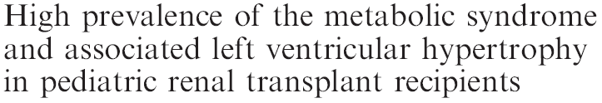

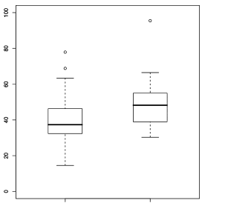
Obesity and metabolic syndrome in renal transplanted children
Pediatrics 2005
Ped Transpl 2010
6658 children - 649 obese (10%)
LVMI (gr/m2.7)
No
Yes
Metabolic syndrome

Slide 18
LERIC cohort: comparison 2000-2010
*
*
*
*
*
*
*
Vogelzang et al, Nephrol Dial Transpl 2013

Slide 19
How are they doing for the rest?

Slide 20
Adult height in patients with advanced CKD requiring RRT during childhood
50%
63%
N = 1612
Harambat J, et al. Clin J Am Soc Nephrol 2014; 9: 92-99

Slide 21
Steroid avoidance, rhGH and less rejections!
Corticosteroid-free kidney transplantation
improves growth (TWIST study)
Living-donor graft rejection according
to transplantation era
 | CW (n = 53) | CC (n = 53) | p
ΔHtSDS adjusted for pubertal status and baseline value (SE) | 0.57 (0.13) | 0.33 (0.14) | 0.006
Webb et al, Transplantation 2015
rhGH in children with CKD, undergoing dialysis
and after renal transplantation
Dharnidharka et al. N Engl J Med 2014
Holmberg and Jalanko,
Nat Rev Nephrol 2016

Slide 22
LERIC cohort: bone disease in 2000
Bone deformities | 26%
Pathological fractures | 13%
Aseptic bone necrosis | 13%
Disability - mild - severe - invalidating | 11% 7% 18%
Nowadays, we are probably doing better!
Gruppen et al, Kidney Int 2003

Slide 23
LERIC cohort: malignancies in 2010
Median age: 33.5 years
Median Transplant exposure: 18.4 years
Malignancies in 21% of patients
- 80% cutaneous
- PTLD most prevalent non-skin
Death secondary to cancer: 12%
HR for squamous cell carcinoma > 800 x after age 40
Ploos van Amstel; Clin JASN 2015

Slide 24
Fertility
NDT 2012
Transplantation 2014
Andrologia 2009
Med Clin N Am 2016
∼20% of adults have normal testicular function
Fertility index:
Control population: 13.0
Dialysis: 0.2
Transplant < 2 years: 5.5
Trasplant > 2 years: 9.3
Fertility is restored soon after transplantation
Pregnancy rates < general population (patient choice?)
Preserved graft function if normal baseline GFR
Increased risk of:
pre-eclampsia
low birth weight
prematurity

Slide 25

HRQoL
More difficulties:
completing education
achieving high level education
securing an employment
developing intimate relationships
Pediatr Nephrol (2016)

Slide 26
QoL
Courtesy J Groothoff

Slide 27
OPBG: QOL in 67 adult pediatric renal transplants (age 23±4)
QOL score | N° of items | Mean (max 100) | SD
Physical well-being | 7 | 72.3 | 25.6
Psychological well-being | 9 | 67.8 | 12.9
Diet & nutrition | 2 | 85.6 | 26.0
Self perception (physical) | 4 | 76.2 | 25.4
Social integration | 6 | 48.8 | 14.3
Overall score |  | 70.4 | 13.6
Significantly worse QOL if co-morbidities
Dellostrologo et al 2008

Slide 28

Thank you
francesco.emma@opbg.net

