Slide 1
Guidelines on Vesicoureteral Reflux
Reva Matta
Pediatric Surgery and Urology
Clinical Assistant Professor of Surgery at
Saint Georges Hospital University Medical Center - Achrafieh

Slide 2
No disclosure

Slide 3
Too much DATA
Vesicoureteral reflux: 10,025 hits on Medline
Evidence based medicine vs. Experience based medicine

Slide 4
Too much DATA
Vesicoureteral reflux: 10,025 hits on Medline
Evidence based medicine vs. Experience based medicine
Controversy persists regarding the diagnosis and optimal management of VUR.
Management should be individualized and focused on the goals of preventing recurrent UTI and renal injury.

Slide 5
The reasons of a misunderstanding
VUR clinical spectrum is highly variable and heterogeneous; hence, the optimal management is still controversial

Slide 6
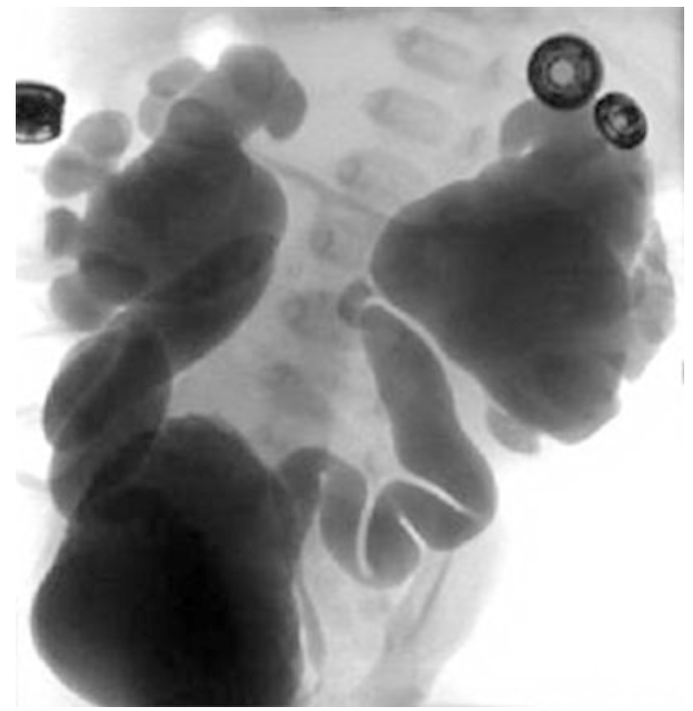
Vesicoureteral reflux
VUR: retrograde flow of urine from the bladder to the upper urinary tract
Most common congenital abnormality of the urinary tract in children with UTI
VUR is found in 30–40% of children with a UTI, with incidence decreasing as the child becomes older

Slide 7
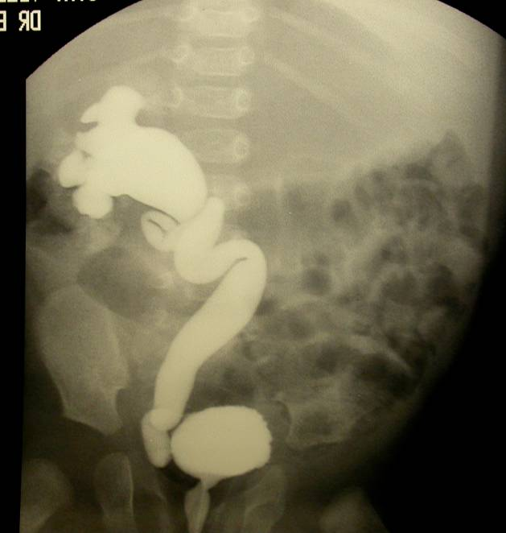
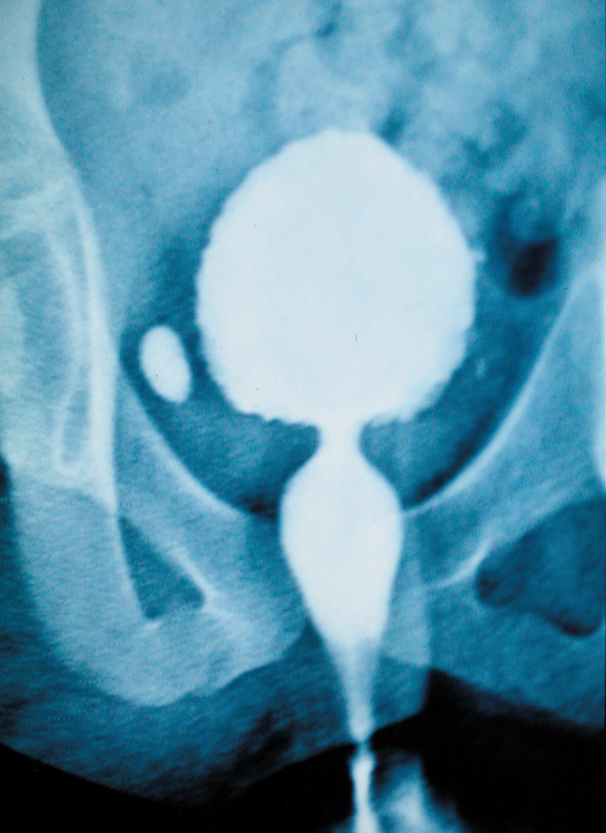
Vesicoureteral reflux - 2 different entities
Can be primary or secondary:
Primary vesicoureteral reflux results from a defect in the “flap valve” effect that normally prevents urine from flowing backward from the bladder into the ureters.
Secondary vesicoureteral reflux results from defective micturation secondary to obstruction in the urethra such as posterior urethral valve or stricture or neurogenic bladder.

Slide 8
VUR is the visible part of the iceberg
Reflux
Bladder immaturity
Bladder dysfunction
Constipation
Congenital
Urine flow
Impairment
Foreskin
Mouriquand (2014)

Slide 9
Vesicoureteral reflux
Two distinct presentations:
–Hydronephrosis, often prenatally identified using ultrasonography
–Clinical urinary tract infection
The incidence of reflux clearly is influenced by genetic factors, although the specific modes of inheritance is not defined.
–Siblings of children with VUR have a 25–33% risk of also having VUR
–Offspring of parents with VUR have a 66 % risk of also having VUR

Slide 10
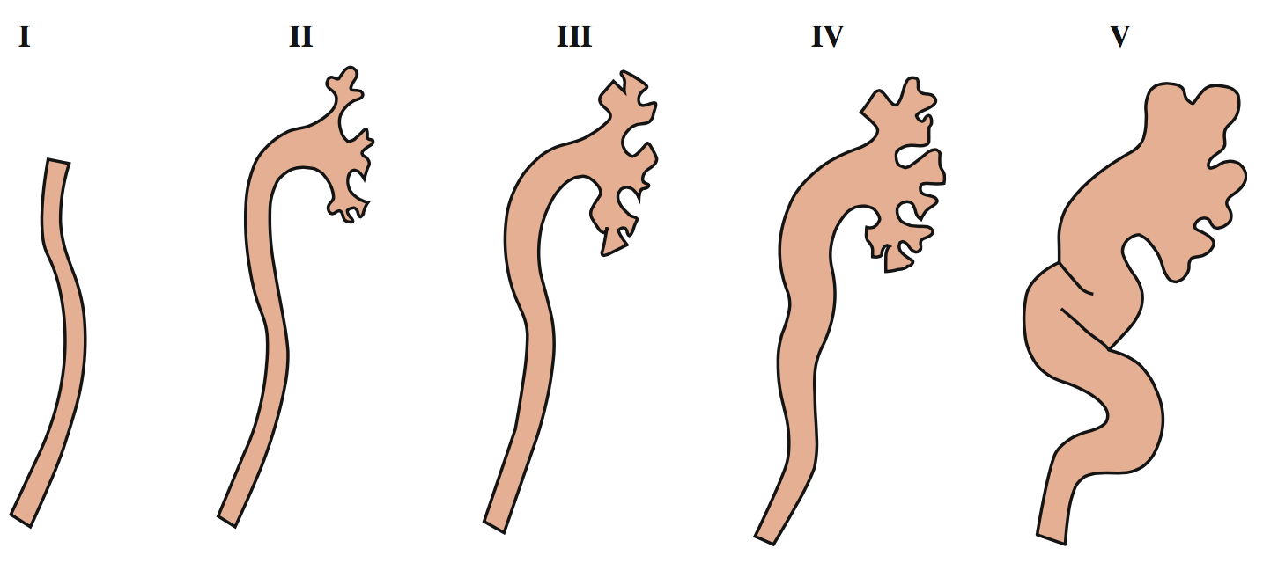
Vesicoureteral reflux
International Reflux Grading Scheme; the severity of VUR is classified as grade I–V

Slide 16
Evolution of VUR management
The definition of what constitutes clinically meaningful VUR
Potential harm of diagnosis and intervening in patients who may not have true clinical impact
This is weighed against the potential risk of missing the opportunity to diagnose VUR and prevent infections and renal scarring.
How much over-treatment will we accept to limit what level of
under-treatment?
The most complex controversy surrounding VUR, however, is who is at risk of renal scarring?
Koyle MA et al Febrile UTI, VUR, and renal scarring: current controversies in approach to evaluation. Pediatr Surg Int 2011 Apr;27(4):337-46.
Notes:
Our perspective has changed as we see fewer children with the severe complications of reflux, arguably owing to more aggressive management

Slide 17
Controversies and consensus
While controversy continues, there is consensus on:
Importance of bladder dysfunction on VUR outcomes
Likelihood of VUR resolution
NOT all children with VUR require active treatment
Early efforts to define risk stratification to provide more patient-specific treatment of UTI and VUR in children.
Edwards A and Peters CA. Managing vesicoureteral reflux in children: making sense of all the data F1000Research 2019,8:29

Slide 18
Diagnostic algorithms
Defining UTI?
Accurate diagnosis of UTI is a critical turning point in the overall algorithm
AAP revised (2011) the guidelines for the diagnosis and management of initial UTI [2 to 24 mo]
Pyuria + >50,000 co/ml of a single uropathogenic species (catheterization or suprapubic aspirate)
A bagged urine specimen is unacceptable due to potential contamination
In case of febrile UTI, then renal and bladder ultrasound (recommendation)
Notes:
Attention to detail on how a urine specimen was obtained and whether pyuria is present is key in the diagnosis of a UTI.

Slide 19
Diagnostic algorithms
Renal and Bladder ultrasound:
Reasonable initial and follow-up imaging modality
The National Institute for Health and Care Excellence in the United Kingdom (NICE) (2007) and the 2011 AAP guidelines recommend that (patients <24mo) ultrasonography alone should be the initial screening test for children after UTI.
If there are no anatomical abnormalities, no further imaging is conducted at that time (thus decrease in the number of VCUG)
In contrast, the American (2012) and European (2015) Urological Associations have continued to recommend performing a VCUG after first febrile UTI in children <2 years of age.
Roberts KB: Urinary tract infection: clinical practice guideline for the diagnosis and management of the initial UTI in febrile infants and children 2 to 24 months. Pediatrics. 2011; 128(3): 595–610.
Garcia-Roig M et al.: National Trends in the Management of Primary VUR in Children. J Urol. 2018; 199(1): 287–93.
Notes:
ased on Bnew evidence demonstrating antimicrobial prophylaxis not to be effective as presumed previously for VUR,^ the National Institute for Health and Care Excellence in the United Kingdom (NICE) (2007) [1] and the American Academy of Pediatrics(AAP) (2011) [2] have recommended that VCUG should not be performed routinely after first, febrile, UTI in patients less than 24 months old unless renal ultrasound (RUS) reveals abnormalities (Bhydronephrosis, scarring, or other findings that would suggest either high-grade VUR or obstructive uropathy^), or other atypical or complex clinical circumstances such as atypical/recurrent febrile UTI. The AAP has reaffirmed the same guidelines in 2015. In contrast, the American (2012) and European (2015) Urological Associations have continued to recommend performing a VCUG after first febrile UTI in children less than 2 years of age [3, 4].

Slide 20
Imaging evaluation
Decision to perform VCUG should be appropriately weighed with patient history (BBD, recurrent infections, changes seen on renal ultrasound and parental desires)
VCUG remains the gold standard: defining the presence, grade, and possible impact of VUR
The principal techniques used in the evaluation of the renal impact of VUR include dimercaptosuccinic acid (DMSA) scanning (3-6 months later)
Frimberger D, et al.: Establishing a standard protocol for the voiding cystourethrography. J Pediatr Urol. 2016; 12(6): 362–6.
Veenboer PW et al.: Diagnostic accuracy of Tc-99m DMSA scintigraphy and renal ultrasonography for detecting renal scarring and relative function in patients with spinal dysraphism. Neurourol Urodyn. 2015; 34(6): 513–8.
Notes:
VCUG, which is viewed as an invasive exam because of the need for catheterization,

Slide 21
Imaging evaluation
The imaging the upper tract prior to VCUG was popularized “top-down approach”
Clinically significant VUR will have associated changes on acute DMSA renal scans and are therefore worthwhile to detect
IF normal DMSA scans any VUR is clinically insignificant
With this approach, a patient receives a DMSA scan shortly after a UTI episode and if abnormalities are present this is followed up with VCUG.
Preda I et al.: Normal dimercaptosuccinic acid scintigraphy makes voiding cystourethrography unnecessary after urinary tract infection. J Pediatr. 2007; 151(6): 581–4, 584.e1.

Slide 22
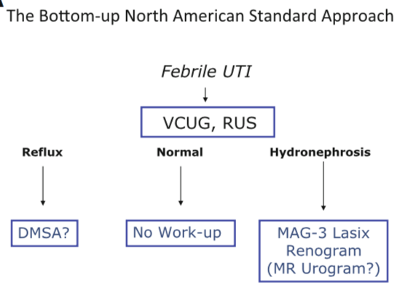
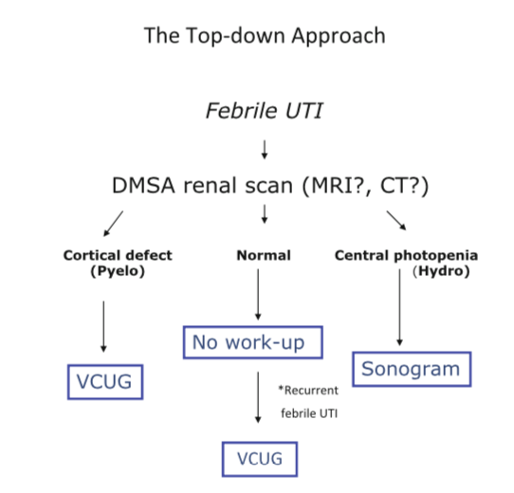
Approach to Evaluation
Koyle MA et al Febrile UTI, VUR, and renal scarring: current controversies in approach to evaluation. Pediatr Surg Int 2011 Apr;27(4):337-46.

Slide 23
Top-down Approach Countered
Shaikh et al 2016, concluded that DMSA lacks the accuracy to detect VUR of any grade BUT children with a negative DMSA scan have <1% probability of having high-grade VUR.
Shaikh et al. showed that top-down and biomarker-based screening for VUR had poor sensitivity, as they DID NOT detect 33% and 29% of high-grade VUR, respectively.
Shaikh N: DMSA or ultrasound in screening for vesicoureteral reflux among children with urinary tract infections. Cochrane Syst Rev. 2016; 7

Slide 24
VUR treatments
Antibiotic prophylaxis
Bladder training
Open surgery
Laparoscopy
Endoscopy

Slide 25
VUR treatments
THE QUESTION IS NOT HOW TO TREAT VUR
BUT WHY ?
Antibiotic prophylaxis
Bladder training
Open surgery
Laparoscopy
Endoscopy

Slide 26
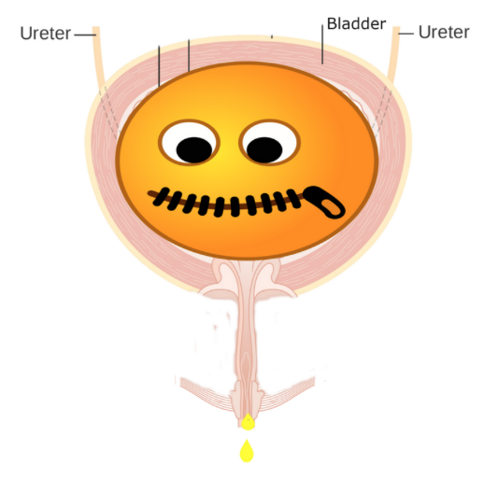
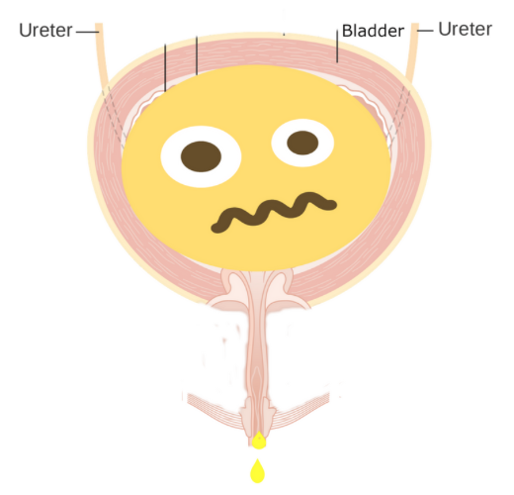
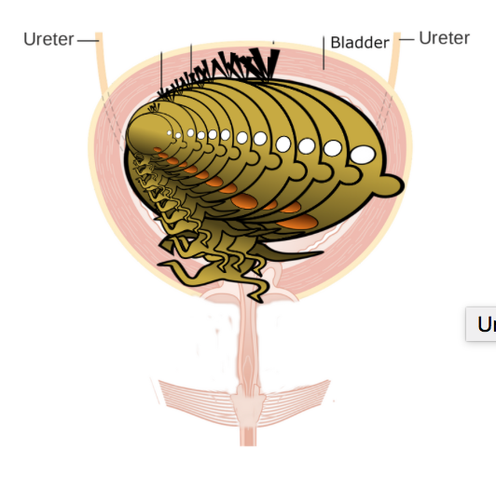
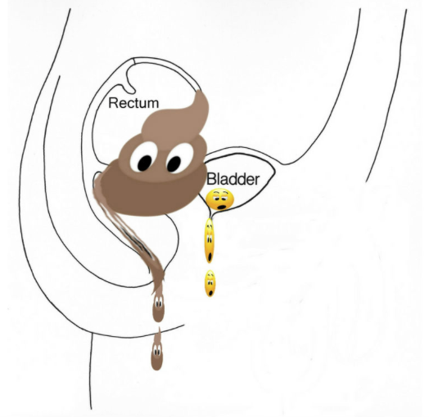
Spontaneous resolution
VUR has been shown to resolve spontaneously 68% of the time but with higher rates of resolution in patients with grade 1 to 3 VUR and at a more rapid pace
The rate of resolution of VUR not only is a factor of VUR grade at presentation but also may be related to BBD and its management

Slide 27
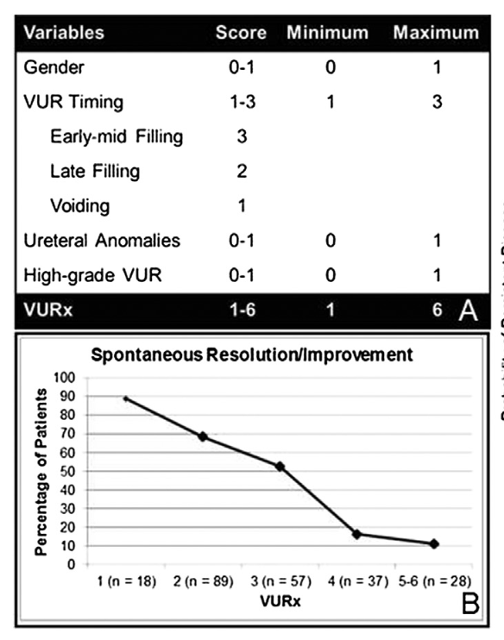
Spontaneous resolution
Kirsch et al. created a validated tool VUR index (VURI), which predicts the resolution for children <2 years of age
High-grade VUR, ureteral anomalies, female gender, and reflux occurring during filling are associated with lower resolution
Kirsch AJ et al.: Vesicoureteral reflux index (VURx): a novel tool to predict primary reflux improvement and resolution in children less than 2 years of age. J Pediatr Urol. 2014; 10(6): 1249–54.

Slide 28
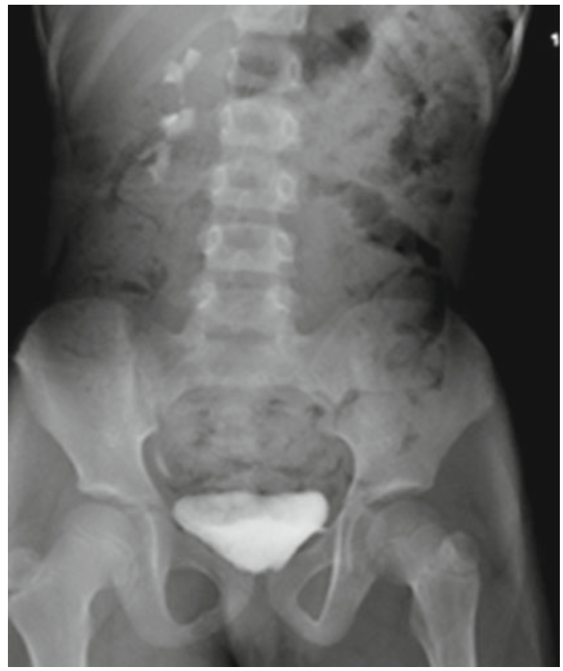
Bladder and Bowel Dysfunction
AUA: The importance of the management of BBD is emphasized in the 2010 metaanalysis.
Reclassification of the RIVUR data (2018): patients non-toilet-trained child with BBD was an independent predictor of breakthrough UTI in the CAP group.
Wang ZT, Wehbi E, Alam Y, et al.: A Reanalysis of the RIVUR Trial Using a Risk Classification System. J Urol. 2018; 199(6): 1608–14.
Peters CA et al.: Summary of the AUA Guideline on Management of Primary Vesicoureteral Reflux in Children. J Urol. 2010; 184(3): 1134–44.

Slide 29
Future directions
The best compromise is to identify the patients with the greatest risk of VUR sequelae and potentially never discover incidental VUR in a low- risk patient.
In 2018, the data from the RIVUR trial were re-evaluated using risk stratification.
Low-risk patients were defined as circumcised males with no BBD present and with grade 1 to 3 VUR.
High-risk patients were classified as uncircumcised males with a grade 4 VUR or as females with BBD.
Wang ZT, Wehbi E, Alam Y, et al.: A Reanalysis of the RIVUR Trial Using a Risk Classification System. J Urol. 2018; 199(6): 1608–14.

Slide 30
Conclusions
It is unlikely that the controversies surrounding the evaluation and management of VUR will be resolved in the near future, the key trends are clear.
With patient risk stratification, those needing aggressive evaluation and subsequent management will be more clearly identified.
So fewer children will be receiving unproductive evaluations and more efficient identification of those in need of therapy.

