Slide 1
Mitochondrial cytopathies
Francesco Emma
Division of Nephrology and Dialysis
Bambino Gesù Children’s Hospital - IRCCS, Rome, Italy
Beirut, June 13-14-15, 2019

Slide 2
Prevalence of mitochondrial cytopathies
Mitochondrial diseases can become clinically relevant in children as well as in adults
Childhood-onset mitochondrial diseases are often severe
Late onset often with nonspecific features (hypotonia, weakness, fatigue, exercise intolerance)
NATURE REVIEWS | DISEASE PRIMERS , 2016

Slide 3
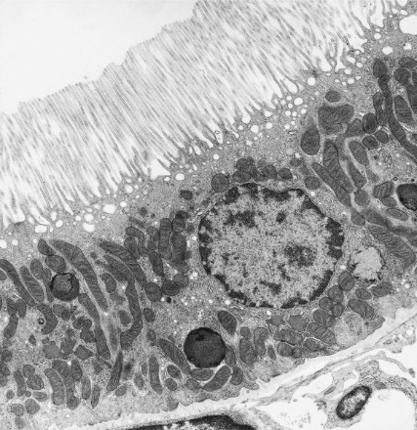
Aerobic metabolism in the kidney
After the heart, the kidneys are the organs with the highest:
number of mitochondria
oxygen consumption
metabolic rate
Aerobic respiration:
Krebs cycle
1 molecule of glucose → 36 ATP
β-oxidation
1 molecule of palmitate → 106 ATP

Slide 4
Aerobic metabolism in the kidney
Glucose
Pyruvate
Amino acids
Fatty acids
Acetyl-CoA
Krebs
cycle
CO₂
ETF
ATP
NADH
FADH₂
H₂O
ADP + P_{i}
ETF-DH
2 H⁺ + ½ O₂
AS
I
II
III
IV
Q
C
e⁻
H⁺
Adapted from Emma et al, Int J Nephrol 2011
Notes:
Figure 1: Schematic representation of different metabolic processes involved in cellular energy metabolism. (a) shows the interrelationships
between the oxidative pathways of glucose, aminoacid, and fatty acid, which lead to ATP production in themitochondrial RC enzymes (black
box). White lines illustrate the electron flow through CoQ10 in the RC. Dashed lines indicate substrates that generate abnormal metabolites
in mitochondrial cytopathies (i.e., lactate, alanine, organic acids, and acyl-carnitines). (b) shows the enzymatic cascade for the biosynthesis
of CoQ10 from mevalonic acid (left) and the principal mitochondrial enzymes with antioxidant function (right): (1) superoxide dismutase,
(2) thioreductase, (3) glutathione peroxidase, (4) catalase, (5) Fenton reaction, (6) prenyl diphosphate synthetase subunit 1 and 2 (PDSS1
and PDSS2), and (7) CoQ biosynthesis enzymes (COQ2–COQ8).

Slide 5
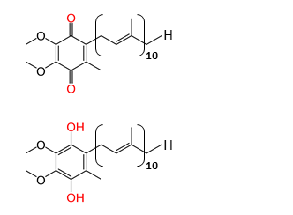
Oxidative stress during oxidative phosphorylations
Mevalonic acid
Farnesyl-PP
Geranyl-geranyl-PP
Catalase
SOD2
GPX
NUCLEUS
H₂O
mtDNA damage
Lipid peroxidation
Protein oxidation
Apoptosis
Decaprenyl-PP
mGSSG
NADPH
Para-OH-benzoate
GPX
mGSH
NADP
NRF2
H₂O₂
H₂O + ½ O₂
Cat
SOD2
Ubiquinone
2 e⁻ + H⁺
ROS
Electron leak
O₂^{• -}
H⁺
CoQ₁₀
O₂
Ubiquinol
AS
I
II
III
IV
UCP2
Q
C
e⁻
H⁺
Adapted from Emma et al, Int J Nephrol 2011
Notes:
Figure 1: Schematic representation of different metabolic processes involved in cellular energy metabolism. (a) shows the interrelationships
between the oxidative pathways of glucose, aminoacid, and fatty acid, which lead to ATP production in themitochondrial RC enzymes (black
box). White lines illustrate the electron flow through CoQ10 in the RC. Dashed lines indicate substrates that generate abnormal metabolites
in mitochondrial cytopathies (i.e., lactate, alanine, organic acids, and acyl-carnitines). (b) shows the enzymatic cascade for the biosynthesis
of CoQ10 from mevalonic acid (left) and the principal mitochondrial enzymes with antioxidant function (right): (1) superoxide dismutase,
(2) thioreductase, (3) glutathione peroxidase, (4) catalase, (5) Fenton reaction, (6) prenyl diphosphate synthetase subunit 1 and 2 (PDSS1
and PDSS2), and (7) CoQ biosynthesis enzymes (COQ2–COQ8).

Slide 6
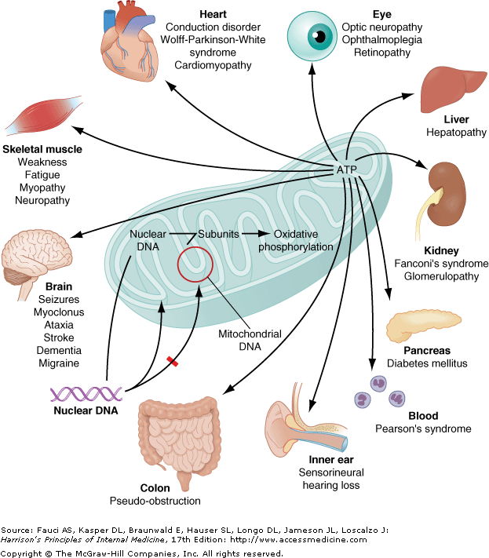
Mitochondrial cytopathies
Heterogeneous group of diseases
Impaired oxidative phosphorylation
Can involve several organs or tissues
Increasing number of tissues affected over time
CNS almost consistently involved in late stages

Slide 7
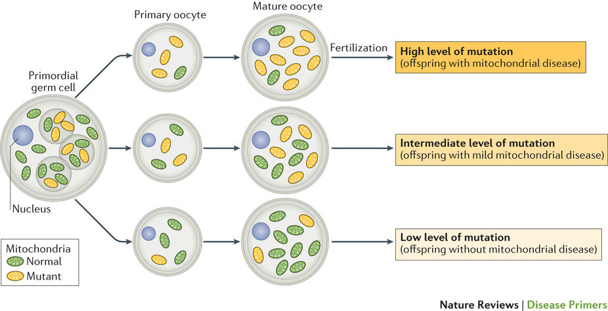
Type of mutations
mtDNA genes mutations/deletions
de novo or maternal inheritance
heteroplasmy
- threshold effect
- proliferative segregation
Gorman et al, Nat Rev Dis Primers 2016
Nuclear DNA gene mutations
classic mendelian genetics
homoplasmy
- structural mitochondrial genes
- mitochondrial assembly and dynamics
- mDNA maintenance and replication
Bhargava and Schnellmann, Nat Rev Nephrol 2017

Slide 8
Diagnosis
Spectrophotometric studies
enzyme activities: CI, CII, CIII, [CII+CIII], CIV, CV
Polarographic studies
oxygen consumption by isolated mitochondria or whole cells in the presence of different oxidative substrates (pyruvate, glutamate, succinate, etc...)
Genetic studies
mtDNA sequencing
specific mutations (m.3243A>G)
(better in urinary sediment; may be missed in blood)
next generation sequencing
Small gene panels - large gene panels – exome sequencing
COQ genes should be included in SRNS panels

Slide 9
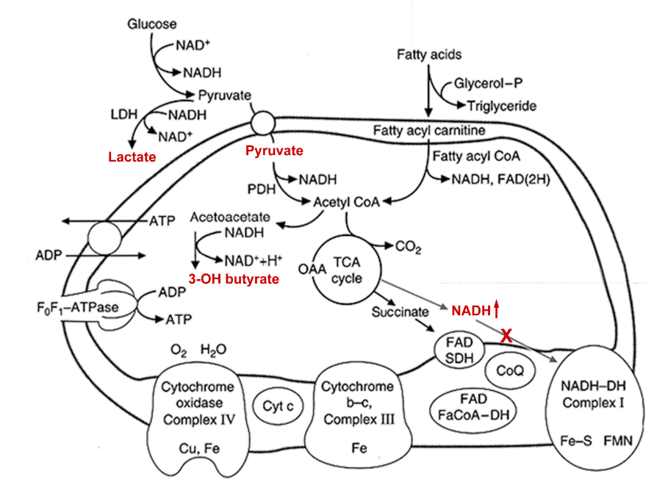
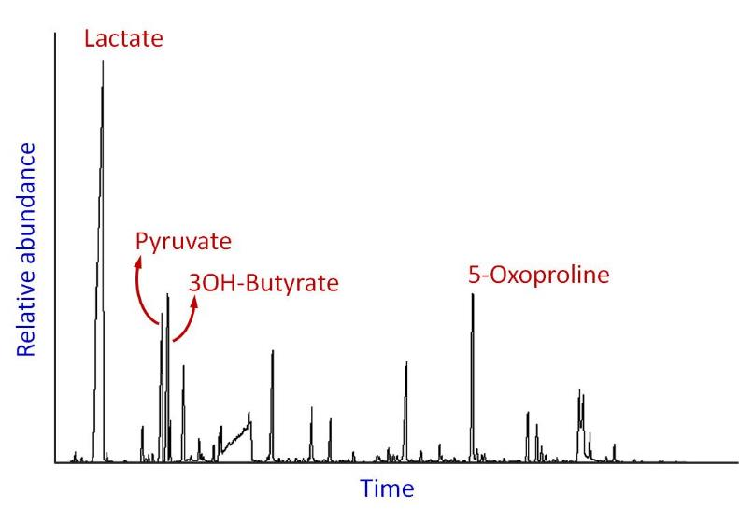
Diagnosis
NB: often observed without hyperlactacidemia
NB: rarely observed in purely glomerular disorders
Urinary organic acids
Also check plasma (and CSF?) lactate, pyruvate
Acylcarnitines
Consider FGF21 and/or GDF15 plasma levels
Neuroimaging and hearing test
Cardiovascular and endocrine evaluation

Slide 10
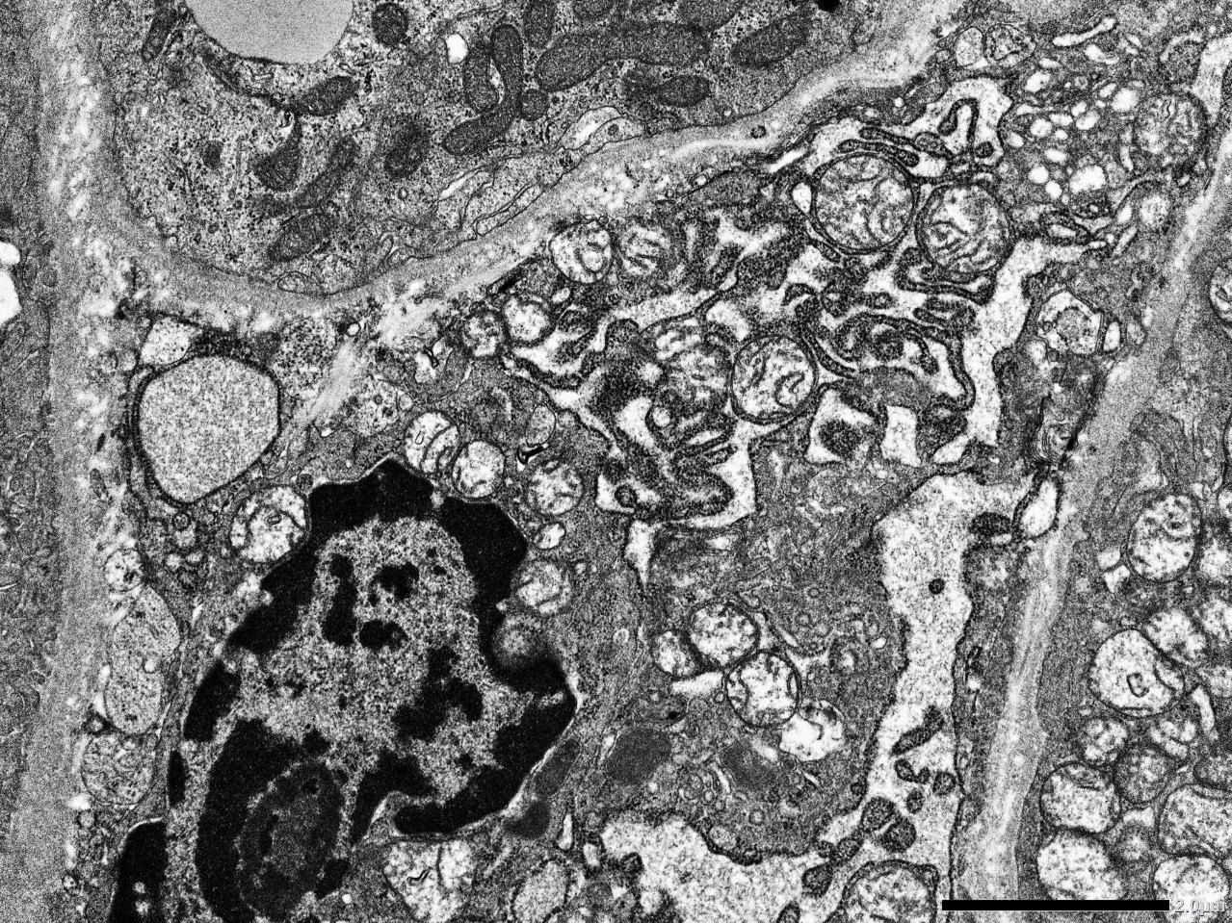
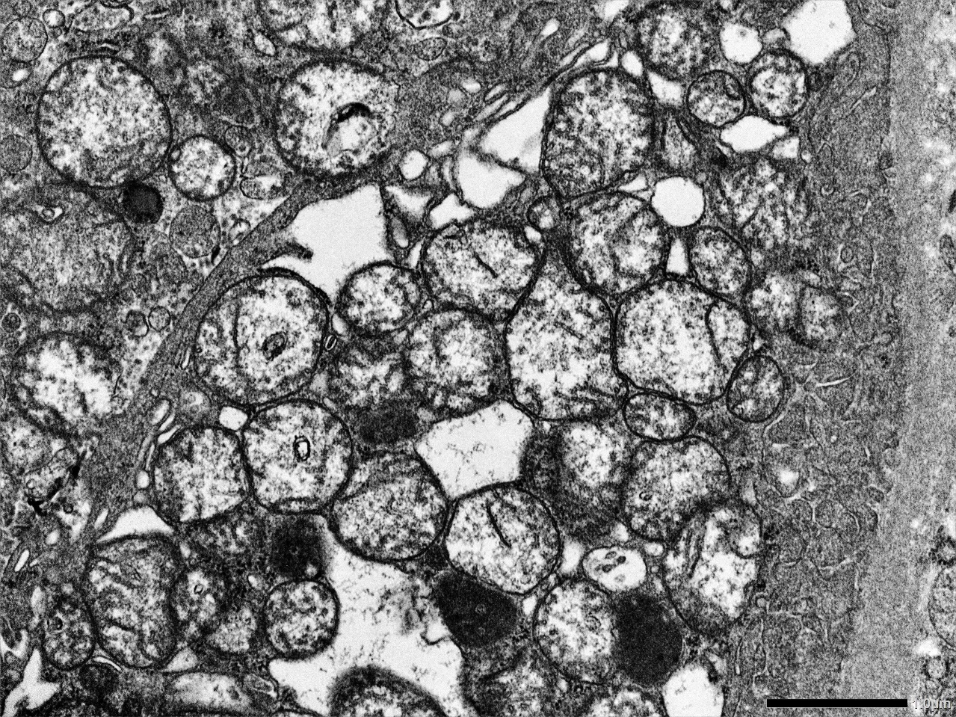
Renal investigations
RTA + glomerular
proteinuria

Slide 11
Renal diseases in mitochondrial disorders
generally Fanconi syndrome
RTA
isolated hyperaminoaciduria
isolated hypomagnesemia
Barrter-like
only a few case reports
Egger 1981, Brum 1994, Lehenart 1995,
Donaldson 1985, Rötig 1995, Szabolcs 1994
Zupanc 1991, Birch-Machin 1989,
Minchon 1983, Muller-Hocker 1983,
Strausbie 1982, Niaudet et al 1997,
Goto 1990, Zaffanello 2005,
Eviatar 1990, Gruskin 1973,
Matsutani 1992, de Lonley 2001
Tubular-
interstitial
Tubular
Glomerular

Slide 12
Renal abnormalities in mitochondrial diseases
Total
100%
20%
30%
50%
Martin-Hernandez, Ped Nephrol 2005

Slide 13
Mitochondrial glomerular diseases
Mostly FSGS
Generally associated with other symptoms
Two clearly defined genetic defects:
  CoenzymeQ10 biosynthesis defects
  tRNALeu mutations
Brun 1994, Rötig 1994, Lowik 2005, Scaglia 2004, Guery 2003, Moulonguet Doleris 2000,
Hotta 2001, Diomedi-Camassei 2007, Quinzii 2006, personal observations

Slide 14
A3243G tRNA^{Leu} mutation
MELAS (Mitochondrial Encephalomyopathy, Lactic Acidosis, and Stroke-like episodes)
MIDD (Maternally Inherited Diabetes and Deafness)
Patients with a renal phenotype
  Generally FSGS, but also cases of TIN and cystic kidney disease
  Other symptoms:
    hearing loss: 80-90% (not always severe)
    diabetes mellitus: 20-30%
    neuromuscular: 10-20%
    cardiomyopathy, retinopathy
  Age of diagnosis 10-30 years
  Progression to CRF
Lowik 2005, Scaglia 2004, Guery 2003, Moulonguet Doleris 2000, Hotta 2001

Slide 15
A3243G tRNA^{Leu} mutation
Deafness > Proteinuria > Diabetes Mellitus
Guery et al, Kidney Int 2003

Slide 16
Some cases are misdiagnosed as having Alport syndrome!
Proteinuria and deafness
  Alport syndrome
  A3243G tRNA^{Leu}
  COQ6
  MYH9
  ARHGDIA
  INF2
Systematic mtDNA screening of Alport syndrome cohorts:
  1/63 misdiagnosis (Jansen et al, JASN 1997)
  1/23 misdiagnosis (Cheong et al, Pediatr Nephrol 1999)

Slide 17
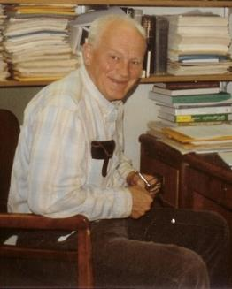
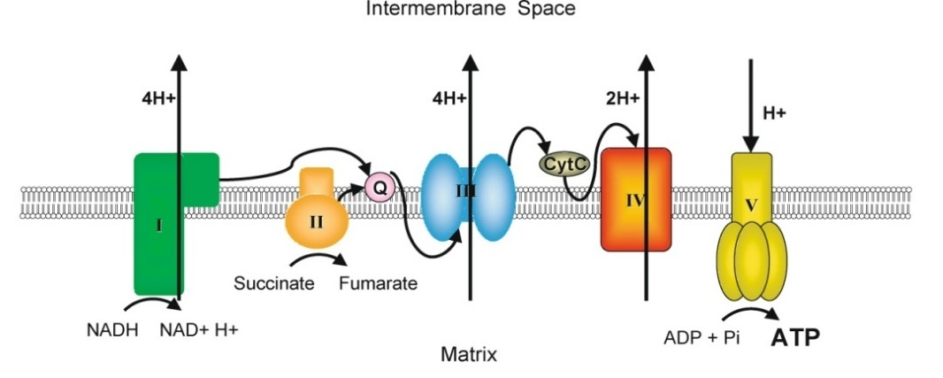
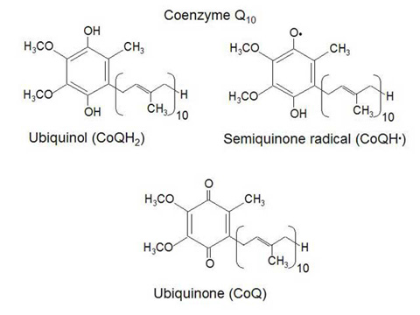
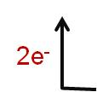
Coenzyme Q10 (ubiquinone)
Isolation of a quinone from beef heart mitochondria.
FL Crane, Y Hatefi, RL Lester, C Widmer.
Biochim Biophys Acta 25: 220-221 (1957).
Fred L. Crane 1925-2016
Discovered in 1957 by Fred Crane
Available in food, but most originates from de novo synthesis
Electron transporter in the mitochondrial respiratory chain
Anti-oxidant
Other functions…

Slide 18
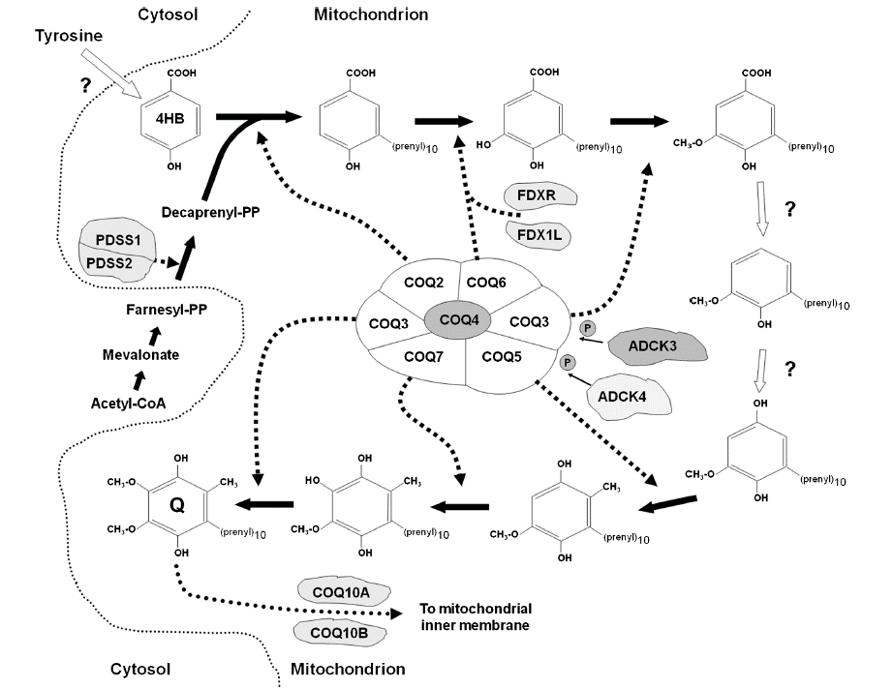
Coenzyme Q10 biosynthesis
Regulatory enzymes
Q complex

Slide 19
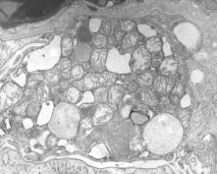

Coenzyme Q10 biosynthesis defects: common features
 | PDSS1 | PDSS2 | COQ2 | COQ4 | COQ6 | COQ7 | COQ9 | ADCK3 | ADCK4
NEUROLOGICAL SYMPTOMS
Encephalomyopathy |  | X | X | X |  | X | X | X
Ataxia |  | X |  |  | X |  |  | X
Seizures |  | X | X |  | X |  |  | X
Dystonia and/or spasticity |  |  |  |  |  |  |  | X
Severe mental retardation | X | X | X | X | X |  |  | X
Deafness |  | X | X |  | X
RENAL SYMPTOMS
Steroid-resistant NS | X | X | X |  | X |  |  |  | X
Tubulopathy |  |  |  |  |  |  | X
Early onset SRNS
Onset during childhood

Slide 20
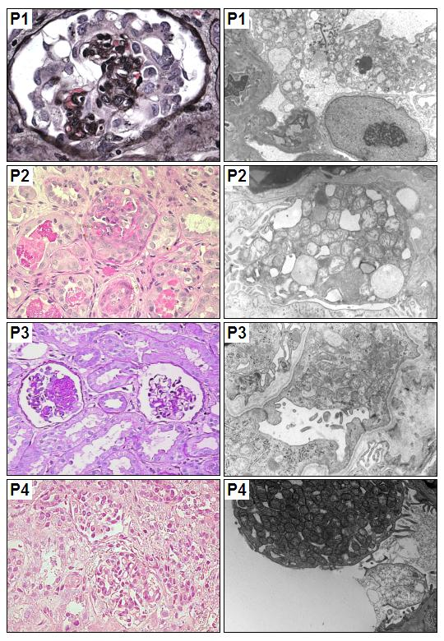
Renal disease in COQ2 mutations
Age onset (months) | Extra-renal symptoms | Renal symptoms | Renal pathology
18 | None | SRNS | FSGS Collapsing
birth | Encephalopathy Seizures Hypotonia | ARF | Crescentic GN
11 | Encephalopathy Seizures Optic nerve atrophy | SRNS | FSGS NOS
12 | None | SRNS | FSGS NOS
Diomedi-Camassei et al, JASN 2007

Slide 21
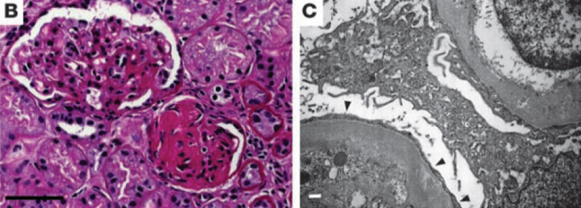
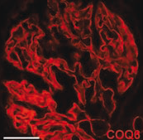
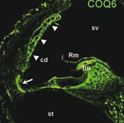
Renal disease in COQ6 mutations
6 different mutations in the monooxygenase 6 gene (COQ6) in 13 subjects from 7 families
Early-onset SRNS with sensorineural deafness
Lack of complementation in coq6-deficient yeast
Knockdown of coq6 causes apoptosis that is partially reversed by coenzyme Q10 treatment (podocyte & zebrafish embryos)
coq6 is expressed in podocytes and in the stria vascularis of the inner ear in rats
Heeringa et al, J Clin Invest, 2011

Slide 22
Renal disease in PDSS2 mutations
Leigh syndrome
Nephrotic syndrome
CoQ10 deficiency
(muscle and fibroblasts)
López et al., Am J Hum Genet, 2006

Slide 23
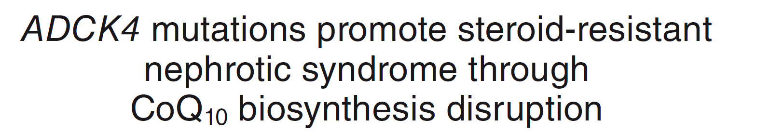
ADCK4 (now COQ8B) defects
2% of SRNS
Mutations in the aarF domain containing kinase 4 (ADCK4)
Low CoQ10 levels and RC activity in cells from mutated individuals
KO of adck4 in zebrafish and Drosophila recapitulates the disease
Most patients have no other significant symptoms
Ashraf et al, JCI 2013

Slide 24
Variable presentations of COQ mutations
Two cousins with COQ2 mutations that developed SRNS in adolescence had only mild neurological symptoms
One infant with COQ6 mutation presenting with SRNS at 8 months but no deafness and no encephalopathy
Gigante et al, Clin Genet 2017

Slide 25
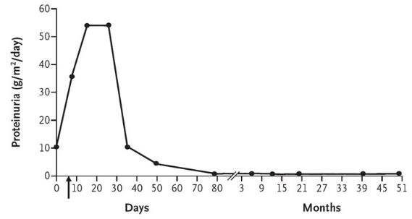
Clinical response to CoQ10 therapy
COQ2 mutation
COQ6 mutation
ADCK4 mutation
Montini et al, NEJM 2008
Lovric et al, Nephrol Dial Transpl 2016
Korkmaz et al, JASN 2015

Slide 26

Thank you
francesco.emma@opbg.net

