Slide 1
Non Surgical Complications
Of Peritoneal Dialysis
Saleh Al Shurafa
QCH – KSA
Joint ISN & IPNA
TEACHING COURSE

Slide 2
Complications
Infection
Metabolic
Mechanical
Respiratory
Nutrition
Saleh Al Shurafa – QCH - KSA

Slide 3
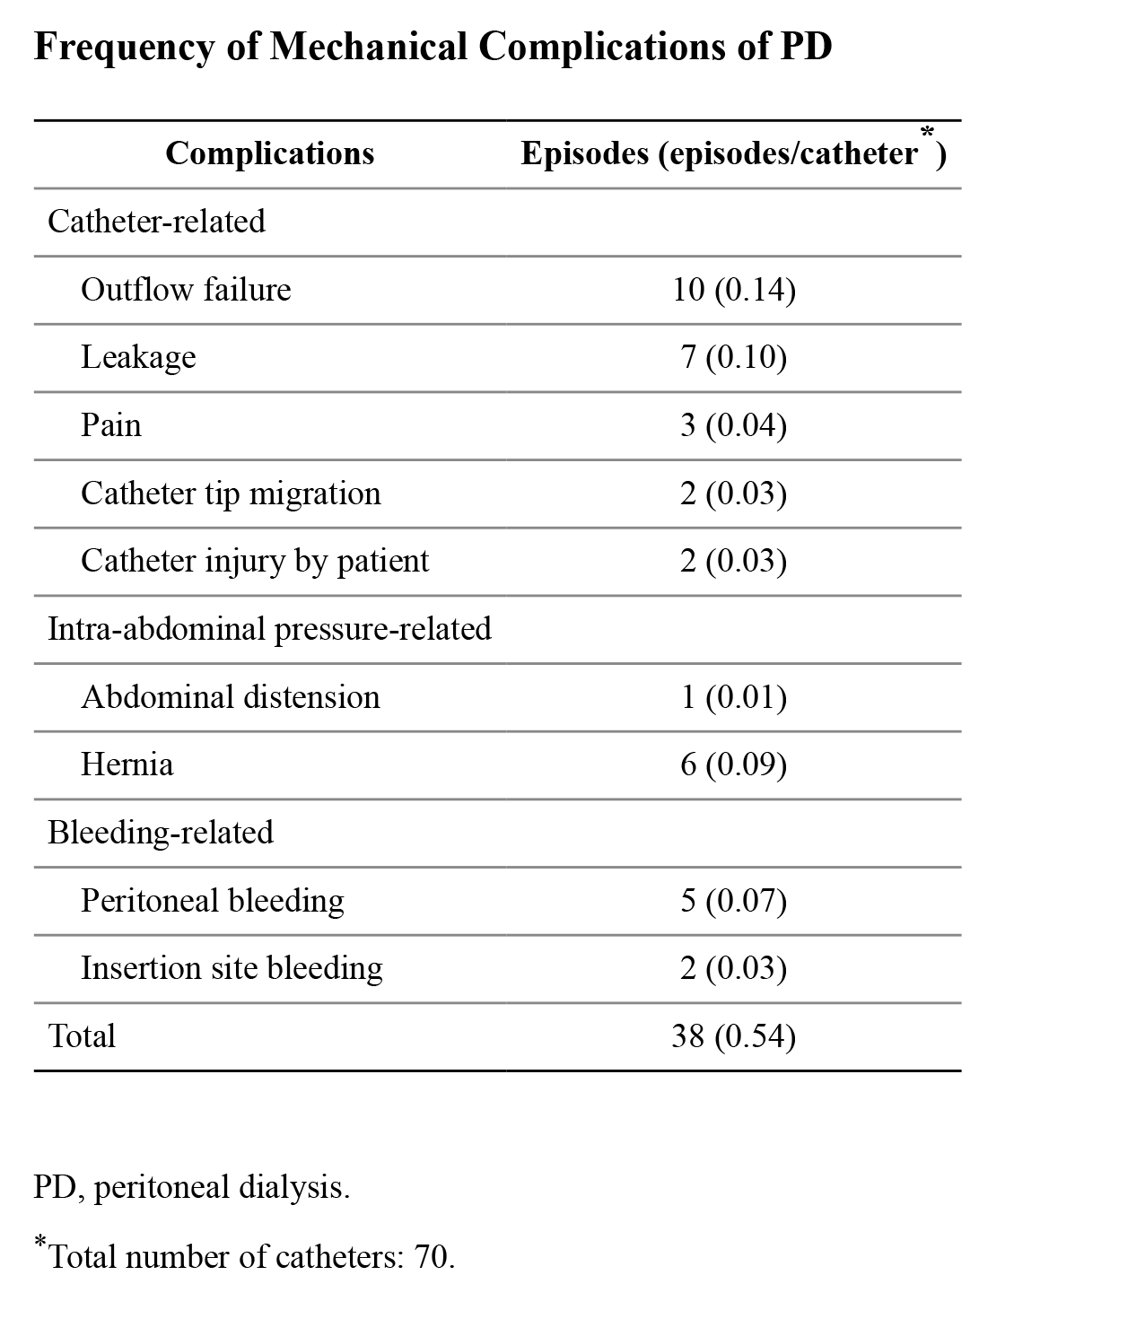
Frequency of Mechanical Complications of PD
doi: 10.3349/ymj.2015.56.5.1359
Saleh Al Shurafa – QCH - KSA

Slide 4
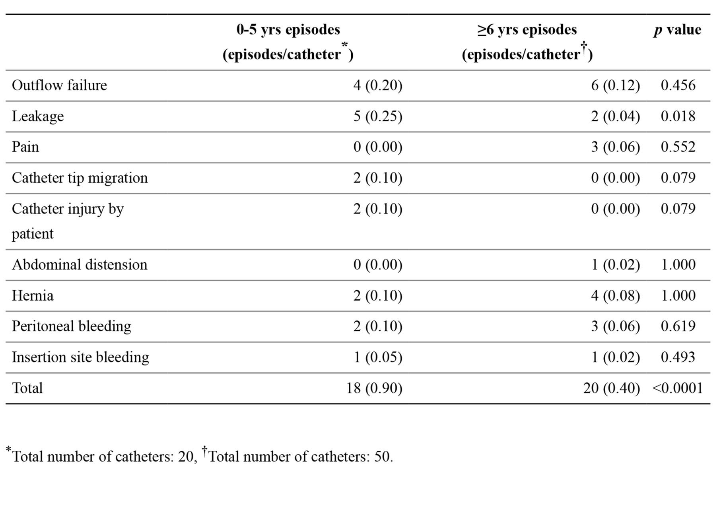
Incidence of Mechanical Complications in 0-5 Years of Age Group and ≥6 Years of Age Group
doi: 10.3349/ymj.2015.56.5.1359
Saleh Al Shurafa – QCH - KSA

Slide 5
Major Complication
Mechanical complications
Occurring early after surgery
Occurring later after surgery
•
Pain
•
Haemoperitoneum
•
Bleeding
•
Poor outflow or inflow
•
Leaks
•
Migration of the catheter
•
Increased IPP (Intra Peritoneal
Pressure)
•
Hernia
•
Pain: infusion and drainage
phases
• Eosinophyllic peritonitis at start of PD
Saleh Al Shurafa – QCH - KSA

Slide 6
Later After Surgery
Haemoperitoneum
Can look dramatic but will usually settle with time
@Causes
Benign (menses ,ovarian cyst, ovulation, PCKD, Trauma, Coagulopathy Serious ( Ischemic Bowel, Colon CA, Pancreatitis, urologic malignancy)
@ Managements
• Review patients medical history.
• Warn the patients during training ,It might affect patients psychologically.
• Dialysis with room temperature.
• Heparinized flushing Recommended dose of heparin is 500 -1000IU / L PD solution
5
Saleh Al Shurafa – QCH - KSA
5

Slide 7
Poor Inflow or Outflow
Typically constipation and catheter migration are major causes of flow problems Clinical features, patient typically reports slow CAPD exchanges or HomeChoice alarms
Causes
Catheter holes are
• Constipation
blocked
• Rapid absorption (lymphatics - in first few days of PD)
• Catheter migration
• Partial Catheter obstruction with fibrin, blood clots
Catheter tip is free
• Omental wrapping
Blood clot
6
Saleh Al Shurafa – QCH - KSA

Slide 8
Catheter Migration
Migration of the catheter is defined if the tip is found not to be in the true pelvis either function or dysfunction migrated catheter
Predisposing factors
Prevention
• Constipation
• Improper implantation or length
• Perfect catheter insertion technique
• Direction of the subcutaneous tunnel and
• Avoid and manage constipation
“memory” of catheter may lead to migration of the catheter.
Management
Conservative
@ Stairecase
@bowel stimulation
Surgical intervention
@ Guidewire or laprascopic manipulation @ Lapratomy and or re-insertion
PERITONEAL DIALYSIS : 1994 | Volume : 40 | Issue : Peritoneal access. Bhatla B, Khanna R, Twardowski ZJ
Saleh Al Shurafa – QCH - KSA

Slide 9
Catheter Obstruction
PD catheter might be obstructed partially or completely due to the following causes :
@Constipation
@ Blood clots or thrombus. @Kink
@Fibrin
@Omental Wrapping (Jerky Outflow).
The omentum is made up of two layers of fatty tissues and both supports and covers the organs and intestines There are two parts of the omentum, the greater omentum and the lesser omentum, which are responsible for storing fat deposits and connecting the intestines and stomach to the liver respectively.
Saleh Al Shurafa – QCH - KSA

Slide 10
Catheter Obstruction
2005 European Guidelines recommendations for management:
• Treat the cause
• Conservative Management strategies such as body position change
•
Laxatives
• Flushing with heparinized saline (‘push-and-suck’ manipulation)
• Thrombolytic therapy TPA (as per hospital’s protocol )
• Fluoroscopic-guided manipulation using a guidewire
• Surgery: will be possible laparoscopic Omentectomy.
• We recommend that each PD unit should have the ability to manipulate
or re-implant PD catheters when necessary
9
Saleh Al Shurafa – QCH - KSA

Slide 11
Infusion and drainage pain
Causes
Management
• Solution jet effect on
• Slower infusion speed
peritoneal membrane
• Use Bicarbonate IP (opinion) up to nephrologists recommendation
Infusion
• Often found to be PD fluid pH related
• Use of biocompatible solutions.
• Tonicity of PD Solution Dialysate temperature
• Replacement of catheter if
irritating peritoneal wall
• Catheter pressing on peritoneal membrane or force
• Lift up the drainage bag a little, decreasing gravity
Drainage
of ‘suction’ is too strong
• Ensure PD cycler is not too high
• Drain time too prolonged
• Tidal modality could be used on
APD
15
Saleh Al Shurafa – QCH - KSA

Slide 12
Nutrition
Malnutrition is common
Arab Countries ?
UK = 22%
Hong Kong = 19 %
Hypoalbuminaemia is common
28 % ours
43 % Toronto series
High PD Volume
Less Gastric Emptying Time
Low Appetite
Low Growth

Slide 13
Pittsburgh University CQI Programme
ESI
0.8 Mupirocin
Peritonitis
CAD for
0.7
cyclers
Gentamicin cream
0.6
Peritonitis retraining
0.5
0.4
0.3
0.2
0.1
0.0
1990-91 1992-95
1996-99
2000-04
2005-07
Period (years)
CAD, compact assist device (introduced for spiking on the cycler)
Qamar M, et al. Adv Perit Dial 2009;25:76-9
Saleh Al Shurafa – QCH - KSA

Slide 14
Exit site & Tunnel infection
Colonisation of exit site:
Infection of exit site
Tunnel Infection
Peritoneal Infection
Loss of catheter
+ Technique failure
Saleh Al Shurafa – QCH - KSA

Slide 15
Differential diagnosis "cloudy/discolored" dialysate
Eosinophilic peritonitis: >10% dialysate eosinophils, most cases immediately after catheter insertion
Chemical peritonitis: clinical symptoms similar to infectious peritonitis, but
usually without fever, culture negative, causative agent
Hemoperitoneum: Bloody dialysate, e.g. menstruation, ovulation
Chylous ascites: cloudy-white, normale dialysate cell count or slightly
increased lymphocytes, increased triglycerides,negative cultures
Cloudy dialysate due to pancreatitis:
negative cultures, dialysate amylase and lipase increased
Peritoneal carcinomatosis: negative cultures, positive cytology, occasionally symptoms of malignant disease
Saleh Al Shurafa – QCH - KSA

Slide 16
Exit site infection
Good Exit site
Signs of Infection
Clean
Soiled
Dry
Wet
Normal skin color
Redness
No exudate
Purulent exudate
No crust
May have crust
No pain
May have Tenderness
No sign of Inflammation
and Inflammation
Saleh Al Shurafa – QCH - KSA

Slide 17
Definition of exit site and tunnel infection
Purulent drainage from the exit site indicates presence of infection; erythema may or may not represent infection (evidence)
Positive culture in absence of abnormal appearance is indicative of colonization rather than infection
- Intensified exit-site cleaning is advised (opinion)
Tunnel infection usually occurs in the presence of exit-site infection, but rarely occurs alone
Although absence of exudate, pain whilst palpating the tunnel, can indicate Infection
Saleh Al Shurafa – QCH - KSA

Slide 18
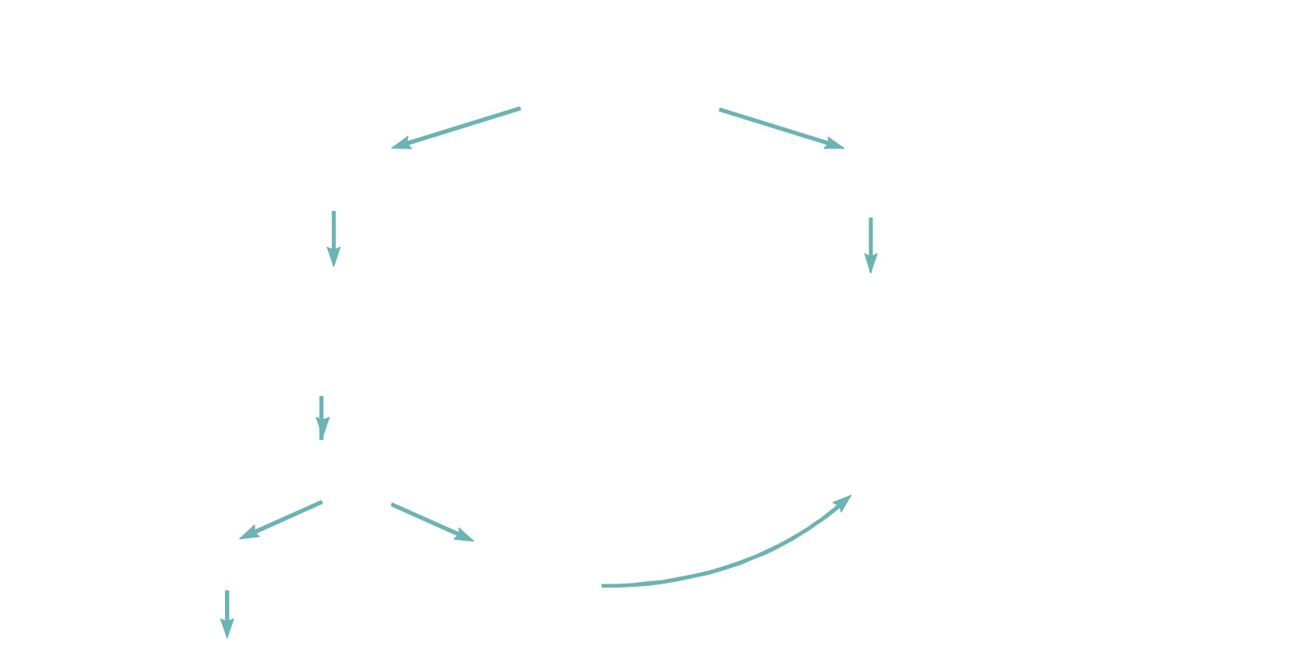
Mild exit site infection
Culture: S. aureus or P. Aeruginosa And is there
tunnel involvement (diagnosed by sonography or clinically)
no
yes
Intensified local treatment (e.g. antibiotic cream,
antibiotic therapy (eg moxifloxacin,
daily dressing changes, hypertonic saline)
levofloxacin, clindamycin, fusidic acid, cefuroxime)
Improvement after 1 week ?
yes no
Continue local therapy (at least 2 weeks)
Saleh Al Shurafa – QCH - KSA

Slide 19
Prevention of Exit-site Infections Exit-site Care
• Prevention of catheter infections (and thus peritonitis) is the primary goal of
exit-site care - the patient needs to understand how important this is.
• Catheter immobilization to prevent trauma
• Antibiotic protocols against S. aureus are effective in reducing the risk of S.
aureus catheter infections (evidence)
• Until healing complete (6 weeks): dressing changes by dialysis nurse or trained
patient using sterile technique, exit-site kept dry
• Routine exit-site care by patient
- Antibacterial soap and water - once daily
- Hydrogen peroxide should be avoided
- There is evidence for daily antibiotic prophylaxis with mupirocin cream or gentamycin cream*
- Patients can be screened for nasal Staph aureus carriage and then given nasal prophylaxis*
*
2011 ISPD position statement on reducing the risk of PD related infections
Saleh Al Shurafa – QCH - KSA

Slide 20
Peritonitis in
peritoneal dialysis
patients
the incidence of peritonitis has decreased during the last years, it still
remains an important complication, often leading to technical failure and transfer to hemodialysis.
Saleh Al Shurafa – QCH - KSA

Slide 21
Peritonitis or peritoneal infection
Criteria
1.
Signs and symptoms (fever, nausea, abdominal
pain, vomiting)
2.
Cloudy fluid
3. WBC count >100/mm3 , of which 50% are poly-morpho nuclear neutrophils (PMN), is confirmation of microbial- induced peritonitis
Identification of organism Two of three required for diagnosis
RELAPSING PERITONITIS
Another episode that occurs within 4 weeks at
completion of therapy of a prior episode, with the same organism or 1 sterile episode
ISPD Recommendations 2010
Saleh Al Shurafa – QCH - KSA

Slide 22
Peritonitis Diagnosis
Cloudy fluid and/or abdominal pain and/or fever
Dialysate effluent should be obtained for laboratory
evaluation
(>4 hrs’ dwell time):
Culture
Cell count, with differential Gram Stain
Confirmation
WBC count >100/mm3 , of which 50% are poly-morpho nuclear neutrophils (PMN), is confirmation of microbial- induced peritonitis
ISPD guidelines 2010
Saleh Al Shurafa – QCH - KSA

Slide 23
Sources of Peritonitis, %
Micro-Organisms Causing Peritonitis
23%
22%
22%
4%
3%
13%
1%
18%
7%
8%
2%
Saleh Al Shurafa – QCH - KSA

Slide 24
Identification of germ / routes of contamination
• Staphylococci coagulase -
• Staphylococcus aureus
Hands
catheter
• Pseudomonas-Xanthomonas
• Other Gram negatives
Water
Enviroment
• Enterococcus
• Bacteroïdes
Colon
• Multiple germs
• Yeast
• Culture negative
Techniques
Saleh Al Shurafa – QCH - KSA

Slide 25
• Know the organisms - know how to prevent
• Touch contamination - training and connectology
• C arriage and colonization - the nose (more than one nose in some cases)
• Bowels - constipation to be avoided
• Water - dry hands
• Care about systemic antibiotics (fungi)
Saleh Al Shurafa – QCH - KSA

Slide 26
Key factors about peritonitis
Needs urgent assessment and treatment
Culture of fluid - Needs to be done correctly
Immediately start antibiotics IP into bag and leave for 6 hours
Assess whether it can be managed at home or needs for patient admission
Treatment continues for at least 2 weeks
Antibiotics are changed according to what is growing
ISPD 2010 Guidelines
Saleh Al Shurafa – QCH - KSA

Slide 27
Initial intervention at PD Unit
• In presence of cloudy effluent with pain and/or fever:
• Consider 2 to 3 rapid exchanges to relieve discomfort as necessary
• Initiate empiric antibiotic therapy within one hour while waiting for test results
• In presence of very cloudy effluent or clot, add heparin 500 to 1000 U/L to new bag until effluent clears (usually 48 to 72 hours)
• Initiate adequate pain management.
• Assess the need for hospitalization or out patient management - many patients can and should be managed at hom
Saleh Al Shurafa – QCH - KSA

Slide 28
Initial antibiotic therapy
• Therapy is initiated immediately before causative organism is known
• Selection of antibiotics must be made in light of both the patient’s and unit’s history of micro-organisms and sensitivities
• Use both antibiotics even if gram stain sees gram positive or negative
• Commence anti-fungal therapy and remove catheter if fungus is observed Continued treatment
• Adapt treatment once organism identified and antibiotic-sensitivities are known
• At 72 hours - if there is no growth on culture then this is defined as culture negative culture
• Catheter should be removed and/or changed if required clinically
Note: ISPD Recommendations 2010-peritoneal dialysis - Related infections update
Saleh Al Shurafa – QCH - KSA

Slide 29
• ISPD Guidelines 2010
• Generally much the same as previous guidelines from ISPD
• Still same knowledge gaps
How to treat culture negative peritonitis? Should all patients be switched to CAPD? What is the best antibiotic regime?
Saleh Al Shurafa – QCH - KSA

Slide 30
• ISPD 2010 - initial treatment
Start intra peritoneal antibiotics as soon as possible
Allow to dwell for at least 6 hours
Ensure gram-positive and gram-negative coverage*
Base selection on historical patient and center sensitivity patterns as available
Gram-positive coverage: Either first-generation cephalosporin or vancomycine
Gram-negative coverage:
Either third-generation
cephalosporin; or aminoglycoside
Determine and prescribe ongoing antibiotic treatment
Ensure follow-up arrangements are clear or patient admitted
Await sensitivity results
Saleh Al Shurafa – QCH - KSA

Slide 31
Treatment of PD-peritonitis
• Assessment
• Culture
• Antibiotic therapy - IP is best
• Intraperitoneal heparin - can be useful
• Analgesic treatment
• Icodextrin and/or APD for ultrafiltration problems
Saleh Al Shurafa – QCH - KSA

Slide 32
Fungal Peritonitis
Flucytosine - loading dose 2 g p.o., maintanance dose 1 g p.o. once a day AND
Fluconazole - 200 mg p.o. / i.p. once a day
•Resistance - consider Itraconazole 100 mg twice a day
Remove catheter
Continue Fluconazole for 4-6 weeks
Saleh Al Shurafa – QCH - KSA

Slide 33
• Terminology of peritonitis
• Recurrent peritonitis: an episode occurs within 4 weeks of completion of therapy of a prior episode (different organism)
• Relapsing peritonitis: an episode occurs within 4 weeks of completion of therapy of a prior episode (same organism)
• Repeated peritonitis: an episode occurs ≥ 4 weeks after completion of therapy of a prior episode (same organism)
• Refractory peritonitis: failure of the effluent to clear after
5 days of antibiotic therapy (catheter removal!)
Saleh Al Shurafa – QCH - KSA
38

Slide 34
Complications of PD Peritonitis
• Temporary reduction of UF
• Increased protein loss
•Catheter removal
•Adhesions
• Transfer to HD
•Death
Saleh Al Shurafa – QCH - KSA

Slide 35
• Regular audit
• Monthly examination - number of ESI, peritonitis and the ESI and peritonitis rates (< 1 in 24 patient months)
• At least annual - culture negative rate (< 20%)
Saleh Al Shurafa – QCH - KSA

Slide 36
Prevention of PD-related Infections Connection Methods
CAPD
- Use double-bag system (flush before fill)
- Avoid spiking of dialysis bags (assist device if spiking required)
- Pay close attention to connection methodology (monitor infection rates)
APD
- Consider training patients to use assist device if spiking is part of the system
ISPD Recommendations 2005
Perit Dial Int 2005; 25(2) : 107-31
Saleh Al Shurafa – QCH - KSA

Slide 37
Prevention of PD-related Infections Training Methods
• Training methods influence the risk of PD infections (evidence European
Guidelines 2005)
• Teach aseptic technique with emphasis on hand washing:
- If water is felt to have a high bacterial count, alcohol hand wash should be encouraged (opinion)¹
- Hands completely dried after washing using a clean towel
- Clean location for exchanges with no animal hair, dust-laden air, or fan
ISPD Recommendations 2005 Perit Dial Int 2005; 25(2) : 107-31
¹ BMJ VOLUME 325 17 AUGUST 2002: Infection Control Unit, Hôpital Henri Mondor, Assistance PubliqueHôpitaux de Paris, Créteil,France
Saleh Al Shurafa – QCH - KSA

Slide 38
•Key messages
• Prevention of infectious problems is key - exit site care and rigorous exchange technique
• ESI needs prompt recognition and treatment
• Peritonitis - requires urgent investigation with right methods and initial IP antibiotics
• Once results of culture and sensitivity are known
- change antibiotics and treat for full duration
• Audit of ESI and peritonitis rates is a key quality indicator
Saleh Al Shurafa – QCH - KSA

Slide 39
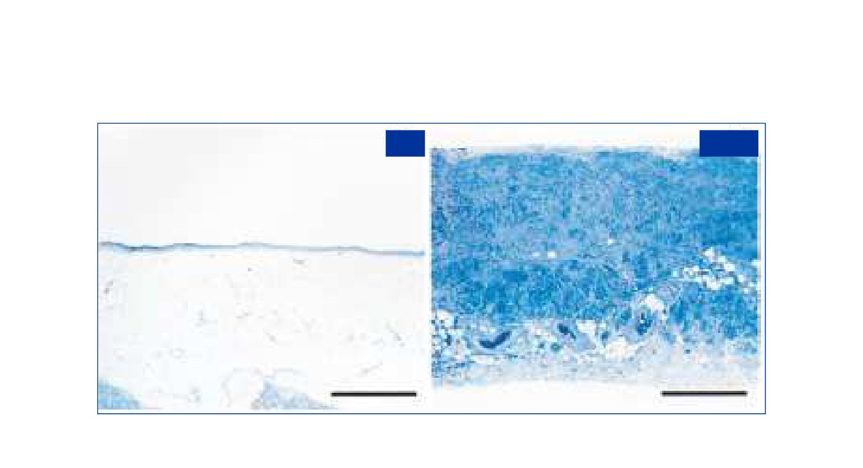
Peritoneal Membrane Changes During Chronic PD Therapy
1a
1b
17
Saleh Al Shurafa – QCH - KSA
Williams J, et al. J Am Soc Nephrol. 2002;13:470-479.

Slide 40
GDPs - Glucose degradation products in PD fluids.
• Are a family of molecules
• Breakdown products of glucose which are eaten, generated internally and formed from glucose
during heat sterilisation of PD solutions
• Both glucose and GDPs form irreversible bonds with proteins to form glycation end products
(AGEs) which damage cells.
• GDPs and AGE are an important problem in all CKD and dialysis patients
• Avoid glucose absorption: reduce local and systemic effects of glucose
• Extraneal can stabilise peritoneal membrane function
Non - glucose PD solutions
Technology for Survival
Note: Williams J.D. et al., Morphological changes in the peritoneal membrane of patients with renal disease. J Am Soc Nephrol 13:470-479., 2002.
Saleh Al Shurafa – QCH - KSA

Slide 41
Peritoneal membrane transport type
D/P Creatinine
D/DO Glucose
Membrane 4-Hour D/P
Transport Type Creatinine
High
82 - 1.03
High average
65 - .81
Low average
50 - .64
Low
34 - .49
The transport types of "low" to "high" are also referred to as "slow" to "fast" by some clinicians
Permission to use chart: Twardowski ZJ, Clinical Value of Standardized Equilibration Test in CAPD Patients, Current Concepts of CAPD, Blood Purif 1989;7:95 108.
Transport
UF
Clearance
Treatment
High Transporter
+
++++
Short Dwells - APD
High Average
++
+++
Low Average
+++
++
Low Transporter
++++
+
Long dwells - CAPD
Saleh Al Shurafa – QCH - KSA

Slide 42
The cyclical impact of PD glucose exposure on CV risk
Glycaemic control
Dyslipidaemia
Glucose
Acute hemodynamic effects
exposure
Volume
in PD
overload
fluid
Negative
Insulin resistance
impact on
Vascular calcification
CV risk
Truncal fat mass
↓peritoneal membrane structure and function
Saleh Al Shurafa – QCH - KSA

Slide 43
Dry Days on APD
• Indications
• Leaks
• Stress incontinence
• Patients commencing PD with very good RRF
• Problems
• Not enough UF
• Sodium sieving on APD - sodium loss can be reduced with short cycles in particular, icodextrin improves Na removal during the
long dwell and returns that to reasonable values
• B2microgolbulin
• Phosphate
Saleh Al Shurafa – QCH - KSA

Slide 44
Sodium removal in mmol/24 hrs/1.73 m2
IV: > 232
III: 181-232
II:
130-181
I:
< 130
p < 0.01
Ates et al, Kidney Int 2001
Saleh Al Shurafa – QCH - KSA

Slide 45
APD and Na removal
“a significant increase of sodium removal can be achieved by the use of icodextrin for the long dwell”
European Best Practise Guidelines (2005)8
250
200
177
Before
After
150 134
148
100
98
64 63
58
50
33
29
23
0
Total Na
Renal Na Peritoneal Na SD Na
LD Na
References Prescribing Information
Home Back Forward End
Rodriguez-Carmona, 2002. Sodium Removal before and after introduction of icodextrin in 16 CAPD and APD patients.
Saleh Al Shurafa – QCH - KSA

Slide 46
APD and icodextrin - considering the whole APD therapy
The result of focusing on all parameters for all patients.
Patient survival on PD
Before the introduction of Icodextrin
After the introduction of Icodextrin
A
Commencing 1990 - 1997
B
Commencing 1998 - 2005
Low
Low average High average High
Davis, 2006. Survival on PD according to transport category at the start of treatment in two cohorts commencing between (a) 1990- 1997, n=320 and (b) 1998-2005, n = 300. Low (-), Low average (-) High average (-) and High (-). In the first cohort, transport category was significantly (P=0.009) associated with survival, whereas in the second this was not the case due to an improvement in the survival of high transport patients.
Months
Months
References
Prescribing Information
Home
Back
Forward
End
* The use of Extraneal has only been tested and monitored on Baxter cyclers!
Saleh Al Shurafa – QCH - KSA

Slide 47
Ultrafiltration Failure
• Can develop over time with PD and can be due to:
- Development of faster transport
- Progressive membrane damage with loss of aquaporin function (so loss of sodium sieving)
• Defined by PET test result
- UF capacity with 2.27% < 200 mls at 4 hours
- UF capacity with 3.86% < 400 mls at 4 hours
• Manage UF failure with the same prescription approaches as discussed but may result in
need to transfer to HD
• This is the rationale for regular PET testing to assess D/P creatinine and UF capacity - to
detect the changes in D/P and UF capacity
Saleh Al Shurafa – QCH - KSA

Slide 48
LOW
LOW HIGH
HIGH
1000
AVERAGE AVERAGE
800
600
NORMAL
400
200
Mechanical Failure
0
0.4
0.5 0.6 0.7
0.8 0.9 1
-200
D/P creatinine (4 hrs)
UF FAILURE
Saleh Al Shurafa – QCH - KSA

Slide 49
Evaluation of Fluid Status
Regular Monitoring
Signs
Symptoms
Fluid Status
Dehydration
Normovolemia
Fluid Overload
Identify cause
Continue regular therapy
Identify cause
Saleh Al Shurafa – QCH - KSA

Slide 50
Evaluating fluid overload
Fluid overload
Intake
Output
Dietary/Fluid Compliance
Appropriate Prescription
Mechanical Decline in
Problems RRF
Salt Intake
Dwell Time
Leaks
Salt/fluid intake
Dialysate
Obstruction
Fluid intake
Tonicity
Malposition
Saleh Al Shurafa – QCH - KSA

Slide 51
Water and Na balance (in = out)
Adjust
Adjust prescription (minimize glucose
prescription → positive net UF
concentration) to achieve UF volume → euvolemia
PD solution absorption
UF
Sweating (climate impact)
Perspiration
Fluid intake
Stool
Urine (↓ over time)
In
Out
Minimize
Maximize: a) diuretics, ARB/ACEI, b) avoidance of
without
nephrotoxic agents and dehydration, c) icodextrin
negative impact on QoL
Continuous assessment and adjustments required!!
Saleh Al Shurafa – QCH - KSA

Slide 52
Determinants of Ultrafiltration
• Achieved peritoneal ultrafiltration is dependant on:
Dwell time
Glucose concentration/ type of osmotic agent Peritoneal membrane function/ transport status
• The effect of these factors is interlinked and should be considered
jointly
Saleh Al Shurafa – QCH - KSA

Slide 53
Preservation of Peritoneal Membrane Function
• Maximize peritonitis prevention efforts
• Minimise exposure to glucose/ GDPs (and other bio-incompatbility factors of PD solutions)
- Maximize urine output (use of diuretics)
- Restrict sodium and fluid intake
- Use non-glucose based solutions, especially icodextrin
Saleh Al Shurafa – QCH - KSA

Slide 54
Eosinophilic Peritonitis
Allergic reaction to the following
Presentation
• PD catheter
• Cloudy bag - but no symptoms
• Lines and bags
• High WBC count with 20% eosinos
• Intraperitoneal air
• Usually early in the course of PD
• Drugs: Vancomicin, gentamicin, streptokinase, cefalosporins.
• Usually slears spontaneously
• May be a sign of an infectious
peritonitis eg fungal infection
Saleh Al Shurafa – QCH - KSA

Slide 55
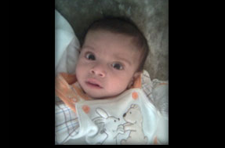
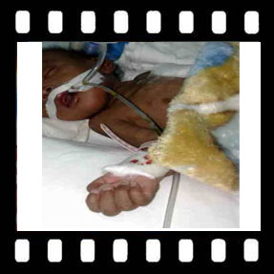
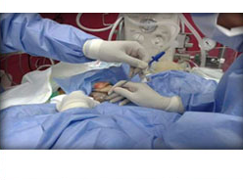
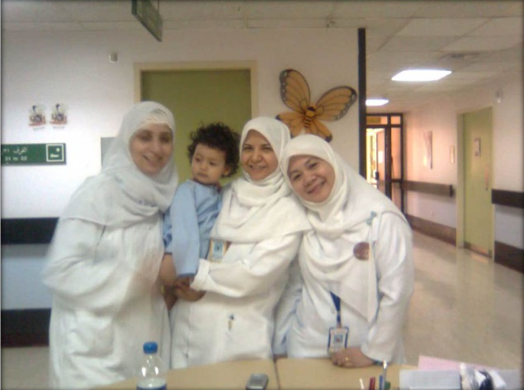
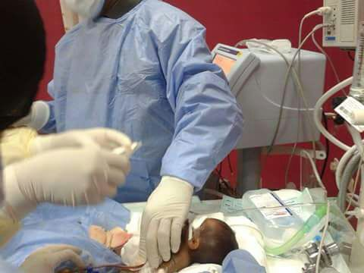
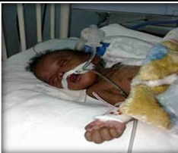
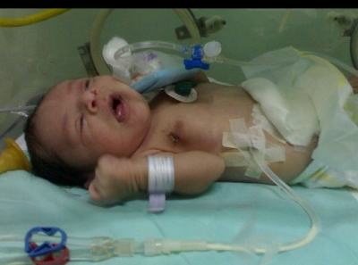
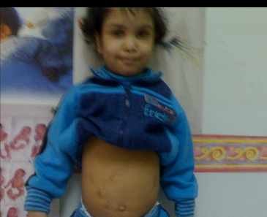
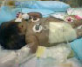
Thank you

Slide 56
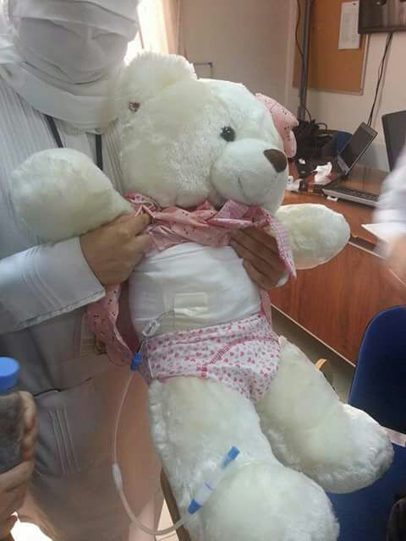
Saleh Al Shurafa – QCH - KSA

Slide 58
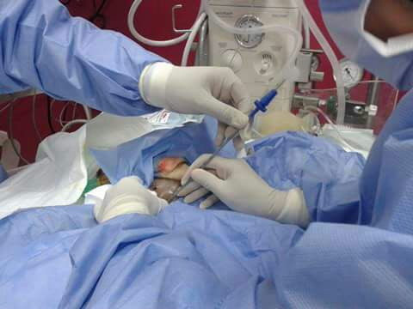
Saleh Al Shurafa – QCH - KSA

