Slide 1
“Overactive bladder’’ in children diagnosis and treatment
Prof Chebl Mourani
2nd IPNA TC (join ISN –IPNA )
Beirut 13-15 june 2019
Notes:
Dear colleges
Welcome
However we need basic knowledge about the bladder function before speaking about diagnosis leaving medical treatment to prof Bogaert

Slide 2
International Children’s Continence Society, overactive bladder (OAB)
The most common voiding dysfunction in children.
Urinary urgency, usually accompanied by frequency and enuresis
with or without urinary incontinence and UTI

Slide 3
Prevalence of OAB in children
15–20%
higher prevalence of OAB in boys
decreasing prevalence of OAB with age
23 % at five years old
12 % at 13 years old
Untreated OAB persists throughout adulthood

Slide 4
OAB has a damaging impact on quality of life
Negative influence on social, emotional, and behavioral well-being
Quality of life improvement is at the foundation of OAB treatment
Can be challenging and might involve multiple failed attempts before success is achieved

Slide 5
Reminder : Anatomy and Physiopathology
Bladder: smooth muscle cells
Sphincter: striated muscle cells
Internal sphincter: smooth muscle cells
Central nerve system
Peripheral nerve system
Notes:
The bladder consist of smooth muscle cells
The sphincter consists of striated muscle cells
There exists a transition zone in the bladder neck where smooth muscle cells gather in a sphincter like configuration, the internal sphincter

Slide 6
BLADDER
BODY (DOME)
BLADDER
BASE
Trigone
Internal sphincter
Proximal Urethra
Striated Sphincter

Slide 7
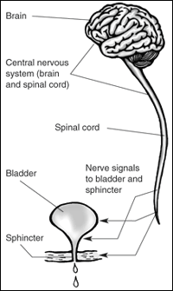
Neuro-anatomy: Central Nerve System (CNS)
cortex
Pons
Onufs’
Nucleus
Notes:
Normal urination needs the coordination of the brain ,pons spinal cord spec the onuf nucleus in the scaral region where departure and arrival
Neves aff and eff nerves controlling bladder and sphincters

Slide 8
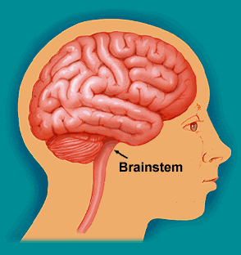
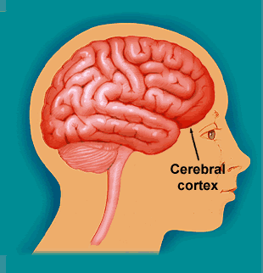
Neuro-anatomy: Central Nerve system
CORTICAL
INHIBITION
PONTINE
COORDINATION
Notes:
Under the control of the CNS
2 roles
Pontine coordination
Cortical inhibition.

Slide 9
Afferent peripheral nerves
Urothelium
D9
D10
D11
hypogastric
pelvic
pudendal
nerves
D12
L1
L2
Notes:
Afferent peripheral nerves get information from the urothelium of the bladder and are responsible of relaxation of bladder

Slide 10
Efferent peripheral nerves
parasympathetic or cholinergic
S2
pelvic
nerve
S3
S4
Notes:
Eff PS or cholinergic responsible of contraction and emptying

Slide 11
Anticholinergic activity
muscarinic receptor: predominantly M3
Notes:
Acethycholine is a the neurotransmitter acting on muscarinic receptors (6) leading to contraction of bladder many others

Slide 12
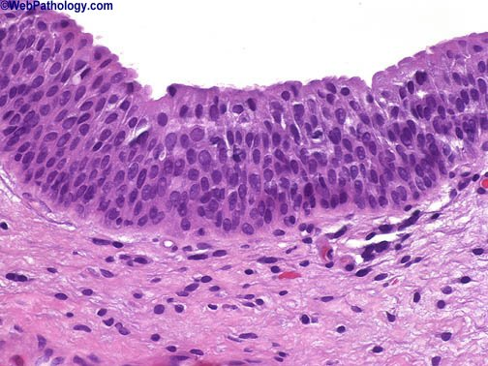
Urothelium
KE Anderson: Bladder activation: the afferent mechanisms. Urology 59: 43-50, 2002
Fry CH et AL: Control bladder function by peripheral nerves: avenues for novel drug targets. Urology 63: 24-31, 2004
Notes:
On histology this is a biopsy showing the urothelium departure and arrival of the nerves and w can imagine that drugs should act on this regions

Slide 13
Much is known, much more is unknown
ATP
Substance P,
Calcitonin gene-related peptide
VIP,Enkephalins
Cholecystokinin
Vanilloied receptors,
Prurinoceptors, Tachykinin,
Prostanoid receptors
P2X₃
Notes:
This true because we know actually the complicated mechanisms of interaction of all other neurotransmitter
ATP adenosine triphosphate acting on the purinergic receptors also many other neuroT acts ond A and C fibers and play I
Also roles in OAB
Any imbalance between all the neurotransmitter lead to OAB ( area of pharmaceutical researches for treating better OAB and other voiding
Disorders

Slide 14
Urologic Presentation Signs & Symptoms which suggest OAB
Frequent voiding (8)
Daytime Incontinence
Urgency at small bladder capacity
Nocturia
Nocturnal enuresis
Holding maneuvers
Urinary tract infections
VUR
Notes:
Healthy child attain day time and nighttime continence between 3 and 6 years with 4 to 6 time voiding per day

Slide 15
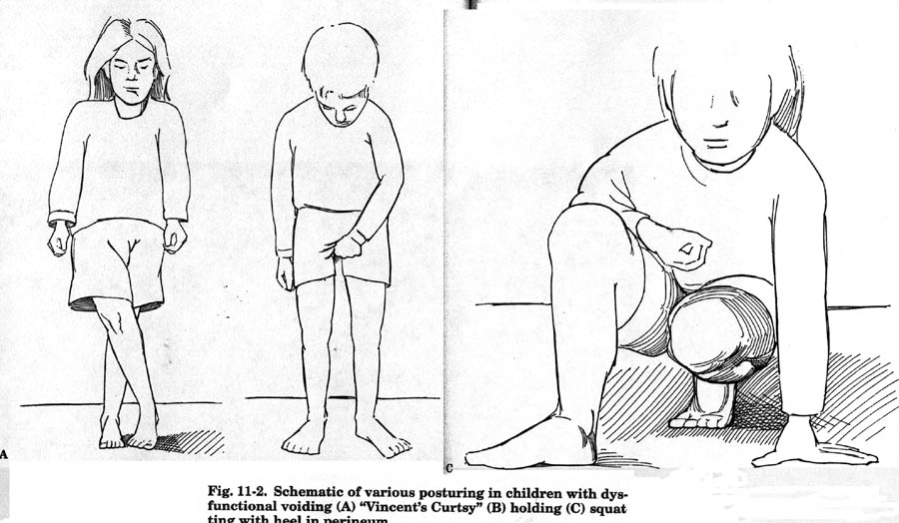
Holding Maneuvers
Notes:
To prevent urine leakage child exhibits various coping strategies in the supine or siting position such as squatting or crossing legs highly suggestive of OAB

Slide 16
GI Presentation Signs & Symptoms associated to OAB
Constipation
Encopresis
Obstipation (i.e., severe constipation causing obstruction)
Abdominal pain
Notes:
Constipation is very frequently associated to OAB and other vd

Slide 17
Evaluation of OAB

Slide 18
Evaluation of Dysfunctional Voiding
History
Physical Exam
Simple Lab Tests
Imaging
Urodynamics

Slide 19
History To characterize the Problem
Evaluation of dysfunctional voiding begins with a detailed history
History of current elimination problems
Detailed voiding history
Detailed Stooling history
Past /urologic History
UTIs
Constipation
Age of toilet training
Notes:
Nephrologist or pediatrician nighttime or daytime wetting or both
Primary or secondary voiding character
Place of chronic constipation ,presence or not uti

Slide 20
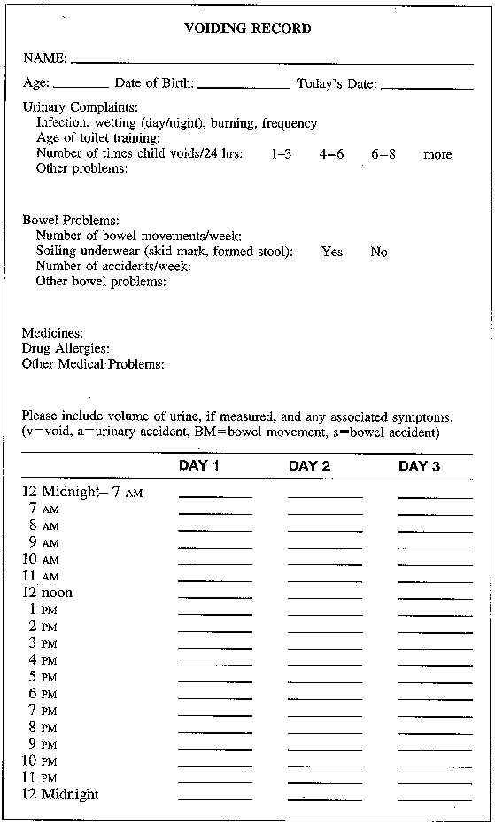
3 Day Elimination Diary-Your most powerful diagnostic tool & its CHEAP & BENIGN
Determines fluid intake
Characterizes voiding
Frequency of voids
Volume of voids
Accidents
Allows Characterization voiding disorder
daytime
Nighttime
Good time to do intake diary
Parents record liquid intake volume
Notes:
A frequency/volume chart or bladder diary is helpful in the evaluation of pediatric OAB symptoms. Ideally, these charts should encompass a 3-day period. This will allow assessment of the child’s functional bladder capacity.
A frequency/volume chart is used to record the volumes voided and the time of each micturition, day and night, for at least 24 hours. A bladder diary is used to record the times of micturitions and voided volumes, incontinence episodes, pad usage, and other such information as fluid intake, the degree of urgency, and the degree of incontinence. A record of the bowel frequency and any fecal soiling is also helpful.

Slide 21
History Irritable Bladder
Urgency & frequency
Small bladder capacity
behaviors to avoid leakage: Dancing, squatting, holding & posturing

Slide 22
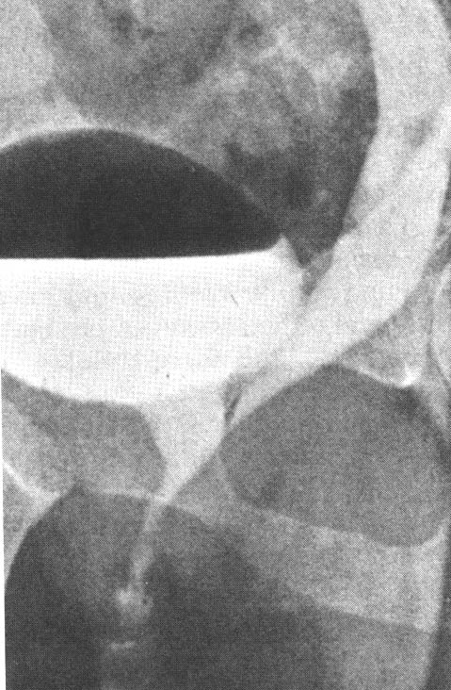
Ectopic Ureter:
Continuous incontinence in a girl suggests ectopic ureter that inserts distal to urethral sphincter or into the vagina

Slide 23
History Infrequent Voider or lazy bladder
Typically school girls with recurrent UTI & often with history of intermittent enuresis
Postpone voiding as long as possible
Voids 2-3 times per day
Large volume of urine
No void on awakening

Slide 24
Physical Examination Perineum & Genitalia
Signs of erythema or irritation perineum
Meatal stenosis in boys
Presence of labial adhesions in girls
Careful examination of the introitus for an ectopic ureter

Slide 25
Focused Neurolgogic Examination
Lumbosacral spine :
lipoma, sinus, pigmentation tufts of hair: clue to underlying occult myelodysplasia
Perineal sensation, lower limb function Peripheral reflexes
Checks lower motor neuron reflex
suggestive of a sacral neurologic lesion

Slide 26
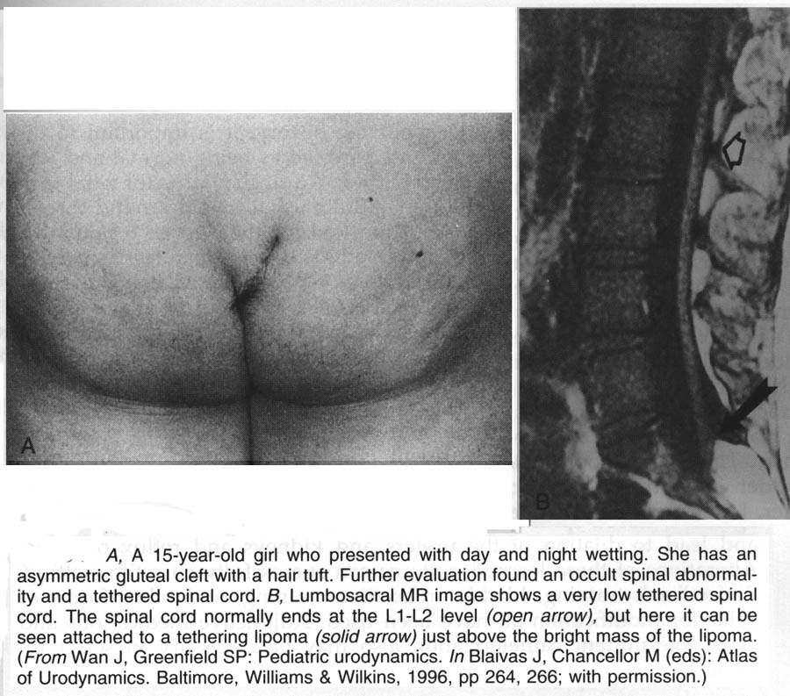

Slide 27
Routine Labs
Urine tests best obtained on 1st AM specimen after overnight NPO
UA
Specific gravity- over 1.020 rules out significant concentrating defect :D.I
Glucose
UC : R /O UTI
Notes:
Urinalysis
All children who present with OAB symptoms should undergo urinalysis. The primary aim is to rule out underlying UTI or glucosuria.

Slide 28
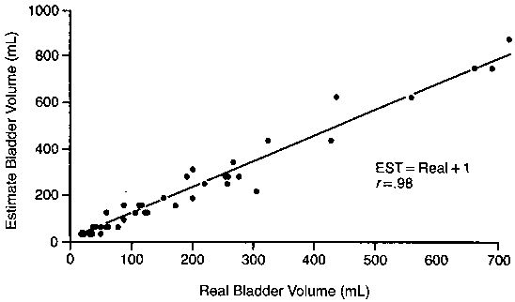
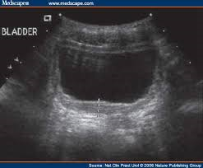
Sonography
Upper tract :
Size, cortical thickness Hydronephrosis,other malformations
Bladder:
3-4 mm measured at 50% of expected bladder capacity suggests OAB
Usually no post void residual
Notes:
Ultrasonography
Ultrasonography of the kidneys and bladder is useful in assessing renal size, cortical thickness, hydronephrosis, and duplicated collecting systems and associated anomalies (ectopic ureters and ureteroceles). Ultrasonography of the bladder may be obtained before and after voiding to assess bladder emptying.
In addition, determination of bladder-wall thickness may be useful. ^{[22, 23]} A bladder wall cross-section of more than 3-4 mm measured at 50% of expected bladder capacity suggests underlying detrusor overactivity.

Slide 29
Voiding Cystourethrography
spinning-top dilated proximal urethra
detrusor-sphincter dysfunction.
Notes:
Cystourethrography
Voiding cystourethrography (VCUG) is indicated in children with a A spinning-top dilated proximal urethra revealed by VCUG during the voiding phase suggests detrusor-sphincter dysfunction.

Slide 30
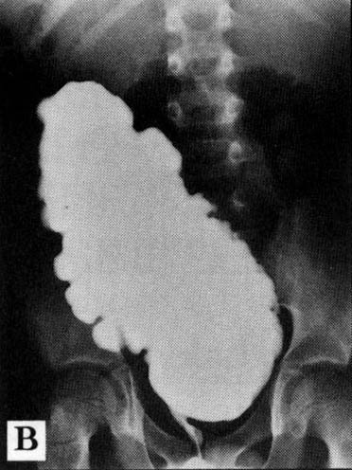
Voiding Cystourethrography
rule out vesicoureteral reflux.
Neurogenic bladder
~febrile UTI or recurrent UTIs
~abnormal flow pattern: bladder outlet obstruction as PUV or stricture, or Neurogenic bladder

Slide 31
Urodynamic Study
Multiple uninhibited detrusor contractions with
increased EMG activity and expressions of urgency

Slide 32
OAB Management :in any case Conservative Management
timed voiding every 2 to 3 hours during daytime
Parent and school collaboration is critical
children should void with their legs spread apart
footstool should be used
50% improvement rate behavioral therapy
Notes:
Children and families need to be educated about OAB and expectations from the different management options in order to have realistic treatment goals. In any case, timed voiding every two to three hours during daytime, should be instituted early on7 and the child should have sufficient periods of time to achieve complete emptying. Parent and school collaboration is critical to the establishment of this voiding routine and positive reinforcement with rewards or a multi-alarm watch might be helpful for this endeavor. In terms of voiding technique, children should void with their legs spread apart and a footstool should be used for the child’s heals to touch the ground if the toilet does not have a proper height. A 50% improvement rate of frequency and urgency symptoms has been reported in children after simple behavioural therapy.

Slide 33
Fluid intake, it has to be regular during the day
Fluid intake has to be regular during the day
minimized towards bedtime
Beverages that can trigger urgency :
Caffeine, chocolate or citrus, carbonated beverages should be avoided
Notes:
Concerning fluid intake, it has to be regular during the day, but minimalized towards bedime. Beverages that can trigger urgency and frequency symptoms, such as those containing caffeine, chocolate or citrus, and carbonated beverages should be avoided.

Slide 34
All children with OAB are constipated
Prompt and aggressive bowel management
in 1997, Loening-Baucke reported
Relief of chronic constipation resulted in disappearance of daytime and night time incontinence in 89% and 63% of patients
Bristol stool scale :
Staying well hydrated
High-fiber diet fundamental to a good bowel regimen
Laxatives are often necessary with initial bowel clean out
Notes:
Until proven otherwise, all children with bladder disorders are constipated, hence the necessity for prompt and
aggressive bowel management in these patients. In a 1997 article, Loening-Baucke reported that the relief of chronic constipation resulted in disappearance of daytime urinary incontinence and nighttime incontinence in 89% and 63% of patients, respectively.10 Because parents are often not the best judges of their children’s bowel habits, children must be questioned directly on the subject. The Bristol stool scale is an invaluable tool for this purpose. Staying well hydrated and having a high-fiber diet are fundamental to a good bowel regimen. Laxatives are often necessary and an initial bowel clean-out is occasionally required.

Slide 35
Biofeedback therapy
Better understanding and perception of the pelvic musculature
Induces greater pelvic floor control
Improvements in all children with voiding dysfunction and OAB

Slide 36
Biofeedback from 1979-2019
Biofeedback to manage voiding disorders in children was described by Maizels. in 1979
Introducing urodynamic biofeedback in 1986
In 1992 : technique has become less invasive, and development of computer games to maintain a high level of patient motivation
Through the use of visual, auditory, and/or tactile signals,
Goal : Control your Bladder

Slide 37
Animated BioFeedback

Slide 38
Animated BioFeedback

Slide 39
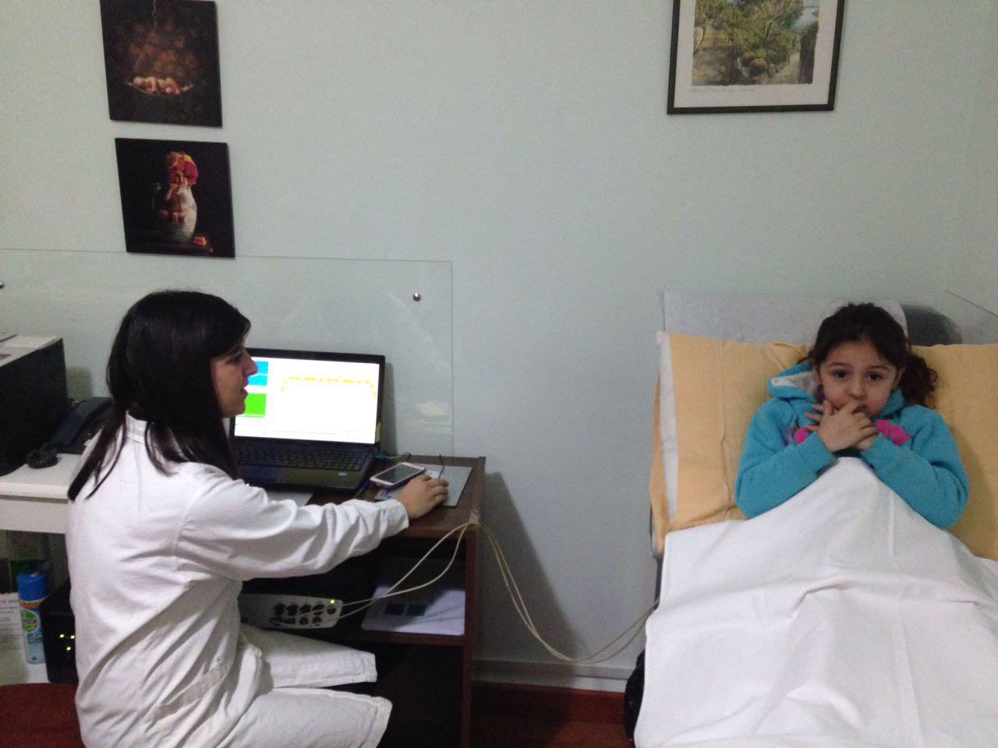
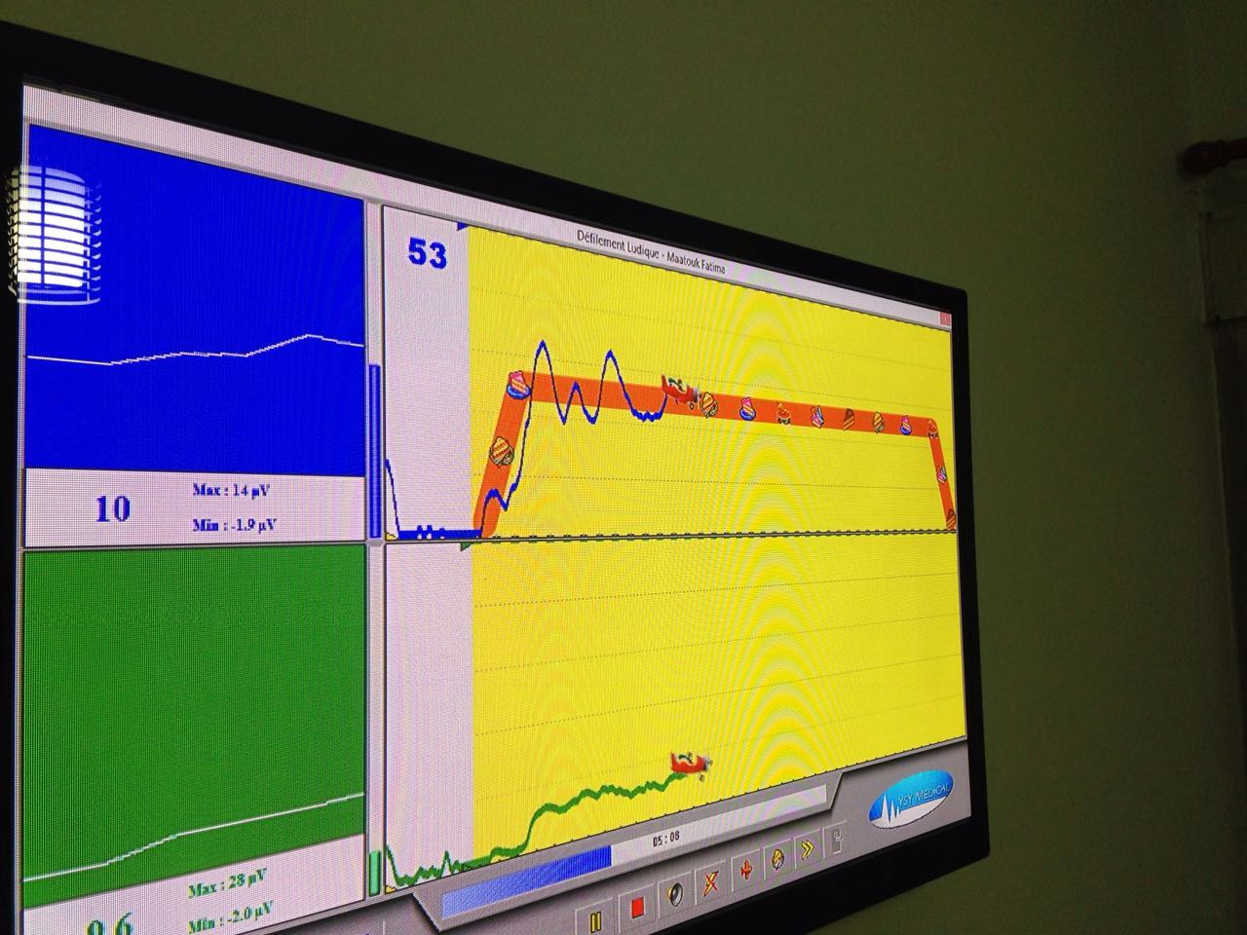
Animated BioFeedback

Slide 40
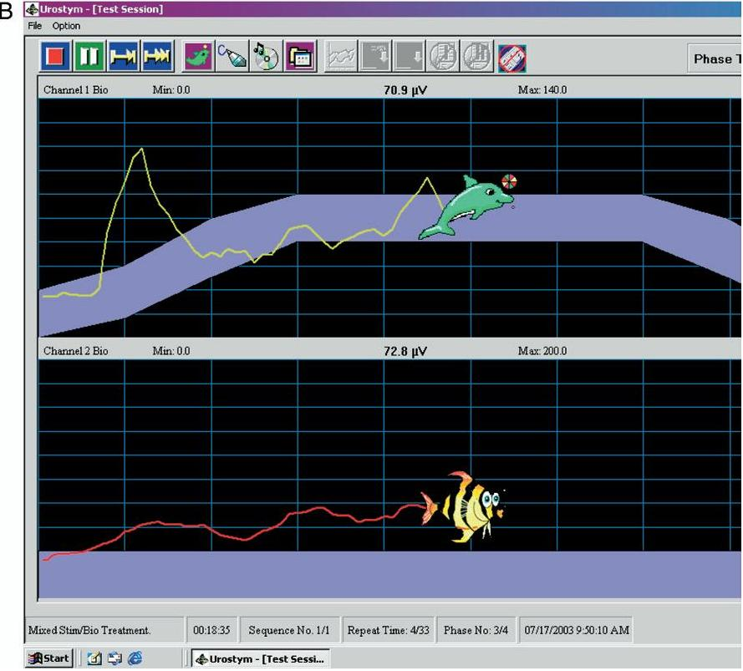

Slide 41
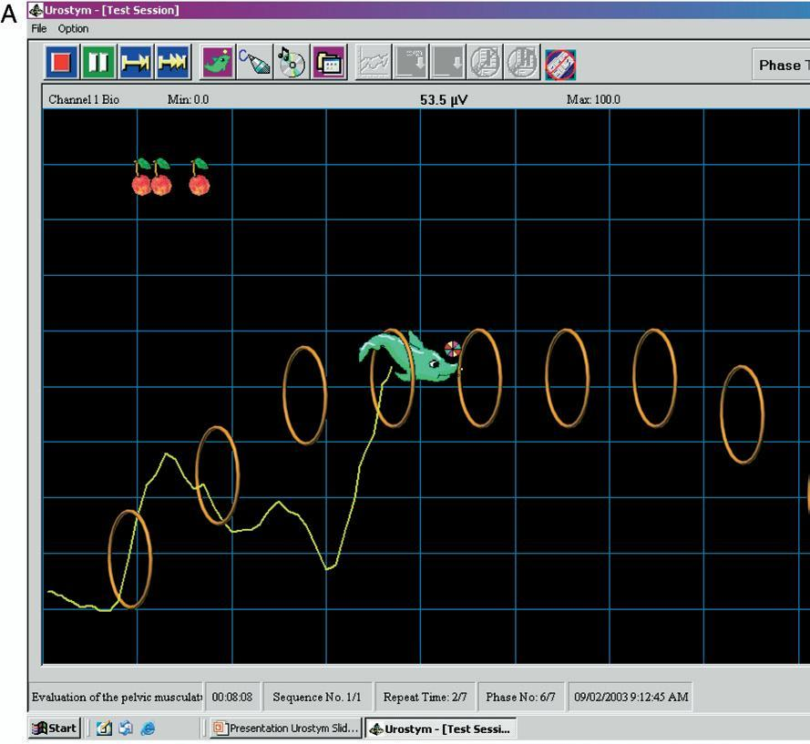

Slide 42
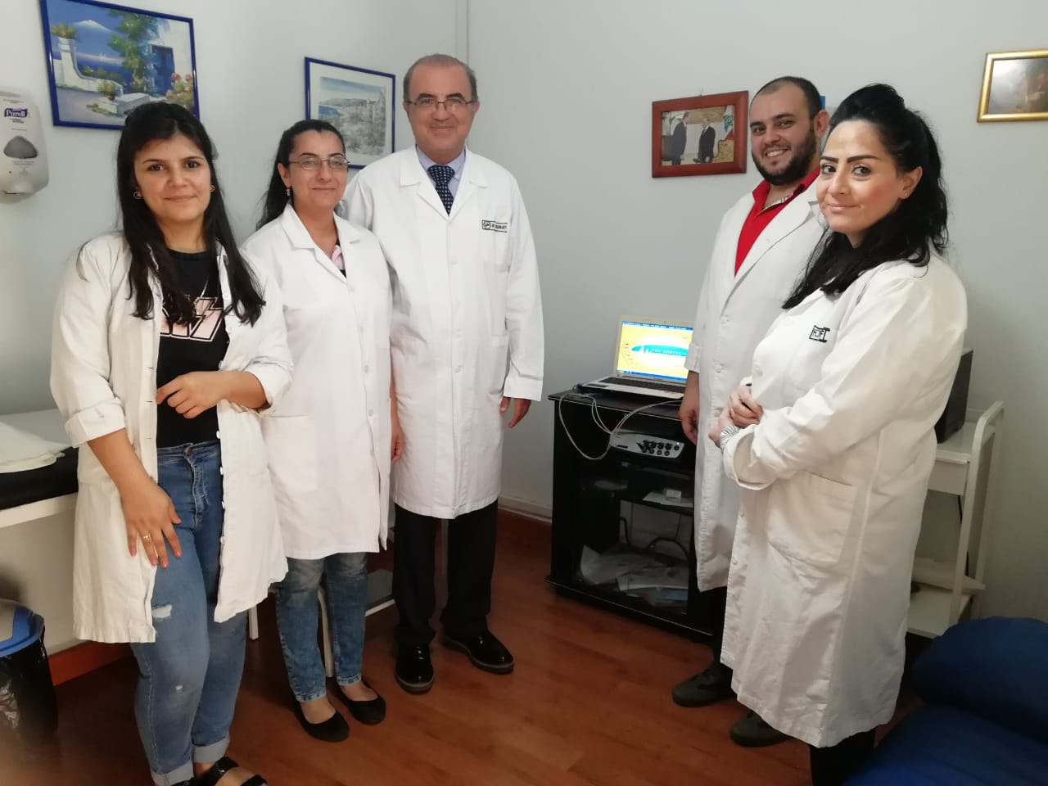

Slide 43
Conclusion
-OAB combines specific daytime voiding dysfunction signs , constipation with enuresis
-OAB diagnosis depends on results of :
-Detailed history
-Physical and neurological examination
-Laboratory studies , UT ultrasonography
-first line Treatment is conservative with relief of constipation and biofeedback

Slide 46
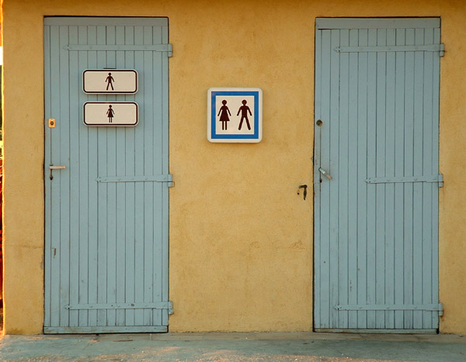
Thank You

