Slide 1
PD catheter placement techniques
Professor Paul Daher
Chief of department of pediatric surgery
Faculty of Medicine-St joseph University
IPNA-ISN 2019

Slide 2
Introduction
PD is a renal-replacement therapy.
Essentials elements:
-viable peritoneal cavity lined by a functional membrane
-attained with a catheter device through which dialysis solutions can be exchanged
-Less infection and mechanical complications (tissue attachment, tip migration, and pericatheter leaks)
→ Best method of PD catheter placement and our experience about 30 cases

Slide 3
CATHETER TYPES
Notes:
Subcutaneous portion : straight or swan neck
Cuff: single , dual cuff, disc and ball deep cuff
Coiled 16 cm portion containing 1mm side holes ; straight with 8cm portion containing 1mm side holes
Intra abdominal segment has multiple small holes and an open terminal end

Slide 4
The material of the catheter is either silicone rubber or polyurethane
No significant difference in functionality has been shown convincingly between straight and coiled-tip catheters with or without a preformed arc bend.
Akyol AM, Porteous C, Brown MW. A comparison of two types of catheters for continuous ambulatory peritoneal dialysis (CAPD). Perit Dial Int. 1990;10:63-6.
Ouyang CJ, Huang FX, Yang QQ, Jiang ZP, Chen W, Qiu Y, et al. Comparing the incidence of catheter-related complications with straight and coiled Tenckhoff catheters in peritoneal dialysis patients—a single-center prospective randomized trial. Perit Dial Int. 2015;35:443-9.

Slide 5
Advantages of Coiled-tip catheters:
provide for better dispersion of the dialysate during inflow → remains speculative.
Shape of curled hold visceral peritoneal surface away from side holes→ Better patency and outflow
Does not impinge on rectum→ no rectal discomfort
Catheters equipped with two cuffs provide better immobilization of the tubing within the abdominal wall
→Most utilized: double cuff with coiled tip.

Slide 6
CHOOSING PD CATHETER SIZE

Slide 7
PD CATHETER INSERTION
Peritoneum
The deep cuff is best implanted between the posterior sheath and fascia transversalis
The superficial cuff is positioned in the subcutaneous tissues 2 to 4 cm from the exit site → to prevent debris and bacteria
Upwardly directed exit sites should be avoided to prevent pooling of cutaneous bacteria and debris, perspiration, and shower water in the exit sinus, predisposing the patient to exit site and tunnel infections

Slide 8
PD CATHETER INSERTION PROCEDURES (3)
Percutaneous Needle-Guidewire Technique
Open Surgical Dissection
Surgical Laparoscopy

Slide 9
Open Surgical Dissection
Omentectomy is performed systematically
The peritoneum and posterior rectus sheath are closed with the internal cuff secured in between
The catheter then is directed to the desired skin exit site placed subfascia.

Slide 10
Surgical Laparoscopy
minimally invasive approach with complete visualization of the peritoneal cavity during the catheter implantation procedure.
Umbilical port for introducing the PD catheter and for the Camera
A right paramedian port is then introduced for manipulation
The catheter end is retrieved via a left introduced grasping forceps
The internal cuff is left in between the muscle and the peritoneum
The external cuff is then retrieved in the same manner of the open technic
The catheter tip is surely well placed in the pelvis and the mechanical outflow is checked by direct vision.

Slide 11
Open vs Laparoscopic

Slide 12
Open vs Laparoscopic

Slide 13
Open vs Laparoscopic

Slide 14
Open vs Laparoscopic
It has been stated that no single implantation approach has been shown to produce superior outcomes

Slide 15
Mechanical Flow Dysfunction secondary to:
Inside the peritoneum, bowel trapping , omental wrapping, and ensnaring by adhesions, or uterine tubes can result in outflow failure, secondary to catheter infection (drainage volume being significantly less than the inflow volume).
Within the catheter lumen, blood clots or fibrin can lead to slow inflow and outflow rates.
Migration of the catheter : Excessive bending, poor immobilization and fixation of the transmural segment

Slide 16
Based on our experience ( Take Home Message)
Open technique:
-safe (low risk of injury to viscera)
-Catheter placed using guide wire in douglas with or without fluoroscopy
-Ommentectomy is manadatory and is best done by open surgery to prevent complications
-Less expensive
the advantage of laparoscopy is principally reserved for recurrence procedures due to mechanical flow dysfunction
In both techniques it’s advisable to keep some fluid in the peritoneal cavity .

Slide 17
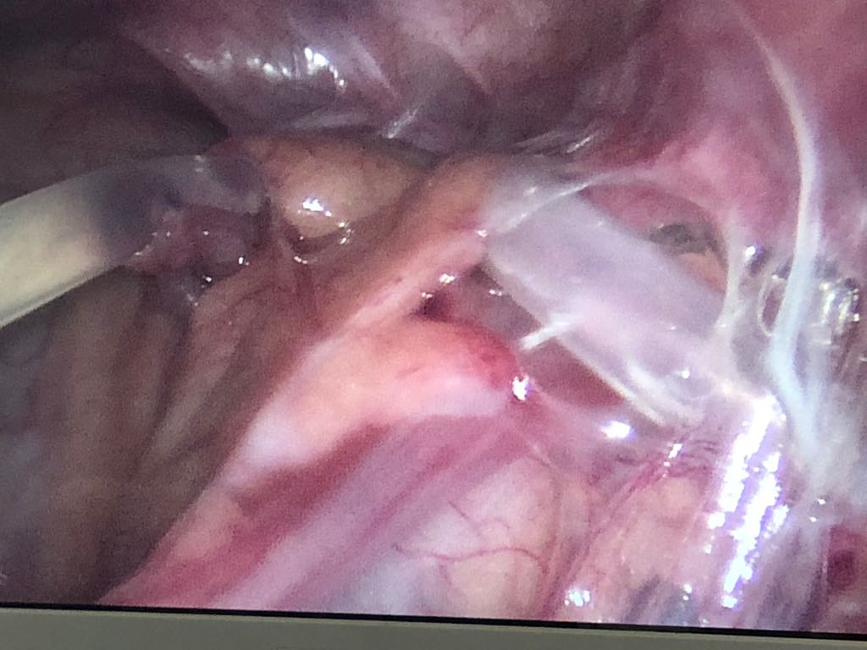

Slide 18
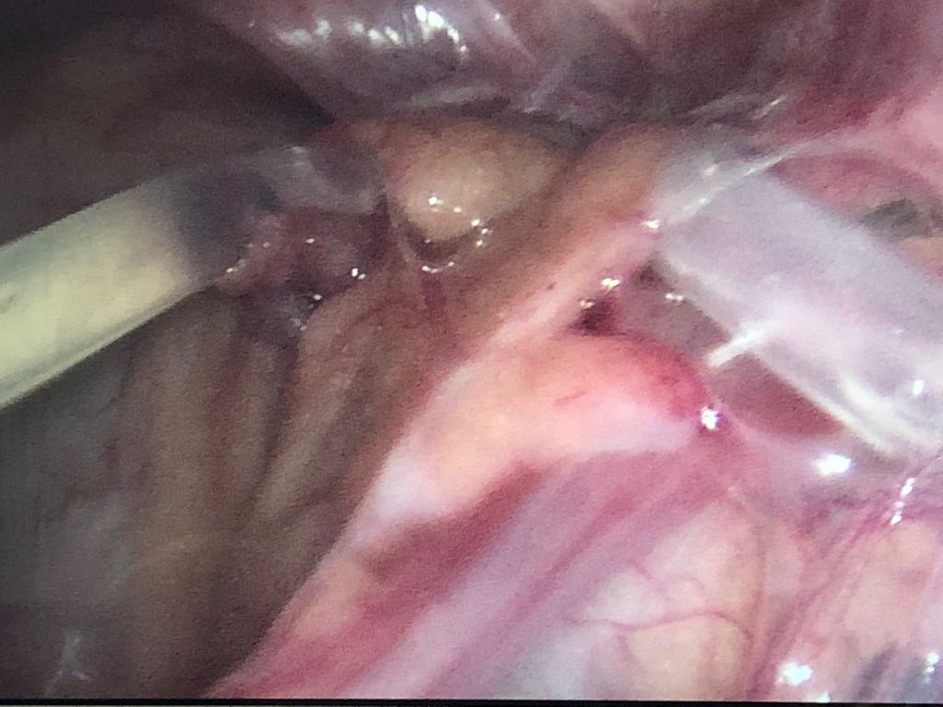

Slide 19
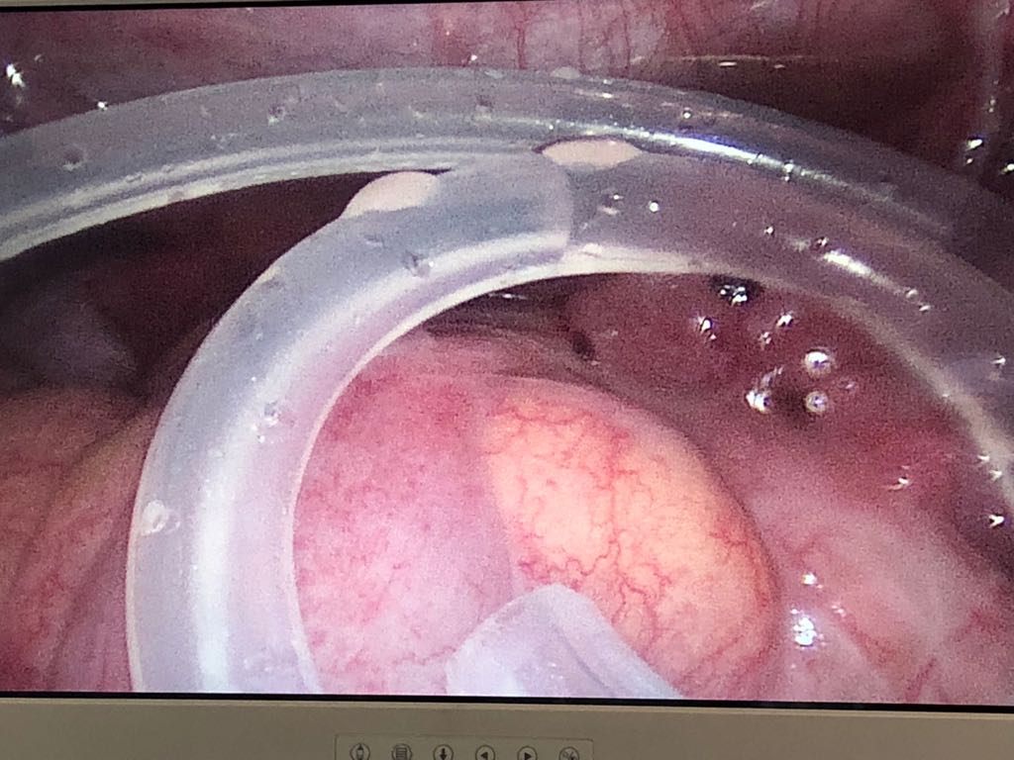

Slide 20
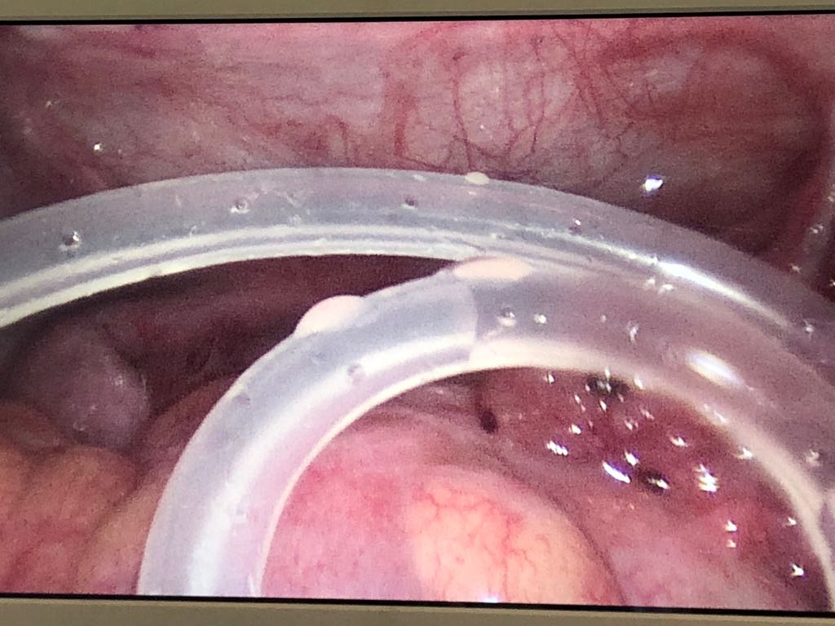

Slide 21
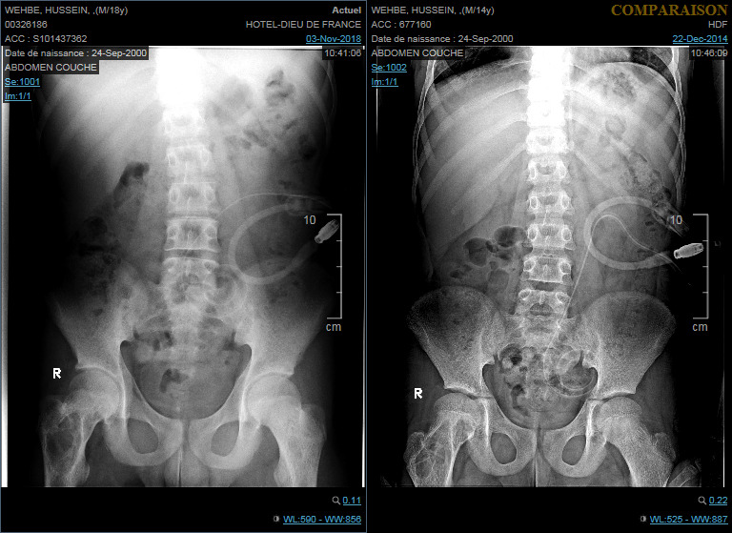

Slide 22
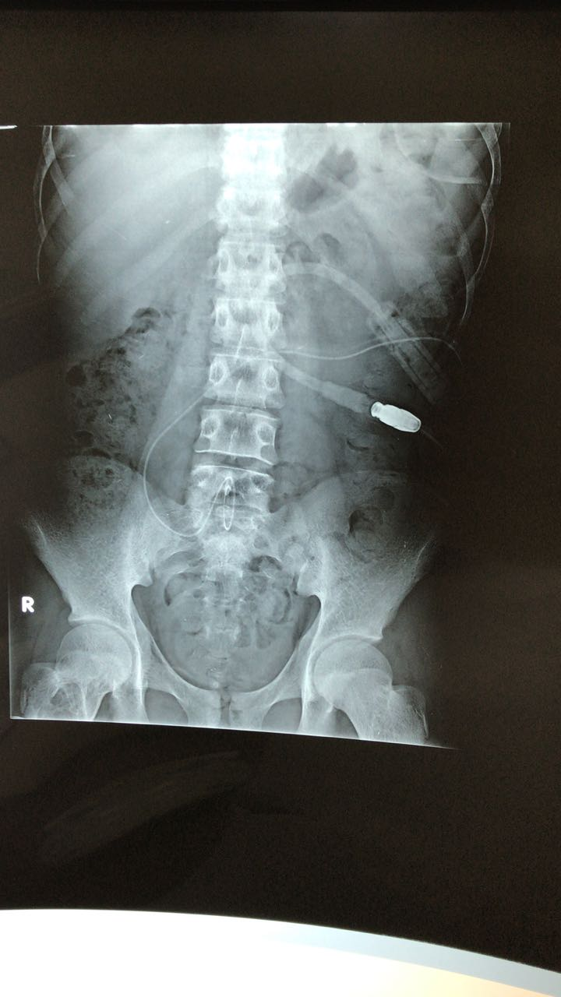

Slide 23
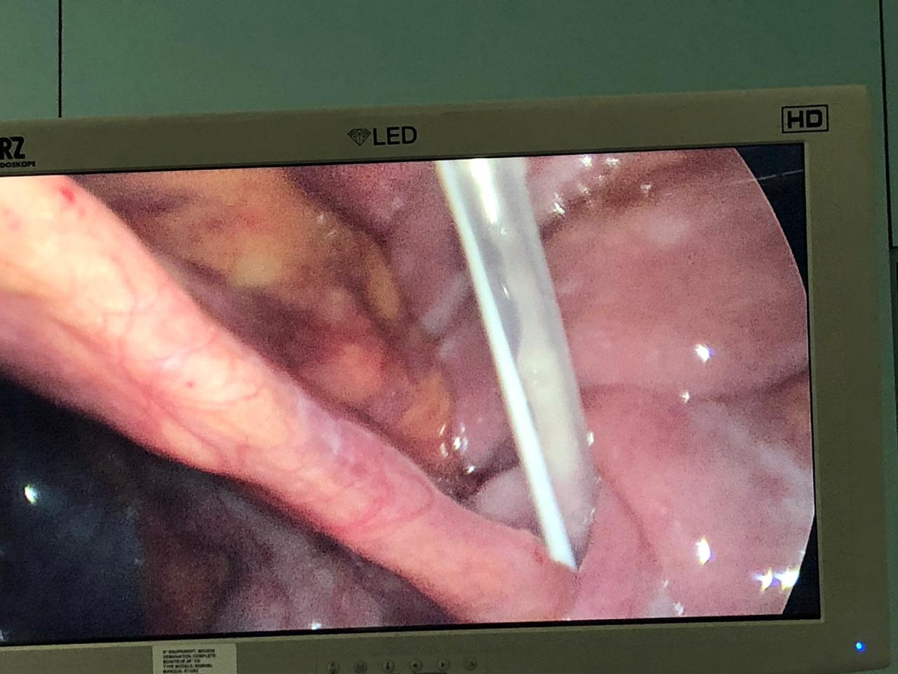

Slide 25
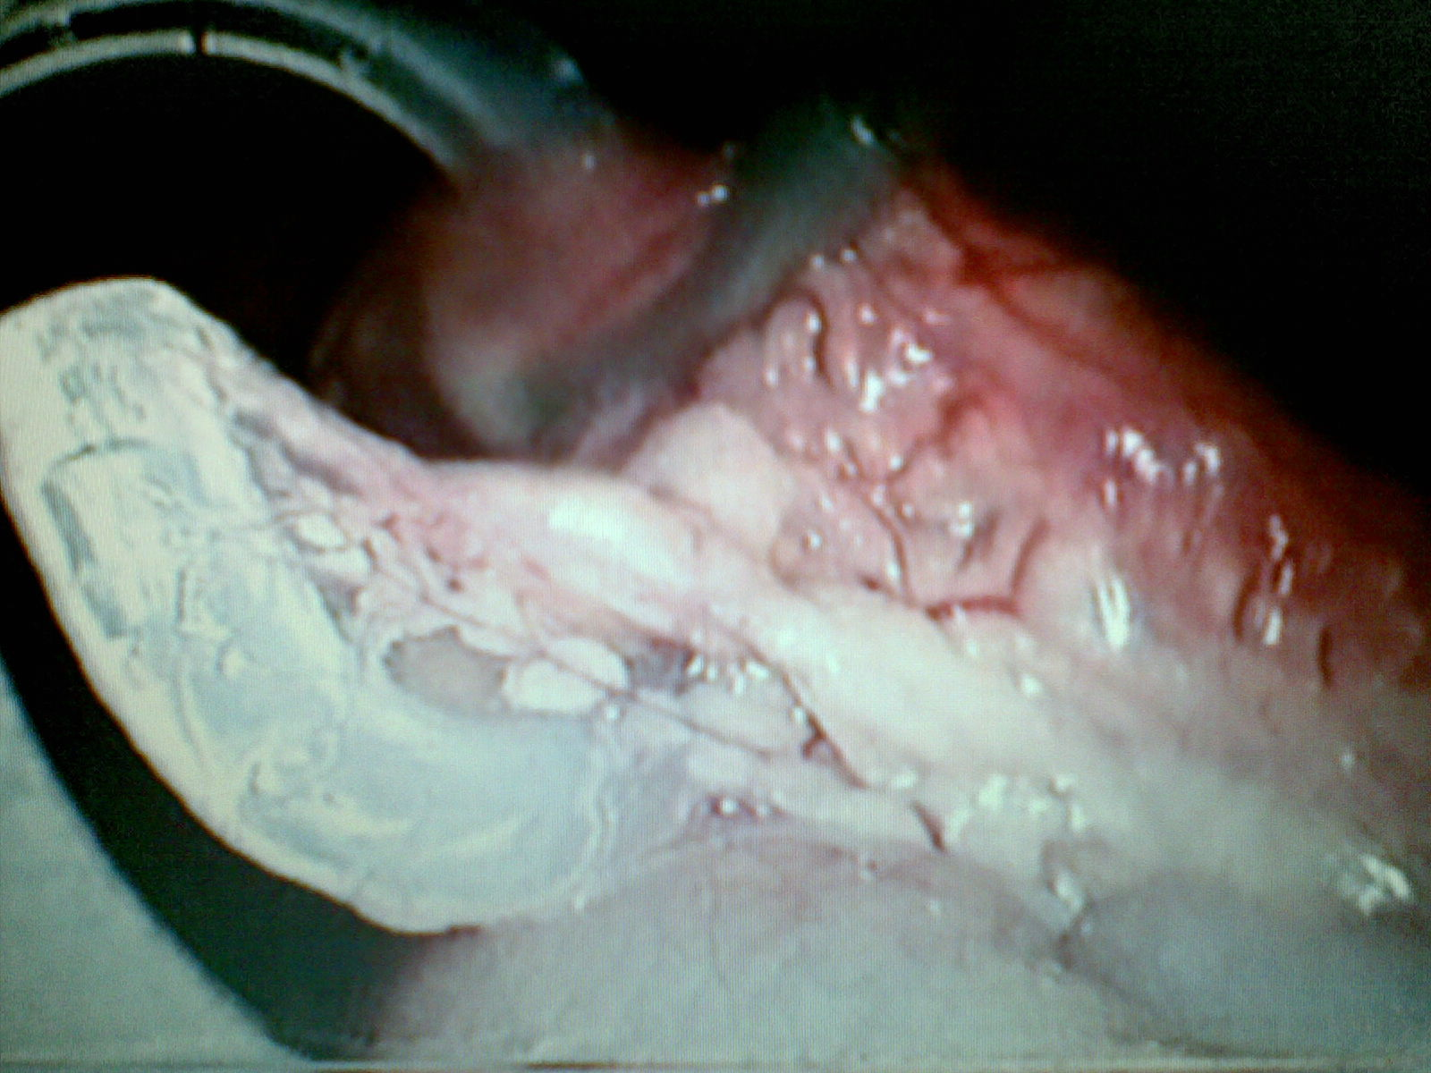

Slide 26
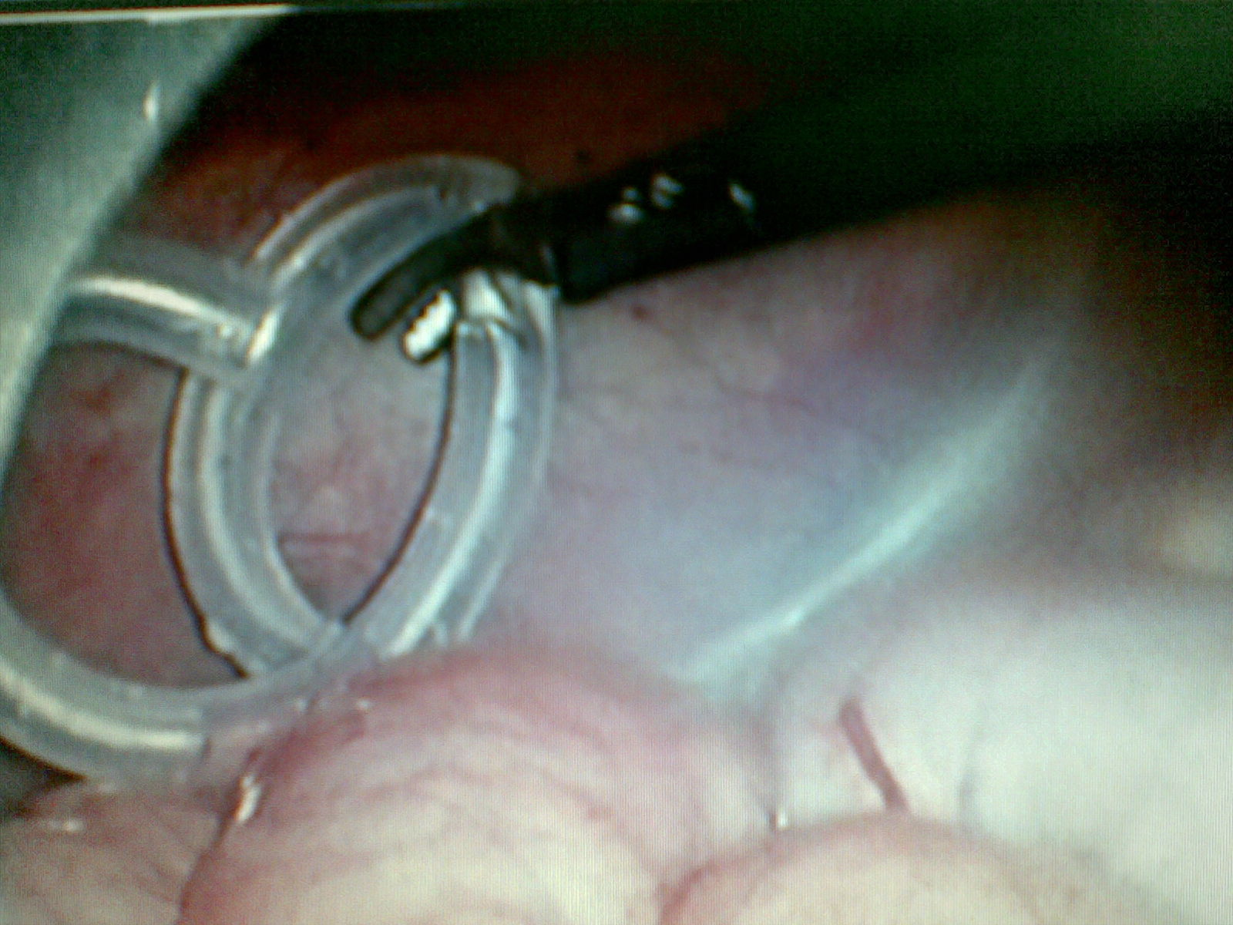

Slide 27
