Slide 1
Peritoneal Dialysis for Acute Kidney Injury in the intensive care unit
Mohamed B A Elfakky, MD, FRCP
Consultant Pediatric Nephrology
Al Qassimi Women and Child Hoispital
Sharjah – UAE

Slide 2
Disclosure
No conflict of interest

Slide 3
Objectives
An over view of AKI in the intensive care
Choice of dialysis modality in the ICU
PD in the ICU
Outcome

Slide 4
AKI
Definition of AKI
AKI reflects an entire spectrum of this process
There are different causative factors for AKI in the ICU

Slide 5
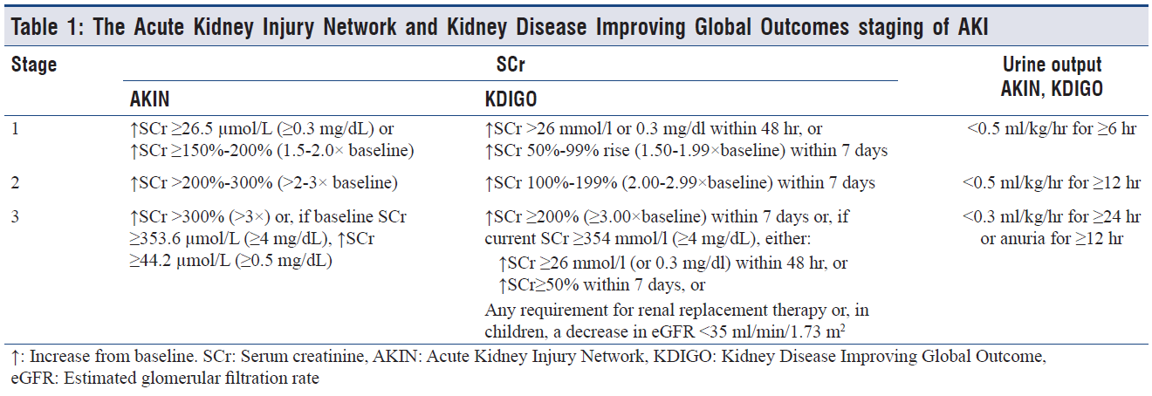
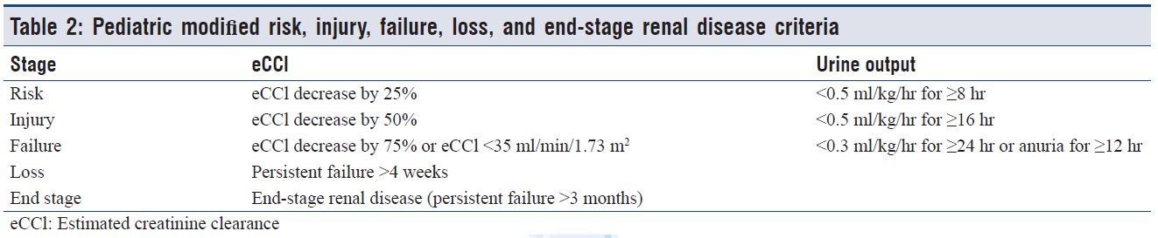
Classification of AKI

Slide 6
Acute Kidney Injury in the ICU
AKI is a common complication in PICU and NICU
About 30% of patients admitted to ICUs develop hemodynamic instability, cardiorenal syndrome, and/or sepsis
The AWARE study revealed AKI in 26.9% of children admitted to the intensive care unit (PICU)
It is associated with mortality between 20 - 30% & is much higher in children with MOF requiring mechanical ventilation
Infectious causes are common in developing countries while ischemic injuries is common in developed countries
Epidemiological data from developing countries is lacking
Mishra OP, PDI 2012, Kaddourah A, Nengl J Med, 2017, Hui-Stickle, Am Jkidney Dis 2005

Slide 7
AKI in the ICU
In a study of 3,396 PICU admissions, 5.7% of patients had some degree of AKI. 10% developed AKI during their stay
Any AKI at admission or worsening AKI was associated with increased mortality (Mortality increase with increase grade)
Children with AKI had double the length of stay
Those who develop AKI in the ICU had fourfold increase length of stay in the PICU
Intubated children and those on BP support medications >80% develop AKI and those with AKI has the worse prognosis
Akcan-Arikan A, Kidney Int 2007

Slide 8
AKI in the ICU
AKI was observed in in 37.4% of critically ill children in a multicentre from Saudi Arabia using the KDIGO definition
Data from centers in India showed comparable data
The incidence was higher in children receiving ECMO
Kari JA, Pediatr Nephrol 2018

Slide 9
RRT
RRT is frequently needed in children in whom supportive therapy is not enough to satisfy their metabolic demands or to be able to provide adequate nutrition
Choices of dialysis is variable and depend on:
  Patient criteria
  Centre specific criteria
Decision to initiate dialysis is complex and related to Patient hemodynamic instability
Clear cut consensus is lacking

Slide 10
Timing of Dialysis in AKI
Patients with AKI
Early Dialysis
Late Dialysis
Recover without
Dialysis
Die
without Dialysis

Slide 11
RRT for AKI
RRT was required in 11.4 % of children with AKI
In the AWARE study 1.5% of AKI children require RRT
Pediatric patients requiring RRT in the UK was 2.9% and may reach up to 8.6% in some centers
PD is the most widely available form of RRT specially in neonates and smaller babies
Safder O, BMC Nephrol 2019, Kaddourah A, Engl J Med 2017, Westrope CA, Peaitr Crit care Med 2018

Slide 12
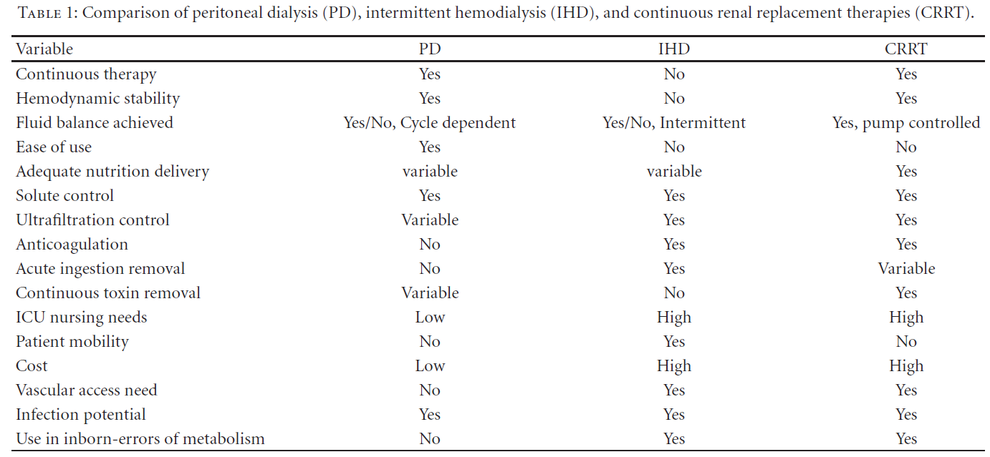
Choices of RRT in the PICU

Slide 13
Advantages of PD for AKI
PD modality is commonly used in small babies (neonates)
Its relatively low cost, simplicity, no need for anticoagulation, Can be done manually
Placement of central venous catheter and tolerance in hemodynamically unstable patients
No need for large extracorporeal circuit
After cardiac surgery (After cardiopulmonary bypass surgery)
Rajiit Basu, Int J of Nephrology 2011
J. M. Sorof, Pediatric Neph, 1999

Slide 14
Disadvantages of PD in AKI
  Not well suited in acute intoxication, sever metabolic disturbances (hypercatabolic status and MOF) and severe fluid overload.
  Major abdominal surgery or trauma
  Congenital abdominal malformations
  The UF cannot be accurately controlled (Specially when nutritional support is needed OR a need for extra-medications)
  Small solute clearance may not be optimal
  The presence of dialysate in the PD cavity (Splinting but supporting studies)
Rajiit Basu, Int J of Nephrology 2011
J. M. Sorof, Pediatric Neph, 1999

Slide 15
PD in AKI in ICU
In a study of RRT in PICU across the UK showed:
  PD was used in 65% of neonates vs 35% CRRT and HD
  PD used commonly post cardiac surgery (81%)
  In older age group CRRT represent 80%
  CRRT used commonly is children diagnosed with sepsis
  Survival was higher in the PD group 80% ??
  Older children receiving CRRT had the highest survival
A study from Saudi, most common RRT modality was PD (70 %), CRRT (17.2 %), and HD (8.6 %). The majority of their patients AKI patients were less than 5 years old (Neonates excluded)
Westrope CA, Peaitr Crit care Med 2018
Safder O, BMC Nephrol 2019

Slide 16
Outcomes
No prospective pediatric studies evaluated the impact of dialysis modality in the outcome of children with AKI in the ICU
An adult study compared CVVHF with Continues PD
  HF provided higher urea and creatinine clearances with faster correction of fluid overload
  However, there was no difference in mortality or hemodynamic stability
In most pediatric studies; hemodynamic instability at the start of RRT, hypotension, use of inotropes, presence of MOF, use of ECMO were all associated with increased risk of mortality
Georje J, Perit Dial Int 2011

Slide 17
PD in AKI, TIPs
PD is less effective in severe acute illness of pulmonary oedema, poisoning, drug overdose and hyper catabolic states
Small solute clearance in lower in PD
Clearance of high molecular weight solutes is higher with continuous PD than with HD
UF is maximum at the beginning of PD exchange (Glucose is high), when glucose is absorbed UF drops
Tidal PD (Can provide better clearance but ??)
The large peritoneal surface area in infants (is an advantage)

Slide 18
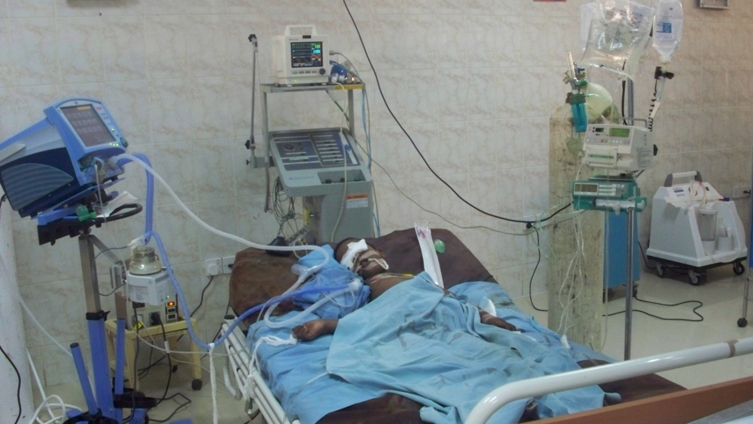

Slide 19
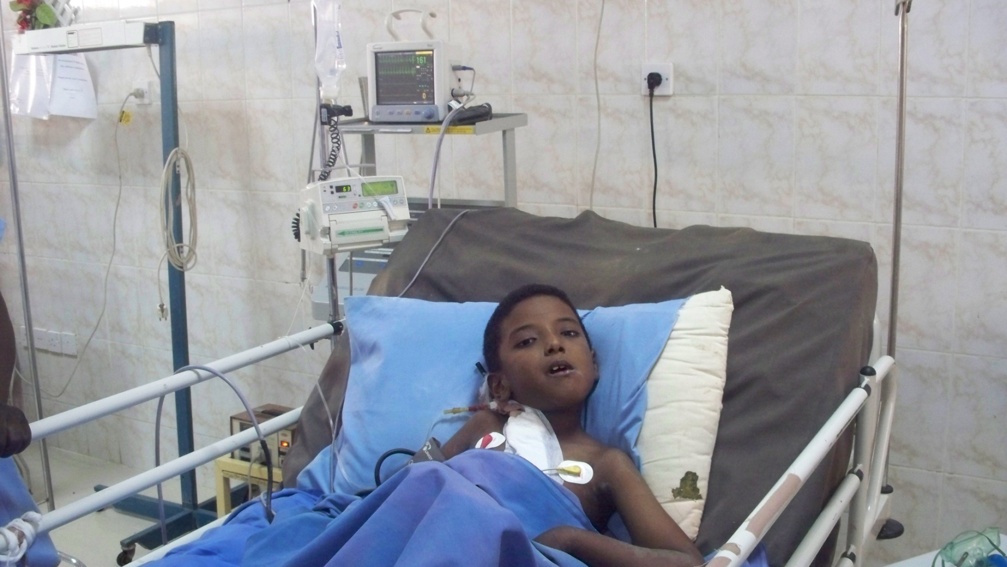

Slide 20
Finally
Patients is considered receiving adequate dialysis if:
  The need of inotropic support decreased
  Oedema resolved
  UF obtained is sufficient for nutrition support
  Metabolic parameters is improving
In principal: adequate dialysis is defined as RRT that makes patient clinical condition improve

Slide 21
In conclusion
Controversy exist regarding the use of PD
PD is an important form of RRT and has its own indications
  PD for AKI markedly decreased in favor of CRRT in developed countries (Different reasons) With the decreased usage of PD, clinical experience will also decrease due to lack of exposure
Decision about dialysis modality is based on:
  Local expertise, resources available and clinical status
PD is very attractive in developing countries and life saving
ISN/IPNA and the 0 by 25 initiative

Slide 22
Thank You

