Slide 1
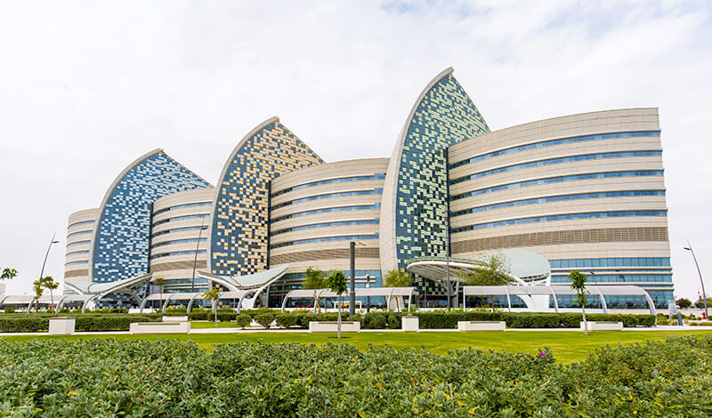
Practical Considerations in AKI and CRRT in Children
Ahmad Kaddourah, MD, MS
Pediatric Nephrology Consultant
Assistant Professor of Clinical Pediatrics
Director of the Center for Acute Nephrologic Extracorporeal Therapies (CANET).
Sidra Medicine
Weill Cornell Medical College in Qatar
akaddourah@sidra.org

Slide 2
Disclosures
Pediatric Acute Care Nephrology and Dialysis Fellowship at Cincinnati Children’s Hospital Medical Center was supported by an educational grant from Gambro Renal Products.
Sidra Internal Research Fund

Slide 3
Objectives
Pediatric Population and the Definition of AKI
Epidemiology of AKI and CRRT Utilization in Critically Ill Children
Options for Conducting CRRT in Children
CRRT dose
CRRT and ECMO
Notes:
Start to talk about why it is important to recognize it

Slide 4

Pediatric Population and the Definition of AKI

Slide 5
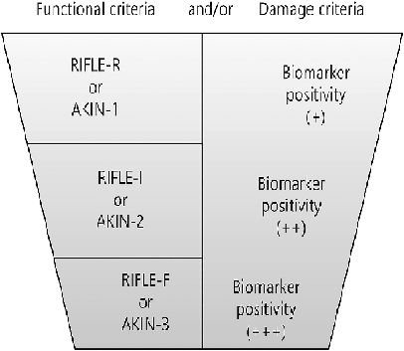
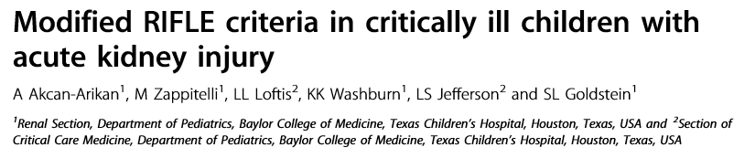
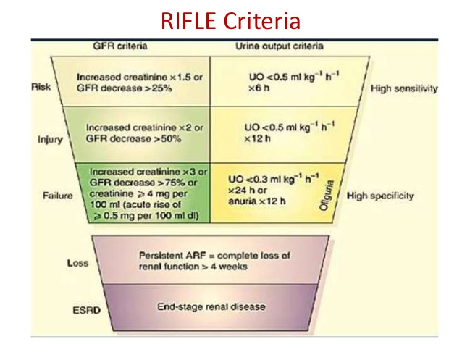
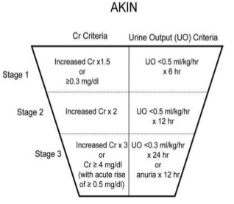
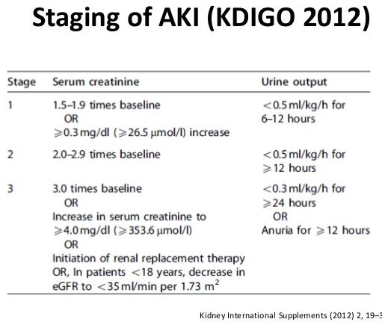
AKI Definition Over Time
No clear definition
2004
2007
2012
ADQI
Mehta RL, et al.Crit Care. 2007;11(2):R31.
Bellomo R, et al. Crit Care. 2004;8(4):R204–12.
Notes:
Acute kidney injury (AKI) is defined as a rapid decline in glomerular filtration rate
(GFR) leading to accumulation of waste products. AKI is common, affecting one
third of the children admitted to intensive care unit (ICU) and is associated with
poor outcomes including increased mortality and morbidity among critically ill
children [1]. Severity and progressions of AKI is directly associated with stepwise
increase in mortality and other adverse outcomes. Therefore, a standardized definition
of AKI is particularly important to diagnose AKI and stratify AKI severity, in
order to manage these patients better. In the past, available literature included multiple
definitions for renal failure based on different thresholds of serum creatinine or
blood urea nitrogen, with or without contribution from urine output, or requirement
of renal replacement therapy, which made detection, diagnosis, classification, and
study of AKI rather difficult. In an effort to better define AKI, three standardized
consensus classifications have been proposed: (1) RIFLE (Risk, Injury, Failure,
Loss, End-stage kidney disease) criteria was developed by the Acute Dialysis
Quality Initiative (ADQI) in 2004 for adult patients by using changes in serum creatinine
levels from baseline and/or decrease in urine output (Table 1.1) [2]. RIFLE
definition was adapted for children by using change in estimated creatinine clearance
from baseline, which is referred to as pediatric RIFLE (pRIFLE) definition
(Table 1.1) [3]. In an adult study, increase of serum creatinine 0.3 mg/dl was found
to be associated with 70% increase in risk of death; those results were replicated
later in a pediatric study where increase of serum creatinine of 0.3 mg/dl was associated
with increased mortality risk in a population with decompensated heart failure
[4, 5]. (2) Further refinement of RIFLE criteria was developed by acute kidney
injury network (AKIN) in 2007 which included the additional criterion of 0.3 mg/dl
increase in serum creatinine in less than 48 h (Table 1.2) [6]. (3) Finally, in 2012
several aspects of RIFLE, pRIFLE, and AKIN criteria were integrated into a single
definition for pediatric and adult patients by the Kidney Disease Improving Global
Outcomes (KDIGO) classification (Table 1.3) [7].

Slide 6

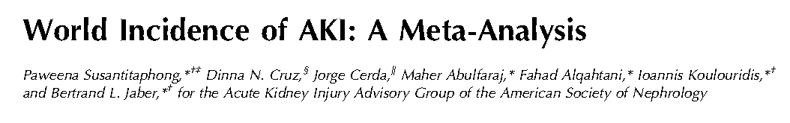
Chances to Get AKI are Equal Between Hospitalized Children and Adults.
Notes:
This is 154 studies that inckudes 3.5 miliion patients

Slide 7

Epidemiology of AKI and CRRT Utilization in Critically Ill Children

Slide 8
AWARE Study
Largest prospective database in critically ill children from more than 30 countries.
Observational Cohort of more than 6000 critically ill children
Notes:
AWARE is spelled as: Assessment of Worldwide AKI, renal angina and Epidemiology

Slide 9
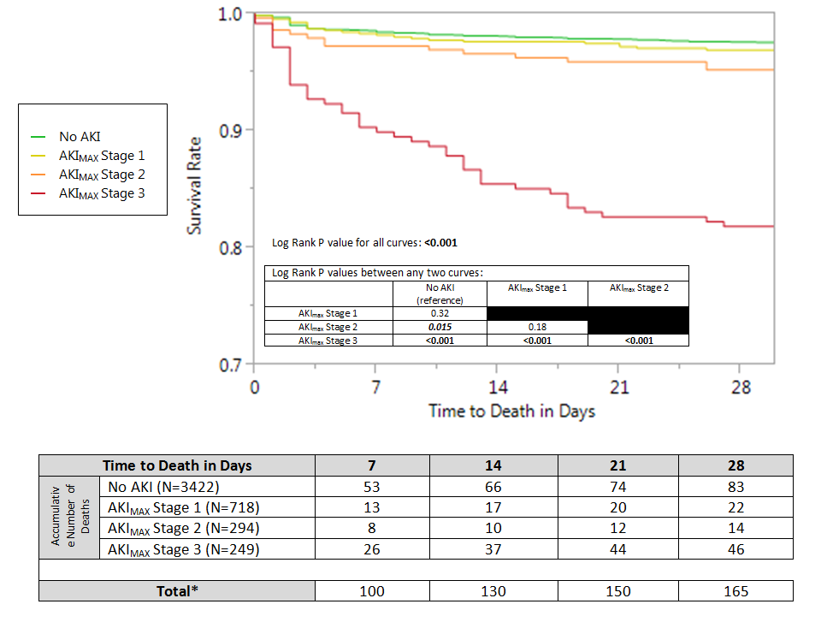

Slide 10

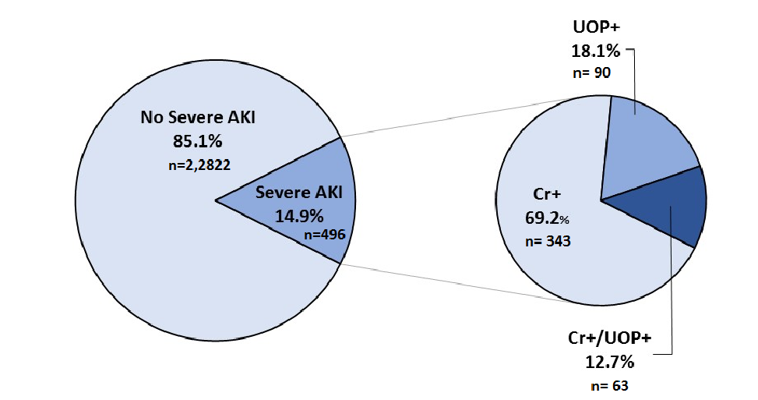
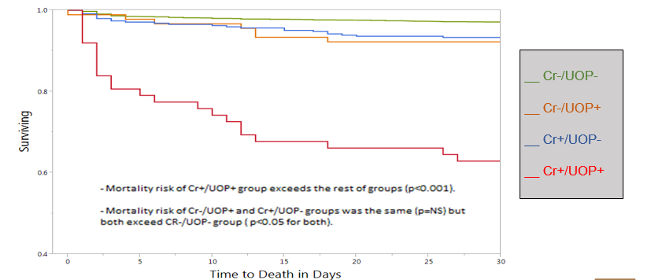

Slide 11
AWARE Study
73 (13.4%) out of 543 received RRT
0 (0%)
PD
17 (23%)
IHD
66 (90%)
CRRT
O (0%)
SLED
12 (18%)
CVVH
7 (11%)
CVVHD
49 (74%)
CVVHDF
Notes:
Remember, 73 out of 543: these are stage 2 and stage 1 AKI.

Slide 12

Options for Conducting CRRT in Children

Slide 13

Adapted from Devices Designed for Adults

Slide 14
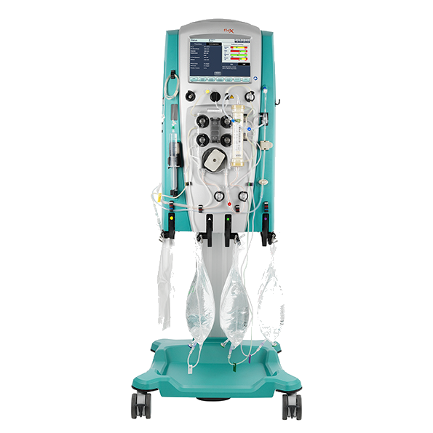
Prismaflex System – Baxter
Modalities: CVVH CVVHD, CVVHDF, and SLED
Compatible all anticoagulation protocols.
- Integrated citrate – anticoagulation protocol.
Extracorporeal Volumes
Set Model | Membrane | Surface Area |  | Volume | Recommended weight (kg) to use
HF 20 | Polysulfone | 0.2 m² |  | 60 ml | < 11 kg
ST 60 | AN 69 ST | 0.6 m² |  | 93 ml | 11-30 kg
HF 1000 | Polysulfone | 1.1 m² |  | 165 | > 30 kg

Slide 15
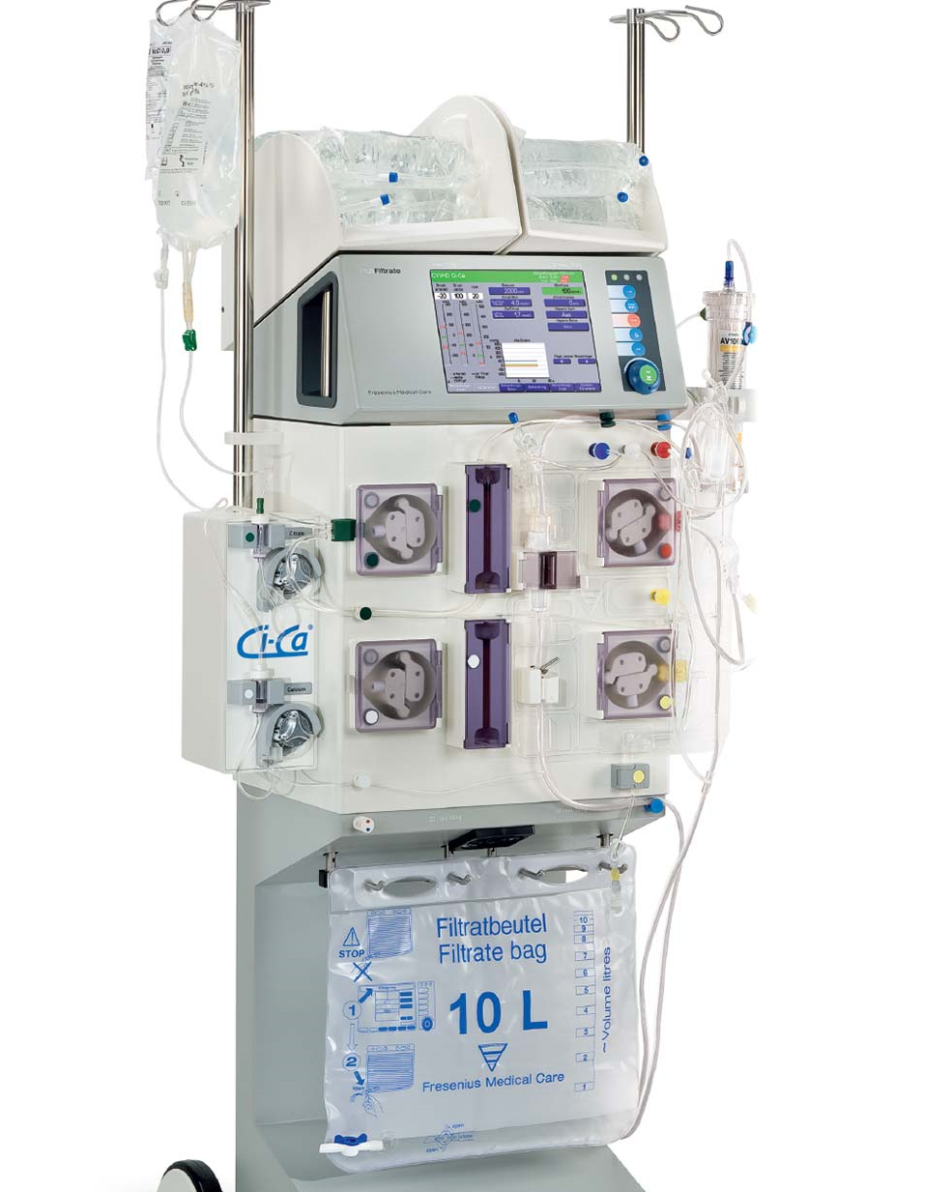
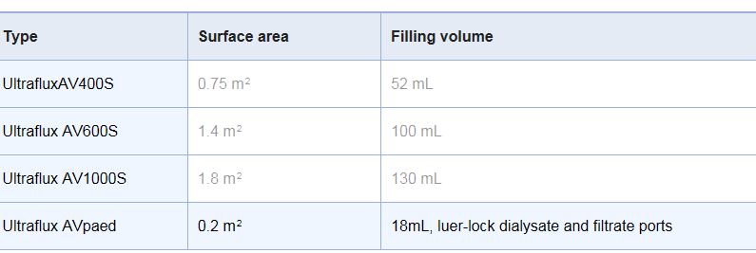
MultiFiltrate System – Fresenius
Modalities: CVVH CVVHD, CVVHDF, SCUF, SLED and PLEX
Compatible with all anticoagulation protocols.
- Integrated citrate – anticoagulation protocol.

Slide 16
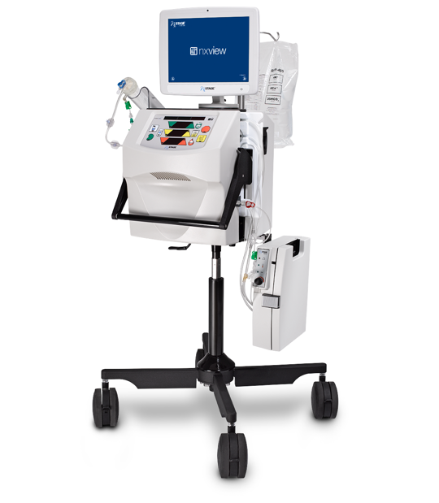
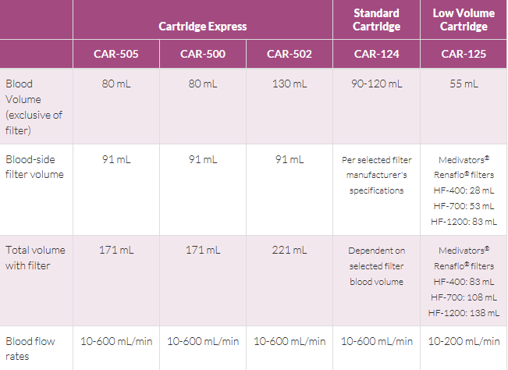
NxStage System One – Fresenius
Simple System
Modalities: CVVH, CVVHD, ,SCUF, or TPE treatments
Notes:
The nxt stage is owned by Freseniusm now
Very simple, good for home dialysis – Mulipleuse
Volumetric system, no scales and no waste bags.
Citarte is managed by the user, no Citrate protocol;
Does not do CVVHDF

Slide 17
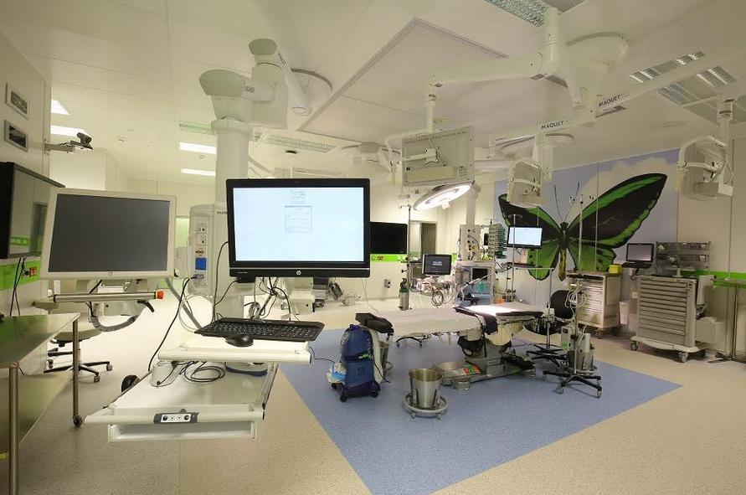
Devices Designed for Children

Slide 18
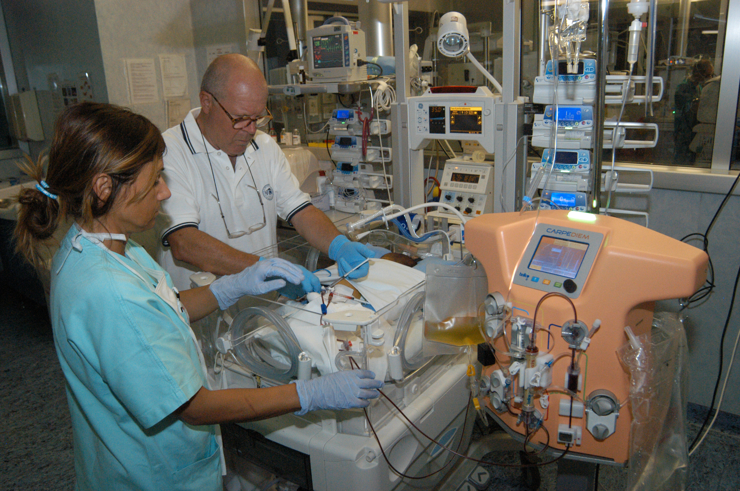

CARPEDIEM
The first report of using this device was in 2014*
First case: 2.9 kg neonate with haemorrhagic shock, multiple organ dysfunction, and severe fluid overload for more than 400 h with the CARPEDIEM.
By the end of 2018**
  13 children received 1,008 h of CVVHD during 95 sessions.
  0.15 and 0.25 m2 filter.
  The median weight was 3 kg (interquartile range [IQR] 2.5-6.2).
  5 and 6.5 Fr double-lumen central vascular access.
  The median prescribed Qb was 17 mL/min (IQR 10-29.5)
  The most common cause for "downtime" was clotting that however occurred in only 3% of all treatments
Ronco et al, Lancet 2014
** Vidal et al, Blood puri, 2019
Notes:
We report the first worldwide experience with continuous veno-venous hemodialysis (CVVHD) in children using the last generation Cardio-Renal Pediatric Dialysis Emergency Machine (CARPEDIEM)TM device. Thirteen children received 1,008 h of CVVHD during 95 sessions, using a 0.15 (n = 7) or a 0.25 m2 (n = 6) hemofilter. The median weight was 3 kg (interquartile range [IQR] 2.5-6.2). In 10 patients, CVVHD was conducted using a 5 Fr double-lumen central vascular access, whereas in 3 children, bigger sizes were used (6.5 and 8 Ch). The median prescribed Qb was 17 mL/min (IQR 10-29.5), with a median Qd of 10 mL/min. Circuits were primed with 5% albumin in 12 out of 13 patients, using anticoagulation with heparin in all 13 cases. The median delivered/prescribed time ratio yielded a 100% result (95-100%). The most common cause for "downtime" was clotting that however occurred in only 3% of all treatments. Survivals at continuous renal replacement therapy discontinuation and ICU discharge were 100 and 69% respectively. The CARPEDIEMTM machine allowed successful delivery of diffusive blood purification modality to very small patients, using small catheters, no blood primes, and excellent concordance between delivered and prescribed treatment duration.

Slide 19
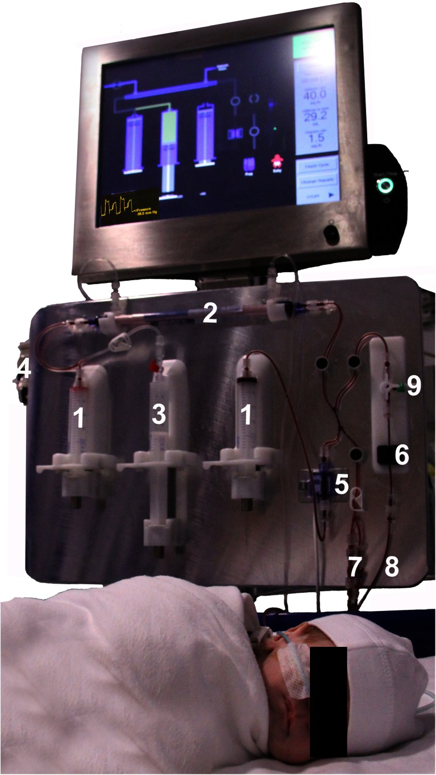
Newcastle Infants Dialysis and Ultrafiltration System (NIDUS)
The extracorporeal circuit volume < 10ml. (0.045 m²)
The most innovative feature of the NIDUS is the uncoupling of blood flow through the dialyzer from the baby’s blood flow.
Dialysis through single needle catheter.
UF accuracy matches that of the CARPEDIEM.
The urea, creatinine and phosphate clearances using the Nidus were consistently higher than PD clearances.
Ultrafiltration was achieved to microlitre precision by the Nidus, but varied widely with PD.
Coulthard et al, Peds Neph 2014
Notes:
Newcastle infant dialysis and ultrafiltration system
A prescribed volume
of blood is removed from the patient and then passes twice
through a high flux polysulfone 0.045 m2 hollow-fibre
haemofilter to allow dialysis and UF and is then returned to
the baby; the cycle is repeated. This strategy also makes it
possible to dialyse infants through a single-lumen catheter
without excessive recirculation. The UF capability of the
circuit is 0–60 ml/h, and UF accuracy matches that of the
CARPEDIEM.

Slide 20
CVVH through Aquadex® - Baxter
FDA approved the use of the Aquadex™ Machine for ultrafiltration of plasma volume in adults with heart failure who did not respond to diuretic therapy.
Askenazi et al reported utilizing the device to do CVVH in neonates in 2016. ¹
Circuit volume is 33 ml and SA of 0.12 m²
Reported 261 CRRT days in 12 neonates. Median age of 30 days.
Blood flow rates : 10-40 ml/min using at least 6 French catheters.
5% required interventions to stabilize blood pressure after initiation.
70% of the circuits were stopped as planned every 72 hours.
The
¹ Askenazi et al, Peds Neph 2016

Slide 21
Continuous Flow Peritoneal Dialysis (CFPD)
An old concept (more than 50 years ago).
CFPD uses a fixed intraperitoneal volume and fast, synchronized continuous movement of dialysate into and out of the peritoneal cavity at a high flow rate up to 100–300 mL/min.
Two peritoneal catheters, or double lumen HD catheter.
CFPD has been shown to be nine-fold more effective than conventional PD for ultrafiltration and at least three- to fivefold more effective for urea and creatinine clearance in addition to less glucose exposure.
On the other hand, it can lead to excessive protein losses and increased intraabdominal pressure especially if ultrafiltration and intraperitoneal fluid volume is not well monitored.
* Nourse et al,. Pediatr Nephrol. 2016;31(7):1137–43.
Notes:
With the limited capacity of the current acute PD prescription, there is renewed
interest for CFPD which, more than 50 years ago, has been shown to be more efficient
than the standard PD prescription [37]. CFPD is a modality that combines PD
with HD technology in which continuous circulation of PD fluid is maintained at a
high flow rate (Fig. 20.4a). The peritoneal fluid effluent is transported to a twin coil
dialyzer, dialyzed, regenerated, and sent back to the second catheter [37]. In addition,
gravity-assisted CFPD with no fixed intraperitoneal volume has also been
described [38] (Fig. 20.4b).
CFPD uses a fixed intraperitoneal volume and fast, synchronized continuous
movement of dialysate into and out of the peritoneal cavity at a high flow rate up to
100–300 mL/min corrected for body surface area. The dialysate fluid from commercially
available bags can be delivered using an adapted continuous venovenous
hemofiltration machine (single-pass CFPD). The sterile dialysate could also be
regenerated using an external dialyzer [39].
For peritoneal access, two peritoneal catheters, one for inflow and the other for
outflow of dialysate, are required, the first is placed in the midline 1 cm below the
umbilicus and oriented towards the pelvis, while the second is placed midway
between the superior iliac crest and umbilicus oriented towards the diaphragm
(Fig. 20.5) [40]. Ideally, the pelvic catheter should have a coiled tip and a preformed
bend to produce an exit site below the insertion site. For minimal recirculation or
streaming, the orientation of the catheter tip should be placed as far apart from each
other as possible. An efficient dual lumen catheter with minimal intraperitoneal
recirculation can also be used.
In children admitted to the intensive care unit with acute kidney injury, CFPD
has been shown to be ninefold more effective than conventional PD for ultrafiltration
and at least three- to fivefold more effective for urea and creatinine clearance
[40, 41]. Because the PD solution is delivered continuously, there is less glucose

Slide 22
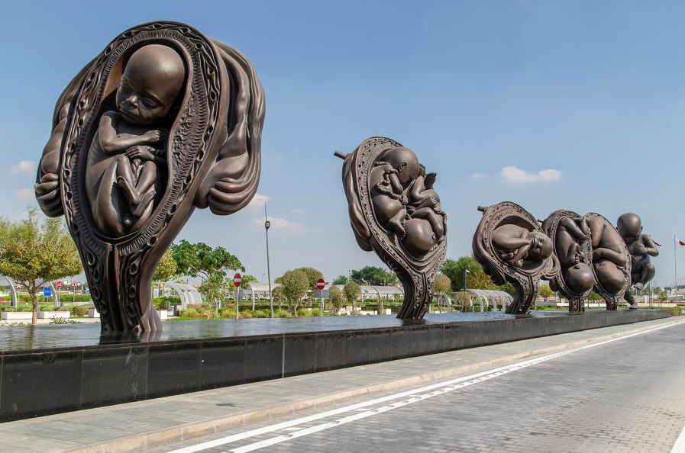
CRRT Dose

Slide 23
CRRT Dose
The concept of “ Dose” was introduced by Ronco et al in 2000 ¹
The recommended dose was 35 ml/kg/hour.
The ATN study (2008) ² and RENAL Study ³ did not support intensity more than 20-25 ml/kg/hour
KDIGO recommended 25-30 ml/kg/hour to assure delivering the desired dose.
In children: 2000 ml/1.73 m² /hr (Bunchman Protocol).
HOWEVER,,,,
The
1 Ronco et al, Lancet 2000
2 Palvesky et ak , NEJM 2008
3 Bellomo et al, NEJM 2009

Slide 24
Hyperammonemia and IEM

Slide 25
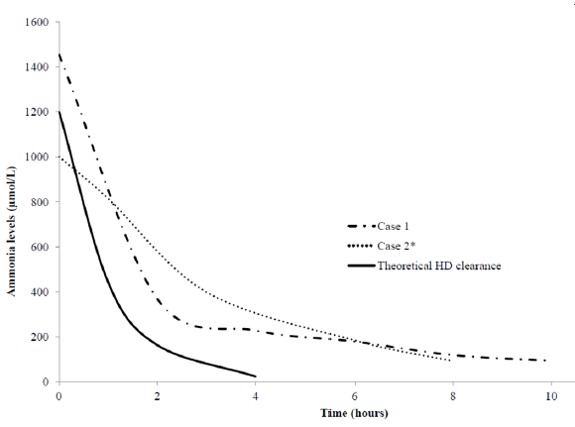
Hyperammonemia and IEM
In hyperammonaemia, there is dysfunction of the astrocytes with shrinkage and secondary hyperactivation of the NMDA receptors which leads to disruption of cerebral metabolism and neuronal and glial injury.
No clear cut-off of the dangerous levels and duration on neural injury.
Ammonia levels >350 μmol/L had poor survival or neurodevelopmental outcome in a study of 92 neonates with urea cycle disorder*
The aim of dialytic therapy is to reduce brain ammonia toxicity as fast as possible into a “safe” zone below 100–200 μmol/L within the first 12–24 hours.
Historically, IHD has had the reputation of having the highest ammonia clearance rates using blood flow rates of 5–10 mL/kg/ min and dialysate flow rates of 500 mL/min
Spinale et al suggested a dose of 8000 ml/kg/min**
* Uchino et al. J Inherit Metab Dis. 1998
** Spinale et al, Peds Neph 2013
Notes:
In contrast Westrope (n = 14) and Picca (n = 45) failed to identify peak ammonia
or duration of raised ammonia as outcome markers [34, 35].

Slide 26
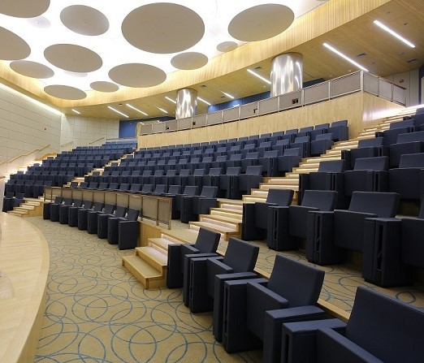
ECMO & CRRT

Slide 27
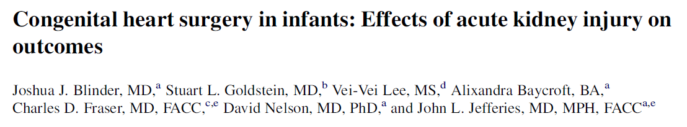
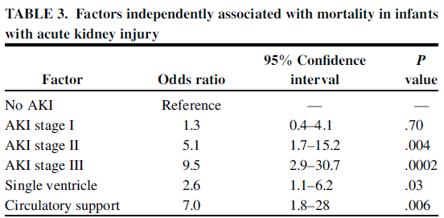
AKI is Worse Than Single Ventricle Physiology

Slide 28
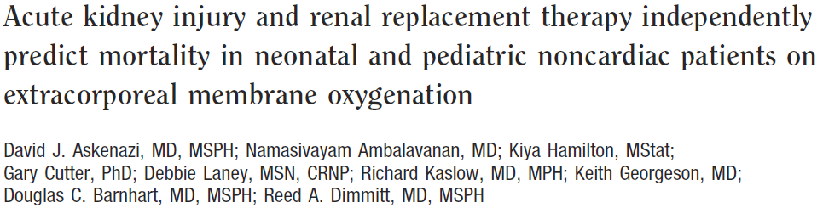
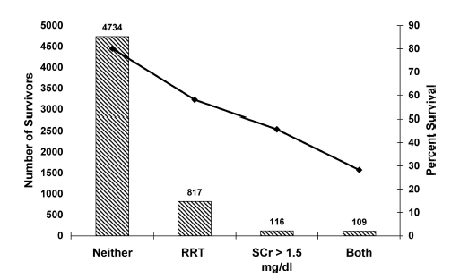
Section title goes here
    AKI + RRT 28% survival
    AKI Ø RRT 45.7% survival
    ØAKI + RRT 58.1% survival
    ØAKI Ø RRT 80.1% survival

Slide 29
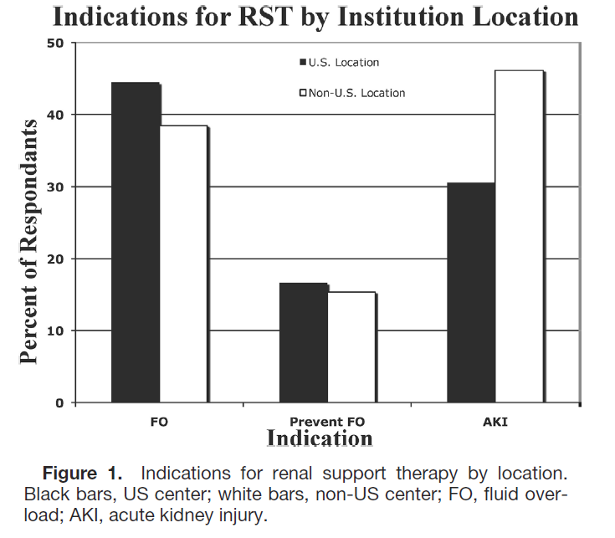

KIDMO
Notes:
Kidney interventional During membrane Oxygenation

Slide 30
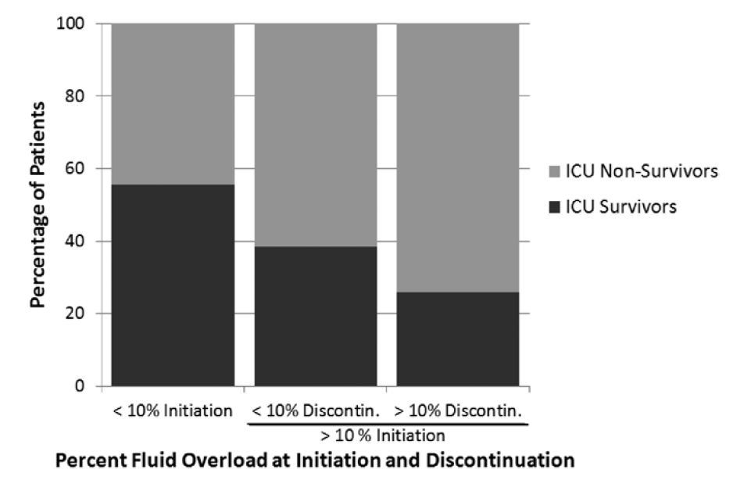

FO and ECMO/RRT
Outcomes:
Section title goes here
Cardiac
  Degree of FO at CRRT initiation significantly higher in nonsurvivors.
Degree of fluid removal and rate of removal:
    NO improvement in outcome

Slide 33






















