Slide 1
Case of a 14-year old girl
Rayan Rammal
PGY-III, Anatomic Pathology
AUBMC

Slide 2
14 year old girl
Polydipsia, polyuria
BUN: 43 mg/dL [nl:8-25]
Cr: 4.8 mg/dL [nl: 0.5-1]
Protein (spot urine): 0.07 g/L [nl <0.14]
C3 & C4: nl (1 g/L [0.9-1.8]; 0.2 g/L [0.1-0.4])
ANA & anti-DsDNA: negative
Anemia (Hb: 9.3)
First degree consanguinity in parents
Notes:
Hb 9.3 [12-16]
Hct 30% [37-46]
MCV 82 [80-94]
Uric acid 5.5 mg/dL [2.5-6.6]
Sodium 139 [135-145] 140
Potassium 5.2 [3.5-5.1] 4
Chloride 103 [98-109] 104
Carbon dioxide 20 [24-30] 23
Calicum 8.3 [8.5-10.5] 6.1
Phosphate, inorganic 3.6 [2.7-5.1] 3.9
PROTEIN (URINE) 0.07g/L<0.14 (12/Oct/18)
CREATININE (URINE) 15.40mg/dL 20.00 - 300.00* PROTEIN/CREATININE 455mg/g Cr - Normal to Mildly Increased:<150.0; Moderately Increased: 150.0-500.0; Severely Increased: >500.0* ALBUMINURIA (URINE) 16.2mg/L<20.0* CREATININE (URINE) 15.40mg/dL 20.00 - 300.00*
ALBUMIN/CREATININE 105.2mg/g Cr Normal to Mildly Increased:<30.0; Moderately Increased: 30.0-300.0; Severely Increased: >300.0

Slide 3
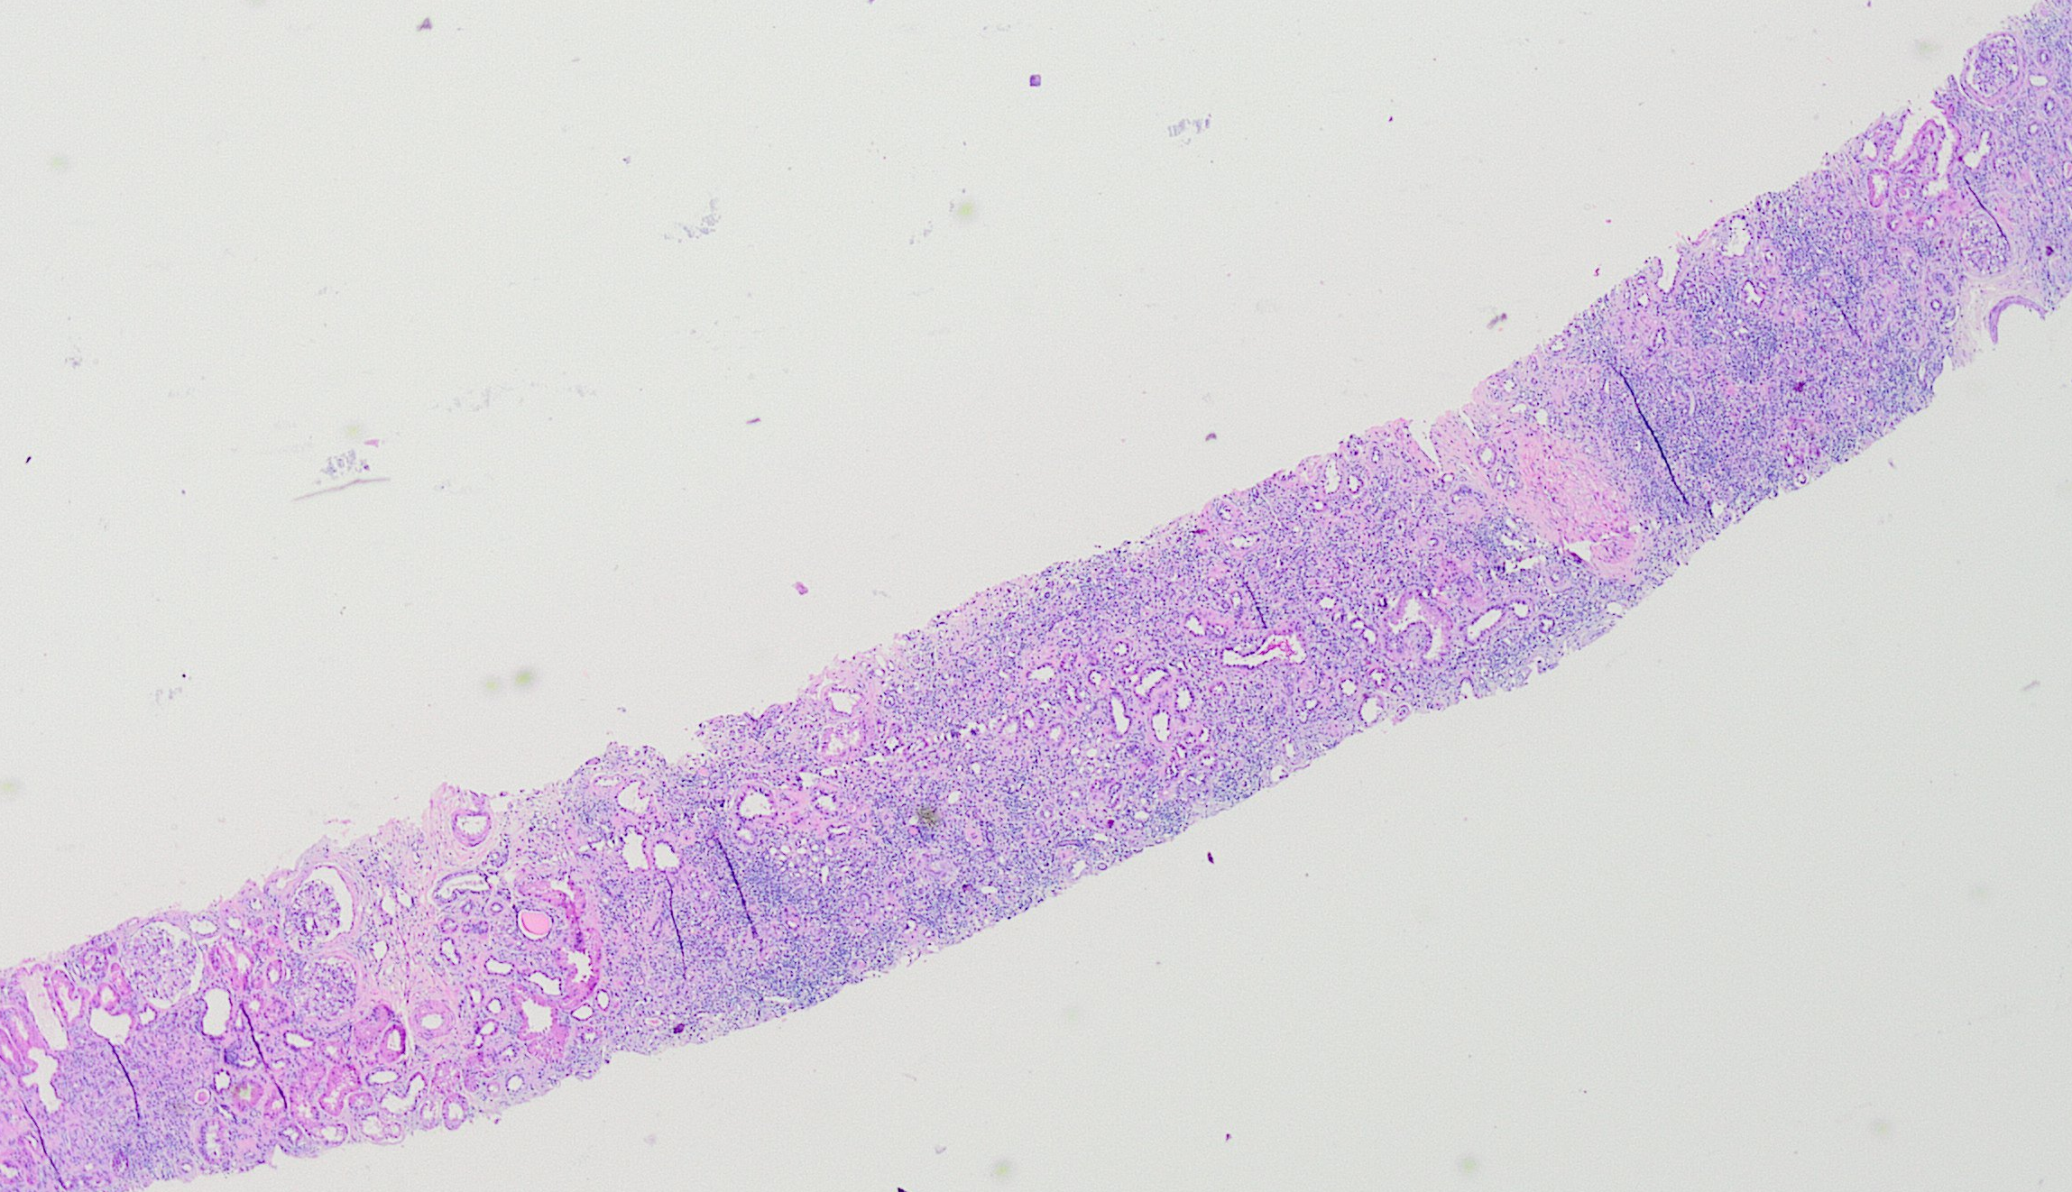
Histology

Slide 5
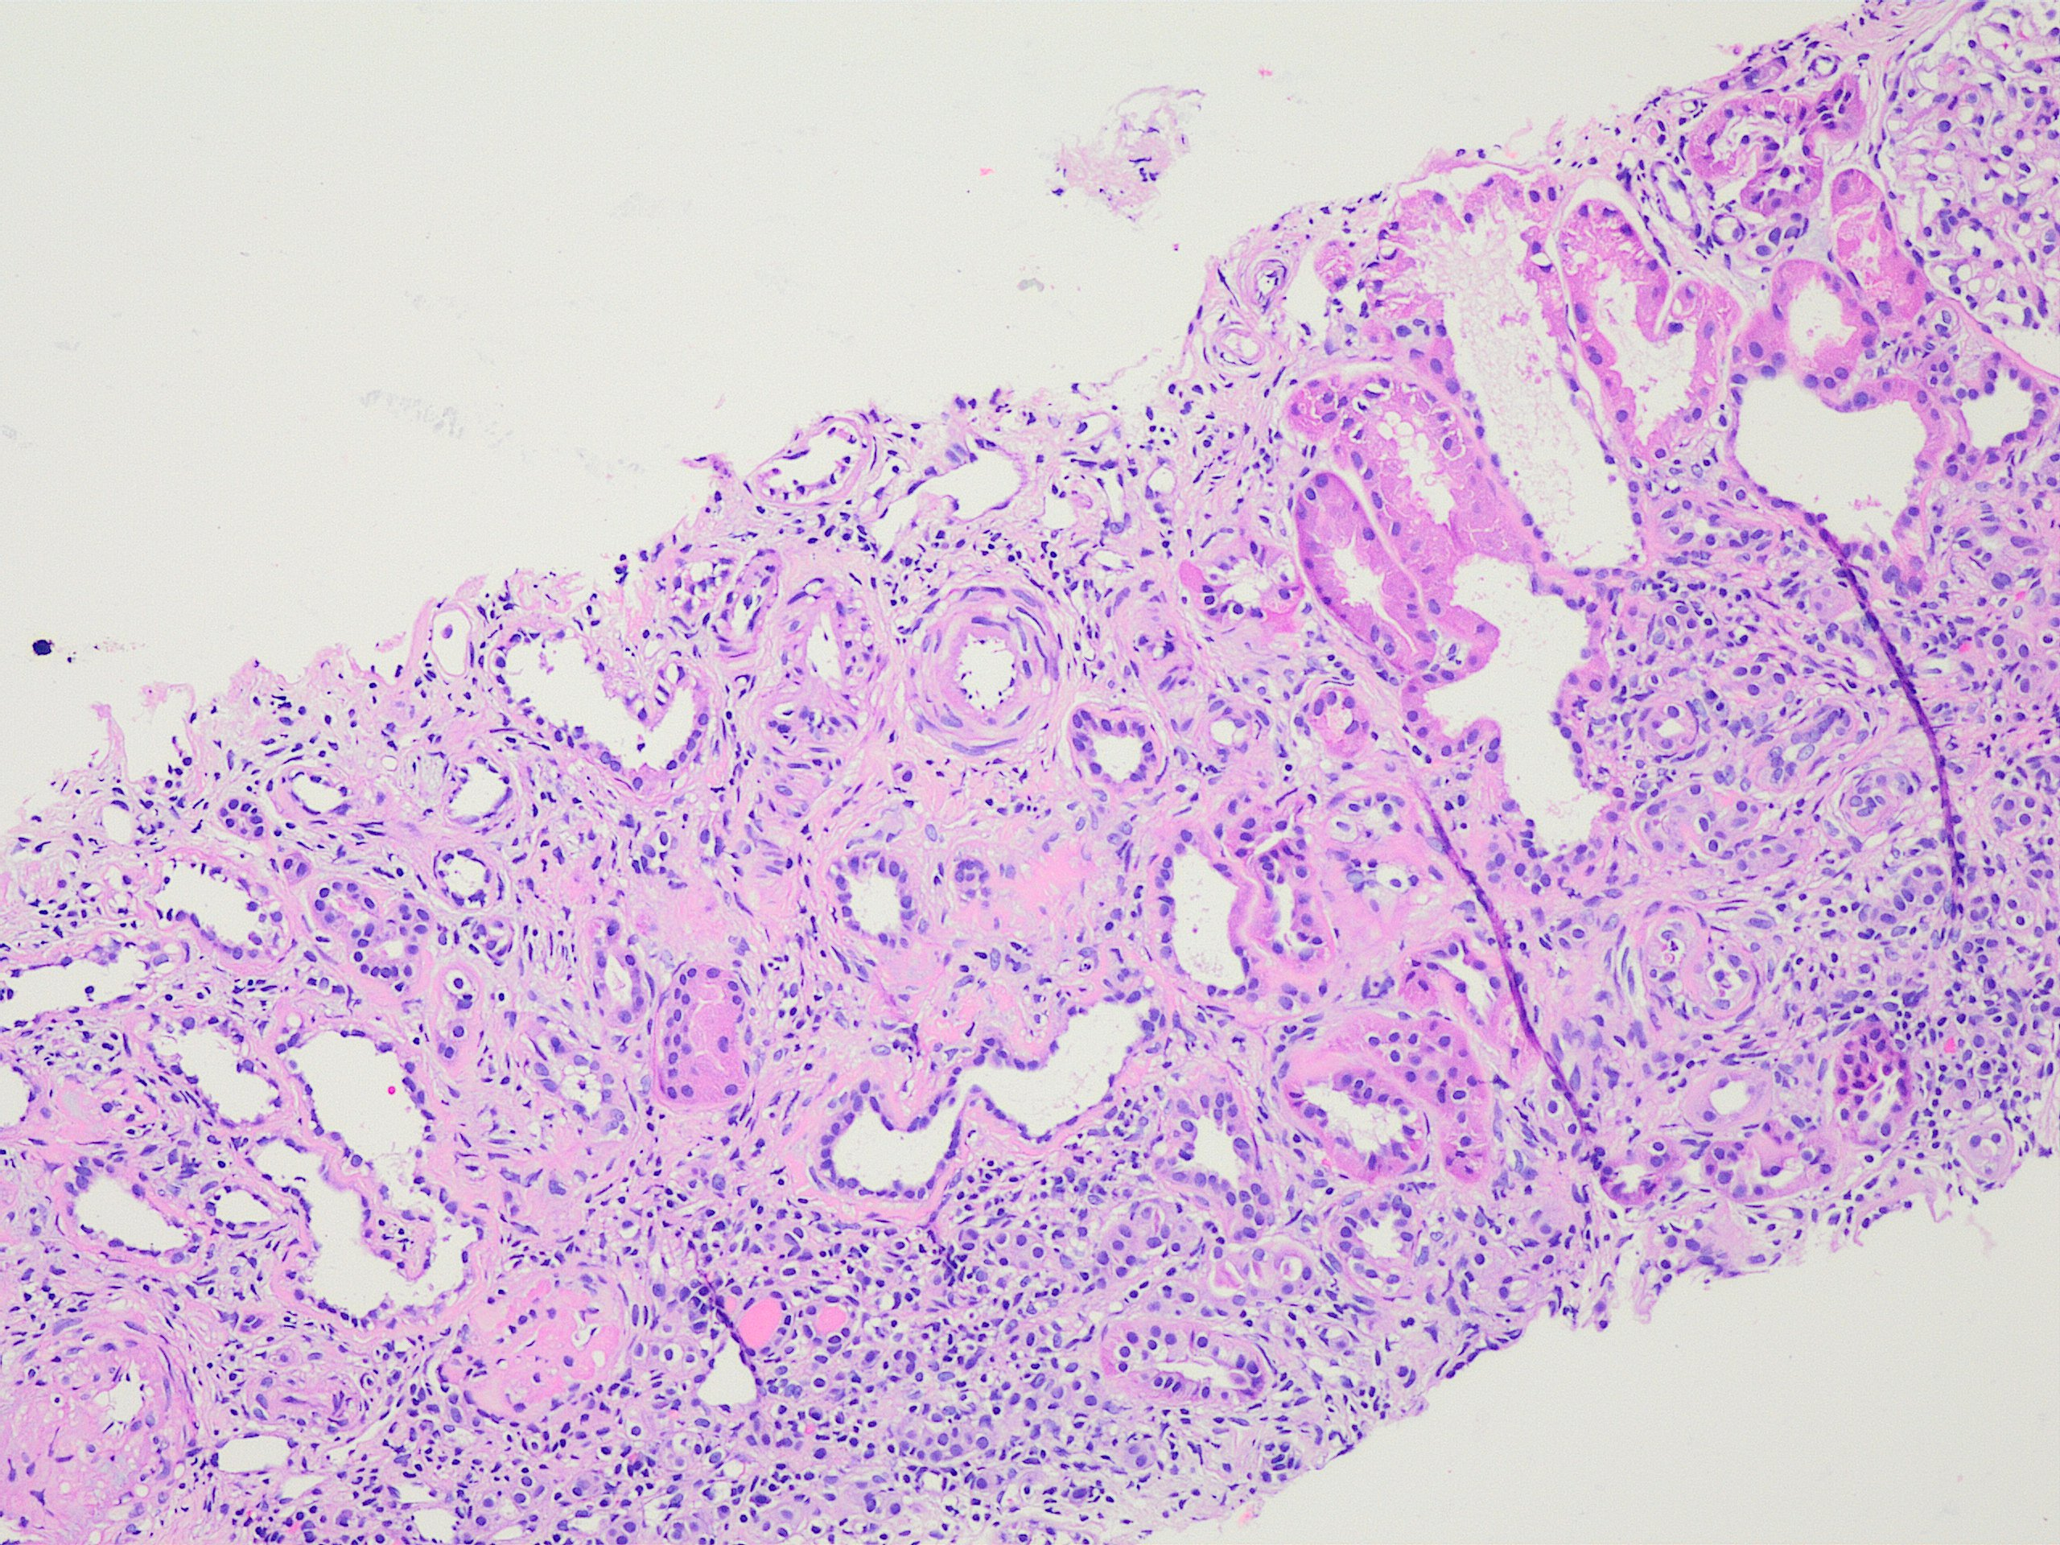

Slide 8
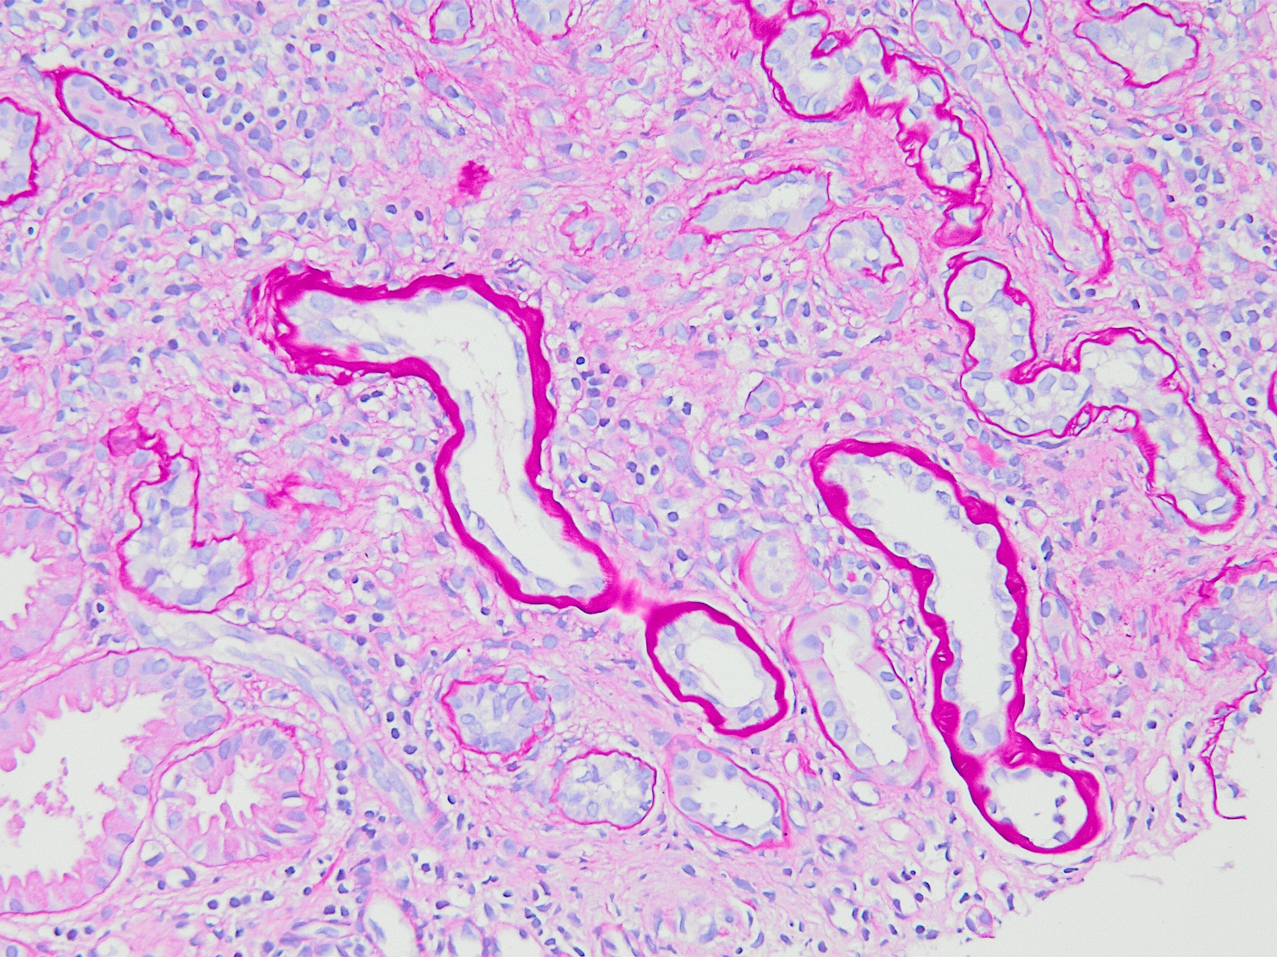

Slide 10
Immunofluorescence
IgA: Negative.
IgG: Negative.
IgM: Non-specific uptake in sclerotic glomeruli.
C3: Non-specific uptake in sclerotic glomeruli.
C1q: Negative.
Kappa: Non-specific uptake in sclerotic glomeruli.
Lambda: Negative.
Fibrinogen: Non-specific uptake in sclerotic glomeruli.

Slide 11
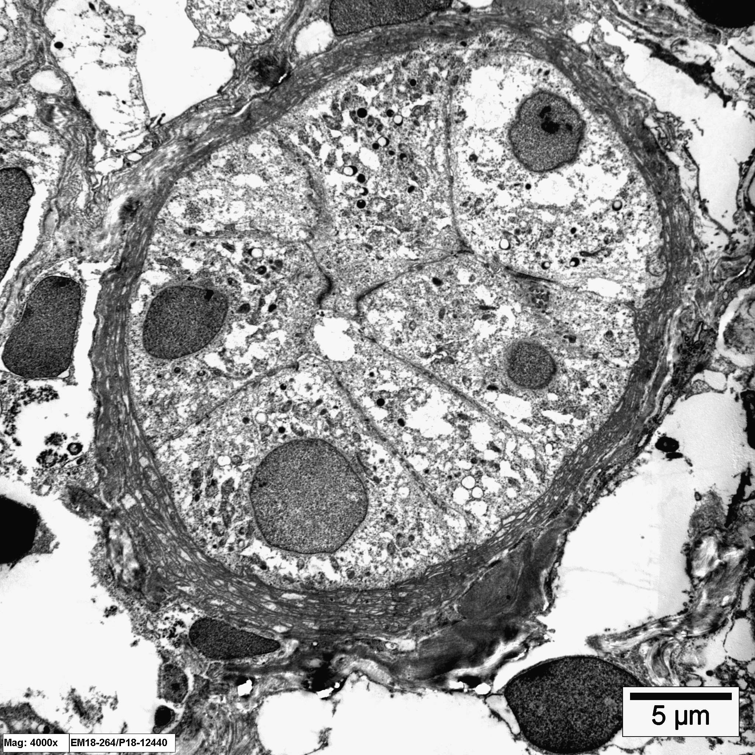
Electron microscopy

Slide 13
Diagnosis?

Slide 14
Nephronophthisis

Slide 15
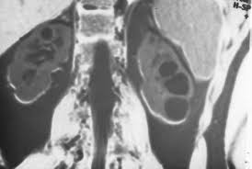
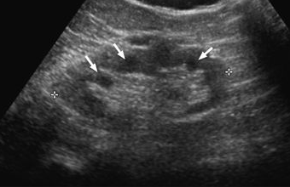
Definition
Nephronophthisis-medullary cystic disease complex is a group of familial chronic tubulointerstitial renal diseases
Cysts at the corticomedullary junction
Notes:
Often have cysts located predominantly at…
MRI
Ultrasound scan features of nephronophthisis. Renal ultrasound scan demonstrating corticomedullary cysts, some of which are arrowed.

Slide 16
Nephronophthisis: autosomal recessive → early-onset renal failure
vs.
Medullary cystic disease: autosomal dominant → late-onset renal failure
Overlapping pathological and clinical features

Slide 17
Clinical features
Incidence: 1 in 50,000-100,000
10-25% of ESRD in children
Polyuria, polydipsia, anemia
& insidious onset of renal failure
Nephronophthisis: ESRD by age 25
Vs.
Medullary cystic disease: ESRD by 3rd decade of life
Notes:
Virtually all patients with nephronophthisis progress to ESRD by age 25. Bcz of the absence of edema & HTN, the renal disease is often not recognized until there is advanced renal failure. Patients with medullary cystic disease usually do not dvp ESRD until the 3rd decade of life

Slide 18
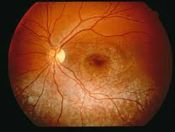
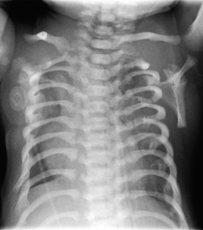
Nephronophthisis is associated with extrarenal abnormalities:
retinitis pigmentosa (Senior-Loken syndrome)
skeletal defects (Jeune syndrome/
asphyxiating thoracic dystrophy)
hepatic fibrosis
cerebellar vermis aplasia (Joubert syndrome)

Slide 19
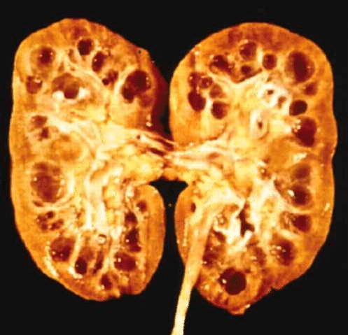
Gross findings
Kidney size normal +/- decreased
Multiple 1-15 mm cysts predominantly at corticomedullary junction
May be found in the deeper medulla
Larger & more frequent later
Cysts are not required for a pathological diagnosis of nephronophthisis-medullary cystic disease complex
Notes:
Surface variably granular
Depending on the extent of chronic tubulointerstitial injury, the surface is… with advanced disease, the kidneys are shrunken and fibrotic.
These grossly discernible cysts are larger…
Not all patients have identifiable cysts…
Medullary cysts in normal-sized kidneys

Slide 20
Light microscopic findings
Marked focal thickening & replication of basement membranes (BMs) in non-atrophic tubules
BMs may have loose woven appearance
Remaining tubules have normal or thinned BMs
Longitudinal sections may show alternating foci of thickened & thinned BMs
Notes:
The most common but somewhat non-specific histologic finding is… in half or more of the tubules.
This BM thickening often affects half or more of tubules. The thickened BMs may have a loose woven appearance (puff pastry in cross section)

Slide 21
With progressive chronic disease,
Interstitial fibrosis, tubular atrophy & chronic inflammation increase
& all atrophic tubules have thickened BMs → non-specific
Islands of Tamm-Horsfall protein may be found in interstitium
Dilated & tortuous tubules
at corticomedullary junction
Cyst formation in distal tubules
Notes:
Dilated & tortuous tubules are seen most often at…
Cyst formation is most frequent in distal tubules. Cysts are lined by a single layer of flat to cuboidal epithelium

Slide 22
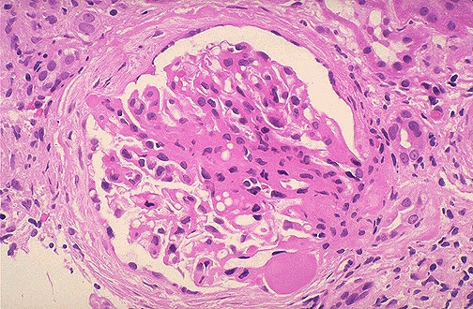
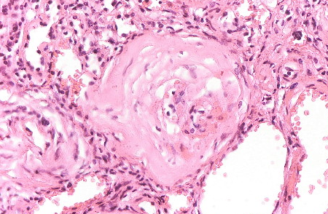
With advanced disease,
Varying numbers of glomeruli with:
segmental or global sclerosis
periglomerular fibrosis

Slide 23
Electron microscopic findings
Marked focal thickening and lamination of some tubular BMs & thinning of others
Abrupt transitions between thick and thin segments may be observed
These changes are qualitatively similar to ones seen in other chronic renal diseases, but are more extensive
Notes:
The tubular basement membrane abnormalities are apparent by EM

Slide 24
Etiology and pathogenesis
Structural and functional abnormalities in tubules, espec. distal nephron
Different genetic defects
autosomal recessive nephronophthisis: nephrocystins
(e.g., NPHP1-4 on Xsomes 2, 9, 3 & 1) → ciliopathy
Notes:
… appear to be the common final pathway of injury caused by the different genetic defects that produce the cplx.
Defects in multiple genes can cause nephronophthisis or MCKD.
The specific gene involved can influence the clinical phenotype Mutations in NPHP2 cause early onset of disease in infancy, NPHP1 and NPHP4 cause disease with onset in childhood & NPHP3 cause disease with onset in adolescence.

Slide 26
Autosomal dominant Medullary Cystic Kidney Disease:
MCKD type 1: MUC1 gene → mucin-1 protein
MCKD type 2: UMOD gene → uromodulin
The genetic abnormalities may cause a defect in the interaction of tubular epithelial cells with BM matrix → degenerative changes
Notes:
Mucin-1 kidney disease (MKD) is due to a mutation within the MUC1 gene, which is located on chromosome 1. The mucin-1 protein is involved in the creation of a mucus-like substance that coats the surface of different small tubules in the body, it is expressed on distal tubular cells in the kidney.
Medullary cystic kidney disease type 2 is due to mutations in a gene named UMOD on chromosome 16 that encodes a protein called uromodulin that is physiologically present in urine. When this protein is concentrated at low pH, it forms a gel. Uromodulin may act as a constitutive inhibitor of calcium crystallization in renal fluids.
There is evidence that the genetic abnormalities may cause… that results in…

Slide 27
Treatment and prognosis
No treatment for the primary abnormality
Tx directed at managing consequences of injury (e- abnormalities, acid-base & water balance)
All patients eventually require renal replacement therapy
The disease does not recur in renal transplants
Notes:
Osteodystrophy, secondary hyperparathyroidism & anemia must also be managed

Slide 28
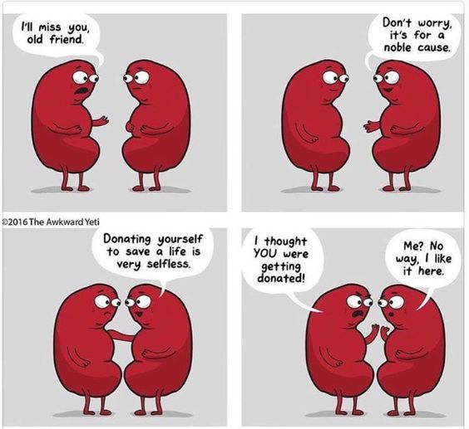

Slide 29
QUIZ

Slide 30
Which of the following is the most characteristic histologic feature of nephronophthisis?
Dilated & tortuous tubules at the corticomedullary junction
Cyst formation in distal tubules
Marked thickening of tubular basement membrane (TBM) in either atrophic or non-atrophic tubules
Marked thickening of tubular basement membrane (TBM) in non-atrophic tubules with or without thinning of TBM

Slide 31
True or false?
The finding of both thickening AND thinning of basement membrane in a tubule, no matter the extent, is seen in nephronophthisis-medullary cystic disease complex but NOT in other chronic renal diseases.
FALSE

Slide 32
True or false?
A pathological diagnosis of nephronophthisis-medullary cystic disease complex can be made without the presence of cysts.
TRUE

Slide 33
Thank you!

