Slide 2
Social Networks and Mobile Applications Use in Young Patients with Kidney Disease
Raymond N. HADDAD, MD
Beirut, Lebanon

Slide 3
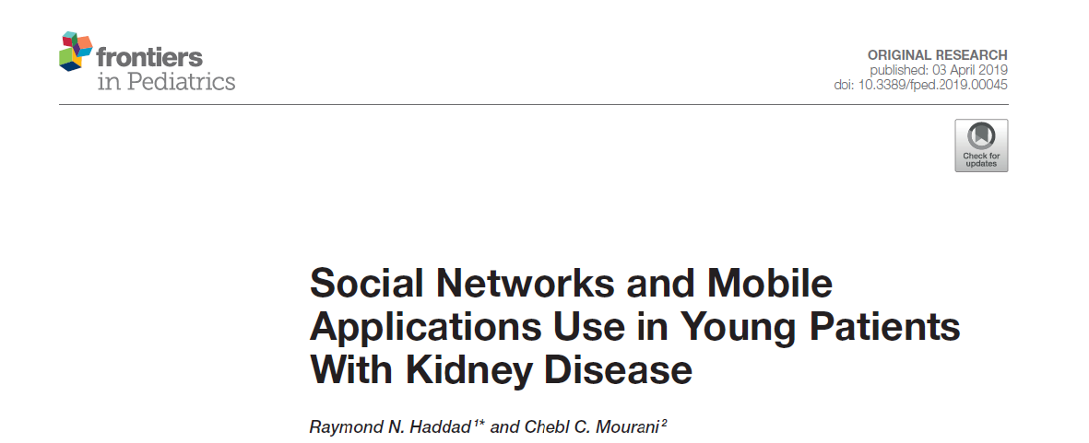
Notes:
This research was published in Frontiers in Pediatrics and was conducted under the supervision of Pr. CM who I thank very MUCH

Slide 4
Introduction
Social Media is an integral part of everyday life [1, 2]
Multiple online platforms are increasingly being used [3–5]
Major positive effect of SNS interventions on health behavior-related outcomes [6]
Notes:
to introduce our presentation topic
-----for millions of users around the world
-----to communicate to young patients rapid healthcare information on several chronic diseases
Recent meta-analysis showed the ------

Slide 5
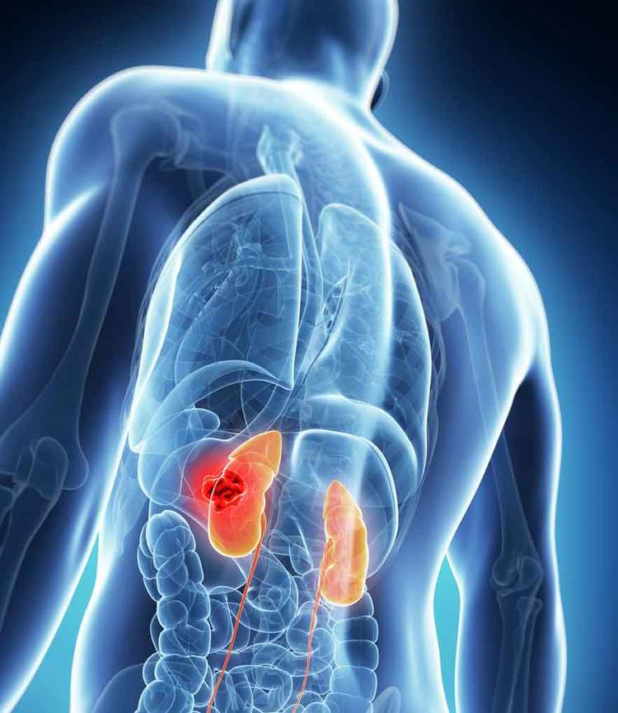
Introduction (Cont’d)
Chronic Kidney Disease (CKD)[7]
Worldwide
Major health problem
Long-term consequences
Uncommon in children
Notes:
On the other hand,
---------
Although relatively uncommon in children, it may be an evolutionary and devastating disease with long-term consequences

Slide 6
Introduction (Cont’d)
Type of information searched by this specific population depends on their age and their ability to find it [8]
Notes:
Moreover

Slide 7
Introduction (Cont’d)
Lacking quality information [9, 10]
Medical MA Development
Reliable therapeutic complement for children with chronic diseases
Maintaining respect for confidentiality [11-13]
Notes:
However, only few SNS with sufficient reliability and quality of provided information are concerned in PKD
And for that, ………… to ensure……….. While……..

Slide 8
Materials & Methods
Descriptive, observational and cross-sectional study
Period of three months
Written informed consent was obtained prior to participants’ enrollment
Data was collected from four big different centers
Questionnaire written in Arabic language
Notes:
Regarding the methods
It was….
------to be understood by the majority of the participants.

Slide 9
Materials & Methods (Cont’d) Patients study groups
Kidney Diesase
Transient Kidney Diseace (TKD)
Chronic Kidney Disease (CKD)
No Renal Failure
Renal Failure Stage
Renal Replacment Therapy (RRT)
Renal Transplant
Hemodialysis
Peritoneal Dialysis
Notes:
Patients were divided into 6 groups according to the stage and the type of the KD
------ who WERE treatable within few weeks to few months
----- who have been treated for a minimum of 12 months
CKD patients were divided into 4 subgroups.

Slide 10
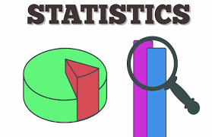
Materials & Methods (Cont’d) Statistics
Statistical analyses were computed using SPSS Statistics, version 21 for Mac (IBM, Armonk, NY)
P value<0.05 considered statistically significant
All reported P values are two-sided
Notes:
All statistical analysis were done using SPSS software

Slide 11
Results
 | N (%), n=428
Age (years), M ± SD (range) | 11.4 ± 7.1
Lebanese Nationality, N (%) | 359 (83.9)
Male, N (%) | 233 (54.4)
Social status, N (%) Low Middle High | 95 (22.2) 313 (73.1) 20 (4.7)
Economic Status, N (%) Low Middle High | 148 (34.6) 270 (63.1) 10 (2.3)
Place of residence, N (%) Beirut Mount-Lebanon South of Lebanon and Nabatiyeh North of Lebanon and Akkar Bekaa, Baalbek, and Hermel | 79 (18.5) 106 (24.8) 105 (24.5) 64 (15) 74 (17.3)
Notes:
For the results
Our sample is representative of the lebanese population with participants equally distributed among Lebanon’s five main regions The 69 foreign participants constitute 17% of our population and are in equivalent proportions to the figures given by the latest statistics of UNHCR and UNRWA

Slide 12
Results (Cont’d) Patients study groups
Renal Disease Groups
Transient Renal Disease
129 (30.1)
Chronic Renal Disease
299 (69.9)
Stage 1 Chronic Kidney Disease
144 (33.7)
Renal failure
76 (17.8)
Hemodialysis
15 (3.5)
Peritoneal dialysis
12 (2.8)
Renal transplant
52 (12.1)
Notes:
Regarding the stage and the type of the renal disease,
had undergone a kidney transplant
while were on dialysis.

Slide 13
Results (Cont’d) Medical information source
Notes:
young patients always refer to the pediatric nephrologist for any intervention
He must provide specialized counseling services and must supervise a continuous education
Unfortunately
there is a lack of research evaluating how HCP individually and collectively provide support to the family of a chronically ill child.

Slide 14
Results (Cont’d) Positive responses to the different items of the survey questionnaire
 | N (%)
Necessity of SNS and MA for the health of the sick child, n=411 | 286 (69.6)
SNS and MA use to recognize the disease and its treatment, n=428 | 82 (19.2)
SNS and MA use to communicate with specialists, n=423 | 115 (27.2)
Participation in a scientific forum , n=419 | 41 (9.8)
E-mail box use to communicate with the doctor, n=424 | 67 (15.8)
SMS use to communicate with the doctor, n=423 | 157 (37.1)
SMS use to make an appointment, n=423 | 160 (37.8)
Communicate with kidney disease patients through FB, n=426 | 32 (7.5)
SNS and MA use to find a possible organ donor, n=424 | 20 (4.7)
Notes:
In fact, thousands of internet platform promote interactions between HCP during their clinical practice
+ broaden their professional links + enhance medical education.
However, these benefits come with some limitations,
as the knowledge of the technical requirements for the use of digital technology + the maintenance of professionalism and data protection.

Slide 15
Results (Cont’d) Positive responses to the different items of the survey questionnaire
 | N (%)
Necessity of SNS and MA for the health of the sick child, n=411 | 286 (69.6)
SNS and MA use to recognize the disease and its treatment, n=428 | 82 (19.2)
SNS and MA use to communicate with specialists, n=423 | 115 (27.2)
Participation in a scientific forum , n=419 | 41 (9.8)
E-mail box use to communicate with the doctor, n=424 | 67 (15.8)
SMS use to communicate with the doctor, n=423 | 157 (37.1)
SMS use to make an appointment, n=423 | 160 (37.8)
Communicate with kidney disease patients through FB, n=426 | 32 (7.5)
SNS and MA use to find a possible organ donor, n=424 | 20 (4.7)
Notes:
The ease of access to online medical sites is possible for all digital natives and those who can understand the advantages and disadvantages of using web resources.
In fact, Many MA are currently offering a digital support to accomplish better symptoms control for patients at the different stages of their chronic disease.

Slide 16
Results (Cont’d) Positive responses to the different items of the survey questionnaire
 | N (%)
Necessity of SNS and MA for the health of the sick child, n=411 | 286 (69.6)
SNS and MA use to recognize the disease and its treatment, n=428 | 82 (19.2)
SNS and MA use to communicate with specialists, n=423 | 115 (27.2)
Participation in a scientific forum , n=419 | 41 (9.8)
E-mail box use to communicate with the doctor, n=424 | 67 (15.8)
SMS use to communicate with the doctor, n=423 | 157 (37.1)
SMS use to make an appointment, n=423 | 160 (37.8)
Communicate with kidney disease patients through FB, n=426 | 32 (7.5)
SNS and MA use to find a possible organ donor, n=424 | 20 (4.7)
Notes:
patients find many interesting forums and even online medical support programs offered by specialized teams in pediatric nephrology. BUT Rolls and al point out in their study that only a limited number of publications regarding new SM platforms are available

Slide 17
Results (Cont’d) Positive responses to the different items of the survey questionnaire
 | N (%)
Necessity of SNS and MA for the health of the sick child, n=411 | 286 (69.6)
SNS and MA use to recognize the disease and its treatment, n=428 | 82 (19.2)
SNS and MA use to communicate with specialists, n=423 | 115 (27.2)
Participation in a scientific forum , n=419 | 41 (9.8)
E-mail box use to communicate with the doctor, n=424 | 67 (15.8)
SMS use to communicate with the doctor, n=423 | 157 (37.1)
SMS use to make an appointment, n=423 | 160 (37.8)
Communicate with kidney disease patients through FB, n=426 | 32 (7.5)
SNS and MA use to find a possible organ donor, n=424 | 20 (4.7)
Notes:
With significant difference in favour of the foreign population using the email in a higher rate when compared to Lebanese participants.
A Lebanese study noted that email communication between doctors and patients has promising advantages in terms of reducing health care costs as
well as improving health promotion and disease management yet, its use among physicians is still insufficient

Slide 18
Results (Cont’d) Positive responses to the different items of the survey questionnaire
 | N (%)
Necessity of SNS and MA for the health of the sick child, n=411 | 286 (69.6)
SNS and MA use to recognize the disease and its treatment, n=428 | 82 (19.2)
SNS and MA use to communicate with specialists, n=423 | 115 (27.2)
Participation in a scientific forum , n=419 | 41 (9.8)
E-mail box use to communicate with the doctor, n=424 | 67 (15.8)
SMS use to communicate with the doctor, n=423 | 157 (37.1)
SMS use to make an appointment, n=423 | 160 (37.8)
Communicate with kidney disease patients through FB, n=426 | 32 (7.5)
SNS and MA use to find a possible organ donor, n=424 | 20 (4.7)
Notes:
SMS reminders on mobile phones increase attendance rates at healthcare appointments in comparison to non-reminders
also have some potential to reduce SAE leading to hospitalization
may provide benefit in supporting the self-management of long-term diseases.
However, no user safety perception, health outcomes, or AE of the intervention were reported

Slide 19
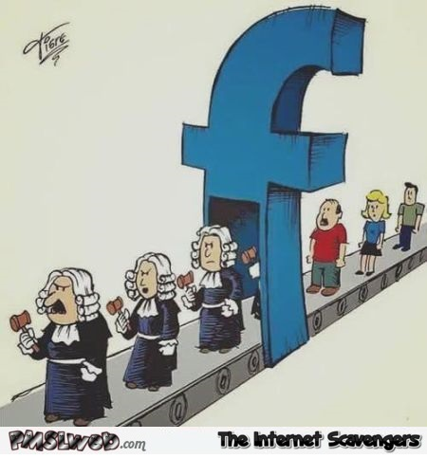
Results (Cont’d) Positive responses to the different items of the survey questionnaire
 | N (%)
Necessity of SNS and MA for the health of the sick child, n=411 | 286 (69.6)
SNS and MA use to recognize the disease and its treatment, n=428 | 82 (19.2)
SNS and MA use to communicate with specialists, n=423 | 115 (27.2)
Participation in a scientific forum , n=419 | 41 (9.8)
E-mail box use to communicate with the doctor, n=424 | 67 (15.8)
SMS use to communicate with the doctor, n=423 | 157 (37.1)
SMS use to make an appointment, n=423 | 160 (37.8)
Communicate with kidney disease patients through FB, n=426 | 32 (7.5)
SNS and MA use to find a possible organ donor, n=424 | 20 (4.7)
Notes:
Although Facebook is the most popular global platform for internet users. This application is seen as a place where you have to be “normal” and cool rather than “a sick teenager”. It is a place where teenagers stay in touch with each others and it is not seen as a place to discuss their diagnosis and treatment.

Slide 20
Results (Cont’d) Distribution of participants' positive answers to the different study variables according to the study groups
 |  |  |  |  |  | Fª | p-value
 | Gr1 | Gr2 | Gr3 | Gr4 | Gr5
Necessity of SNS and MA and for the health of the sick child , n=286 | 83 (29.0) | 88 (30.8) | 60 (21.0) | 19 (6.6) | 36 (12.6) | 8.17 | 0.084
SNS and MA use to recognize the disease and its treatment , n=82 | 17 (20.7) | 21 (25.6) | 19 (23.2) | 8 (9.8) | 17 (20.7) | 14.34 | 0.006
SNS and MA use to communication with specialists , n=115 | 42 (36.5) | 29 (25.2) | 18 (15.7) | 9 (7.8) | 17 (14.8) | 7.29 | 0.119
Participation in a scientific forum , n=41 | 16 (39) | 8 (19.5) | 8 (19.5) | 3 (7.3) | 6 (14.6) | 4.88 | 0.287
E-mail box use to communicate with the doctor , n=67 | 18 (26.9) | 22 (32.8) | 11 (16.4) | 4 (6.0) | 12 (17.9) | 2.64 | 0.621
SMS use to communicate with the doctor , n=157 | 51 (32.5) | 53 (33.8) | 25 (15.9) | 10 (6.4) | 18 (11.5) | 0.94 | 0.924
Communication with kidney disease patients through FB n=32 | 3 (9.4) | 5 (15.6) | 10 (31.3) | 5 (15.6) | 9 (28.1) | 22.72 | <0.001
SNS and MA use to find a possible organ donor , n=20 | 1 (5.0) | 2 (10.0) | 3 (15.0) | 7 (35.0) | 7 (35.0) | 31.48 | <0.001

Slide 21
Conclusion
Notes:
SM will play a major and leading role in the upcoming future
Especially when patients are becoming more demanding and seek fast medical answers and explanations through SM.

Slide 22
Conclusion (Cont’d)
PHYSICIAN
Center of action
Participate in the making of a medical website
Web surfing guidance
Realizes impact of e-communication in his practice
Misinformation correction
Notes:
In order to deliver the most accurate basic medical information.

Slide 23
References
Boyd, D., & Ellison, N. (2008). Social Network Sites: Definition, History, and Scholarship. Journal of Computer-Mediated Communication. 13(1):210-230. doi: 10.1111/j.1083-6101.2007.00393.x
Obar JA, Wildman S. (2015).Social media definition and the governance challenge: an introduction to the special issue. Telecomm Policy. 39(9):745-750. doi: 10.1016/j.telpol.2015.07.014\
Rolls K, Hansen M, Jackson D, Elliott D. (2016). How health care professionals use social media to create virtual communities: an integrative review. J Med Internet Res. 16;18(6):e166. doi: 10.2196/jmir.5312
Capurro D, Cole K, Echavarría MI, Joe J, Neogi T, Turner AM. (2014). The use of social networking sites for public health practice and research: a systematic review. J Med Internet Res. 16(3):e79. doi: 10.2196/jmir.2679
Moorhead SA, Hazlett DE, Harrison L, Carroll JK, Irwin A, Hoving C. (2013). A new dimension of health care: systematic review of the uses, benefits, and limitations of social media for health communication. J Med Internet Res. 15(4):e85. doi: 10.2196/jmir.1933
Laranjo L, Arguel A, Neves AL, Gallagher AM, Kaplan R, Mortimer N, Mendes GA, Lau AY. (2015). The influence of social networking sites on health behavior change: a systematic review and meta-analysis. J Am Med Inform Assoc. 22(1):243-256. doi: 10.1136/amiajnl-2014-002841
Becherucci F, Roperto RM, Materassi M, Romagnani P. (2016). Chronic kidney disease in children. Clin Kidney J. 9(4): 583–591. doi: 10.1093/ckj/sfw047
Health for the World's Adolescents: A Second Chance in the Second Decade. Geneva, Switzerland: World Health Organization; 2014. URL: http://apps.who.int/adolescent/second-decade/ [accessed 2017-06-14] [Website Cache ID 6rDggvHL7
McPherson AC, Gofine ML, Stinson J. (2014). Seeing is believing? A mixed-methods study exploring the quality and perceived trustworthiness of online information about chronic conditions aimed at children and young people. Health Commun. 29(5):473-482. doi: 10.1080/10410236.2013.768325
Helping Adolescents and Young Adults With End Stage Renal Failure. : The British Association for Paediatric Nephrology and the Renal Association; 2009. http://www.renal.org/docs/default-source/special-interest-groups/bapn/clinical-standards/bapn-ra-transition-document.pdf?sfvrsn=2
Brannon EE, Cushing CC. (2015). A systematic review: Is there an app for that? Translational science of pediatric behavior change for physical activity and dietary interventions. J Pediatr Psychol. 40(4):373-384. doi: 10.1093/jpepsy/jsu108
Majeed-Ariss R, Baildam E, Campbell M, Chieng A, Fallon D, Hall A, McDonagh JE, Stones SR, Thomson W, Swallow V. (2015). Apps and Adolescents: A Systematic Review of Adolescents' Use of Mobile Phone and Tablet Apps That Support Personal Management of Their Chronic or Long-Term Physical Conditions. J Med Internet Res. 17(12):e287. doi: 10.2196/jmir.5043.
Nightingale R, Friedl S, Swallow V. (2015). Parents' learning needs and preferences when sharing management of their child's long-term/chronic condition: A systematic review. Patient Educ Couns. 98(11):1329-38. doi: 10.1016/j.pec.2015.05.002. Epub 2015 May 27.

Slide 24
Thank you for your attention
Raymond HADDAD

