Slide 1
RENOVASCULAR HYPERTENSION IN CHILDREN AND ADOLESCENCE
Dr. Mazen Abou Chaaban
Consultant Pediatrics and Pediatric Nephrology
Medical Director

Slide 2
Approach and Radiological Diagnosis

Slide 3
Renovascular hypertension is an uncommon but important cause of hypertension in children.
It constitutes not more than 1% of children who do have hypertension in childhood.
The delay in the diagnosis is due to infrequent blood pressure measurement in children and high values are generally dismissed as inaccurate.

Slide 4
Children with Renovascular disease may have other abnormalities of blood vessels like aorta, cerebral, intestinal or iliac.
The prevalence is much higher in patients with acute, severe or refractory hypertension resistant to treatment at young age.

Slide 5
Causes of RVH in Children
Fibromuscular dysplasia
Focal
Multifocal
Mid-aortic syndrome with RAS?
Syndromic RVH
NF1
William syndrome
Alagille syndrome
Other (TSC, moya-moya?)
Vasculitis
Takayasu’s disease
Polyarteritis nodoa
Kawasaki disease
Other vasculitides
Extrinsic compression
tumors (neublasoma, Wilms tumor, paraganglioma, etc.)
Other
Trauma
Post-surgical complications
radiation

Slide 6
Renovascular Hypertension Pathophysiology
Elevation of blood pressure caused by RAAS (unilateral renal artery stenosis) and/or RAAS and sodium retention (bilateral renal artery stenosis).
Maintenance of elevated blood pressure with new threshold for natriuresis (bilateral RAS).
Kidney damage:
Ischemic kidney – ischemic nephropathy (decreased volume, tubular atrophy, tubulointerstitial fibrosis)
Hypertensive nephropathy (arteriolar and glomelular injury) in the other healthy kidney.
Hypertensive crisis

Slide 7
Whom to suspect with RVH to Investigate:
The clinical findings suggest a secondary hypertension rather than primary.
Severe and resistant hypertension
Acute rise in blood pressure over a previously stable value
Young onset hypertension with a negative family history
Unexplained an acute elevation in serum creatinine of at least 30% after administr. of ACE inhibitor or ARB
Recurrence episode of flash pulmonary edema
Unilateral small kidney (cannot be explained by another reason)
Systolic or diastolic abdominal bruit

Slide 8
The patient does not appear to have another cause of secondary hypertension
Primary kidney disease
Primary aldosteronism
Pheochromocytoma
Cushing’s syndrome
Sleep apnea syndrome
Coarctation of aorta
Hypothyroidism
Primary hyperparathyroidism
An intervention is planned if a significant stenotic lesion is found.

Slide 9
Because of the potential harm from invasive procedures, patients who have a high likelihood of benefitting from the procedure should be selected
Patients who experienced short duration (weeks or months) of blood pressure elevation prior to the diagnosis of renovascular disease.
Failure of optimal medical therapy to control the blood pressure.
Intolerance to optimal medical therapy (rise in serum creatinine after initiation of renin- angiotensin system inhibitor).

Slide 10
Progressive deterioration of renal function (bilateral renovascular disease)
Suspected fibromuscular disease in a young patient (to avoid need of life-long antihypertensive therapy).
Recurrent flash pulmonary edema and/or refractory heart failure.

Slide 11
DIAGNOSTIC PROCEDURE OPTIONS Renal Artery Stenosis?
Renal Arteriography
Gold standard of diagnosis (invasive procedure)
Non-Invasive alternatives are:
Duplex Doppler ultrasonography
Computed tomographic angiography (CTA)
Spiral CT scan with CT angiography
Magnetic resonance angiography (MRA)

Slide 12
The choice of the appropriate procedure depends upon:
Local availability
Clinical expertise of each technique
Presence or absence of renal impairment
Radio contrast media and gadolinium are potentially harmful in patients with stage 4-5 chronic kidney disease.

Slide 13
Duplex Doppler Ultrasonography
ADVANTAGE
Provides functional assessment of the renal arteries and some anatomic information.
Can detect both unilateral and bilateral disease.
Inexpensive and suitable for serial measurements to determine disease progression.
Can be used to detect recurrent stenosis in patients previously treated with angioplasty or surgery.

Slide 14
Stenotic lesions can be detected by comparing the systolic flow velocity in the renal artery to that in the aorta
Velocity of the flow increases as an artery narrows
Diastolic velocity, maybe increased distal to a stenotic lesion

Slide 15
Duplex Doppler Ultrasonography
DISADVANTAGE
It is time consuming (taking up to 2 hours to perform).
It is technically difficult (particularly in large patients).
Operator dependent.
A positive test is more informative that a negative test.

Slide 16
Duplex Doppler Ultrasonography with Resistive Index
RESISTIVE INDEX
It is the peak systolic velocity minus end diastolic velocity divided by peak systolic velocity.
High resistive index is associated with a greater degree of intrinsic renal damage (likely a reversible small vessel injury) and, therefore, a diminished predicted benefit from revascularization.
In the hands of experienced operator improves the ability to predict outcome after revascularization.

Slide 17
Spiral CT Scan with CT Angiography
Rapid development in CT imaging with improved tissue reconstruction, multi-detector slice acquisition, high resolution with less contrast exposure continues to improve the value of CT Angiography as a diagnostic tool for renovascular disease.
Highly accurate non-invasive diagnostic test for imaging renovascular disease due to atherosclerosis but less so for fibromuscular disease.

Slide 18
It combines the diagnostic accuracy of arteriography with the low risk of intravenous digital subtraction angiography.
Patients with fibromuscular dysplasia sensitivity and specificity of CTA were 64% and 92% respectively since fibromuscular disease usually involves distal arterial segments that are more difficult to image.

Slide 19
Magnetic Resonance Angiography
Technical improvement in MRA, including imaging without the use of gadolinium based contrast, have enhanced the detection of significant renal artery disease.
Used of breath-hold MRA with paramagnetic contrast material as gadopentetate dimeglumine substantially improves the ability to visualize the majority of accessory arteries in a better way.
Phase contrast MRA produces result similar to digital subtraction angiography (Ann Intern Med 2004; 141:730).
In patients with fibromuscular dysplasia sensitivity of only 22-28% has been noted with MR and CT angiography.

Slide 20
Other Diagnostic Testing
PLASMA RENIN ACTIVITY
Peripheral venous PRA is elevated in only 50-80% of patients with renovascular hypertension.
Suppress by high dietary sodium intake
Bilateral renal artery disease
Volume expansion related to intrinsic kidney disease
Various antihypertensive drugs

Slide 21
It has limited value for the diagnosis of renovascular hypertension.
The predicted value of PRA can be increased by measuring the rise in PRA one hour after the administration of 25-50mg captopril, patient with renal arteriosclerosis have an exaggerated increase in the PRA as compared with normal individuals (removal of the normal suppressive effect of high angiotensin II on renin secretion in stenotic kidney.

Slide 22
CAPTOPRIL RENOGRAM
DPTA and/or MAG3 are being used as radionuclides in renography.
MAG3 is more reliable in patients with renal insufficiency.
The predictive value can be increased by administration of oral captopril 25-50mg one hour before Isotope was injected. The efficacy of this test is based upon the expected ACE inhibitor-induced decline in glomerular filtration rate in stenotic kidney accompanied by an increased in GFR in the contralateral kidney due to removal of angiotensin II mediated vasoconstriction.
The sensitivity and specificity of the AC inhibitor scan varies substantially in different studies and have limited inter-observant agreement.

Slide 23
RENAL VEIN RENIN MEAUREMENT
Renin secretion should be increased in stenotic kidney by approx. ≥ 1.5x the value to contralateral kidney.
The large discrepancy in renin secretion between the two kidneys is present in less than 10% of normal individuals.
The accuracy of this measurement may be enhanced by the prior administration of AC inhibitor and/or diuretics which will increase renin secretion on the affected side.
Many false negative and occasional false positive result may be encountered.

Slide 24
Renal vein renin have a limited role in estimating physiologic significance of a stenotic lesion.

Slide 25
There is no sufficiently accurate, non-invasive radiologic or serologic diagnostic test, if negative will completely exclude the presence of renal artery stenosis.
Each tests is associated with strengths and weaknesses.

Slide 26
Patients without renal insufficiency
Duplex Doppler US, CT Angiography and MR Angiography all provide minimally invasive options for diagnostic evaluation prior to intra-arterial angiography.
In addition to diagnosing renal artery stenosis, these tests can identify anatomic abnormalities of kidneys, aortic disease and whether the stenosis is unilateral or bilateral.

Slide 27
Digital subtraction angiography should be performed when non-invasive testing is inconclusive.
If the Arteriogram is positive, endovascular revascularization often with primary renal artery stenting can be performed during the same procedure.

Slide 28
Patients with renal insufficiency
Evaluation for Renovascular disease should be considered in Patients with
chronic ischemic renal disease
A progressive decline in renal function
Recurrent episode of flash pulmonary edema
Uncontrolled hypertension
The optimal approach in such patients is uncertain although some will have recovery of kidney function or slowing of renal function deterioration after successful revascularization.

Slide 29
Evaluation of Renovascular disease in these patients can be with:
Duplex Doppler ultrasonography, if technical expertise is available, is the preferred initial non-invasive diagnostic test.
If technical expertise is not available, Spiral CT scan with CT angiography in patient with GFR <30ml/min. despite the risk of radiocontrast nephropathy.
MRA with gadolinium should be avoided if possible in patients with GFR <30ml/min because of the risk of nephrogenic systemic fibrosis which is sometimes very severe.

Slide 30
Contrast induced kidney injury, nephrogenic systemic fibrosis (gadolinium) and atheroembolism are expected risks to such category of patients.

Slide 31
Conclusions
RVH is a leading cause of secondary Hypertensionin pediatric age group
Pharmacotherapy does not cure but may lower BP
RTA &/or Surgery may cure in 50% of case
RVH is not only disease of renal arteries.

Slide 32
Thank you

Slide 33
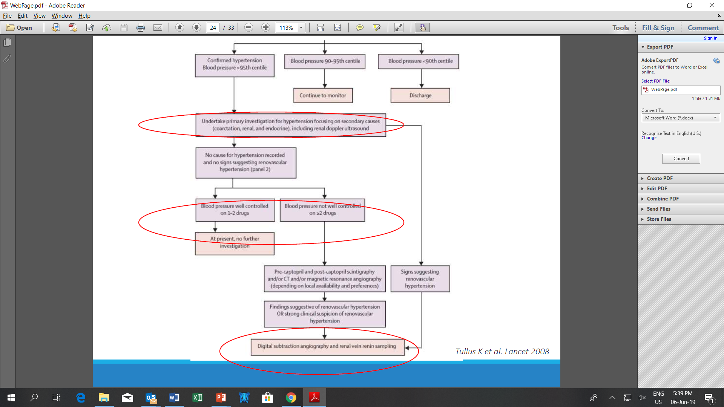

Slide 35
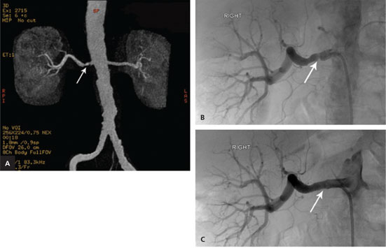

Slide 36
