Slide 1
بِسْمَ اللهِ الرَّحمن الرَّحيم وَمَا أُوتِيتُمْ مِنَ الْعِلْمِ إِلَّا قَلِيلًا صدق الله العلي العظيم سورة الإسراء- الآية {85}

Slide 2
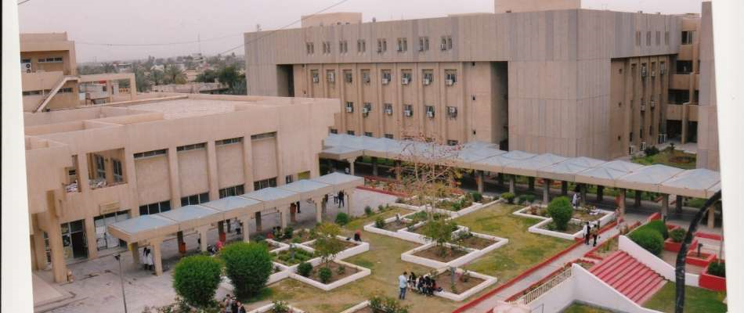

Slide 3
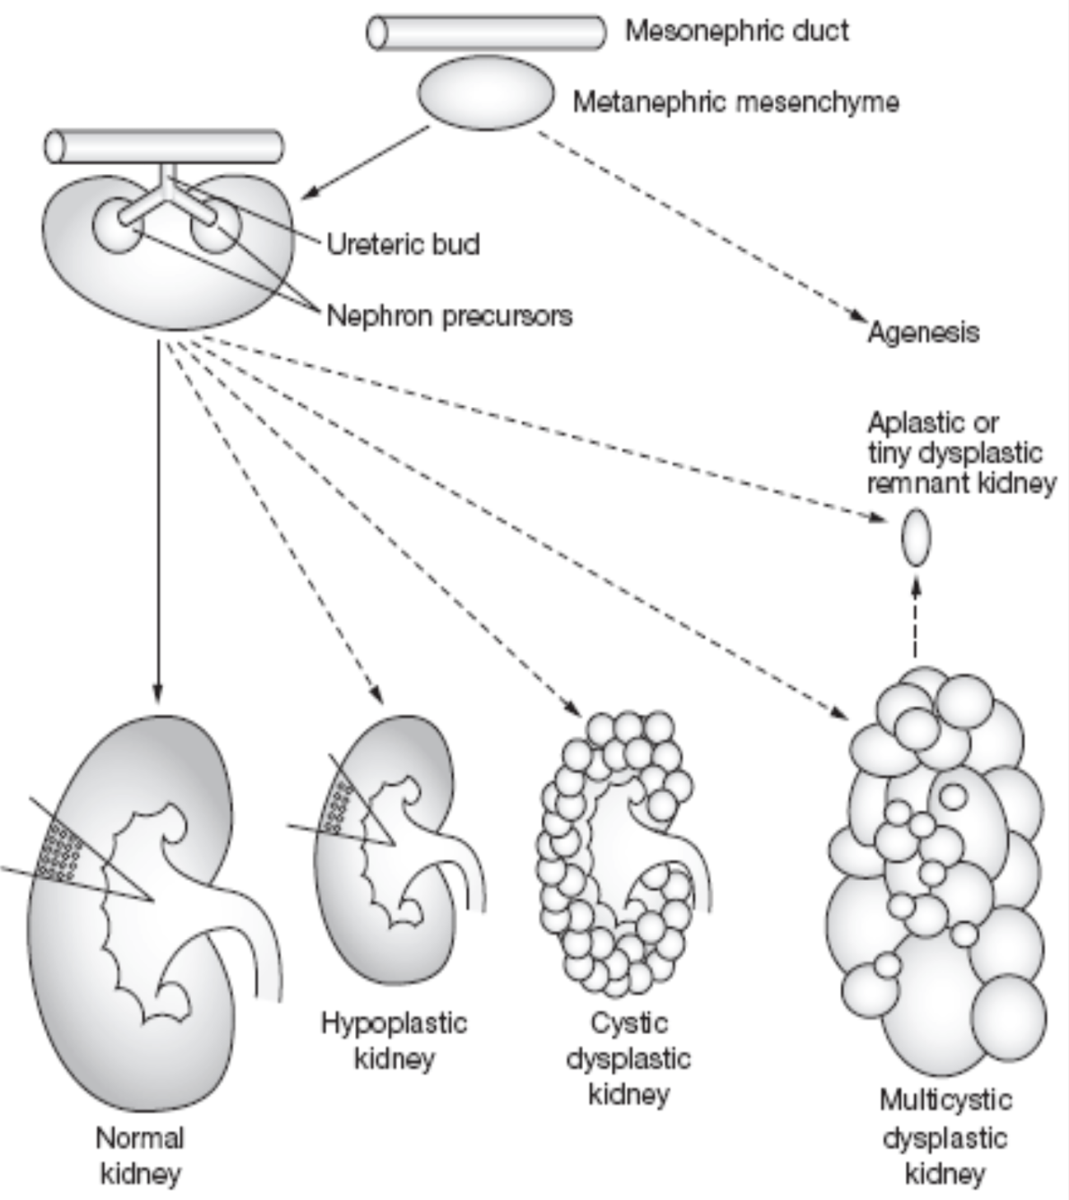
Spectrum of Renal anomalies
in children
BY
Prof. Dr. Shatha Hussain Ali
Professor in pediatrics,
College of Medicine,
Al – Nahrain University
Dr. Ahm
Ahmed Zuhair Jaffer
Qahtan Mohammed Ali

Slide 4
INTRODUCTION

Slide 5
Congenital anomalies of the kidney and urinary tract [CAKUT] comprise a wide range of structural malformations that result from defects in the morphogenesis of the kidney and/or the urinary tract. This wide range of renal system structural and functional malformations that occur at the level of the kidney, collecting system, bladder, or urethra account for about 40–50% of children with chronic kidney disease (CKD), and are the most common cause of end-stage renal disease (ESRD) in children.
That being said, it is important to diagnose these anomalies early enough and initiate therapy to minimize renal damage, prevent or delay the onset of ESRD, and provide supportive care to avoid complications.

Slide 6
Types of Renal Anomalies
Abnormal number
Renal agenesis.

Slide 7
Potter syndrome bilateral renal agenesis

Slide 8
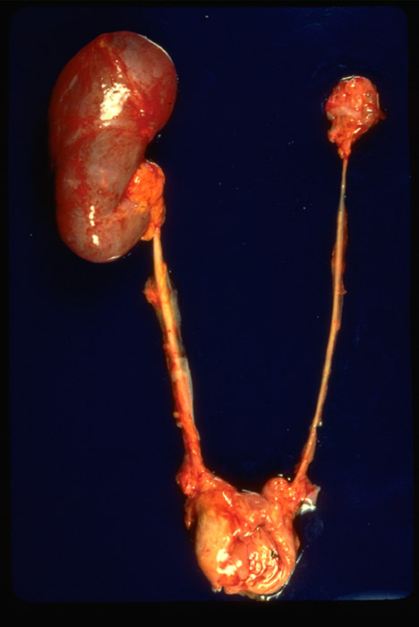
Abnormality in size.
Renal Hypoplasia

Slide 9
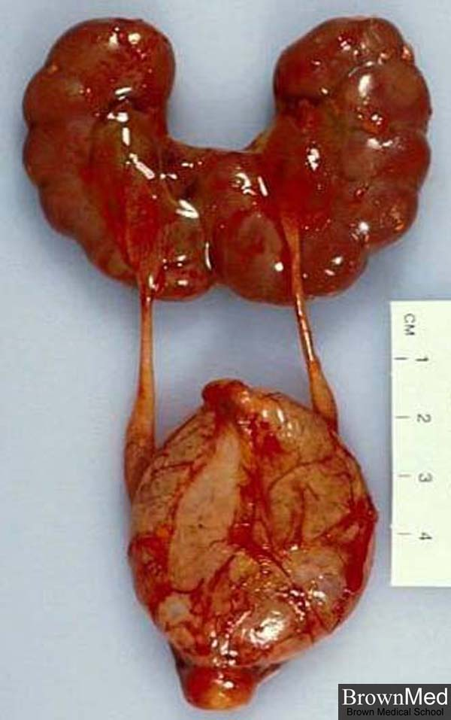
Anomalies in shape.
Horseshoe kidney

Slide 10
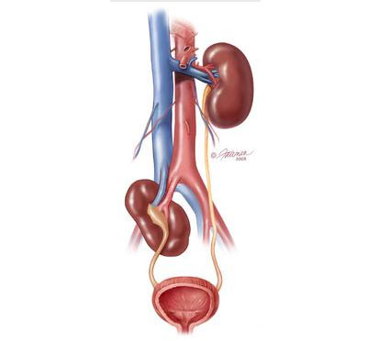
Anomalies in position
Ectopic kidney

Slide 11
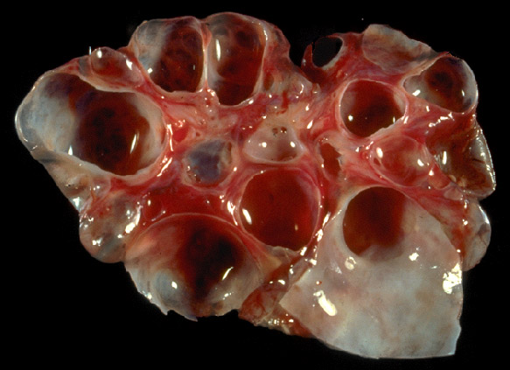
RENAL DYSPLASIA AND CYSTIC ANOMALIES ;
Multicystic renal dysplasia

Slide 12
polycystic kidney disease

Slide 13
Non-obstructive RA with hydronephrosis vesicoureteral reflex (VUR)

Slide 14
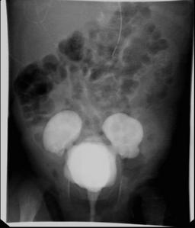
Obstructive Renal anomalies
ureteropelvic junction obstruction
vesicoureteral junction obstruction
posterior urethra valve

Slide 15
Aims of the study
Study the types of Renal anomalies according to their :
clinical presentations,
age of diagnosis,
radiological methods of diagnosis
complications.

Slide 16
PATIENTS AND METHODS

Slide 17
This is a descriptive study, conducted from 1st January 2015 till 1st January 2016, included children with renal anomalies.
Patients were collected from pediatric nephrology clinic and pediatric ward from 4 pediatric centers hospitals :
1. Imamain Kadhimein Medical City.
2. Central child Teaching hospital in Al-Iskan.
3. Children Welfare Teaching hospital.
4. Karbala Pediatric Teaching hospital.
Examination of the patient was including: height, weight, thorough physical examination was done.
Investigations included renal function test(B.urea, s.creatinine), urinalysis, urine culture, imaging study were documented , these include: U/S of abdomen, VCUG, IVU, CT-scan abdomen. Some patients have more than one image study. One patient had DMSA scan and other one had retrograde Pyelography were done outside Iraq.

Slide 18
One hundred sixty patients were studied with Renal anomalies, 23 patients of them had combined renal anomalies, 14 patients out these 23 had combined obstructive and non-obstructive RA,
The following parameters were studied in these patients:
1. Family history of congenital anomalies.
2. Consanguinity.
3. Age of presentation.
4. Age of diagnosis.
5.Type of renal anomaly (obstructive or non-obstructive).
6. Radiological methods of diagnosis.
7. Clinical presentation.
8. Associated complications.

Slide 19
Presenting symptoms of the cases.
Urinary symptoms: oliguria, dribbling, frequency, polyuria, gross hematuria, dysuria, turbid urine, enuresis.
Abdominal symptoms: abdominal mass, distention, pain.

Slide 20
Patients were categorized into 2 groups:
obstructive phenotype :PUV, PUJ, VUJ, Ureterocele, Duplex system and megaureter.
Non-obstructive phenotype :VUR, Renal agenesis, MCDK, Polycystic kidney diseases, Renal hypoplasia, Ectopic kidney , Horse-shoe kidney.

Slide 21
RESULTS AND DISSCUSSION

Slide 22
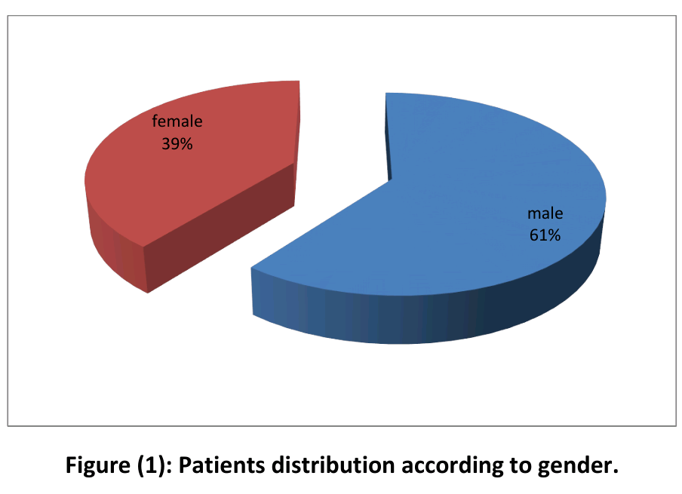
Patients distribution according to gender, there were (61%) males and (39%) females with M/F ratio 1.54:1.

Slide 23
In several studies from different regions of the world, male gender was also predominant as by Hasoon study in Iraq(2009), Neveen A. study in Egypt(2015), Hwang (USA) study(2014), Indian study by Saha A(2009) & Saudi study by Ahmadzadeh A(2009).
One Turkey study by Bulum B et la (2013), with female predominance, M/F ratio 0:84, which is disagree with this study, this was due to selection of patients renal anomalies in relative families only.

Slide 24
most of the patients diagnosed between 1 and 5 years.
age ranged between prenatal to 13 years with a mean 31.36± 37.44 months.

Slide 25
Positive family history found in (22.5%) of the patients which agree with the Hwang et la (USA) study with (21.4%) and Turkey study by Bulum B. et la (8.8%), this means that renal anomalies are mostly sporadic.
Positive consanguinity was in (41.9%), which is nearly similar to Egyptian study, this reflect the high rate of consanguine marriage in Arab population.

Slide 26
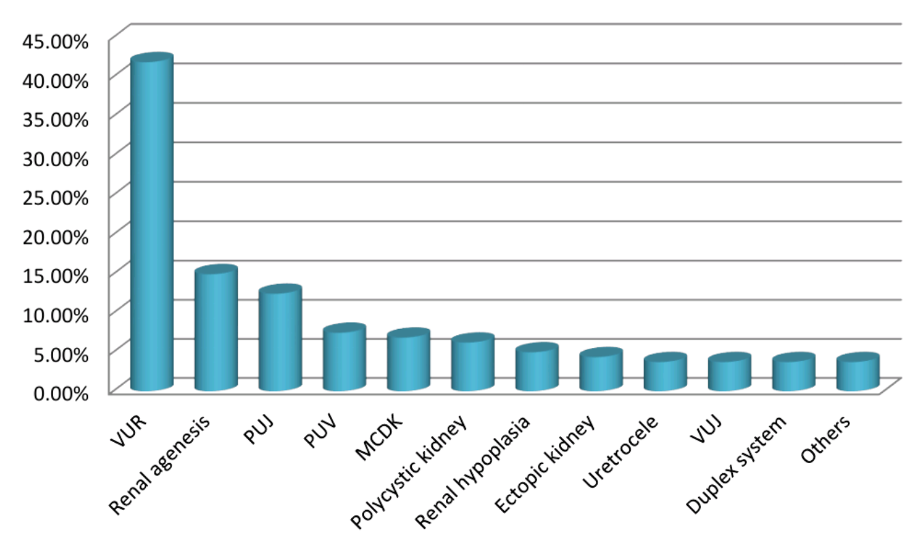
In this study, different Renal Anomalies have been identified of which VUR was the commonest (41.9%), followed by Renal agenesis (15.0%), then PUJ (12.5%).

Slide 27
Table (4): Patients distribution according to types of Renal anomalies.
Anomaly | No. 183 | %
VUR** | 67 | 41.88
Renal agenesis (single kidney) | 24 | 15.00
PUJ | 20 | 12.50
PUV | 12 | 7.50
MCDK | 11 | 6.88
Polycystic kidney | 10 | 6.25
Renal Hypoplasia | 8 | 5.00
Ectopic kidney | 7 | 4.38
Uretocele | 6 | 3.75
VUJ | 6 | 3.75
Duplex system | 6 | 3.75
Others*** | 6 | 3.75

Slide 28
Other investigators identified the commonest renal anomaly was similar to our result (VUR) include: Iraqi study by Faisal Ch. Hasoon (33.3%), Saudi study (40.3%), Turkey study (44.7%), Boston(USA) study (38.5%).
The Egyptian study was disagree with our result in that the most common anomaly was PUV (36.4%), this might be due to collection of patients from Pediatric Urological Unit where PUV patients frequently visited.

Slide 29
23 patients out of 160 patients in the study had combined renal anomalies (14.4%), PUJ & VUR was the most frequent combination 7 patients (30.4%).
Table (5) Distribution of 23 patients with combined renal anomalies.
Combined renal anomaly | No. | %
PUJ and VUR | 7 | 30.4
Renal agenesis and VUR | 7 | 30.4
Ureterocele and duplex | 4 | 17.4
MCDK and VUR | 2 | 8.6
VUR and duplex | 1 | 4.4
Ectopic ureter and duplex | 1 | 4.4
VUJ and megaureter | 1 | 4.4
Total | 23 | 100

Slide 30
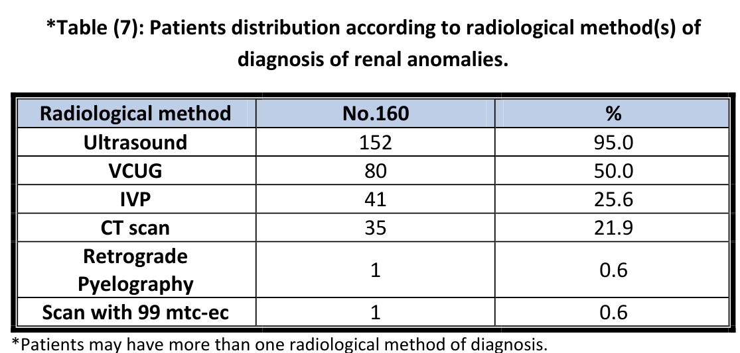
Abdominal Ultrasound was the most Radiological method used for diagnosis of these anomalies (95.0%), followed by VCUG (50.0%),

Slide 31
In Iraqi study by Muneera Fadhil mentioned that (59.4%) of infants and children with symptomatic UTI had positive ultrasound findings, and (32.6%) of them had positive findings by VCUG.
This reflects the importance of abdominal ultrasound in children as an initial imaging method for diagnosis of renal anomaly, we also noticed the high percentage of VCUG and that was due to high frequency of VUR and PUV patients in this study.

Slide 32
There was significant change of B.urea and serum creatinine between initial and last values, these changes because (34.4%) of the patients developed renal impairment (CKD+ESRD).

Slide 33
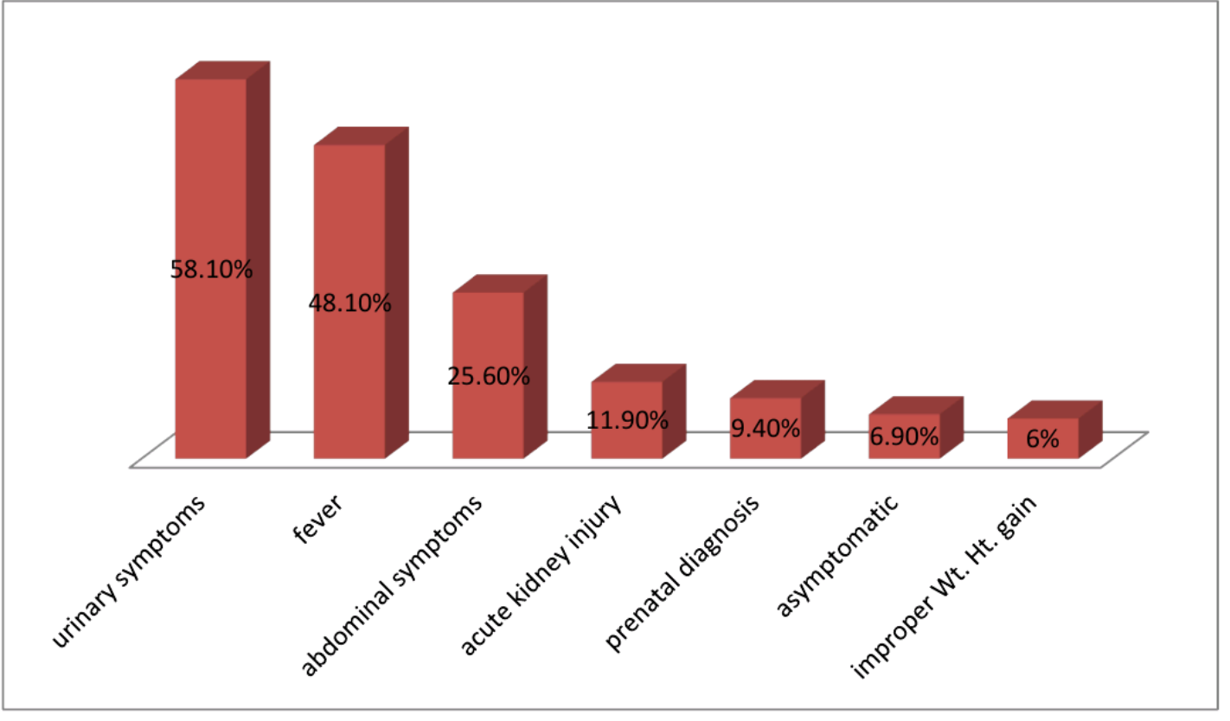
Regarding clinical presentation(s) of the study patients, urinary symptoms were the commonest (58.1%), followed by fever (48.1%), while in Egyptian study had abdominal symptoms more than urinary symptoms, this difference might be due to the difference in the types of Renal anomalies of the two studies which reflects different clinical presentation.

Slide 34
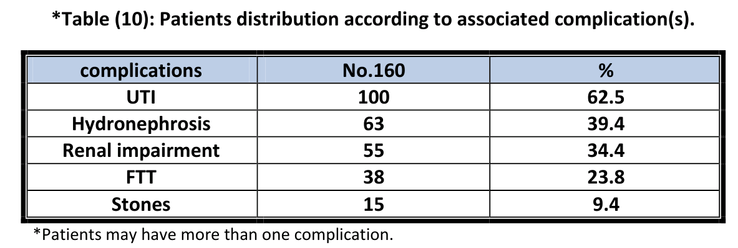
Regarding complication of Renal anomalies, UTI (62.5%), followed by hydronephrosis (39.4%), in compare to Egyptian study which is nearly similar to our study in UTI (76.2%), but different in hydronephrosis (78.2%) that's because the high percent of PUV.

Slide 35
Conclusions:
VUR was the commonest Renal anomaly followed by Renal agenesis.
Renal anomalies were diagnosed mostly at >1-≤ 5 age group.
Males exceeded the number of females with ratio 1.54:1.
The majority of patients in this study were diagnosed initially by ultrasound confirmed mostly by VCUG ,
Most of the patients presented with urinary symptoms.
The most prominent complication was UTI, followed by hydronephrosis
Significant change of Renal function tests(B.urea, s.creatinine) between initial and last values.

Slide 36
Recommendations:
Development of a comprehensive treatment plan between primary care physicians, Urologist and pediatric nephrologists for children with Renal anomalies in order to provide optimal care.
More efforts should be aimed at improving antenatal detection.
To emphasize the necessity of an early referral of patients with suspected Renal anomalies to the nephrologists, so that the health team can intervene to delay the decline of renal function and arrest disease progression.
Family members of CAKUT should be informed, followed carefully and screened for the possible urinary tract abnormalities.
Enhance diagnostic & therapeutic tools for both nephrology & urology pediatric units by providing cystoscopy, contrast media , urodynamic study, urinary catheters with pediatric size line for radiographic facilities.

