Slide 1
Therapeutic Plasma Exchange for
Children with Kidney Disorders:
Definitions, Prescription, Indications, and Complications

Slide 2
Outline :
Introduction
Terminology
Mechanism of Action
Techniques of Plasmapheresis
Prescription
Indications for Apheresis for renal disease
Complications
Clearance of MEDs
Conclusion

Slide 3
Plasmapheresis is a medical procedure that broadly refers to the extracorporeal separation of blood components, resulting in a filtered plasma product.

Slide 4
Manual plasmapheresis was first used in 1952 to manage hyperviscosity in patients with multiple myeloma.

Slide 5
Plasmapheresis was introduced into the management of renal disease in the mid-1970s when it was reported to be of benefit in addition to immunosuppressive drugs in the management of Goodpasture’s disease .

Slide 6
Since then, plasmapheresis, or therapeutic plasma exchange (TPE), has been used in a variety of renal diseases

Slide 7
The early literature consists of case reports or uncontrolled series, but in the last few years there has been an increasing number of controlled studies comparing TPE with standard therapy .
Journal of Clinical Apheresis 31:149–338 (2016)

Slide 8
The American Society for Apheresis produced helpful guidelines on the evidence-based use of TPE in 2016

Slide 9
Terminology
Therapeutic apheresis (TA) is a general term that includes all TA-based procedures

Slide 10
Plasmapheresis: is a procedure that involves the separation and removal of plasma from blood without replacing the removed volume.

Slide 11
TPE or PLEX : involves the removal of a large volume of plasma that is replaced with a replacement fluid, which is usually 5% albumin or FFP.

Slide 12
Immunoadsorption
is a procedure by which the patient’s plasma, after separation from the blood, is passed through a medical device that removes immunoglobulins by binding them to the active component (for example, staphylococcal protein A) of the device.

Slide 13
Mechanism of Action:
TPE effectively removes large molecular weight substances from the plasma, including:
- Antibodies
- Immune complexes
- Complement components
- Coagulation cascade factors

Slide 14
The clearance of different circulating substances depends not only on their size but also on their distribution between intravascular and extravascular compartments.

Slide 15
For instance, IgM is removed more effectively than IgG because it is largely intravascular.
Pusey CD, Levy JB.Blood Purif 2012;33:
190-8.

Slide 16
Evidence suggests that TPE may have a different mechanism of action through an immunomodulatory effect by different mechanisms
Shariatmadar S , et al ,Am J Hematol 2005;79:83-8.

Slide 17
Exchange of a single plasma volume can remove around 70% of IgG, and sustained reduction in antibody levels is usually achieved by around five exchanges
^{J Lab Clin Med 1984}

Slide 18
A controlled study of TPE in ANCA-associated vasculitis, seven exchanges were shown to improve recovery of renal function in patients with a serum creatinine > 500 mmol/l, as compared with pulse methylprednisolone
J Am Soc Nephrol 2012

Slide 19
Techniques of Plasmapheresis
Plasmapheresis can be carried out by two different technological approaches to plasma separation are available, namely filtration by centrifugal cell separation and filtration by hollow fiber plasma filters.
Johnson RJ, Feehally J, Floege J, editors.
Comprehensive Clinical Nephrology. 5.
Philadelphia: Elsevier; 2014. p. 1323.

Slide 20
Centrifugal TPE (cTPE) is the most preferred plasma treatment in KSA and North America, whereas other countries, including Japan and Germany, prefer membrane TPE (mTPE).
Hafer C, Golla P, Gericke M, et al. Int Urol Nephrol 2016;48:133-8.

Slide 21
Centrifugal TPE (cTPE) | Membrane TPE (mTPE)
Treatment time is shorter | Treatment time is usually longer
Needs special machines and trained nurses | Easily performed in renal units
No upper limit to the molecular weight of the substances cleared. example : IgM or immune complexes | Cannot efficiently remove large molecular weight Subs
Can be performed using peripheral access | Hemolysis can occur if TMP are too high

Slide 22
Prescription of TPE
Access
Dose of TPE
Replacement fluid
Priming
Anticoagulation
Frequency

Slide 23
Access
A wide range of vascular access options can be used for TPE:
Central venous catheters (CVCs)
Peripheral venous access
AVF & AV graft
CVC ports.

Slide 24
The physician should select the most suitable vascular access option for each patient , eg;AV graft

Slide 25
Peripheral venous access :
It can be used in older children (weight >30 kg).
In cases where a single-lumen peripheral venous access catheter is used, therapy is discontinuous because blood is withdrawn, processed, and then reinfused.
Continuous therapy can be administered with peripheral access, but two access ports are required

Slide 26
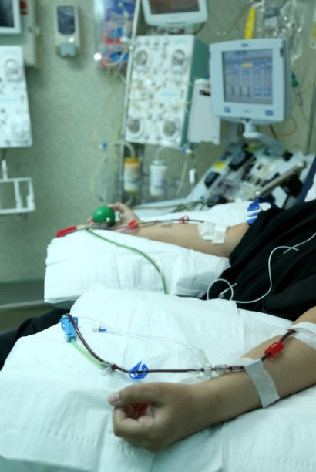
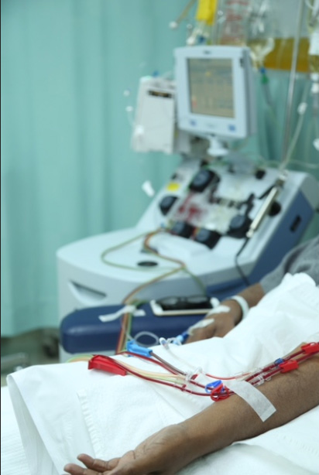

Slide 27
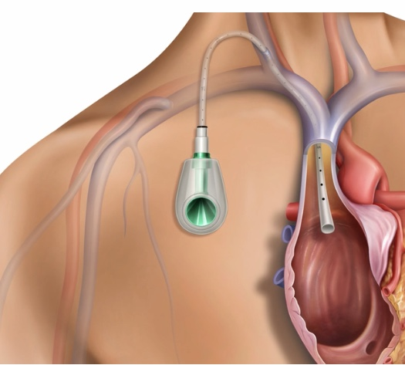
CVC ports: Are tunneled devices that are implanted below the skin ,anterior chest wall with their distal tip reaching the junction of the SVC and right atrium

Slide 28
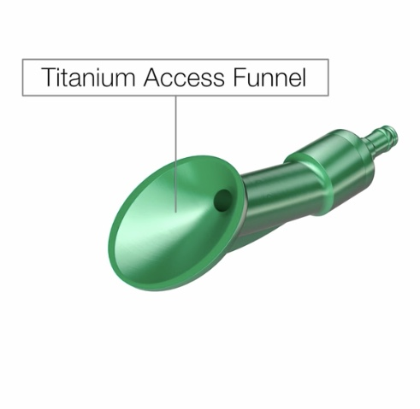
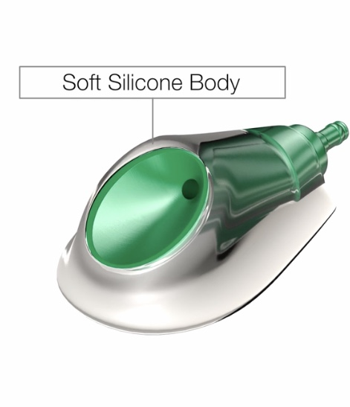
Many types of ports with the tubing are made of silicone or polyurethane, and the chamber can be funnel shaped or cylindrical.

Slide 29
In the United States, Power Flow is the only port approved by US FDA.
In Saudi Arabia, no port has been approved by the Saudi Food and Drug Authority until now.

Slide 31
Dose of TPE
The standard practice is 1.0–1.5 plasma volume (PV) exchanged per session.
PV =TBV (1−Hct/100).
To calculate the TBV, several formulas can be used

Slide 32
Proposed formulas to estimate blood volume based on
gender and body weight and age

Slide 33
Replacement fluid
FFP and 5% albumin can be used as replacement fluid.
FFP should be used in cases of derangements in coagulation factors or complements (as in aHUS) or ADAMTS-13 (as in TTP)

Slide 34
The fibrinogen level should be monitored in cases where 5% of albumin is used as the only replacement fluid.
If the patient’s fibrinogen level is <1.25 g/L, FFP should be used +/- 5% of albumin

Slide 35
Frequency
The efficiency of the removal of pathogenic substances from plasma is greatest early in the procedure, and it decreases progressively during the same exchange session.

Slide 36
This explains why the routine practice is to exchange only 1–1.5 PV during each session
Approximately 60%– 70% of the antibodies and substances present in plasma is removed during each 1–1.5 PV exchanged.

Slide 37
Sustained reduction in antibody levels is usually achieved after about five Exchanges

Slide 38
Indications for Apheresis for renal disease :
During the past 10 years, TPE has been increasingly used as a first-line, often the lifesaving treatment for different conditions in both the adult and pediatric populations.

Slide 39
The American Society for Apheresis (ASFA) is responsible for reviewing and categorizing indications for TA through an evidence-based approach.

Slide 40
The recommendations of the ASFA are based on evidence from studies conducted on adults and these studies do not differentiate childhood from adult-onset disease.

Slide 41
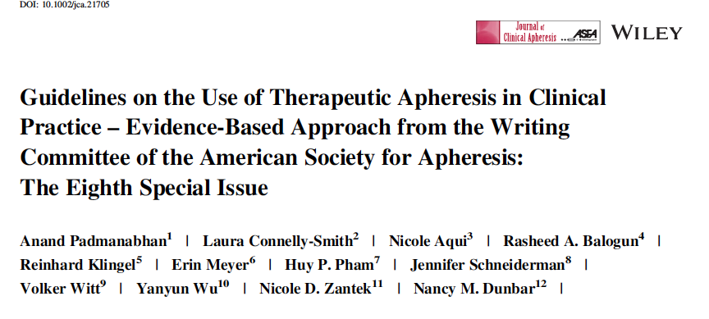
The ASFA grades indications into four categories based on systematic reviews and evidence-based strategies
Anand Padmanabhan, et al ,J Clin Apher. 2019;34:171–354.

Slide 42
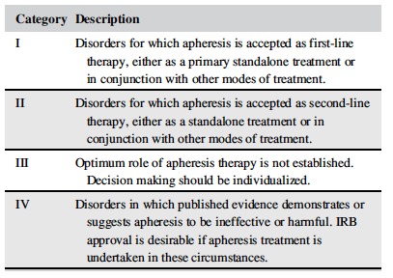

Slide 43
Based on 2014 registry data from the Canadian Apheresis Group there are 6 most common renal indications for TPE :

Slide 44
1- TTP / aHUS
2- Renal transplantation
3- ANCA associated vasculitis
4- Cryoglobulinemia
5- FSGS
6- Goodpasture syndrome

Slide 45
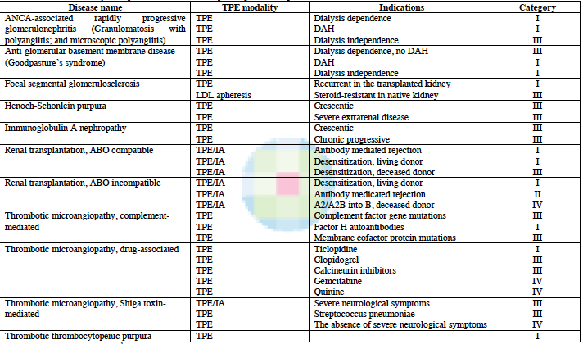

Slide 46
Complications of TPE
In contrast to adults in whom complications are relatively uncommon (<6%) and usually minor, children have a much higher incidence of complications, with the rate reaching up to 55%.
Norda R,et al,Transfus Apher Sci 2003;29:159-66.

Slide 47
Includes :
Hypotension
symptomatic hypocalcemia
Anemia, Thrombosis and Infection
Michon B,et al,Blood 2004;104:3645

Slide 48
Clearance of Medication by TPE
The removal of medications by apheresis depends on the volume of distribution of the medication and its protein-bound state.
Medications that are highly protein bound and have a low distribution volume will likely be removed by TPE.

Slide 49
Immunoglobulins, basiliximab, and rituximab are greatly removed by TPE.
CNI and corticosteroids are minimally removed by TPE.
Cyclophosphamide and azathioprine , most researchers recommend giving a dose after TPE
Szczepiorkowski ZM, et al, J Clin Apher2010;25:83-177.

Slide 50
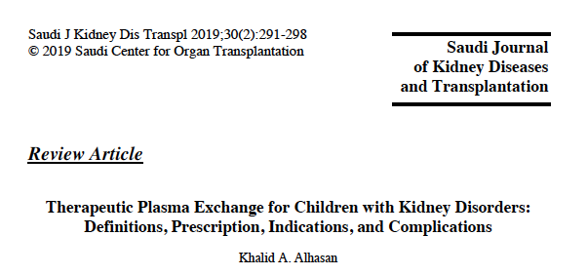

Slide 51
THANK YOU

Slide 52
1-TTP ⁄ aHUS
Three entities have been defined based on main target organ:
HUS exclusively affecting the kidneys,
TTP ⁄ HUS affecting kidneys and CNS
HELLP syndrome (hemolysis, elevated liver enzymes, low plts) always involving liver and placenta in association with pre-eclampsia

Slide 53
It has been well established that use of TPE in TTP reduces the mortality rate from 90-20%
Etiology of TTP :
1- Idiopathic with decreased ADAMTS 13
(IgG inhibitor in 65% )
2- TTP can also occur in association with pregnancy, autoimmune diseases, infection, drugs & BMT
^{Am J Hematol 50:84–90,}

Slide 54
In aHUS :
1- Mutations in four regulatory proteins in AP of complement activation :
CFH ,MCP , CFI and thrombomodulin (THBD), as well as two proteins of the C3 convertase (C3 and CFB)
2- Anti-CFH autoantibodies
Pediatr Nephrol 25:2431–2442, 2010

Slide 55
TPE serves to replenish the deficient ADAMTS13
TPE removes ADAMTS13 inhibitory ,mutant CFH, CFI, CFB and C3, and anti- CFH autoantibodies
FFP can be given to replenish normal amounts of these proteins & deficient ADAMTS13 while preventing complications such as volume overload

Slide 56
2- Renal Transplantation:
Plasmapheresis has been used since the 1980s for treatment of ABM rejection ,
More recently as part of desensitization protocols for ABO-incompatible renal transplants and for patients with preformed anti-HLA antibodies .

Slide 57
1-Treatment of AMR
AMR is mediated by DSA, which can be removed from the plasma by TPE
IVIG appears somewhat less effective on its own, and is often given in addition to TPE
^{Transplantation 89:277–284,}

Slide 58
Rituximab or bortezimib may be given to reduce antibody production
Reversal of acute rejection has been reported in 55–100% of episodes.
There appears to be no benefit in patients with chronic rejection.
Am J Transplant 2010; 10:1247–1253.

Slide 59
2- HLA and ABO incompatible Tx :
Combinations of TPE, IVIG, and rituximab achieve desensitization in a greater percentage of potential recipients, and with less subsequent rejection.
Am J Transplant 10:2033–2042, 2010
Curr Opin Organ Transplant 2010

Slide 60
HLA incompatible LKT
High risk:
1. Positive CXM
2. Positive DSA (class I and/or class II)

Slide 61
Rituximab single dose two weeks prior to transplant.
TPE followed by small dose IVIG (100 mg/kg)
The remaining of high dose IVIG (2gm/kg) over 48 hours prior to the day of surgery.
Target prior to transplantation: negative T cell IgG AHG CDC CXM and/or negative B cell CDC CXM

Slide 62
Intermediate risk:
1-Negative T IgG and B IgG CXM by AHG CDC 2- PositiveT and/or B IgG by PD flowCXM 3- Positive DSA
Rituximab single dose two weeks prior to transplant.
High dose IVIG (2gm/kg)

Slide 63
Relative Low risk:
Negative CXM
Positive DSA
Small dose IVIG (1 gm/kg) over 12-24 hours

Slide 64
ABOi LKT
Desensitization regimen is similar to desensitization of high risk HLA I Tx with the exception of the timing of remaining dose of high dose IVIG.
The dose is administered at the conclusion of the first two weeks postTx

Slide 65
Anti-GBM Disease
TPE effectively removes anti-GBM antibodies and most patients are depleted of circulating antibodies after 10–14 exchanges, provided further antibody synthesis is prevented by immunosuppressive drugs.

Slide 66
Prior to the introduction of this approach, mortality of anti-GBM disease was around 90% and very few patients recovered renal function.

Slide 67
One year survival in recent series is now 70 -90 % and renal recovery is good in those with a creatinine of less than 500 mmol/l at presentation, but still only around 10% in those who are dialysis dependent
^{Blood Purif 2012;33:190–198}

Slide 68
It is recommend that all patients not already on dialysis receive intensive plasma exchange: initially for 14 days or until anti-GBM antibodies are undetectable
^{Blood Purif ;33:190–198}

Slide 69
Lung hemorrhage provides a separate indication for TPE, and resolved in around 90% of patients in recent studies

Slide 70
Conclusion
TPE is an important therapy for several kidney diseases, based on strong evidence form clinical trials and series, and embodied in well estab- lished guidelines.

