Slide 1
Thrombosis of the Kidney Allograft
React and Prevent
Mohamed H. Wehbe, MD, FACS

Slide 2
Background
Can be secondary to renal vein or renal artery thrombosis
Devastating, in most occasions leads to loss of the graft
Timely diagnosis is most critical
Difficult; High suspicion
Low threshold to react

Slide 3
Incidence
Wide Incidence variation 0.1-4.6%
Due to variation in type of transplant patient groups.
  Variations in different recipient and donor factors…
RV or RA thrombosis responsible for 2-8% of early graft loss in adults
RV or RA thrombosis responsible for 35% of graft loss in children < 6 y of age
  North American Pediatric Renal Transplant Cooperative Study NAPRTCS
Peak Incidence in the first 48 hours

Slide 4
Presentation
Primary non-function or Acute Oligo-anuria usually within 48 hours of transplantation
Renal Vein Thrombosis is usually associated with tenderness over a painful swollen kidney, low grade fever and preceded by hematuria
RVT can mimic Acute Rejection clinically
Renal artery Thrombosis is usually silent
RVT and RAT can be triggered and may follow acute rejection or DGF

Slide 5
Differential Diagnosis
Acute oligo-anuria within first 48 hours
Differential diagnosis
  Renal vein thrombosis
  Renal artery thrombosis
  Accelerated acute cellular rejection
  Acute AMR
  Urologic complications: ureter kinking or compression, Dehiscence of uretero-vesicular anastomosis, Foley occlusion by blood clots

Slide 6
Causes of Acute Allograft thrombosis
Donor factors
Recipient factors
Surgical factors
Medication factors

Slide 7
Donor Factors MRAs
Multiple Renal Arteries from living donors
MRAs are present in 15-20% of donors
Many studies reported increased risk of complications: RAT, DGF, Ureteral complications
Other studies reported minimal risk with vascular surgical expertise
MRAs in cadaveric donors can be taken over a common aortic patch which may decrease the risk of allograft thrombosis. However, long vessels are more prone to kink

Slide 8
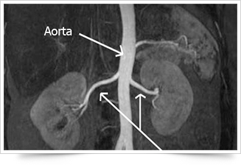
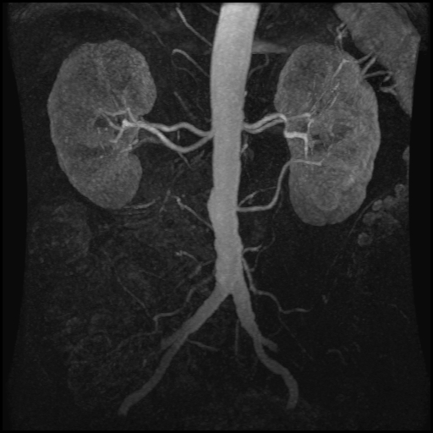
Donor Factors MRAs
MR Angiogram
Typical RAs
MRAs

Slide 9
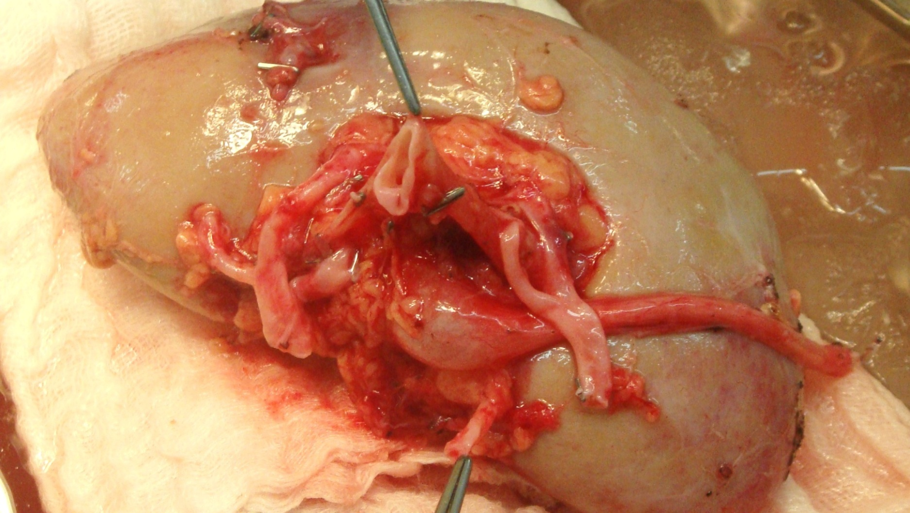
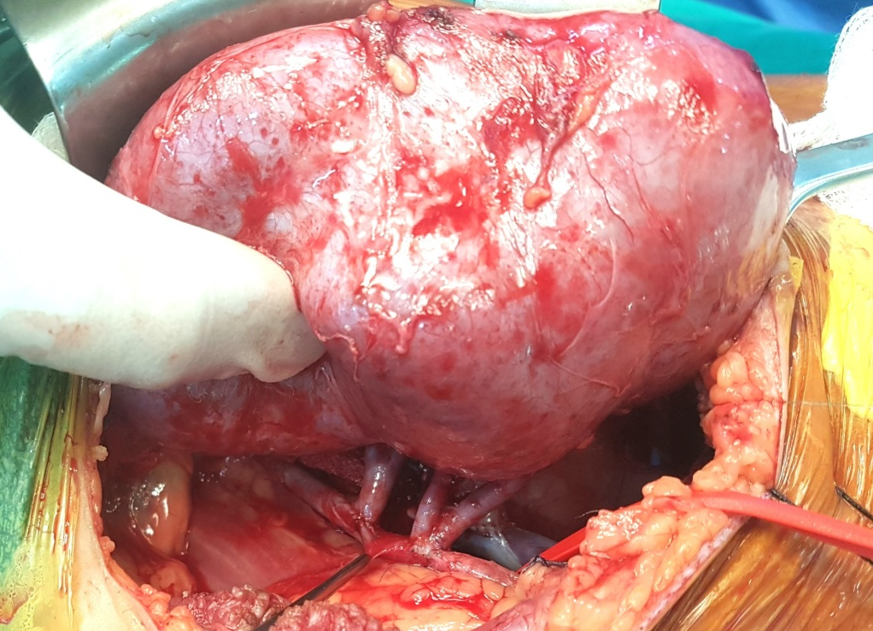
Donor Factors MRAs
Four arteries

Slide 10
Donor Factors MRAs
Hammoud Hospital Experience
423 Kidney Transplants as of january 2019
Only 11 CDT
MRAs were present in 72 living donors (17.5%)
66 had 2 arteries, 4 had 3arteriesss, and 2 had 4 arteries
Ureteral complications were 2% in the single artery group, and 8.3% in the MRA group
There was increase in WIT, CIT, DGF and urologic complications
There was no increase in Allograft thrombosis in our series

Slide 11
Donor Factors Donor Age
Elderly donors > 65 years
Living elderly donors had no increased risk of allograft thrombosis: optimal pre-transplant work-up
Cadaveric transplants from elderly donors had increased risk especially if there was donor hypotension. Ischemia-reperfusion injury activates pro-coagulant activity. UNOS data.
Increased risk of atherosclerotic vessels
Cadaveric donors younger than 6 years: relatively small vessels
Pediatric en-bloc from very young donors decreased risk of thrombosis

Slide 12
Donor factors Female donor
There was an increased risk of Renal Vein Thrombosis in the Australian and New Zealand Dialysis and Transplant Registry.
This was not duplicated in other data
Recent studies from Spain and Netherlands showed an increased risk of Renal vein Thrombosis from right kidneys of female living donors
Harvested right kidneys may have a very short and thin wall vein

Slide 13
Donor Factors Cadaveric Kidneys
Cold Ischemia Time >24 hours
Delayed Graft Function
Hemodynamic instability of the donor
In many series, these factors increased the risk of allograft thrombosis because ischemia alters the adhesive properties of the endothelium and ischemia-reperfusion injury inhibits fibrinolysis and triggers pro-coagulant activity
These effects are exacerbated in elderly donors with hemodynamic instability
Warm Ischemia Time does not increase risk of allograft thrombosis as long as it does not exceed 12 minutes

Slide 14
Recipient factors Age
Children < 6 years
Anastomosis of the renal vessels to the iliac vessels increased the risk of thrombosis by 26%. UNOS data
Anastomosis of the renal artery to the aorta and the renal vein to the IVC decreased the risk of thrombosis to 3.3%. This type is now adopted by most pediatric transplant surgeons
Trans-peritoneal Vs Extra-peritoneal kidney placement. Extra-peritoneal decreases GI complications at the expense of space
Weight is more important than age. Wait till > 5kgs preferably more than 10 kgs if possible

Slide 15
Recipient Factors Hemodynamic Instability
Intra- and post-Op hemodynamic instability. Rarely documented or charted
SBP < 70 mmHg for > 10 min intra-operatively or within 48 hours of transplantation
Independent risk factor. Hemodynamic instability was reported in 33% of patients who developed allograft thrombosis Vs 4.5%,. Netherlands Registree
Bigger impact in young children. Children have a relatively lower cardiac output in order to sustain a larger kidney (adult kidney)
Aggressive hemodynamic monitoring intra and post-operatively

Slide 16
Recipient factors Age
Elderly recipients
More than 18.9% of kidney transplants are performed in recipients > 65 years of age UNOS data
Increased risk of atherosclerotic complications
Myocardial instability, comorbidities…

Slide 17
Recipient factors Primary disease
Diabetic nephropathy. Angiopathy with secondary atherosclerosis and calcifications. Importance of adequate vascular work-up
Systemic Lupus Erythematosis. Anti-PhosphoLipid Antibodies
Nephrotic syndrome. Loss of > 3 gms of protein/day in urine, hypo-albuminemia,edema. High independent risk of both arterial and venous thrombosis especially in young children. Pre-transplant nephrectomy may be considered

Slide 18
Recipient factors
Type of Renal Replacement therapy
Pre-emptive transplantation although favored has increased risk of graft thrombosis
Similarly patients who are on Hemodialysis and still have high UO.
These patients get easily dehydrated and require aggressive fluid monitoring
Consider pre-Op cessation of PO diuretics and antihypertensive drugs except for B-Blockers
Peritoneal Dialysis has the highest risk.
-Acquired thrombophilic state due to selective protein loss as in nephrotic syndrome
-Patient switch from HD to PD may be due to atherosclerotic and vascular access problems

Slide 19
Recipient Factors Thrombophilia
Inherited and acquired thrombophilia
Screening for thrombophilia decreases the number of events
Some centers include thrombophilic studies in the pre-op work-up for all patients. May not be cost-effective
High risk groups include patients with history of DVT or PE, multiple miscarriages, history of graft thrombosis, SLE, obesity, diabetes, or family history of thrombosis…
The most factors screened for in the literature are FVL, protein C, protein S, anti-thrombin defect, pro-thrombin mutation and APA

Slide 20
Medication Factors
Pre-medication with steroids was found in some series to increase risk of graft thrombosis. It may activate Tissue factor/factorVII pathways. Solumedrol dose should not exceed 8 mg/kg
OKT3 significantly increases the risk of graft thrombosis by inducing pro-coagulant activity. Almost not used anymore
Thymoglobulin decreases thrombosis risk by decreasing platelet counts and pro-coagulant activity by down-regulating Immune modulators
Similarly IL-2 receptor antibodies have protective effect
Calcineurin inhibitors were not proven to increase the risk of thrombosis although they cause hypofibrinolysis. Use post-transplant may be safer
Role of erythropoietin is controversial. High Hematocrit is more important

Slide 21
Technical factors
The transplant surgical technique is well established
Learning curve is essential especially for laparoscopic nephrectomy
Many graft failures and complications are secondary to inattention to minor details or overconfidence.
Technical complications are under-reported
As well, are the hemodynamic parameters on the anesthesia charts.
Harmony and honesty between the surgeons, anesthesia team and nephrologist

Slide 22
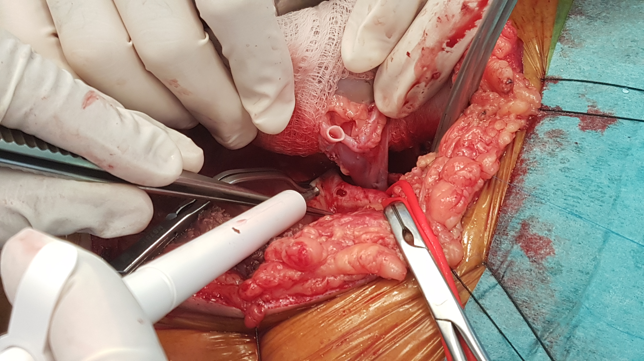
Technical Factors
Aortic punch
Decreases elastic recoil of arterial wall smooth muscle
Makes the anastomosis easier and more exact

Slide 23
Technical Factors
Vascular clamp injury
Cannulation injury at time of perfusion
Kinking secondary to relatively long vessels.
Compression of renal vein by renal artery. Risk may be decreased by ipsilateral placement ( left kidney to left iliac fossa)
Extrinsic compression by hematomas, lymphocoeles…
Kidney positioning: relatively tight space. The very young and thin males

Slide 24
Standard Prophylaxis
High risk of thrombosis with normal thrombophilic studies
Adults: S/Q heparin 5000 u TID for 3 days then low dose aspirin 100mg /day
Pediatrics: 10u/kg/hr continuous infusion for 3-5 days followed by aspirin 1-5 mg/kg/day
This proposed prophylactic protocol is not a guideline
Some centers use a single dose of IV heparin before iliac vessel clamping aiming at an ACT of 200
Risk of aspirin especially if kidney biopsy is needed
Weigh the risk of thrombosis against the risk of bleeding

Slide 25
Intensive prophylaxis
High risk and presence of a thrombophilic state
S/Q heparin 5000 u TID for 4 weeks. Can use LMW heparin alternatively
Then switch to either low dose aspirin or long-term anti-coagulation
Aspirin decreases graft arterial complications and CV risk
Anti-coagulation decreases graft venous complications and VTEs ( DVT and PE)
Individualization is the key

Slide 26
Diagnosis
High index of suspicion
Allograft thrombosis can follow Acute rejection, DGF, Infection or collections
Duplex Ultrasound
MRI without gadolinium. Is gaining popularity in the literature. Though it is time consuming, needs transport and expensive. For follow-up or semi-emergent setting
Renal scintigraphy use is well established
Continuous mini-invasive graft monitoring promising future modalities
- Microdialysis catheter in parenchyma measures via semi-permeable membrane T metabolites Q30 min
- Thermodilution electrode in parenchyma measures microcirculatuion continuously ml/100g tissue/min

Slide 27
Diagnosis Duplex Ultrasound
In cases of renal vein thrombosis, it characteristically shows reversed arterial diastolic flow (arterial waveform positive during systole and negative during diastole along with non-visualization of the renal vein
Reversed or absent diastolic flow is a sign of extremely high vascular resistance in small intra-renal or large extra-renal vessels
Not pathognomonic for renal vein thrombosis. It can occur in severe AR, severe ATN, compression by hematoma or vascular kink. But, may indicate early exploration.
At our center, a duplex machine is available on board. At any point of time, the transplanted kidney can be examined by the transplant team. Both transplant nephrologists are certified and perform all the transplant duplex studies. This saves precious time and can rule out other causes of anuria. As well we do the kidney biopsies.

Slide 28
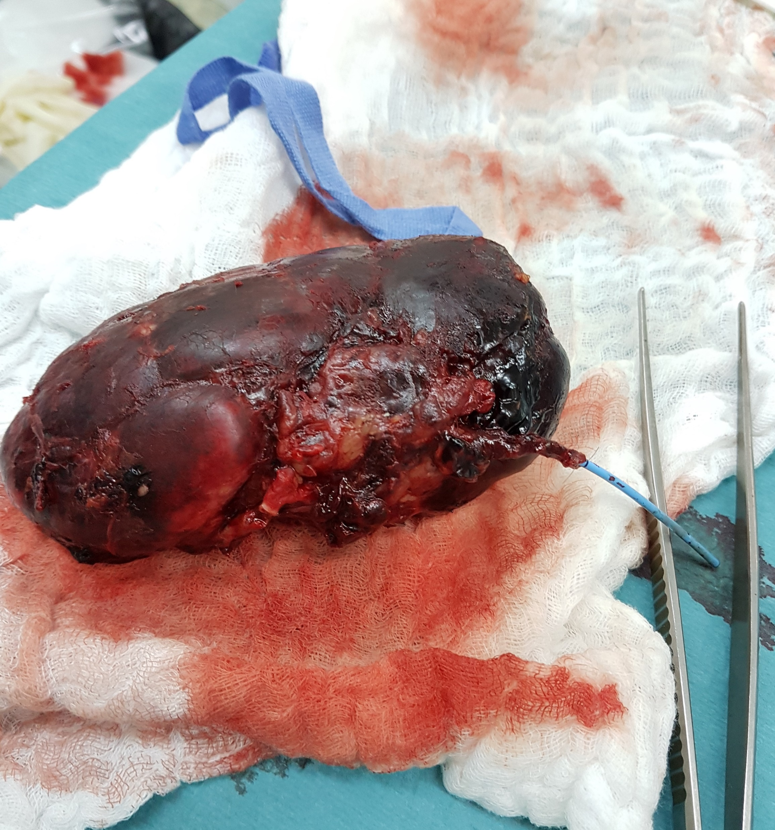
Renal vein thrombosis
2 documented cases of renal vein Thrombosis. One was saved
4 cases that gave urine after unclamping progressed to anuria while closing the incision. Reopening and repositioning while still in the OR

Slide 29
Complications of Graft Thrombosis
Kidney graft failure and back to dialysis
Kidney graft rupture can complicated renal vein thrombosis
Later infection or necrosis of a devascularized graft
Deep vein Thrombosis
Pulmonary Embolism

Slide 30
Treatment Open Exploration
Most papers concerning the subject are anecdotal cases or retrospective chart reviews at best
The true cause of graft failure is not clearly documented or questionable
Timely prompt exploration may salvage kidneys with acute dysfunction secondary to renal artery or renal vein thrombosis, renal artery or renal vein kinking, ureteral obstruction or leaks, compressive hematomas, urinomas or lymphocoeles.
Open surgical embolectomy of the renal artery or renal vein is done by most authorities within the first week of transplantation
Always take a biopsy in order to document the diagnosis and to help in the decision of future re-transplantation

Slide 31
Treatment Non-surgical
If presentation is late (notably after the second week), some authors reported a rare improvement in graft function or salvage by
- Systemic thrombolysis with streptokinase or urokinase...
- Percutaneous embolectomy along with direct catheter thrombolysis
Thrombolysis is very risky especially following the early post-operative period, and results are poor
Weigh the benefits of rare graft salvage against the risks of bleeding
Heparins and anti-platelets have no role in allograft thrombosis

Slide 32
If Suspect, Act
Thank You

