Slide 1
Intermittent Catheterization versus
Bladder Augmentation in
Neurogenic Bladder
Yaser El-Hout, MD, FEBU, FACS
Associate Professor of Clinical Surgery
Chief, Section for Pediatric Urology
Director, Residency Training Program
Division of Urology, AUB-MC

Slide 2
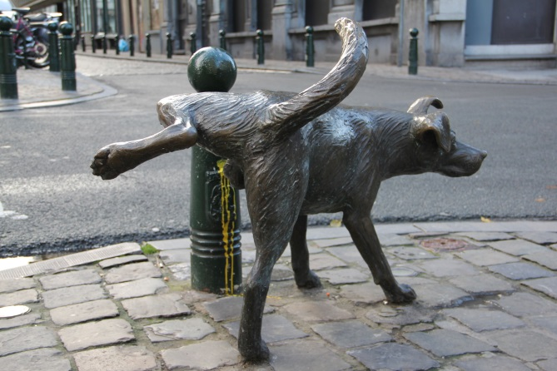

Slide 3
Disclosures
I have no financial disclosures.

Slide 4
Objectives
To provide a focused, practical overview of neurogenic bladder in children, pertinent to the clinical practice of the pediatrician

Slide 5
List of Conditions Associated with Neurogenic Bladder:
CENTRAL
Alzheimer’s disease
Birth defects of the spinal cord
Brain or spinal cord tumors
cerebral palsy
Encephalitis
Multiple sclerosis
Parkinson’s disease
Spinal cord injury
Stroke recovery
Alcoholic neuropathy
Diabetic neuropathy
Nerve damage due to pelvic surgery
Nerve damage from a herniated disc
Non-neurogenic Neurogenic Bladder (Hinmann-Allen Syndrome)
PERIPHERAL
OTHER
pediatric age group

Slide 6
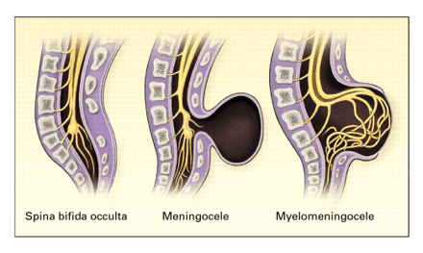
A Major Concern : Spina bifida
1500 newborns/year in USA
Prevalence: 2.5-4/10,000
MULTIDISCIPLINARY CARE
CONGENITAL
SOCIAL SUPPORT
LIFE-LONG
COST BURDEN
TRANSITIONAL CARE

Slide 7
Are we doing better in managing spina bifida?
Folic acid
Antenatal diagnosis & termination of pregnancy
VP shunting for hydrocephalus: increased survival
Pre-emptive treatment- early CIC & anticholinergics
Botox
Minimally invasive surgical technologies

Slide 8
Diagnostic Tools
Ultrasound
VCUG
Urodynamics
Uroflow
Cystometrogram (CMG)

Slide 9
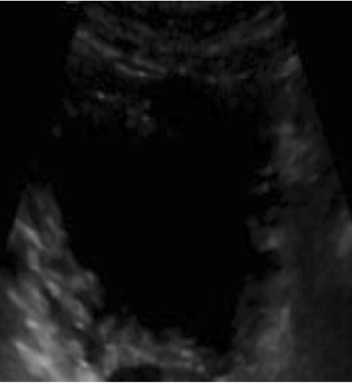
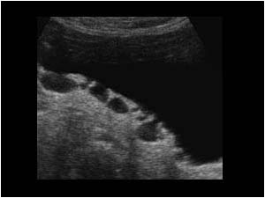
Diagnostic Tools: Ultrasound

Slide 10
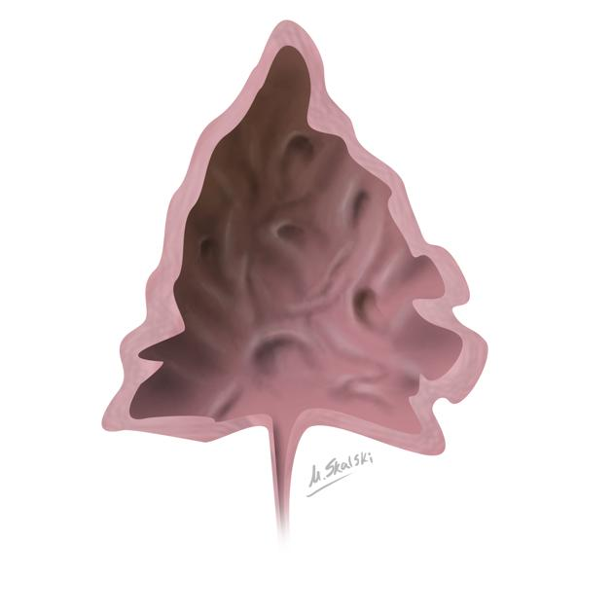
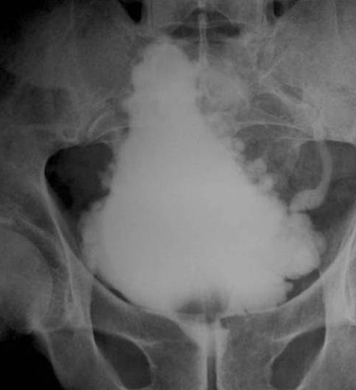
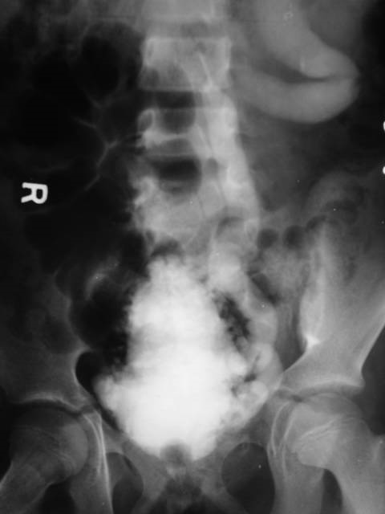
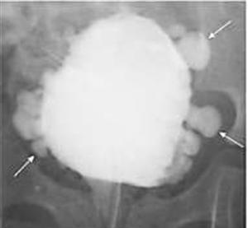
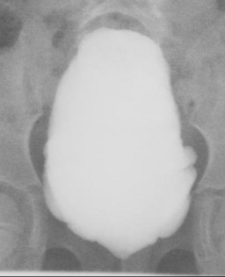
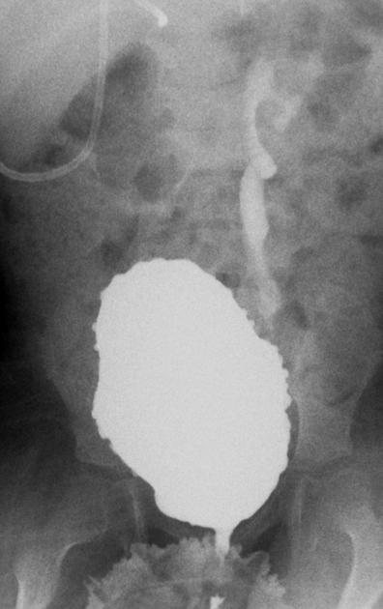
Diagnostic Tools: VCUG

Slide 11
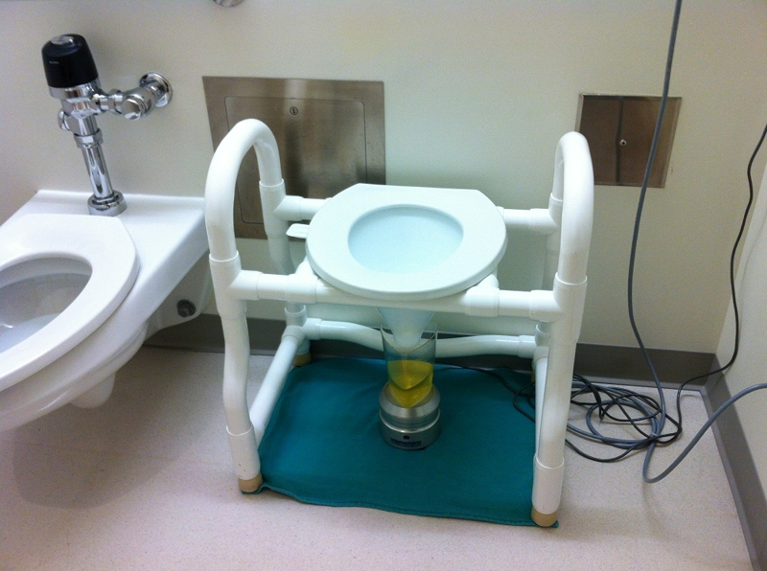
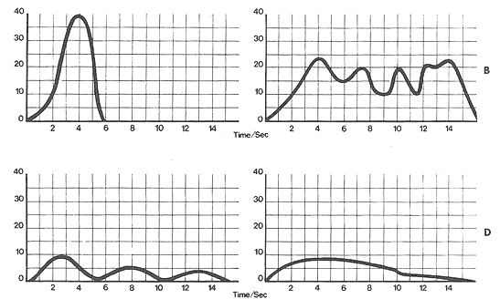
Urodynamics: Uroflowmetry
Non-invasive
Performed on toilet trained kids
It is a volume (mL) vs. time (sec) tracing
May be coupled with EMG : dyssenergia
Bell-shaped
Intermittent
Flattened-intermittent
Flat

Slide 12
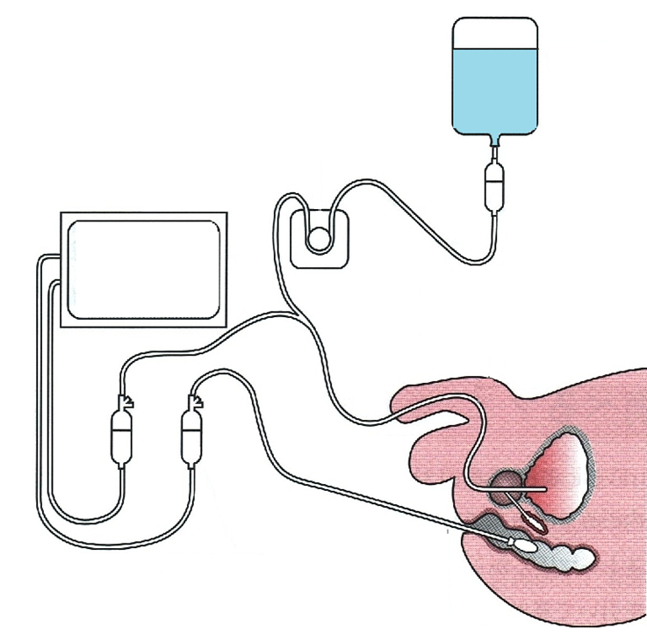
Urodynamics: Cystometrogram
Two-way urethral catheter
1) Filling (VOLUME)
2)measures Intra-vesical Pressure (Pves)
Invasive
Pressure (cmH₂O) vs. Volume (mL) tracing
1)
2)
3)
Detrusor Pressure
Pdet= Pves -Pabd
Rectal catheter
3) measures Intra-abdominal Pressure (Pabd)

Slide 13
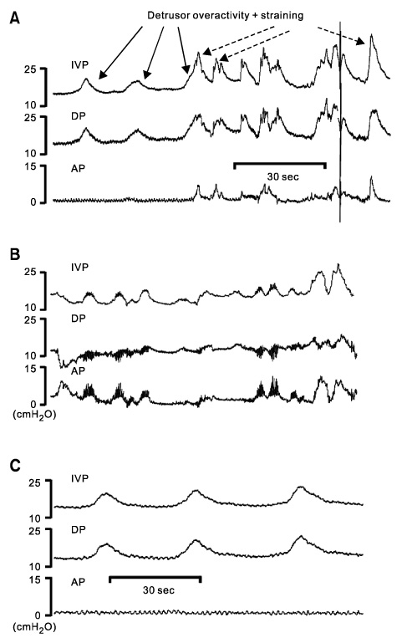
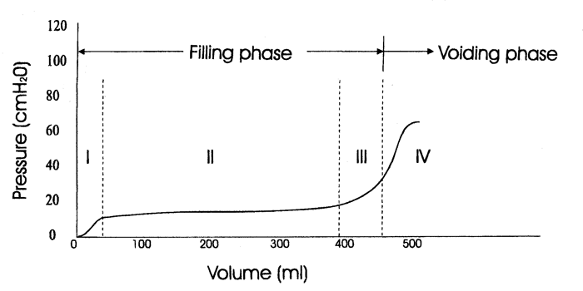
Cystometrogram: basic tracings

Slide 14
Cystometrogram: Pitfalls
Solution Temperature
Calibration
Catheter insertion complications
Non-compliant young child
CRY-O-GRAM

Slide 15
El- Hout Y, Leslie B, Weber B, Kozakowski K, Lorenzo AJ, Bagli DJ, Pippi Salle JL, Farhat WA: Are routine urodynamic studies (UDS) necessary in follow-up evaluation of spina bifida patients with neurogenic bladder? The 1st World Congress of Pediatric Urology, San Francisco, USA, May 27-31, 2010
Retrospective analysis of n=133
Change of management
Change frequency CIC
Change dose anticholinergics
Scheduling surgery
95% based on deterioration of Ultrasound
When Ultrasound normal, 27% based on urodynamics results

Slide 16
Types of Neurogenic Bladder Dysfunction
Good bladder
Good sphincter
Good bladder
Bad sphincter
Bad bladder
Bad sphincter
Bad bladder
Good sphincter

Slide 17
The abnormal bladder of childhood
Birth
School
Transition
Prevent renal injury
Prevent injury to bladder
(or bowel) that could compromise future treatment or necessitate more extensive future surgery
Ensure social fecal
& urinary continence
Enable self care
Enhance image/confidence
Maximize socialization & QoL
Sexuality & fertility
Independence & transition to adult society

Slide 18
Bladder Management
Management Goals:
1. Prevent kidney & ureter
injury
2. Prevent bladder & colon
injury that could compromise
future function or necessitate
more extensive surgery
SAFE
Indicators:
1. Low post-void
residual
2. LPP < 40 cm H₂O
3. Synergy
PHASE 1: Protecting the Kidneys
Age: Newborn to Onset of School
UNSAFE
Anticholinergics +/-
Intermittent
Catheterization
Indicators:
1. Ultrasound
a. Hydronephrosis
b. Thickened bladder wall
2. VCUG
a. Bladder irregularity
b. Vesicoureteral reflux
3. UDS
a. Elevated post-void residual
b. High bladder pressures
c. Dyssynergy
Vesicostomy

Slide 19
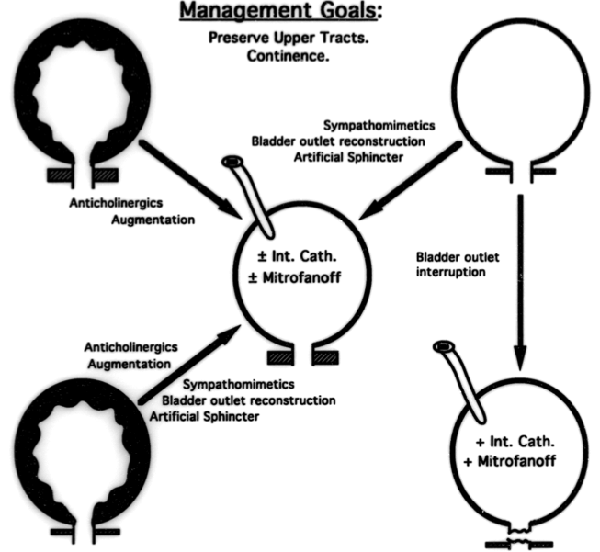
Bladder Management
Management Goals:
Preserve Upper Tracts.
Continence.
Self Care.
Sympathomimetics
Bladder Outlet Reconstruction
Artificial Sphincter
(Bladder neck
Injection)
PHASE 2: Maximizing Life Style
Age: School to adult
Anticholinergics
Augmentation
Bladder Outlet
Interruption
Anticholinergics
Augmentation
Sympathomimetics
Bladder Outlet Reconstruction
Artificial Sphincter
(Bladder Neck Injection)

Slide 20
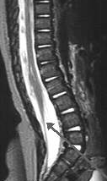
BEWARE: tethered cord
25% patients age 2-8 years
Usually combination of new-onset neurological, orthopedic and urological problems
10% present with isolated new urologic problem

Slide 21
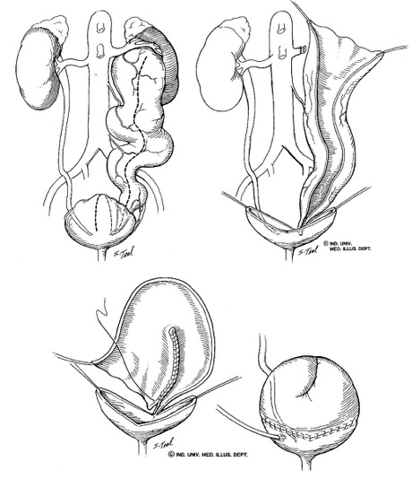
Vesicoureteral Reflux
In neurogenic bladder, VUR is secondary
Focus on optimizing bladder (CIC + anticholinergics)
Accept bacteriuria !! (treat if febrile or symptomatic)
Severe reflux : option for ureterocystoplasty

Slide 22
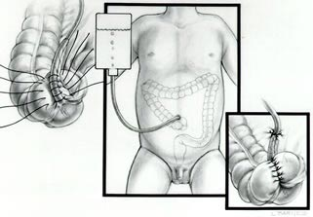
Constipation: When everything fails MACE: Malone Antegrade Continence Enema
Appendix is always first choice
Best done coincidentally with GU procedure in 1 planned sitting
Consider split appendix if possible and Mitrofanoff the other part
Tap water effective and safe
Alternative: C-tube

Slide 23
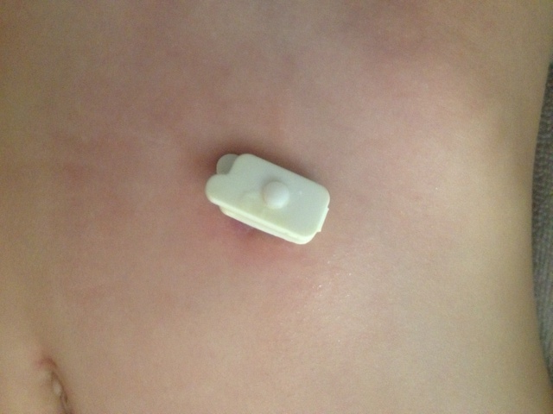
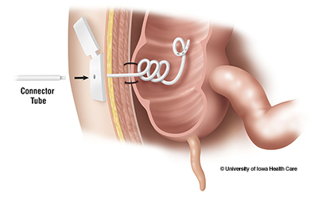
C-tube

Slide 24
Neonatal vs. later childhood treatment of bladder in spina bifida
Fewer bladder augments needed in patients treated neonatally (11% vs. 27%).
“At the present time, the only individuals who seem to require a bladder augmentation in later childhood are those who have not been managed prophylactically since early infancy”
Wu HY et al. JUrol (1997) 157(6): 2295-2297
Bauer S., Dialogues in Pediatric Urology, Vol 24, Sept, 2001

Slide 25
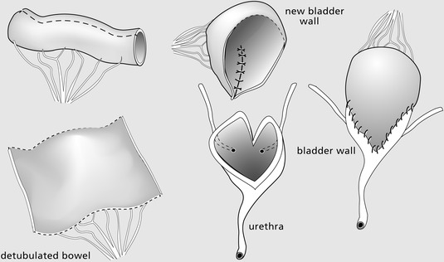
Absolute indication : DLPP > 40 cmH2O Best segment: ileum
Augmentation Cystoplasty

Slide 26
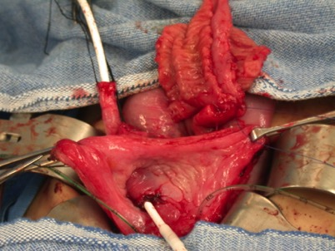
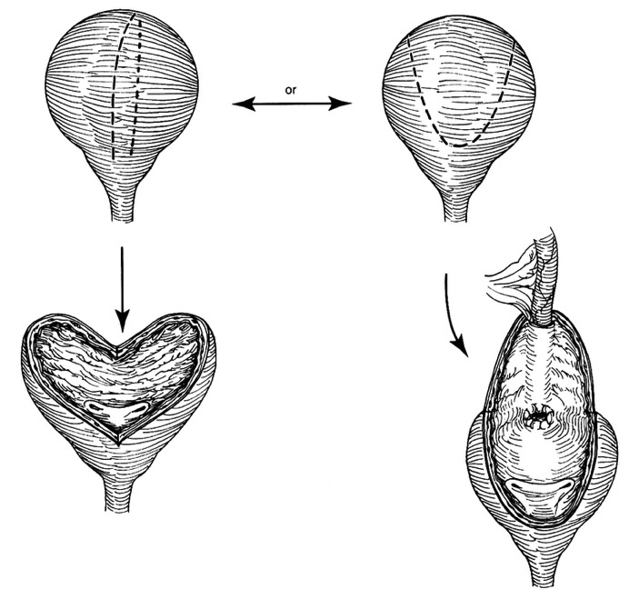
Catheterizable Channels: Mitrofanoff & Friends
Clearly indispensable
Preferred by patient & family:
51/52 patients with MTF & urethral access chose MTF over urethra
Diameter is biggest issue-determines catheter size (emptying time, compliance?)
Length a secondary issue (short length, large distance to abdominal wall, morbidly obese)

Slide 27
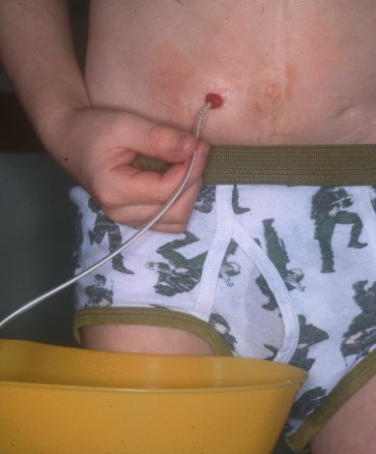
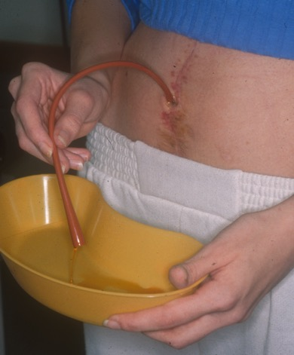
Abdominal Stoma
Umbilical Stoma

Slide 28
Outlet Procedures:
Reserved for ongoing incontinence
BEWARE: upper tract deterioration
Most difficult issue to assess preoperatively and correct medically & surgically
Urethral lengthening (YDL, Mitchell, Kropp, Pippi-Salle)
Sling
Injection
AUS

Slide 29
Augmentation cystoplasty – Modern concerns
All ongoing concerns related to surgical reconstruction
Long term concerns:
need for further surgery
pregnancy
metabolic considerations
cancer

Slide 30
Time & Vitamin B-12
Pediatric patients who have undergone ileal enterocystoplasty are at risk for development of vitamin B12 deficinecy
Highest risk beginning @ 7 years post op
Risk increases with time
Now it is recommended an annual serum B12 value in children beginning at 5 years following bladder augmentation
Rosenbaum DH et al. J Urol. 2008 Apr;179(4):1544-7

Slide 31
Is additional bladder surgery needed?
Retrospective review of 1st 500 bladder augmentations performed 1978 -2003
Mean follow up -13.3 yrs
Complications -169 patients (34%)= 254 surgeries
Metcalfe PD et al J Urol. 2006 Oct;176(4 Pt 2):1801-5

Slide 32
Is additional bladder surgery needed?
3 (0.6%) developed TCC
all presented with fatal,metastatic TCC
Bladder perforation occurred in 43 patients
(8.6%) = 53 events
16 (3.2%) required laparotomy for bowel obstruction
47 (9.4%) required repeat augmentation
Bladder stones were treated in 75 patients (15%), who required a total of 125 surgeries
Metcalfe PD et al J Urol. 2006 Oct;176(4 Pt 2):1801-5

Slide 33
Perforation
High index of suspicion as delayed dx is associated with death!
False (-) rate 10-20% with standard VCUG
CT cystogram is most accurate
Must be warned of high recurrence rates
Bauer SB et al. JUrol (1992) 148:699-703.
Shekarriz B. Urology (2000) 55:123-128.
DeFoor W et al. Urology (2003) 62:737-741.
Fontaine E et al. J R Soc Med (2003) 96:393-394.
Metcalfe PD et al. JUrol (2006) 175:1466-1470.
Shekarriz B et al. Urology (2000) 55:123-128.

Slide 34
Complications of cystoplasty-Mucus, bugs & stones
Mucus
Intestinal mucosa continues to produce mucus, which is rich milieu for bacteria
Stones
Immobility, urinary stasis, foreign bodies, continent stoma, non-complicance
Hydration
Efficient catheterization (large enough catheter)
Irrigation*
Avoid staples if possible
Stone surveillance??
Hensle et al. BJUI 2004; 93:585-7

Slide 35
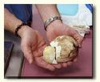
Stones
8-52% of patients
Infection, foreign bodies, mucus, incomplete emptying
Higher risk with abdominal stomas (Blyth et al. 1992)
23/74 stoma pts. had stones vs. 3/87 without stomas (P<0.0001)

Slide 36
Non compliance with CIC & ESRD
Augmentation cystoplasty
8/12 (67%)- noncompliance with CIC was incipient cause of ESRD
Asymptomatic 1/3 of time
Symptomatic 2/3 of the time!!!- >4 symptomatic UTI/ yr or persistent UTI; recurrent gross hematuria; abdomino-pelvic pain
Husmann D. Plenary session CUA. Niagara Falls, NY. June 2013

Slide 37
Late issues- pregnancy
After lower urinary reconstruction- Higher risk of APN, ureteral obstruction, HTN, & impaired renal function… temporary vs permanent?
Temporary incontinence in 3rd trimester is common
Conflict as to need for C/S- should be based on obstetrical indications, not presence of reconstruction
Hill DE, Kramer SA. JUrol (1990) 144:457-459.
Creagh TA et al. JUrol (1995) 154:1323-1324.

Slide 38
Late issues- pregnancy
Issue of bacteriuria & pregnancy-controversy re: continuous antibiotics prophylaxis
Vascular pedicle shifts laterally & augment blood supply is not usually affected in C/S
If C/S- ideally urologist should be present, especially if catheterizable (Mitrofanoff/ MACE) channels

Slide 39
Pregnancy & fetal demise
Risk of eclampsia, fetal prematurity & fetal death related to:
Pre-existing HTN
Pre-existing proteinuria
Renal scarring
creatinine >1.2
Pregnancy may be considered with
Cr < 2.0 (some will allow up to 2.2)

Slide 40
Late Issues: Cancer!
Case
Cancer: enterocystoplasty as independent risk factor for cancer (6th decade of life)
153 patients after ileo or colocystoplasty vs. age-matched controls on CIC without augmentation (neurogenic, post-valves, exstrophy/epispadias)
Augmented 7/153 (4.5%)= 7-8 fold increase*
Normal population (SEER data base) 0.6% risk
* N.S. p<0.05
Higuchi et al. J Urol 2010; 194:2492-2497

Slide 41
Late Issues: Cancer!
Whereas enteric augmentation carries a 7-8 fold increased risk of developing cancer, gastric augments may have double that risk, i.e. 14-15 fold increase!
Triad of augmentation, immunosuppression, & CMV &/or EBV should heighten concern for malignancy!
Husmann DA. Ther Adv Urol (2009) 1(1):5-11.

Slide 42
Can we screen for cancer?
Endoscopic surveillance should begin between 7 and 10 years following surgery.
semiannual urinalysis
Estimated cost of annual cystoscopy & cytology to diagnose 1 cancer (which is unlikely to be curable): >$950,000
Kurzrock, EA. World J Urol (2009) 27:69-73

Slide 43
Conclusions
Care of the patient should be INDIVIDUALIZED & must be based on sound clinical assessment & experience
Imperative that the patient & family understand that follow-up is lifelong & the potential for complications & tune ups are virtually universal
Realistic expectations & tremendous motivation & ongoing education are mandatory for long term success

Slide 44
Thank you

