Slide 1
Failure to thrive case: Endocrinology point of view
Carole Michel SABA, MD
Pediatric Endocrinology and Diabetes
Saint George Hospital Medical University Center
14 September 2019

Slide 2
Case presentation
A 14-year-old male presents with 3 year history of abdominal pain, diarrhea and recent weight loss.

Slide 3
History
Abdominal pain with occasional diarrhea since he was in middle school but he often passed it off as the stomach flu.
Now has 10 episodes of diarrhea per day with no blood
Wakes up with abdominal pain and diarrhea about 3 times per night.
No urgency, incomplete emptying or incontinence.
Low grade temperature of 38.5°F on most days.
Weight dropped by 5 kg
Severe rectal pain upon defecation
Back stiffness in the mornings and some arthralgias of the knees, elbows and hands for the past 2 years.

Slide 4
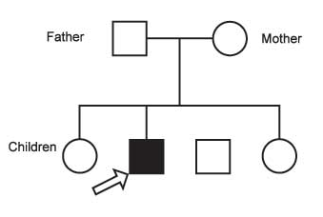
Case presentation
PMH: Childhood asthma (Off treatment)
PSH: Negative
Meds: Currently NSAIDS for arthralgias
Paternal ht: 180 cm
Maternal ht: 165 cm
Target height: 179 cm
Family history: Crohn’s disease in his uncle and in 2nd degree cousin

Slide 5
P/E
Ht: 137 m (-1.5 SD)/ Wt: 32 kg (- 3 SD)
Abdomen: Mild tenderness in the right lower quadrant.
Rectal exam showed a perianal fistula at the 3 o'clock position, drained pus on gentle pressure.
No skin lesions
Rest of ROS: Unremarkable
A1P1G1

Slide 7
Labs
WBC 12.3 k/uL
Hb 9.8 g/dL
MCV: 62
Plt 480 k/uL
Electrolytes normal (K: 3.2 mmol/L)
Liver enzymes: Normal
Stool cultures: Negative
CMV and C difficile: Negative.
ESR: 45mm/hr
Albumin low: 17g/L
Fecal calprotectin: 500 μg/mg
Celiac workup: Negative
FSH: 0.1 mUI/L
LH: 0.1 mUI/L
Testosterone: 11 ng/dL
IGF1: 85 ng/mL

Slide 8
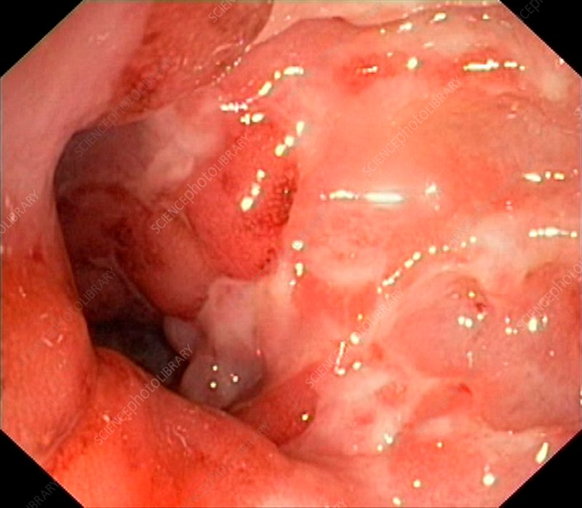
Endoscopic findings

Slide 9
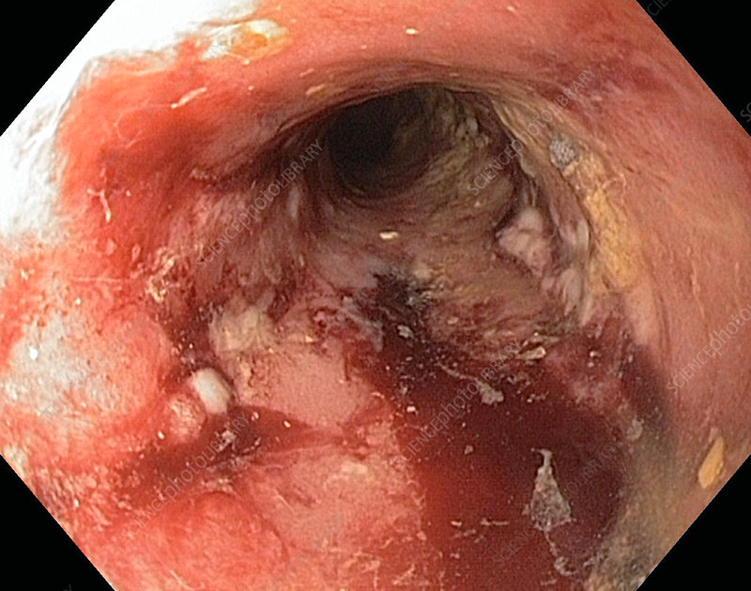

Slide 10
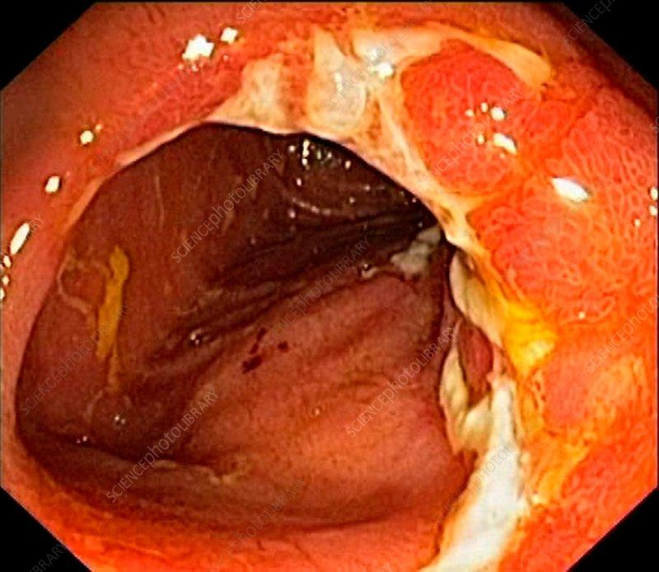

Slide 11
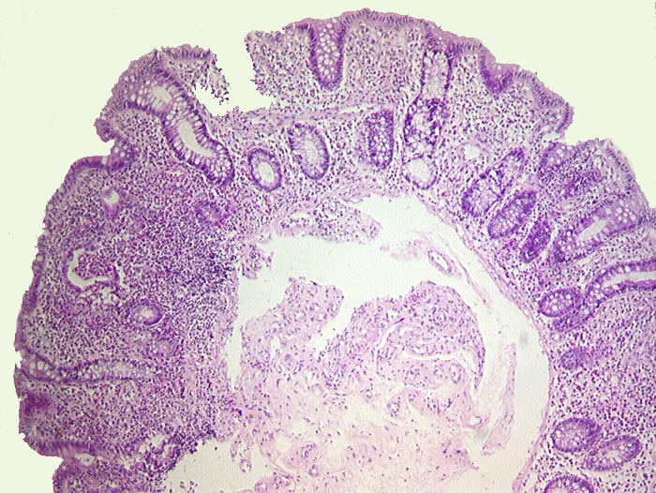
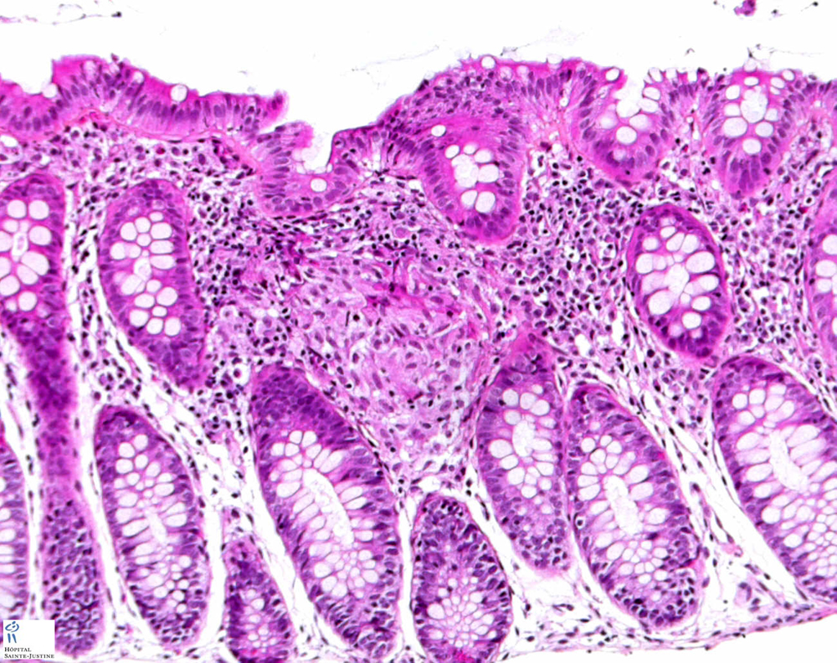
Histology
Transmural inflammation
Granulomas

Slide 12
Management
GI management oh his Crohn’s:
5-Aminosalicylic Acid (5-ASA)
Ciprofloxacin and metronidazole
Hydrocortisone (rectal enema)
Anti TNF alpha
Nutrition
Psychological support

Slide 13
Endocrinology point of view FTT induced by IBD
GH treatment recommended?
Pubertal induction?
How to follow up?

Slide 14
Introduction
Impairment of growth is recognized as one of the most significant complications of IBD in pediatric patients.
The reported incidence of growth failure at diagnosis is 15–40% in pediatric onset CD and 3–10% in UC.
Levine A, Griffiths A, Markowitz J, 2011

Slide 16
Mechanism
Growth failure is associated with:
decreased appetite
abdominal symptoms
malabsorption due to mucosal inflammation
growth hormone resistance due to inflammation
genetic factors.

Slide 17
Mechanism: Malnutrition
Occurs secondary to decreased food intake due to abdominal pain and other symptoms
Malabsorption due to intestinal mucosal damage
Increased energy requirement due to inflammation
Drug-nutrient interactions.
Hypercytokinemia occur before other symptoms develop in pediatric patients.
Ballinger et al

Slide 18
Mechanism
Ballinger et al. (6) have shown increased release of serotonin (hydroxytryptamine) from the hypothalamus in rats with experimental colitis, and that this was associated with anorexia.
Gryboski et al. (10) reported that children with CD have delayed gastric emptying

Slide 19
GH resistance
The GH-insulin like growth factor (IGF)-1 axis regulates linear growth, and circulating IGF-1 levels were decreased in patients with active CD
The cause of low IGF-1 concentrations in children with CD is thought to be multifactorial: Nutritional status, disease activity, and circulating plasma cytokine levels, including levels of tumor necrosis factor (TNF) and IL-1.

Slide 20
Mechanism: GH resistance
Increased levels of proinflammatory cytokines like IL-6, TNF-α, and IL-1β lead to changes in secretion and sensitivity of the GH/IGF-1 system, causing partial GH resistance, inhibition of growth hormone receptor (GHR) expression and action, and a decrease in IGF-1 (irrespective of GH levels)

Slide 23
rGH therapy recommended?

Slide 24
No role for GH therapy
Tietjen et al: growth failure was caused by impaired GH secretion?
Measured urinary GH: They found normal urinary growth hormone levels in CD, concluding that growth failure in patients with CD is not caused by GH deficiency

Slide 25
Tietjen et al, 2012

Slide 26
Role?
Another randomized controlled trial at two tertiary children’s hospitals:
rhGH group: Median HV increased from 4.5 (range 0.6-8.9) at the baseline to 10.8 (6.1-15) cm/year at 6 mo (P = 0.003)
≠ Control group it was 3.8 (1.4-6.7) and 3.5 cm/year (2.0-9.6), respectively (P = 0.58)
The median percentage increase in HV over 6 mo was 140% (16.7-916.7) in the rhGH group and 17.4% (42.1-97.7) in the control group (P < 0.001).

Slide 27
Role GH?
Change in bone age for chronological age was also similar in the two groups
Role of high dose rGH? (0.067 mg/kg )
Cannot occur if cannot maintain remission of IBD activity

Slide 28
Yes or no GH?
No role if active disease, high inflammation
Consider high dose if need to treat
Clinician judgment (Multifactorial decision)

Slide 29
Mechanism: Genetics
Lee et al. investigated 317 patients with CD, and reported that a polymorphism in the Dymeclin DYM gene was significantly associated with growth impairment.
D’Mello et al. suggested that GM-CSF antibody and CARD15 risk allele carriage was associated with growth failure
Russell et al. reported on a possible association of OCTN1/2 variant with growth failure

Slide 30
CD versus UC???
ESPGHAN suggests that growth impairment is considered rare in patients with UC who are not dependent on CS.
Therefore, exclusion of Crohn’s colitis or primary GH deficiency should be sought when significant growth impairment is detected

Slide 31
Other possible mechanisms:
Retrospective data from UK shown that jejunal disease was negatively associated with lower final height.
However, registry data from Belgium showed no association of growth outcome with age, sex, diagnostic delay, type of treatment, disease location, or disease activity at diagnosis, but only with disease activity 3 years after disease onset

Slide 32
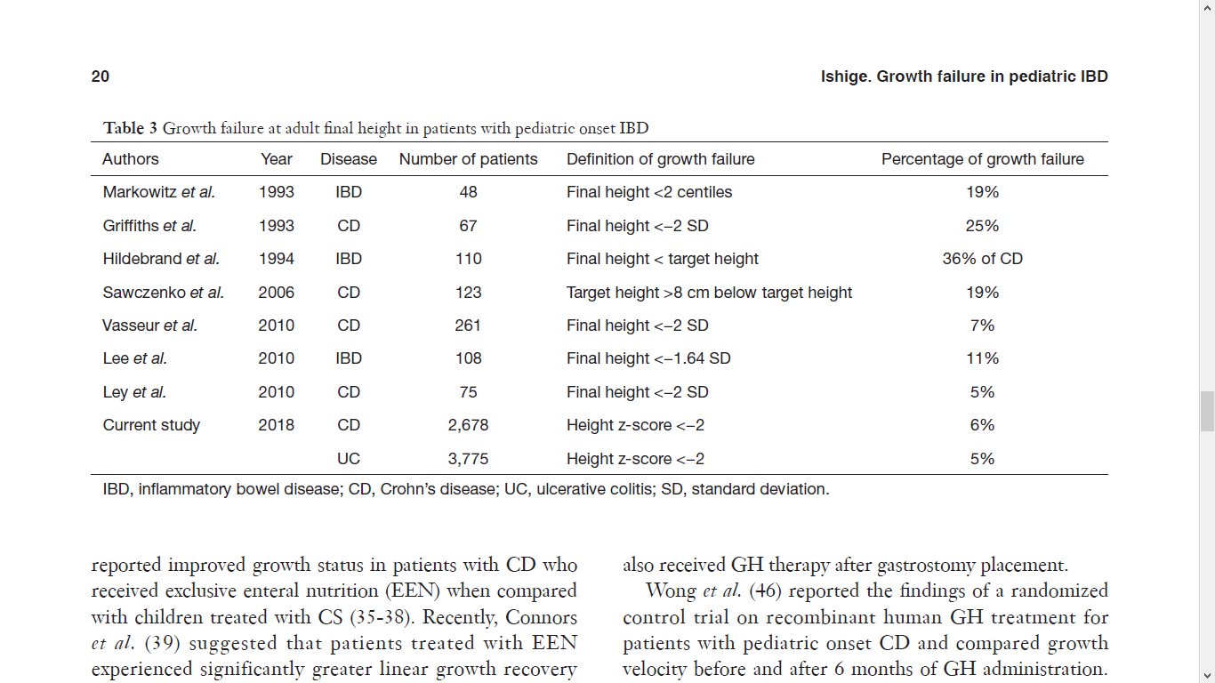
Effect of IBD treatment on growth
Outcome based on inflammatory status:
Controlled inflammation impacts adult height prognosis

Slide 33
Effect of IBD treatment on growth
A guideline for the management of growth, published in 2008, suggested to use CS-sparing agents and initially treat with enteral nutrition, possible in combination with azathioprine/6-mercaptopurine (6-MP).
Surgery can be also considered in steroid-dependent patients

Slide 34
Anti TNF alpha
Borrelli et al. treated 16 patients with infliximab and reported that their mean height z-score was significantly improved after 6 months of therapy.
Bamberger et al. retrospectively reviewed the data of 61 patients with CD who had received anti-TNF agents and showed improvement in their adult final height.

Slide 35
Anti TNF alpha
A study from Canada suggested that a positive effect on height velocity was observed only in pre-pubertal or pubertal patients, but was absent in patients with Tanner stage IV–V
The IMAgINE 1 study: Adalimumab also improved and normalized the growth rate of patients with CD at 26 and 52 weeks of treatment compared to baseline

Slide 36
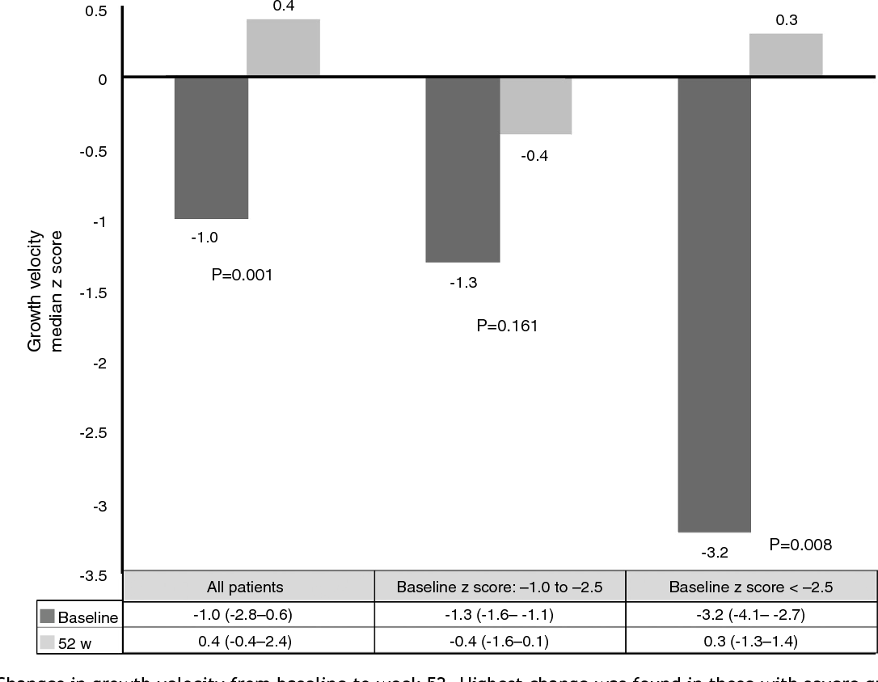

Slide 37
Delayed puberty
Potential causes of late puberty in patients developing IBD in pre-pubertal and pubertal age due to:
Malnutrition (correlates mainly with a delay in menarche and sexual maturity).
Gasparetto M et al, 2014

Slide 38
Delayed puberty
Reduced fat mass: Normally rich in the aromatases that induce the conversion of androgens into estrogens and the consequent active production of female hormones
Interactions between proinflammatory cytokines and the endocrine system: disrupted in IBD patients, due to a direct effect of proinflammatory cytokines, such as TNF-α, IL-6, and IL-1β, on hormonal feedback mechanisms
Gasparetto M et al, 2014

Slide 39
Back to our patient
Received anti TNF alpha
Rare flare up
Improved nutrition and appetite
Development of pubertal signs at 14 years 7 months (No induction)
Rare use of CS
Remission of his Crohn’s

