Slide 1
Hypotonia
Dana Hasbini MD, MSc
Pediatric Neurology
Rafic Hariri University Hospital

Slide 2
Sajidah
6 years old girl presented to our hospital with pneumonia.
Pediatric Neurologic consultation:
Hypotonia severe with NDD (mostly motor)
No seizures
History of recurrent pneumonia
Partially vaccinated
Unremarkable perinatal history
Negative family history, no consanguinity
No surgeries

Slide 3
Physiacl exam
PE:
Cachectic oxygen face mask
Alert
No dysmorphic features
Hypotonic
Deep tendon reflexes decreased-absent
Weak MP
Neg Babinsky

Slide 4
Definition
Tone = involuntary resistance to a passive stretch
=tension of a muscle when relaxed
Hypotonia=low tension, decreased resistance to passive stretch
Low muscle tone

Slide 5
Phasic tone= rapid contraction in response to a high intensity stretch
ex: DTRs
Postural tone= prolonged contraction in response to a low intensity stretch
ex: gravity (a steady low amplitude stretch on antigravity muscles)
A decreased postural tone : Infant cannot maintain body and limbs against gravity

Slide 6
To maintain a normal tone :
intact -CNS,
Cerebral hypotonia=of central origin
more >common in infants than diseases of motor unit
-PNS: S.C., N, M; “motor unit”

Slide 7
Hypotonia may be the presenting sign of both benign and serious conditions that affect motor control.

Slide 8
Clinical appearance
Supine: lack of spontaneous movements;
legs fully abducted ;lateral surface against the table
arms extended at the side of body or flexed at elbow with hands beside head
=> Head flattening/loss of hair
Sitting: head falls forward, shoulder drop; limbs are limp
In utero: arthrogriposis,dislocation of hips-joint, contractures

Slide 9
Signs and Symptoms of Hypotonia
Difficulty maintaining head control
Difficulty sitting upright without significant lean or support
Slow to attain motor milestones
Difficulty transitioning in and out of positions
Clumsy or inefficient movement patterns
Global Developmental delay
Difficulty with hand eye coordination
Prefer to observe rather than participate
Low frustration tolerance with physically challenging tasks

Slide 12
Approach to diagnosis
Differential diagnosis of hypotonia
Where does our patient fit?

Slide 13
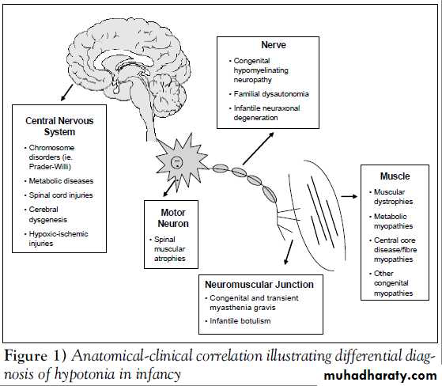

Slide 15
Approach to diagnosis
Cerebral, spinal,motor unit dysfunction
More than one site involvement is possible
Ex: -mitochondrial diseases
-lipid storage disease
-familial dysautonomia
- neonatal myotonic dystrophy

Slide 16
Clues
To cerebral hypotonia
History
Physical exam
Presence of other abnormal brain functions as seizures, altered consciousness
Presence of dysmorphism or organ malformation or dysfunction
To motor unit dysfunction
Absence of multiorgan dysfunction except for deformities and malformations of bony structures
Decreased or absent DTRs
Muscle atrophy =motor unit dysfunction except for severe brain damage
Fasciculations

Slide 18
Gower’s Sign

Slide 19
Our patient

Slide 20
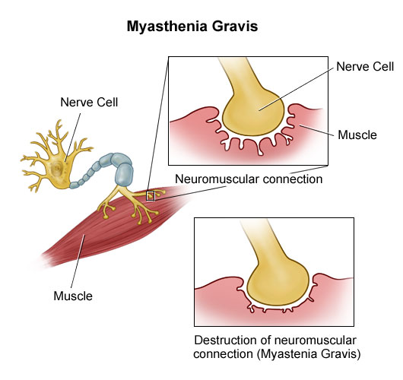
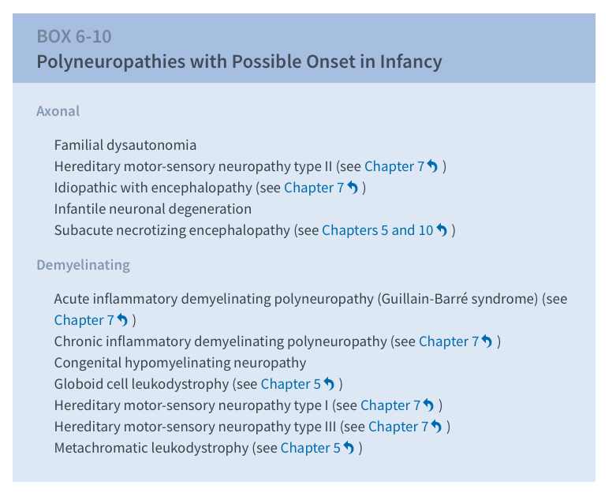
Motor unit disorders
Spinal muscular atrophies
Polyneuropathies
Neuromuscular transmission disorders
Infantile Botulism
Myasthenia Gravis
Congenital myopathies
Muscular dystrophies
Metabolic myopathies

Slide 22
Diagnosis: The motor unit
clinical findings
EMG/NCS
Blood tests
Muscle biopsy
Genetic tests

Slide 23
SMA
SMA is one of the more common motor unit disorders causing hypotonia.

Slide 24
The spinal muscular atrophies (SMAs) are genetic disorders in which anterior horn cells in the spinal cord and motor nuclei of the brainstem are progressively lost.
The onset of weakness may be at any age from birth to adult life.
Infantile/Intermidiate/Juvenile

Slide 26
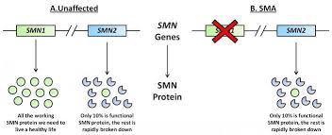
SMN1 (survival motor neuron) on 5q12.2-q13.3 is the primary SMA disease-causing gene

Slide 28
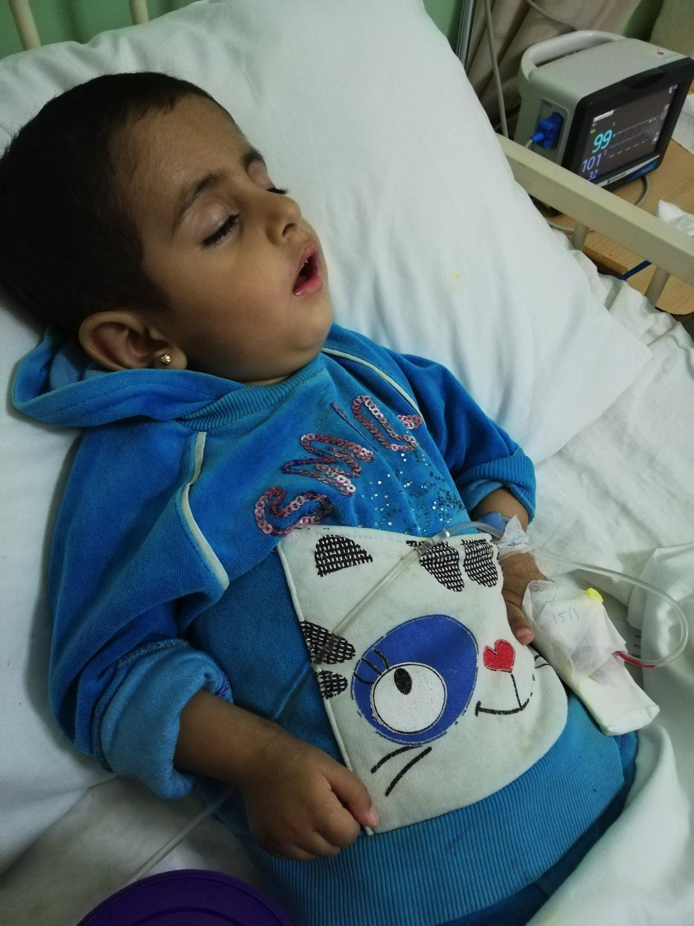
SMA
generalized weakness
hypotonia
areflexia

Slide 29
facial expression is relatively well preserved and extraocular movement is normal
The tongue may show atrophy and fasciculation but these are difficult to see in newborns.
After the gag reflex is lost, feeding becomes difficult and death results from aspiration and pneumonia.

Slide 30
Diagnosis
Molecular genetic testing: SMN1 gene
About 95 % of individuals with SMA are homozygous for the absence of exons 7 and 8 of SMN1, and about 5 % are compound heterozygotes for absence of exons 7 and 8 of one SMN1 allele and a point mutation in the other SMN1 allele
The serum concentration of CK is usually normal but may be mildly elevated in infants with rapidly progressive weakness.
EMG: fibrillations and fasciculations at rest
Muscle biopsy: unnecessary

Slide 31
Treatment
Supportive
Ventilation
Gastrostomy

Slide 33
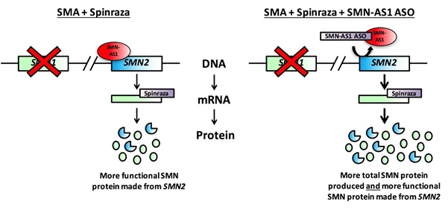
Treatment
Spinraza

Slide 34
Treatment
The long term effects of hypotonia on a child’s development depend primarily on the severity of the hypotonia, as well as the nature of the underlying etiology.
Some of these disorders have a specific medical treatment,
but the principal treatment for most children with hypotonia is in fact
Multidiscipplinary approach with:
-Medical
-Physical
-Occupational Therapy

