Slide 1
Autoimmune Hemolytic Anemia in Children
Diagnostic and Therapeutic Pearls
Presented in the Lebanese Pediatric Society Meeting on Sept 14th, 2019
By Dolly Noun

Slide 2
Outline
Case scenario
Definition and Epidemiology
Classification
Pathophysiology
Clinical manifestations
Diagnostic steps and work-up
Differential diagnosis
Therapy
Recapitulation

Slide 3
AIHA Case scenario
10 yo girl
4 days history of fever, vomiting, jaundice and pallor, diffuse mild arthralgias
No PMH
No recent drug ingestion
Family history: maternal treated Hodgkin lymphoma and breast Ca
PE: tachycardic, pale, icteric
No palpable hepatosplenomegaly

Slide 4
AIHA Case scenario
Work-up:
Hb 4.9g/dL MCV 100fl MCHC 37g/dL WBC 15000/mm3
Retic 1.5%
LDH 560 IU/L BR 2.3/0.4
Urine analysis no hematuria, bilirubin, hemoglobin
Smear
WBCs: Leukocytosis with left shifted granulopoeisis.
RBCs: Slight macrocytosis, hypochromia, slight polychromasia, few tear drop cells and nucleated RBCs seen. Plts: Adequate, large plts seen.

Slide 5
AIHA Case scenario
Work-up:
Positive/IgG
WAA

Slide 6
AIHA Case scenario
Work-up:
ANA, anti-dsDNA, EBV, CMV, HIV, HBV, HCV NEGATIVE
Parvovirus IgM and IgG and PCR POSITIVE
Baseline IgQ normal
BM: enlarged cells showing nuclear inclusions that are strongly suggestive of parvovirus infection

Slide 7
AIHA Case scenario
Diagnosis:
Parvovirus-associated autoimmune hemolytic anemia

Slide 8
AIHA Case scenario
Treatment:
Transfusion: associated with severe reaction, fever and chills
Methylprednisolone
IVIG
D/C on prednisone 2mg/kg/day, slow weaning over the following months
2 months later RECURRENCE
Steroids
Rituximab
Weaned slowly off steroids
10 years later: no recurrence of the AIHA

Slide 9
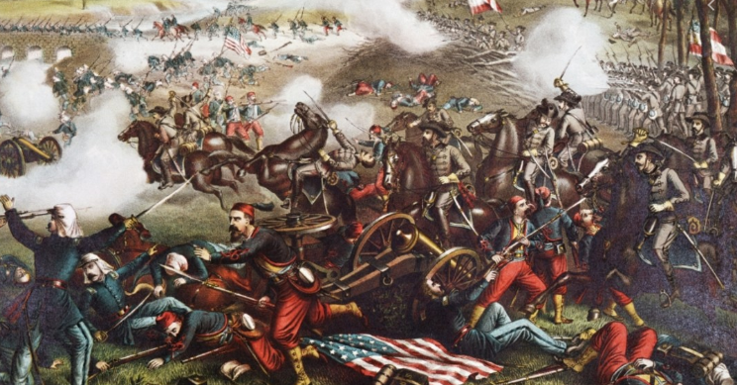
AIHA Definition
Civil war: First Battle of Bull Run. Chromolithograph by Kurz & Allison, 1889
Collection of disorders
Autoantibodies against one’s RBCs
Anemia

Slide 10
AIHA: Epidemiology
1/100 000
Less common than ITP
More common that aplastic anemia
Male=Female
No ethnic predilection

Slide 11
AIHA Epidemiology
37% primary, no underlying systemic disorder
53% secondary
10% post-infectious
Mortality 4%
Previous older reports 11% to 18%

Slide 12
AIHA Classification
Immune Hemolytic anemia
Autoimmune
Drug induced
Alloimmune (HDFN, DHTR)
AIHA based on the thermal reactivity of the autoantibody
WAIHA 60-90%
CAD
PCH
Mixed <5%

Slide 13
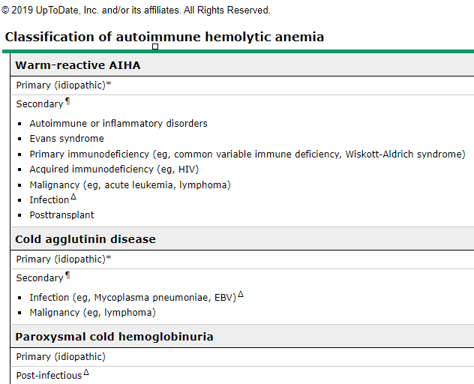
AIHA Classification Secondary AIHA
ALPS

Slide 14
AIHA Pathophysiology
Self-tolerance breakdown
Dysregulation of B and T cells
Molecular mimicry (cross-reactivity between environment and autoantigens)
Genetic predisposition and HLA
C55 and C59 Ag on RBC prevent formation of MAC
Secondary AIHA: Immune dysregulation and proliferation of Autoreactive B-Lymphocytes
Autoimmune diseases
Transplantation:
Immune deficiency

Slide 15
AIHA Pathophysiology
IgG coated RBCs
🡪 macrophages in the spleen
🡪spherocytes
+/-Complement activation
IgM antibodies
🡪 macrophages in the liver
🡪Phagocytes tend to engulf the entire cell
🡪 no spherocytes

Slide 16
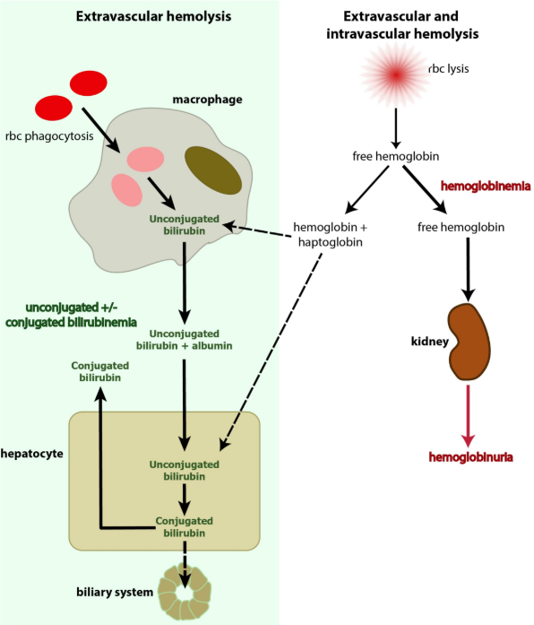
AIHA Pathophysiology

Slide 17
AIHA Pathophysiology Secondary
Evans syndrome 15-30% of pediatric AIHA
Anemia +/- thrombocytopenia +/- neutropenia (Abs DO NOT cross react)
More difficult to treat
Chronic relapsing course, systemic autoimmunity
50% have underlying ALPS
Seif AE, Manno CS, Sheen C, et al. Identifying autoimmune lymphoproliferative syndrome in children with Evans syndrome: a multi-institutional study. Blood 2010; 115:2142
How I manage Evans Syndrome and AIHA cases in children Maurizio Miano Clinical and Experimental Haematology Unit, Department of Haematology/Oncology, IRCCS Istituto Giannina Gaslini, Genoa, Italy British Journal of Hematology 2016.

Slide 18
AIHA Pathophysiology Secondary
Infection
Non-immune hemolytic anemia (malaria, babesiosis, clostridium secreting toxins causing lysis, Pneumococcus and HUS)
Mycoplasma, EBV, measles, varicella, adenovirus, mumps, rubella
CAD: IgM cold Abs
against I (adult, mycoplasma)/i (infant, EBV) polysaccharide Ag on RBC
P polysaccharide
A distinct entity is PCH

Slide 19
AIHA Pathophysiology
Paroxysmal Cold Hemoglobinuria
IgG Binds P Ag
Binds RBCs at COLD T with C3
Dissociates from RBC at warming (C3 remains) and causes lysis
Intravascular lysis (poorly understood mechanism)
1 week following a usually viral infection
(measles, rubella, EBV, mycoplasma, E coli…)
Associated with syphilis in the past

Slide 20
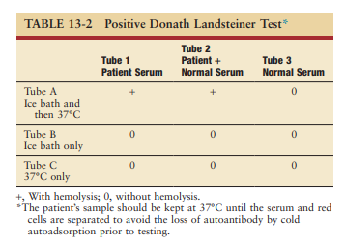
AIHA Pathophysiology
Paroxysmal Cold Hemoglobinuria

Slide 21
AIHA Clinical presentation
Anemia onset severity affects presentation
Symptoms and signs of anemia
Symptoms and signs of hemolysis
Abdominal pain, fever (around 40% of patients)
3% presented with collapse, coma, AKI due to profound acute hemolysis
Aladjidi N, Leverger G, Leblanc T, et al. New insights into childhood autoimmune hemolytic anemia: a French national observational study of 265 children. Haematologica 2011; 96:655.

Slide 22
AIHA Clinical presentation
Physical exam
Palpable HSM If significant look for secondary causes
Medical history: viral illness, drug intake
FH: a family history of AIHA is usually related to SLE
12% had ID or autoimmune disease
Aladjidi N, Leverger G, Leblanc T, et al. New insights into childhood autoimmune hemolytic anemia: a French national observational study of 265 children. Haematologica 2011; 96:655

Slide 23
AIHA Clinical presentation
Cold agglutinin disease
agglutination of RBCs at exposure to cold temperatures
🡪Acrocyanosis
Dark urine: if intravascular hemolysis occurs
CAD and PCH

Slide 24
AIHA Diagnostic steps and work-up
1st level studies
CBC
Reticulocytes
Antigen testing: DAT an IAT- Coombs
Smear
Cold agglutinin titer
Chem, LDH
Haptoglobin
Bilirubin

Slide 25
AIHA Diagnostic steps and work-up
CBC
Anemia degree varies
WBC
Plts
Anemia and thrombopenia or leukopenia
r/o Evans syndrome
r/o TMA, HUS, TTP
Bm failure or infiltration

Slide 26
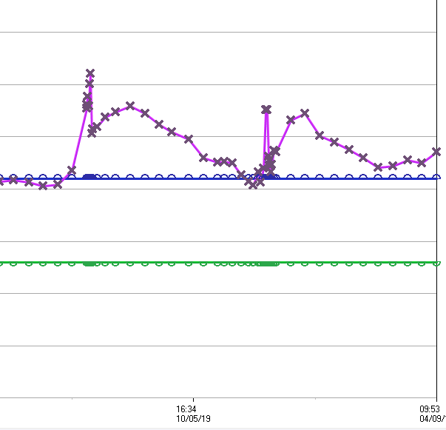
AIHA Diagnostic steps and work-up
CBC
Hemoglobin variation during recurrent AIHA attacks
MCV variation during recurrent AIHA attacks
-spherocytes
-Reticulocytes clumping

Slide 27
AIHA Diagnostic steps and work-up
Reticulocytosis: >50.10^3 /uL
absolute reticulocyte count
reticulocyte index (takes into consideration the anemia, the survival of reticulocytes…)
<2%, inadequate response
>3%: adequate compensation

Slide 28
AIHA Diagnostic steps and work-up
Reticulocytosis: EXCEPTIONS
Other causes of reticulocytosis
>1/3 of patients have a transient reticulocytopenia
Autoantibody directed at erythroid progenitor cells
Lagging bone marrow response
Concomitant BM suppression (viral or drug-induced)

Slide 29
AIHA Diagnostic steps and work-up
Smear
Spherocytes
Polychromasia
Agglutination: IgM mediated hemolysis
Fragmented and nucleated RBCs
Schistocytes: r/o TMA
Erythrophagocytosis

Slide 30
AIHA Diagnostic and therapeutic pearls

Slide 31
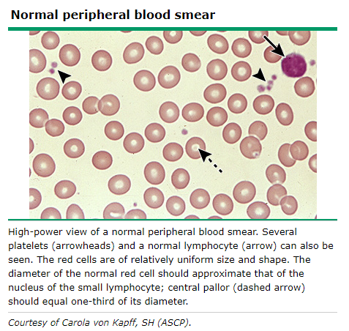
AIHA Diagnostic steps and work-up
Smear

Slide 32
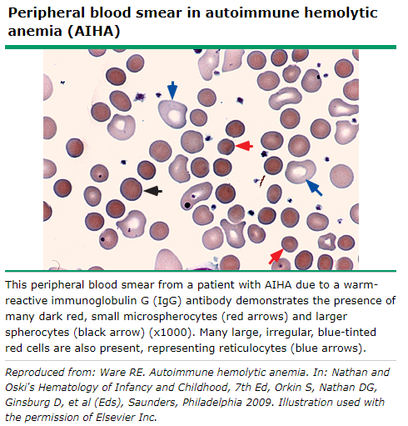
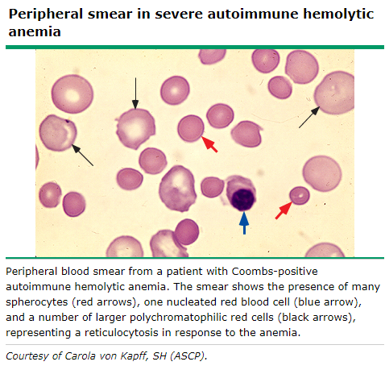
AIHA Diagnostic steps and work-up Smear

Slide 33
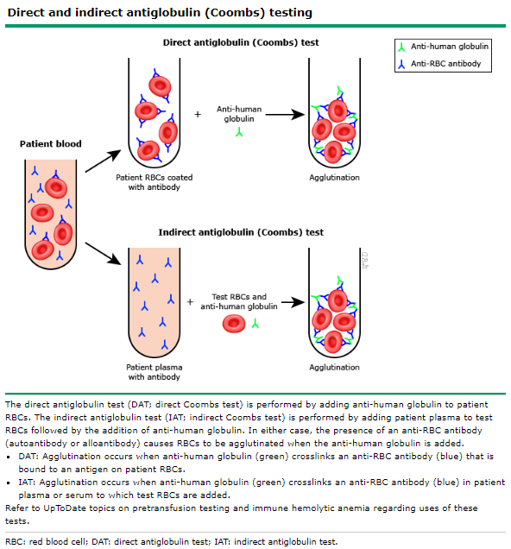
AIHA Diagnostic steps and work-up
Coombs/DAT
DAT distinguishes AIHA from other hemolytic anemias
1/ RBCs washed free from adherent proteins
2/ polyspecific Ab
3/ monospecific anti-IgG and antiC3 serum
4/ semiquantitative scoring

Slide 34
AIHA Diagnostic steps and work-up
Coombs/ DAT

Slide 35
AIHA Diagnostic steps and work-up
DAT🡪 Elution🡪 characterize the antibody
Isotype: IgG (and subtypes), IgM IgA
Complement
Thermal reactivity
Binding specificity (usually panagglutinin in WAIHA)

Slide 36
AIHA Diagnostic steps and work-up
Antigenic reactivity
"panreactive" pattern (which is the most common finding) 🡪 identification of fully compatible blood for transfusion impossible.
Presence of alloantibodies
transfusion reactions
If exposed to transfusion or pregnancy
If alloantibodies are detected, extended blood phenotyping or genotyping is warranted to help find compatible blood.

Slide 37
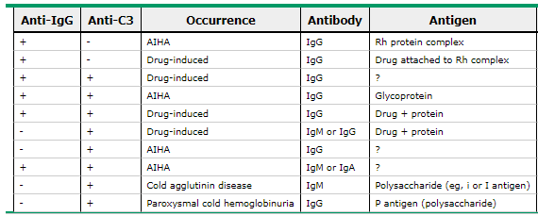
AIHA Diagnostic steps and work-up
Coombs
WARM
AIHA
Cold AIHA

Slide 38
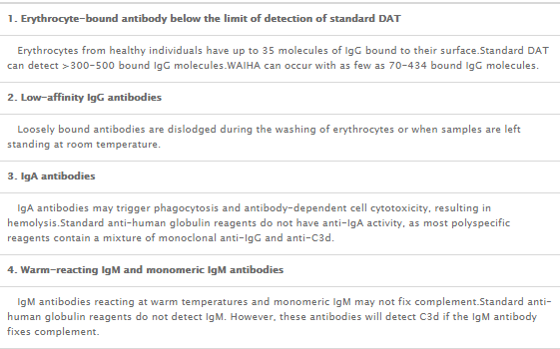
AIHA Diagnostic steps and work-up
Coombs
WAIHA 5% have negative DAT
severe hemolysis: few RBCs left for detection
Modified techniques and/or referral to an immunohematology reference laboratory
Supercoombs, polybrene, flow cytometry, elution
How I treat autoimmune hemolytic anemia
Ronald S. Go, Jeffrey L. Winters and Neil E. Kay
Blood 2017

Slide 39
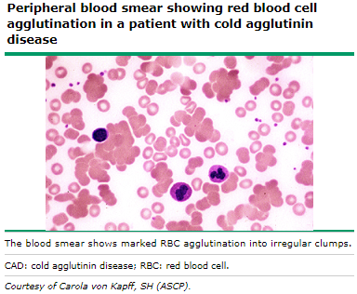
AIHA Diagnostic steps and work-up Cold reactive AIHA
Cold AIHA
Mainly IgM mediated🡪 spontaneous room temperature agglutination in EDTA specimens

Slide 40
AIHA Diagnostic steps and work-up Cold reactive AIHA
Cold agglutinin titer
highest dilution of the serum sample at which agglutination of red cells in the cold is still seen.

Slide 41
AIHA Diagnostic steps and work-up
Acute hemolysis may cause kidney injury
Urine analysis
Hemoglobinuria and Hemosiderin in intravascular hemlysis

Slide 42
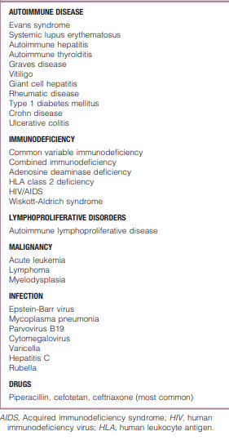
AIHA Diagnostic steps and work-up
Secondary AIHA in up to 50% of the cases
Screening recommended upon initial presentation
except in case of life-threatening anemia
Consider yearly re-screening

Slide 43
AIHA Diagnostic steps and work-up
Well-defined infection was identified in 22% of the cases
Half turned out to be immunological and chronic
Infection: initiating rather than a causal factor
Complete immunological investigations should be done, even if a well-defined infection is diagnosed

Slide 44
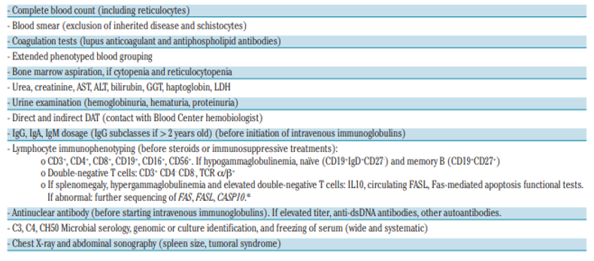
AIHA Diagnostic steps and work-up

Slide 45
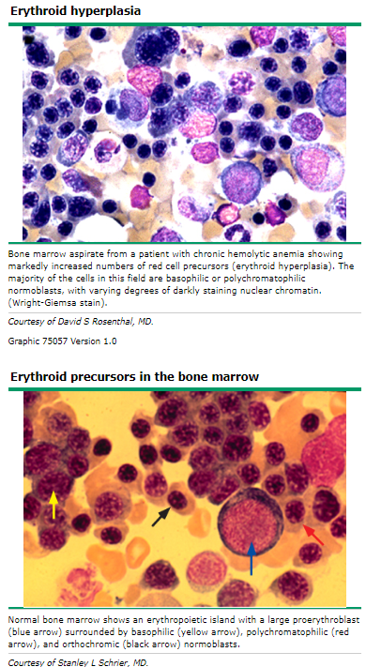
AIHA Diagnostic steps and work-up
BM
if there is another cytopenia
If suspicion of neoplasia/ MDS
(level 8.7 B of recommendation)
Diagnosis and management of newly diagnosed childhood autoimmune haemolytic anaemia. Recommendations from the Red Cell Study Group of the Paediatric Haemato-Oncology Italian Association Saverio Ladogana, Giovanna Russo Blood transfusion 2017

Slide 46
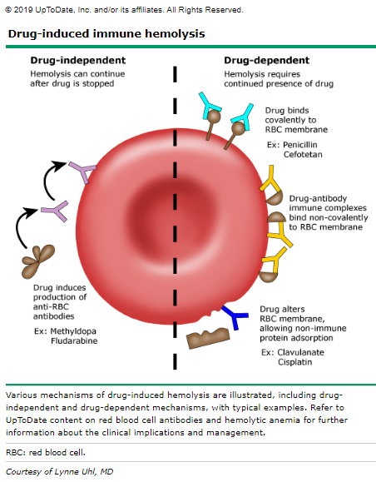
AIHA Differential diagnosis
Ceftriaxone🡪rapid acute intravascular hemolysis occurring within minutes to hours
Cephalosporins
Penicillin/penicillin derivatives
Nonsteroidal antiinflammatory drugs

Slide 47
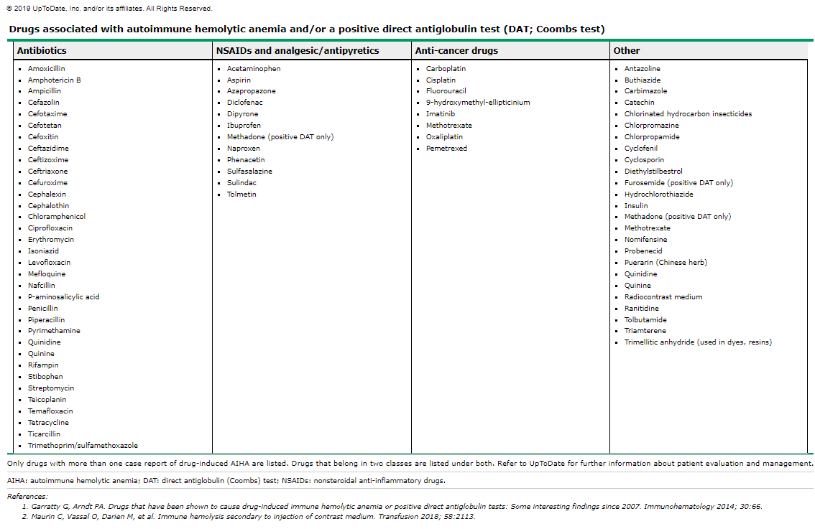
AIHA Differential diagnosis

Slide 48
AIHA Therapy
Defining response criteria:
Complete response
Partial response
No response:

Slide 49
AIHA Therapy Transfusion
Most important decision
Indicated if severe anemia and precipitous decline of Hb and symptomatic patient and impairment of vital signs
Consider early phenotyping or genotyping of RBCs
Transfusion of Leukodepleted PRBCs
Crossmatching:
Mixing donor blood with patient’s serum
Look for hemolysis or agglutination

Slide 50
AIHA therapy Transfusion
Challenge: autoantibodies mask alloantibodies
autoantibodies against common Ag found on all RBC
panagglutinin
no truly matched RBC units are possible, but transfusion can be safely performed if underlying alloantibodies are excluded
“Least incompatible unit”

Slide 51
AIHA therapy Transfusion
tests to detect alloantibodies masked by autoAbs
Risk for alloantibodies: previous transfusions, pregnancy
Alloimmunization rate between 15% and 45% (adult studies)
Time consuming 2-3 hrs, up to 6 hrs

Slide 52
AIHA Therapy Transfusion
No patient with autoantibodies should be denied a lifesaving transfusion because of difficulties in finding compatible blood for transfusion
such patients are likely to tolerate serologically incompatible blood without significant complications
Same rate of hemolysis
Discussion between primary team and blood bank personnel and director

Slide 53
AIHA Therapy Transfusion
Give 3-5ml/kg (the minimum to alleviate symptoms)
Give 1ml/kg over 30minutes
take blood sample from the recipient
look for hemolysis
(suggesting intravascular hemolysis)

Slide 54
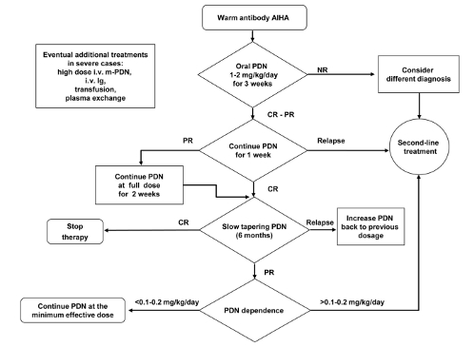
AIHA Therapy WAIHA
Blood Transfus 2017; 15: 259-67

Slide 55
AIHA Therapy Steroid
Steroids first choice
Decrease Ab-receptors on monocytes/ macrophages 🡪Decreases sequestration in spleen
Decrease Ab concentration (slower process)

Slide 56
AIHA therapy Steroids
Steroids
Response within 3 weeks
Slow Tapering over 3-12 mo
80% achieve remission
Second line if
no response within 3 weeks
Dependent on dosage >0.1-0.2mg/kg/day

Slide 57
AIHA Therapy
PO prednisone 1-2mg/kg/day
May start with 4mg/kg/day
Not recommended with adults and adolescents
IV methylprednisolone 0.8-1.6mg/kg/day
1-2mg/kg/dose q 8
Megadoses
Not recommended

Slide 58
AIHA Therapy Steroids
Side effects
Irritability or even psychoses
Sleep disturbances
Hypertension
hyperglycemia that may require insulin therapy
weight gain
impaired longitudinal growth
Osteoporosis
Increased risk of thrombosis and esp. central-line related thrombosis

Slide 59
AIHA therapy IVIG
IVIG
0.4 to 2 gm/kg/day for 2 to 5 days in published cases
Higher efficacy in children (55%) than adults
Response may be noted within 10 days
May be indicated as adjunctive therapy in addition to steroids
Flores G, Cunningham-Rundles C, Newland AC, Bussel JB. Efficacy of intravenous immunoglobulin in the treatment of autoimmune hemolytic anemia: results in 73 patients. Am J Hemathol 1993
A combined report of patients treated with intravenous immunoglobulin that included 37 cases that were part of pilot studies at three institutions and a review of 36 cases in the literature
Side effects
Aseptic meningitis
Risk of hypercoagulability and thrombosis
Hemolytic anemia
Neutropenia
Infusion reactions and systemic inflammatory response

Slide 60
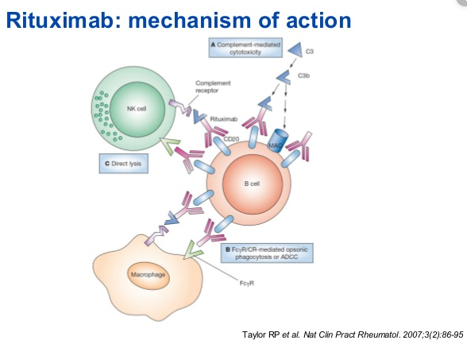
AIHA therapy Rituximab
Rituximab
Monoclonal antiCD20
375mg/m2/dose weekly for 4 doses
Infusion reactions
Hypogammaglobulinemia
HepB reactivation
Berentsen S, Ulvestad E, Gjertsen BT, et al. Rituximab for primary chronic cold agglutinin disease: a prospective study of 37 courses of therapy in 27 patients. Blood 2004; 103: 2925-8.
Schollkopf C, Kjeldsen L, Bjerrum OW, et al. Rituximab in chronic cold agglutinin disease: a prospective study of 20 patients. Leuk Lymphoma 2006
Side effects

Slide 61
AIHA Therapy Therapeutic plasma exchange
TPE category III intervention by the American Society of Apheresis
may be beneficial but insufficient evidence
IgG 🡪TPE may not be efficient
IgM / CAD🡪TPE may be efficient
Plasmapheresis may be considered as a temporizing measure in a severely ill child who has a suboptimal response to RBC transfusion and may not have time to respond to steroids
Roy-Burman A, Glader BE. Resolution of severe Donath Landsteiner autoimmune hemolytic anemia temporally associated with institution of plasmapheresis. Crit Care Med 2002; 30: 931-4. (P-V)
McCarthy LJ, Danielson CF, Fernandez C, et al. Intensive plasma-exchange for severe autoimmune hemolytic anemia in a four-month-old infant. J Clin Apher 1999; 14: 190-2. (P-V)

Slide 62
AIHA Therapy
Splenectomy
2/3 short-term complete and partial response
50% of patients will remain in remission for years.
Perioperative mortality 0.6%
Coon WW: Splenectomy in the treatment of hemolytic anemia. Arch Surg 120:625–628, 1985
Immunizations: S pneumoniae and N meningitides and H influenzae.
PNC prophylaxis
Penicillin V potassium
250 mg twice daily, >3 to 5 years,
125 mg twice daily younger patients.
Long-term risk of thromboembolism and pulmonary hypertension
Other approaches such as rituximab have become available and are relatively safe.

Slide 63
AIHA therapy Cold AIHA
PCH
Warm, supportive therapy
+/- steroids
CAD
control the underlying illness
warm, hydration
Preheat PRBCs before transfusion (heat generator inside the tubing)
TPE
Steroids: 15% of response with adults
Rituximab response 45-60% of adults; first line
Prospective trials, non randomized non controlled

Slide 64
AIHA Therapy Immunosuppressive therapy
Cyclophosphamide, cyclosporine, MMF, 6-mercaptopurine, Campath-1H
case reports
response may take months
Cyclosporine
T-lymphocyte function🡪alter autoantibody synthesis.
Side effects: nephrotoxicity, hypertension, and hirsutism.
6-mercaptopurine
case series of 7 patients who responded
Side effects: leukopenia, thrombocytopenia, and elevated transaminase levels.
Sobota A, Neufeld EJ, Lapsia S, et al: Response to mercaptopurine for refractory autoimmune cytopenias in children. Pediatr Blood Cancer 52:80–84, 2009.
Sirolimus:
mTOR inhibitor, blocks T abd B cells activation
response in 75% (16 patients)
Mycophenolate mofetil and Sirolimus as second or further line treatment in children with chronic refractory Primitive or Secondary Autoimmune Cytopenias: a single centre experience
Maurizio Miano Francesca Fioredda British journal of Hematology 2016

Slide 65
AIHA Therapy Secondary AIHA
Same as WAIHA: Steroids, rituimab imunosuppression
Evans syndrome
Immunodeficiency
Autoimmune lymphoproliferative syndrome
Systemic lupus erythematosus

Slide 66
AIHA Therapy Secondary AIHA
Drug-induced AIHA
Discontinuation of the offending drug
corticosteroids
plasmapheresis can be considered if the patient has clinical deterioration.

Slide 67
AIHA Therapy
Hematopoetic stem cell transplant
22 children
Auto- vs alloSCT
50% response
Toxicity
M Rabusin, R Saccardi April 2013

Slide 68
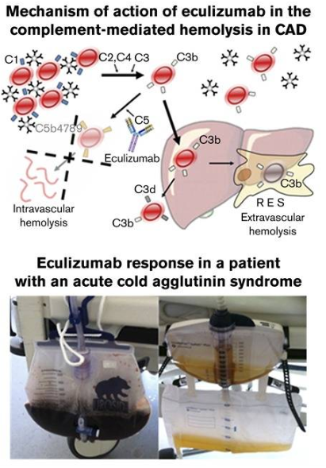
AIHA Therapy
Eculizumab in cold agglutinin disease (DECADE): an open-label, prospective, bicentric, nonrandomized phase 2 trial
Alexander Röth, Ulrich Dührsen 2018

Slide 69
AIHA Recapitulation
This presentation has been designed using resources from PoweredTemplate.com
https://poweredtemplate.com/03281/0/index.html

