Slide 1
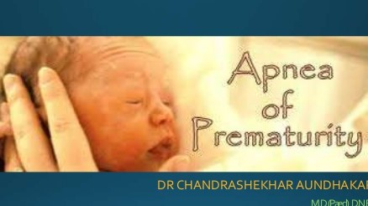
Controversies in the Neonatal management of apnea
Dunia Nakhoul MD, MRCPCH, CCST
Consultant Neonatologist
Clemenceau Medical Center
Ass. Prof. at the LAU- School of Medicine

Slide 2
Apnea of prematurity
AOP is a developmental disorder that usually resolves by term gestation
In most cases, AOP likely reflects a “physiological” rather than a “pathological” immature state of respiratory control.
AOP is related inversely to gestational age
7% of neonates with GA 34-35 weeks
15% of neonates with GA 32-33 weeks
54% of neonates with GA 30-31 weeks
Nearly 100% of neonates with GA<29weeks or wt < 1000g

Slide 3
Apneic spells
Cessation of airflow for at least 15-20 seconds
Bradycardia and cyanosis are usually present after 20 sec. of apnea
After 30 to 45 sec., pallor and hypotonia are seen, and infant may be unresponsive to tactile stimulation.

Slide 4
Born < 28weeks, apnea can often persist past term
Apneic pauses can be problematic if associated with intermittent hypoxemia
Chronic intermittent hypoxia (CIH) compromise oxygenation and perfusion to vital organs
Clinical challenge:
**Optimal level of arterial oxygen that prevents CIH without increasing the risk of ROP**

Slide 5
Apnea of prematurity

Slide 9
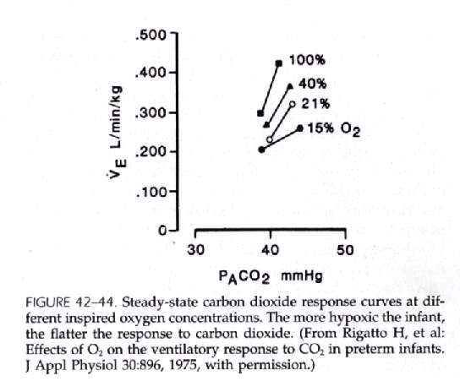

Slide 10
Consequences of apnea
Gas exchange is compromised due to:
PA CO2, PAO2
Extrapulmonary shunting
Muscle relaxation

Slide 11
3 types of neonatal apnea
Central (diaghragmatic)
Peripheral (obstructive)
Mixed

Slide 12
Central apnea
A pause in alveolar ventilation due to a lack of diaphragmatic activity
There is no signal to breathe being transmitted from the CNS to the respiratory muscles
This is due to immaturity of brainstem control of central respiratory drive
The premature infant manifests also an immature response to peripheral vagal stimulation

Slide 13
Obstructive apnea
A pause in alveolar ventilation due to obstruction of the airflow within the upper airway, particularly at the level of the pharynx
Once collapsed, mucosal adhesive forces tend to prevent the reopening of the airway during expiration
Neck flexion will worsen this form of apnea
Excessive secretions in the nasopharynx and hypopharynx may also cause obstructive apnea

Slide 15
Mixed apnea
A combination of both types of apnea representing as much as 50% of all episodes
Mixed apnea consists of obstructed respiratory efforts usually following central pauses
Central apnea is either preceded or followed by airway obstruction

Slide 16
Biological basis of therapeutic interventions
Inhibition of pro inflammatory responses
Optimization of mechano-sensory input
Optimization of gas exchange and blood gas status
Continuous positive airway pressure (CPAP)
Prevention of gastroesophageal reflux
Methylxanthine therapy

Slide 17
Biological basis of therapeutic interventions
Inhibition of pro inflammatory responses
Optimization of mechano-sensory input
Optimization of gas exchange and blood gas status
Continuous positive airway pressure (CPAP)
Prevention of gastroesophageal reflux
Methylxanthine therapy

Slide 18
Inibition of proinflammatory responses
Synthesis of Prostaglandin B2
Neonatal sepsis
Systemic immune response
Maternal chorioamnionitis
Altered respiratory rythm
Hypoxic respiratory depression
IL-1B binding to IL-1 receptors on vascular endothelial cells of the blood brain barrier
Hofstetter el al., 2007 ; Balan el al. 2011

Slide 19
Biological basis of therapeutic interventions
Inhibition of pro inflammatory responses
Optimization of mechano-sensory input
Optimization of gas exchange and blood gas status
Continuous positive airway pressure (CPAP)
Prevention of gastroesophageal reflux
Methylxanthine therapy

Slide 20
2. Optimization of mechanosensory input
Optimal thermosensory environment
Maximal opportunity for parental interaction and physical contact (Kangaroo care) with their baby.
Enhance respiratory control -----No evidence
Bloch-Salisbury et al. 2009—Novel technique of stochastic mechanosensory stimulation J Appl Physiol (1985). 2009 Oct; 107(4): 1017–1027.

Slide 21
2. Optimization of mechanosensory input (cont)
Stochastic resonnance stimulation (SR) is a novel, non invasive, non pharmacologic method of delivering subarousal vibration to infant via specialised mattresses (imbedded with actuators)
The use of SR stimulation decreased the rate of AOP (50%), oxygen desaturation(18%) and some aspects of bradycardias in preterm infants (35%)
Apr 2012-July2014, 36 premature enrolled, Massachussets
Stochastic resonance stimulation may decrease apnea of prematurity
November 23, 2015 | James Gray, MD and Cordelia Ross, MD, MS

Slide 22
Biological basis of therapeutic interventions
Inhibition of pro inflammatory responses
Optimization of mechano-sensory input
Optimization of gas exchange and blood gas status
Continuous positive airway pressure (CPAP)
Prevention of gastroesophageal reflux
Methylxanthine therapy

Slide 23
3. Optimization of gas exchange and blood gas status
Optimal saturation: 85-89% versus 90-95% in preterm <28 weeks gestation
Lower target range:
less ROP, higher mortality (stenson et al. 2011; SUPPORT study group of the Eunice Kennedy Shriver NICHD Neonatal research network 2010)
higher incidence of intermittent hypoxic episodes (Di Fiore et al., 2012) resulting in apnea and ineffective ventilation

Slide 24
3. Optimization of gas exchange and blood gas status (cont)
Oxygen Saturation Limits for Premature Babies: The Final Word for Now
Robin H. Steinhorn, MD reviewing Askie LM et al. JAMA 2018 Jun 5 Bizzarro MJ. JAMA 2018 Jun 5
An oxygen saturation target of 91%–95% reduces early and late mortality for extremely preterm infants.

Slide 25
3.Optimization of gas exchange and blood gas status (cont)
Novelties:
Automated control of inspired oxygen (Claure et al., 2011) to maintain intended range between 87-93% to reduce times in the hyperoxic range.
Supplementation of inspired air with very low concentration of supplemental CO2 to increase respiratory drive (Alvaro et al., 2012)
Interesting from physiological perspective, might decrease apnea BUT preterm babies have residual lung disease and are prone to baseline hypercapnia, ? Clinical acceptance.

Slide 26
Biological basis of therapeutic interventions
Inhibition of pro inflammatory responses
Optimization of mechano-sensory input
Optimization of gas exchange and blood gas status
Continuous positive airway pressure (CPAP)
Prevention of gastroesophageal reflux
Methylxanthine therapy

Slide 27
4. Continuous Positive airway pressure (CPAP)
PEEP ranging between 4-6cm H2O has proven safe and effective therapy
It has dual function:
Stabilise lung volume, optimize FRC
Improve airway patency by limiting upper airway closure.
Longer episodes of apnea --- obstructive component
High flow NC is an option: it allows CPAP modality while enhancing mobility of the infant

Slide 28
Biological basis of therapeutic interventions
Inhibition of pro inflammatory responses
Optimization of mechano-sensory input
Optimization of gas exchange and blood gas status
Continuous positive airway pressure (CPAP)
Prevention of gastroesophageal reflux
Methylxanthine therapy

Slide 29
5. Prevention of gastroesophageal reflux
3% of apnea related events are preceded by GERD (Di Fiore et al., 2010)
Non acid, rather than acid, reflux is more likely to elicit a respiratory pause (Corvaglia et al., 2009)
? Need for anti reflux medications

Slide 30
Biological basis of therapeutic interventions
Inhibition of pro inflammatory responses
Optimization of mechano-sensory input
Optimization of gas exchange and blood gas status
Continuous positive airway pressure (CPAP)
Prevention of gastroesophageal reflux
Methylxanthine therapy

Slide 31
6. Methylxanthine therapy
Competitively blocks adenosine receptors🡪 stimulation of respiratory neural output
Two treatment options:
- Theophylline
- Caffeine
*preferred due to longer half life (65-100 hrs) and safety profile*

Slide 32
6. Methylxanthine therapy

Slide 34
Caffeine administartion
Start with a loading dose of 20mg/kg
Transition to maintenance dose of 5-10mg/kg after 24 hrs
Discontinuation at 34 weeks CGA and no apneic episodes requiring intervention for >5days.

Slide 35
Caffeine treatment
Effective in decreasing the rate of BPD (Davies et al., 2010)
Improve neurodevelopmental outcome at 18-21 months (Schimdt et al., 2007) possibly related to decrease in apnea and resultant intermittent hypoxic episodes.
Improve pulmonary outcome

Slide 36
In Summary
Management of apnea of prematurity typically include supportive care, CPAP and caffeine therapy
Caffeine therapy is usually continued until 32-34 weeks CGA, no benefit seen after 36 weeks
Home monitoring is usually not necessary during discharge if infant has no apneic spells for more than 5-7 days
No further monitoring is necessary after 44 weeks since respiratory control is established during that time

Slide 37
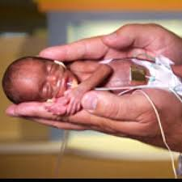
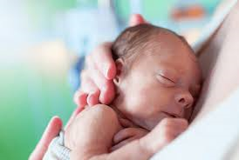
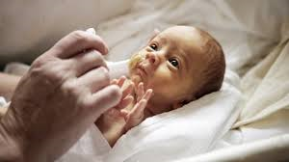
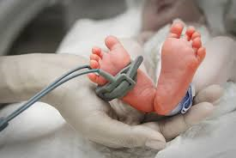
THANK YOU

