Slide 1
Updates In The Management of Sickle Cell Disease In Pediatrics and Future Directions
Introduced By : Fatima Srour, MD

Slide 2
Case
A 16 years old male reported to the ER for severe joint pain, severe weakness, cough and defective vision.
Past history reveals episodes of jaundice, severe body aches, and gall stones.
In childhood : swelling of hands and feet , chest pain , nosebleeds and frequent URTIs.
Family history: similar problem in one of his cousins who died at the age of 30, used to receive blood transfusions

Slide 3
Physical exam
pale , mildly jaundiced
VS : T 39.1°C, ,HR of 90, BP 116/84,RR 26 , O2 Sat 89%
ulcers on right leg, inflamed gums
Enlarged spleen.

Slide 4
CBCD
○ WBC 17 500/μL
62% neutrophils
25% lymphocytes
9% monocytes 2% eosinophils
1% basophils
○ Hb 8 g/dL  Reticulocyte 25%
○ Platelet 206 000/μL

Slide 5
What is most probable cause of patients problem?
What complications the patient may have?

Slide 6
outline
Pathophysiology of SCD
Manifestations and sequelae of SCD
Health maintenance recommendations
Current treatments for SCD
Hydroxyurea
Chronic transfusion therapy
Hematopoietic stem cell transplantation
Future directions

Slide 7
Sickle cell Disease
An autosomal recessive genetic disease of Hb synthesis
Results from substitution of the amino acid valine for glutamic acid at the sixth position of the beta globin chain, causing formation of hemoglobin S.
100,000 individuals (36,000 children) in US

Slide 8
SCD Clinical disorders
Sickle cell anemia (SCA) : HbSS or HbSβ0-thalassemia.
Sickle cell disease (SCD) :all disease genotypes:
-SCA and compound heterozygous disorders(HbSC, HbSD).
- Sickle cell trait is not a form of SCD
Notes:
Clinically similar disorders
SCA and compound heterozygous disorders, such as HbSC,

Slide 9
Pathophysiology
HbS polymerizes into rod-like structures upon deoxygenation
A hallmark of SCD is chronic haemolysis with vaso-occlusion.
Notes:
caused by polymerization of HbS molecules.
Polymerization usually occurs during hypoxia, acidosis or in the setting of pyrexia or dehydration.

Slide 10
Manifestations and Sequelae of Sickle Cell Disease (SCD) in Infants and Children
Splenic sequestration:
30% of SCD patients
less than 6 years of age :
->circulatory collapse requiring transfusion.
Splenic pathology-> functional asplenia ->higher risk for infection with encapsulated organisms
Acute vaso-occlusive crisis : the hallmark of SCD
50% of all emergency room visits by SCD patients
60% of hospitalizations

Slide 11
Manifestation and Sequelae of Sickle Cell Disease (SCD) in Infants and Children
Acute chest syndrome (ACS) :
- 30% of SCD patients
-fever, cough, wheezing, tachypnea or chest pain.
Microvascular organ damage :spleen, liver, bone marrow, kidney, brain, lung, gallstone, priapism, leg ulcers.

Slide 12
COMPLICATIONS
Acute Chest Syndrome
Septicemia
Stroke or CVA
Acute splenic sequestration crisis (ASSC)
Aplastic Crisis
VasoOcclusive pain: Sickle cell crisis
Osteomyelitis

Slide 13
Health Maintenance Recommendations for People With Sickle Cell Disease

Slide 14
Managing Acute Complications of Sickle Cell Disease
acute vaso-occlusive crisis (VOC).
Infection
acute kidney injury (AKI)
hepatobiliary complications
acute anemia
splenic sequestration
acute chest syndrome (ACS)
acute stroke
Priapism
central retinal artery occlusion (CRAO)

Slide 15
KQ1. For adults and children with SCD-related acute pain, what are the most effective acute pain management strategies?
Diagnostic evaluation of causes of pain other than a VOC
Start therapy within 30 minutes of triage or within 60 minutes of registration.

Slide 16
Fever
septicemia and meningitis, primarily due to Streptococcus pneumoniae.
ACS
Osteomyelitis(Staphylococcus aureus, salmonella, or other enteric pathogens)
gram-negative enteric infections involving the urinary tract, hepatobiliary system

Slide 17
Fever
In children with SCD and a temperature ≥ 38.5 °c :
Obtain CBCD and pancultures
Empiric parenteral antibiotics against Streptococcus pneumoniae and gram-negative enteric organisms.
Hospitalize people with SCD and a temperature ≥ 39.5 °C) and who appear ill for close observation and intravenous antibiotic therapy.

Slide 18
CHOLELITHIASIS
KQ2. In people with SCD, what is the appropriate management of cholelithiasis and related cholecystitis ?
Treat acute cholecystitis with antibiotics and surgical consultation.
Treat asymptomatic gallstones with watchful waiting
In children with signs and symptoms of AHS or AIC, provide hydration, rest, close observation,
confirmed AHS or severe AIC, perform simple or exchange transfusion.

Slide 19
Acute Anemia
A decline by 2.0 g/dL or more in hemoglobin concentration below the patient’s baseline value
Acute splenic sequestration, an aplastic episode, a delayed hemolytic transfusion reaction, ACS, and infection.
Aplastic events : immediate red blood cell transfusion
Notes:
During splenic sequestration,
the reticulocyte count and circulating nucleated red blood cells are usually elevated, and the platelet count is
generally decreased because both red cells and platelets are trapped in the spleen. Sequestration usually
develops without warning or known cause.

Slide 20
outline
Pathophysiology of SCD
Manifestations and sequelae of SCD
Health maintenance recommendations
Current treatments for SCD
Hydroxyurea
Chronic transfusion therapy
Hematopoietic stem cell transplantation
Future directions

Slide 21
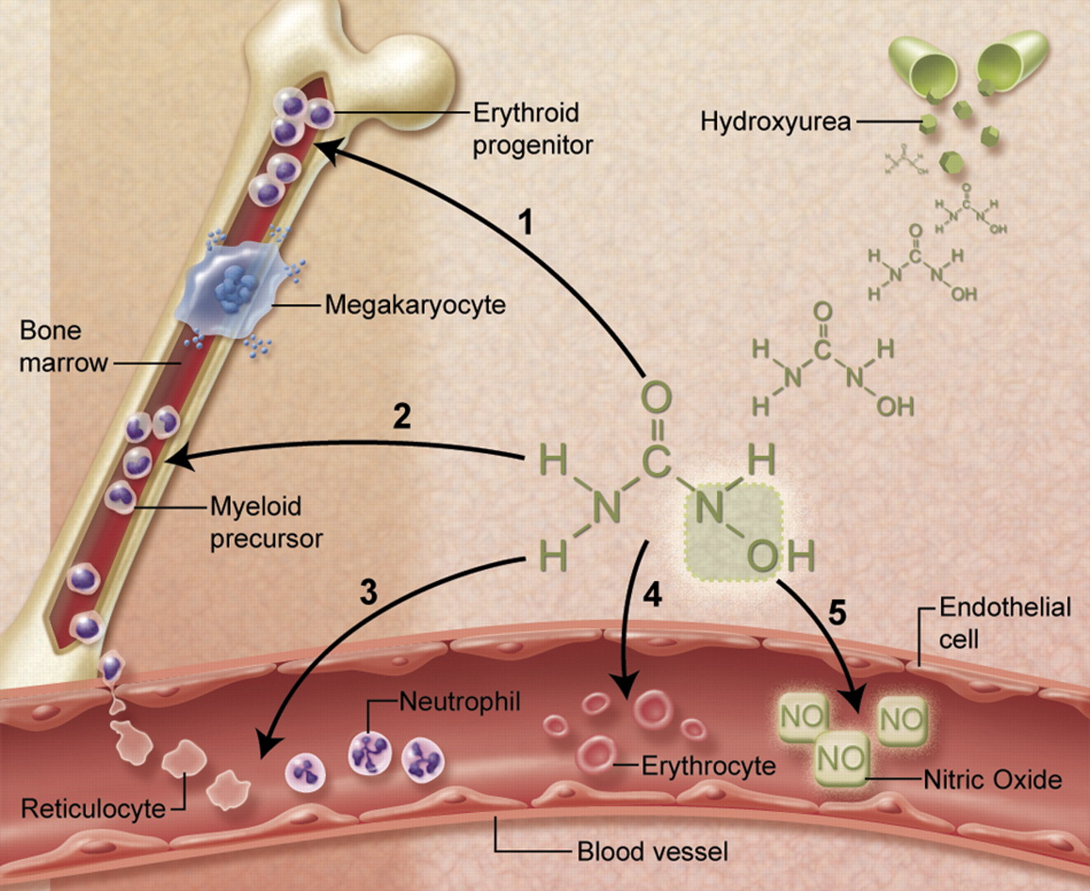
Hydroxyurea – Mechanisms of Action
1. ↑ HbF through altered erythroid kinetics and cGMP
2. ↓ Neutrophils and reticulocytes
3. ↓ Adhesiveness to vascular endothelium
4. ↓ Hemolysis
5. ↑ Nitric oxide release

Slide 22
Timeline for Clinical Trials of Hydroxyurea

Slide 23
BABY HUG Trial
Objectives
Primary: To determine whether hydroxyurea can prevent or reduce chronic organ damage to the spleen and kidneys in very young children with sickle cell anemia (SCA)
Secondary: To investigate safety, determine hematologic effects and effects on other measures of organ function.
HbSS or HbSβ0thal
Ages 9 – 18 months
No requirement for clinical severity
193 subjects randomized to HU vs. placebo
HU dose = 20 mg/kg/d x 2 years

Slide 24
BABY HUG Trial
Conclusions
HU decreases incidence of pain, dactylitis, acute chest syndrome, transfusions and hospitalizations
Hydroxyurea does not prevent splenic or renal dysfunction (based on primary endpoints), although differences favoring HU were seen for several secondary endpoints.
HU does not have significant toxicity other than moderate, transient neutropenia.

Slide 25
Complications of Sickle Cell Disease

Slide 26
SWiTCH Trial
Multi-center Phase III randomized trial in children with SCA and previous overt stroke
Subjects transfused for ≥1.5 years and iron overloaded
133 subjects randomized to Standard treatment: continued chronic transfusion+ iron chelation, or
Alternative treatment: hydroxyurea (phase in) +phlebotomy
Composite 1° endpoint: stroke risk + iron status

Slide 27
SWiTCH Trial Results
Liver iron concentration (LIC) was not lower with phlebotomy
Median LIC was 15.7 in the alternative arm
Median LIC was 16.6 in the standard arm
Recurrent stroke rate was unbalanced :
7 subjects in the alternative arm = 10% (12% predicted)
0 subjects in the standard arm = 0% (6% predicted)
With no iron advantage, no stroke margin was justified
Therefore, management for secondary stroke prevention
remains chronic transfusion + iron chelation

Slide 28
TWiTCH Trial
Phase III multi-center trial in patients who were transfused for primary stroke prophylaxis (because of abnormal Transcranial Doppler (TCD) velocity) for ≥1 year.
121 subjects, ages 4-16 years, without severe vasculopathy
Randomized to continued chronic transfusion vs. switching to HU treatment
Primary endpoint was TCD velocity after 24 months.
Final TCD velocities = 143 cm/sec on chronic transfusion and 138 cm/sec on HU; no patients in either arm had stroke.
Therefore, HU treatment was not inferior to transfusion treatment.
Implications:
– Fewer patients will need to be on long term transfusion for primary stroke prophylaxis.
– Fewer patients will require primary stroke prophylaxis if “all” SCA patients are placed on HU.

Slide 29
Complications of Sickle Cell Disease

Slide 30
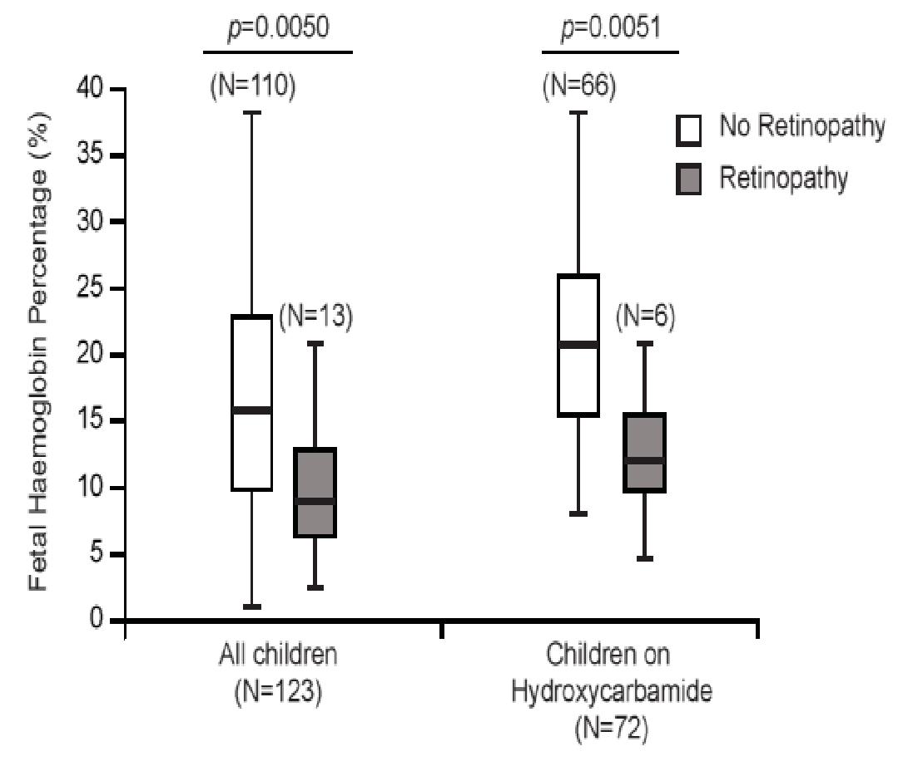
Hydroxyurea and Retinopathy
123 children with HbSS at SJCRH; routine eye exams beginning at age 10
10.6% developed retinopathy
HbF<15% → 7x more likely to develop retinopathy than HbF>15%
Among children treated with HU, those with retinopathy had ↓ HbF
Induction of HbF with HU may prevent retinopathy

Slide 31
Complications of Sickle Cell Disease

Slide 32
Hydroxyurea and Cardiopulmonary Function
↑ Exercise tolerance on treadmill in boys on HU (Wali, PHO, 2011)
↑ SaO2 (95 → 98%) in 5-21 year old HbSS patients on HU(Pashankar, JPHO, 2015)
Patients on HU had higher SaO2 - both when awake and asleep – compared with those not on HU (98.5% vs. 96.1%), but no difference in obstructive sleep apnea (Narang, Annals ATS, 2015)
No change in tricuspid regurgitant (TR) jet velocity – marker of pulmonary hypertension - in 152 children with SCD(Gordeuk, Blood, 2009)

Slide 33
Complications of Sickle Cell Disease

Slide 34
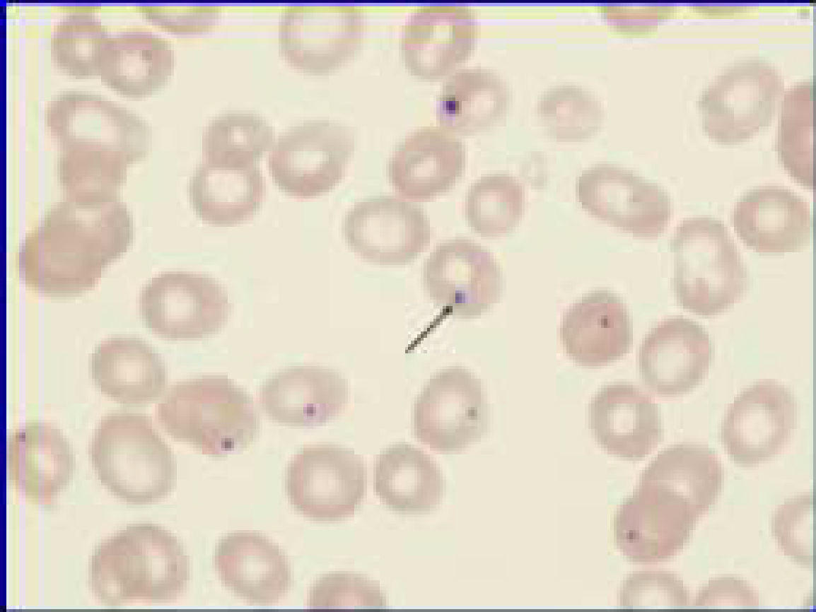
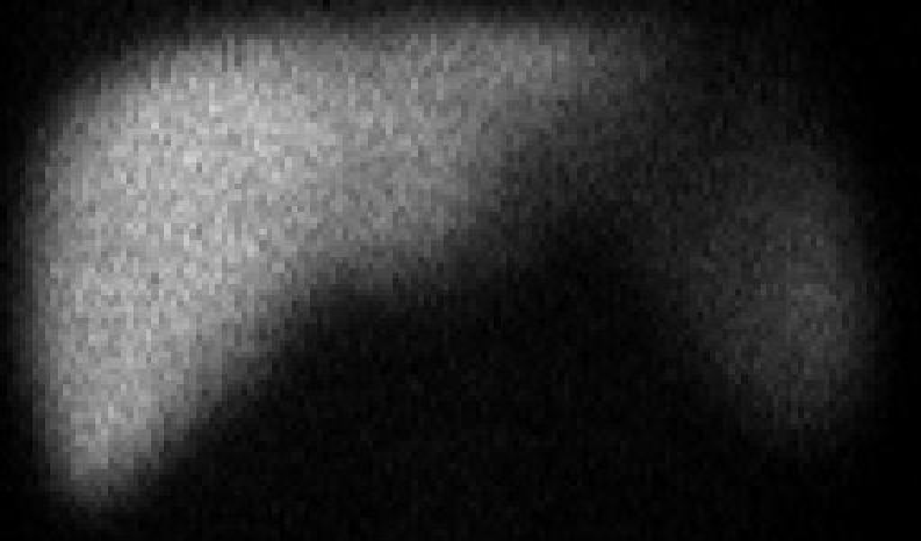
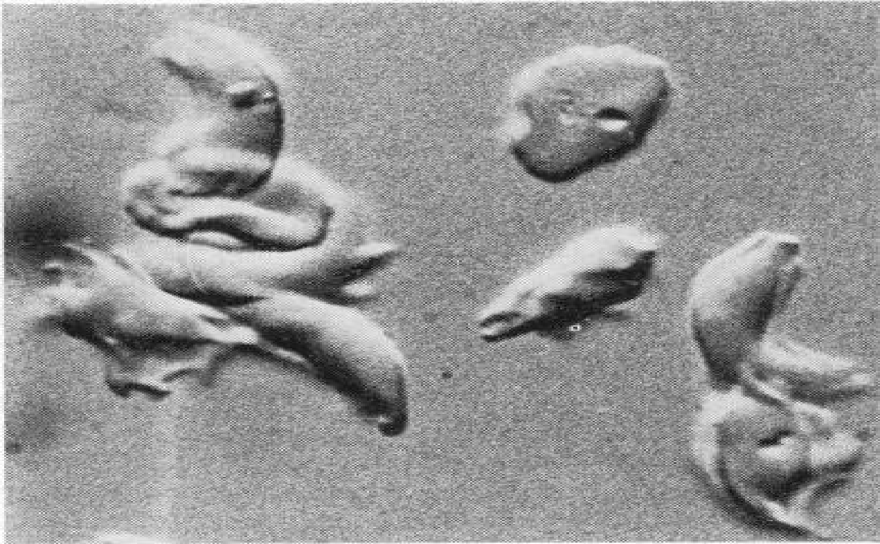
Spleen Function(in BABY HUG Trial) (Rogers Blood, 2010)
Liver spleen scan
Qualitative interpretation of spleen uptake (relative to liver)
• Categorized as normal present, but decreased, or absent
• No significant difference between HU and placebo in BABY HUG
• However, Howell-Jolly Bodies (HJB)and pitted cells were significantly less in HU patients (p<0.04)

Slide 35
Hydroxyurea and Spleen Function
Splenic function normally lost by age 2 years in 90% of HbSS patients
HUSTLE Study: Liver-spleen (L-S) scans performed at initiation of HU treatment and every 3 years afterwards
In 40 children with sickle cell anemia (SCA), mean age 9.1 years, 33% had some uptake on L-S scans after 3 years of HU
Younger age, higher HbF, and baseline splenic function were associated with preservation or re-induction of spleen function

Slide 36
Complications of Sickle Cell Disease

Slide 37
Hydroxyurea and Renal Function
GFR (by DTPA clearance): No difference between HU and placebo in BABY HUG Trial (Wang, Lancet, 2011)
Urine concentrating ability: HU > placebo in BABY HUG(Alvarez, PBC 2012)
Albuminuria: ↓frequency of albuminuria on HU in adults (OR 0.28)(Laurin, Nephrol Dial Transplant, 2014)
↓ albumin:creatinine ratio (3.0→1.7) after 6 months on HU in adults (Bartolucci, J Am Soc Nephrol, 2015)

Slide 38
Complications of Sickle Cell Disease

Slide 39
Hydroxyurea and Priapism
Case report #1 (Ali Hassan, 1998)
– 25 year old Saudi man
– Stuttering priapism relieved by HU
Case report #2 (Anele, 2014)
– 16 year old African-American man
– 72 hr. episode of priapism -> erectile dysfunction
– HU x 18 mo. -> recovery of erectile function

Slide 40
Complications of Sickle Cell Disease

Slide 41
Hydroxyurea and Parvovirus Infection
Retrospective review of 330 children with SCD
120 known cases of aplastic crisis due to parvovirus B19 infection; 12% (n=14) on HU at time of infection
Children with HbSS/Sβ0 on HU had fewer transfusions (71% vs. 94%, p=0.03) and higher Hb concentration nadirs (6.5 vs. 5.2 g/dL, p=0.01) than untreated children
Conclusion: HU may reduce need for transfusion and may attenuate symptoms during aplastic crises due to parvovirus.

Slide 42
Consensus Treatment Protocol of Hydroxyurea Therapy
Baseline elevation of HbF should not affect the decision to initiate hydroxyurea therapy.
Starting dosage for infants and children: 20 mg/kg/day
Monitor CBC with WBC differential and reticulocyte count at least every 4 weeks when adjusting dosage.
Aim for a target absolute neutrophil count ≥2,000/Ul
Maintain platelet count ≥80,000/uL

Slide 43
Hydroxyurea: Optimal Dose?
Benefits of hydroxyurea are primarily due to fetal hemoglobin.
Laboratory benefits are dose-dependent.
Escalation >25 mg/kg/d → HbF ~20%
Non-escalated ~20 mg/kg/d → HbF ~15%
liquid formulations are bioequivalent.

Slide 44
outline
Pathophysiology of SCD
Manifestations and sequelae of SCD
Health maintenance recommendations
Current treatments for SCD
Hydroxyurea
Chronic transfusion therapy
Hematopoietic stem cell transplantation
Future directions

Slide 45
Benefits of erythrocyte transfusion in SCD :
Increase oxygen carrying capacity
Increase hemoglobin/hematocrit
Decrease reticulocyte count
Reduce Hb S level <30%
Reduce circulating sickle cell forms

Slide 46
Pre and post chronic transfusion therapy
untreated
transfused

Slide 47
Indications
Prevention of secondary stroke
Prevention of primary stroke
Recurrent acute chest syndrome
Symptomatic anemia due to chronic renal failure

Slide 48
Prevention of secondary stroke
Without transfusion :70% recur within 3 years of initial stroke
Chronic transfusion therapy Recurrence only 10%

Slide 49
Transcranial Doppler ultrasound

Slide 50
Primary stroke prevention
Most clinical strokes occur in children with increased TCD flow velocities
< 170 cm/sec “Normal”
> 170 cm/sec “Conditional”
> 200 cm/sec “Abnormal”

Slide 51
Complications of chronic transfusion
Immunologic
Infections
Iron overload

Slide 52
outline
Pathophysiology of SCD
Manifestations and sequelae of SCD
Health maintenance recommendations
Current treatments for SCD
Hydroxyurea
Chronic transfusion therapy
Hematopoietic stem cell transplantation
Future directions

Slide 53
Stem cell transplantation for SCD
The goal is to cure the SCD
Only 15% of patients have an HLA-matched sibling
Requires the use of highdose chemotherapy and radiation
Sterility likely
Currently reserved for patients with significant complications ( stroke, or recurrent episodes of ACS and pain)

Slide 54
challenges
Hydroxyurea not effectively used
Chronic transfusion therapy does not prevent all CNS complications and leads to iron overload
Not enough donors for SCT

Slide 55
Future directions

Slide 56
Nitric Oxide
keeps blood vessels dilated
Inhaled gas versus oral preparations

Slide 57
Gene therapy for SCD
Potential cure or significant amelioration of SCD symptoms
Not tested in humans with SCD yet Vector inserted (lentivirus) in stem cells
“Convinces” the body to produce more HbF
More HbF ► less HbS ► less problems

Slide 58
Gene therapy trials for hemoglobinopathies
Trial using vector containing β-globin (Cavazzano-Calvo, Nature, 2010) –
one pt. with HbE-β- thalassemia now transfusion independent after ~30 mo.
Three trials (Memorial Sloan-Kettering, Cincinnati Children’s, St. Jude) beginning enrollment soon

Slide 59
Induced pluripotent stemcells (Ips)
Reprogramming adult somatic cells into induced pluripotent stem cells
iPS can be manipulated to correct a genetic error

Slide 60
Conclusions
Treatment options much better than 20 years ago
Chronic transfusion useful for specific problems –especially involving the CNS
Curative therapy with HSCT expanding
genetherapy not yet ready for large-scale trials
Hydroxyurea has best potential for treatment of most patients with SCD, particularly for decreasing vasoocclusive complications and mortality—and it should be considered for all HbSS patients

Slide 61
Thank you

