Slide 1
Clinical aspects of polycystic kidney diseases
Francesco Emma
Division of Nephrology and Dialysis
Bambino Gesù Children’s Hospital - IRCCS, Rome, Italy
Beirut, June 13-14-15, 2019

Slide 2
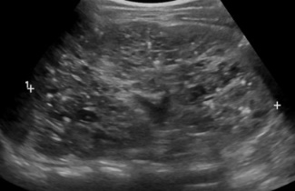
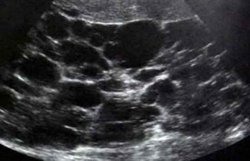
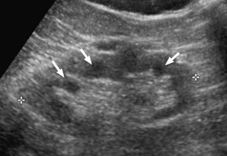
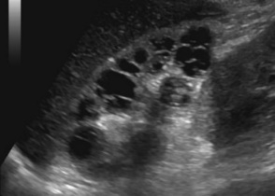
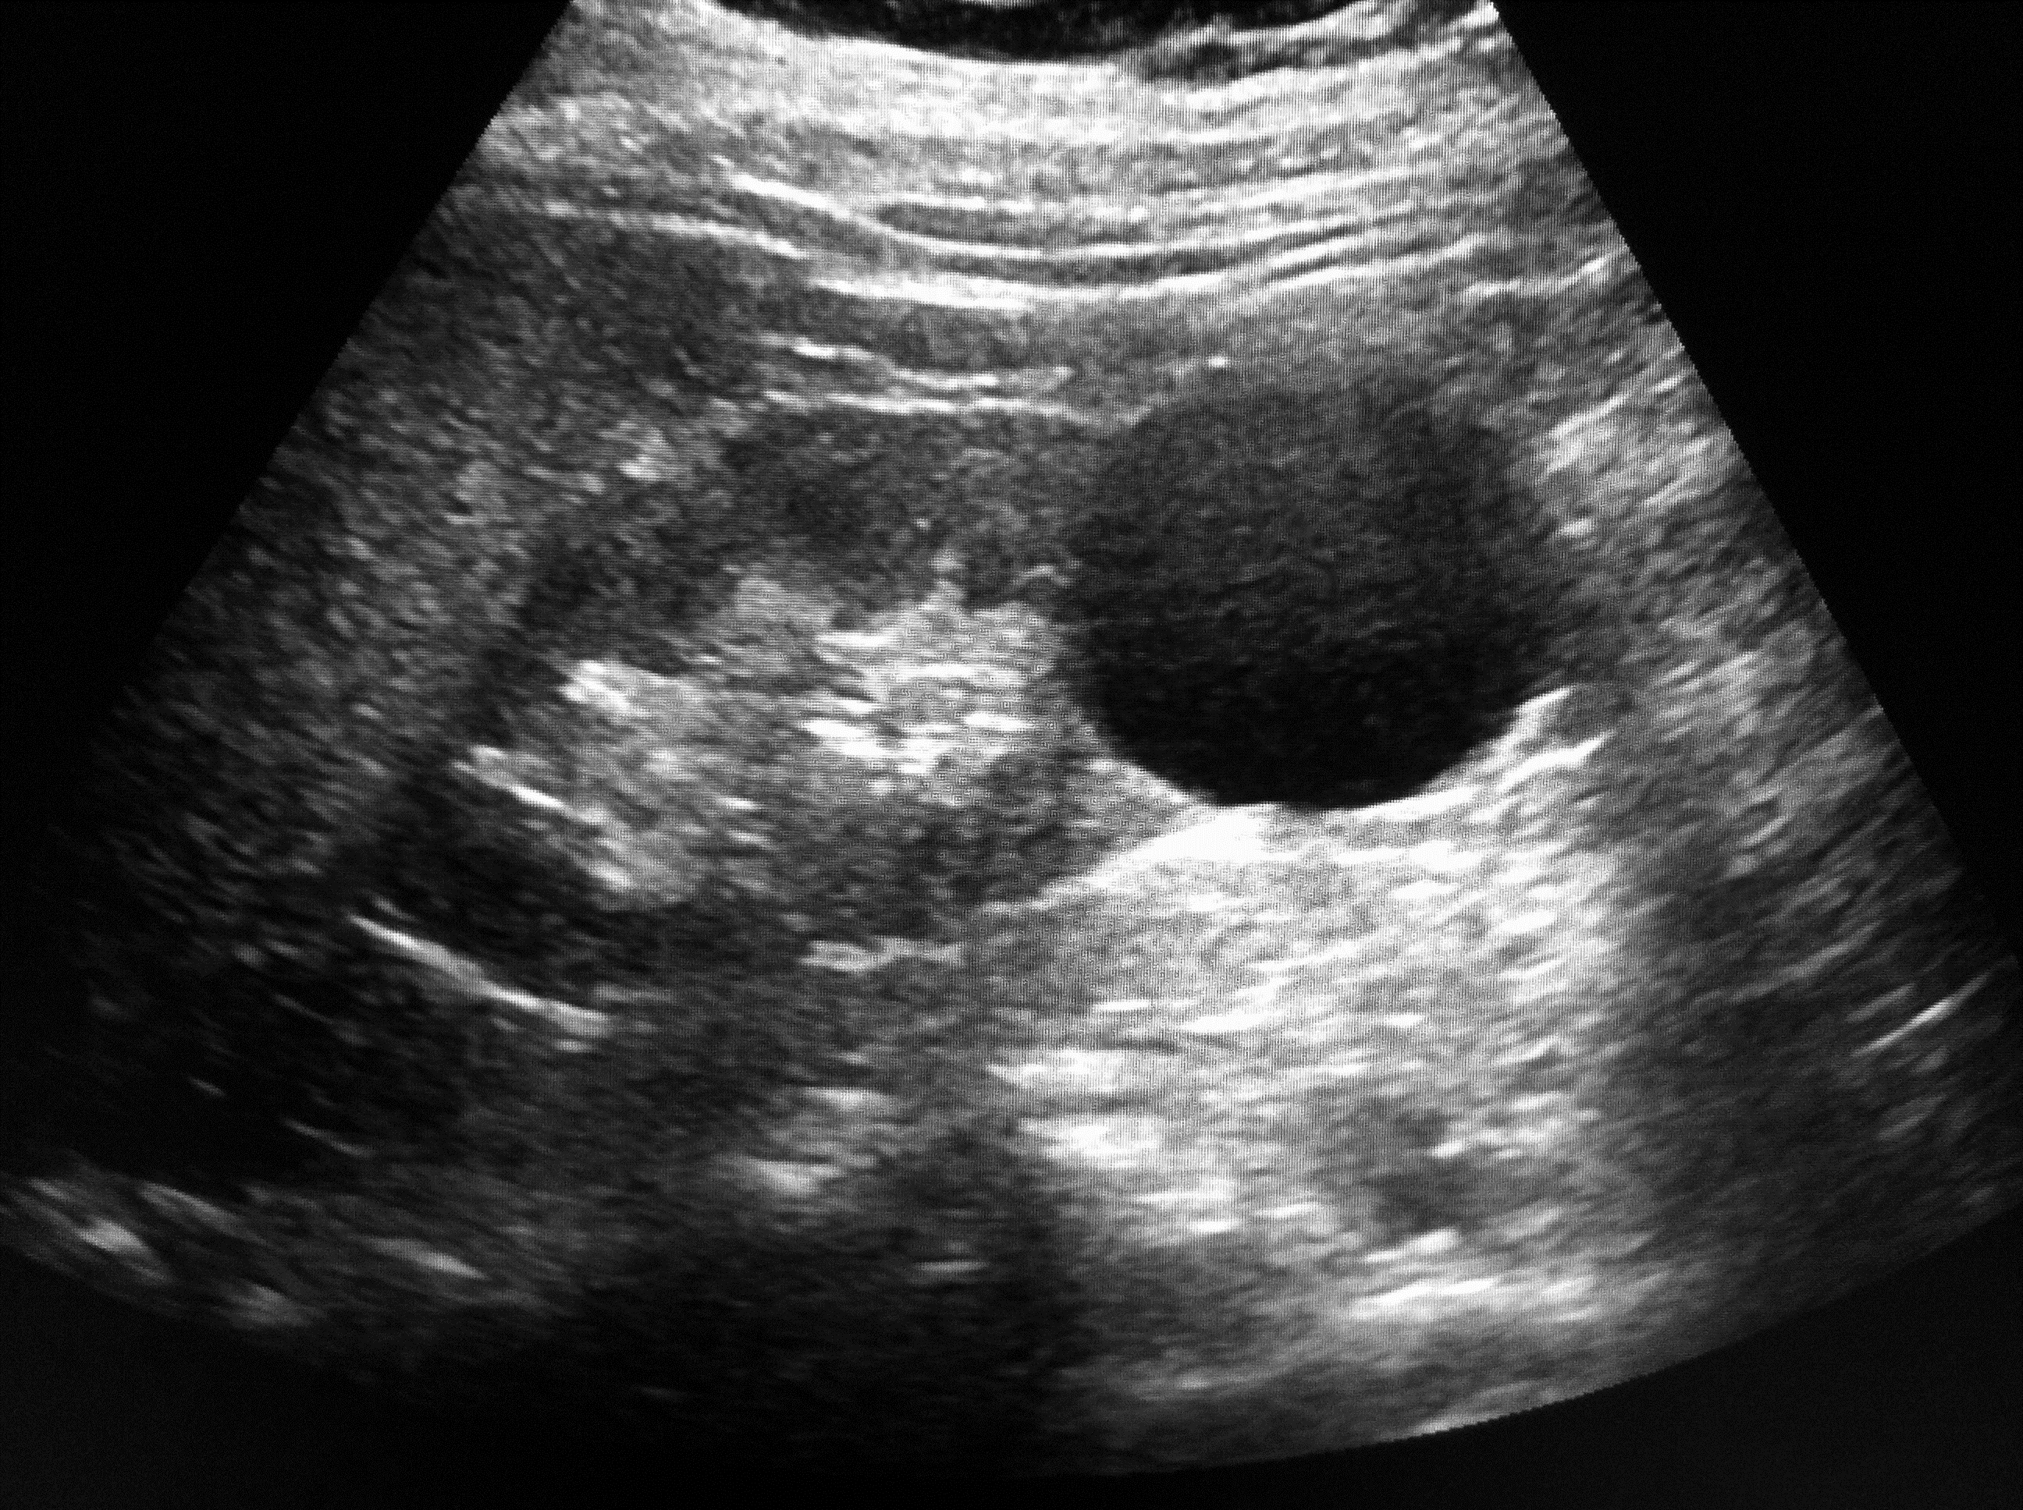
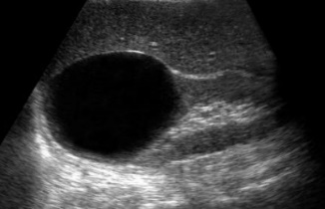

Renal cysts in children
Diagnosis
ARPKD
ADPKD
NPH
ADTDK
Dysplasia
MCDK
Simple cysts
Ultrasound
Inheritence
AR
AD
AR
AD
Rarely
Rarely
Rarely
Symmetry
Bilateral
Bilateral
Bilateral
Bilateral
Unilateral
Unilateral
Unilateral
Age
Congenital
Childhood
Childhood
Childhood
Congenital
Congenital
Adulthood
Kidney size
Large (early)
Large (late)
Normal/small
Normal/small
Normal/small
Variable
Normal

Slide 3
Differential diagnosis of cystic diseases in children
  Sporadic disorders associated with renal cysts
  Cystic dysplasia
  Multicystic dysplastic kidney (MCDK)
  Isolated renal cysts
  Inherited disorders associated with polycystic kidneys
  Tuberous sclerosis complex (TSC)
  Ciliopathies
  AD tubulointerstitial kidney disease (ADTKD)
  Other disorders
  Von-Hippel-Lindau syndrome (VHL)
  Oro-facial-digital syndrome Type 1 (OFD1)
  Zellweger cerebrohepatorenal syndrome
  Chromosomal defects (trisomy 9, 3)
Diseases with apparent isolated polycystic phenotype
  AD polycystic kidney disease (ADPKD)
  AR polycystic kidney disease (ARPKD)
  Glomerulocystic kidney disease (GCKD)

Slide 4
Age prevalence of simple cysts
Eknoyan et al, JASN 2008

Slide 5
Isolated renal cyst: differential diagnosis
Simple cysts are a diagnosis of exclusion
Diagnosis | Comments
First cyst of ADPKD | This is the real concern !!!
Hydrocalyx | Experienced radiologist usually makes the correct diagnosis Sometimes can be difficult (uro CT or uro MRI)
Renal dysplasia | Experienced radiologist usually makes the correct diagnosis Renal parenchyma is not normal The kidney is usually small Usually more than 1 cyst
Caliceal diverticulus | Rare, may be difficult to differentiate
Hydatid cysts | Exceptional

Slide 6
Bosniak classification in children
8 year-old girl
renal cell carcinoma
10 year-old girl
benign multilocular cyst
J Urol 2008

Slide 7
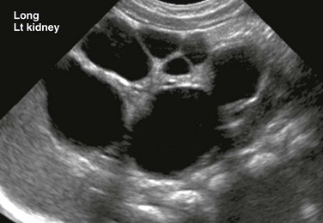
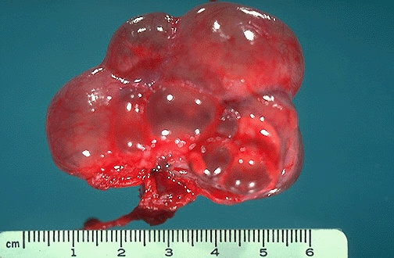
Multicystic dysplastic kidney

Slide 8
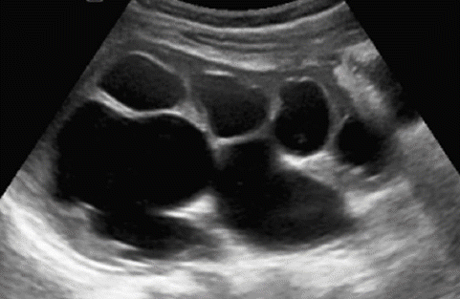
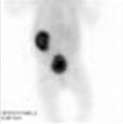
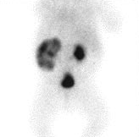
Multicystic dysplastic kidney
  In a minority of cases, differential diagnosis with obstructive uropathy may be difficult
  MCDK
  Hydronephrosis
  MAG3 scan

Slide 9
Natural evolution of multicystic dysplastic kidneys
Involution
Hypertrophy
Gaither et al, J Urol 2018

Slide 10
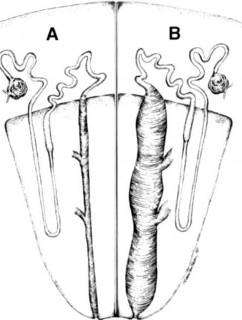
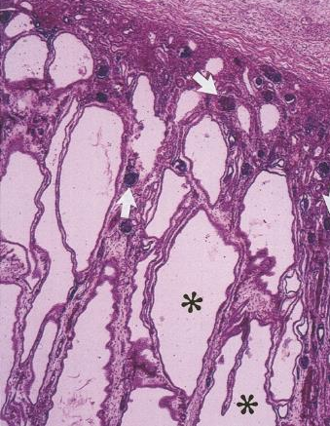
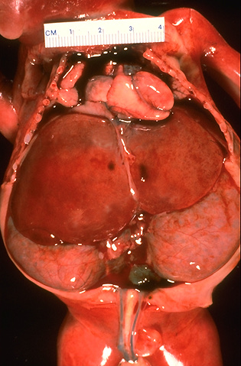
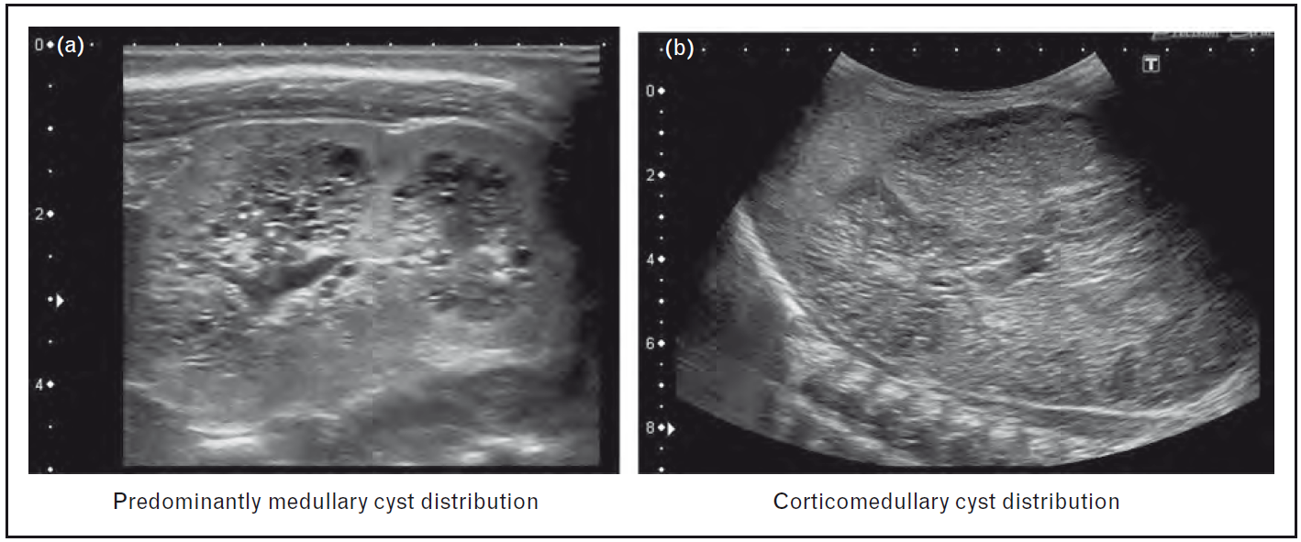
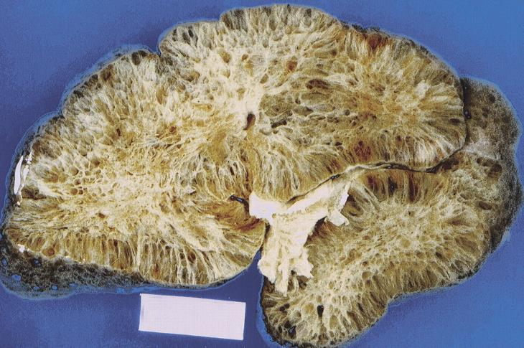
Autosomal Recessive Polycystic Kidney Disease
Corticomedullary distribution
Mainly medullary distribution
www.library.med.utah.edu
Hoyer P, Curr Opinion Pediatr 2015
Lonergan et al ,RadioGraphics (2000)

Slide 11
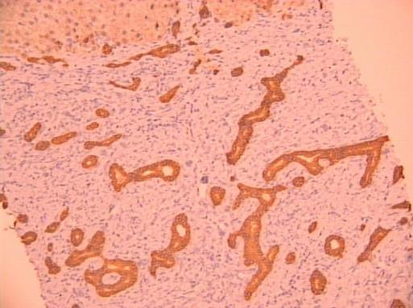
Autosomal Recessive Polycystic Kidney Disease
> than 300 mutations in the PKHD1 gene have been described
weak genotype–phenotype correlation
Oligohydramnios before 28 weeks of gestation is often lethal
Neonatal forms
> 60% of neonates with pulmonary hypoplasia survive
± 25% of neonates need postnatal dialysis
± 60% require renal replacement therapy at 10 years
Liver
Congenital hepatic fibrosis is always found
Hoyer P, Curr Opinion Pediatr 2015

Slide 12
Diagnosis of ARPKD
Prenatal ultrasound is not positive in the early weeks of gestation
Prenatal diagnosis is only feasible by molecular genetics
Caution when predicting the phenotype!
Siblings
ARPKD expression can be highly variable within the same family
Abdominal imaging of siblings into adulthood may be appropriate
Genetic testing when possible
Guay-Woodford et al, J Pediatr 2014

Slide 13
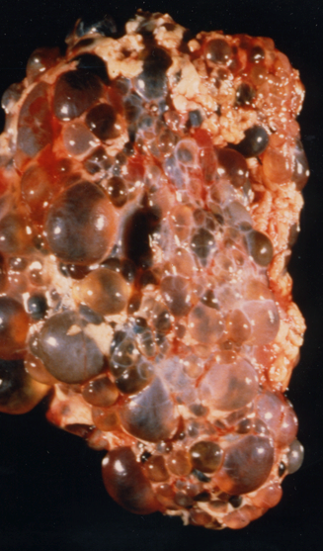
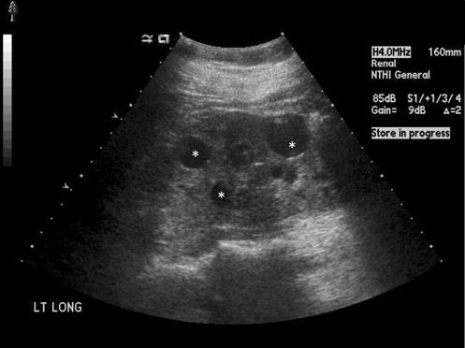
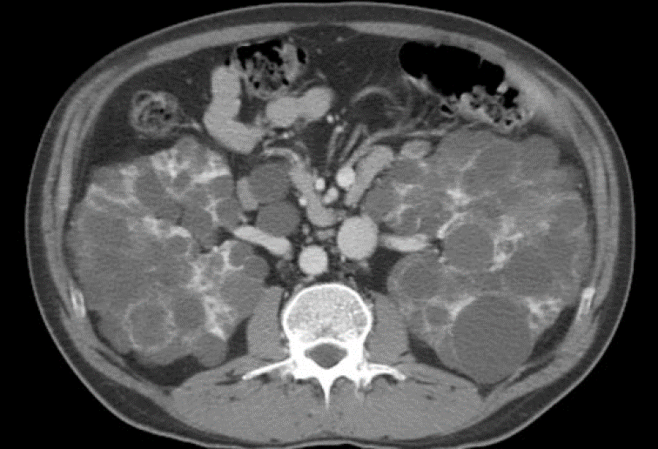
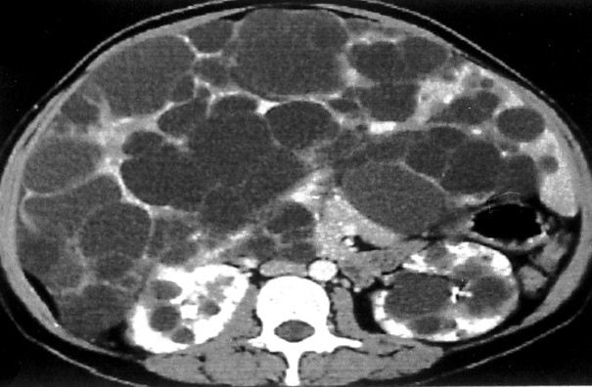
Autosomal Dominant Polycystic Kidney Disease
8 y/o
35 y/o

Slide 14
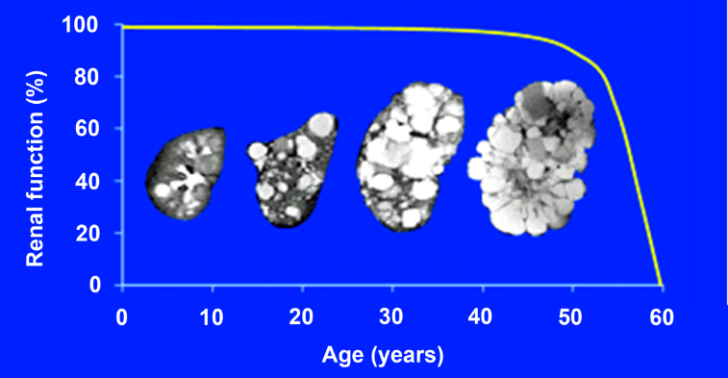
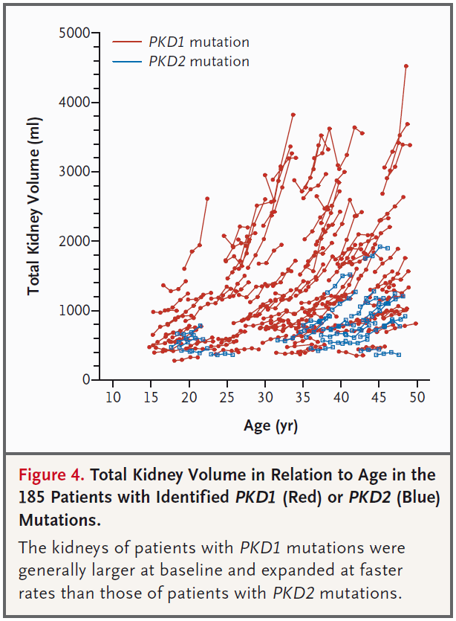
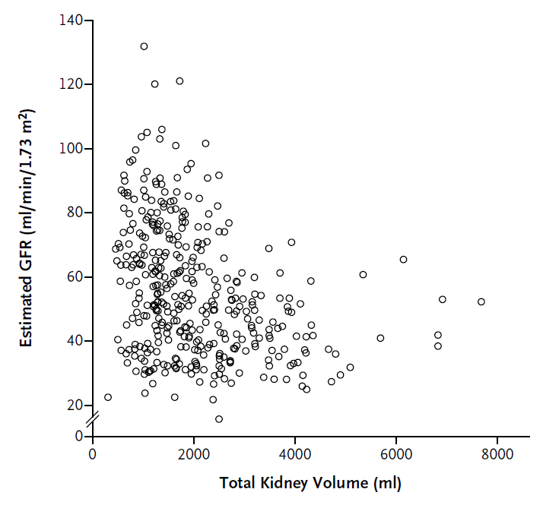
Autosomal Dominant Polycystic Kidney Disease
Gene | Pathogenic variants
PKD1* | ∼78%
PKD2* | ∼15%
GANAB | ∼0.3%
DNAJB11 | ∼0.1%
Unknown | ∼7%
* ∼10% de novo mutations
Waltz et al NEJM 2010
Grantham et al, NEJM 2009

Slide 15
Patient classification: classes 1A to 1E
Mayo clinic
CRISP cohort
Irazabal et al, Clin JASN 2015, Chebib and Torres, Clin JASN 2018
Notes:
Classification by HtTKV0 and age at HtTKV0 predicts renal survival in class 1
patients. Kaplan-Meier survival plots of time to ESRD by subclasses in the class 1 MTPC
(A) and CRISP (B) patients and for the class 2 MTPC (C) patients.

Slide 16
Prognostic factors in ADPKD
Mutation
Gender
Hypertension
PROPKD score
TKV
Complications
Class 1A – 1E
vs. age
GFR

Slide 17
PROPKD score
low risk (0–3 points)
Intermediate risk (4–6 points)
High risk (7–9 points)
Cornec-Le Gall et al, JASN 2016

Slide 18
Extrarenal symptoms in children with ADPKD
Liver cysts
no data in children (55% between 15-25 years)
very rarely pain, infection or hepatomegaly
Intracranial aneurisms
exceptional cases
Mitral valve prolapse
15% in children
MacRae Dell Adv Chronic Kidney Dis 2011, Risk et al Pediatr Nephrol 2008

Slide 19
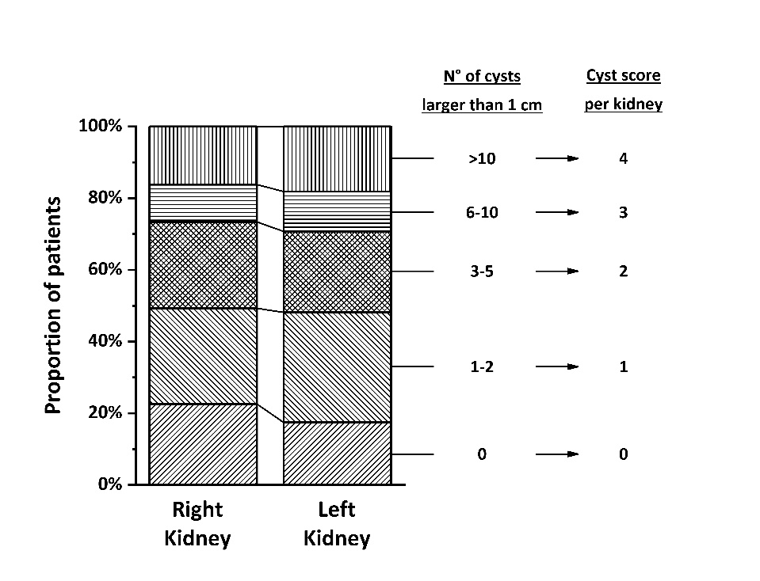
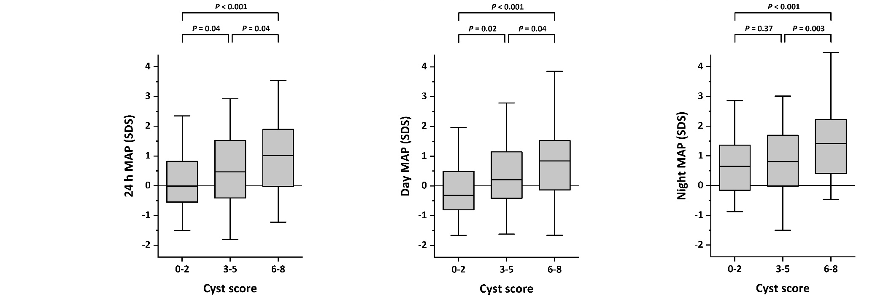
ADPKiDs study: ABPM results
Massella et al, CJASN 2018
 | Day | Night | 24h
Hypertension (SBP and/or DBP ≥ p95) and/or BP medication | 31% | 42% | 35%

Slide 20
Diagnosis of ADPKD in adults
AGE | CRITERIA (Pei et al, JASN 2009)
15-39 years | ≥ 3 cysts unilateral/bilateral
30-59 years | ≥ 2 cysts in each kidney
>60 years | ≥ 4 cysts in each kidney
no available criteria < 15 years
isolated cysts are rare in young children

Slide 21
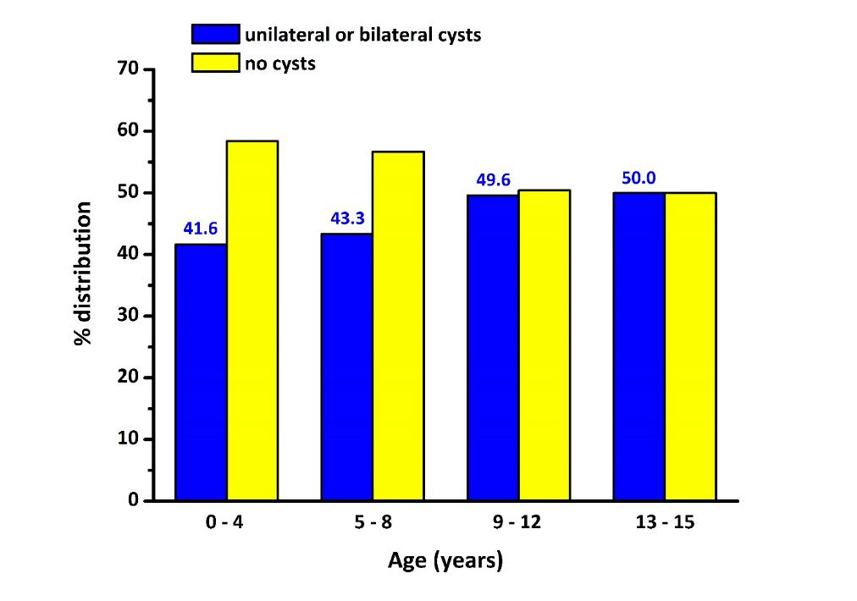
Making the diagnosis in children at risk
420 children at risk (50%)
Adapted from Reed et al,
Am J Kid Dis 2010
positive PKD1/PKD2 mutation
≥ 1 renal cyst in a child with a parent with ADPKD

Slide 22
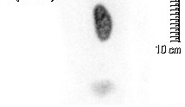
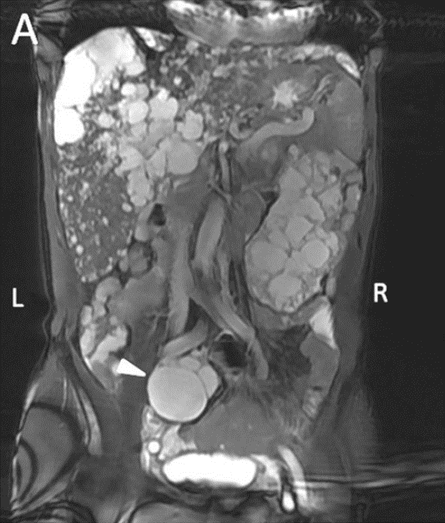
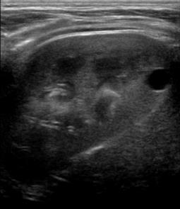
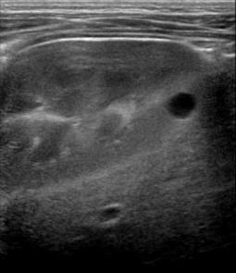
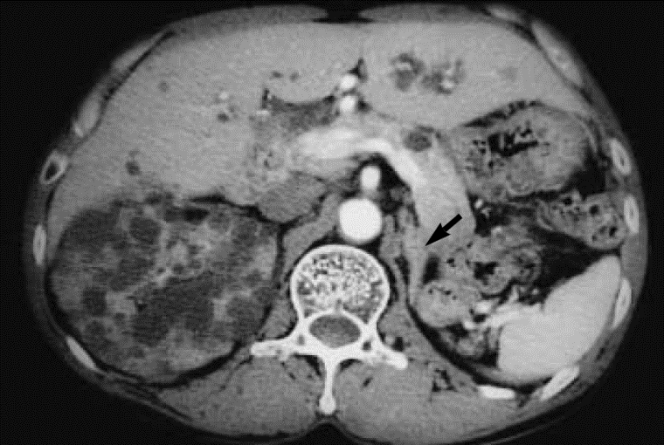
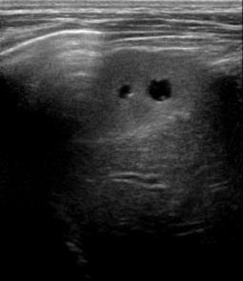
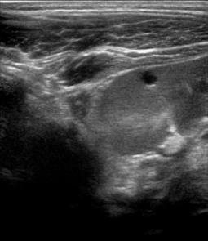
ADPKD: difficult cases…
L
R
ADPKD
Renal
Agenesis
3 y/o boy
MCDK
Xu et al, BMC Nephrol 2013
ADPKD
Renal
Agenesis
Jeong et al, J Korean Medn Sci 2003

Slide 23
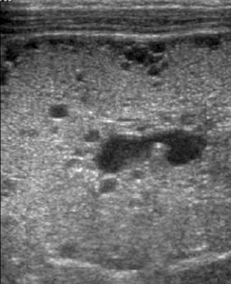
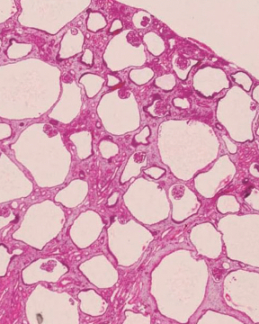
ADPKD presenting as glomerulocystic kidney disease

Slide 24
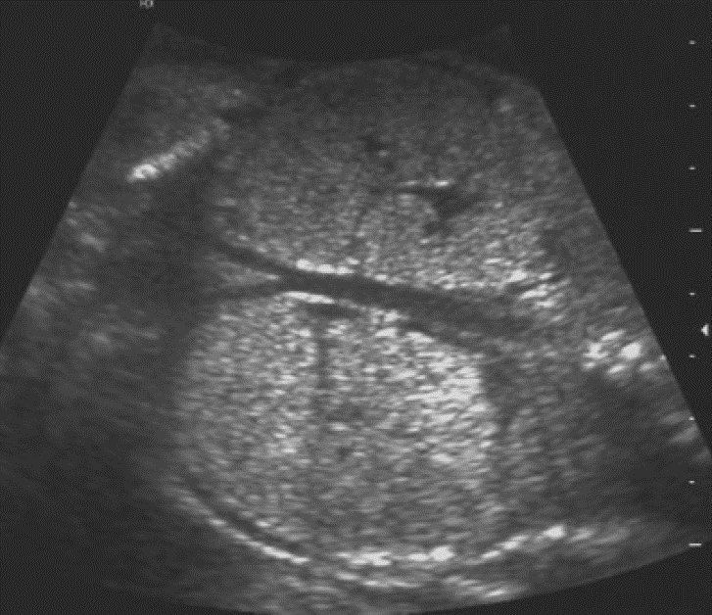
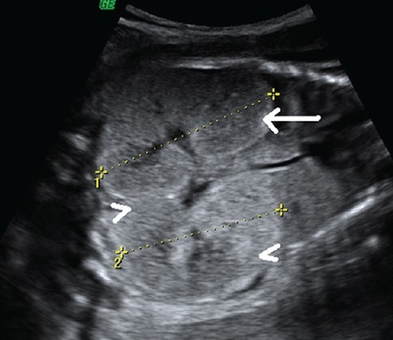
ADPKD: congenital forms
28.5 wks gestation
30 wks gestation
ADPKD
ARPKD
Brun et al, Ultrasound Obstet Gynecol 2004
Rajanna et al, J Clin Imaging Sci 2013
Coinheritance of a hypomorphic PKD allele in trans with an inactivating PKD allele

Slide 25
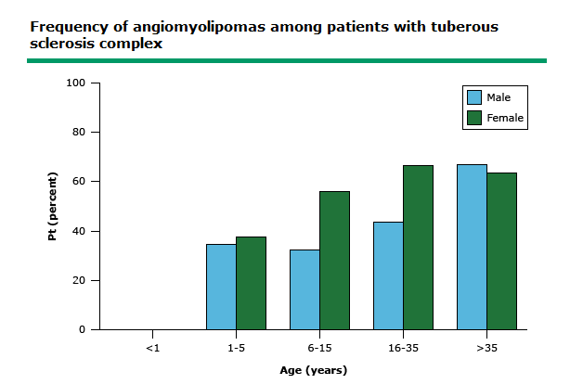
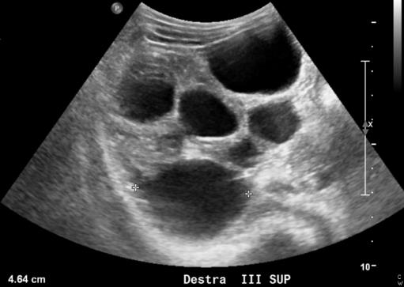
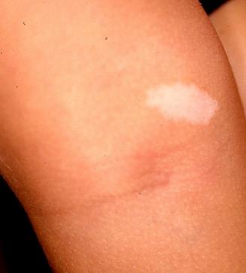
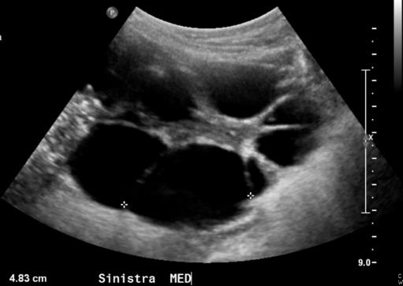
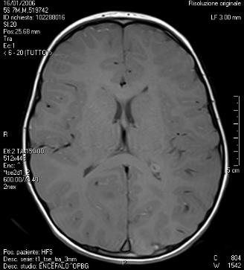
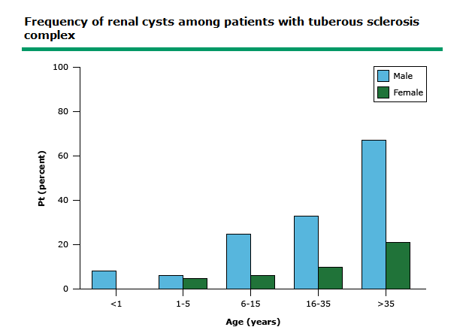
Polycystic kidneys in TSC
L
Angiomyolipomas
R
Renal cysts
Adapted from Torres et al, Adv Nephrol Neker Hosp 1994

Slide 26

Thank you
francesco.emma@opbg.net

