Slide 1
Overview of Available and “In-Pipeline” Antibiotics
Ghassan Dbaibo, MD
Professor and Vice-Chair
Department of Pediatrics and Adolescent Medicine
Head, Division of Pediatric Infectious Diseases
Director, Center for Infectious Diseases Research
American University of Beirut
Received funding and honoraria from GSK, MSD, Pfizer, Sanofi, Roche, Medimmune, Sandoz, and Hikma

Slide 2
Historical overview of the discovery of new classes of antibiotics

Slide 3
Mechanisms of action of existing antibiotics

Slide 4
Mechanisms of Antibacterial Resistance
1-Decreased permeability
Permeability barrier
Porin channels
2-Inactivating enzymes
β-lactamase
Aminoglycoside modifying enzymes
Esterases, acetyltransferases
Active efflux
4-Target bypass
3-Altered target sites
Penicllin binding proteins
DNA gyrase
Ribosomes
RNA polymerase and DHFR
1. Tenover FC, Mechanisms of antimicrobial resistance in bacteria, Am J Infect Control. 2006 June; 2. Kaye KS, Engemann JJ, Fraimow HS, Abrutyn E, Pathogens resistant to antimicrobial agents: epidemiology, molecular mechanisms, and clinical management., Infect Dis Clin North Am. 2004 Sep

Slide 5
Spectra of β-Lactamase Activity
Narrow spectrum β-lactamase
Resistance to Penicillins
Extended spectrum β-lactamase
Resistance to:
Penicillins
1st, 2nd, and 3rd Gen. Ceph’s
Aztreonam
Resistance to:
Penicillins
1st, 2nd, 3rd Gen. Ceph’s
Aztreonam and Cephamycins
AmpC (Class C enzyme)
Resistance to:
All β-lactams
Carbapenems
NOT to monobactams
Carbapenemases
Allen HK, et al Nature Reviews Microbiology volume 8, pages 251–259 (2010)

Slide 6
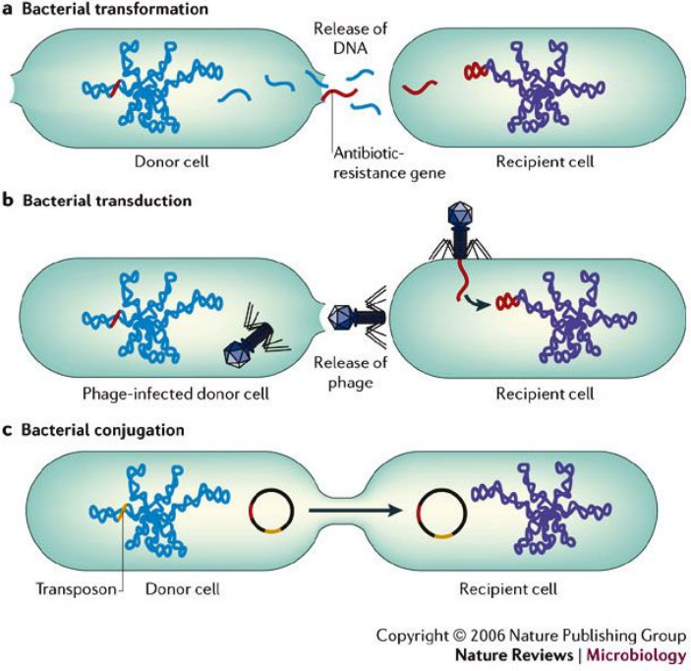
Resistance Genes Can Spread Between Bacteria by Several Mechanisms
Furuya EY, et al Nature Reviews Microbiology volume 4, pages 36–45 (2006)

Slide 7
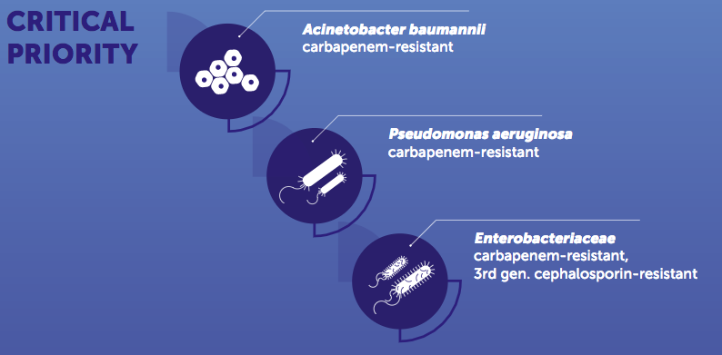
WHO called the alarm on the urgent need to develop new antibiotics: Critical Priority
WHO/EMP/IAU/2017.11

Slide 8
WHO called the alarm on the urgent need to develop new antibiotics: High Priority
WHO/EMP/IAU/2017.11

Slide 9
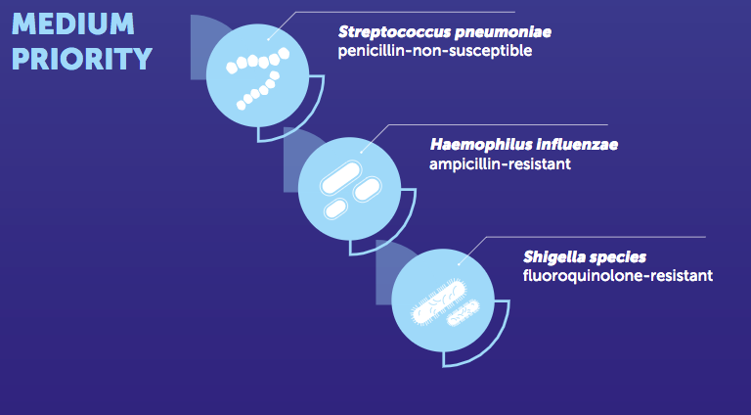
WHO called the alarm on the urgent need to develop new antibiotics: Medium Priority
WHO/EMP/IAU/2017.11

Slide 10
New uses of old antibiotics
Clindamycin
Timethoprim-sulfamethoxazole
Fluoroquinolones
Ciprofloxacin: ESBL or Pseudomonas UTI
Ciprofloxacin: resistant Salmonella and Shigella
Levofloxacin: S. pneumoniae Otitis media, sinusitis, pneumonia (also for Mycoplasma)
Ciprofloxacin, gatifloxacin, levofloxacin: conjunctivitis
Ciprofloxacin, levofloxacin: Otitis externa, otorrhea with PE tubes
Jackson et al, The Use of Systemic and Topical Fluoroquinolones. PEDIATRICS Volume 138 , number 5 , November 2016

Slide 11
What’s in the pipeline?

Slide 12
Is it really a Pipeline?
vs March Through a Minefield

Slide 13
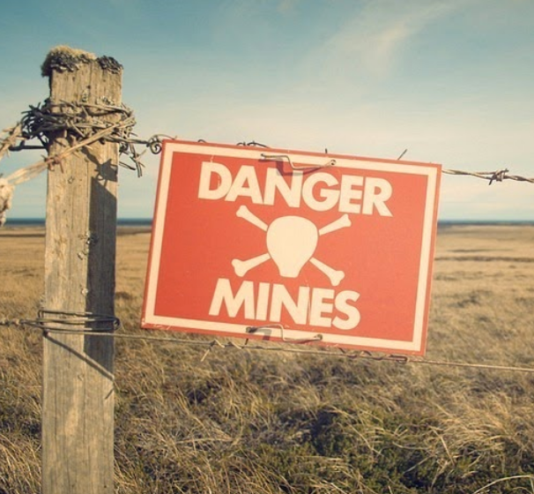
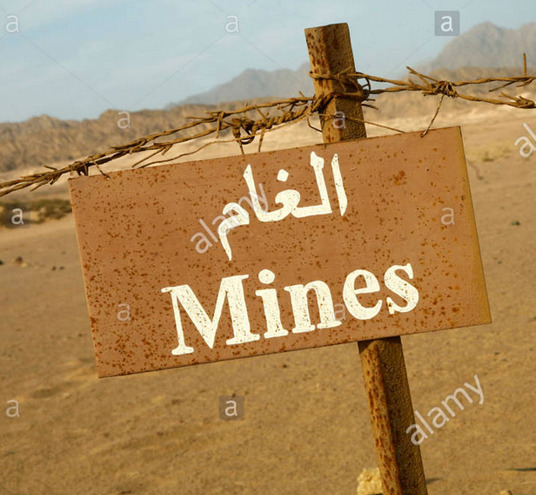
Or a March Through the Developmental Minefield?
Candidate Antibiotic
Efficacy
Toxicology
Bioavailability
Resistance
Interactions
Pharmaceutical companies prefer to invest in drugs for chronic diseases that are taken over long periods of time (more profitable)

Slide 14
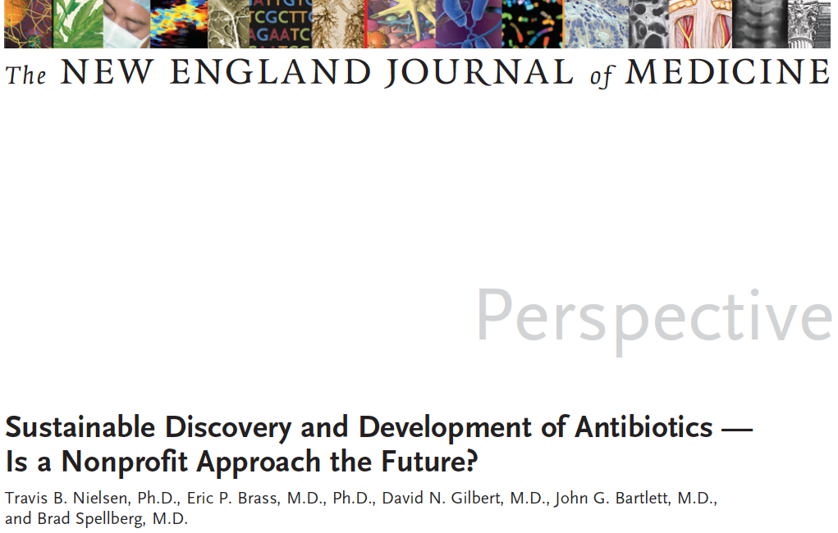
This article was published on June 19, 2019, at NEJM.org

Slide 15
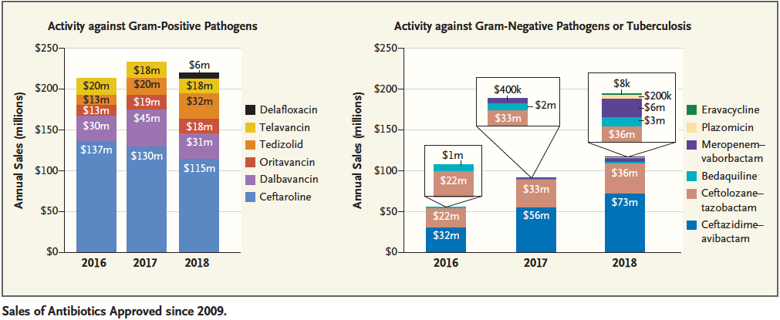
Economic incentives given are estimated at $1 to $2 billion per new antibiotic
Could a take-over by non-profit organizations be the answer?
Recent antibiotics compete with each other for sales as they target the same bugs in a small market (even smaller for pediatrics)
Could target wider markets with greater need (TB, Malaria, etc.)
TB Alliance developed the drug Bedaquiline for resistant TB, others in line
Poor sales lead to unhappy shareholders and companies threatening to exit the antibiotic business
Challenge of securing seed money
Nielsen TB, et al New England Journal of Medicine June 19, 2019

Slide 16
Current Approach: More of the same, or have we reached the end of the road?

Slide 17
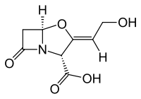
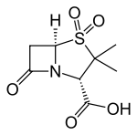
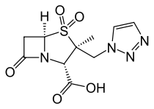
Are β−Lactamase Inhibitors the Answer?
Given in combination with a β-lactam antibiotic to inhibit the activity of β-lactamase
Some ESBL producing bacteria produce large amounts of β-lactamase(s) overwhelming the inhibitor and making in vivo activity unreliable
An inoculum effect occurs when the MIC of antibacterial rises with the increasing size of inoculum rendering many β-lactam antibiotics ineffective in vivo
NEW inhibitors: Vaborbactam, Relebactam, Zidebactam, Nacubactam, others
Clavulanic Acid
Entasis Therapeutics, Waltham, Massachusetts, has two new inhibitors in development:
ETX1317 for IV
ETX0282 for PO
Showing promise in mice against Gram negative bacteria. Close to Phase 1 study
NATURE | VOL 555 | 8 MARCH 2018
Sulbactam
Tazobactam

Slide 18
New Antibiotics in the Pipeline
WHO/EMP/IAU/2017.11

Slide 19
Looking for new antibiotics everywhere

Slide 20
Teixobactin from the soil bacterium Eleftheria terrae isolated using the iChip:
1. New class of antibiotics
2. New mechanism of action
3. Inhibits the building of the cell wall by binding to peptidoglycan and teichoic acid
4. Unlikely to have resistance develop against it
5. Works only on Gram positive bacteria and M. tuberculosis
The iCHIP technology may be the more important development (99% of all bacteria cannot be cultured)
Ling LL, et al Nature. 2015 Jan 22;517(7535):455-9

Slide 21
Arylomycin and derivatives
No new class of antibiotics effective against gram-negative bacteria has been described for more than 50 years.
Arylomycins discovered from a soil sample more than 20 years ago
Derivative is significantly more potent than parent natural compound
G0775 able to reach its target in Gram negative bacteria by crossing the outer membrane, despite its large size
The target is novel, the type I bacterial Signal Peptidase (Spase)
Effective in vitro and in vivo against MDR Gram negative bacteria
Very low level of resistance emergence
Smith PA, et al Nature Vol 561: 189-195 (Sep 13 2018)

Slide 22
Options other than antibiotics?
Back to the Future

Slide 23
Bacteriophages, were discovered independently by:
identified the source of this phenomenon, attributed the plaques to bacterial viruses, and coined the term “bacteriophage” in 1917
conceived of the idea to use phages therapeutically
🡪first described the characteristic zone of lysis associated with phage infection in 1915

Slide 24
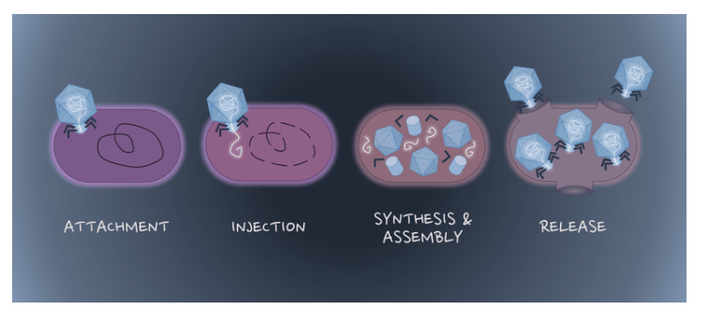
How do phages work?

Slide 25
Historical Perspective
1919-The first Clinical Trial at the Hôpital des Enfants-Malades- Paris by Félix D’Herelle:
🡪phages were successfully used to treat 4 pediatric cases of bacterial dysentery
1927 - First Mass application of phages Campbell Hospital, India
1931 - Trial of phage therapy as a Rx for cholera in the Punjab region of India by D’Herelle:
118 control subjects
73 experimental subjects: received phage treatment;
90% reduction in mortality:
74 lethal outcomes in the control group
5 in the experimental group.
Wittebole X, et al, Virulence. 2014 Jan 1;5(1):226-35

Slide 26
Development and use of personalized bacteriophage-based therapeutic cocktails to treat a patient with disseminated resistant Acinetobacter baumannii infection
A 68-year-old diabetic man who developed necrotizing pancreatitis complicated by an MDR A. baumannii-infected pancreatic pseudocyst.
Vancomycin, meropenem, colistin, and tigecycline were started.
Repeated culture from the pseudocyst fluid grew resistant A. baumannii to cephalosporins, meropenem, gentamicin, amikacin, TMP/SMX, tetracycline, ciprofloxacin, and colistin.
During the remainder of the second and third months of hospitalization, the patient's clinical course further deteriorated with peristent production of A. baumannii from different culture sites.
Organism sent to two laboratories for screening of effective phages
Emergency approval for an investigational drug use obtained from the FDA
Preparations were purified and were used intravenously and intralesionally
Several rounds of treatment were required with modification of the phage cocktail to account for the developing resistance
Patient recovered fully!
Schooley RT, et al Antimicrob Agents Chemother. 2017 Oct; 61(10): e00954-17.

Slide 27
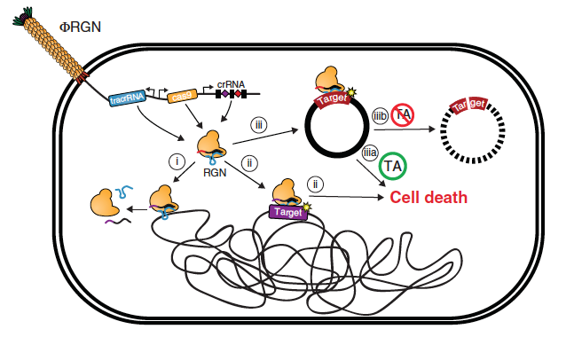
Phage-mediated activation of CRISPR
CRISPR: clustered regularly interspaced short palindromic repeats
Part of the bacterial immune response against bacteriophages
Used for gene editing
Many applications where correction or modification of a gene is required
RNA-guided nucleases (RGN) take advantage of the CRISPR system to target specific genes
Citorik RJ, et al Nat Biotechnol. 2014 Nov;32(11):1141-5.

Slide 28
Conclusions
Development of new antibiotics and new approaches of overcoming antimicrobial resistance is gaining momentum
The “pipeline” is more like a “minefield”, we should not be overtaken by optimism until we get there
Threat of pharmaceutical companies exiting the antibiotic business should be countered with a take-over by non-profit organizations
Antimicrobial stewardship will remain an essential component of our practice irrespective of how many new antibiotics arrive

Slide 29
THANK YOU!
College Hall, The American University of Beirut
Notes:
‹#›

